Slide 1
Benchmark Culminating Project: Psycho-Educational Small Group
Power Point Assignment
Carrie Wade

Slide 2
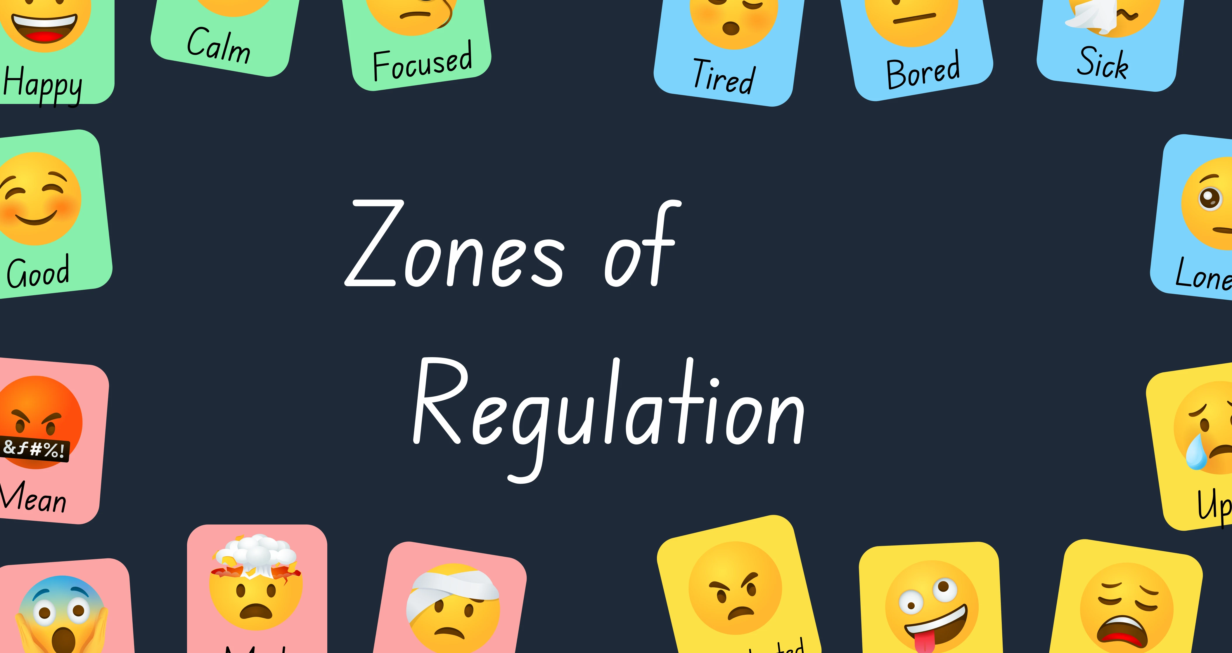


Psycho-Educational Small Group Topic :
Level Participants
of The Small Group
For the students to walk away with knowledge and skills of knowing how to effectively use self-regulating strategies. And to use those skills to self-regulate their emotions and change them from one emotional zone to another to get regulated. Also, for students to demonstrate improvement in areas of behavior, discipline, attendance and academics by reducing classroom disruptions, and increase academics, and attendance.

Slide 3
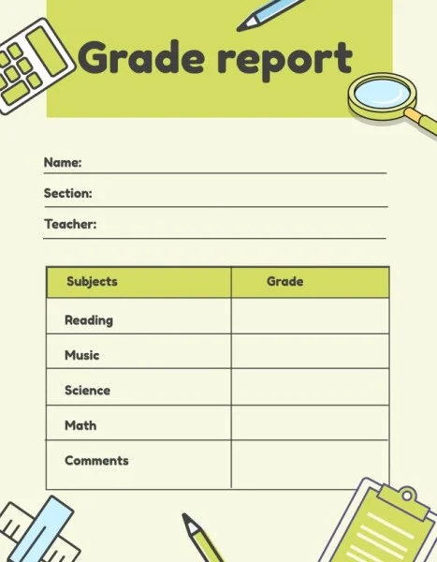
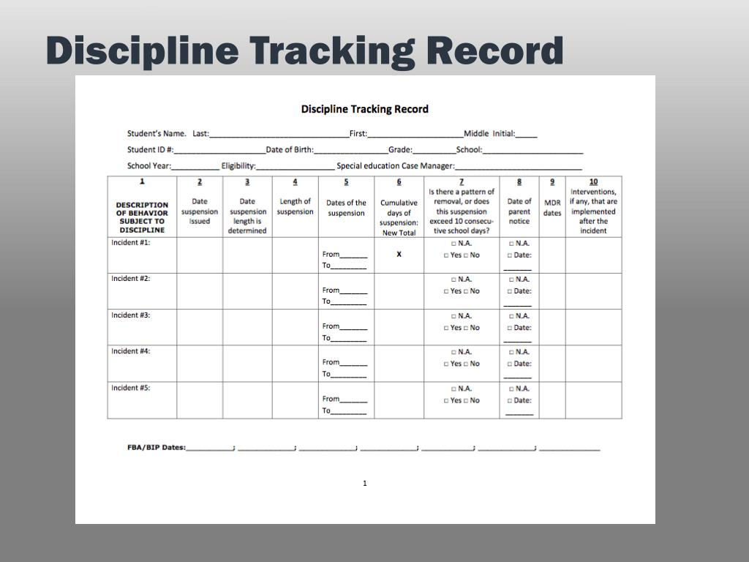

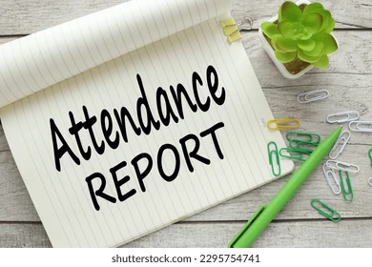
Data Sources
(DCPS) Duval County Public Schools uses a system called FOCUS: A district platform used to track the information on all students enrolled. Basically, a communication system.
This data was a collaborative effort in justifying why the intervention is useful in addressing emotional issues for the students.
NOTE: To identify and support the need for this group at this practicum site

Slide 4
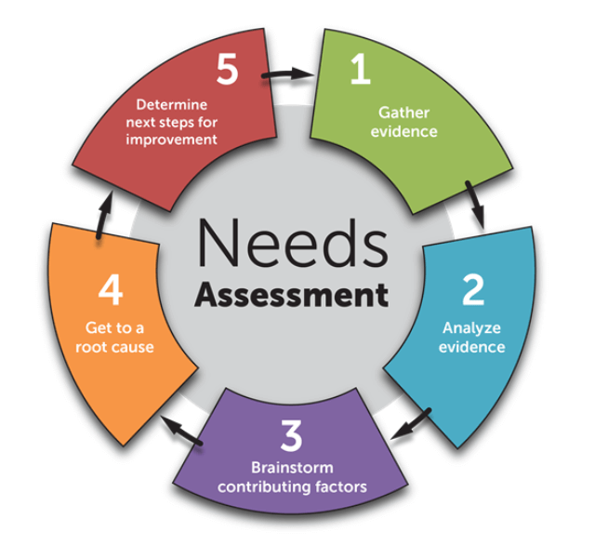
Administrators: Principal, Assistant Principal, Teachers and Food Service Workers provided administrative insights on each student
The Parents: Contacting the parents provided great viewpoints of their child’s challenges and strengths in hopes for improvement and positive development
School Staff: The School Counselor, Food Service Workers, and Substitute Teachers provided data and insights from observations and their experiences with the students. This allowed me to assess the students before and after the students participated in the psycho-educational small group sessions (Fanin-Hauwel, 2022)

Slide 5

Screening Process
The need and selection of the students were identified and referred by the Teachers, Parents, and School Counselor based on their emotional behaviors and/or disruptions in the classroom as well as in the home
A Consent Form was completed and signed by the parent to proceed with the group for a total of six sessions
Pre-Post Test was administered in order to evaluation the outcome and effectiveness of the sessions

Slide 6
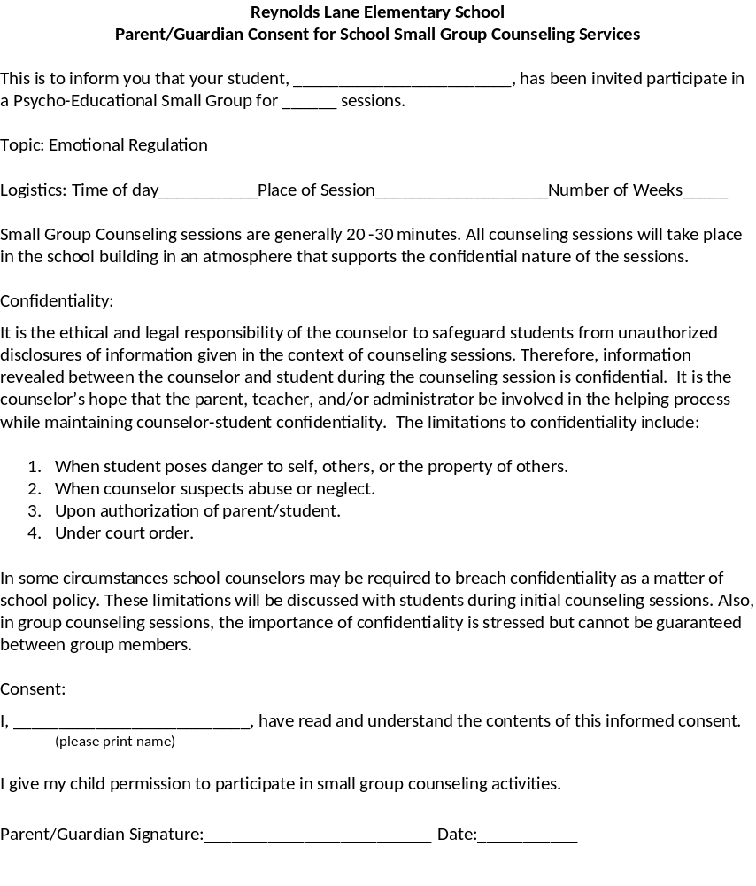
Consent Form

Slide 7
Pre/Post Test
What are the Zones of Regulation Colors?
Red, Green, Pink, Orange
Green, Yellow, Black, Blue
Green, Red, Blue, Yellow

Slide 8
Pre-AIA Specialty Standard(s)
Counseling and Intervention (D1, D2, D3):
Students will demonstrate self-awareness related to diversity of individuals in the group, and the classroom
Students will be provided group counseling to promote the academic and social/emotional development.
Designs and implements intervention and prevention plans related to the effects of wellness, resilience on the student’s learning and development.
Assessment (H.1, H.2, H.3):
Assesses and interprets students’ strengths and needs, recognizing uniqueness in cultures, languages, values, backgrounds, and abilities
Selects appropriate assessment strategies that can be used to evaluate a students’ academic, career, and social/emotional development
Analyzes assessment information in a manner that produces valid inferences when evaluating the needs of individual students and assessing the effectiveness of educational programs.

Slide 9
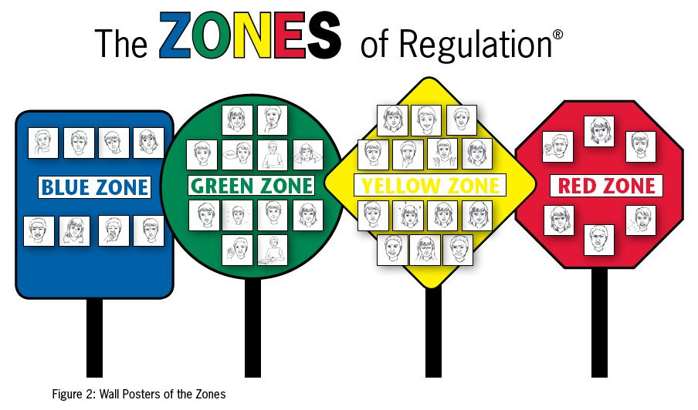
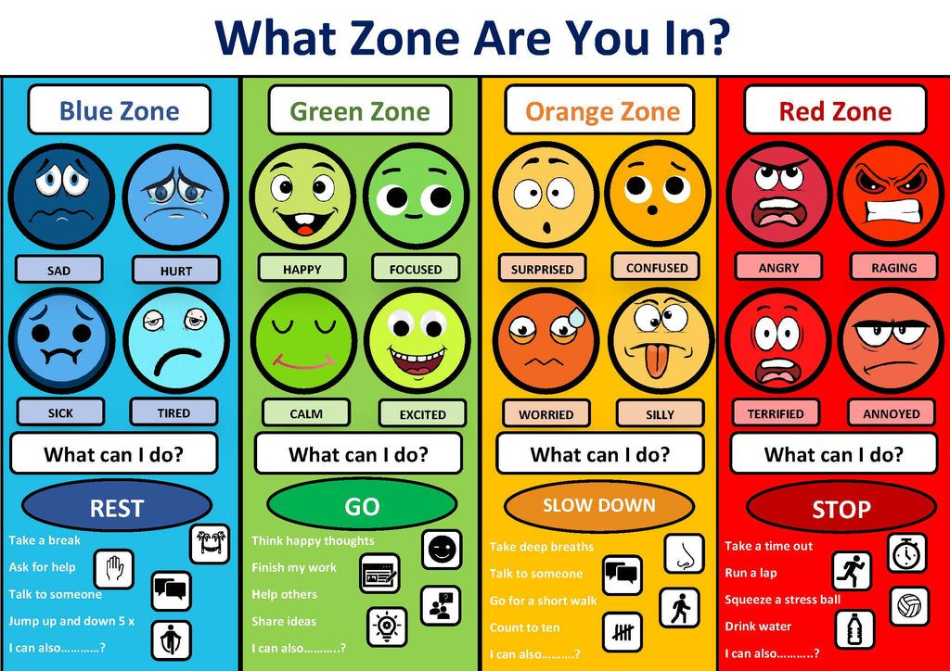
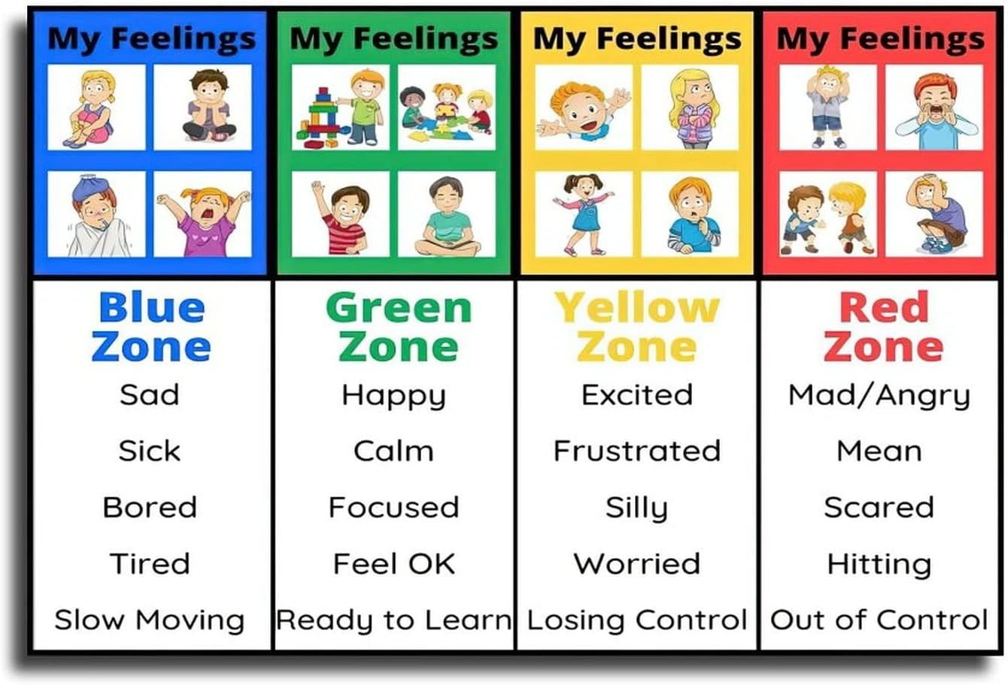
Sessions/Activities
Pre/Post Test (What are the zones of regulations related feelings and colors)
Coloring/Pasting/Matching Crafts
Videos

Slide 10
Culminating Project
Psycho-Educational Small Group
Awareness of different religions, race, ethnic groups and ensuring that beliefs or religion were not infringed upon or forced on others. Also increased emotional intelligence and built self-confidence in students and adaptation (Khoruzla, et., al., 2025)
Established norms for the group, respecting others’ opinions, stick to the material pertaining to the topic, did not speak on topics of religion, ethnicity, beliefs, and would table conversations that may arise and cause conflict as it relates to differences (Khoruzha, et., al., 2025)
Created a safe comfortable environment, set rules, establish rapport and trust for the group to speak and open up, acknowledged big and small accomplishments and set clear expectations. Also group members had the ability to recognize and empathize with group member’s emotions (LaGrutta, et., al., 2025)

Slide 11


Discipline, Behavior and Disruptions were decreased to a minimum in the classrooms for all students
Academics: Grades increased from a high B to an A for one student. And a low C to a B for the other students
Communication, respect and team work was gained among the students during the group sessions.
Periodic classroom, cafeteria visits and evaluations showed positive effectiveness of techniques/strategies used in the group sessions.

Slide 12

Things That I Would do differently or Modify
Be better prepared to redirect students that have behavioral issues
Choose videos that are more attention catchers for the specific topic
Choose a small group of a higher grade level
Choose another topic for this particular grade level

Slide 13
References
Pre-AIA Specialty Standard(s)
Carter, G., Brown Wilson, C., & Mitchell, G. (2021). The effectiveness of a digital game to improve public perception of dementia: A pretest-posttest evaluation. PloS One, 16(10), e0257337. https://doi.org/10.1371/journal.pone.0257337
Fantini-Hauwel, C., Dovi, E., Bier, J.-C., & Gély-Nargeot, M.-C. (2022). Difficultés et besoins non satisfaits des aidants de personnes âgées démentes : une analyse phénoménologique interprétative avant et après un groupe de psycho-éducation. Geriatrie et Psychologie Neuropsychiatrie Du Vieillissement, 20(1), 131–141. https://doi.org/10.1684/pnv.2022.1024
La Grutta, S., Epifanio, M. S., Piombo, M. A., Alfano, P., Maltese, A., Marcantonio, S., Ingoglia, S., Alesi, M., Lo Baido, R., Mancini, G., & Andrei, F. (2022). Emotional Competence in Primary School Children: Examining the Effect of a Psycho-Educational Group Intervention: A Pilot Prospective Study. International Journal of Environmental Research and Public Health, 19(13). https://doi.org/10.3390/ijerph19137628

