Slide 1
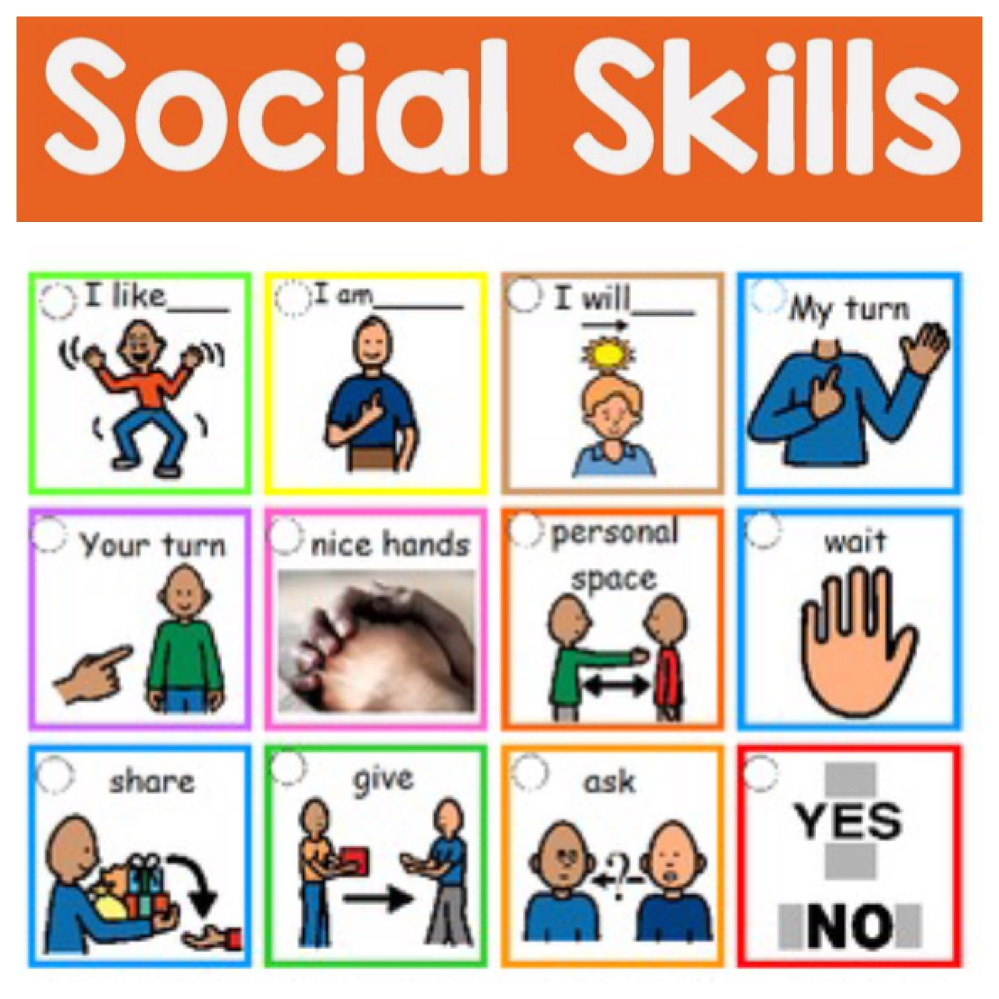
Internship Culminating Project
Power Point Assignment
Carrie Wade

Slide 2
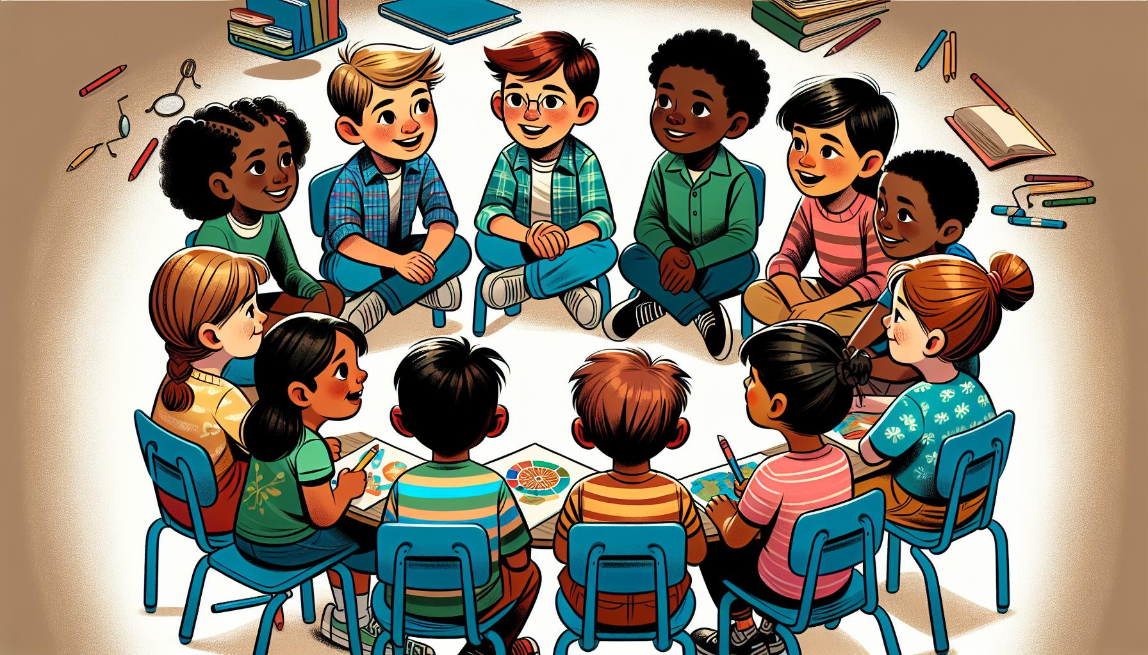


Internship Project Topic: Social Skills
Level of Participation
of Classroom Guidance Lesson
For students to learn effective use the social skills strategies learned and use those skills daily. Also, for students to demonstrate improvement in areas od academics and social skills in the classroom as well as the home. To include, classroom manners, active listening, social norms, interpersonal abilities, and emotional intelligence.
NOTE: Students are periodically observed based on their social skills in their classroom setting.
of academics and social skills in the classroom as well as home. To include, Classroom manners, Active Listening, Social Norms,

Slide 3
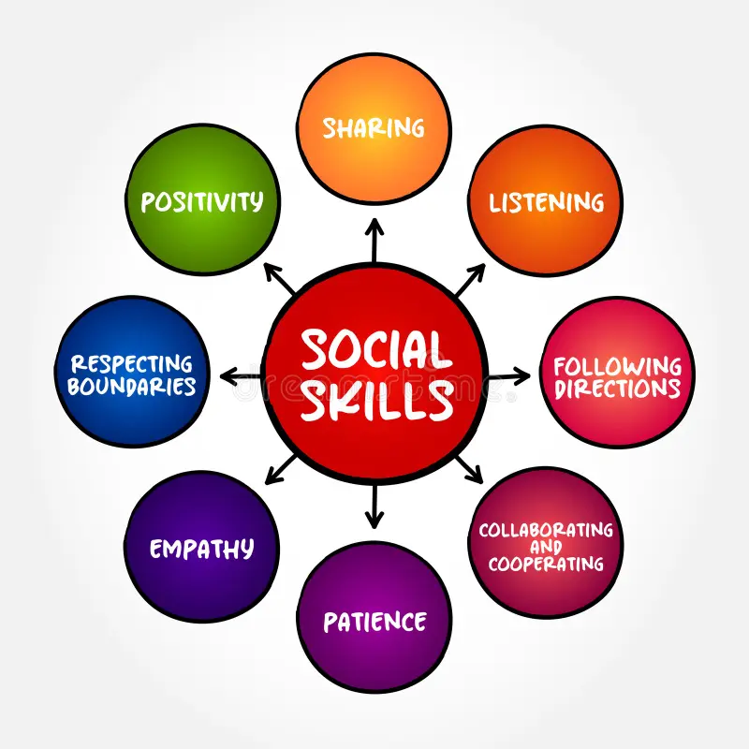

Data Sources
(DCPS) Duval County Public Schools uses a system called FOCUS: A district platform used to track the information on all students enrolled. Basically, an educational communication system. Parents/Guardians also have access to their child’s important student information.
This particular data was a collaborative effort in justifying why the intervention is useful in addressing emotional issues for the students with academic and social skills issue.
NOTE: FOCUS tracks and stores information of all students assigned to their particular school setting.
NOTE: To identify and support the need for this group at this practicum site

Slide 4
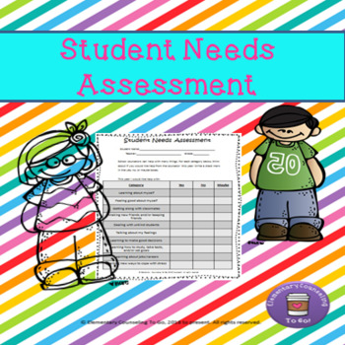
Administrators: Principal, Assistant Principal, and School Counselor provided administrative insights on each student.
The Parents: counselor, parent contact provided great viewpoints of their child’s strengths and challenges in hopes for improvement and positive development in the area of social skills.
School Staff: Office Administrators, Food Service (Cafeteria) Workers, Teachers, ESE Teachers, and Paraprofessionals provided data and insights from observations and their experiences with the students. This allows the counselor to assess the students before and after the student’s participation in the classroom guidance sessions (Fanin-Hauwel, 2022).
NOTE: The assessment was a collaborative effort to support the students’ needs based on their social skills

Slide 5

Screening Process
The need and selection of the students were identified and referred by the Teachers, Parents, and School Counselor based on their need for social skills and academics in the classroom as well as in the home
NOTE: The screening process was based on classroom observations of each student.

Slide 6
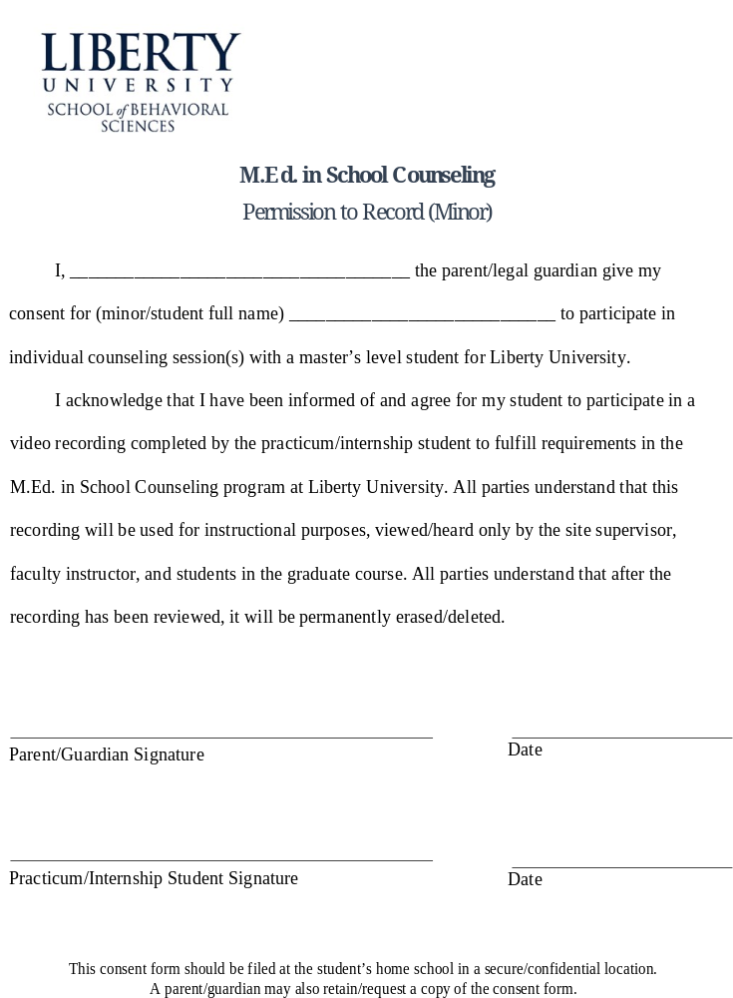
Consent Form

Slide 7
AIA Specialty Standard(s)
Counseling and Intervention (A1.1d,f)
Intern independently applies self-evaluation and reflection to improve counseling skills.
Demonstrates self-awareness, sensitivity to others, and the skills needed to diverse individuals, groups, and classrooms.
Provides individual and group counseling and classroom guidance to promote the academic, career, and social/emotional development of students.
Academic Development (A1.a.d,e,f))
Intern evaluates existing programs/services/strategies making suggestions that result in improved differential instructions, student achievement, and/or postsecondary opportunities/options.
Conducts programs designed to enhance student academic development.
Implement strategies and activities to prepare students for a full range of postsecondary options and opportunities.

Slide 8
Cultural Sensitivity
Complete awareness of different religions, race, ethnic groups and ensuring that beliefs or religion were not invaded or forced on others. Also increased emotional intelligence and built self-confidence in students and adaptation.
Settled norms for the group, respecting others’ opinions, stayed focused on the material pertaining to the topic, avoided topics of religion, ethnicity, beliefs, and would table conversations that may arise and cause any conflict as it relates to differences.
A safe and comfortable environment was established, set rules, establish rapport and trust for the group to speak and open up, recognized big and small accomplishments and set clear expectations. Also group members had the ability and/or opportunity to recognize and empathize with group member’s emotions (LaGrutta, et., al., 2025)

Slide 9
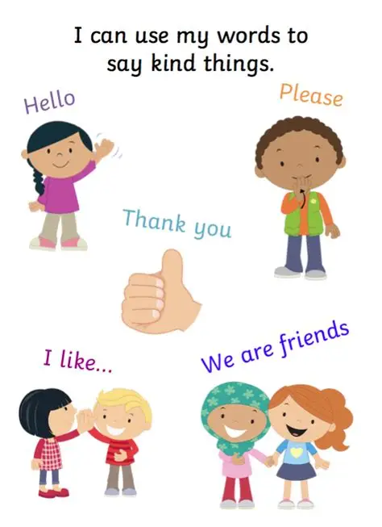
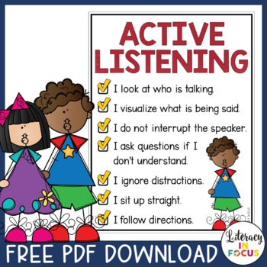
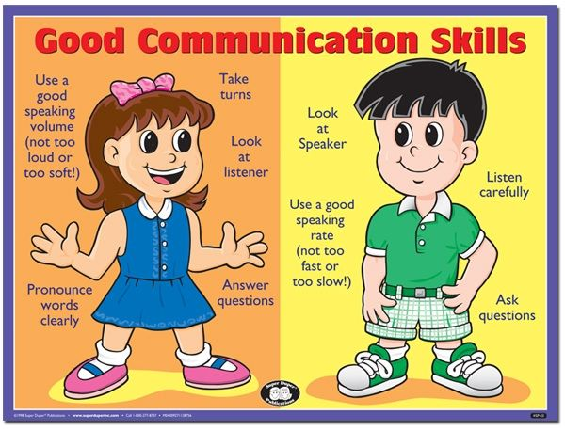
Classroom Guidance Lessons
(1) Effective Communication (verbal & non-verbal),
(2) Listening Attentively,
(3) Engaging in conversation (Active Listening)
(4) Saying it kindly

Slide 10

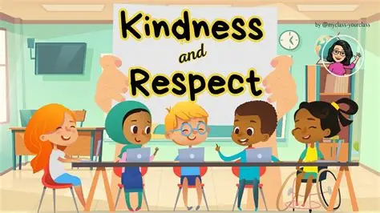
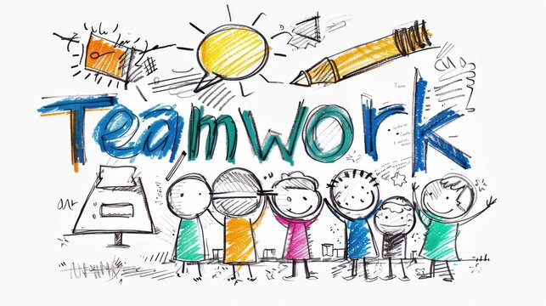
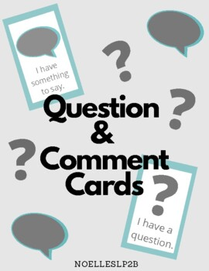
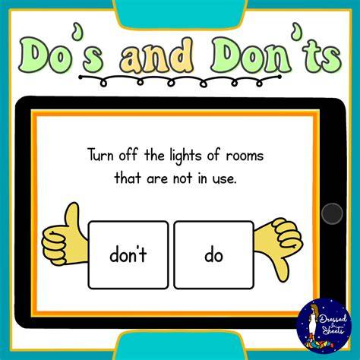
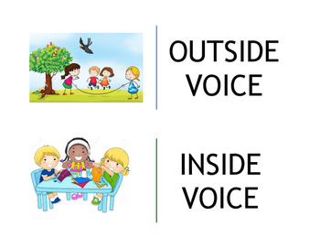
Activities

Slide 11


Evaluation
Academics: Grades increased from a high B to an A for several student. And from a C to a B for the other students
Communication, interpersonal abilities, social norms, and emotional intelligence was gained among the students during the group sessions.
Cafeteria visits, periodic classroom, and evaluations showed positive effectiveness of techniques/strategies used in the group lessons.
NOTE: Academics (Grades) can be viewed to show any success and/or improvements in FOCUS and social skills can be determined by classroom observations.

Slide 12
References
AIA Specialty Standard(s)
Fantini-Hauwel, C., Dovi, E., Bier, J.-C., & Gély-Nargeot, M.-C. (2022). Difficultés et besoins non satisfaits des aidants de personnes âgées démentes : une analyse phénoménologique interprétative avant et après un groupe de psycho-éducation. Geriatrie et Psychologie Neuropsychiatrie Du Vieillissement, 20(1), 131–141. https://doi.org/10.1684/pnv.2022.1024
La Grutta, S., Epifanio, M. S., Piombo, M. A., Alfano, P., Maltese, A., Marcantonio, S., Ingoglia, S., Alesi, M., Lo Baido, R., Mancini, G., & Andrei, F. (2022). Emotional Competence in Primary School Children: Examining the Effect of a Psycho-Educational Group Intervention: A Pilot Prospective Study. International Journal of Environmental Research and Public Health, 19(13). https://doi.org/10.3390/ijerph19137628

