Slide 1
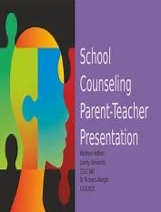
Benchmark: School Counseling Parent-Teacher Presentation Assignment
Carrie Wade

Slide 2
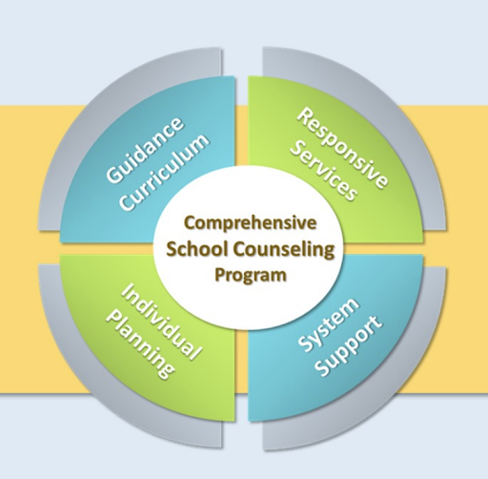
Comprehensive School Counseling Program?
This program is a structured system designed to support the academic, career, and social-emotional development of all students, ensuring unbiased access to educational resources and opportunities.
In fact, this counseling program aims to support all students in terms of maximizing opportunities for academic achievement, ensuring mental health, reinforcing healthy emotional choices, and advocating for students in general.
Note: The Framework and Standards of the program is often guided by the ASCA National Model, which outlines the essential components and best practices for school counseling. This model emphasizes a data-driven approach to program development and implementation

Slide 3
Benefits of implementing a comprehensive Counseling Program
Improved Student Outcomes: Research indicates that schools with comprehensive counseling programs see higher academic achievement, reduced disciplinary issues, and improved school climate.
Holistic Development: These programs support the overall development of students, equipping them with the skills and knowledge necessary for success in school and beyond.
Increased Engagement: By addressing the diverse needs of students, comprehensive counseling programs help increase student engagement as participation in the educational process.
Note: In Summary: a comprehensive school counseling program is essential for fostering a supportive and effective educational environment that promotes the success and well-being of all students. It is characterized by its structured approach, collaborative efforts, and focus on equity and date-driven practices.

Slide 4
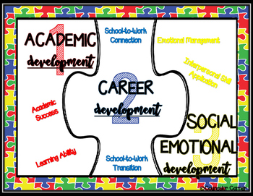
Comprehensive Program
Elements
Academic Development
Career Development
Social/Emotional Development
Advocacy
In these domain areas, school counselors deliver school counseling programs that enhance student growth.
Notes: As part of the program elements, school counselors implement strategies and activities to help all students enhance their career development-the mindsets and behaviors students need to understand the connection between school and the world of work, plan for and make successful transition to postsecondary education, and work across the lifespan-while recognizing that growth in all three domains is necessary for students to be successful now and later in life.
Simply Put: The counselor is concerned and therefore serves the needs of all students as they operate in all 3 domains (directly and indirectly).

Slide 5

Goals of a comprehensive
School Counseling Program
Support students in achieving their academic goals through guidance, resources, and interventions tailored to their individual needs.
Prepare students for future career opportunities by providing career exploration resources and guidance on post-secondary education options.
Foster students; social and emotional well-being by addressing issues such as stress, anxiety, and interpersonal relationships, promoting healthy decision-making and resilience.
NOTE: These goals are elements of Academic Development, Career Development, and Social/Emotional Support.

Slide 6
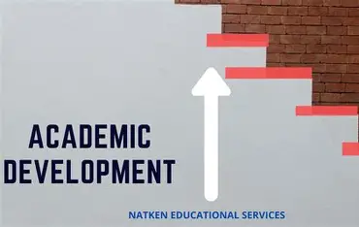
Academic Development
Provides opportunities for students to:
1. Develop a positive attitude toward work and learning.
2. Enhance their belief in development of whole self and ability to succeed.
3. Develop long and short-term academic goals.
4. Demonstrate positive, respectful and supportive relationships with students and adults.
5. Demonstrate self-motivation and self-direction for learning.
Note: School counselors work with administrators, teachers and other school staff to create a school environment encouraging academic success and striving to one’s full potential.

Slide 7

Career Development
Help students plan the transition from school to postsecondary education and/or the world of
work, including high-quality CTE programs (ASCA, 2021).
Connect students to early-college and career development programs (e.g., dual credit/dual enrollment,
AP, IB, CTE).
Advise students on multiple postsecondary pathways (e.g., college, career-specific credentials and
Certifications, apprenticeships, military, service-year programs, full-time employment with a family-supporting wage or with a sufficient wage for sustaining an independent lifestyle).
Collaborate with administrators, teachers, staff and decision-making to create a postsecondary-readiness, career-preparedness and college-going culture.

Slide 8
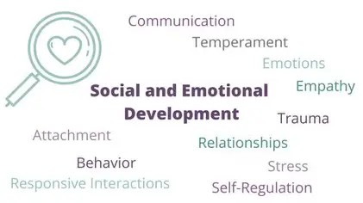
Social/Emotional Development
Uses counseling theories that are effective in a school setting to inform both direct and indirect student services supporting k-12 students’ social/emotional development.
Collaborate with school staff to create an inclusive and affirming environment for all students.
Use evidence-based, inclusive, and trauma-informed curriculum and resources when delivering interventions to enhance social/emotional development.
NOTE: This particular domain is composed of standards to help students manage, learn and apply their international skills.

Slide 9

Advocacy
School counselors use data to advocate for student needs and the school counseling program.
However; School counselors cannot advocate for student achievement and success without accessing, collecting and reviewing outcome date.
School counselors advocate for student success by creating a vision statement describing a future world where student outcomes are successfully achieved.
Advocacy is a broad and multifaceted process.
NOTE: Advocacy means communicating to stakeholders what the comprehensive school counseling program is, how it makes a difference, and how it affects the success of all students.

Slide 10
Summary
School counselors provide resources and opportunities that help students explore their strengths and interests as well as career fields that might align with these attributes.
School counselors provide a school counseling program that helps all students enhance their career development and successfully navigate postsecondary education and the world of work, while recognizing the growth in all three domains of academic, career and social/emotional development is necessary for students to be successful now and later in life.
School counselors ensure that students have access to explore all postsecondary options, including CTE pathways.

Slide 11
References
American School Counselor Association (2019). ASCA National Model: A framework for school counseling programs (4th ed.). Alexandria, VA: Author. ISBN: 9781929289592.
American School Counselor Association (2019). ASCA national model implementation guide: Manage and Assess (2nd ed). Alexandria, VA: Author. ISBN: 9781929289608

