Slide 1

Delivery of a Classroom Guidance Lesson Plan Assignment Power Point
Writing Grades 11-12
Carrie Wade

Slide 2

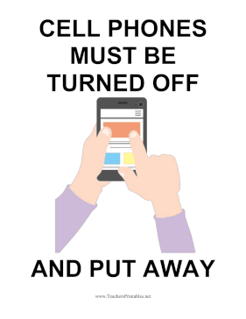

“First Thing First”
Please put away all cell phones and remove all hoodies
NOTE: It is crucial to set the tone and condition students on how to respond to rules and/or expectations

Slide 3

Grades 11-12

Slide 4
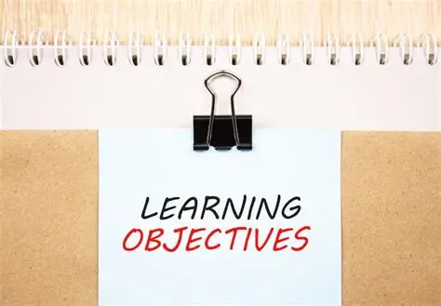
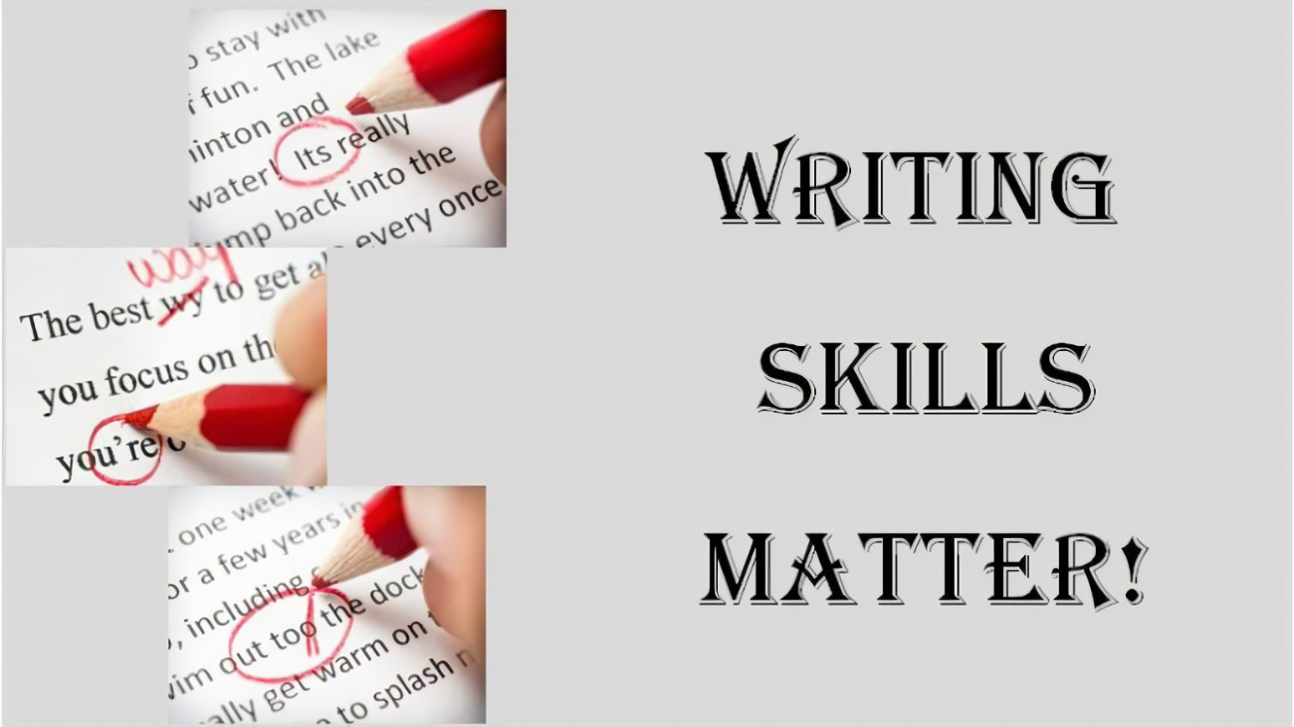
Because high-quality jobs are so competitive today, Today you will explore how the use of the writing abilities you’ve learned through your education this far will help you create a well-structured resume that will ultimately help you to achieve high-quality careers following your post-secondary education, to include better career opportunities.
NOTE: Writing skills matter and these skills are essential in order for you to meet your academic requirement before graduation. In fact, writing will always be apart of your journey through life and writing will ultimately help you as you compete for high-quality career opportunities which is also another essential part of your journey. This is why resume writing is a great tool to use in order to achieve better career opportunities.
As a result of this lesson, you will have confidence and belief that your resume will look and be viewed as a well-structured resume (M&B/M5)

Slide 5
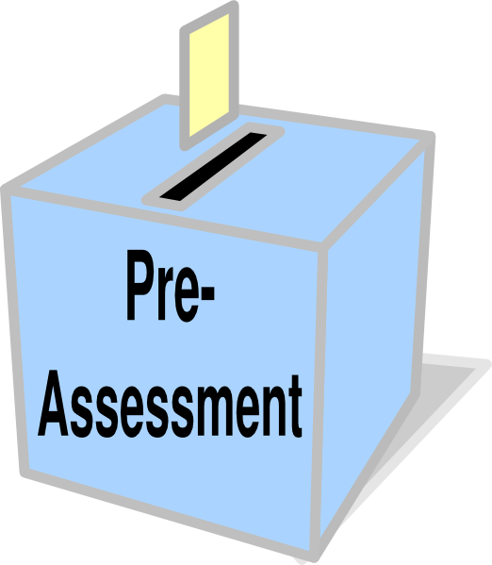
Pre-Assessment
Students will identify ways to build a well-structured resume
Typically, a well-structured resume includes how many parts?
6
4
7
5
NOTE: Post-secondary education in expensive and therefore; getting a job in the field in which you have studied in crucial and yet rewarding at the same time.

Slide 6

A resume is a formal document that summarizes your work experience, skills, and qualifications.
Typically, this type of resume will include (5) key components:
Contact Information: Name, Phone Number, Address
Summary/Objective: What you have to offer, career goals
Work Experience: Graduation dates, institutions, degrees
Education: Relevant skills that match what the job requires
Skills: Relevant skills that match what the job requires
Overall, a resume serves as your professional introduction to potential employers, showcasing your capabilities and making you a strong candidate for specific role and/or specific job.

Slide 7

Your resume gives the manager or recruiter their first impression of you
Your resume will stand out from the other resumes submitted
Your resume allows you to the opportunity to show why you are better qualified for the position you are seeking (Worman, 2021)
NOTE: So, writing a resume focusing on skills and achievements is the key to obtaining an interview for a high-competitive role

Slide 8
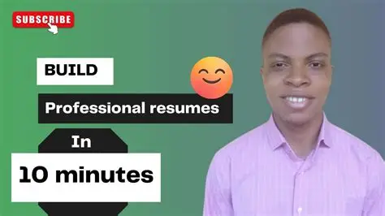
Building a Resume (Video)
My main goal today is to build your confidence, encourage and insure you that everyone will learn how to create and build an amazing well-structured resume following this lesson.
https://youtu.be/udC8gCBTsxs
NOTE: Every student learn, interpret, process and retain information differently. Therefore, it is my responsibility to reach each of your level of learning.

Slide 9

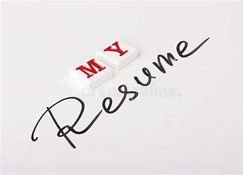
Practice
Create a Resume
NOTE: After the practice exercise, resumes can be given to another student for their critique.

Slide 10
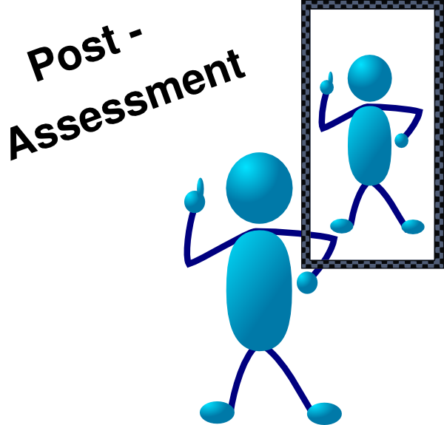
Students will identify ways to build a well-structured resume
Typically, a well-structured resume includes how many parts?
6
4
7
5
NOTE: Following the lesson and building their resume, students will take the Post-Assessment to see what they learned/recalled from the lesson.

Slide 11
Summary
Good writing skills can be used throughout a person’s journey through life. However; in order to improve and strengthen your writing skills, to become a “Great” writer, and to create incredible resumes, it takes the right mindset, great websites, and belief in your abilities to achieve great results and outcomes. These tools can assist in creating a well-structured resume.
CCSS ELA-Literacy.W.11-11-12.5 (English/Writing)
NOTES: Student(s) will: Use the website: English Language Arts Standards » Writing » Grade 11-12 | Common Core State Standards Initiative; https://www.myperfectresume./

Slide 12
References
American School Counselor Association (2019). ASCA National Model: A framework for school counseling programs (4th ed.). Alexandria, VA: Author. ISBN: 9781929289592.
https://www.myperfectresume./
https://youtu.be/udC8gCBTsxs
Worman, D. (2021). Coaching on Resume Development and Interview Preparation for Nurses Desiring Career Progression. Journal of Continuing Education in Nursing, 52(11), 502–504. https://doi.org/10.3928/00220124-20211008-04

Slide 13
Now that I have completed my Power Point on Resume Writing and you have been given some valuable information, I would like for you to locate the assessment that you were given earlier and answer that one question again. My hope is that if you did not answer it correctly the first time, you will answer it correctly this time.
Thank You

