Slide 1
Needs Assessment Data Analysis
Bailey Schif
COSC 661

Slide 2
Why perform this survey?
Purpose
Providing data regarding 6th grade students academic, career and social/emotional wellbeing and development
The data concluded will provide school counselors with a better idea of what interventions to implement
Technology
Google forms was utilized to provide accurate and trackable data
This format is easily accessible to students through school provided laptops
Using Big Data provides trends, patterns and potential opportunities to decision makers. This causes education to become more effective and relevant to students (Efendi et al., 2024).

Slide 3
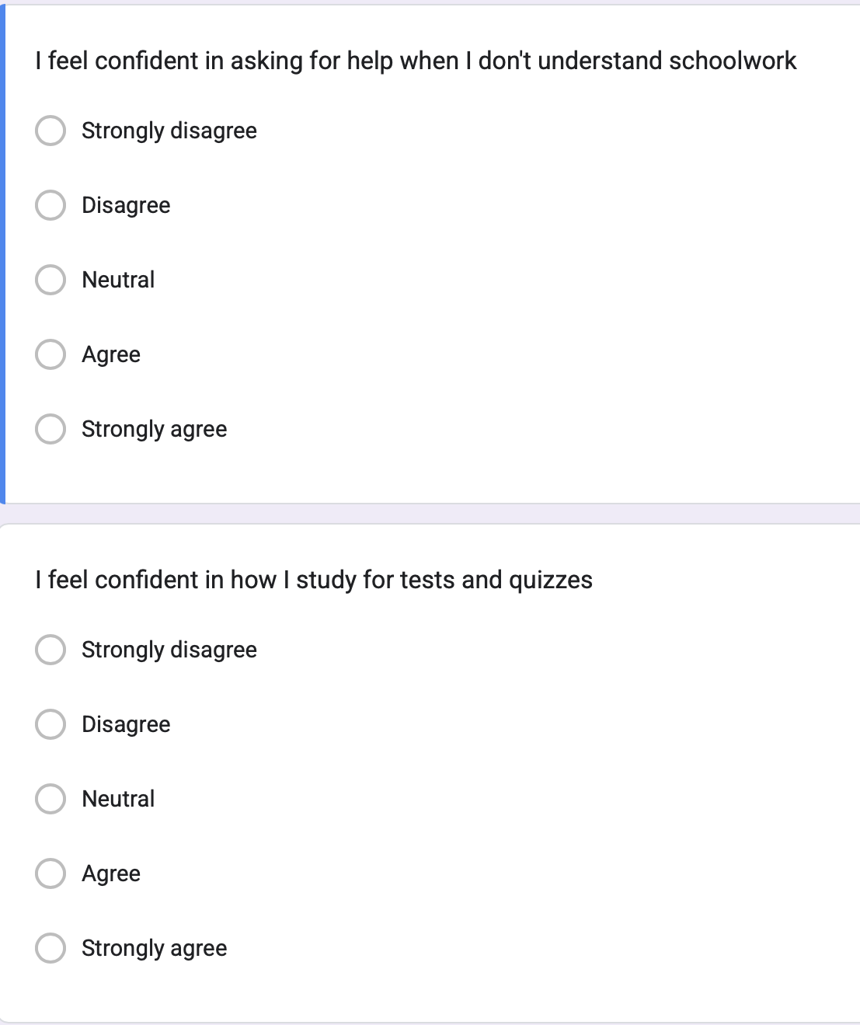
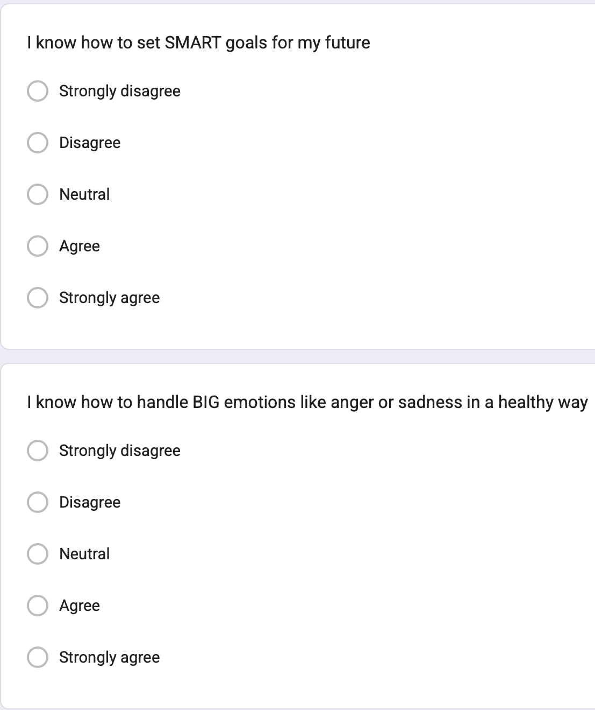
Survey
Example questions
  I feel confident in how I study for tests and quizzes
  I want to learn more about different job and career options for me
  I would like to learn more about how to manage my stress and worries

Slide 4
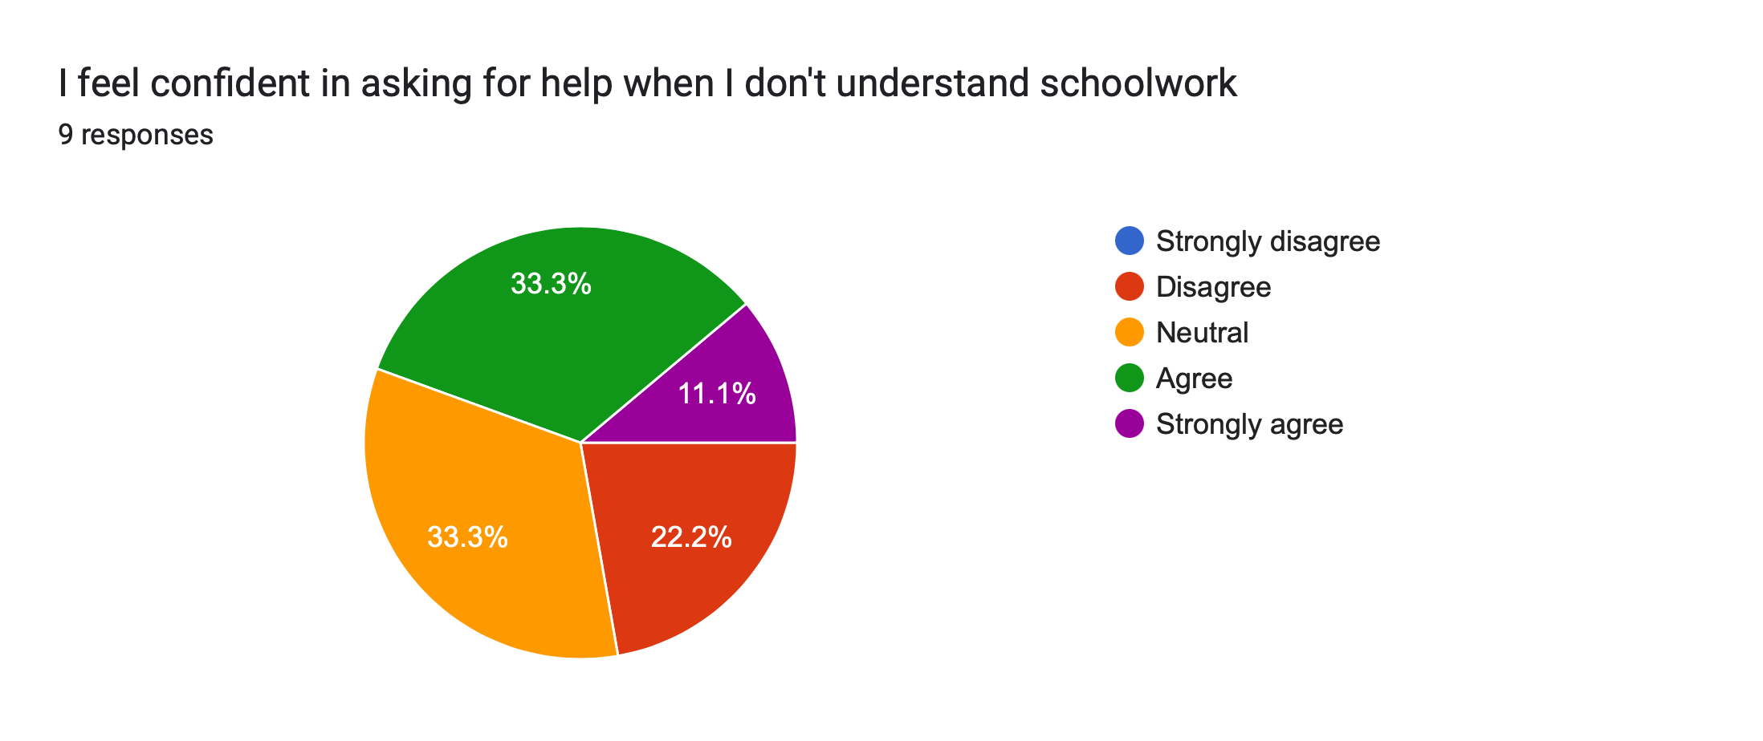
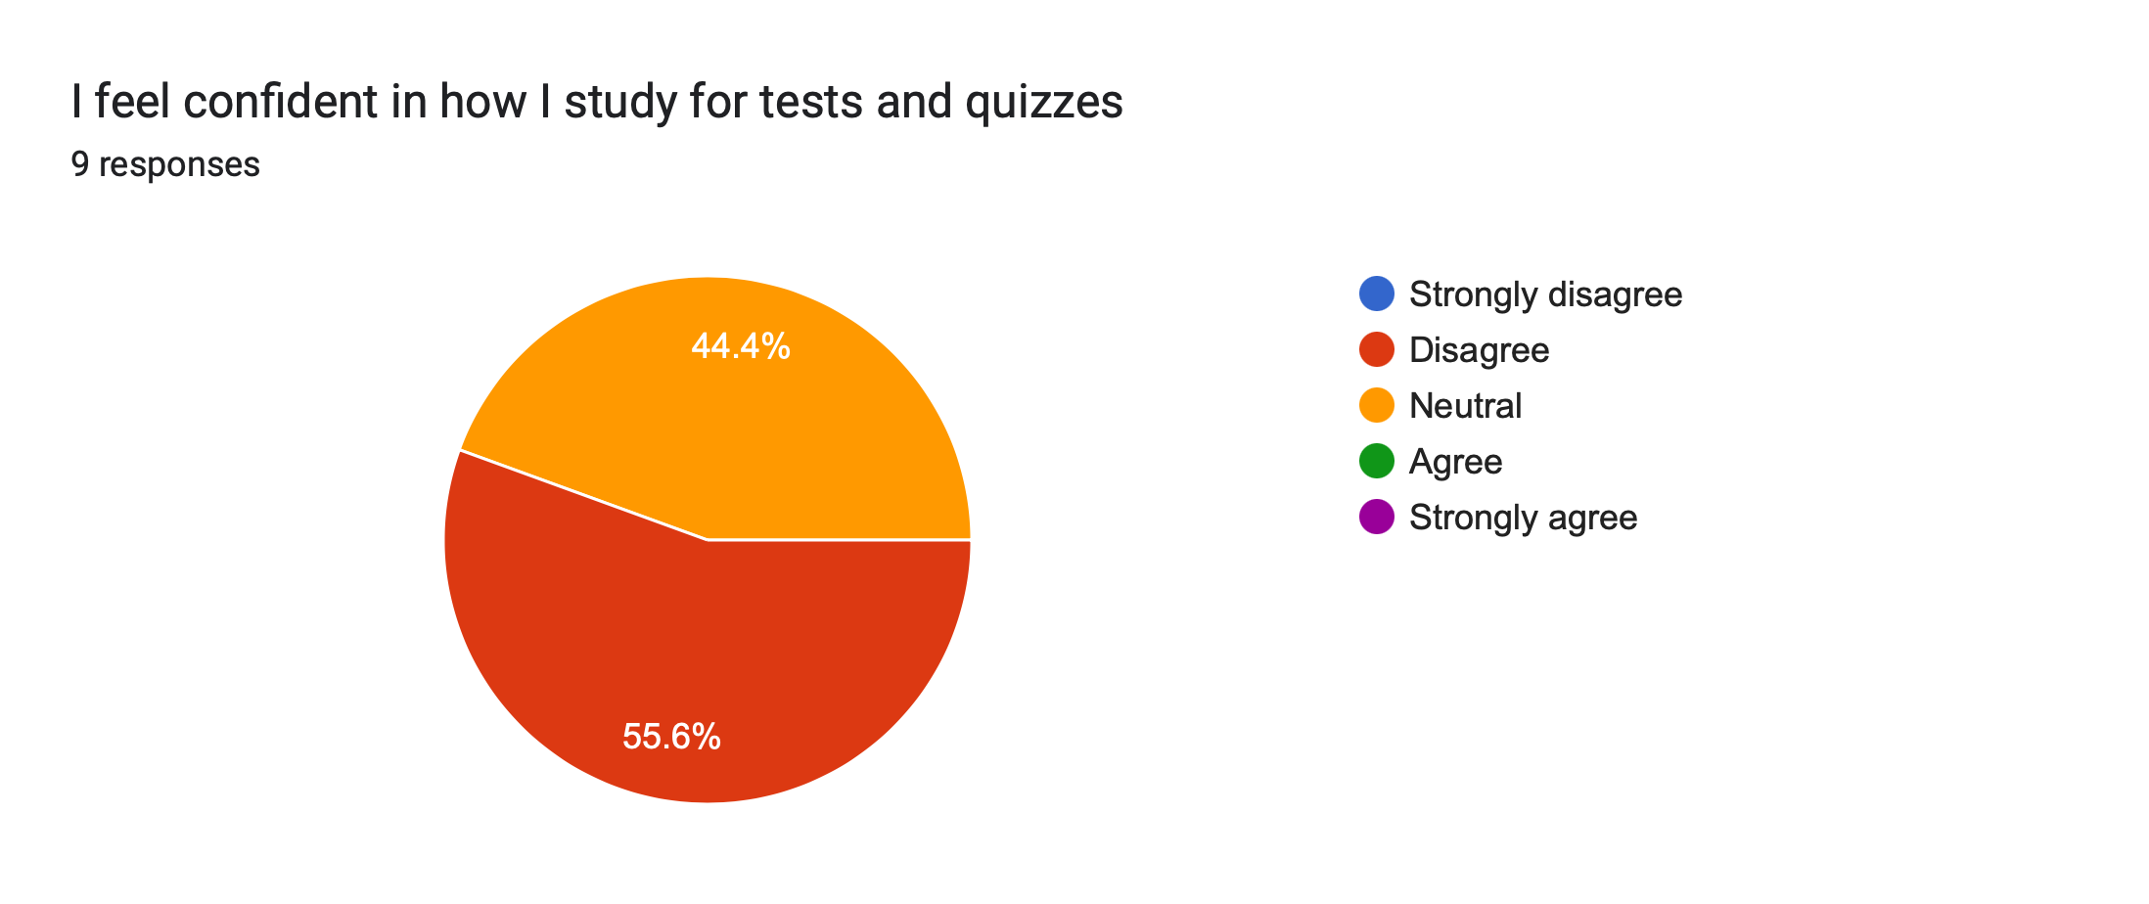
Results
Notes:
The data in the first question reveals mixed feelings among students in their confidence to seek help with schoolwork. Equal parts feel confident as well as remaining neutral. This indicates hesitation or uncertainty. 22.2% of students express lack of confidence in reaching out to school staff. This suggests that some students do feel comfortable asking for help, however it may be beneficial for students to be shown encouragement to build their confidence.
The data in the second question reveals an overall lack of confidence in the students' study habits. With the majority (55.6%) expressing they do not feel confident, and the other 44.4% expressing hesitancy, it would be beneficial to support these students in learning positive study habits.

Slide 5
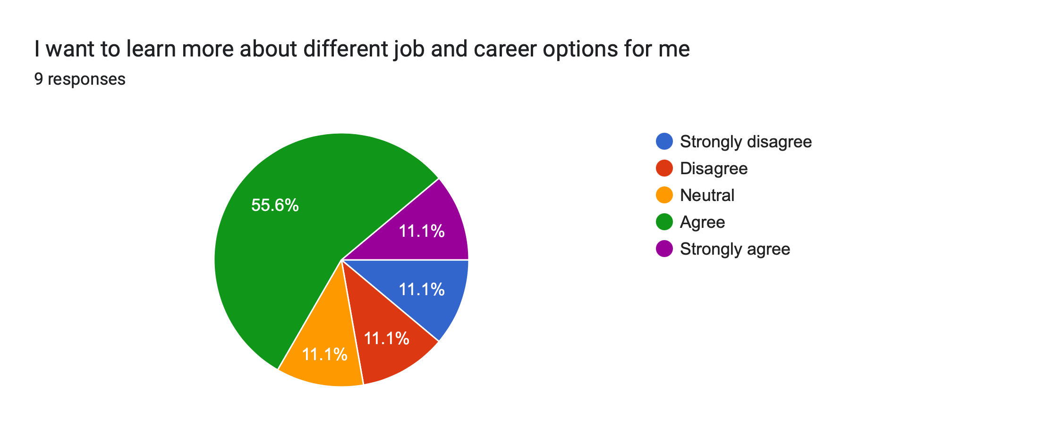
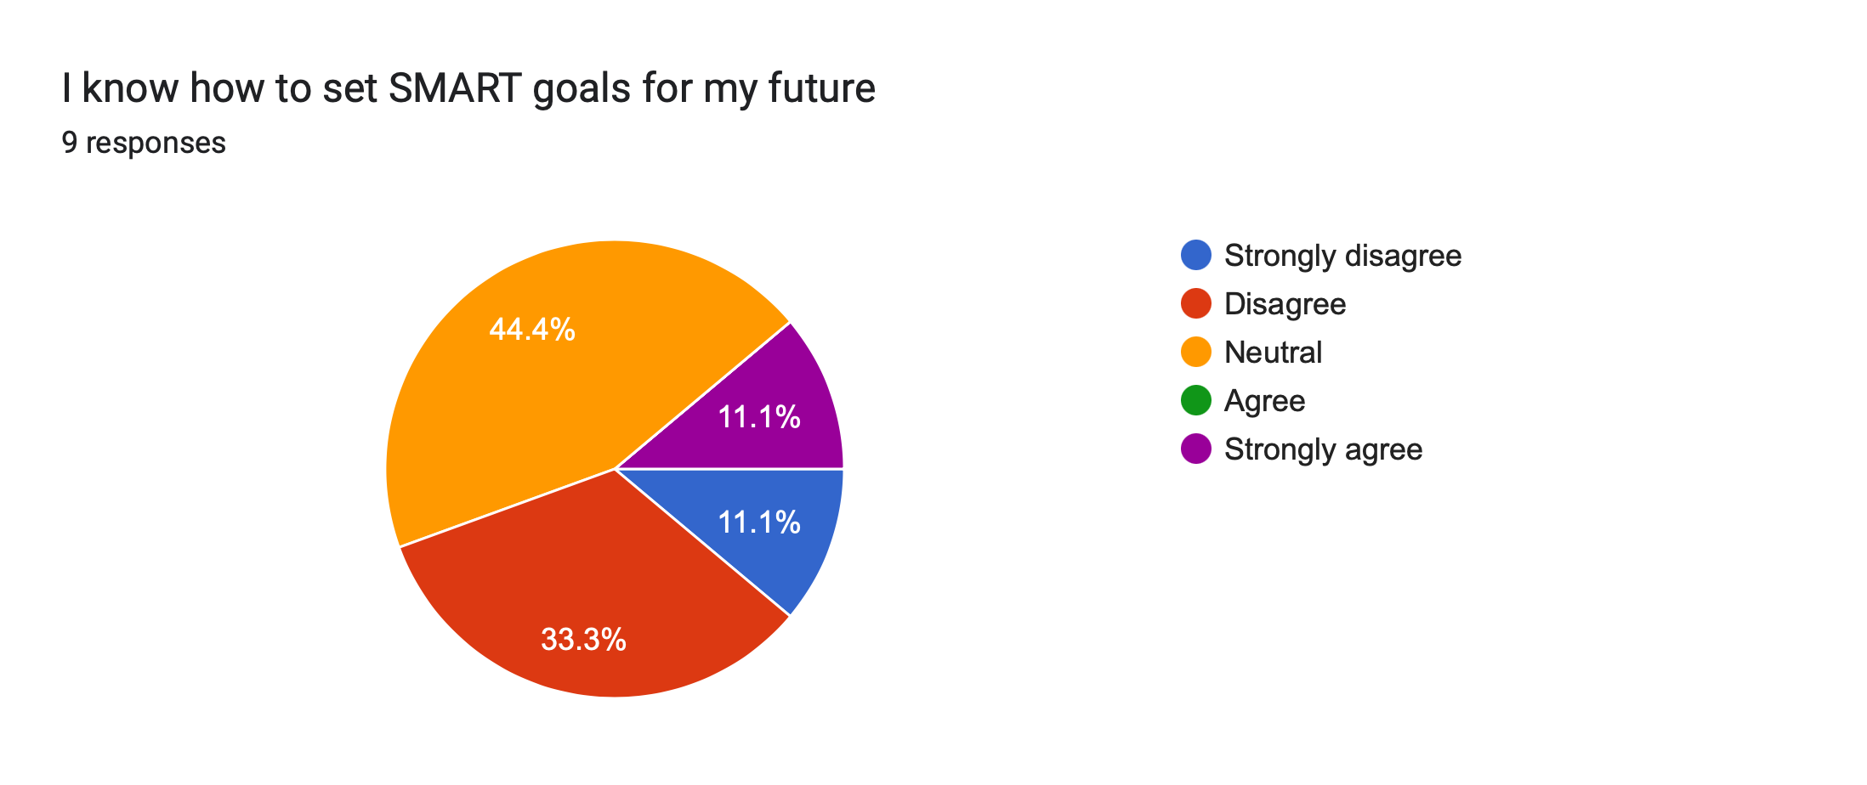
results
Notes:
The first question shows a clear majority (66.7%) of students expressing a desire to learn and explore more about potential job options after school. There is a small minority (22.2%) that do not share the same interest and only one student remaining neutral.
The second question shows a majority of students (44.4%) feeling neutral and 44.4% expressing a lack of confidence in their ability to set SMART goals. There is only one student that expressed feeling confident in their ability to set these goals.

Slide 6
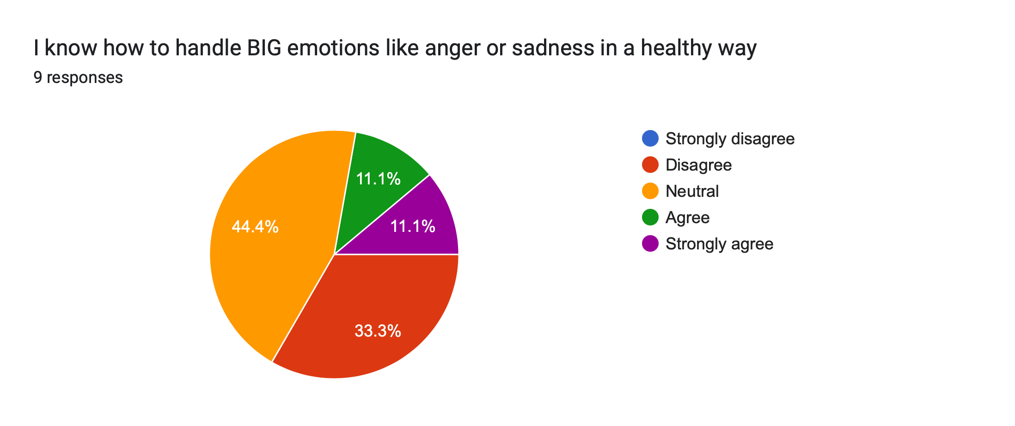
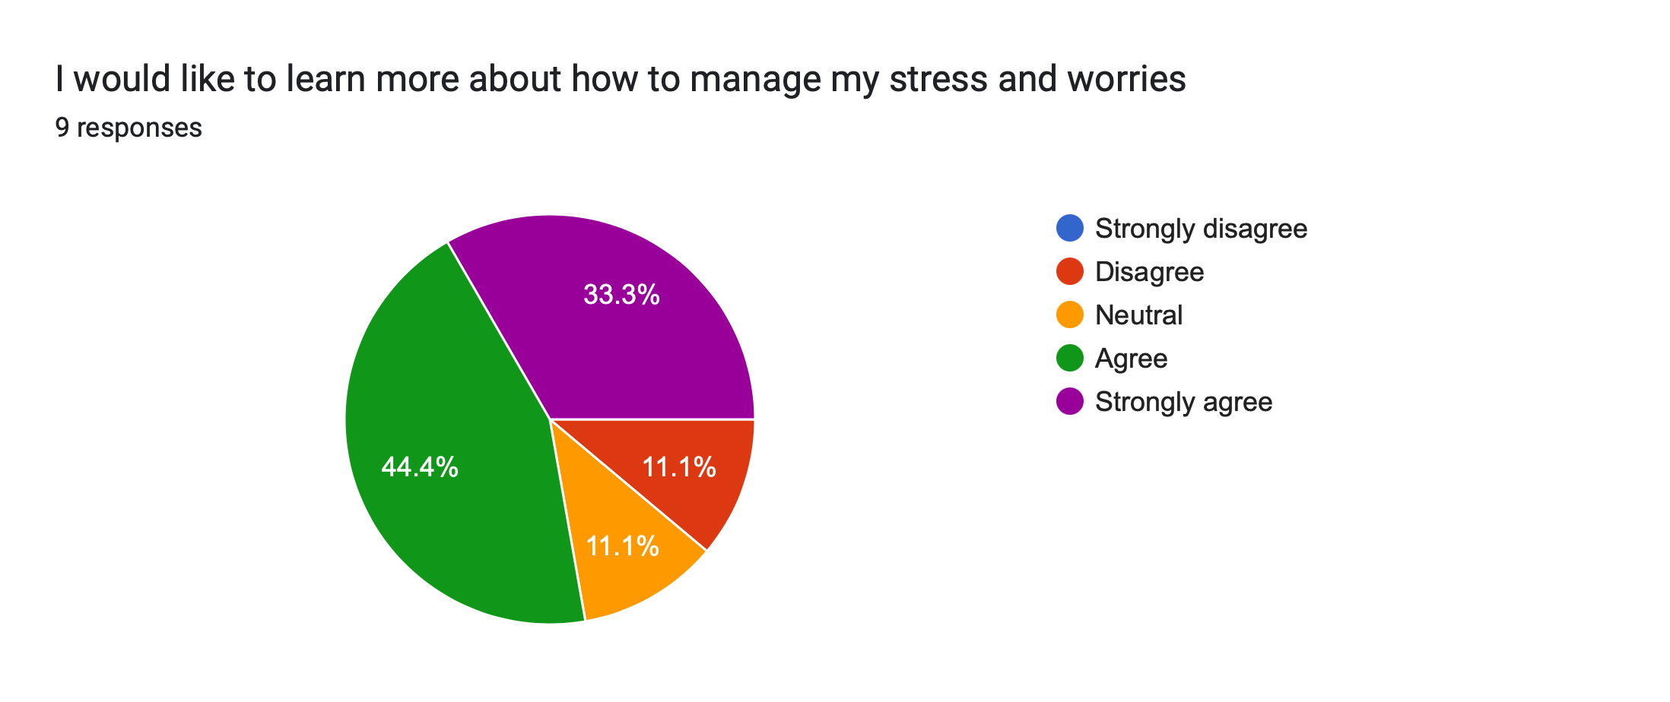
results
Notes:
A clear majority of students in the first question (77.7%) responded that they feel neutral or strongly disagree with their ability to handle their negative emotions in a positive way. There are only 22.2% of students that express confidence in their ability to handle negative emotions. This results in the potential need for classroom guidance for emotional regulation.
The second question shows another clear majority (77.7%) of students that are desiring to learn more about how to manage stress and worries in a positive way. One student responded that they feel neutral about this, indicating hesitancy and indecisiveness and one student expressed not wanting to learn about stress management skills.

Slide 7
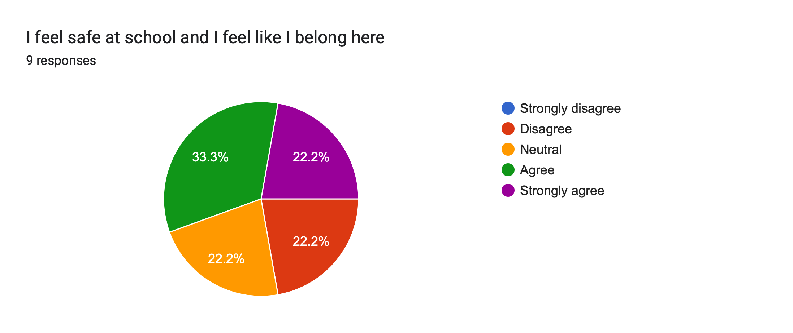
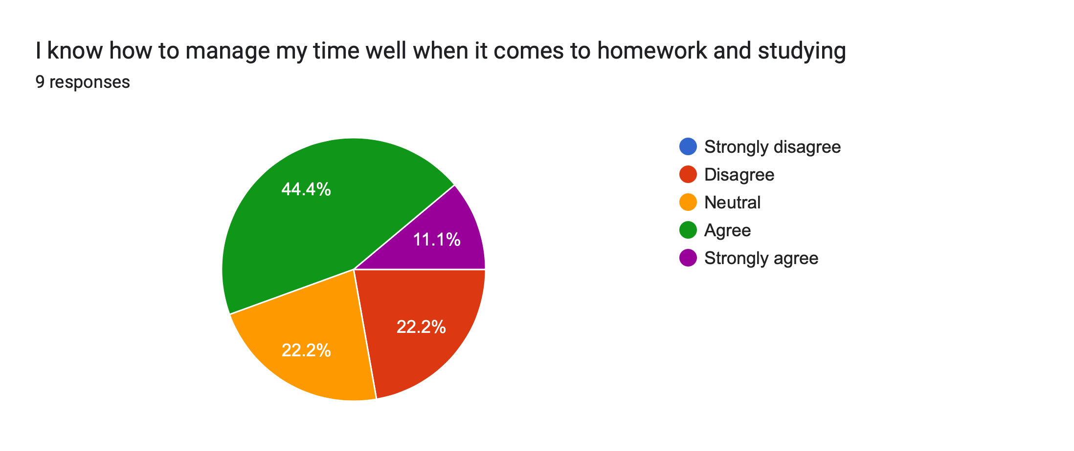
Results
Notes:
In the first question, a little over half of the students (55.5%) expressed that they feel safe and feel as though they belong at school. However, there is a portion (44.4%) that chose neutral or disagree as their responses. These results indicate a mixed student experience. A little less than half of students may be experiencing challenges relating to the school environment.
In the second question, over half of the students (55.5%) felt confident in their time management and study skill abilities. There was however 44.4% of students that chose neutral or disagree as their response, much like the previous question. These mixed results show that a majority of students are not requesting assistance, but it seems it may still be beneficial for the entire class.

Slide 8
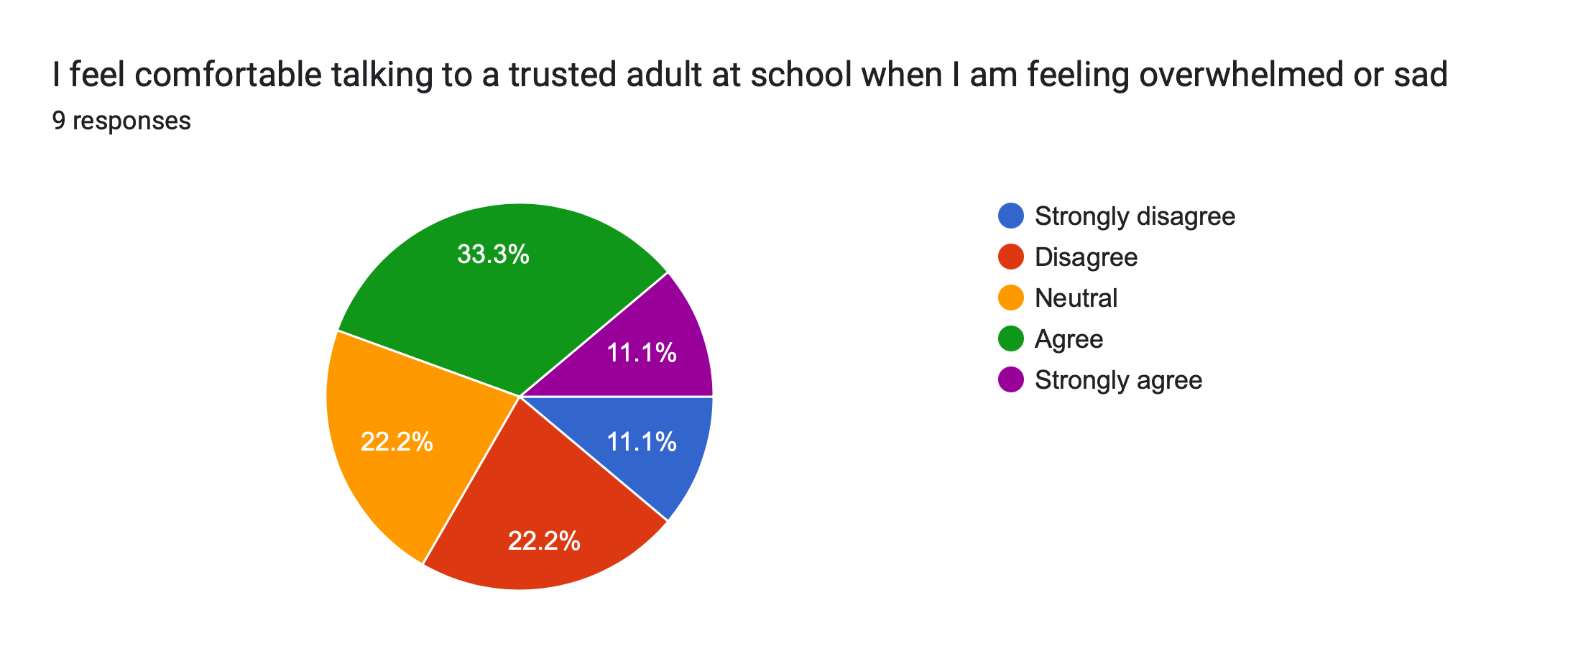
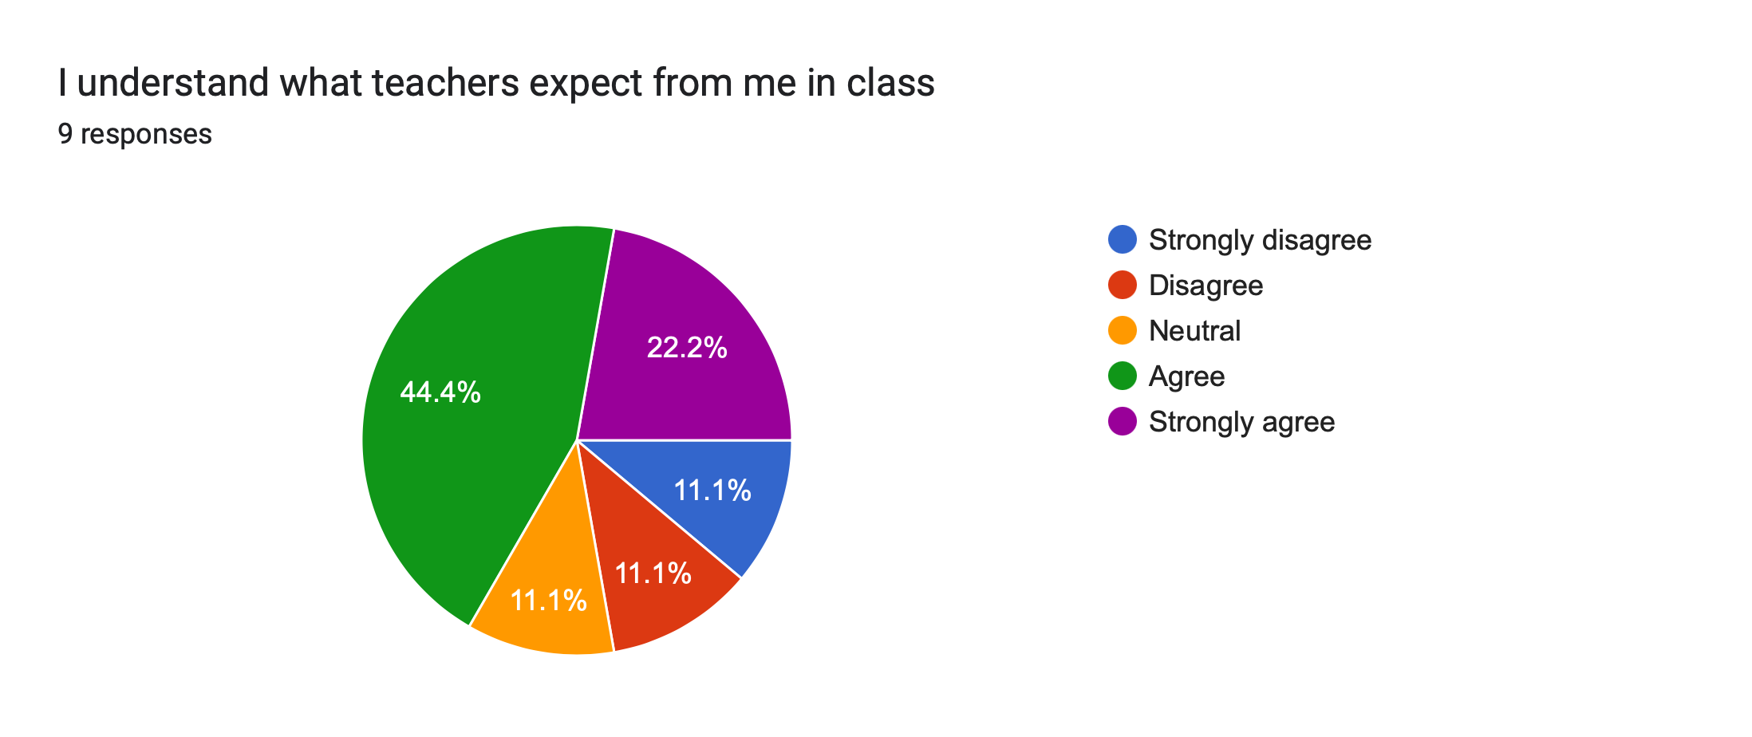
results
Notes:
In the first question, less than half of students (44.4%) selected that they feel comfortable coming to an adult at the school when they are feeling intense emotions. There were 33.3% of students that expressed that they do not feel comfortable coming to an adult in a time of need. Lastly, there was 22.2% of students that selected “neutral”, expressing that they are uncertain about their ability to contact an adult at school.
In the second question, the majority of students (66.6%) expressed that they do feel confident in knowing what is expected from them in class. The remaining 33.3% expressed that they are either unsure or do not know what is expected from them in class.

Slide 9
Interpretations
Key takeaways
Students are unsure about asking for help (academically and socially/emotionally)
Students want to learn more about career options and setting SMART goals
Students have a desire to learn how to manage emotions better (anger, sadness and anxieties)
Recommendations
Efforts for students feeling comfortable asking for help can include
Highlighting staff members that are there for support
Making students aware of mental health resources that are available for them
Implementing monthly check-ins for students potentially struggling with both academics and emotions

Slide 10
Recommendations
Efforts for students wanting to learn more about career options and SMART goals
Individuals can be brought into correlating classes to give a presentation about their career
A career fair can be hosted for students to ask questions and learn about career options
Classroom guidance can be administered at the beginning of the school year to provide students with resources and tools to create their own SMART goal. This can be followed up second semester
Efforts for students wanting to learn how to manage emotions positively
Classroom guidance lessons highlighting the wheel of emotions and giving students options for positive coping skills
A coping skill strategy toolbox can be created for students to utilize when they are unable to manage their emotions. This can be found in classrooms
Mindfulness and self-regulation techniques can be taught through classroom guidance lessons

Slide 11
interventions
Direct student services
  Evidence based cognitive behavioral counseling in small groups or individually (Kaffenberger & O’Rorke-Trigiani, 2013).
    Using coping skill games to teach self-regulation skills
    “I Can Program”
  Study Skills Group (Brannigan, 2006).
    A 16-week group help for screened students
    Asking for recommendations for students struggling with test taking
    This group includes topics such as time management skills, and individual improvement plans
  Mentoring Program (Osiname, 2014)
    Builds leadership capabilities in mentors and mentees
    If students participate in making their own decisions it increases their participation in growth and development
    Adolescents feel empowered and develop leadership skills
Indirect student services
  Parent collaboration
    School counselor can meet with students’ parents to discuss potential at home strageties to better assist their childten
  Referral to outside resources
    Community resources can be utilized (community mental health centers, youth and family services, support groups) to promote mental wellbeing for students.
  Outside tutoring services
    Sylvan Learning
    Khan Academy
    Local libraries
    These can be utilized to promote academic wellbeing for the students
Notes:
Found from previous research, counselors in middle schools can better address academic needs in a group format (Brannigan, 2006). The need for an academic advising group depends on data from the students in their classes, however, when contacting the teachers and the students parents, a school counselor can screen students that will fit in this program. This program lasts 16 weeks and is done during the students lunch period. In this skills group, students will learn how to manage their time better, learning styles, study aids, note taking and memory etc.
A peer mentoring program allows for the growth of a safe learning environment (Osiname, 2014). Positive role models are pertinent in this stage of life, so providing healthy social structures can allow them to create positive relationships among peers (Osiname, 2014). Peer mentors can assist their mentees in academic struggles, social struggles or any unresolved tension or stressors. Mentors are more likely to continue to go into mentor positions and this causes their mentees to feel safe and welcomed at school, fostering a healthy and inclusive environment.

Slide 12
Systemic focus
Policies of practices that could create inequities to proposed interventions
  Parent and/or guardian engagement barriers
    Often these practices favor English-speaking families
    Some guardians may not understand how or have time to access available services
    Solutions
      Having access to multilingual communication or flexible meeting formats. This can include a virtual meeting or translator
  Insufficient mental health staffing
    Often, there is one school counselor per school. This can create issues of not being able to reach and assist every student in need. This can cause issues in the timeliness that we are able to assist these students
    Solutions
      Advocacy for increased funding in order to hire more counselors or school
      Raising money as a school for this cause

Slide 13

Implementation plan
Goal of the plan
  Student improvement in academic success, career awareness and social/emotional wellbeing
Academics
  Objective is to increase student achievement and motivation through learning of SMART goal setting and study/time-management skills
  Interventions include
    Classroom guidance lessons on SMART goals and organization
    Individual sessions with students to review grades and track progress
    Peer mentoring program
Career
  Objective is to expand students’ awareness in potential career or postsecondary options
  Interventions include
    Classroom exploration in the O*NET Online website
    Events which local guest speakers come to inform the students on potential careers
    Small group career interest inventories

Slide 14
Implementation plan
Social and Emotional
  Objective is to help students improve on emotional regulation skills and peer relationships
  Interventions include
    Classroom guidance curriculum lessons on topics such as anxiety management, anger management and conflict resolution
    Small group lessons for students struggling with a specific issue (grief, family stress etc)
Monitoring Progress
  There will be monthly data reviews on students' academic success and behavior changes. This data will be documented and placed into the annual report.
  Participation will be documented and placed into an annual report. Documentation will include ASCA mindset and behavior changes as well as the final data
  Both families of students and staff at the school will remain in contact about student success from quarterly newsletters and an end of year report

Slide 15
Asca mindsets and behaviors
Academics
Mindsets
M 5 – “Belief in using abilities to their fullest to achieve high-quality results and outcomes” (ASCA, 2019)
Behaviors
B-LS 4 – “Apply self-motivation and self-direction to learning” (ASCA, 2019)
Career
Mindsets
M 4 – “Understanding that post secondary education and life-long learning are necessary for long-term career success” (ASCA 2019).
Behaviors
B-LS 7 – “Identify long- and short-term academic, career and social/emotional goals” (ASCA, 2019)
Social and Emotional
Mindsets
M 1 – “Belief in development of whole self, including a healthy balance of mental, social/emotional and physical wellbeing” (ASC, 2019)
Behaviors
B-SMS 2 – “Demonstrate self-discipline and self-control” (ASCA, 2019)
Notes:
Academically, our goal is to help students in their mastery of school and studying. Through this they will learn how to believe in their own skills while also learning new ones. This self-motivation will be directed towards learning, allowing them to thrive and grow in a school environment.
Career wise, students should be able to understand the importance of post-secondary options that are available for them. This will include, learning about these options and also setting long term goals for them to get there.
Socially and emotionally students will be able to learn new skills in order to promote wellbeing. Learning the healthy balance between mental, emotional and physical wellbeing will allow them to thrive in and outside of school. Students that are struggling with emotional regulation will also benefit from this.

Slide 16
Communicating impact and effectiveness
Teachers and Administration
We will be sharing data regarding student participation, outcomes and our plans alignment with ASCA Mindsets and Behaviors
How will we be sharing?
Presentation or handout at staff meetings as well as an end-of-year impact report. This will include our data comparison in written form and graph form
Parents, guardians and members of the community
We will be sharing what our program will be highlighting as well as anonymous success stories
How will we be sharing?
Weekly parent newsletter, parent-teacher conferences, beginning of year conference, and at school board meetings
Students
We will be sharing anonymous results of student feedback as well as progress on the SMART goals that were made
How will we be sharing?
We will be posting charts and small-group themes on the counseling center bulletin board as well as certificates for students that participate in these groups and programs

Slide 17
Advocate for programs and students
Design | The purpose of this survey is to assess the academic, career and social/emotional needs of 6th grade students. This survey was administered to 9 students but can be used over a large group as well.
Ask | Data was collected over Google Forms. The link for the survey was sent out to students to complete anonymously. The software then organized the data and created pie charts to show the data.
Track | Overall, the results noted three consistencies. Students are unsure and hesitant to ask school staff for help in all areas previously mentioned. Students are also interested in learning more about potential career options as well as making SMART goals. Finally, students have a desire to learn how to manage their negative emotions in a positive way.
Announce | All three areas (academics, career and social/emotional) are key to a student's success in school and outside of school. Students deserve to have access to the best education and due to this they must also know how to receive it well. The implementation plan designed will allow this to come to fruition

Slide 18
References
Association, A.S. C. (2019). The ASCA National Model (4th ed.). American School Counselor Association. https://mbsdirect.vitalsource.com/books/978-1-929289-61-5
Brannigan, M. (2006). A Psychoeducational Group Model to Build Academic Competence in New Middle School Students. The Journal for Specialists in Group Work, 32(1), 61–70. https://doi.org/10.1080/01933920600978554
Efendi, Alfiah, A., Qorib, F., Firdaus, F., & Sabri. (2024). Benefits of Big Data in Supporting Better Educational Decision Making. JILTECH: Journal International of Lingua & Technology, 3(2), 395–408. https://doi.org/10.55849/jiltech.v3i2.676
Kaffenberger, C. J., & O’Rorke-Trigiani, J. (2013). Addressing Student Mental Health Needs by Providing Direct and Indirect Services and Building Alliances in the Community. Professional School Counseling, 16(5), 323–332. https://doi.org/10.5330/PSC.n.2013-16.323
Osiname A. Transformative Leadership Framework: Designing a Peer Mentoring Program for Middle School Students. BU Journal of Graduate Studies in Education. 2014;6(1):52-56. Accessed May 2, 2025. https://search.ebscohost.com/login.aspx?direct=true&db=eric&AN=EJ1230719&site=ehost-live&scope=site

