Slide 1
LEGAL ENTANGLEMENT PROJECT: PART 4 – PRESENTATION
Samuel Pedersen
School Law - EDAS 647

Slide 2
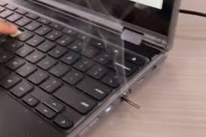
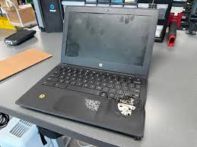
The Issue
The “Chromebook Challenge” is a TikTok trend that began in May of 2025. This viral trend involves students destroying school provided technology in order to gain a stronger social media presence and peer respect. Schools across the country are being plagued by this trend.
Notes:
Protecting students is one of the largest responsibilities of adults within a school. Sometimes, adults must protect students from themselves by enacting policies that discourage potential actions which could harm students. Recently, students in our district and across the country have been causing damages to themselves and school equipment by participating in the TikTok trend “Chromebook Challenge” where students intentionally destroy school Chromebooks, even to the point of them catching fire. Students are attempting this dangerous action in order to gain peer respect and a larger social media presence. Although most stakeholders would understand the apparent danger involved in the “Chromebook Challenge,” some of our students, our most important stakeholder, are seeming to shirk a cause for concern. It is the responsibility of adult stakeholders to protect those whom we are responsible for educating.

Slide 3
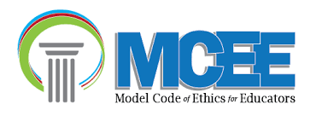
Model Code of Ethics for Educators (MCEE)
Ethical Framework
Principle V.D.2: Promoting the benefits and clarifying the limitations of various appropriate technological applications with colleagues, appropriate school personnel, parents and community members.
Principle II.C.3: Protecting students from any practice that harms or has the reasonable potential to harm.
Principle V.A.2: Staying current with trends and uses of school technology.
Notes:
The first principle has been selected because it addresses the action of reaching out to the community about the appropriate usage of school provided technology. In order to win over the hearts of the students, the district must win over the hearts of the students’ families. Communicating appropriately to parents/guardians about the challenges the district is facing when it comes to keeping technology intact will help mold the minds of the students. While students will likely always get into trouble of some sort, convincing parents to have conversations with their students about the potential risks of actions like destroying school property will lead to the formation of a more productive and fruitful learning environment.
The second principle has been selected because it demonstrates cerebration on the topic of student’s physical wellbeing. When students begin to dismantle technology provided by the school, they open up the potential for significant injury. It is the responsibility of the adults to protect the students, even if that means protection from themselves. Understanding the principle of respect, of oneself and of others, will be beneficial for students and adults alike.
The third principle has been selected because understanding the trends of current technology allows adults to anticipate and mitigate the destruction a student can inflict on a piece of technology, like a Chromebook laptop. While staying on top of current trends is generally thought of as a way to promote and introduce positive trends into a classroom, it is also a way to understand what negative trends are being promoted online. Unfortunately, students have access to the negative aspects of the side effects of the internet. The trends that students try to mimic can lead to many issues for the students and school district alike, which is why staying current with trends is an imperative task for school teachers and administrators.

Slide 4
Reviewing the Literature
Notes:
The following two slides will review court cases related to the policy proposal and relevant literature on the topic. This material helps lay a foundation for understanding the research that contributed to the suggested policy creation. This knowledge base allows stakeholders to understand that problem at hand, as well as the factors that are being put in place to end it.

Slide 5
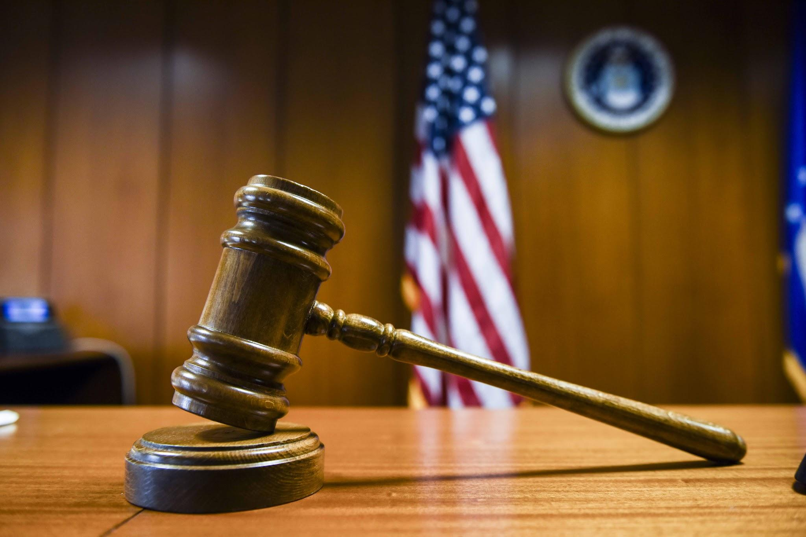
Court Cases
Buena Park School District v. Parents of Student Vandals (1993)
Salem-Keizer Public Schools v. Student and Parents (2016)
Commonwealth v. Domenic Buccella (2001)
All three court cases center around a common theme, student vandalism.
While each case has its own individual facts, all three cases ruled in favor of the school district.
Notes:
The policy that is taking shape over the course of the Legal Entanglement Project deals with the misuse of school provided technology, like Chromebooks, by students that are on school grounds. The cases that were reviewed do not specifically deal with the destruction of technology, however, as time and technology progress, it is important to keep a similar principle in place when dealing out consequences for students’ poor behavior. When students destroy something that belongs to the school they should be held responsible for the financial aspect of replacing that damaged object. Additionally, given that students may not be in a position to take on hefty monetary payments, as was the case in the Salem-Keizer Public Schools v. Student and Parents (2016) ruling, parents must be held accountable for their students’ actions.
The court case of Buena Park School District v. Parents of Student Vandals (1993) focuses on the responsibility that parents play in the actions of their children when those children are at school. In this case the group of boys, ages 10 to 15, were accused of conducting vandalism acts, such as spray-painting, carving symbols into walls, and breaking windows. The school district cited California Education Code section 48904 in the case, which states that parents are liable for the negative actions that their minor children cause, even to the extent of facing financial reimbursement for damaged property. The state of California’s court ruled in favor of the school district. This case demonstrates that parents are responsible for their minor children’s actions, even when they are not present for or aware of a committed crime. This case directly relates to the overarching assignment policy in that it demonstrates a serious attitude towards protecting students and school equipment alike.
The court case of Salem-Keizer Public Schools v. Student and Parents (2016) involved the school district of Salem-Keizer suing a 12-year-old student and his parents for purposely breaking into a science classroom, destroying school property, and wasting school supplies, like chemicals and food coloring. Under Oregon law ORS 30.765, parents of students that are found to have damaged school property are liable for paying up to $7,500. Students that destroy things that are not theirs should be held responsible for actions. Expecting parents to take responsibility for their children’s actions in a financial role is the right course of action. This ruling remains consistent with others, which places an emphasis on not only the actions of the student, but also on the parent(s). This case relates to that of the policy which is being proposed in this course. When students destroy school property, they should have to face consequences for their actions.
The court case of Commonwealth v. Domenic Buccella (2001) took place in the Massachusetts Supreme Judicial Court. This case involved a student purposely vandalizing a school classroom with graffiti, writing racial slurs and using vulgar language. The school district turned in samples of these students writing to the local police department to help them identify the students’ writing characteristics. This led to the eventual charges being held against Buccella. This relates to the overall policy being proposed in that it places an emphasis on students being held accountable for their actions. Additionally, schools are able to use the resources they have available to them to prove a student guilty, even when the student does not want to admit that guilt.

Slide 6
Related Literature
Articles from these websites were reviewed to gain a better understanding of the nature and effects of the “Chromebook Challenge.”
These articles addressed the severity of the challenge, the motivations of those attempting the challenge, and the plans that a school can put in place to stop this from happening.
Sources used in the literature review:
  USA Today
  Colorado Official State Web Portal
  New York State Official Website
Notes:
Many states are trying to share the potential dangers of their students’ actions with the parents themselves. Both Colorado and New York are pushing information to adults to help prepare them for what to do if students behave in a way that causes potential harm to themselves and others. Parents are being reminded that TikTok trends can lead to real life problems, and they should be encouraging their young ones to not participate in these mischievous acts. The court cases and the literature about this topic are in harmony. The court cases demonstrate the schools’ rights to expect students to properly handle school equipment, and that penalties will be enforced if the equipment is purposely harmed. The literature on the topic shares that parents should be aware of what their students may be doing.

Slide 7
The Policy Proposal
CCSD students will not purposely destroy, tear apart, and/or intentionally harm school technology equipment, such as Chromebooks or iPads, either on or off of school grounds.
Notes:
The following policy is a new proposal to be implemented into Cardinal Community School Districts school policy, effective immediately. While the policy is not exceedingly lengthy, its intentions are clear. Protecting CCSD and its students / staff is the driving factor in its creation. While its related procedures and benefits will be discussed further throughout the presentation, understanding that this policy is intended to bring about a safer learning environment is key.

Slide 8
Procedures Related to the Policy Implementation
If students engage in these types of actions they will receive an out of school suspension lasting for the length designated by school administration.
Additionally, students, and their families will be held responsible for covering all financial expenses involved in repairing or replacing the damaged equipment.
CCSD is also in a position to pursue legal action against any student(s) who committed the act, if deemed appropriate by the superintendent of schools.
Notes:
Teachers and school staff must be made aware that this policy will affect them positively and require very little effort on their part to enforce. Teachers and school staff will simply need to be vigilant of students intentionally abusing school technology. If they see a student that is acting in this way, they will need to report that to the office. This action on the part of the teachers and school staff would likely happen regardless of the policy implementation or not, yet now all school staff will be able to enforce this expectation with more validity. The policy gives all school staff a leg to stand on and limits empty threats.

Slide 9
Advocacy for the Policy Proposal
Notes:
The following two slides will discuss the impacts that this policy would have on our school, as well as the stakeholders within the school district. The main focus of these slides is to address the immediate and future benefits that implementing this policy will have.

Slide 10

Immediate Benefits
Safer environment
Improved classroom management
Less anxiety
Better understanding of consequences
Notes:
The implementation of the above policy will create a safer environment for all CCSD students and staff. Without the threat of fires starting, electrocutions happening, or other types of dangers happening as a result of the “Chromebook Challenge” school staff will be able to focus on classroom management, instruction, and the overall success of their students. Students who do not participate in the challenge will not have to worry about the distraction that the act of destroying school technology creates in the classroom. Those who would have otherwise been tempted to participate in the challenge will possess a richer understanding of the dangers involved in the challenge, as well as the consequences that would take place if destructive actions were carried out. Parents will not only have an opportunity to build trust with their children by explaining the risks involved in taking part in this type of activity, they will also ensure that their child is safer while at school.

Slide 11

Future Benefits
Stronger family relationships
Improved academic success
Richer understanding of technological capabilities
Added maturity within the student body
Notes:
Although there will always be challenges when it comes to keeping students engaged with classroom instruction, and students will undoubtedly still find ways to get into trouble, limiting the severity of their actions will ensure a more successful learning experience to take place for all involved. The bulleted benefits will build a better atmosphere in and out of our school walls. Focusing on the students needs first, all stakeholders affected by this policy will experience long term and short term benefits.

Slide 12
References
Cano, D. (1993, February 27). School officials sue parents of suspects in campus vandalism: civil action: the buena park school district seeks to recover more than $13,000--what it will cost to repair graffiti damage. Los angeles times: https://www.latimes.com/archives/la-xpm-1993-02-27-me-550-story.html
Chromebook Social Media Trend. (n.d.). New york state website: https://www.dhses.ny.gov/chromebook-social-media-trend-0
Claxton, R. (2019). Public and private school administration: an overview in christian perspective (2nd ed.). Kendall hunt publishing company.
Commonwealth vs. Domenic Bucella. (2001). Justia: https://law.justia.com/cases/massachusetts/supreme-court/volumes/434/434mass473.html
Essex, N. L. (2016). School law and the public schools (6th ed.). Pearson.
Lee, Y. (2025). Continuity in criminal behavior: the interplay of early-onset delinquency and victimization. Crime & delinquency, 00(0). https://doi.org/10.1177/00111287251331572
English Standard Bible. (2001/2016). ESV online: https://esv.literalword.com/
Pate, N. (2017, October 4). Salem-keizer district sues student, his parents for $19,000. Statesman journal: https://www.statesmanjournal.com/story/news/education/2017/10/04/salem-keizer-school-district-sues-student-parent-crossler-middle-school-property-damage/732562001/
Snider, M. (2021, September 21). 'Devious licks' challenge on tiktok leads to criminal charges against students across us. USA today: https://www.usatoday.com/story/news/nation/2021/09/21/tiktok-devious-licks-challenge-schools-police-students-arrests/57974550s01/
TikTok Chromebook Challenge Leads to Damaged School Laptops. (n.d.). Colorado office of school safety: https://oss.colorado.gov/news-article/tiktok-chromebook-challenge-leads-to-damaged-school-laptops#:~:text=Schools%20and%20law%20enforcement%20nationwide%20are%20alerting,to%20short%2Dcircuit%2C%20emit%20smoke%2C%20and%20even%20ignite.
Quick Facts. (2025, January 20). Cardinal community school district website: https://www.cardinalcomet.com/about/quick_facts/

