Slide 1
Internship Culminating Project PowerPoint Assignment: Kindergarten Transitioning
Kendra Zaremba
Liberty University, School of Behavioral Sciences

Slide 2
Existing Data Sources
Counselor: The elementary school counselor stated that last year’s Kindergarten class required the most supports of the entire schools six grade levels.
Special Education Teacher: Special education kindergarten teachers were also consulted as their population requires additional classroom supports due to not only transitional needs, but behavioral concerns as well.

Slide 3
Needs Assessment
Over the recent year’s, perhaps due to COVID isolation, the kindergarten population requires assistance transitioning into the school environment within social and emotional domains. Kindergarten students need help with acceptable peer interactions as they may have not been appropriately exposed to others learning skill sets on how to build and maintain friendships, treating others respectfully, showing kindness and making good choices. Within this specific school are also cultural differences which may impact peer relationships due to values, beliefs and worldview upbringings. This was considered and why diversity was chosen as a topic.
Children entering kindergarten may not have been in an environment with expectations placed on them regarding rules, consequences and tolerable mannerisms. This can be especially difficult for special needs children who require more help comprehending behavior. The most discipline referrals come from the kindergarten level and from the special education classrooms.

Slide 4
Needs Assessment-Discipline Referrals
Mrs. Montgomery’s classroom discipline referrals pre-classroom guidance lessons
8/19-striking a student/refusal to comply
8/21-sriking a student/biting a student
9/5-disruption/reckless behavior
9/6-speaking uncivil/striking a student

Slide 5
Description of Project
Upon review of the two kindergarten special education classrooms discipline referrals, the classroom with the most referrals was chosen in hopes they would benefit and learn from the classroom guidance lessons.
Consultation with the teacher was utilized to determine timing, morning was found best due to student attention and focus.
Various formats were employed to keep student attention and interactions (books, activities, discussions, projects).
Each session lasted 30 minutes.

Slide 6
Description of Project
Classroom Guidance Lesson 1: Good and Bad Choices
-Class discussion: What are choices? How do you know if choices are good or bad?
Read outloud: The Magic of Me: My Magical Choices by Becky Cummings
-This book is empowering to children, showing them responsibility for themselves. Highlighted keyword: responsible, forgiving, generous confident, brave, calm, etc…
Sort it Out Worksheet: this allowed children to also practice minimal scissor practice of cutting twelve good vs. bad choices and sorting them into the correct column with glue. We reviewed the answers together on the overhead.
-Examples: Listen to my teacher, talk in line, clean up, run in the hall, hit my friends, not share, share, do my work, say mean words, scream and cry.

Slide 7
Description of Project
Classroom guidance lesson 2: Kindness
-Class discussion- What is kindness? How do we show kindness to others? Countered with the opposite: What do we do if someone is not being kind? (tell you teacher or an adult)
Read outloud: A Little Spot of KINDNESS! By Diane Alber
This book allows children to join SPOT on a journey spotting kindness in everyday situations in a school environment (sharing, using encouraging words, being friendly, lending a helping hand, etc…)
Emotions & Feeling project-children were allowed to choose between eight faces showing various emotions and color them. Students were directed to choose a face related to an emotion they were feeling and a color they felt represented that emotion. They then glued it to a blank piece of paper a drew themselves doing what made them feel the emotion.

Slide 8
Description of Project
Classroom guidance lesson 3: Diversity
-Class discussion- students inherit and preferential differences. Defined and discussed uniqueness. Ended with all students' similarities being kindergarten students in Mrs. Montgomery’s class at Gladys West Elementary, enforcing commonalities.
Read outloud: It’s OK to be Different by Sharon Purtill
-This book encourages children to be themselves and accept others as they are in our modern world.
Project: Students were provided handprints to color and utilized scissor skills to cut out. Handprints were glued around the phrase “We are all Different and that is Beautiful” and hung in their classroom.

Slide 9
Description of Project
Classroom guidance lesson 4: Friendship
Classroom discussion: What is friendship? How do we know someone is our friend? How do we treat our friends? Countered with the opposite: If someone is not our friend what should we do? (avoid, we will not be friends with everyone).
Socialization worksheet: Find Someone who… (Fall Version)
-students were encouraged to find other students in their class who experienced activities on the sheet (ate pumpkin pie, picked apples, ate a candy apple, etc…)
Initiated ongoing Ways to be a Friend storybook: Coloring booklet they can continue in time that provides examples of how to be a good friend to others (listen and pay attention, have fun, share, play fair, etc…)

Slide 10
AIA Specialty Standards and Rationales
Foundations: Advocated for an appropriate school counselor identity and program in teaching important classroom guidance lessons concerning transition skill sets to kindergarten students.
Counseling Prevention and Intervention: Suggested social/emotional programming to improve growth and development of students in relation to peer relationships, which has lacked in recent years at this grade level. This correlates to ASCA Mindsets and Behaviors standards B-SS 2. positive respectful supportive relationships with others, B-SS 4. empathy and B-SS 9. social maturity and behaviors appropriate to situations and environments.
Diversity & Advocacy: Collaborated with Early Language Learners teachers to reinforce lessons to ELL students who may not have comprehended lessons in the English language. This correlates to ASCA Mindsets and Behaviors standard B-SS 10. cultural awareness, sensitivity and responsiveness.

Slide 11
AIA Specialty Standards and Rationales
Collaboration & Consultation: Consulted with my site supervisor for a needed service within the school and collaborated with SPED and ELL teachers for social/emotional service delivery developments.
Leadership: Worked with others to enhance the services provided to kindergarten students as part of a comprehensive school counseling program.

Slide 12
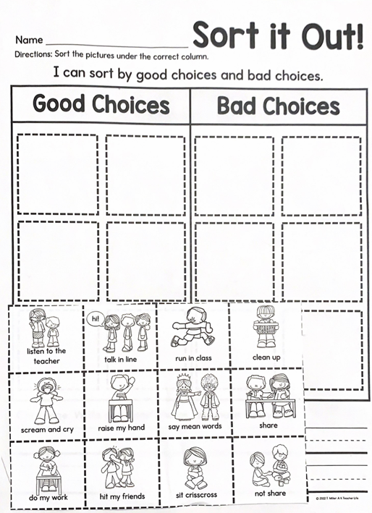
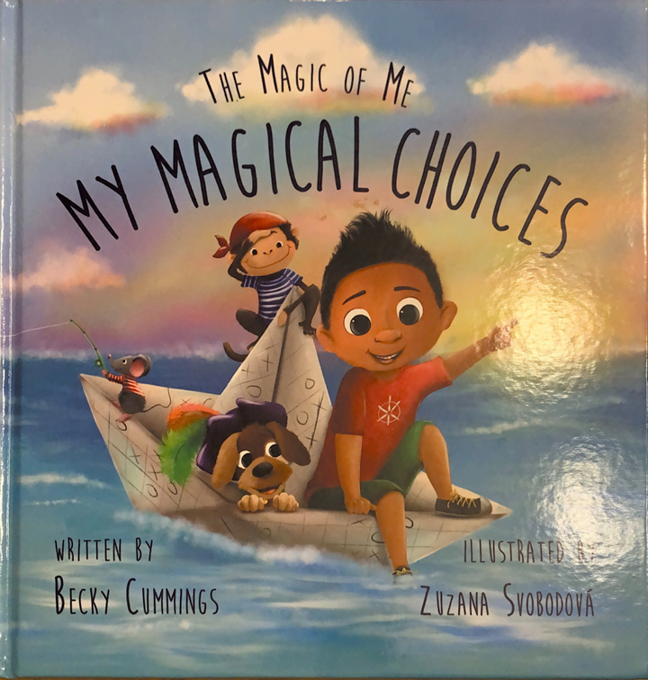
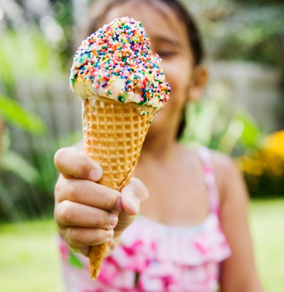

Classroom Guidance Lesson 1: Good and Bad Choices
Caption
Caption
Notes:
NOTE: To change images on this slide, select a picture and delete it. Then click the Insert Picture icon in the placeholder to insert your own image.

Slide 13
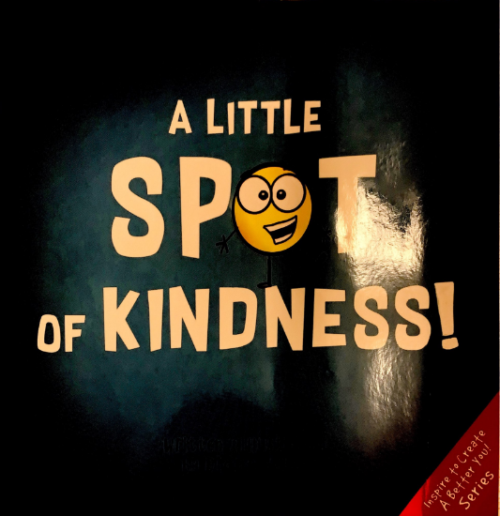
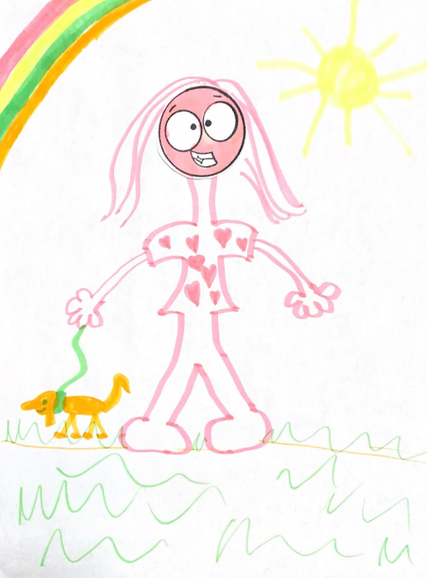
Classroom Guidance Lesson 2: Kindness
Caption
Caption
Notes:
NOTE: To change images on this slide, select a picture and delete it. Then click the Insert Picture icon in the placeholder to insert your own image.

Slide 14
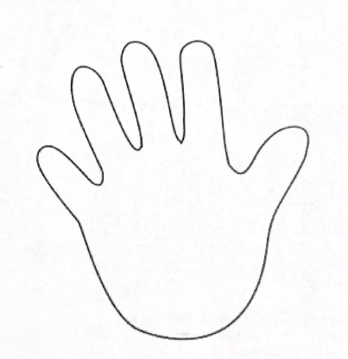
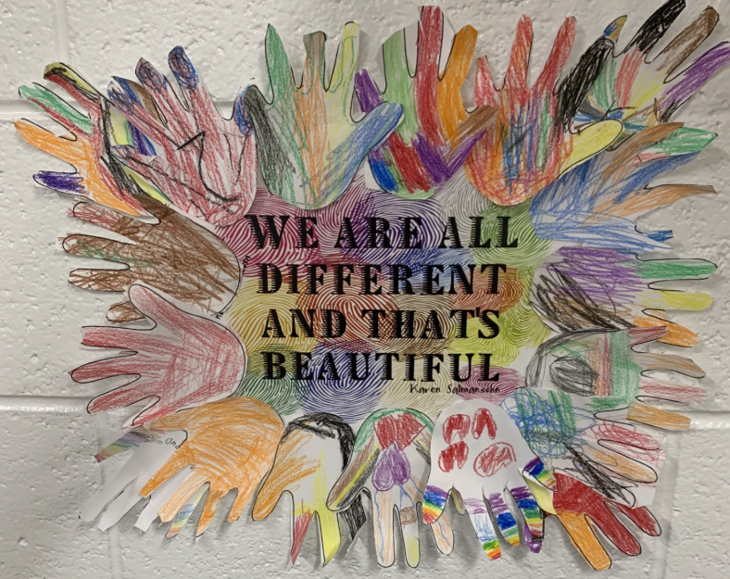
Classroom Guidance Lesson 3: Diversity
Caption
Caption
Notes:
NOTE: To change images on this slide, select a picture and delete it. Then click the Insert Picture icon in the placeholder to insert your own image.

Slide 15
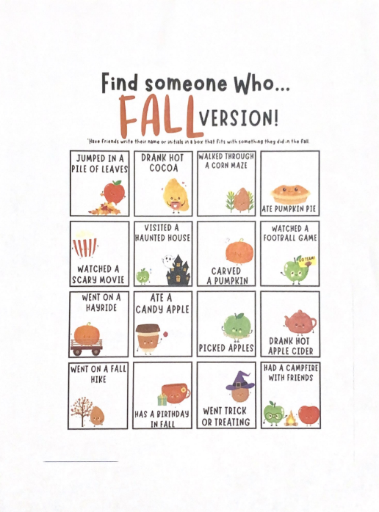
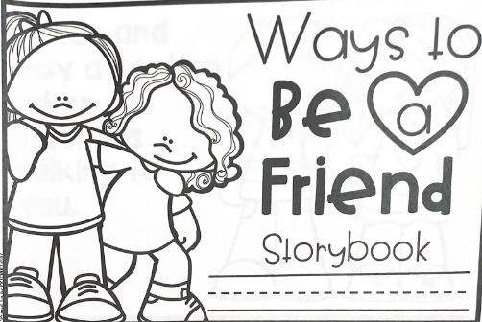
Classroom Guidance Lesson 4: Friendship
Caption
Notes:
NOTE: To change images on this slide, select a picture and delete it. Then click the Insert Picture icon in the placeholder to insert your own image.

Slide 16
Cultural Sensitivity
This elementary school has high populations of Hispanic and Muslim religions. There are three Early Language Learner teachers based on student level to which I collaborated with to discuss reinforcing lessons to students within their language for understanding. This ensured comprehension of material for inclusion.
Classroom guidance lesson four comprised culture and diversity. We read a book about how all are different and we accept everyone, then all students decorated handprints that outlined a positive cultural phrase that was hung inside their classroom.
All lessons were taught objectively without personal values, beliefs or worldview interference.

Slide 17
Evaluation
Pre-Classroom Guidance
Post-Classroom Guidance
8/19- striking a student/refusal to comply
8/21- striking a student/biting a student
9/5- disruption/reckless behavior
9/6- speaking uncivil/striking a student
9/26- speaking uncivil
10/16- interfering with learning/failure to respond
10/16- interfering with learning/failure to respond

Slide 18
Evaluation
My intervention was evaluated based upon disciple referral data pre- and post-classroom guidance lessons.
Results indicate there were four disciple referrals pre-delivery and three referrals either during lessons or post-delivery of lessons.
According to types of disciple referrals, pre-classroom guidance lesson data represented more socio-emotional behaviors such as hitting and biting other students. In post-classroom guidance lesson data this has not been reported.
My goal was to provide this classroom with transitional social/emotional assistance, and this data supports my intentions as students are no longer intentionally harming their peers.
Data will be reported as a shared data comparison file in Microsoft Teams along with lesson plans to administration and my site supervisor in hopes of implementing these transition lessons to all kindergarten students next school year.

Slide 19
Thank you!!

