Slide 1
Internship Culminating Project PowerPoint Presentation: Junior Postgraduate Presentations
Kendra Zaremba
Liberty University

Slide 2
Existing Data Sources
Counselor feedback was of high importance in determining the need for these classroom guidance lessons. According to Morgan et al. 2014, “School Counselors are expected to offer comprehensive, developmental, and empirically-based programs that emphasize the social, emotional, academic, and vocational education for all students” (Paolini, 2020, p.5). High school students’ achievement and correlating post graduate transitioning is under the umbrella of school counselor responsibility.
School attendance is key for successful transition and is directly related to grades, ability to obtain important lessons and instructions and overall learning. School attendance data revealed that students who attended school regularly held better grades and went on to college, military and technical trade schools.

Slide 3
Needs Assessment
Counselors: The counseling team was consulted to support the need for Junior level postgraduate planning. It has been a topic on their “to do” list for some time now but due to time constraints and over ratio limitations it was never initiated. Counselors were all in agreeance that Juniors are in a prime position to start receiving information about how to begin gearing senior year transition options. Counselors also agreed attendance needs to be encouraged to gain valuable information.
Students: Various opportunities allowed myself to ask Junior students what areas they deemed assistance could be provided to become more successful and many stated graduation, college and employment.

Slide 4
Needs Assessment-Research
Poor Attendance
Good Attendance
Number of Absences | Number of Failing Classes
44 | 4
33 | 5
23 | 2
21 | 4
20 | 0
18 | 6
18 | 0
18 | 0
17 | 5
11 | 0
Number of Absences | Number of Failing Classes
3 | 0
2 | 2
2 | 0
2 | 0
2 | 0
1 | 1
1 | 1
1 | 1
1 | College Dual Enrollment
1 | College Dual Enrollment

Slide 5
Description of Project
All Juniors received these four classroom guidance lessons. If a student was absent, their first block teacher would send them to the counseling department their next present day, directly after morning announcements to receive materials they missed with an update on the lesson. Once a small group convened, I would meet with them in the counseling lobby.
The only criteria for these lessons were that students had to be at an academic standing as a Junior.
Upon reviewing the school schedules, it was decided that these lessons could be scheduled in March, the week before Spring Break. Junior US and World History classes were taking SOL’s the week prior, so this allowed them the opportunity to break from their normal schedule and focus on another important topic.
All students attended each session regardless of whether they already had a postgraduate plan in place to allow the opportunity of learning all options available to them.
Lesson plans were utilized to guide each session

Slide 6
Description of Project
Classroom Guidance Lesson 1: Your Counselors, Attendance and Resumes
This session described the roles of the school counselors: advocate for students, ensure students take courses that are aligned with their career and post secondary pathways, participate in academic intervention meetings, consult with parents/teachers/administrators/ social workers/students, provide information and resources to parents on a variety of issues.
Attendance is directly correlated to student success and graduation rates. Regular attendance has a strong bearing on your GPA, which colleges consider. Skipping class decreases learning that affects your life plans.
Start resume building now! Include volunteer work, babysitting, pet sitting or church work.

Slide 7
Description of Project
Classroom Guidance Lesson 2: Diploma Types and SAT vs. ACT
Standard Diploma-3 Science, 3 History, 3 Math, 4 English, 4 Electives, 2 Health & PE (CPR), 1 Economics & Personal Finance, 2 Fine Art/ Career & Tech or World Language (5 SOL’s)
Advance Studies Diploma-4 Science, 4 History, 4 Math, 4 English, 3 Electives, 2 Health & PE (CPR), 1 Economics & Personal Finance, 1 Fine Art/ Career & Tech and 3 World Language (5 SOL’s)
SAT ACT
Achievement Test Aptitude Test
Math, English Science, Writing Writing is optional
National percentage Science Heavy
PSAT for practice

Slide 8
Description of Project
Classroom Guidance Lesson 3: Post Graduate Options and Career Readiness
College-reviewed and passed out the following: senior year college prep checklist broken down into months entailing what should be completed each month to stay on track, college application types (early decision, early action, early decision II, rolling admission and regular admission), SAT testing and registration deadlines, transcript release forms and brag sheets where that students can fill out to assist counselors in writing college recommendations.
Technical and vocational trade schools- explained these are work based learning schools.
Military-Reviewed each militia branch. ASVAB testing date provided.
Employment-Resume assistance, interviewing skills and job searching with Ms. Johnson.
Career Readiness-Ms. Johnson, Career Readiness paraprofessional, presented on externships, internships, mentorships, school-based enterprise, job shadowing, entrepreneurship and apprenticeship that can take place during the school year.

Slide 9
Description of Project
Classroom Guidance Lesson 4: Xello and College
Xello replaced Naviance for a complete college application process. Xello allows students to choose their areas of interest that align with their strengths and abilities, they can research careers and employment, and can also research colleges they are interested in. If they are going to college, they can apply through this application which will take them through a step-by-step process. Counselors can pull up the student's profile and assist them when needed and complete letters of reference on their behalf. Xello keeps an updated portfolio for each student, so they are aware of updates and next steps within the application process such as applying for scholarships and FAFSA.
Students were asked to login to their accounts and follow along, so they are aware of where to locate which options they require.

Slide 10
AIA Specialty Standards and Rationales
  FOUNDATIONS: Aligning the school counseling program with key roles according to the ASCA National Model to assist students with post graduate planning to successfully transition students from school to the world of work.
COUNSELING PREVENTION & INTERVENTION: Provides diverse group counseling classroom lessons conducive to student learning of postgraduate options.
DIVERSITY & ADVOCACY: Applies multicultural competence within classroom guidance lessons.
ASSESSMENT: Identified the need for this classroom guidance lesson to support students career development. I will also identify and make myself available to students who require additional support outside of the lessons.
COLLABORATION & CONSULTATION: Closely consults and receives site supervision for these lessons to improve skills, techniques and counseling skills.
LEADERSHIP: Follows the ASCA National Model and provides information to parents/guardians.

Slide 11
ASCA Mindsets & Behaviors and Rationales
M.6 Understanding that postsecondary education and lifelong learning are necessary for long-term success. Learning a particular skill set or becoming an expert within a field yields higher earnings, employment security and the ability to support yourself as an adult.
B-LS 4 Self-motivation and self- direction for learning. Provide students information for future planning that will allow them to become motivated to explore their life goals.
B-LS 7 Long- and short-term academic, career and social/emotional goals. Working on short-term goals while in high school enables students to reach their long-term career goal.
B-SMS 4 Delayed gratification for long-term rewards. Students need to be aware that reaching long-term career goals may take time, hard work towards this goal must persist.
B-SMS 5 Perseverance to achieve long- and short-term goals. Students are in the midst of becoming adults, achieving goals takes determination and dedication.
B-SMS 10 Ability to manage transitions and adapt to change. The transition from high school to the work world is big, but manageable if planned carefully.
B-SS 1 Effective oral and written communication skills and listening skills. Students must listen to adults attempting to assist them with postgraduate goals and take advantage of the information and resources available to them to become successful with transitioning.

Slide 12
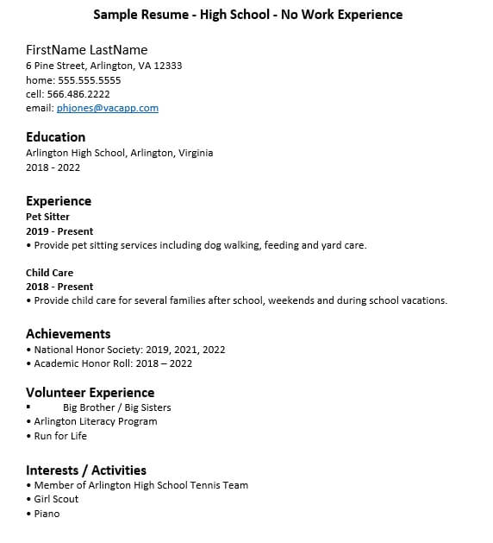
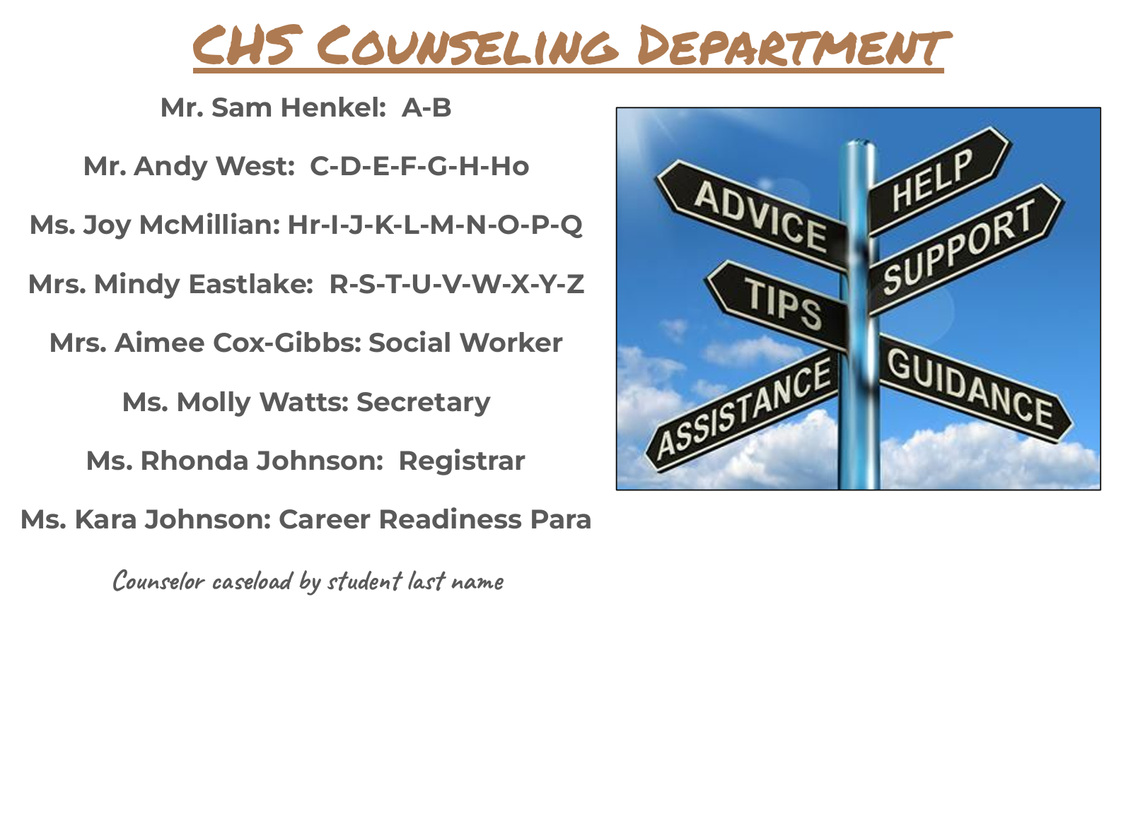
Visual Aid for Lesson 1
Enhancing your presentation

Slide 13
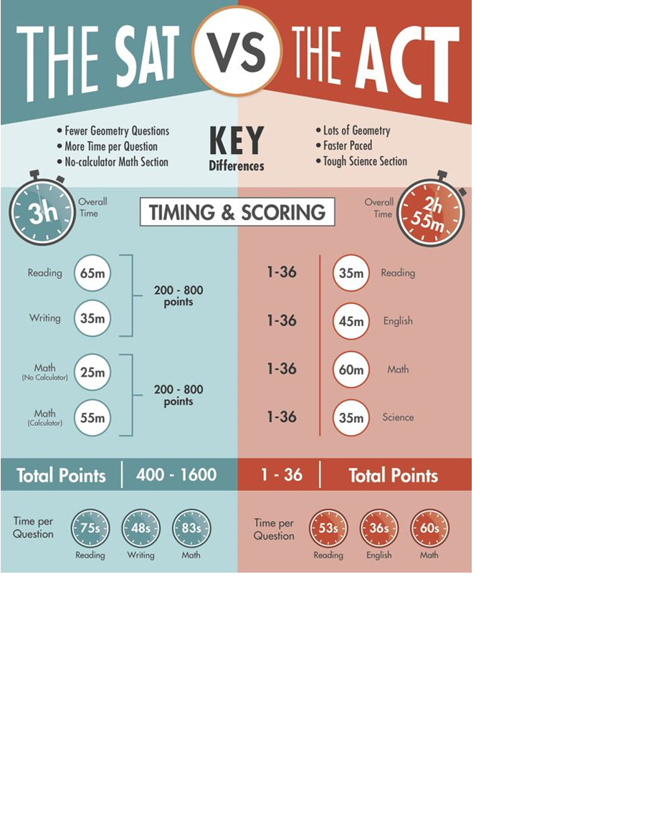
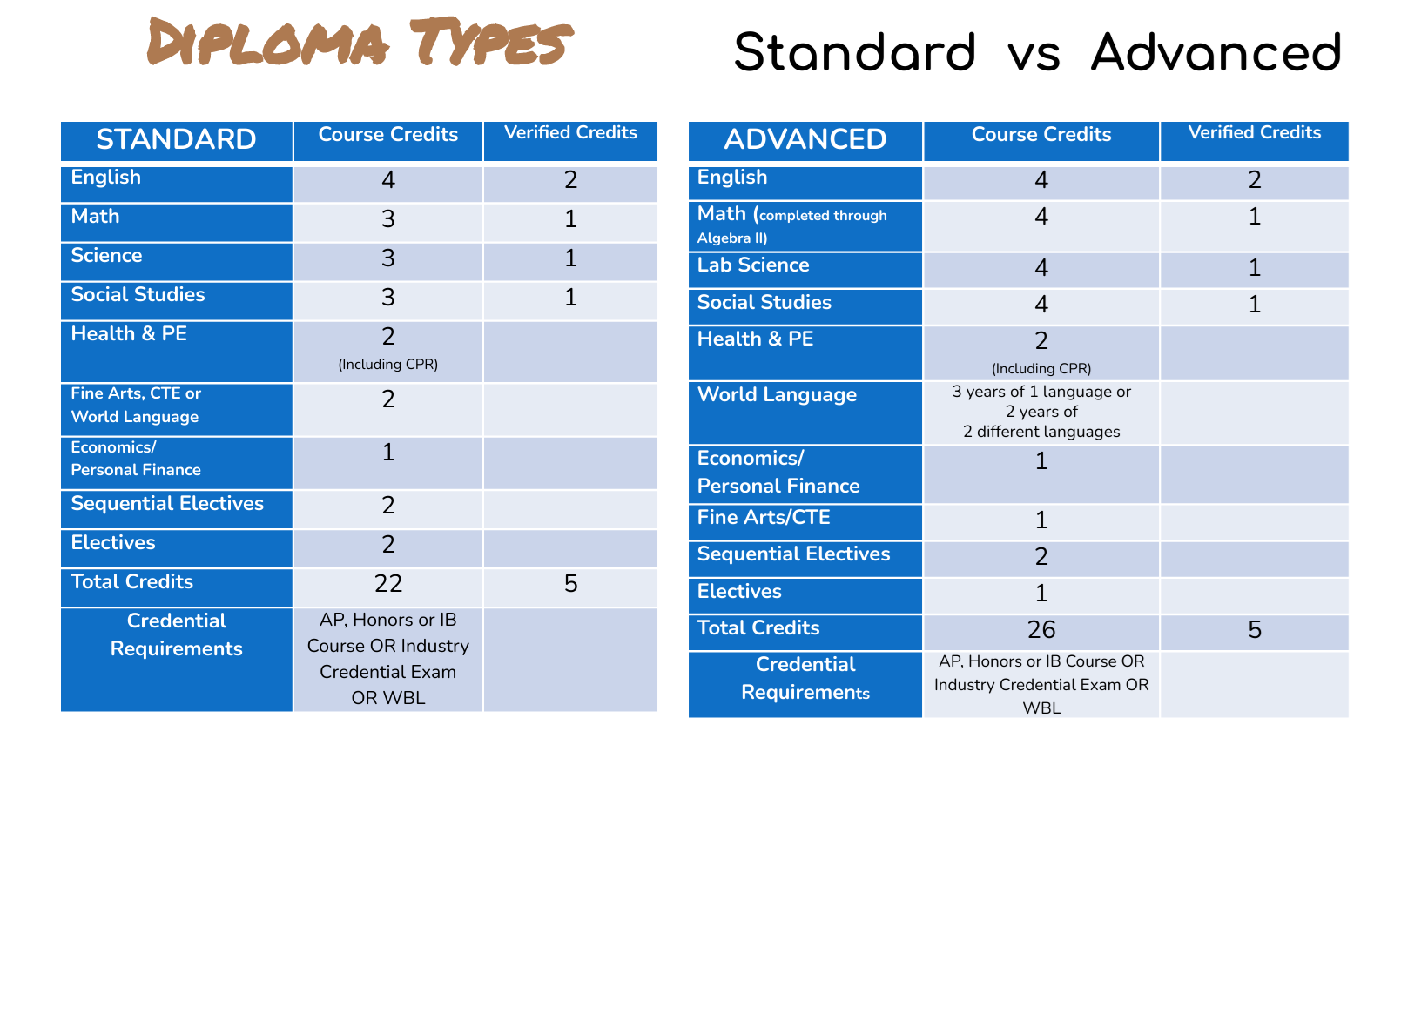
Visual Aids for Lesson 2

Slide 14
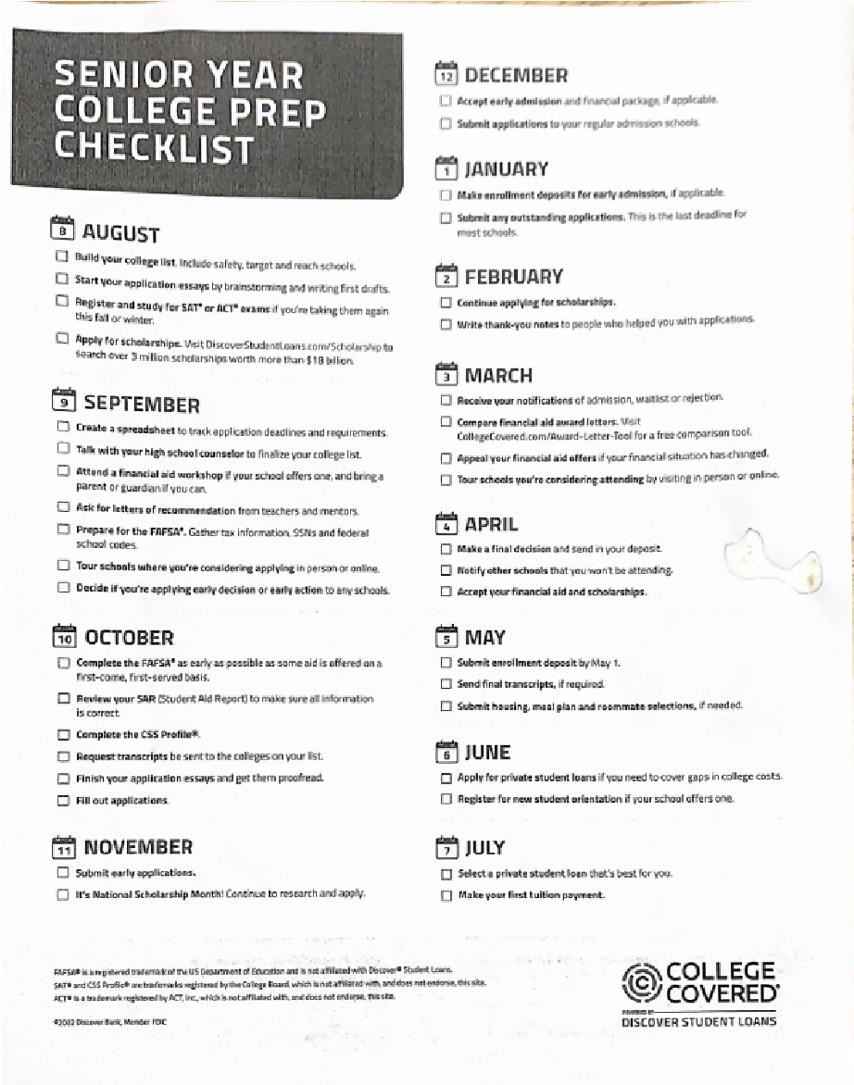
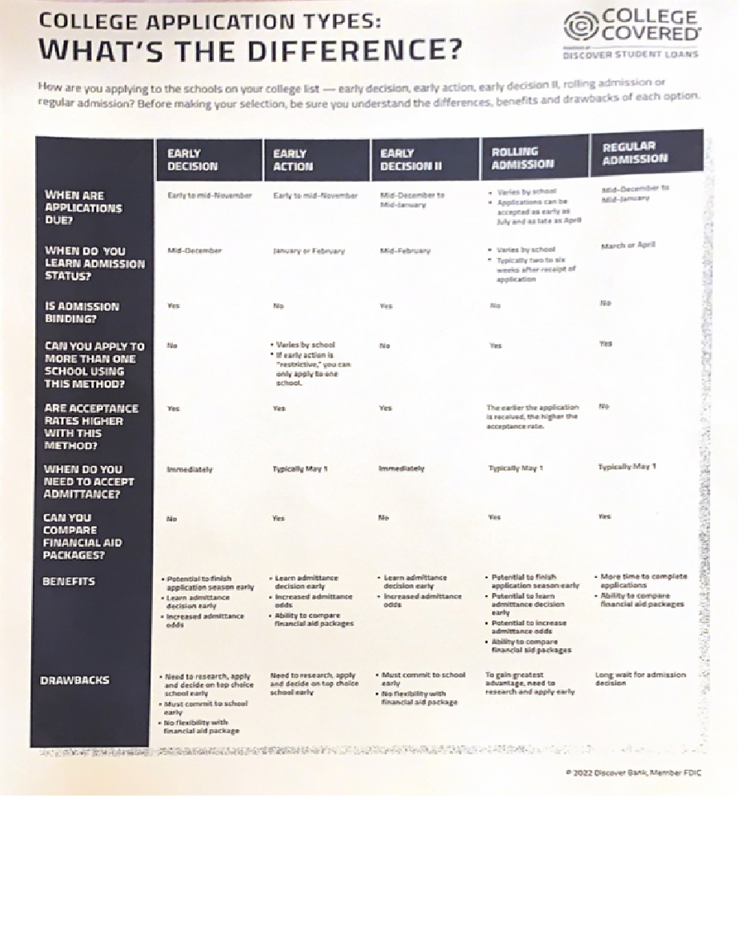
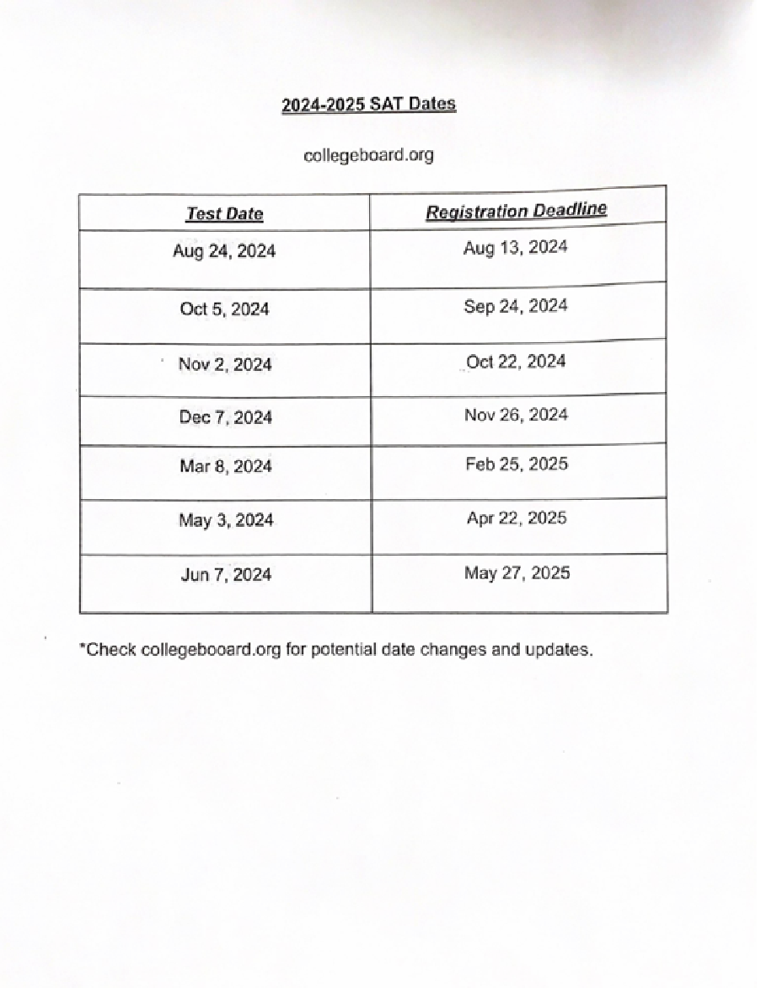
Fliers for Lesson 3

Slide 15
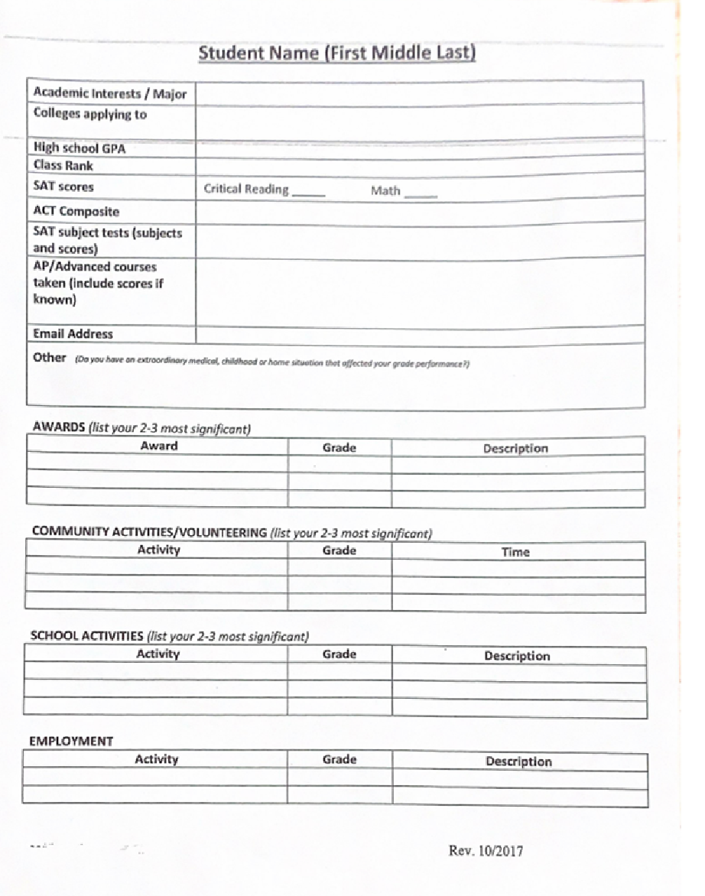
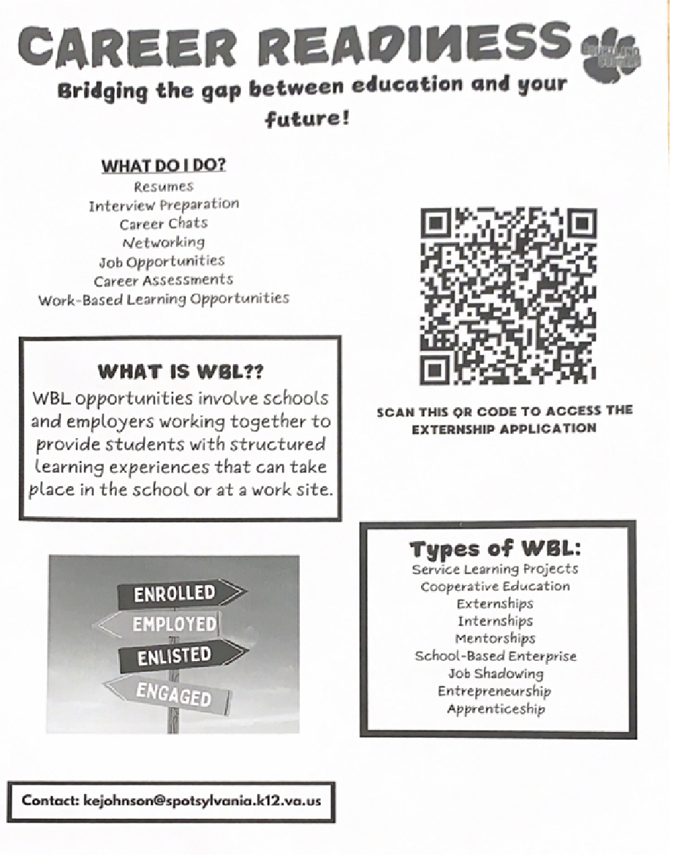
Fliers for Lesson 3 Continued

Slide 16
Cultural Sensitivity
Sue et al. (2010) state that “Teachers can integrate diversity and inclusiveness in the classroom on a daily basis by promoting policies and processes for equality, diversity, and inclusion in schools” (Baidoo-Anu, 2023, p.940). All students will be treated as equals regardless of differences. Classroom guidance lessons will be facilitation with genuine respect for all cultures.
Burns et al. (2020) notes that any type of individual teaching students should first access their own personal values, beliefs and worldviews as this can influence their instruction. By doing this, you are aware of yourself and careful not to protrude your personal influence onto others, making yourself objective. Therefore, presenting facts is more obtainable. Classroom guidance lessons will be facilitated carefully to allow multiple cultural perspectives.

Slide 17
Evaluation
There was a pre and post survey given to Juniors.
The survey read: I have a plan and strategies in place for my future postgraduate goals.
Students rated the question on a 5 point scale from strongly disagree to strongly agree.
Pre-survey results calculated 55% agree and 23 % neutral, other calculations were minor.
Post survey results calculated 63% agree, 17% neutral and 9% agree.
These results showed that post-survey and presentations, students were able to better identify postgraduate plans and strategies.

Slide 18
References
American School Counselor Association (2021). ASCA Student Standards; Mindsets and Behaviors for Student Success. Alexandria, VA: Author
Baidoo-Anu, D., Gyamerah, K., Mahama, I., & Ofori-Sasu, E. (2023). Towards classroom inclusivity: exploring K-12 teachers’ sensitivity to cultural diversity ( Hacia la inclusividad en el aula: explorando la sensibilidad a la diversidad cultural del profesorado de K-12 ). C&E, Cultura y Educación /, 35(4), 938–975. https://doi.org/10.1080/11356405.2023.2200590
Burns, K. C., Lundgren, M., Vecchie, R., & Burns, K. C. (2020). Culturally responsive assessment in the psychology college classroom. Scholarship of Teaching and Learning in Psychology., 6(3), 177–184. https://doi.org/10.1037/stl0000220
Paolini, A.C. (2020). School counselors promoting college and career readiness for high school students. Journal of School Counseling. (4)1, 4-21.

