Slide 1
Comprehensive School Counseling Program: Enhancing Student Academic Achievement
Grace Suttera

Slide 2
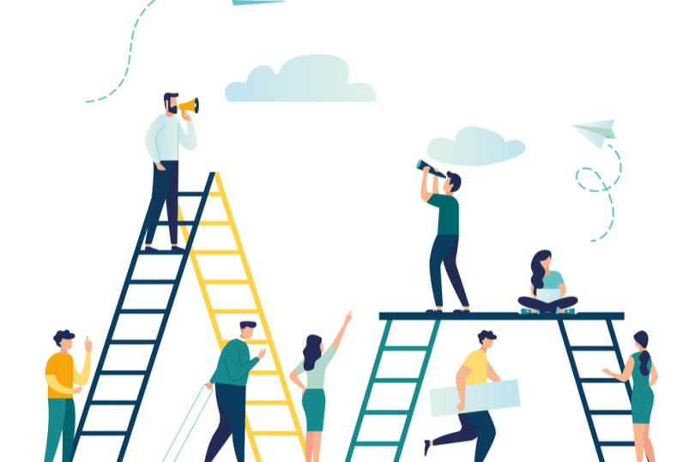
Comprehensive Program Elements
Career Development:
Career Exploration Workshops: host career fairs, guest speakers, or mock workplace activities to excite students and gauge their interests
Resume Building/Interview Practice: conduct resume workshops and offer mock interviews for students to practice and build their skills and confidence
Post-Secondary Planning: assist students in researching and applying for secondary education, plus provide information on financial aid and scholarships
Notes:
Career Development:
The first domain is Career Development, which aims to guide students in the exploration of post-secondary options. School counselors, parents, and teachers must be equipped to help students explore, plan, and prepare for their future careers by providing appropriate resources and information.
Career Exploration Workshops:
One way we can strive for students’ career development is to host career exploration workshops.
This would include career fairs, guest speakers, or other activities that help students envision their potential career paths.
The goal is to expose students to different options and incite an excitement for future career choices and goals.
Resume Building/Interview Practice:
A second initiative is resume building and interview practice.
We want to ensure that students are prepared for the workforce or higher education.
By hosting resume workshops, we can encourage students collaborate and showcase their experience.
With interview practice, we can prepare and empower students to take on real interviews.
Both activities will help students navigate the job application process and lead to their future success.
Post-Secondary Planning:
A third way we can foster career development is to work one-on-one with students on post-secondary planning.
This means providing information and resources on financial aid, scholarships, and anything else to help them transition to post-secondary education.
We aim to help students make informed decisions about their career paths and future education.

Slide 3

Comprehensive Program Elements
Academic Development:
Goal Setting Workshops: facilitate workshops that help students set realistic goals and create action plans for meeting those goals
Study Skills: conduct sessions to teach skills such as time management and personalized approaches for different learning styles
Individualized Academic Coaching: provide one-on-one, personalized sessions to identity academic strength and weaknesses, then use those strengths and weaknesses to students’ advantage
Notes:
Academic Development:
The second domain is Academic Development, which focuses on fostering the academic growth and success of every student. The job of school counselors is to recognize the importance of helping students achieve their academic aspirations.
Goal Setting Workshops:
One way we can strive for academic development is to establish goal setting workshops.
In these workshops, we will guide students in setting academic goals that are both realistic and meaningful.
We will also provide them with the resources necessary to achieve those goals.
The goal is to empower students to strive for success in their academic journey.
Study Skills:
A second initiative is to teach effective study skills.
We will conduct seminars meant to employ students with these skills.
It is important to recognize that each student has a unique learning style, so we will use personalized strategies as best as we can to cater to different needs.
Individualized Academic Coaching:
A third way we can foster academic development is to use individualized academic coaching.
We will work with students one-on-one to identify their talents, needs, and any potential challenges.
During the process of these sessions, we can collaborate with teachers and parents to gather insight and provide updates.
The personalized approach will ensure that every student receives proper guidance.

Slide 4
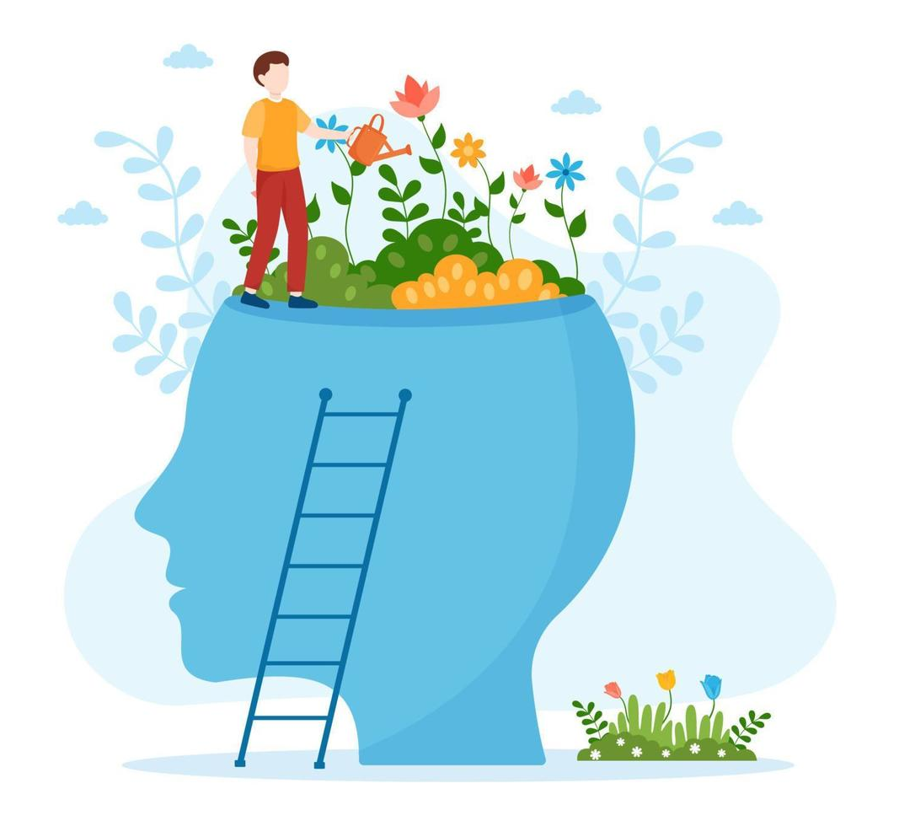
Comprehensive Program Elements
Personal and Social Development:
Social Skills Workshops: enhance students’ social skills by addressing topics such as effective communication and conflict resolution
Peer Mentoring: establish a peer mentoring system to focus on fostering positive and supportive relationships between older and younger students
Support Groups/Group Counseling: offer group counseling sessions to combat emotional challenges and practice conflict-resolution techniques
Notes:
Personal and Social Development:
The third domain is Personal and Social Development, which focuses on the well-being and holistic growth of each student. This may be the most important domain above academic and career, because we need to make sure a student is happy above all. It is a school counselor’s job to make sure students are safe, emotionally stable, and able to navigate socially.
Social Skills Workshops:
One way we can aim for personal and social development is to host a social skills and emotional intelligence workshop.
This would consist of ways that students can effectively communicate, develop a deeper understanding of each other, and resolve conflicts.
The goal of these workshops is to foster emotional intelligence and help students form positive, healthy relationships.
Peer Mentoring:
A second initiative is to to employ a peer mentoring program.
For this, we can establish a system where older students mentor younger students in the classroom, and collaborate on special projects.
This would create a level of support and bond between different age groups, while promoting positive social interactions.
Support Groups/Group Counseling:
A third way we can foster personal and social development is to create support groups.
With this initiative, students can have a safe place to discuss potentially sensitive topics or personal challenges and receive guidance from peers and the counseling team.
This would contribute to a healthier and openly communicative student group.

Slide 5

Advocacy
School counselors serve as advocates to ensure and promote the well-being, academic success, and personal development of all students. Here are ways that school counselors advocate for students:
Student Rights and Equity: school counselors advocate for fair and equitable treatment of all students, including promoting policies and practices that are free of discrimination and bias
Access to Educational Opportunities: school counselors ensure that all students have access to educational resources and opportunities by eliminating barriers and providing equal support
Collaboration with Stakeholders: school counselors collaborate with teachers, administrators, and parents to build a supportive network and address any issues that may impact students
Notes:
School counselors have a responsibility to serve as advocates for students to ensure their well-being and success. Advocacy means actively campaigning for students’ rights, needs, and access to resources. We must do our best to recognize, support, and celebrate each student’s potential and success.
Student Rights and Equity:
One example of advocacy is ensuring the rights and equal treatment of all students.
School counselors, parents, and teachers must actively work to create an inclusive environment free from discrimination.
We should put in the effort to make sure each student feels valued and has equal access to opportunities.
Access to Educational Opportunities:
A second example of advocacy is to identify and eliminate any barriers that may prevent students from receiving educational opportunities.
Our goal is to create an environment where students can thrive.
We will describe more of these barriers and how to eliminate them later in the presentation.
Collaboration with Stakeholders:
Another example of advocacy is collaboration with stakeholders.
This means that school counselors, teachers, administrator, parents, and community members will work together to ensure there is a supportive network for students.
By building strong partnerships, we can strengthen our advocacy initiatives and create more opportunities for students.

Slide 6

Advocacy (con.)
Here are ways that school counselors advocate for students:
Individual Student Advocacy: school counselors may work one-on-one with students to advocate for specific needs, accomodations, mental health support or personalized interventions
Promoting a Positive School Climate: school counselors work to prevent bullying, promote acceptance, and ensure that students feel safe and valued at all times
Crisis Response and Support: school counselors advocate for appropriate support services and programs that should be used in times of crisis or emergency
Notes:
Individual Student Advocacy:
It is important that advocacy extends to the individual student level.
School counselors should meet one-on-one with students to discuss their specific needs, potential challenges, and/or mental health accommodations.
Individual student advocacy involves personalized support and figuratively holding students hands through academic, behavioural, or emotional challenges.
Promoting a Positive School Climate:
Advocacy involves actively promoting a safe and positive school environment for all students.
School counselors work to prevent bullying, promote respect and understanding, and ensure that each student feels valued.
Crisis Response and Support:
Advocacy is especially important In times of crisis or emergency.
School counselors advocate for support services and programs that promote the emotional well-being of the school community.

Slide 7

Advocacy (con.)
Here are ways that school counselors advocate for students:
Promoting College and Career Readiness: school counselors advocate for resources to support career exploration and ensure that students have information on post-secondary education options
Policy and Program Development: school counselors participate in committees to develop school policies and programs that align with the best interests of students
Social Justice and Cultural Competency: school counselors addresses any systemic inequalities and advocate for an environment that embraces social and cultural diversity
Notes:
Promoting College and Career Readiness:
School counselors advocate for specific resources geared towards career exploration for each student.
Students need unique support to plan and weigh different options for post-secondary education.
School counselors advocate for equal access to these resources and ensure that each student is well equipped to make decisions.
Policy and Program Development:
As school counselors and advocates, we actively participate in committees for policy and program development.
By provide our feedback and insights, we can influence school policies and programs that align with the best interests of our students.
Advocating for policies and programs is an ongoing and ever-changing responsibility as we learn more about students and adapt to their needs.
Social Justice and Cultural Competency:
School counselors must actively address any systemic inequalities and promote culturally responsive practices.
We must work to promote cultural competency and social justice initiatives within our school community
Advocacy in the social justice and cultural competency realm contributes to a more inclusive learning environment.

Slide 8
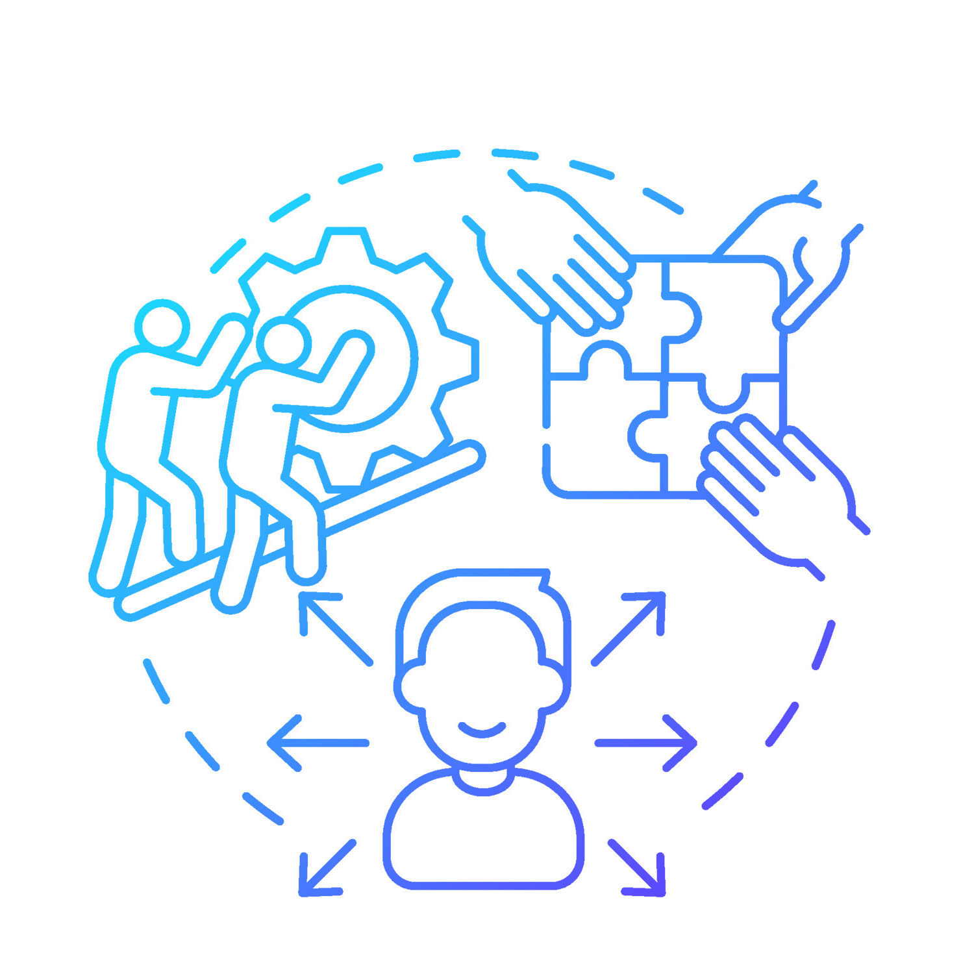
Access, Attainment & Achievement
Access refers to the availability of resources, educational opportunities, and support services for all students, regardless of their background, abilities, or circumstances.
School counselors work to ensure that every student has equal access.
School counselors work with students to address any barriers, (language, socio-economic challenges, or special needs), that may hinder them from fully taking advantage of educational opportunities
School counselors ensure students have the proper information and guidance on post-secondary pathways, career options, and extracurricular activities
Notes:
Access focuses on providing equal opportunities for students regardless of their background, abilities, or circumstances.
Access is about breaking down barriers and ensuring that every student has equal opportunities to thrive.
School counselors actively work to address challenges that may hinder students’ access to certain resources or educational opportunities.
The goal is to create an inclusive environment where students can access the information and guidance they need to succeed.
We can enhance access by offering support for diverse needs and actively engaging with students and their support systems to get them the resources they need.

Slide 9
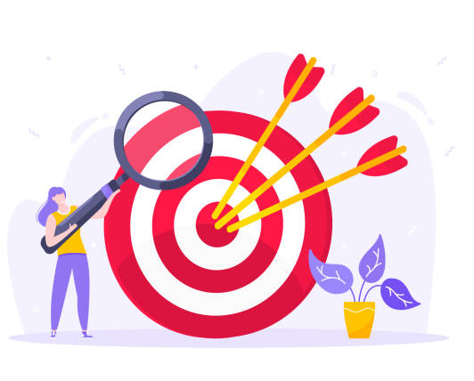
Access, Attainment & Achievement
Attainment focuses on students setting academic or personal goals/milestones and successfully completing those goals.
School counselors assist students in setting realistic goals, emphasizing the importance of attainment.
School counselors provide guidance on course recommendations, long-term academic planning, and post-secondary options to help students achieve and attain their aspirations.
School counselors track and monitor student progress, identify any potential challenges, and implement one-on-one interventions to lead to successful academic outcomes.
Notes:
Attainment focuses on setting academic and personal goals, then guiding students as they progress and eventually achieve those goals.
School counselors assist students by understanding their unique goals, and planning for their educational and personal milestones.
Part of the attainment process involves monitoring of student progress to be sure they are on track.
School counselors can help to identify areas of improvement and implement targeted strategies to assist students in reaching their goals.
The journey toward attainment is a collaborative effort between students, parents, and educators.

Slide 10

Access, Attainment & Achievement
Achievement involves the demonstration of acquired knowledge and skills, which shows personal growth and reflects success in both academic and non-academic areas.
School counselors support students in achieving academic, personal, and social development.
School counselors promote a holistic view of achievement, emphasizing the importance of social-emotional skills and self-confidence and how they contribute to academic success.
School counselors actively recognize and celebrate students’ unique talents and accomplishments, fostering a positive school culture that values diverse contributions.
Notes:
Achievement represents personal, career, and academic success for students in this case.
Achievement should be holistic, meaning that it includes a blend of academic performance, development of social-emotional skills, career aspirations, and a positive self-concept.
The goal of school counselors is to nurture students as they become well-rounded individuals prepared for their futures.
It is important to celebrate students’ achievements, both big and small.
When teachers, parents, and school counselors recognize and celebrate students’ achievements, it builds their self-confidence and helps motivate them to achieve more.

Slide 11

Barriers
School counselors work with students to detect and overcome barriers, which are obstacles or challenges that can hinder the success of students. Here are some examples of barriers:
Limited Resources: insufficient funding, staffing, or time constraints can limit resources
Stigma/Misconceptions: negative attitudes or misconceptions may prevent students from seeking help
Lack of Awareness: students may be unaware of the availability or scope of counseling services
Cultural/Linguistic: may hinder effective communication between students and faculty
Notes:
Identifying and eliminating barriers is crucial to ensure that a counseling program can effectively support the diverse needs of students.
Limited Resources:
Limited resources involves certain constraints in funding, staffing, or time.
Insufficient or constrained resources may limit our capacity to provide adequate support to all students.
Without the proper resources, the quality of counseling services may be lacking.
Stigma/Misconceptions:
Another barrier is the stigma and misconception surrounding counseling services.
There are sometimes negative attitudes or misunderstandings about the idea of seeking help from a school counselor.
It is important to address these stigmas so each student feels comfortable seeking support.
Lack of Awareness:
Another barrier for school counseling is lack of awareness.
Students and parents may not be fully aware of the counseling services that are provided.
It is important for teachers and staff to increase awareness throughout the school community.
Cultural/Linguistic:
Another barrier involves cultural and linguistic elements.
Sometimes there can be cultural misunderstandings between school counselors, staff, parents, and students.
It is essential for our system to be culturally and linguistically competent to ensure that students feel understood and supported.

Slide 12

Barriers (con.)
Here are some examples of barriers:
Student-to-Counselor Ratio: large caseloads may result in counselors having limited one-on-one time
Limited Parental Involvement: lack of parental engagement and decision-making
Policy Barriers: school policies or administrative practices may hinder students getting help
Lack of Collaboration: insufficient collaboration between school counselors and stakeholders
Notes:
Student-to-Counselor Ratio:
This is a common barrier that has to do with the structure of counseling.
Large caseloads may affect the number of staff available to help students in counseling.
To address this barrier, we need to advocate for reasonable caseloads and find ways to support a large number of students.
Limited Parental Involvement:
Another barrier is the lack of parental involvement.
Sometimes parents do not have the time or proper awareness of the school counseling program.
We should consider strategies to make sure parents are involved in their child’s development.
Policy Barriers:
Another barrier has to do with policy and administrative practices.
It is important to stay up to date on changes in policies that may hinder students’ success.
Furthermore, it is crucial to be involved in the implementation of certain mandated services or programs.
Lack of Collaboration:
Lack of collaboration or communication between school counselors and stakeholders is another barrier.
It is essential to maintain good communication and ensure a holistic approach for student support.
We need to break down barriers to make sure everyone is working towards the common goal of providing for students.

Slide 13
Thank you!

