Slide 1

Small Group Internship Project
Grade Level: 2
Topic: Friendship
By: Grace Suttera

Slide 2
Goal of the group
Teach students the importance of being kind to others
Improve students' social development
Help students learn how to resolve conflicts
Promote acceptance and understanding of different perspectives
Learn techniques to cope with difficult situations

Slide 3
Data Sources
My small group consists of 5 second grade girls. In the beginning of the school year, their teacher had asked me if I could meet with them because he noticed that they were not being kind to one another in class. I took this as an opportunity to form a small group centered around the topic of friendship.

Slide 4

Data Sources
In addition to the teacher seeking guidance for his students, he also had a parent call him about this particular group of girls having drama in the classroom. Having two different data sources shows that this group is necessary.

Slide 5
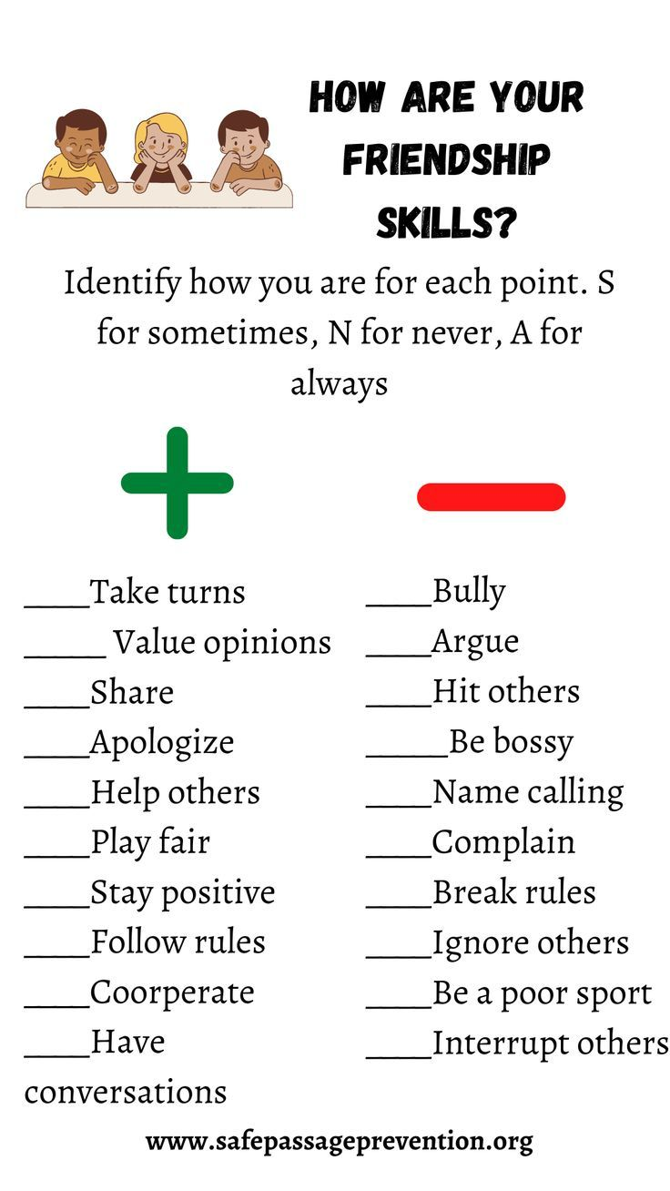
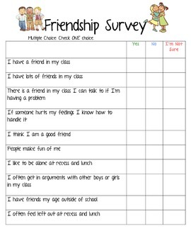
Needs Assessment

Slide 6
Needs Assessment
For confidentiality purposes I’m not going to post the girls work. However, in the pervious slide you can see the assessments I provided them with. Based on their answers it was clear that this group would be very beneficial for them. The students have a hard time being good friends to one another.

Slide 7
AIA Alignment/ASCA
In this small group students will learn how to collaborate with one another by learning skills like communication and listening through team building exercises and self reflection. Students will also learn how to be a positive leader by expressing their ideas and feelings clearly and nicely. Before starting the group, we established rules that everyone must follow if they want to remain in the group. One, raise your hand before speaking or leaving your seat. Two, treat others with respect. Three, listen and follow direction. Four, use kind words to one another. Five, respect other people's space. Maintaining these rules throughout the group should hopefully create positive habits.

Slide 8
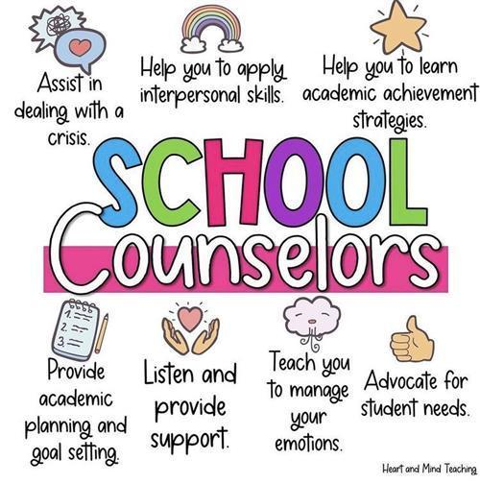
AIA Alignment/ASCA

Slide 9
Cultural Sensitivity
Before we started our small group meetings, students were informed that it’s important to take everyone's feelings into consideration before speaking. Each student comes from different socio-economic statuses and each student is experiencing different hardships in their lives. As a future school counselor, I cannot assume each student is receiving the same support at home. Strategies we can use to make sure the group remains culturally sensitive include ice breakers, going over rules before each session, and remind students that not everyone is going to have the same beliefs and values as one another and that’s okay.

Slide 10
Specific Activities
Friendship story time: Read books about positive friendships and discuss the characters qualities that make them a good friend.
Role-play friendship scenarios: Act out different situations where students can practice being a good friend.
“what makes a good friend” worksheet: Have students brainstorm and write down what characteristics make them a good friend.
Sharing circle: Have students share stories about a time they were a good friend, or someone was a good friend to them.

Slide 11
Evaluation
I was able to evaluate my students progress by checking in with their teacher at the end of each week. I want to make sure they're using the skills we practice in group even when I’m not around. During the end of our group meetings the student's teacher reported positive feedback. The girls are being kind to not only each other but to all their classmates and they're even reminding each other of our group rules when someone needs a reminder.

Slide 12
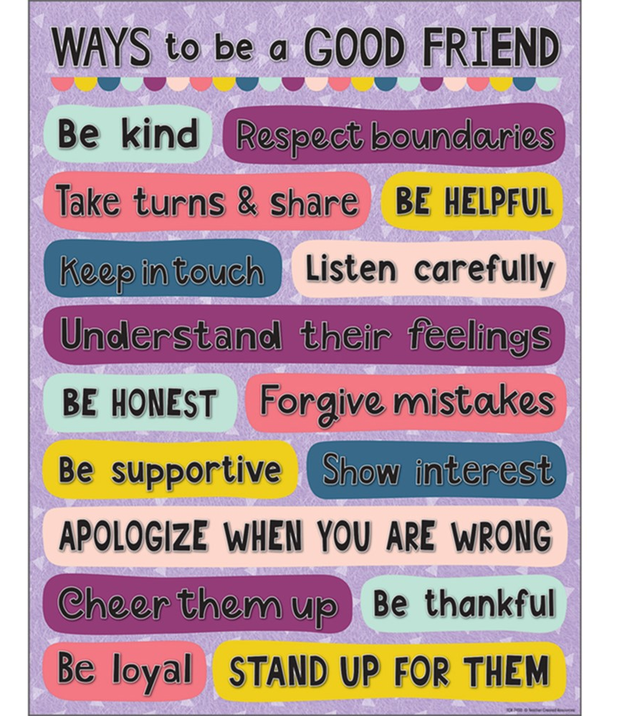

For our last group session, I provided my group with a poster that reminds them ways they can be a good friend since we will not be meeting anymore.

