Slide 1
Psycho-Educational Small Group PowerPoint
Grade Level: 5
Topic: Anxiety
By: Grace Suttera

Slide 2
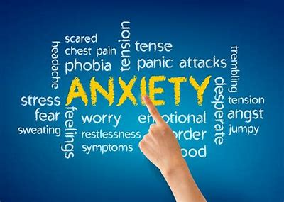
The Goal Of The Group
To understand what anxiety is
Where to seek help when experiencing anxiety
Who to go to when experiencing anxiety
Learn what causes anxiety
Learn coping strategies to use when experiencing anxiety

Slide 3
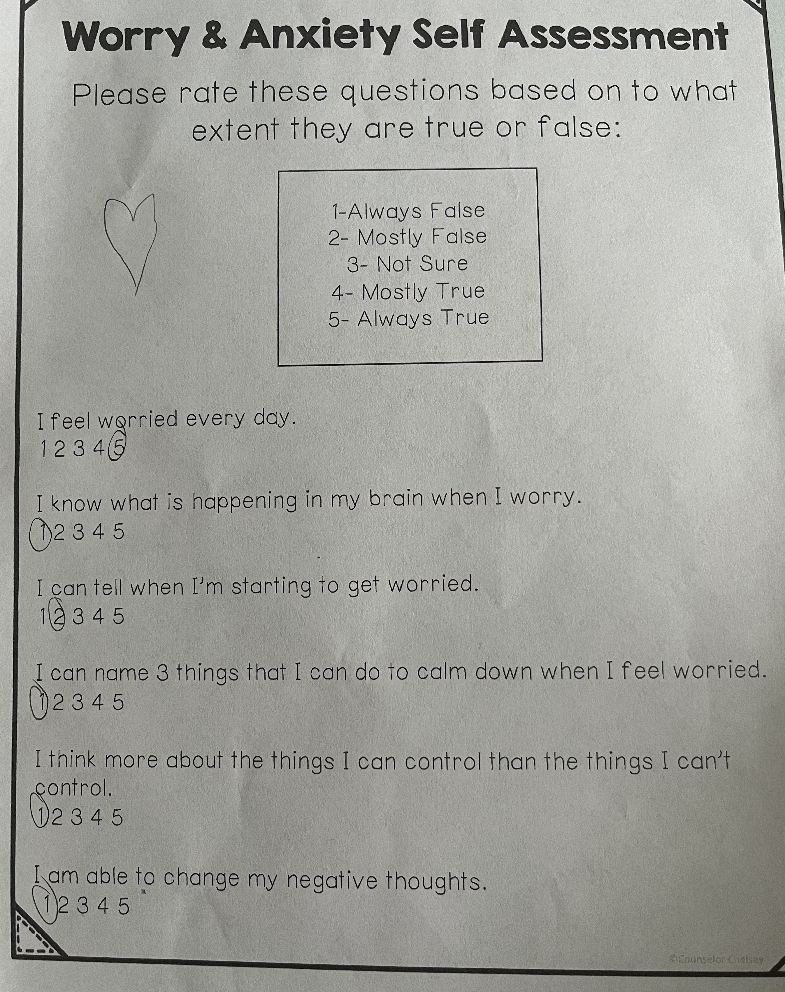
Data
In the first session with my small group, the students were asked to fill out an anxiety self assessment form. As you can see, this particular student doesn’t know what anxiety is or how to manage it. Majority of the group had similar answer choices.

Slide 4
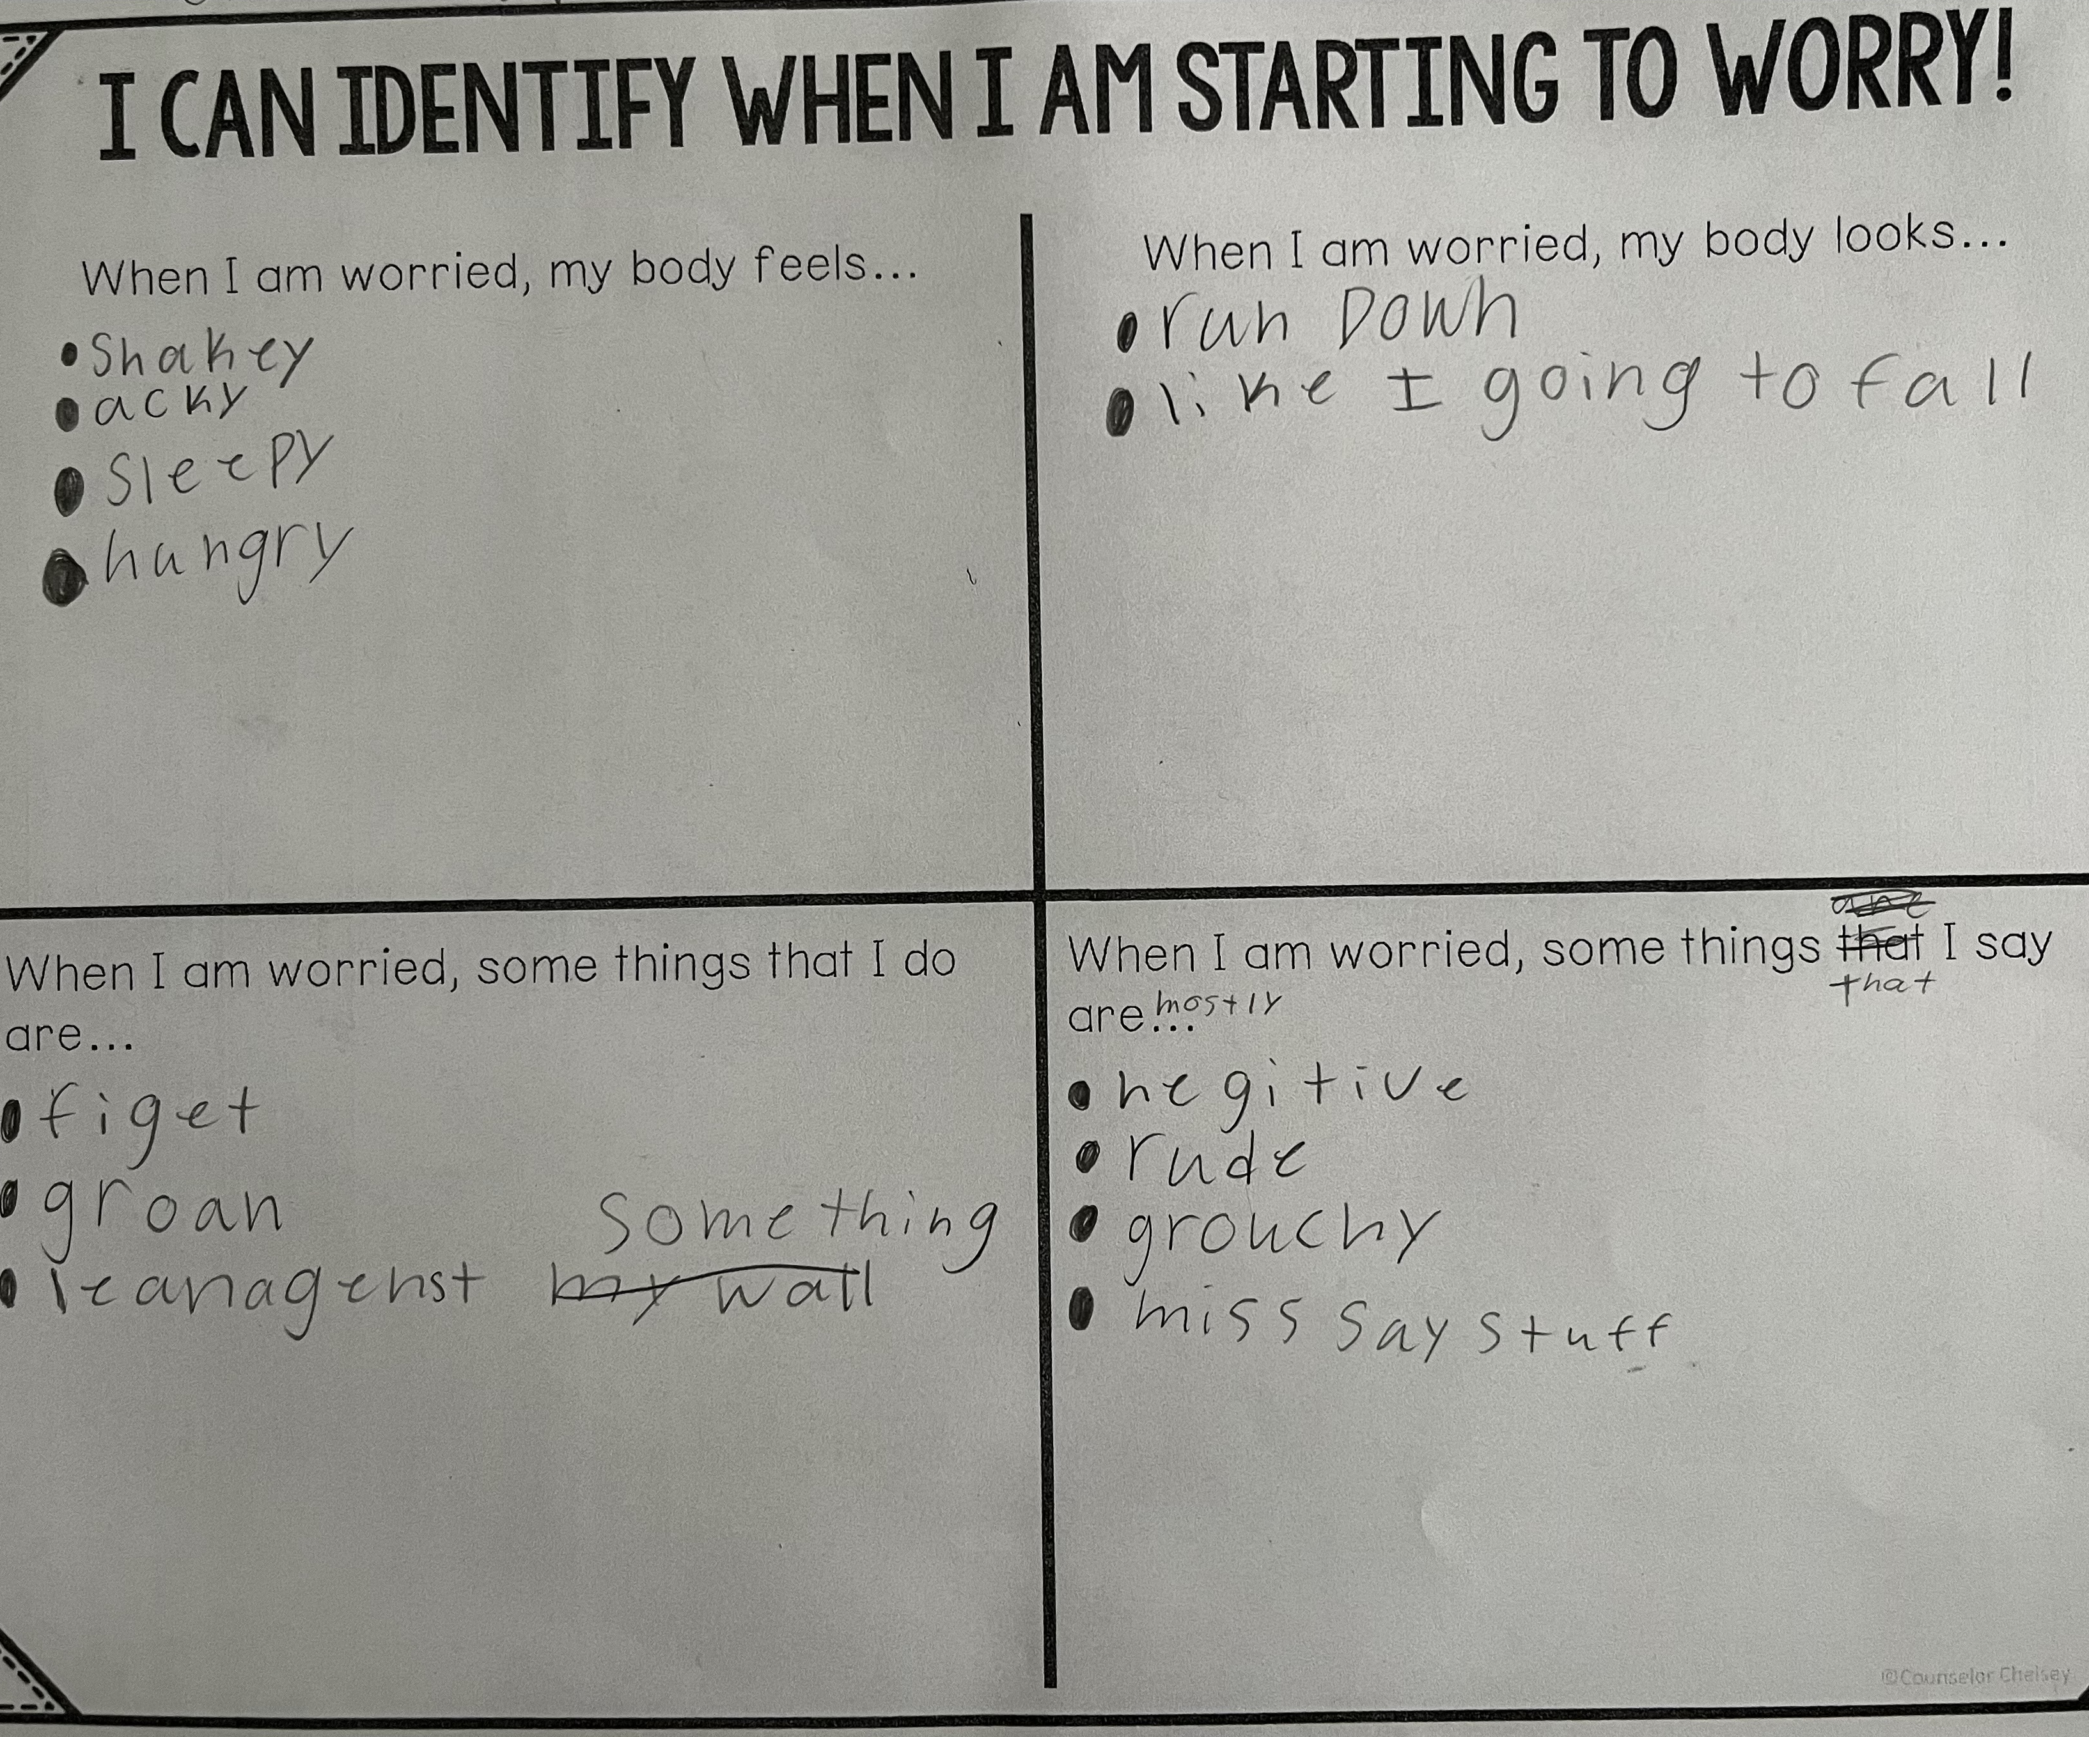
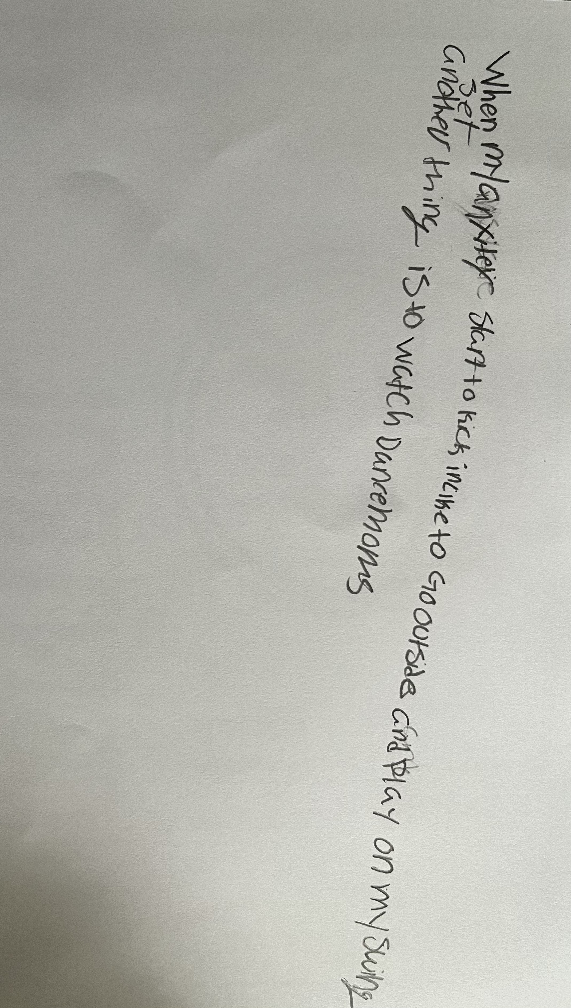
Data
“When my anxiety starts to kick in, I like to go outside and play on my swing set. Another thing is to watch dance moms.”
Both work sheets were filled out during the last two sessions. Meeting with the small group was beneficial to them because now they understand what anxiety is and what to do when they're experiencing it.

Slide 5
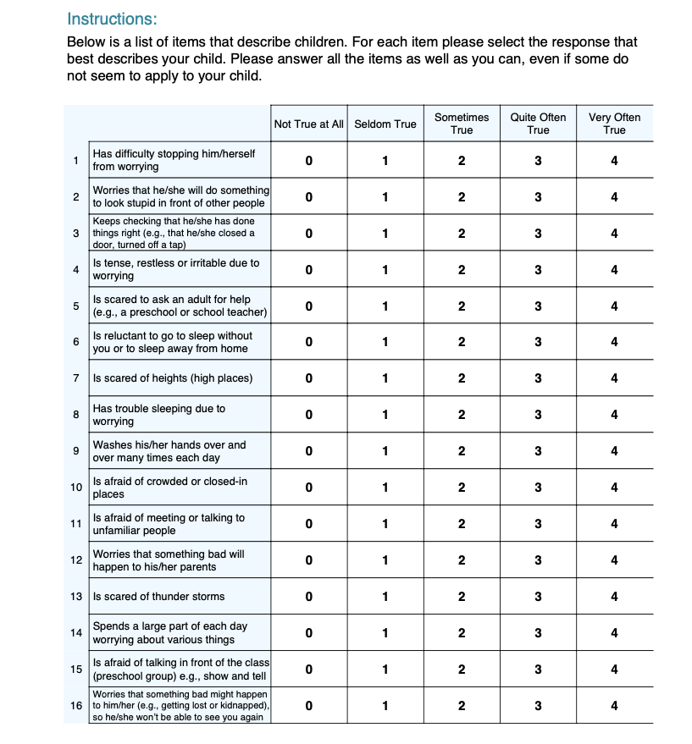
Needs Assessment
Students and faculty were both surveyed to support the need for the group with the assessment pictured. After evaluating all the assessment responses, it was clear that anxiety was a great topic for my small group.

Slide 6
Pre-AIA Specialty Standards
Collaboration and Consultation
Working with all faculty to strategize ways we can best assist the students so that they're successful in and out of the classroom.
Counseling Prevention and Intervention
We are providing students with a small group atmosphere that will be used to promote positive academic success and ways to cope with stress and anxiety.

Slide 7
Culturally Sensitive
Before we started our small group meetings, students were informed that it’s important to take everyone's feelings into consideration before speaking. Each student comes from different socio-economic statuses and each student is experiencing different hardships in their lives. With that being said, as a future school counselor I cannot assume each student is receiving the same support at home. Strategies we can use to make sure the group remains culturally sensitive include ice breakers, going over rules before each session, and remind students that not everyone is going to have the same beliefs and values as one another and that’s okay.

Slide 8
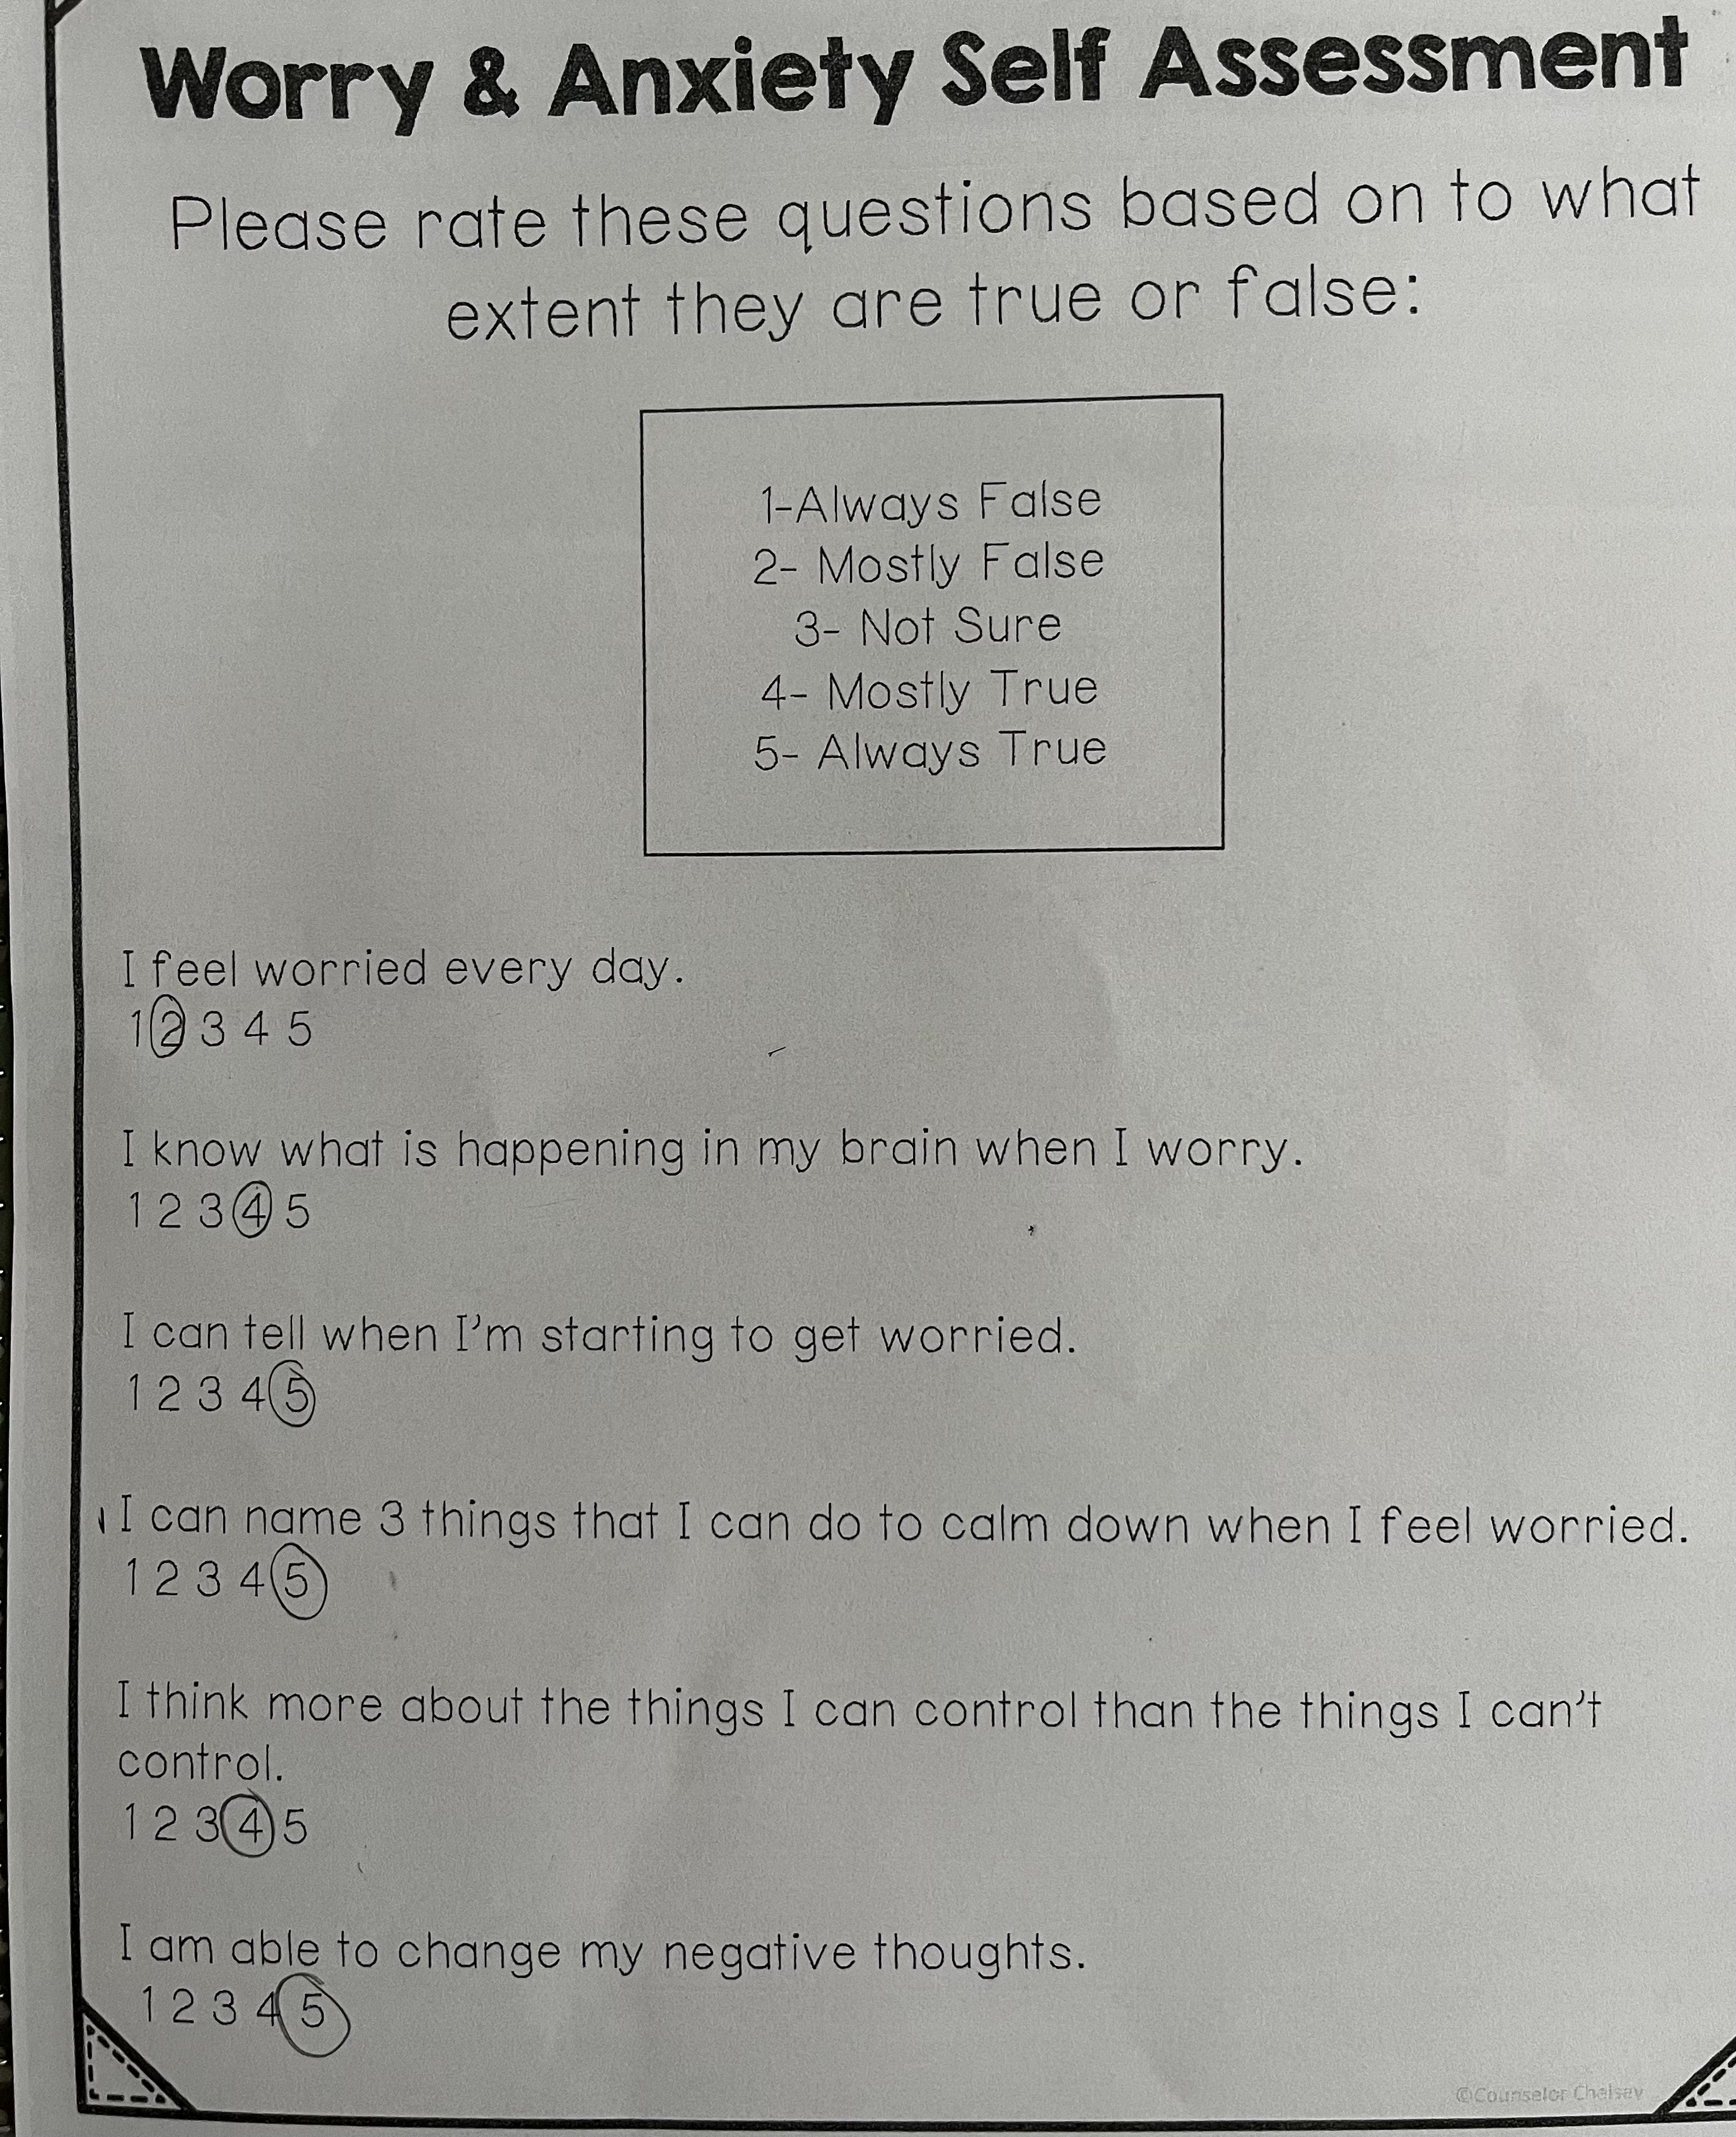
Evaluation
I was able to evaluate the students by comparing their progress from the first session to the last. Pictured is a self assessment form taken by the same student. She took the same assessment on the first day of group and on the last day of group. Her answers indicate that our group sessions were very beneficial to her.

Slide 9
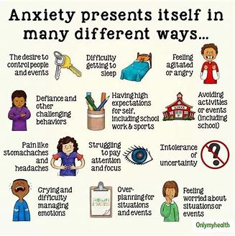
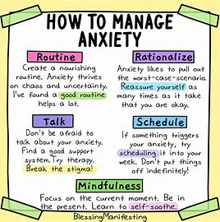
Since I won't be meeting with my small group anymore, I wanted to leave them with some reminders when they need it.

