Slide 1
How Does Cell Phones and Social Media Affect Our Lives?
9th Grade Freshman Class
By
School Counselor: Seth Eby

Slide 2
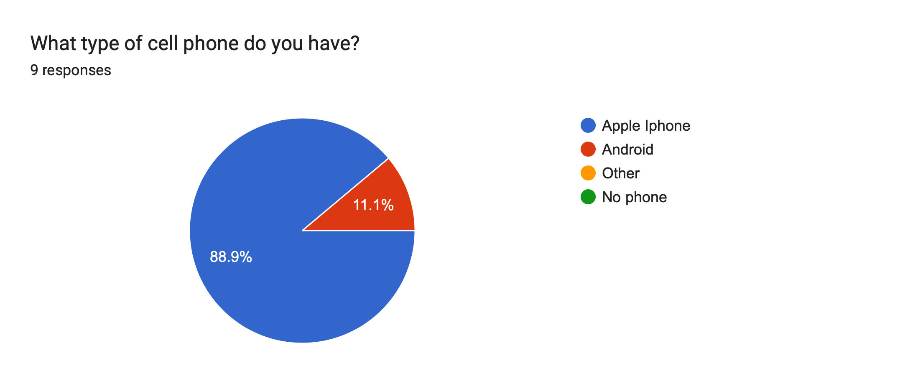

Slide 3
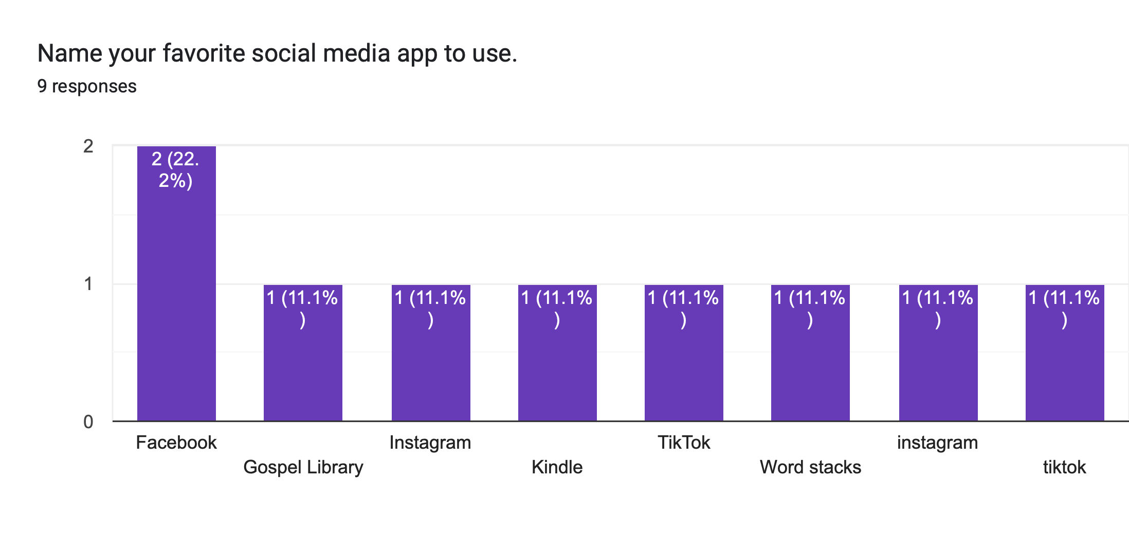

Slide 4
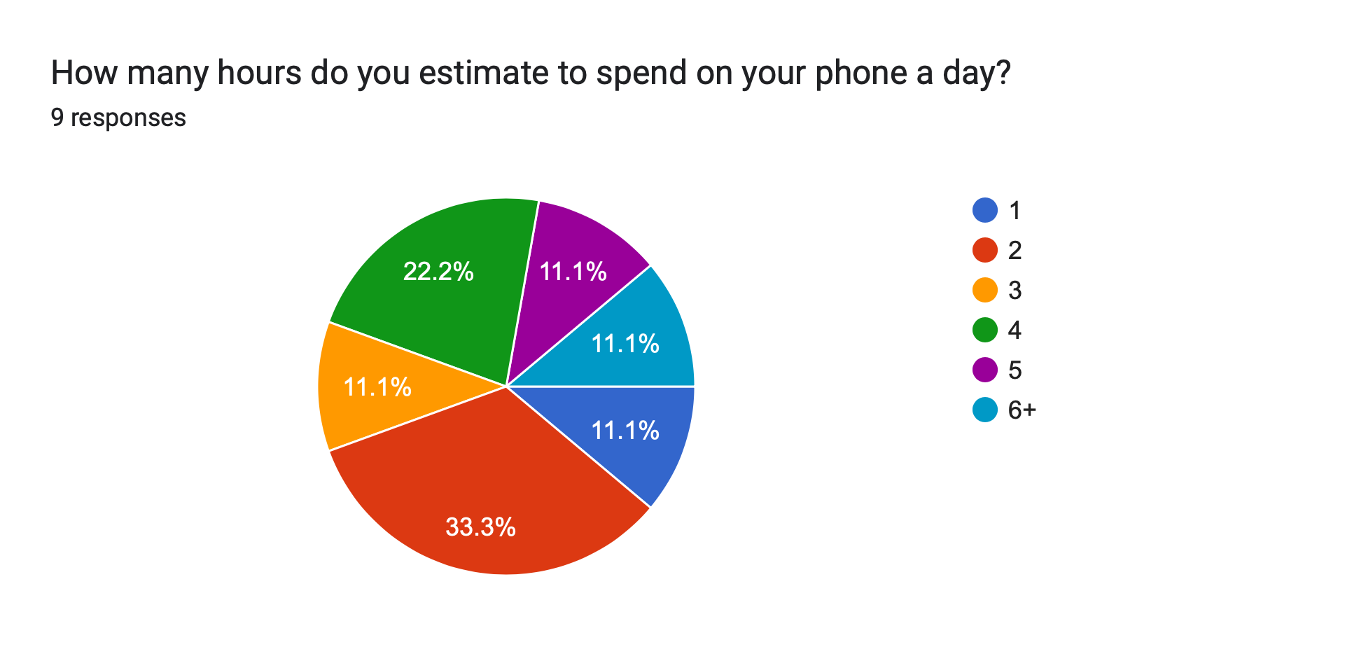

Slide 5
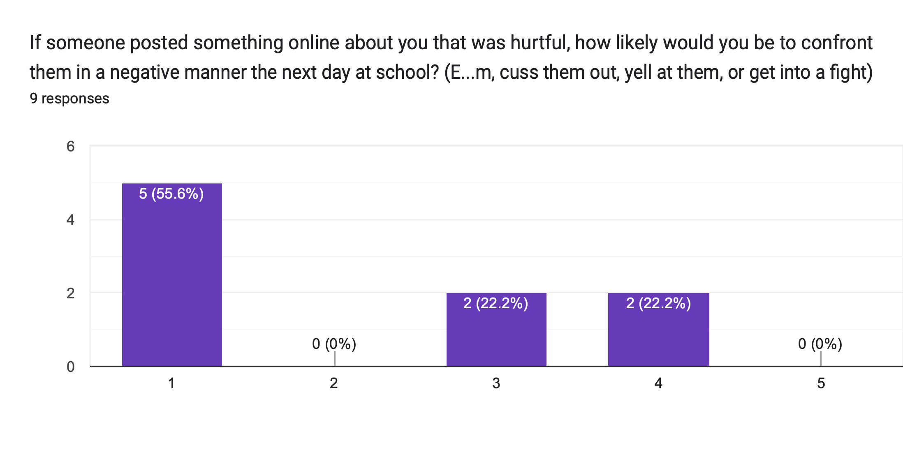
1=Very Unlikely 2=Unlikely 3=Neutral 4=Likely 5=Very Likely

Slide 6
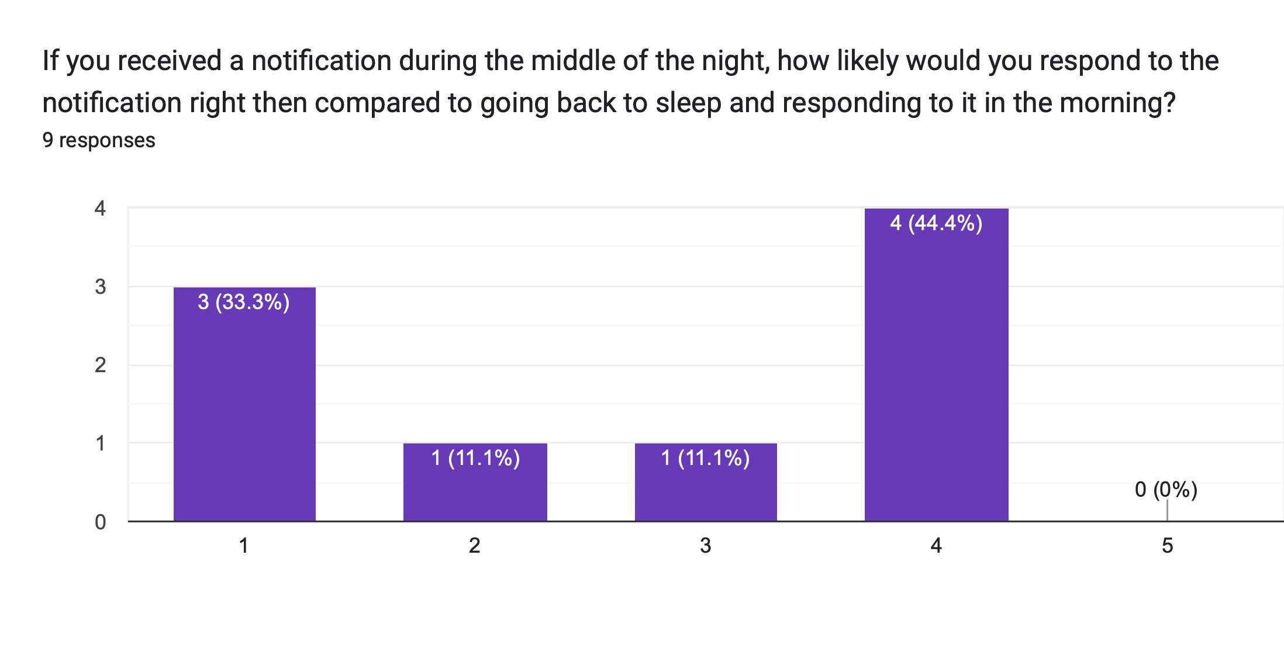
1=Very Unlikely 2=Unlikely 3=Neutral 4=Likely 5=Very Likely

Slide 7
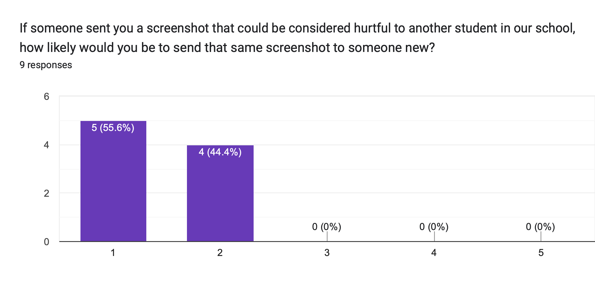
1=Very Unlikely 2=Unlikely 3=Neutral 4=Likely 5=Very Likely

Slide 8
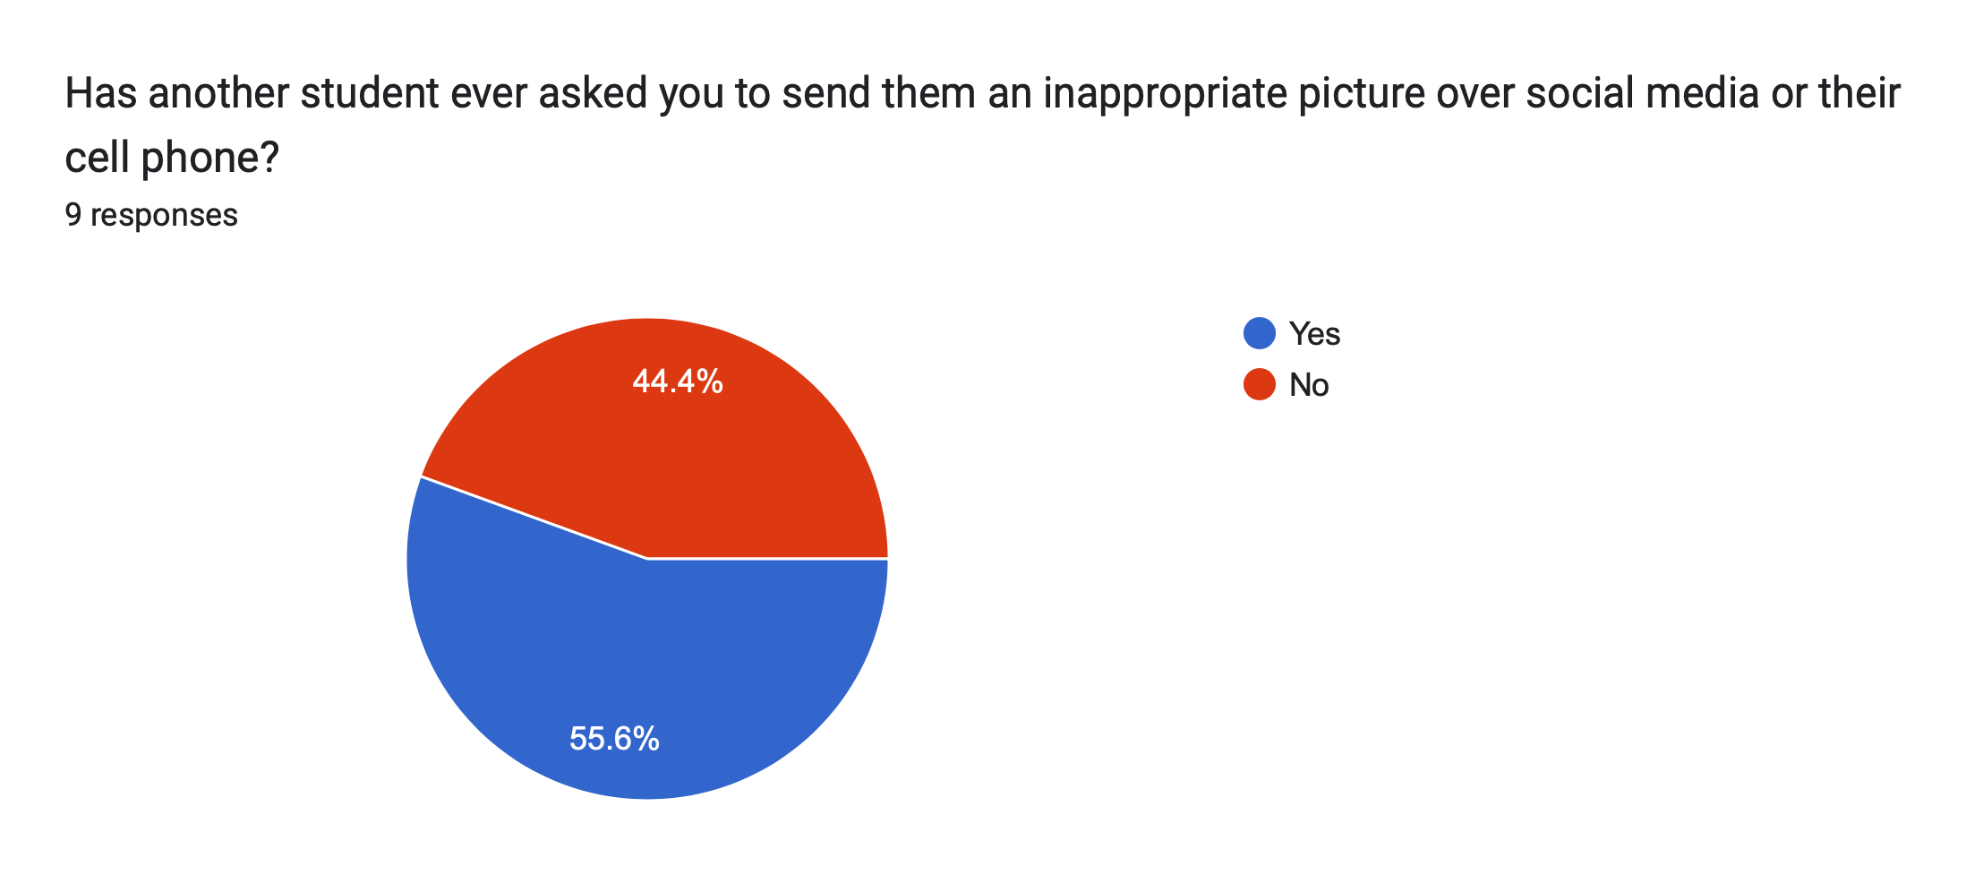

Slide 9
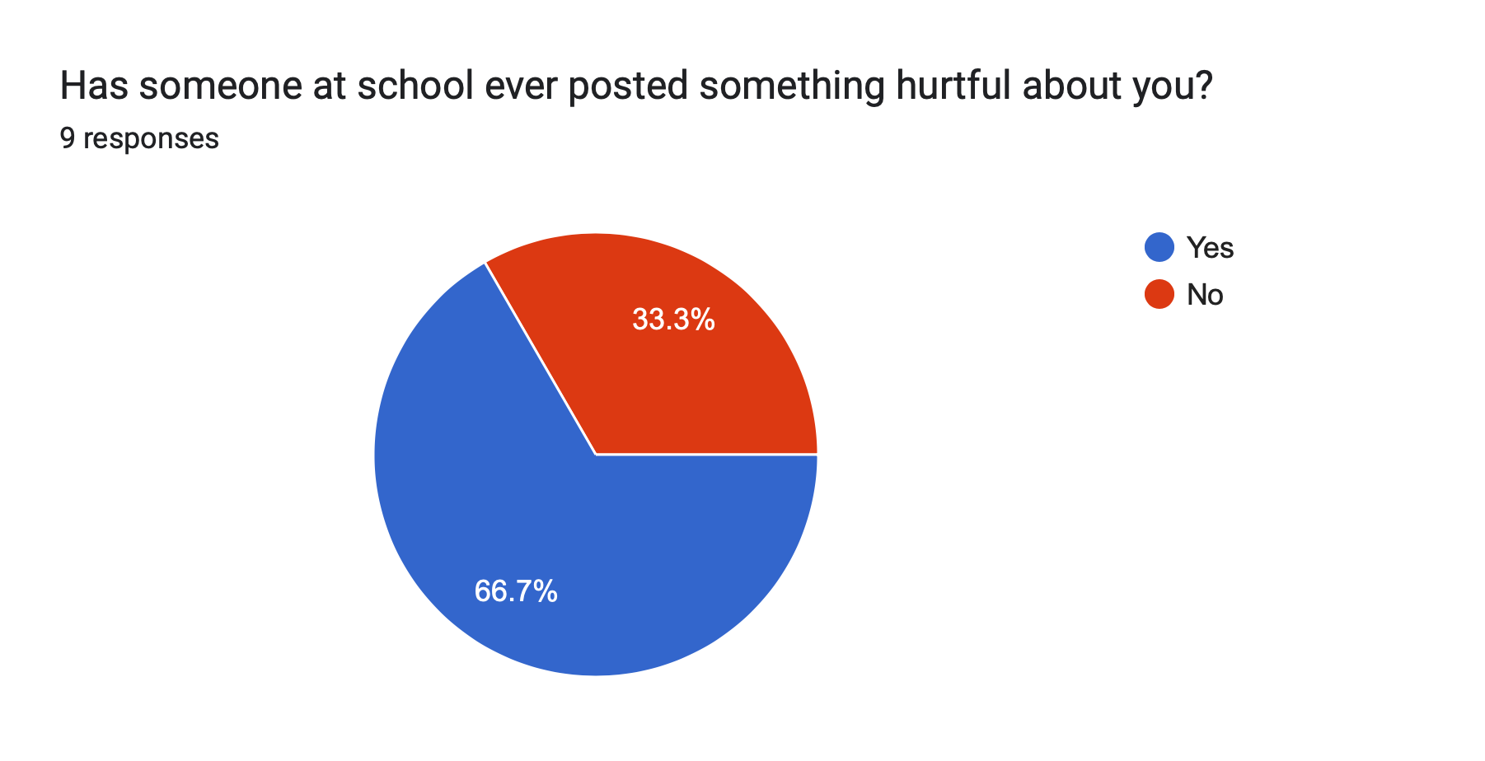

Slide 10
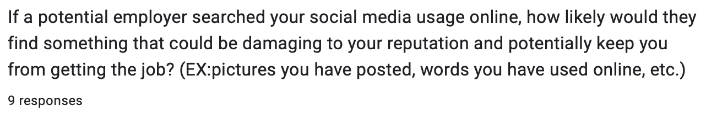
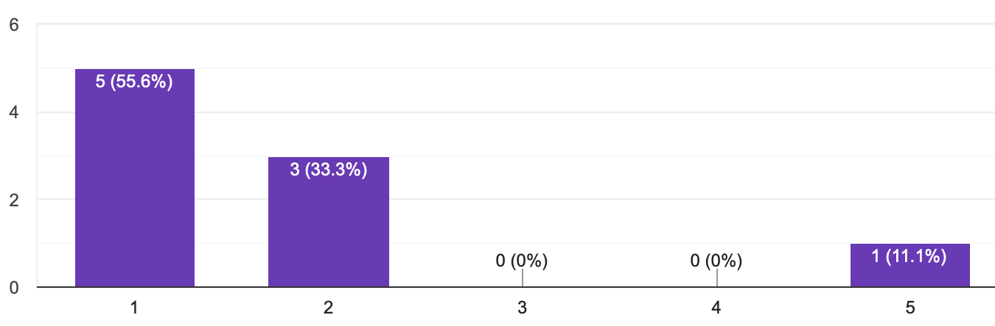
1=Very Unlikely 2=Unlikely 3=Neutral 4=Likely 5=Very Likely

Slide 11
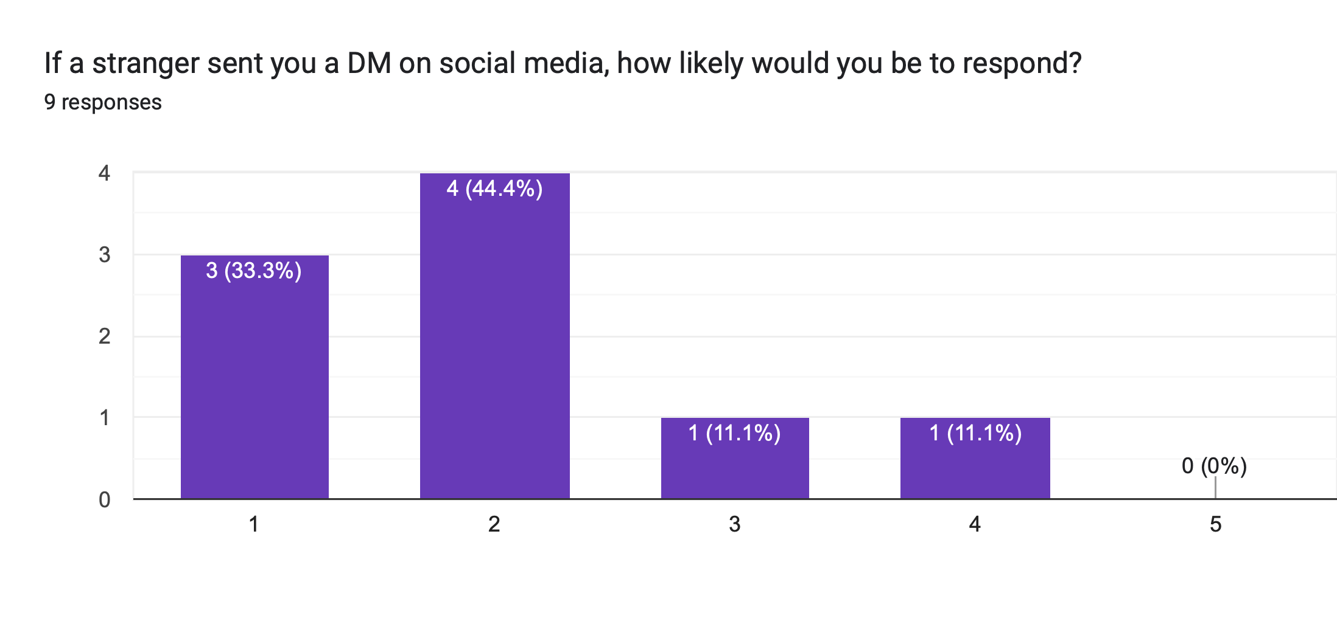
1=Very Unlikely 2=Unlikely 3=Neutral 4=Likely 5=Very Likely

