Slide 1
Benchmark School Counseling Parent Teacher Presentation Assignment
Seth Eby (School Counselor)
Spring Mills High School
Notes:
-Introduce yourself as the school counselor
-Disseminate the school brochures and calendars example
-Show the parents to the refreshmants

Slide 2

Component #1: Program Elements
Beliefs: “Each student is unique and will be given equal opportunity to succeed.”
Mission: “To partner with teachers, parents, and the community to provide a comprehensive school counseling program for all.”
Vision: “The counseling department here at Spring Mills High is dedicated to reach each and every student socially and emotionally, empower them towards academic success, and guide them into obtaining a fulfilling career, which will help them become productive citizens in our society.”
Notes:
-Read each of the definitions and go into detail on the meanings
-Tie this into the school brochure for clarity on the statements
-Key point to make here is the aspect of COLLABORATION and meeting ALL Students

Slide 3

Component #1: Program Elements
Academic: How are we preparing and advising the students to thrive within the classroom?
(Individual counseling, 4 year goals and planning, peer tutoring, advisory groups)
Career: How are we leading the students into a career choice?
(James Rumsey, Dual enrollment, O*NET Online Career Center, Career Van)
Social: How are we promoting skills to thrive within society?
(peer groups, schoolwide clubs, classroom lessons)
Notes:
-Define each of the aspects of the program
-Explain the aspect of meeting the students holistically
-Spend time emphasizing the strategies to meet these elements. Explaining the why and how is just as, if not more, important compared to just explaining what they are

Slide 4
Component #2: Advocacy
“The Spring Mills Counseling Department strives to ensure each student is accounted for through a positive school culture, developing teacher led healthy alternative ways to respond to behaviors, and empower students to take charge of their own future.”
We work collaboratively with all stakeholders to accomplish this task
Parents, counselors, teachers, admin, community, etc.
TEAMING & PARTNERING
Notes:
-Advocacy statement comes straight from the school brochure. Having this document for them to look back and forth in is important for them to keep and have access to.
-The emphasis of this slide is the teaming and partnering aspect. Without the buy in from all stakeholders, the program will not be as effective as possible.

Slide 5
Component #2: Advocacy
GAMECHANGER Lifesavers
District Wide Translators
Crisis response/grief teams
Data collection to identify achievement gaps (ASCA, 2019)
REFERRALS, RESOURCES, and much more
Equitable Educational Practices
&
Responsive Climates
Notes:
-This slide is all about the strategies offered here at Spring Mills High
-Emphasis on the equitable and responsive aspects. We need the parents to buy in and understand the emphasis of working to provide for each and every student. If we want all the stakeholders to work together, we need to teach the parents we are advocating for their children. We want them to feel connected and the fact that they child will not fall through the cracks.
Resource: (ASCA, 2019) Discusses the importance of constantly collecting data to improve techniques and strategies to benefit the students in all areas of life.

Slide 6
Component #3: Access, Attainment, and Achievement
ACCESS: “Having entry and producing the data for the programs within the comprehensive school counseling program”
ATTAINMENT: “Reaching the highest educational level possible”
ACHIEVEMENT: “The act of working towards one’s personal goals”
Notes:
-This slide is our 3 A’s of the program.
-The emphasis here is giving each and every student the ability to succeed.
-The parents need to understand we will be working along side of their child the entire 4 years to help reach their achievement goals and highest possible attainment

Slide 7
Component #3: Access, Attainment, and Achievement
Cultural: need the ability to learn new cultures
(Culture fairs, multicultural projects, trips abroad)
Ethical: The ability to discern and make appropriate decisions
(volunteer opportunities, service projects, peer leadership groups)
Economic: need the ability to access and understand financial management
(Money management classes, Career fairs, applying for colleges)
Legal: need to advocate for the legal rights of the students (Stone, 2022)
(Debate teams, student council, Public communications classes)
Political: The ability to understand the world around them
(Student government, current events and news, studying abroad/field trips)
Notes:
Issues
Cultural-racism, prejudices, stereotypes
Ethical- family neglect, abuse, relationship choices
Economic-low-income families, lack of money management skills, debt issues, lack of school resources
Legal-policies may make it difficult to reach every student, issues between the counseling department and administration (Stone, 2022)
Political- Issues happening around the community, state, nation, and world that may affect their daily lives
The emphasis on this slide is the strategies and examples put in place to overcome these issues. Yes, there will always be gaps in the journey towards success for your child, but we are prepared to overcome them.
Resource-(Stone, 2022) shows the importance of advocating for the legal rights of the students. This article was an example of an administrator who did not believe in the counselor’s curriculum and used their power to suppress the counselor. The school counselor went “over their head” and was disciplined for it. The court ultimately ruled in the school counselor’s favor and proved the concept of overcoming legal issues and advocating for the students.

Slide 8
Component #4: Barriers
Academic Achievement
Attendance
Achievement Gap (Quinn & Desruisseaux, 2022)
Discipline
Mental Health Struggles
Student Well-Being
Bullying
Relationships
Family
Substance Abuse
Notes:
-Here comes the difficult aspects of the school counseling program. In a perfect world, everyone would succeed without any issues, but we recognize that is not reality. There are many barriers in life that hinder students from succeeding easily. As competent professional school counselors, we must be prepared to diminish these effects and advocate for the student’s success. We are also dedicated to their holistic development, which means we are looking at both their academic achievement and well-being, not just one or the other.
-Resource: (Quinn & Desruisseaux, 2022) studies the aspects of the “achievement gap” and the importance of language used throughout the building as well as the collaboration throughout the school to provide equitable access for everyone.

Slide 9
Component #4: Overcoming Barriers
OLWEUS Bullying Prevention Program
GAMECHANGER Lifesavers
PBIS/RAPP Awards
Schoolwide Shoutouts
Individual & Group Counseling
Afterschool Tutoring and Clubs
Athletic Programs
James Rumsey/Dual Enrollment Program
Multicultural Days/Months & Red Ribbon Week
School Pride Events
Notes:
This is the empowering aspects of Spring Mill’s Counseling Program. These are the programs that are offered throughout the school to empower and enrich the students toward success. This is the hours and hours spent building the program coming to fruition to help build the success of the students.

Slide 10
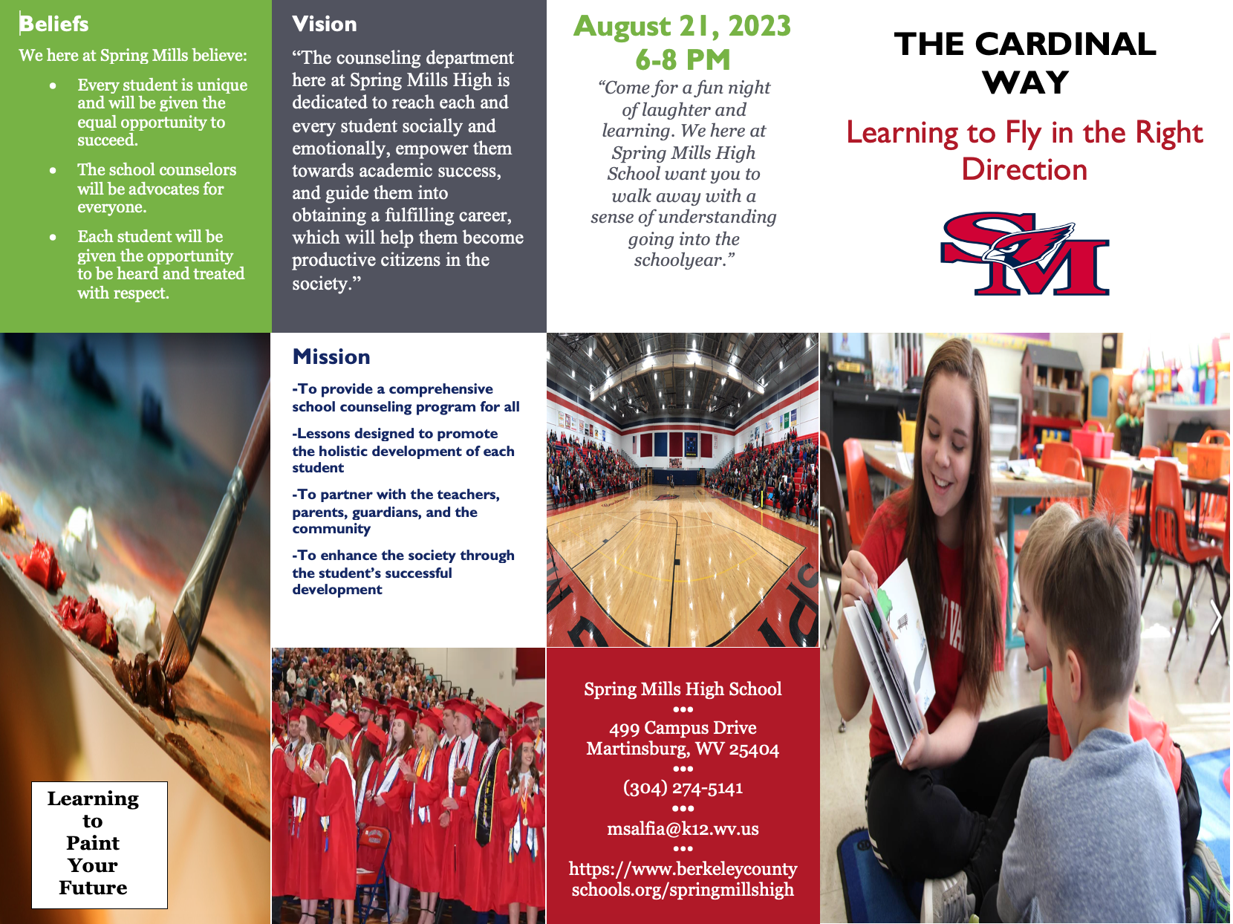
Brochure

Slide 11
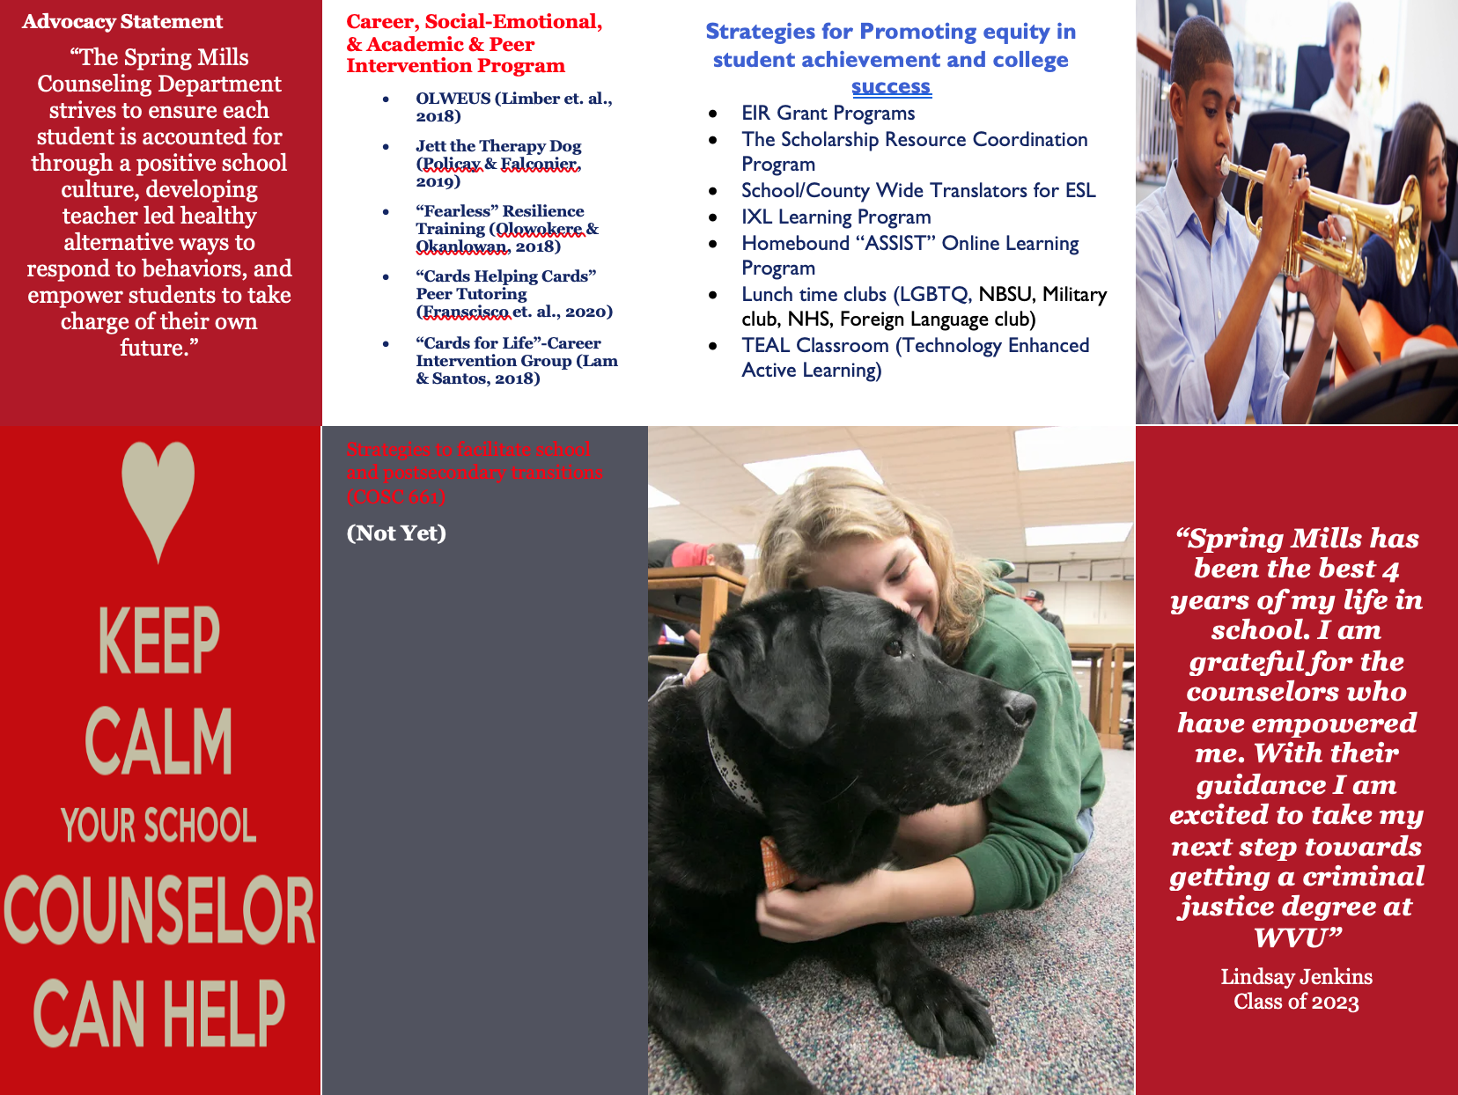

Slide 12

Calendars
Reminder: Daily/Weekly & Annual Calendars have been adjusted based on instructor feedback from previous submission. Correct ASCA templates have been used. Calendars are detailed, realistic, and provide evidence of thoughtful planning. All changes were highlighted.

Slide 13
References
American School Counselor Association. (2019). ASCA National Model: A Framework for School Counseling Programs, 4th Edition. Alexandria, VA: Author.
Quinn, D. M., Desruisseaux, T. (2022). Replicating and Extending Effects of “Achievement Gap” Discourse. Educational Researcher, 51(7), 496-499. https://doi.org/10.3102/0013189X221118054
Stone, C. (2022).Legal & Ethical: Collaborating with Stakeholders: Cautionary Tales from the Courts. ASCA School Counselor. https://www.schoolcounselor.org/
Magazines/January-February-2022/Collaborating-with- Stakeholders-Cautionary-Tales-f

