Slide 1
Cell Phones and Anxiety
By: Seth Eby
Notes:
Title of the Guidance lessons

Slide 2
How did this come about?
1. Conversation with Mr. Davis
2. Analyzing cell phone survey
3. Surveying stakeholders
(4 principals, 4 counselors)
2 existing data points: Discipline data and Project Aware Data
Notes:
When presented with this project, I went and sat down with Mr. Davis, my supervisor, to discuss details on what he thought would be appropriate for this project. Something that was beneficial to the students compared to just “checking a box” for the college requirements. We both came to the mindset of lessons focused on cell phones, and how they are playing a role in our society. Following this conversations, I went about finding a bunch of data to support this philosophy. First I sent out a cell phone survey to all the 10th grade advisory/homeroom classes. The goal was to find out who self reported as addicted to cell phones. After this next step, I surveyed the principals and counselors as 2 other stakeholders. I chose them specifically due to the fact they deal with cell phone situations all day long with the students. I knew they would have a great perspective regarding the ”big picture” or students and cell phones. Lastly, I found 2 tangible data points to prove the need for this guidance unit. The first one was our school’s discipline data. Unfortunately, as freshman, my 10th grader’s ”write ups” increased 23% last year, and within those referrals, cell phones were involved in some capacity 72% of the time. This proves cell phones are being used too much within our school building in a negative manner. Along with this concept, I found out that Project Aware Referrals, our in house private counseling resource, has seen an uptick in 32%. In other words, our students are struggling to process their emotions and anxiety, and cell phones historically are playing a factor in this.

Slide 3
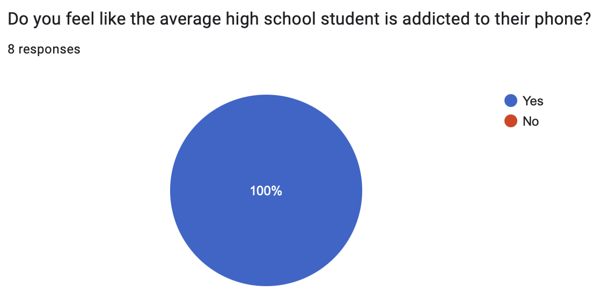
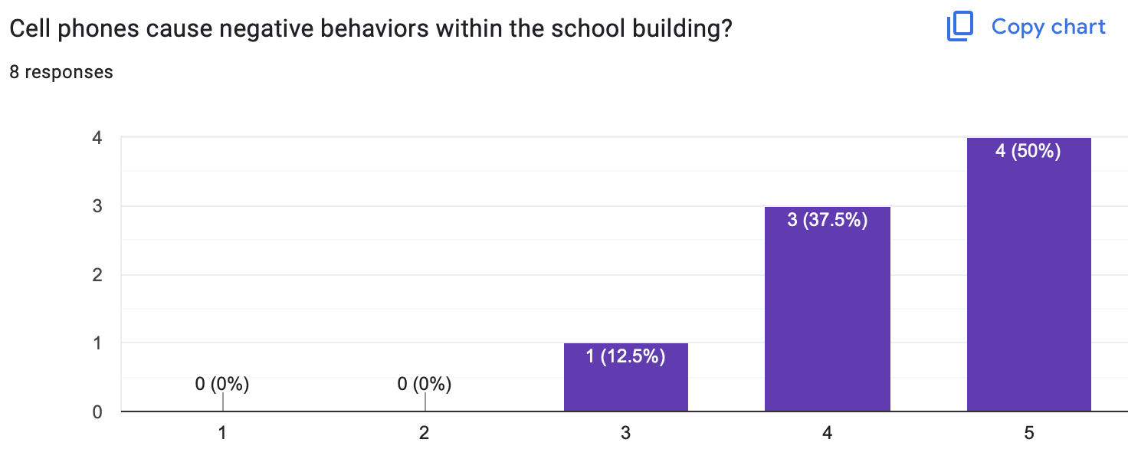
Needs Assessment Statistics
Notes:
Here are 2 of the needs assessments questions asked to the principals and counselors. You can see that these 2 pictures shed light that everyone thinks cell phones are playing at least some form of negative role within our building.

Slide 4
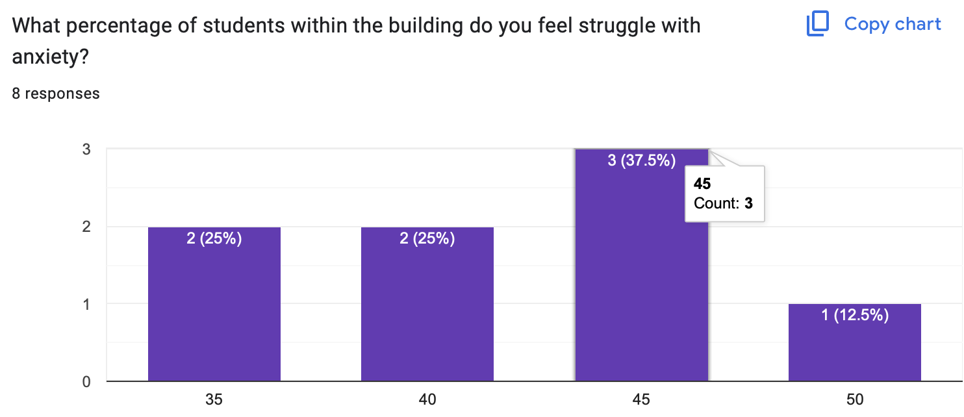
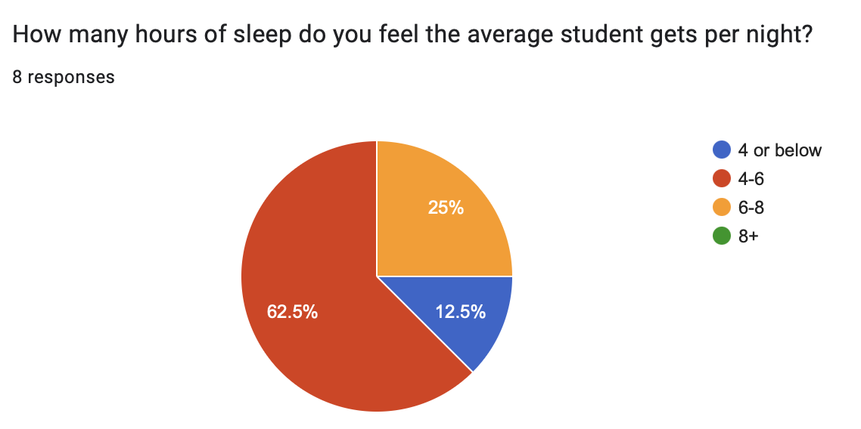
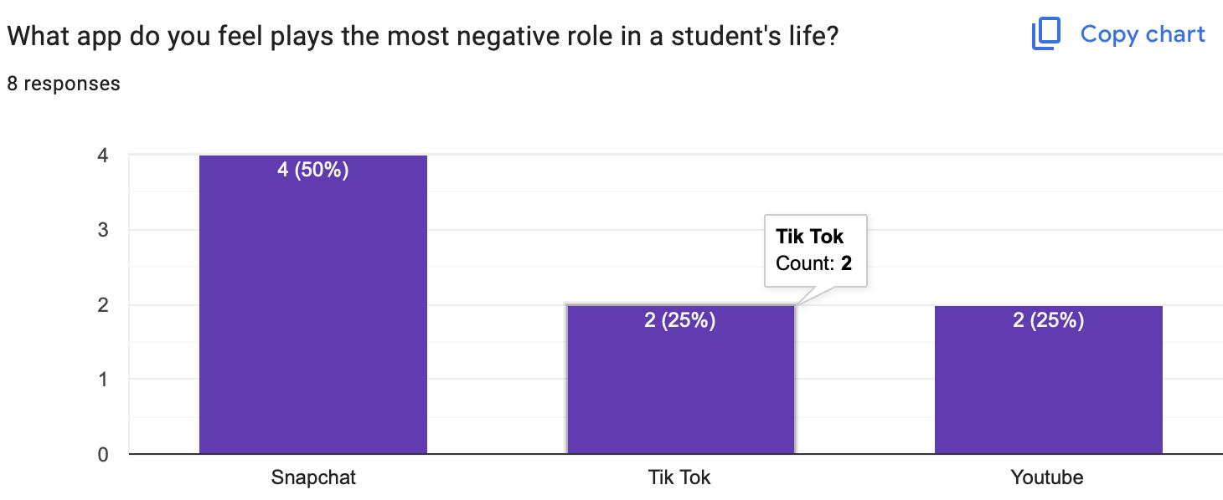
Notes:
Here are the last 3 questions and results to the needs assessment. These 3 questions focused on anxiety, sleep, and social media apps. The goal was to get a pulse on what they thought of the school.

Slide 5
AIA & ASCA Mindsets and Behaviors
1. Assessment H.1
2. Research & Evaluation J.1
3. Academic Development L.3
1.B-LS 9
2. B-SMS 2
3. B-SS 9
*ASCA(2021) & Liberty(2023)
Notes:
Assessment H.1 is all about assessing and interpreting students strengths, needs, and abilities. This was incorporated within the student’s surveys and discussions within the lessons. The goal was to understand where they are thriving and struggling with cell phones within the school building. Research and evaluation J.1 applies relevant research findings to inform the counseling. This was done through all the needs assessments and data, which helped to shape these lessons. Academic L.3 implements different ways to reach the students in their learning. Throughout the lessons, I tried multiple forms of teaching. I used discussions, videos, activities and such. Each of these ideas was focused on reaching each student’s needs, or ways of learning. ASCA B-LS 9 focuses on making decisions based off of gathering evidence. This was the foundation of the entire project. I surveyed students multiple times, researched school data, and surveyed multiple adults in charge. All of these ideas were focused on building purposeful, legitimate lessons, which were data driven compared to just my thoughts. B-SMS 2 focuses on self-discipline and self-control. This was the tough part of the lessons discussed with the students. I explained that all this data and information given is great, but there is an element of a need to make a choice to stay off their phones. Lastly, B-SS 9, which is all about social maturity and behaviors, plays into this same concept. Yes, cell phones can be amazing and used properly, but the goal of these lessons were to get students to use them effectively and to understand how they can be playing a role in anxiety levels.

Slide 6



How did I pick the class?
Sent out survey to every 10th grade Advisory class
Ordered negative results by class
What Advisory class had the highest percentage of cell phone addiction?
*Mr. K’s Homeroom
Notes:
How did I pick the class to do the lessons? There was a step by step process to get there, which ended up with Mrs. K’s homeroom. First, I sent out a Google form to all 10th grade homerooms. I then had to analyze the results and order the negative cell phone results by homeroom. The homeroom, or Advisory group, with the highest percentage of cell phone addiction turned out to be Mr. K’s class.

Slide 7
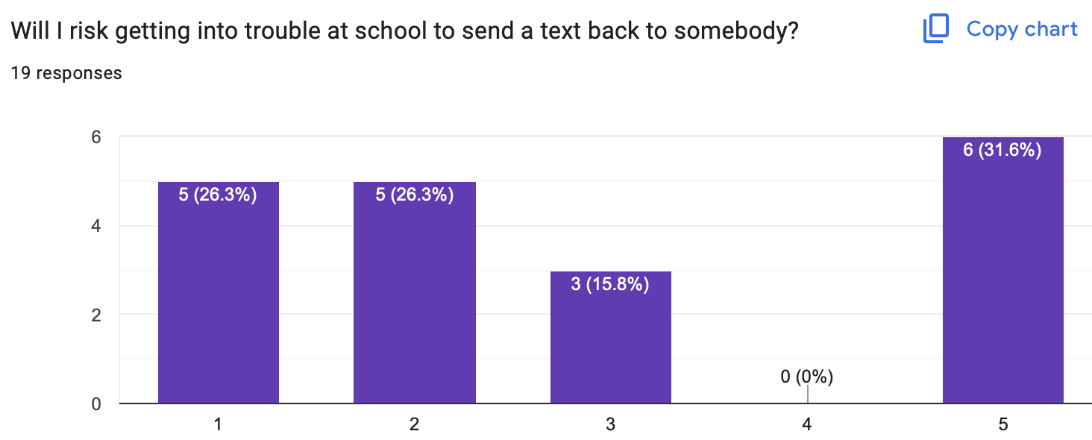
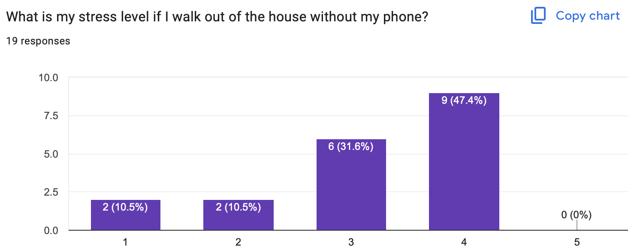
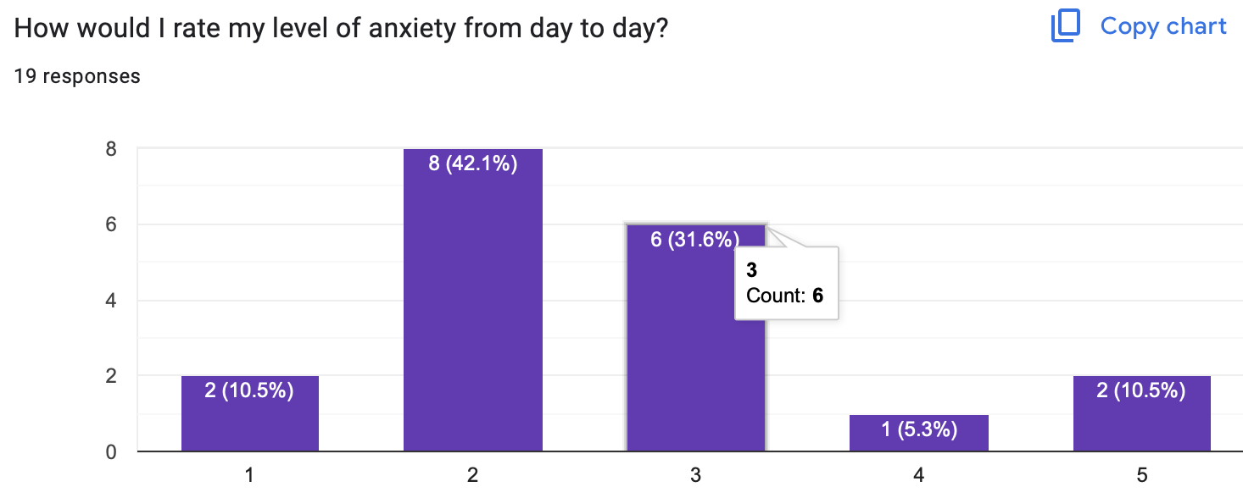
Pre-test
Notes:
Here are the results for the first 3 questions of the Pre-Test given to the students.

Slide 8
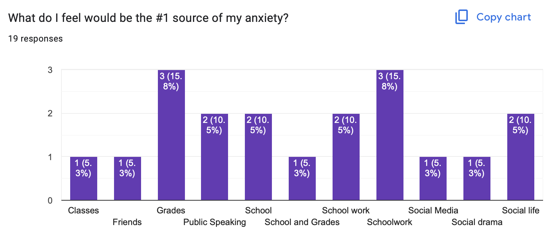
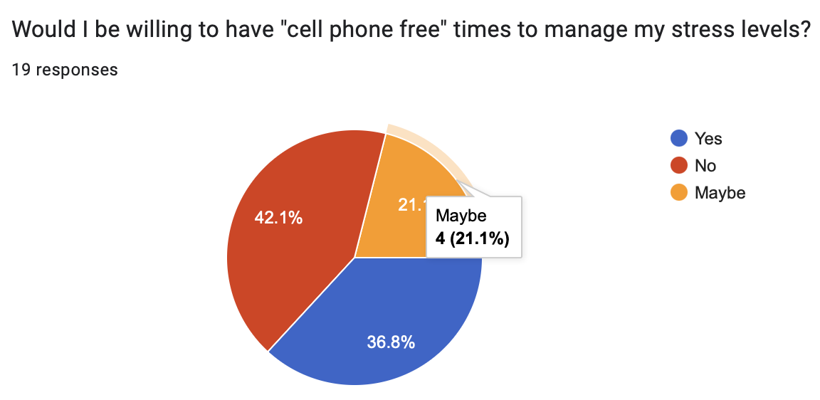
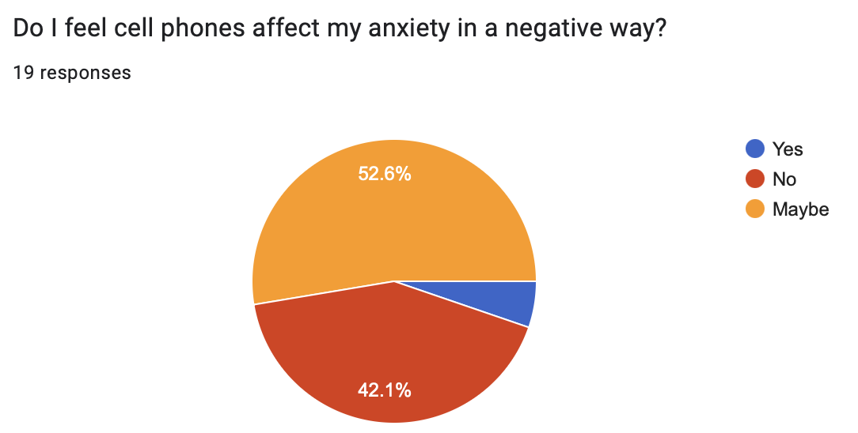
Notes:
Here are the other 3 questions and results from the student’s Pre-Test.

Slide 9
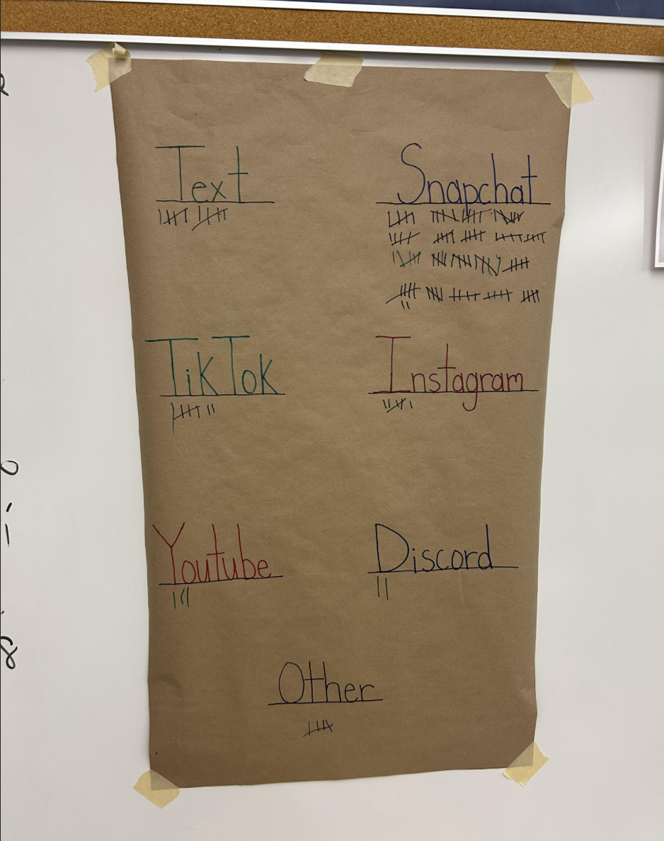
Day 1
Bellringer: What is the most popular app, and why?
Social Media App Activity
Cell Phone Pre-Test
Ted Talk Video and Discussion
*Ramsey(2023)
Notes:
This was lesson day 1. This was an awesome social media activity that I read about a little while ago. At the beginning of class, I told the students to put their phones on their desk, turn the sound off, but turn on the notifications. As you can see in the picture from class, I had the students come up and make a mark on the poster every time they received a notification. The goal of this was for them to look at the poster at the end of the class and notice how many times their attention is being pulled away from class. This was only 1 period in the day. Think if this was completed every single class all day long. We then took the Pre-test and ended the class with a Ted Talk video, which talked all about how cell phones affect the brain.

Slide 10



Day 3
Day 2
Bellringer: Why do people like cell phones so much?
Cell phone addiction test
Discussion based off the results
"The Rise of Cell Phones"
Notes:
Day 2 focused on the rise of cell phones in America. We first had a bellringer discussion focused on why people like cell phones so much. We then moved into a discussion and statistics explaining how much more America uses phones compared to years ago. This was followed by a class activity/test measuring how addicted to our phones we are. The class ended then with a discussion based on these results.

Slide 11
Day 3
Bellringer: Should cell phones be allowed in school?
Cell phone addiction stats vs SMHS stats
What is anxiety discussion
Stressful scenarios activity
Notes:
For day 2 bellringer, my goal was to start a debate on the thoughts of having phones within the school building. After hearing the opinions back and forth, I showed some negative cell phone stats. To add further to the conversation, I showed some discipline stats from our school and how cell phones negatively impacted them. We then transitioned to a discussion on anxiety, and especially how cell phones are wrapped up in those emotions. We ended the class with a scenarios activity where the students responded with how they would handle their stress in particular situations.

Slide 12
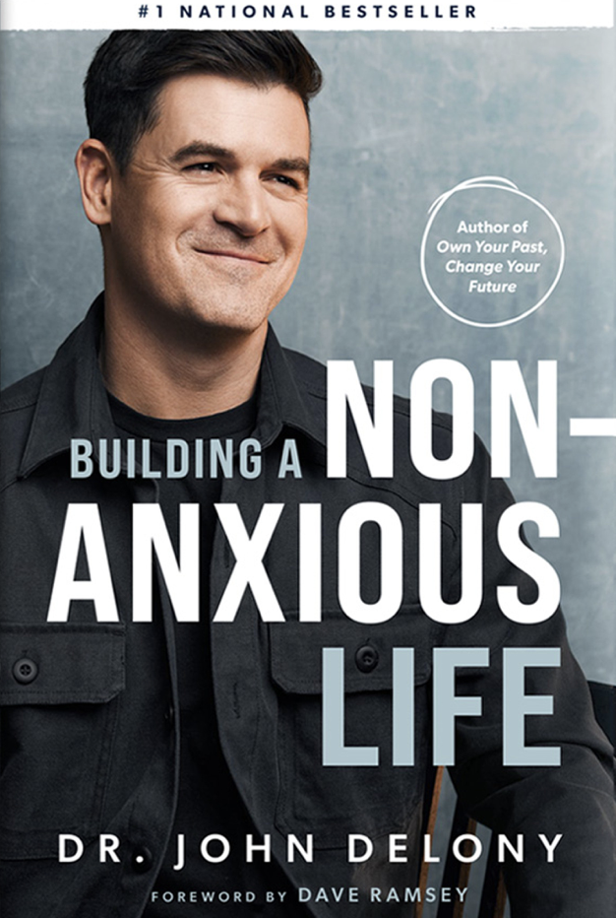
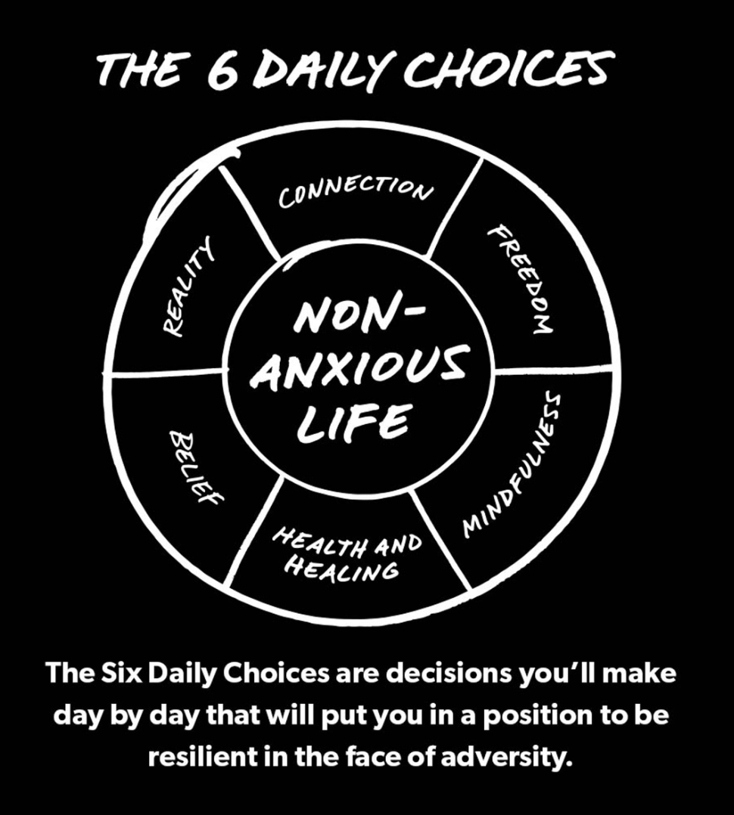
Day 4
Day 4
Bellringer: How do I live a “Non-Anxious Life”?
The 6 Pillars discussion
Dr. John Delony Youtube Video on Anxiety
Posttest survey
Notes:
Day 4 bellringer was all about introducing the concept of a “non-anxious” life. I read an amazing book by Dr. John Delony, who has his own podcast surrounding this philosophy. In the book and his podcast, he introduces the 6 pillars of living a non-anxious life. We talked about what they meant within our lives as 10th graders, and then went into a video with Dr. Delony specifically talking about handling anxiety. Ending the class, we took the posttest survey to see how the student’s results have changed.

Slide 13
Cultural Sensitivity
PASS option
Partner work/discussions
Interviews while ”time on the clock”
Notes:
To create a “safe environment,” I used the APL teaching philosophy. This teaching method is focused on helping the students feel safe answering in the class. Examples of this method would be the pass option, partner work, and the “interviews.” Each one of these aspects help the student to feel comfortable knowing they have the correct answer compared to “being on the spot.”

Slide 14
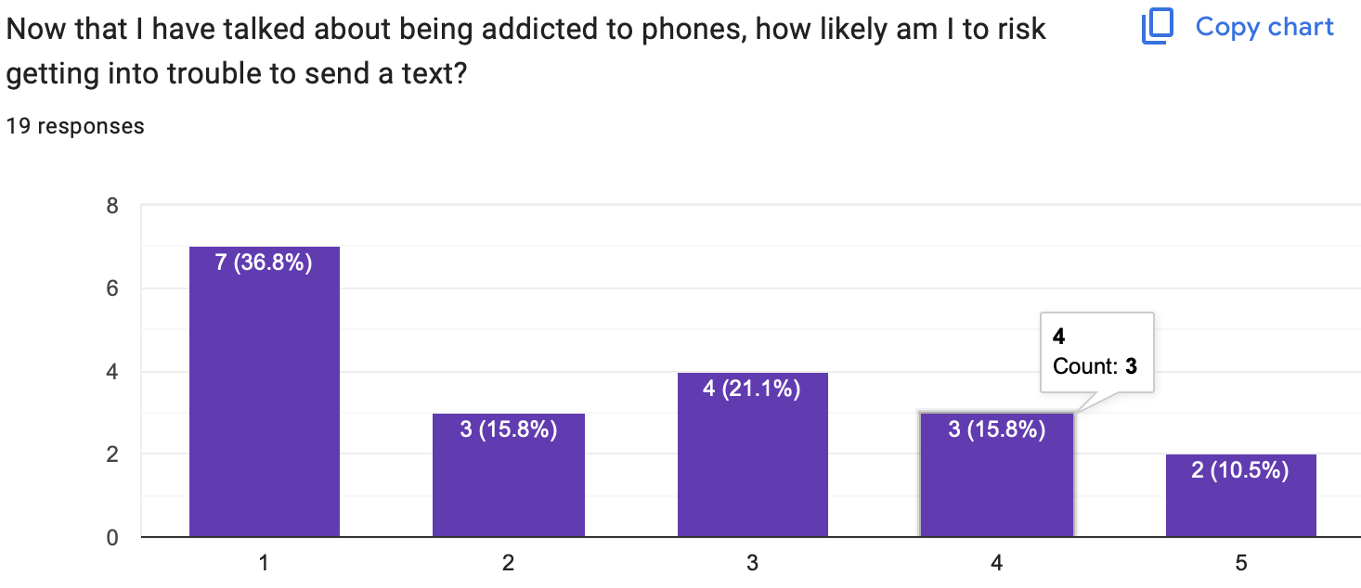
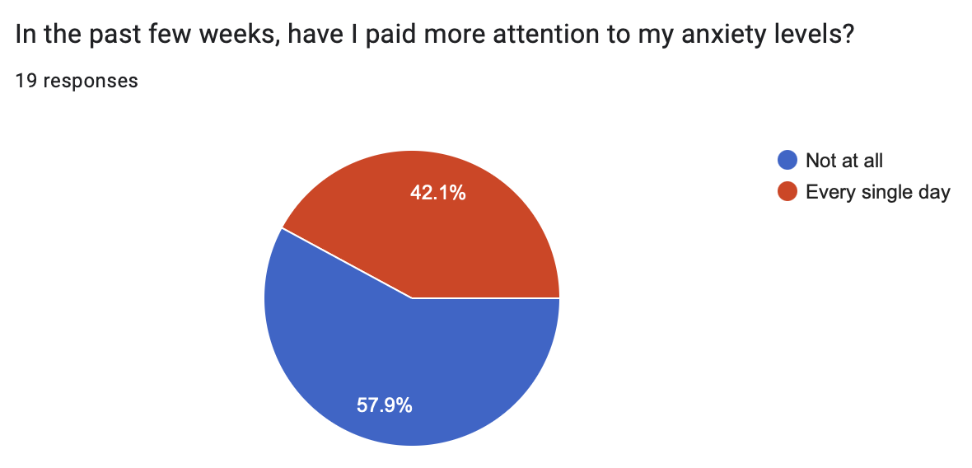
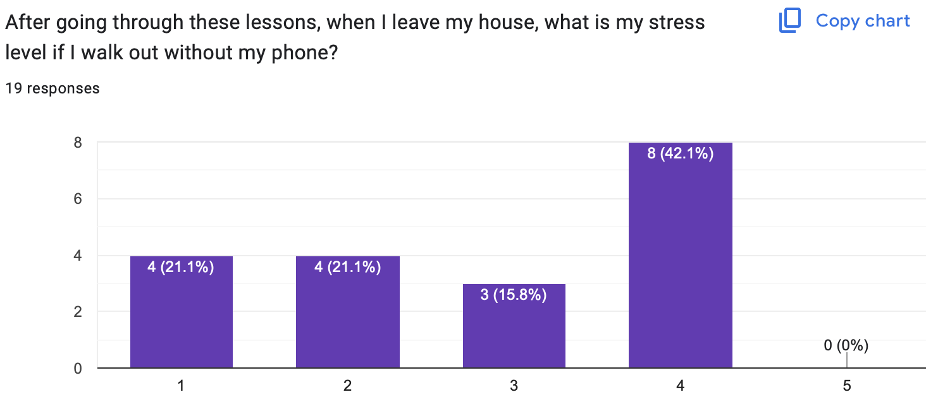
Post
Test
Notes:
Here are the first 3 results from the Posttest.

Slide 15
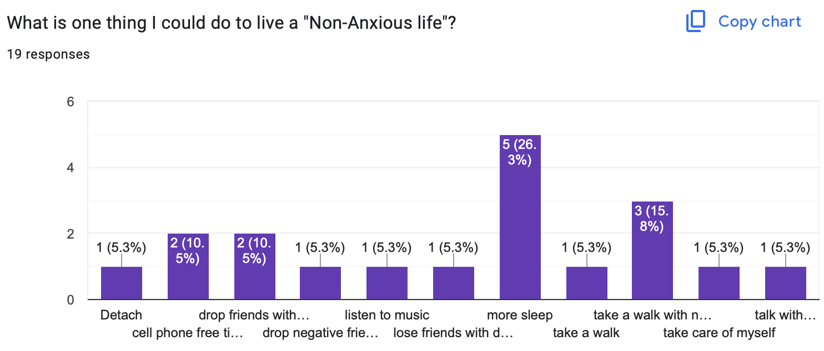
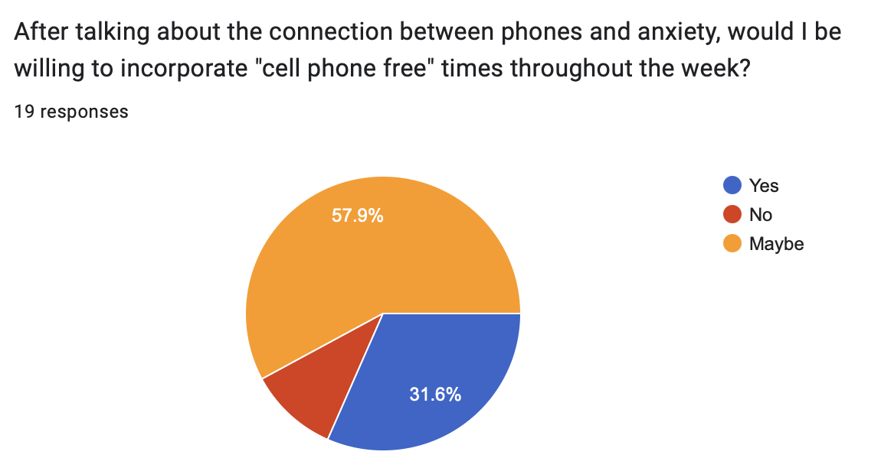
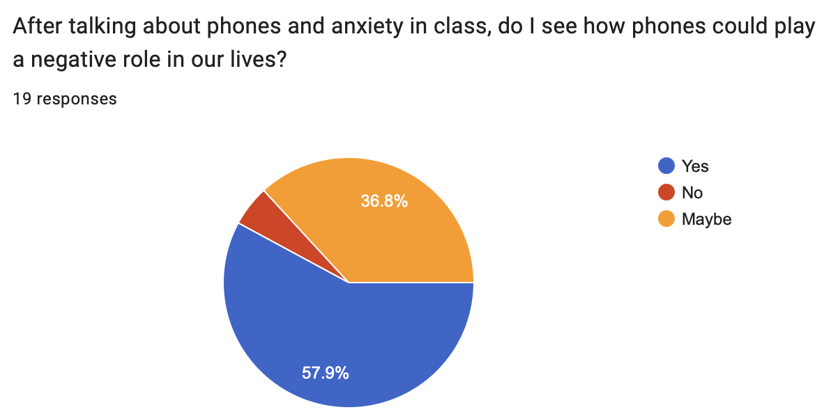
Notes:
Along with the last 3 results of the Posttest.

Slide 16
References
American School Counselor Association (2021). ASCA Student Standards; Mindsets and Behaviors for Student Success. Schoolcounelor.org. https://www.schoolcounselor.org/getmedia/7428a787-a452- 4abb-afec-d78ec77870cd/Mindsets-Behaviors.pdf
Liberty University (2023). PRE-ADVANCED INTERNSHIP ASSESSMENT (PRE-AIA): COSC 698 Master of Education (M.Ed.) in School Counseling. liberty.edu. https://www.liberty.edu/behavioral- sciences/counselor-ed/wp-content/uploads/sites/43/2021/02/PRE-ADVANCED-INTERNSHIP- ASSESSMENT-COSC-698-Practicum.pdf
Notes:
Here are the references I used to create this PowerPoint and run my guidance lessons.

