Slide 1
CCK Group
“Cool Counseling Kids”
Seth Eby

Slide 2
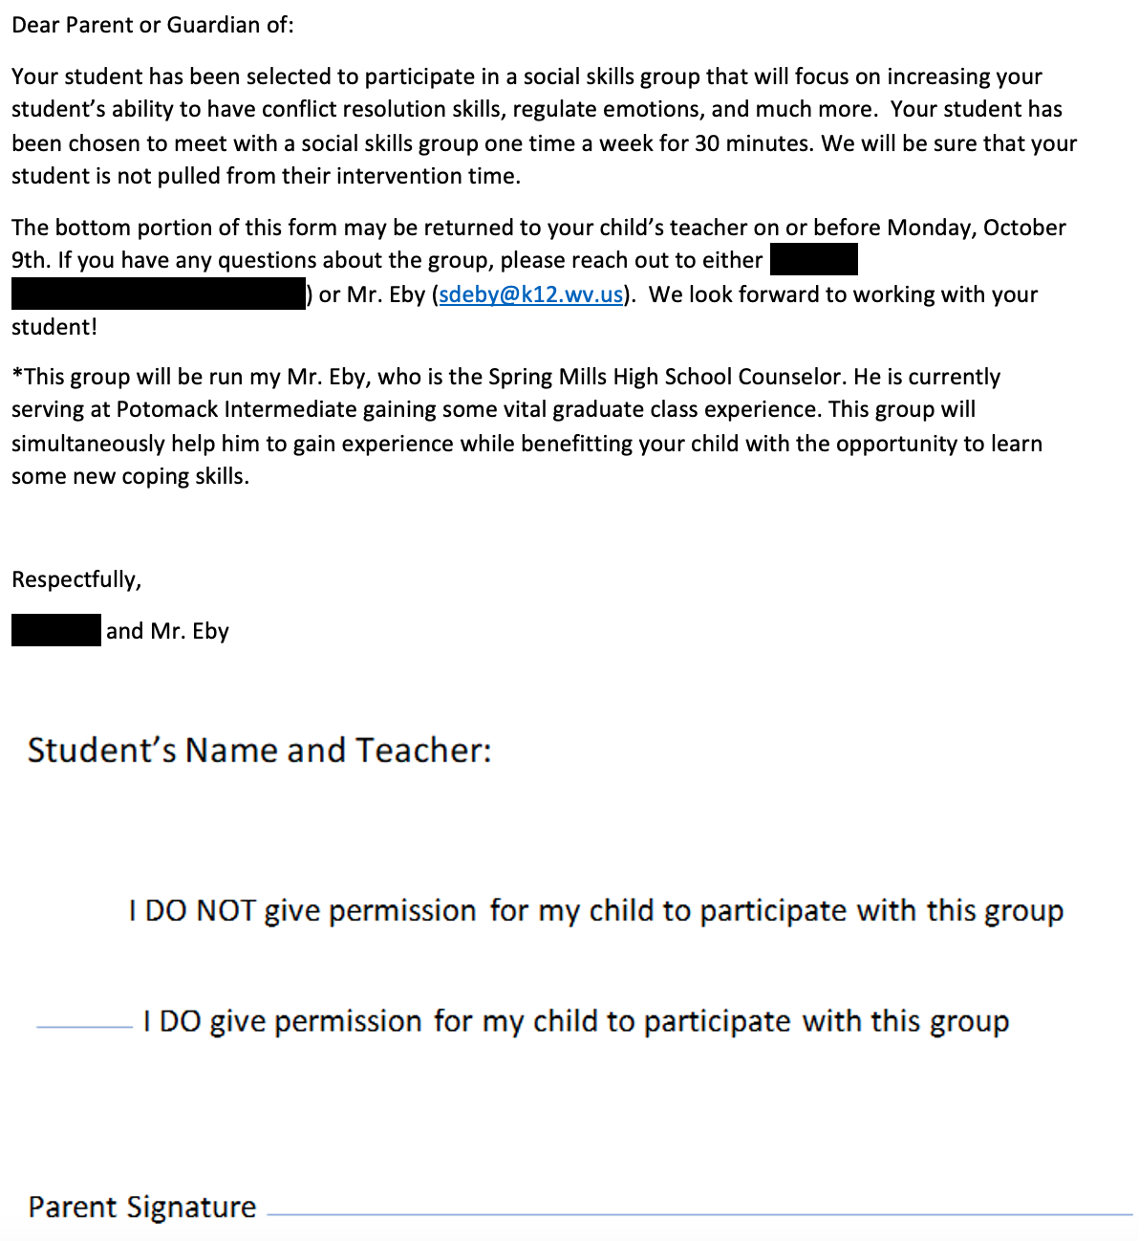
Permission Form
Goal: To have a group
of students who struggle
with their anger get
together and practice
their skills in the areas
of anger management,
communication, and
respectfulness.

Slide 3
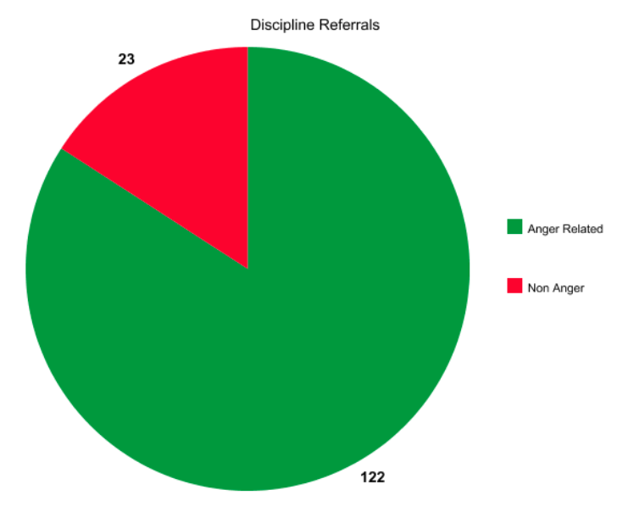
Why have a group based on Anger management?
Biggest Intermediate school in the state of WV
-“It is undeniable that the student population in the classroom positively impacts the teaching and learning processes (Ancho et. al., 2021)
2. High Discipline Data
-11/17=increase of 145
-84%=anger related such as
hitting, yelling, throwing things

Slide 4
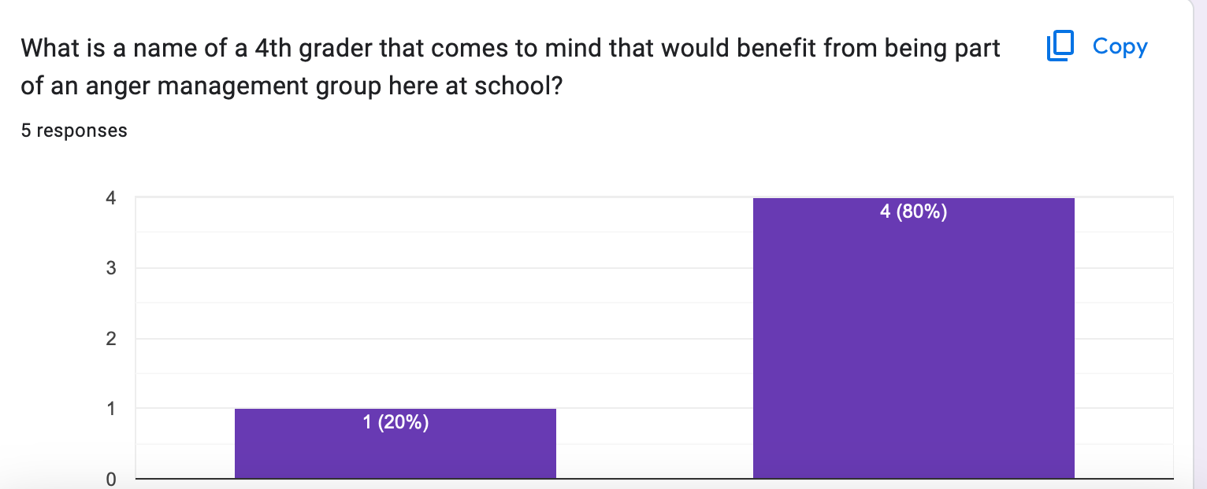
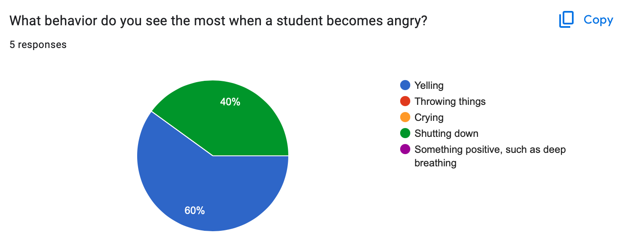
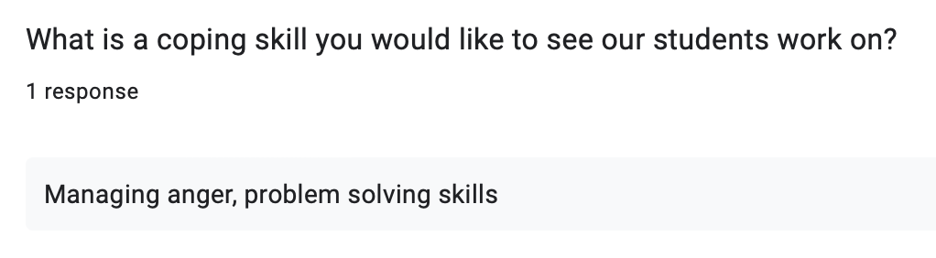
Needs Assessment(s)
Stakeholders: Administrators, teachers, and school counselors

Slide 5
Standards and Rationale
B-SS 1: “Effective oral and written communication skills and listening skills” (ASCA, 2021)
(Prevention and Intervention)-Getting together to practice the communication skills needed to effectively convey their emotions
M-4: “Self-confidence in ability to succeed” (ASCA, 2021)
(Academic Development)-building confidence in themselves
B-SS 7: “Leadership and teamwork skills to work effectively in diverse groups” (ASCA, 2021)
(Diversity and Advocacy)-Learning to work with others even when they are different and/or we do not get along well

Slide 6
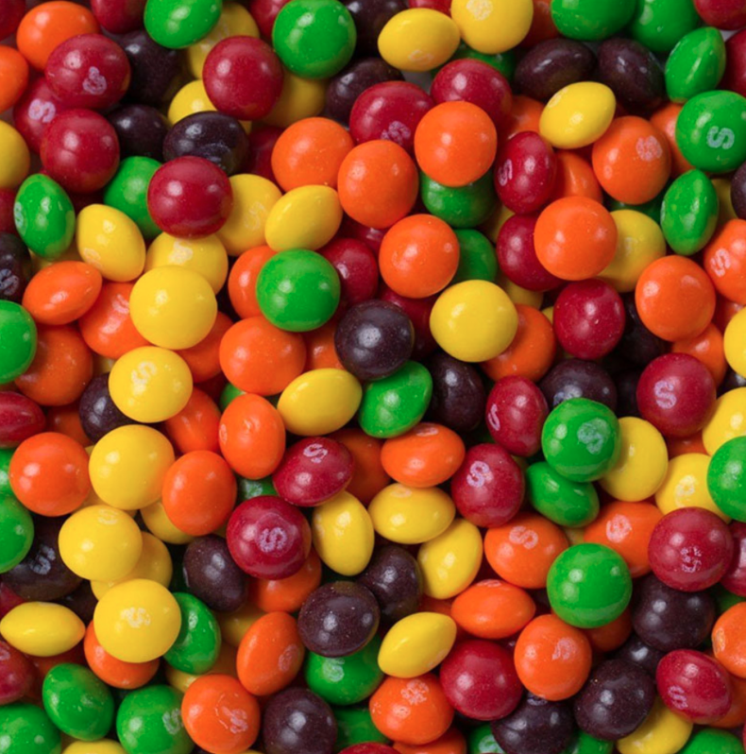
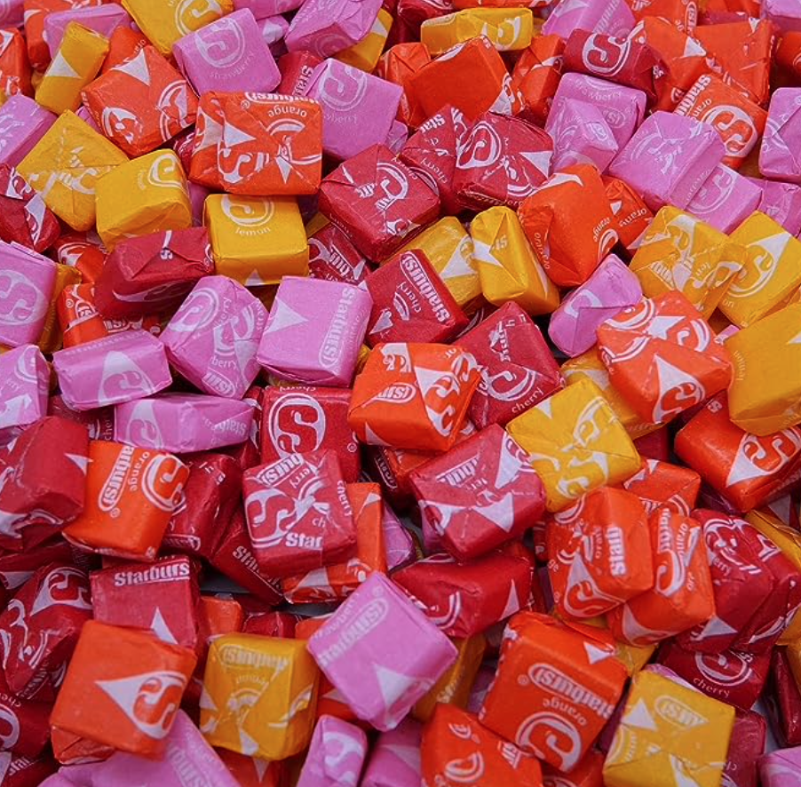


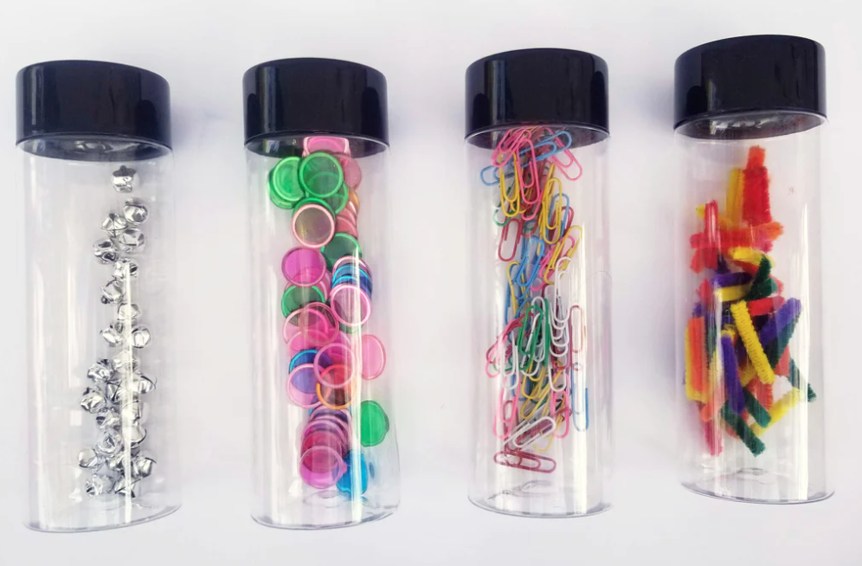
Activities and Examples
123/Skittles Activity
The ”Unfair Game”
Soda shaker sensory bottles
Anger Scenarios
Typical Day
-Ice breaker, activity, and discussion

Slide 7

Creating a Culturally Positive Environment
Safe Space Conversation
Positive student interactions
Creating the “CCK Team”
*Divorced families

Slide 8
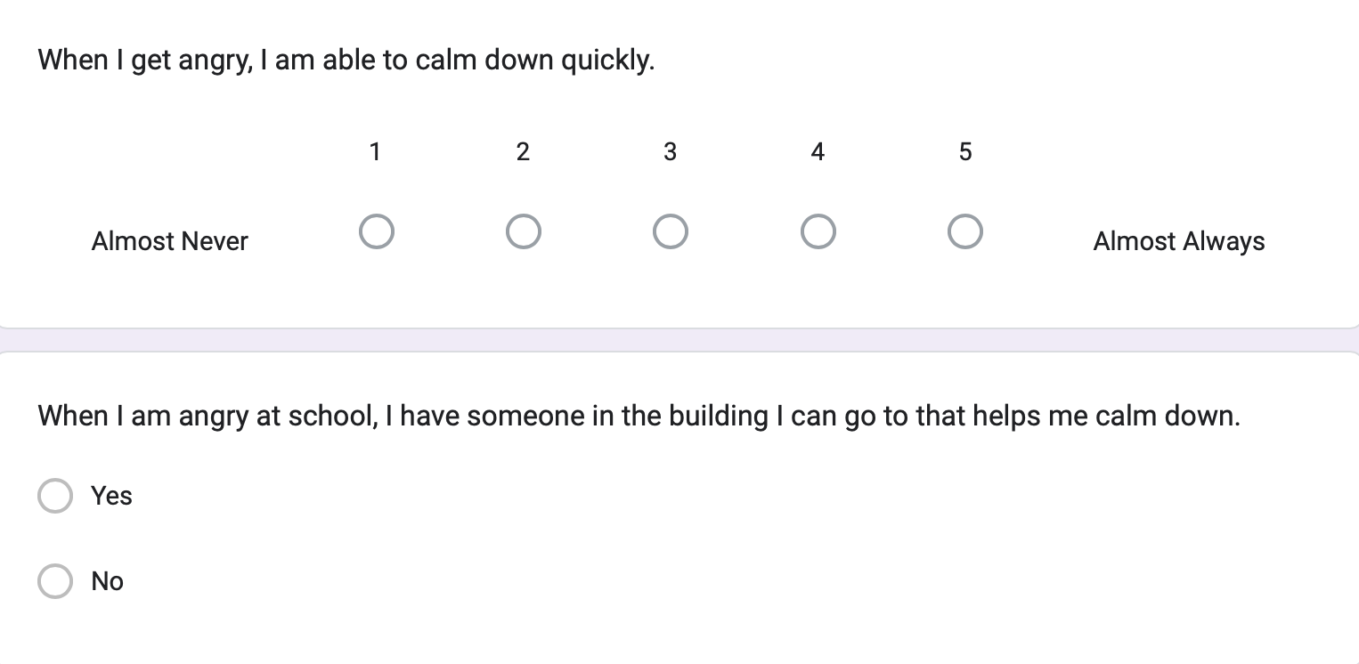
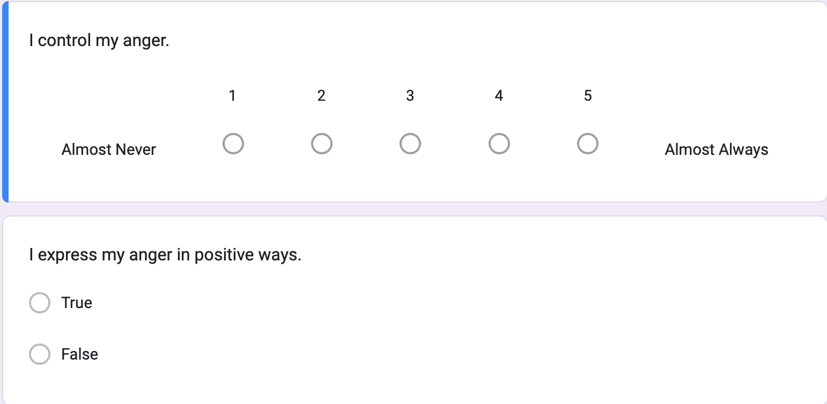
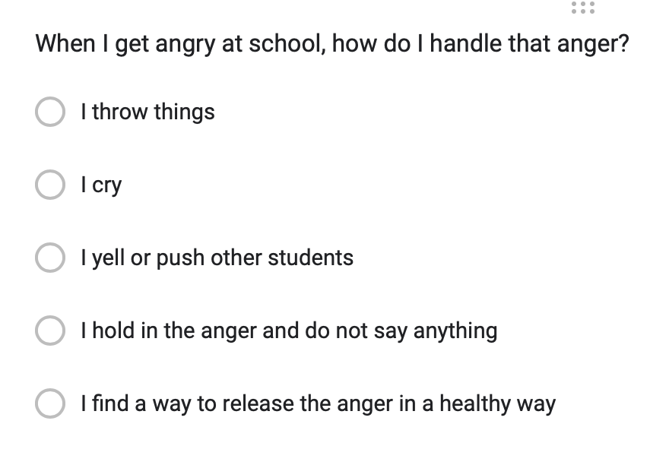
Evaluation
Pre-Post Test

Slide 9
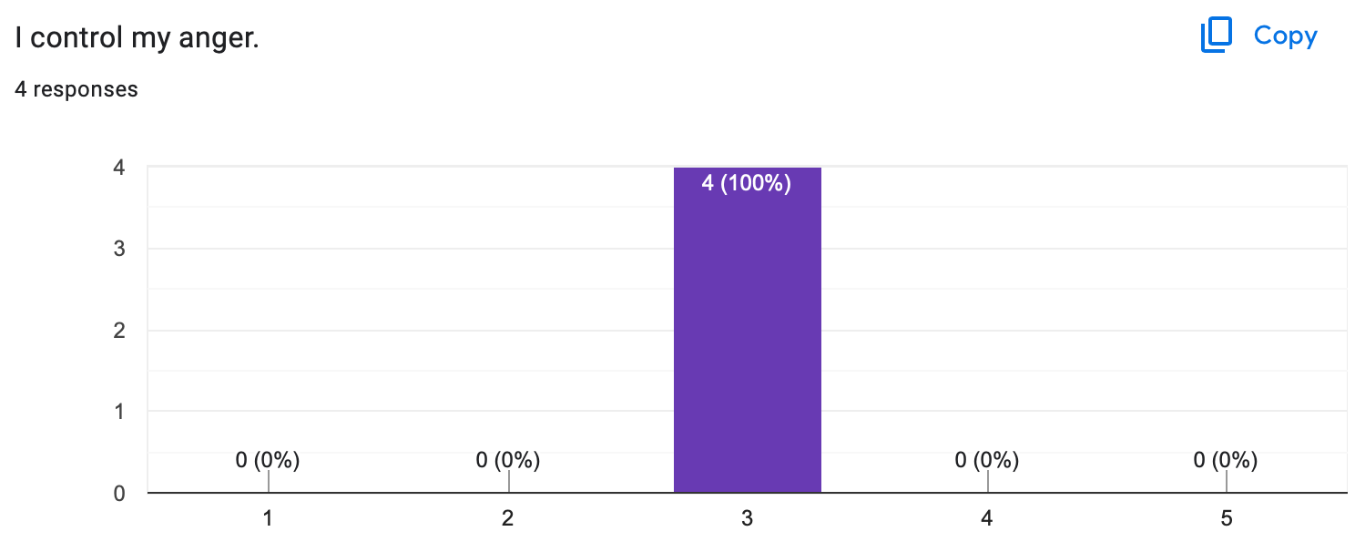
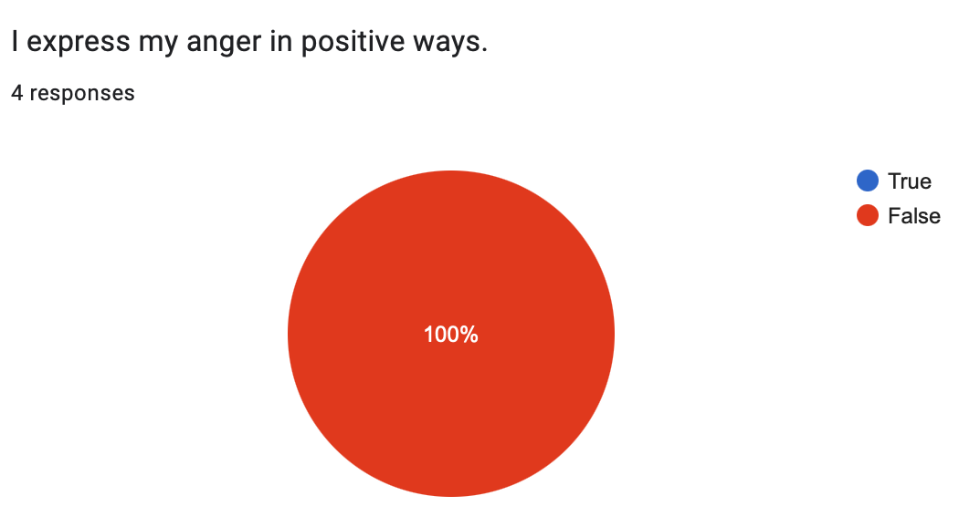
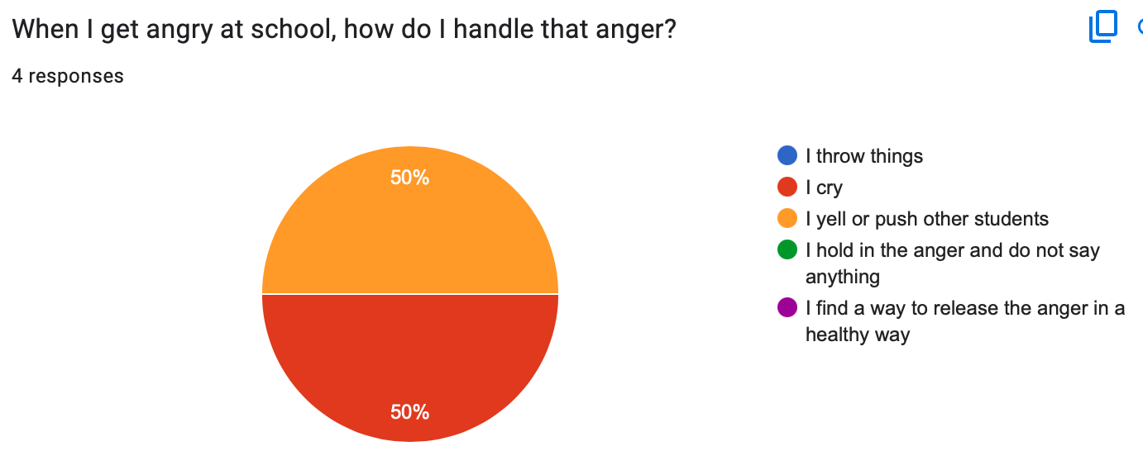
Results (Pre-test)

Slide 10
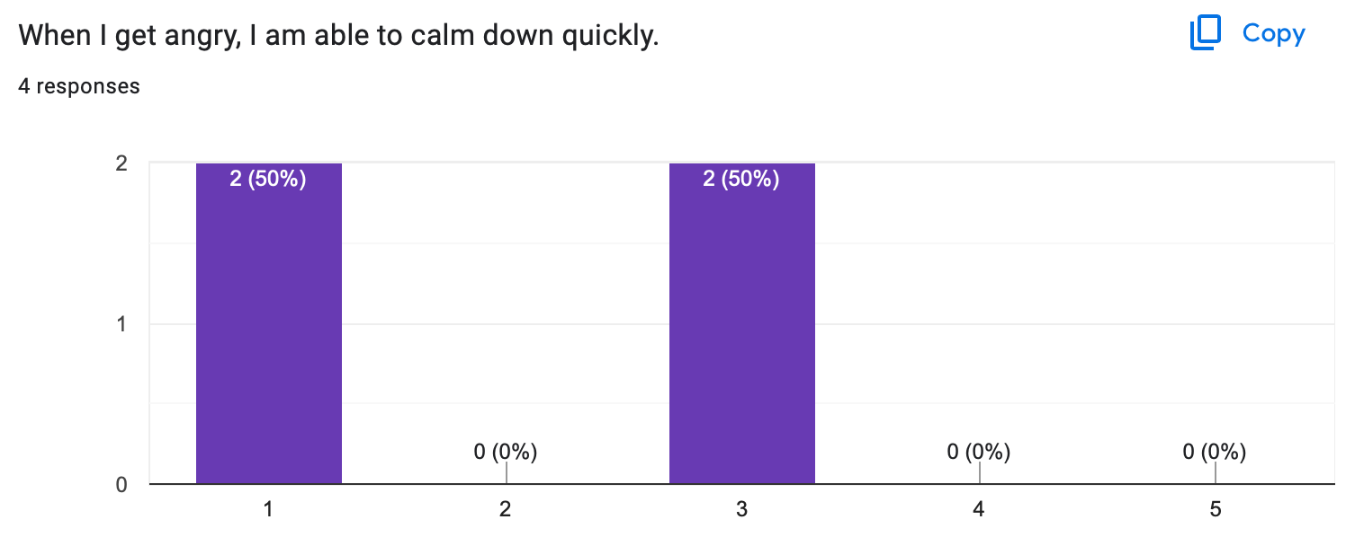
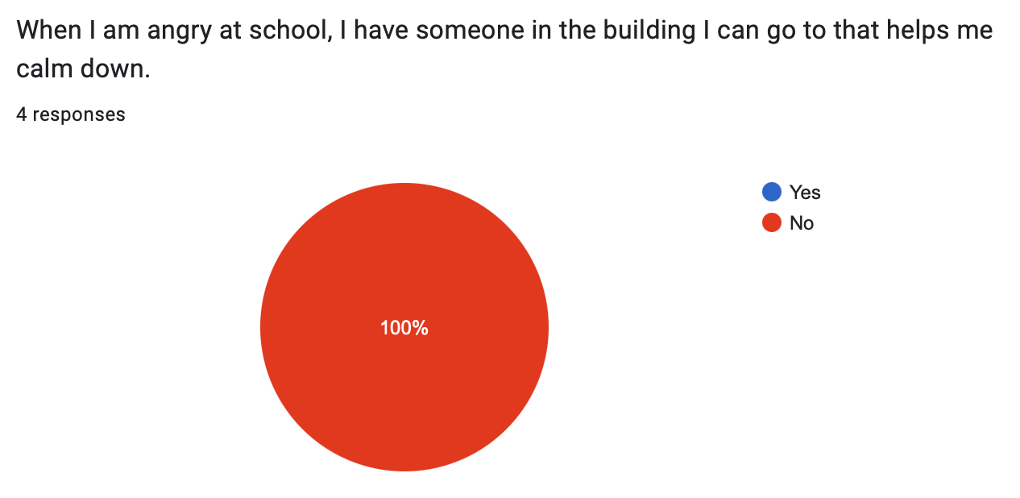
Results Continued (Pre-test)

Slide 11
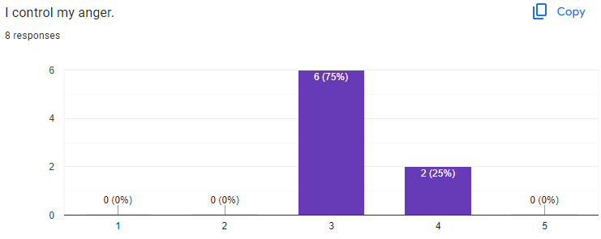
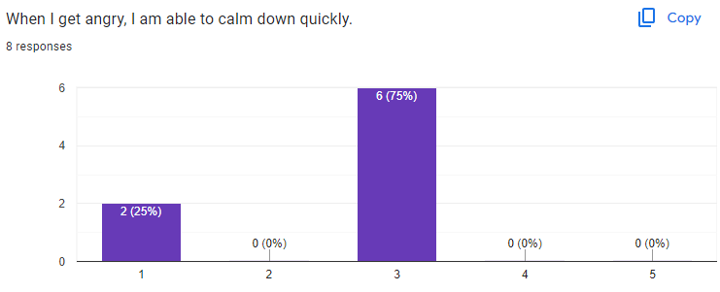
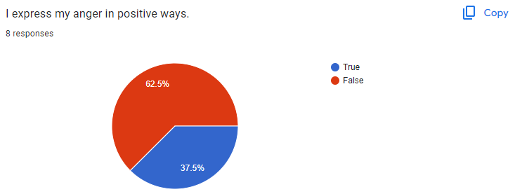
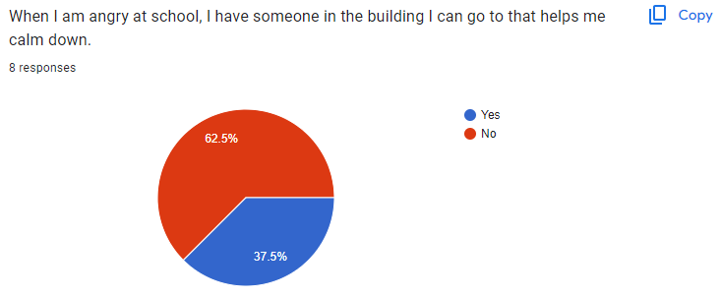
Post Test (Increased Results)

Slide 12
References
American School Counselor Association. (2021). ASCA Student Standards; Mindsets and Behaviors for Student Success. Schoolcounselor.org. https://www.schoolcounselor.org/getmedia/7428a787- a452-4abb-afec- d78ec77870cd/Mindsets-Behaviors.pdf
Ancho, I., Galang, A., Dela Cruz, A., Dela Cruz, R. (2021). Investigating Student-Teacher Ratio As A Factor In Reading Performance. Eternal: English, Teaching, Learning and Research Journal, 7(1), 52-64. https://doi.org/10.24252/Eternal.V71.2021.A4
Liberty University. (2023). Advanced Internship Assessment (AIA): Master of Education (M.Ed) in School Counseling. liberty.edu. https://www.liberty.edu/behavioral-sciences/counselor- ed/wpcontent/uploads/sites/43/2021/02/ADVANCED-INTERNSHIP-ASSESSMENT_ASCA- 1.pdf

