Slide 1
Careers: What do you want to do in the future?
By: Seth Eby

Slide 2
How did this come about?
1. Conversation with Mr. Davis
2. Analyzing scheduling papers
3. Surveying stakeholders
(4 principals, 2 career teachers)
2 existing data points: PEP Plans and CTE scores
Notes:
When presented with this project, I went and sat down with Mr. Davis, my supervisor, to discuss details on what he thought would be appropriate for this project. Something that was beneficial to the students compared to just “checking a box” for the college requirements. We both came to the mindset of lessons focused on future careers. This conversation was a key point to reaching this main idea of the project, but there were a few other factors as well. First off, I went through and analyzed the career question on the scheduling papers. 151 out of the 398 students filled it out correctly (37.9%). In other words, less than half of the students properly came up with a future career. Another form of data was the needs assessment that I provided to important stakeholders; the 4 principals and 2 career teachers. Lastly, and most importantly, there were 2 formal data points I used to support this unit. The PEP plans and CTE scores. Coming from the middle school only 52 out of the 398 students had a formal PEP plan, which discusses future plans for a career. Along with the PEP plans, the school’s CTE, or completer graduate, scores have gone down for the past 3 years.

Slide 3
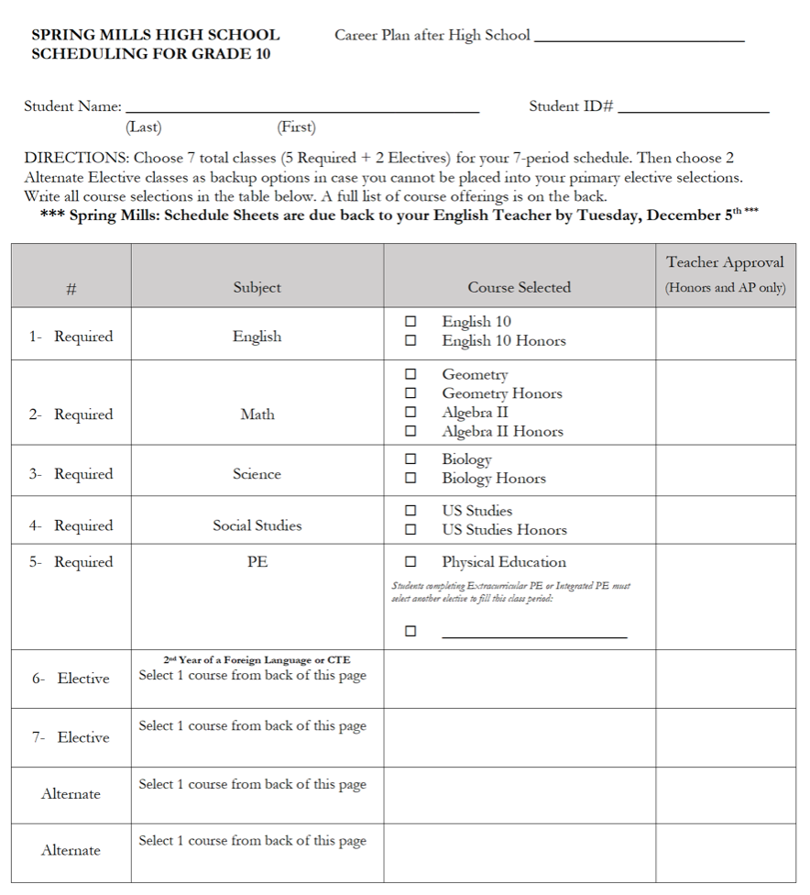
Notes:
Here is the scheduling paper that I go over with the freshman students. At the top right of the page, you can see the line where the students are supposed to write down a career they are looking to get into after high school. This was one of the areas of concern for the freshman students, which led to these lessons.

Slide 4
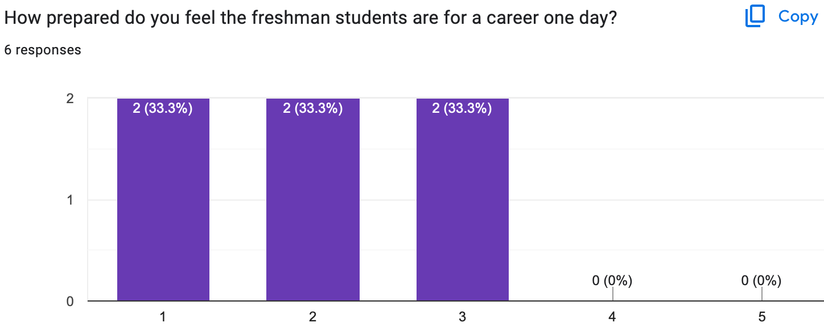
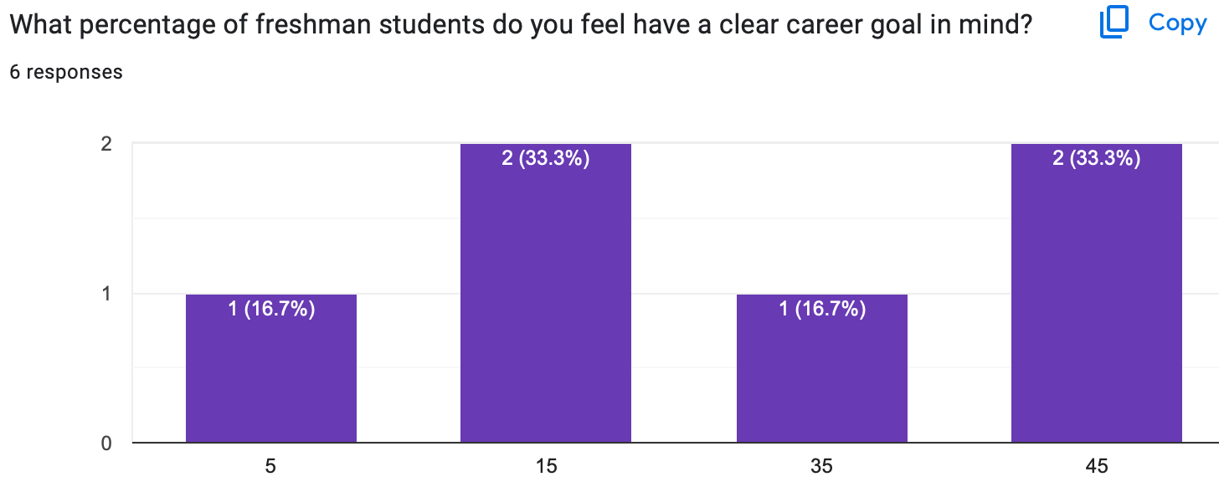
Needs Assessment Statistics
Notes:
Here are 2 of the needs assessments questions asked to the principals and career teachers. As you can see, the scores are on the lower side in their viewpoints.

Slide 5
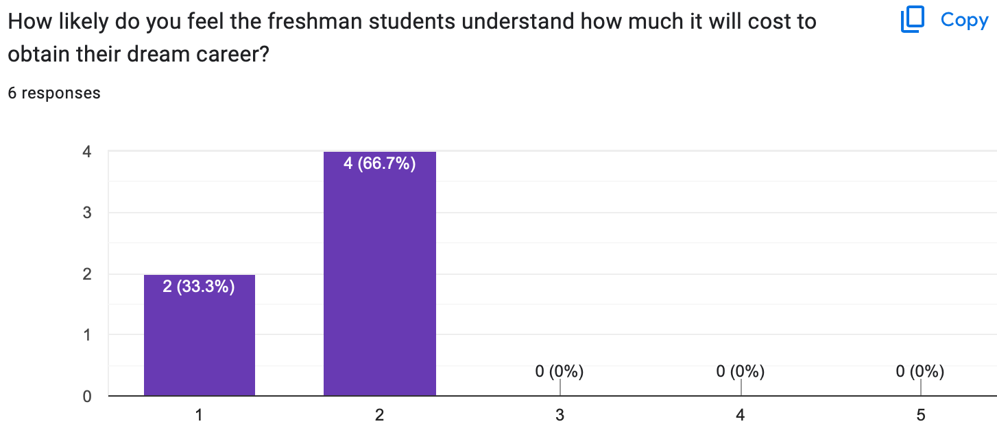
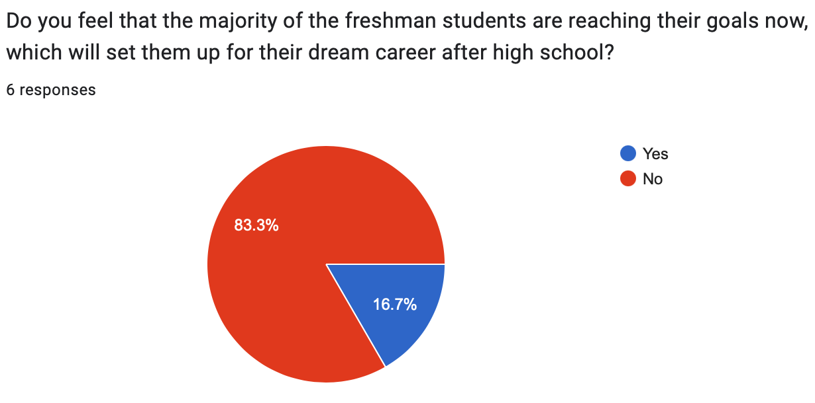
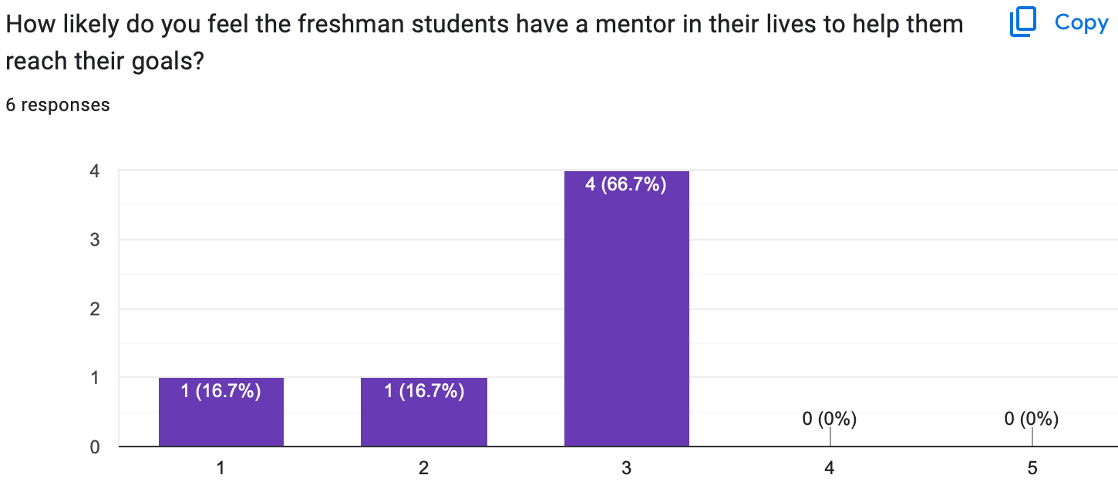
Notes:
Here are the last 3 questions and results to the needs assessment. These 3 questions were focused on money, goals, and mentors. The goal was to highlight multiple important factors which would lead the students to obtaining their ultimate career. Again, you can see the scores are subpar.

Slide 6
AIA & ASCA Mindsets and Behaviors
1. Assessment H.1
2. Research & Evaluation J.1
3. Academic Development L.2
1.B-LS 7
2. B-SMS 4
3. B-SS 3
*ASCA(2021) & Liberty(2023)
Notes:
Assessment H.1 is all about assessing and interpreting students strengths, needs, and abilities. This was incorporated with the career interest survey taking what they like and are good at and turning it into a career. Research and evaluation J.1 applies relevant research findings to inform the counseling. This was done through all the needs assessments and data, which helped to shape these lessons. Academic L.2 implements strategies and activities for a full range of postsecondary options. This was talked about a lot. College is not the only option, and all of these activities were dedicated to figure out what the students would be good at compared to “everyone needs to go to college.” ASCA B-LS7 focuses on long term and short term goals. This was completed when speaking about SMART goals. Understanding that we need measurements to get to where we want to go. B-SMS 4 was focused on delayed gratification for long term rewards. Patience and hard work was a theme throughout discussions to help them desire work ethic to get to their rewards. B-SS 3 talks about positive relationships with adults to support their success. Day 4 focusing on mentorship was dedicated to this concept.

Slide 7



How did I pick the class?
Analyze every schedule paper
Analyze every health class
What health class had the highest percentage of unanswered career questions?
*Mrs. A’s 2nd period
Notes:
How did I pick the class to do the lessons? There was a step by step process to get there, which ended up with Mrs. A’s 2nd period health class. First I had to go through all 398 and mark down whether or not they had a career plan in mind. Then I had to compare those to each health class. In all the health rosters, I had to mark down in each class which student was a yes or no for their plan. Then I had to compare each health class and see which class had the highest percentage of “no’s” for the class. This turned out to be Mrs. A’s 2nd period health class.

Slide 8
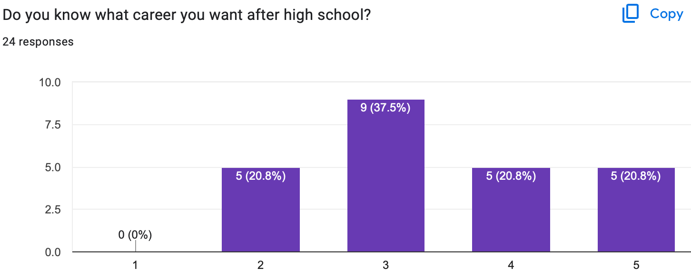
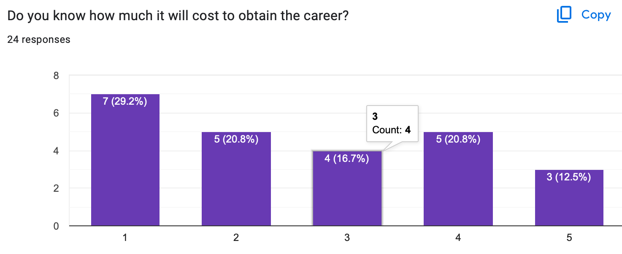
Pre-test
Notes:
Here are the results for the first 2 questions of the Pre-Test given to the students.

Slide 9
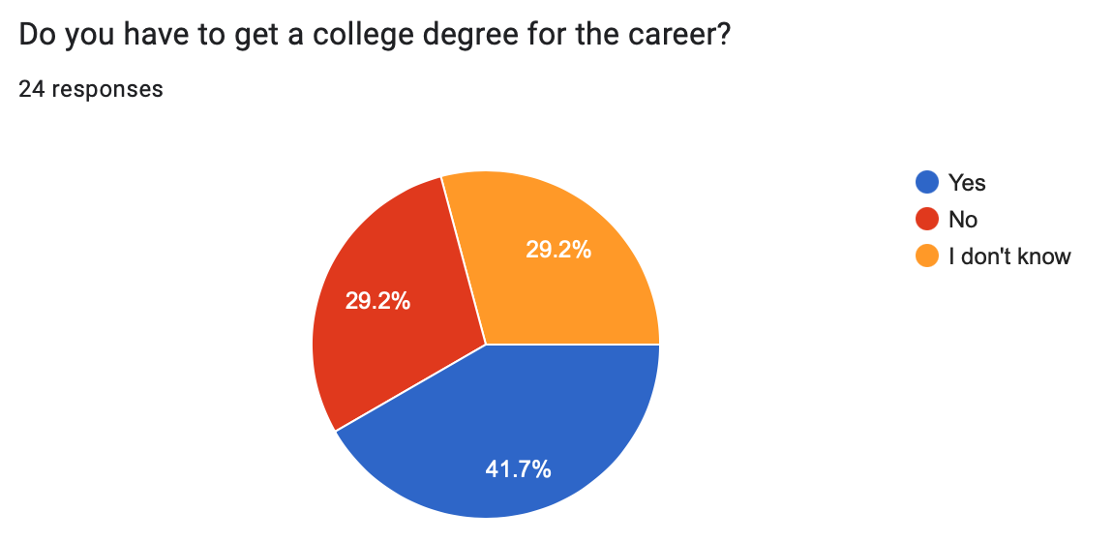
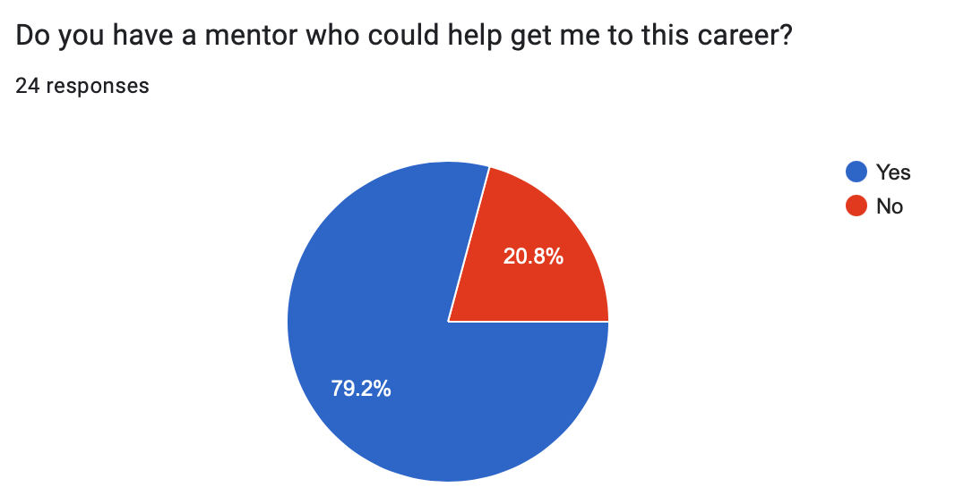
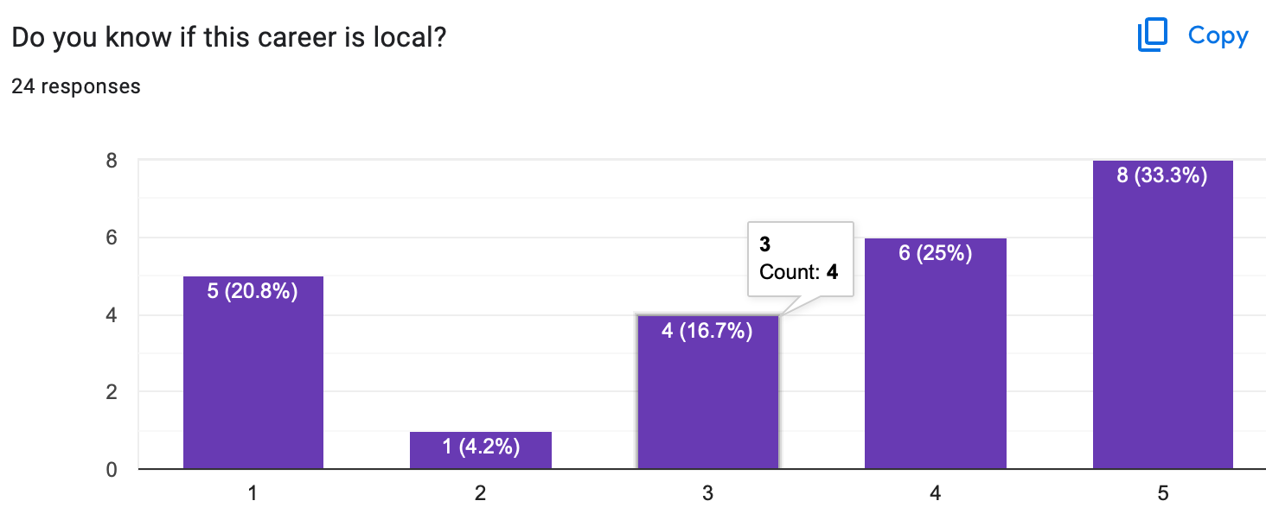
Notes:
Here are the other 3 questions and results from the student’s Pre-Test.

Slide 10
Day 1
Bellringer: What are the top 5 careers of millionaires?
Pre-Test Survey
Job vs. Career discussion
*Shorter Day (2 hour delay)
*Ramsey(2023)
Notes:
This was lesson day 1. We went over Bellringer 1 about millionaires, which came from a study done by Ramsey(2023), because many of my students say they want to become a professional athlete to make a lot of money. The goal of this was to help them understand it comes down to the way you save and invest money compared to how much you make. The students then took the Pre-Test to see their initial results. We then ended the class with a career vs. job discussion so that everyone could understand the long term vs. short term concepts of a career and to make sure everyone was on the same page with their definitions.

Slide 11
Day 2
Bellringer: What are 2 careers related to a professional athlete?
O*NET Career Interest Survey
Discussion based off the results
*Career Research Worksheet
Notes:
For day 2 bellringer, my goal was to get the students to understand there is multiple jobs in the same “field or industry.” So many students want to become a professional athlete. I had them try to expand their mindset to understand there are examples such as physical therapist, athletic trainer, coach, team doctor, etc. We then conducted a career interest survey to analyze what their skills and abilities are to match those up with careers. We talked about the results a little and then only had a couple minutes left to introduce the next week’s research worksheet.

Slide 12
Day 3
Bellringer: Would you rather? $200,000 & 75+ hours or $50,000 & 40 hours?
Career Scenario Activity
Career Research Worksheet
Notes:
Day 3 bellringer was all about money vs. time. Most high paying positions come with long work weeks. More time at work leads to less time at home with family and friends. The bellringer was supposed to lead to a discussion of analyzing the important things in the student’s lives. After the bellringer, the class took part in a “scenario’s activity.” I presented the students with different scenarios, or questions, and they had to stand on a certain side of the room depending on the answers. Examples were, could you handle working outside in the hot and cold, or could you handle working around blood? After the activity, I introduced the research worksheet, which was based off of their interest survey career results.

Slide 13
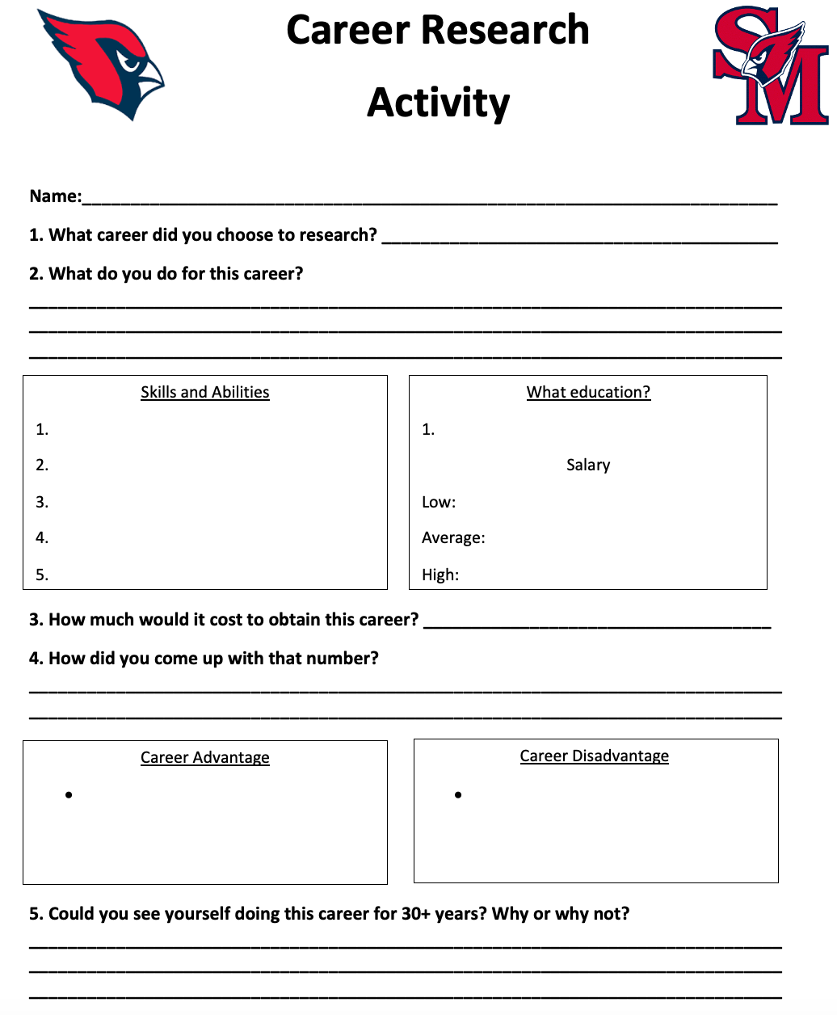
Notes:
Here is the career research activity worksheet I created for the students to answer.

Slide 14
Day 4
Bellringer: Why do you feel or not feel that having a mentor is important?
Career Research Worksheet (finish)
Presentations
Posttest survey
Notes:
Day 4 bellringer was focused on mentors in our lives and the importance they play in helping us reach our goals. I then gave them a little to finish their career worksheet, which then led into the presentations. We went around the room having the students give a snippet of the answers they found, something that stood out to them from their research. We ended the class with the posttest to evaluate the results of how effective the lessons were.

Slide 15
Cultural Sensitivity
PASS option
Partner work/discussions
Interviews while ”time on the clock”
Notes:
To create a “safe environment,” I used the APL teaching philosophy. This teaching method is focused on helping the students feel safe answering in the class. Examples of this method would be the pass option, partner work, and the “interviews.” Each one of these aspects help the student to feel comfortable knowing they have the correct answer compared to “being on the spot.”

Slide 16
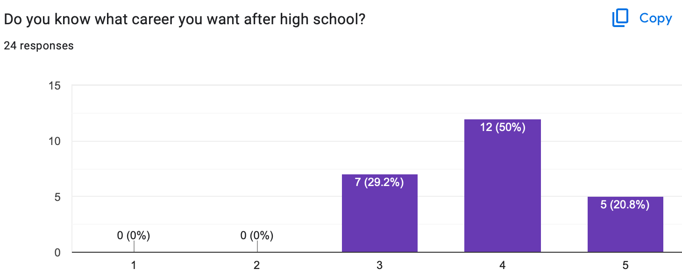
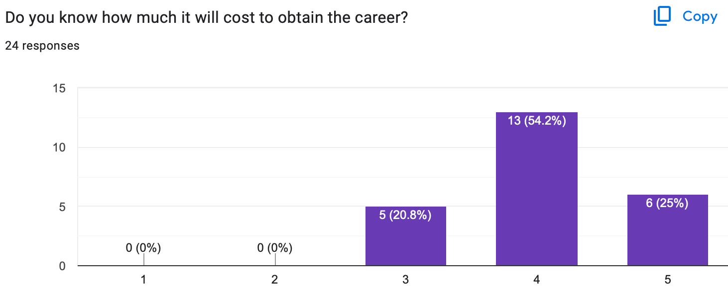
Post
Test
Notes:
Question 1 about knowing what career you want increased to 100 Percent 3-5, and question 2 about knowing how much it will cost to obtain your career went up to 100 percent. Both questions were a successful increase.

Slide 17
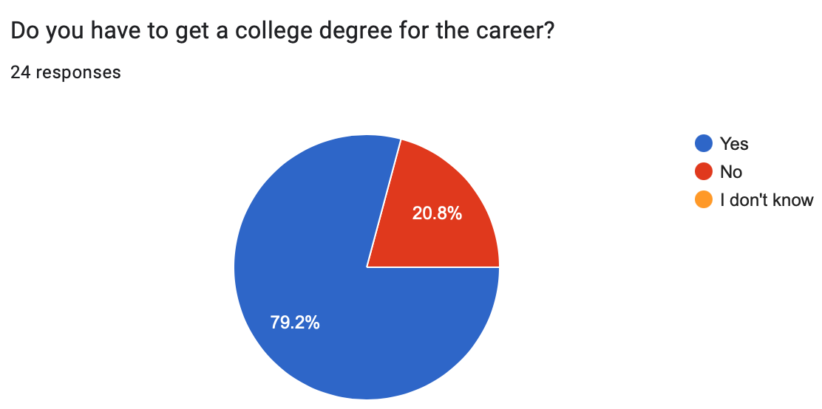
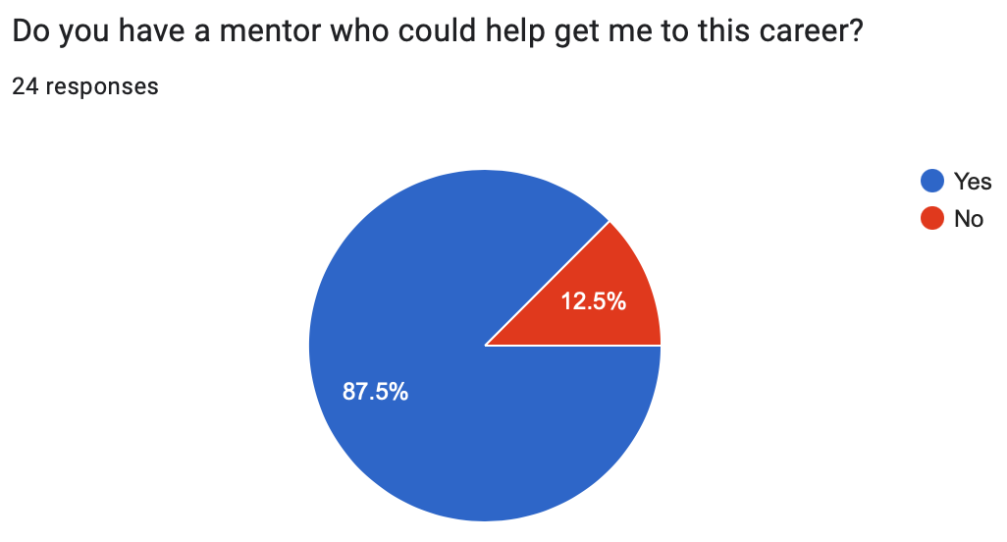
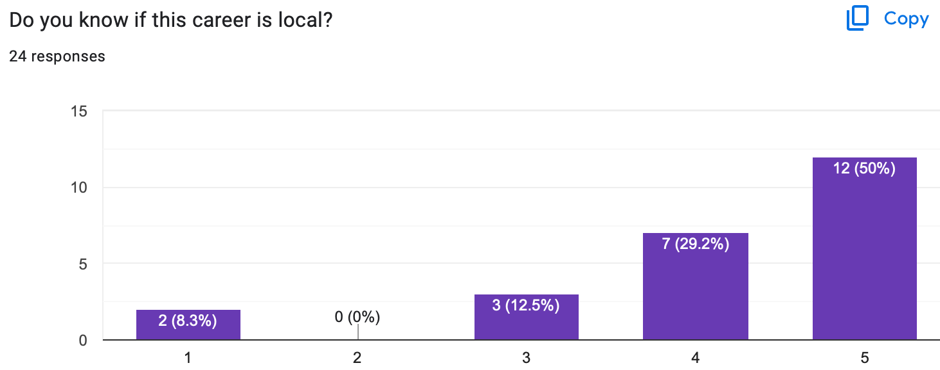
Notes:
Question 3 about knowing whether or not you need a degree went from 30 % not knowing to 0 % not knowing, which is a success. Question 4 about having a mentor dropped from No’s being 20.8 percent to 12.5 percent, which is also a success. Lastly, knowing if their career choice is local or not went from 75% being a 3-5 to 91.7%, which is also a success. All in all, I was 5 for 5 increasing each question in a positive manner from the pre-test to posttest.

Slide 18
References
American School Counselor Association (2021). ASCA Student Standards; Mindsets and Behaviors for Student Success. Schoolcounelor.org. https://www.schoolcounselor.org/getmedia/7428a787-a452- 4abb-afec-d78ec77870cd/Mindsets-Behaviors.pdf
Liberty University (2023). PRE-ADVANCED INTERNSHIP ASSESSMENT (PRE-AIA): COSC 698 Master of Education (M.Ed.) in School Counseling. liberty.edu. https://www.liberty.edu/behavioral- sciences/counselor-ed/wp-content/uploads/sites/43/2021/02/PRE-ADVANCED-INTERNSHIP- ASSESSMENT-COSC-698-Practicum.pdf
Ramsey (2023, Apr 12). The National Study of Millionaires. Ramseysolutions.com. https://www.ramsey solutions.com/retirement/the-national-study-of-millionaires-research
Notes:
Here are the references I used to create this PowerPoint and run my guidance lessons.

