Slide 1
Cultural Immersion Experience
ASIAN AMERICANS
By: Seth Eby

Slide 2
Four Key Elements Learned
1. Family Structure-collectivism and patriarchal (Yoon et. al, 2019, 122)
-Family is everything
-Clear gender roles
2. Customs and Behaviors-music, shoes, and dating (Choi, 2021, 113)
-Karen O, Steve Aoki, Mitski, and Bruno Mars
-Parents introduce potential mates

Slide 3
Four Key Elements Continued
3. Historical Events/Figures-Chinese Exclusion Act, Louisiana settlement, Hiram Fong (Nicola, 2021, 443)
-1882 by President Charles A. Arthur
-Spanish ships in the Gulf of Mexico
-First Asian American US Senator
4. Spirituality and Religion-Confucianism, Buddhism, Hinduism, and Christianity (Hays & Erford, 2018, 332)
-Polytheistic

Slide 4
Historical and Current Oppression
Internment Camps (Pegler-Gordon, 2017, 374)
“Model Minority Myth” (Hays & Erford, 2018, 323)
COVID-19 Oppression

Slide 5
AAPISTRONG Seminar
Asian American and Pacific Islander Strong
Asian American Mental Health, Trauma, and Healing
Dr. Hyunji “Hannah” Lee
100 Participants
Minority in the group was ME
Main focus-Teach, advocate, connect

Slide 6
Sixteen:Fifteen Churches in Missions Webinar
Mobilizing the Asian American Church
Erin and Brian Lee from OMF
-Overseas Missionary Fellowship
Main Focus-Teaching everyone and empowering Asian Americans

Slide 7
Three Things Learned From the Two Events
1. Asians seek out mental health therapy 60% less than White Americans (Dr. Lee)
-Suicide-Ages 15-24
2. Oppression is so intergenerational (Dr. Lee)
-distrust of of others and negative self-esteem
3. Clear racism within the church
-Erin Story from OMF

Slide 8
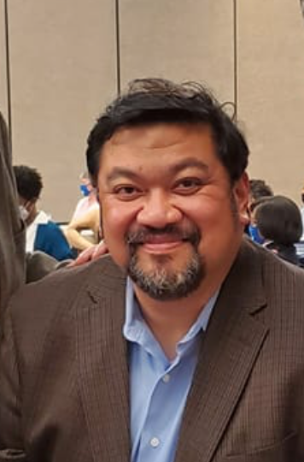
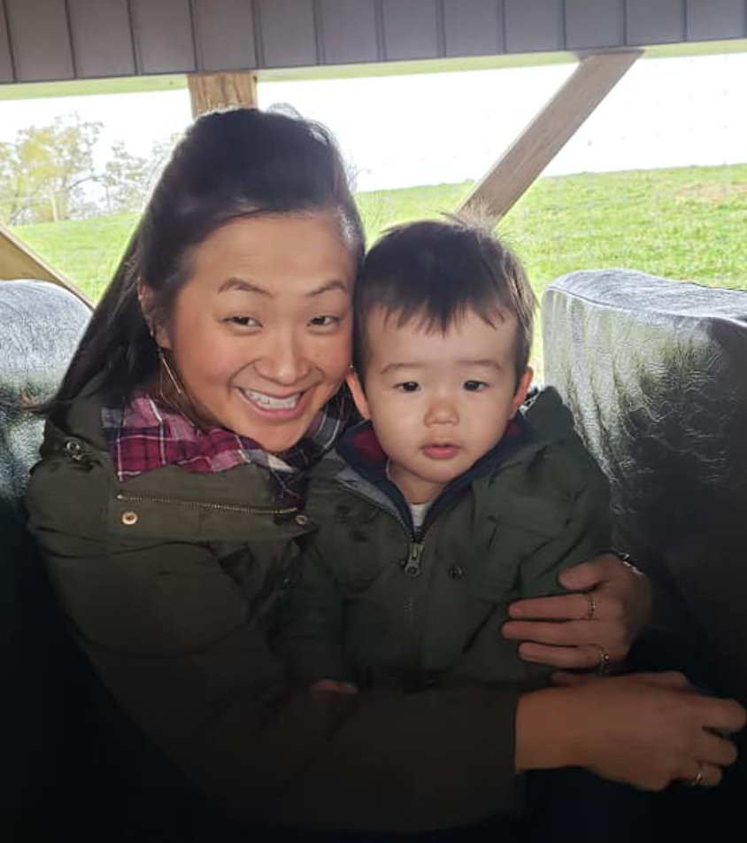
Dr. Gestoso
Bethany Hanft

Slide 9
Dr. Gestoso’s Interview
Professor at Cairn University
Lives outside of Philadelphia, PA
Dean, School of Social Work
Founding member of ASIAC
-Aids Services in Asian Communities
Fought for competent healthcare, HIV/AIDS services, and social services
Homosexual community and Human trafficking

Slide 10
Bethany Hanft Interview
Acquaintance from friends at a different church from my family
Adopted from South Korea at the age of 1
-Stressors Doubled
Ship Korean Club
Kindergarten teacher/stay at home mom
Asian American friends faced more racism (homeschool)
Identity in Christ

Slide 11
Summary of Experience
Terrified at first
Eye opening/loved it by the end
Favorite part was the interviews
I lived a very sheltered life/much better counselor now

Slide 12
References
Choi, H. (2021). Curating Koreanness Musical Activities of Elite Korean Women in Hawaiʻi during the Japanese Colonial Period, 1910–1945. Women and Music, 25(1), 110- 127.https://www.proquest.com/docview/2576370406/f ulltextPDF/F3782215DCEA488APQ/1?accountid=12085
Devlin, J. M., Toof, J., West, L., Andrews, N., Cole, J. (2019). Integrative Family Counseling. The Family Journal, 27(3), 319-324. https://journals- sagepub.com.ezproxy.liberty.edu/doi/epub/10.1177/10 66480719844035
Grady, M. D., O’Toole, R., Schneider, D. A. (2022). Growing Up in the Age of COVID-19 through the Lens of Psychodynamic Theory. Psychoanalytic Social Work, 29(1), 44-73. https://www-tandfonline- com.ezproxy.liberty.edu/doi/pdf/10.1080/15228878.20 21.1931375?needAccess=true

Slide 13
References Continued
Hays, D. G., Erford, B. T. (2018). Developing Multicultural Counseling Competence: A Systems Approach. Pearson Education Inc.
Li, Y., Nicholson Jr., H. (2021). When “model minorities” become “yellow peril”—Othering and the racialization of Asian Americans in the COVID-19 pandemic. Sociology Compass, 15(2), 1-13. https://compass- onlinelibrarywiley.com.ezproxy.liberty.edu/doi/pdf/10.1 111/soc4.12849
Nicola, T. H. (2021). Rediscovering Toy Kee’s True Son: Chinese Immigration and Federal Bureaucracy Documented in Chinese Exclusion Act Case Files. Oregon Historical Quarterly, 122(4), 442-544. https://web-s-ebscohost- com.ezproxy.liberty.edu/ehost/pdfviewer/pdfviewer?vi d=0&sid=ffb2c9f4-7a9c-4520- 8595fb7591cb1b84%40redis

Slide 14
References Continued
Office of the Historian. (2022, July 27). FONG, Hiram Leong. History, Art & Archives: United States House of Representatives. https://history.house.gov/People/Detail/15032451315
Pegler-Gordon, A. (2017). “NEW YORK HAS A CONCENTRATION CAMP OF ITS OWN” Japanese Confinement on Ellis Island during World War II. Journal of Asian American Studies, 20(3), 373- 404.https://www.proquest.com/docview/2030928908/f ulltextPDF/E0ECB934A8C843C1PQ/1?accountid=12085
Yoon, E. Cabirou, L., Bhang, C., Galvin, S. (2019). Acculturation and Patriarchal Beliefs Among Asian American Young Adults: A Preliminary Investigation. Asian American Journal of Psychology, 10(2), 122-130. https://web-s- ebscohost- com.ezproxy.liberty.edu/ehost/pdfviewer/pdfviewer?vi d=0&sid=74bdbac1-071e-4d8d-ab06 dc27aa051c79%40redis

