Slide 1




Brandy Zehner
Small Group Lessons on Employability Skills

Slide 2




01
Data Sources

Slide 3





Existing Data Sources
01
02
03
Attendance
Discipline
Academics
  Students in small group must have 95% attendance rate and zero unexcused absences
  Students in small group must have zero discipline referrals
  Students in small group must be in good academic standing with zero missing assignments.
Notes:
In order for students to be in the small group that will lead the decided upon project they must be in good standing for attendance, discipline, and academics. If a student does not meet these requirements, he/she will not be considered for the leadership small group.

Slide 4

02
Needs Assessment
Notes:
This “needs assessment” was sent to over 10 different stakeholders. Each answer was compiled, and the top six answers became our employability skills to be taught to our students.

Slide 5

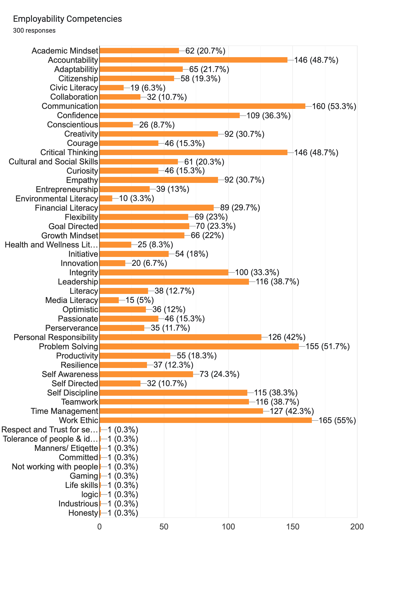
Needs Assessment Results
Notes:
There were over 300 replies. The object of the needs assessment was to narrow down 50 Employability Competencies to just 6.

Slide 6
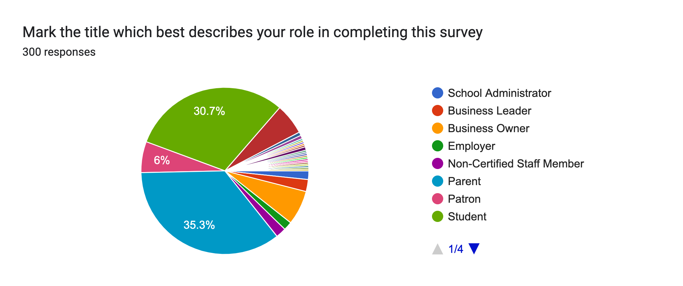
Needs Assessment Results
Notes:
There were over 300 replies. Most replies coming from parents and students.

Slide 7
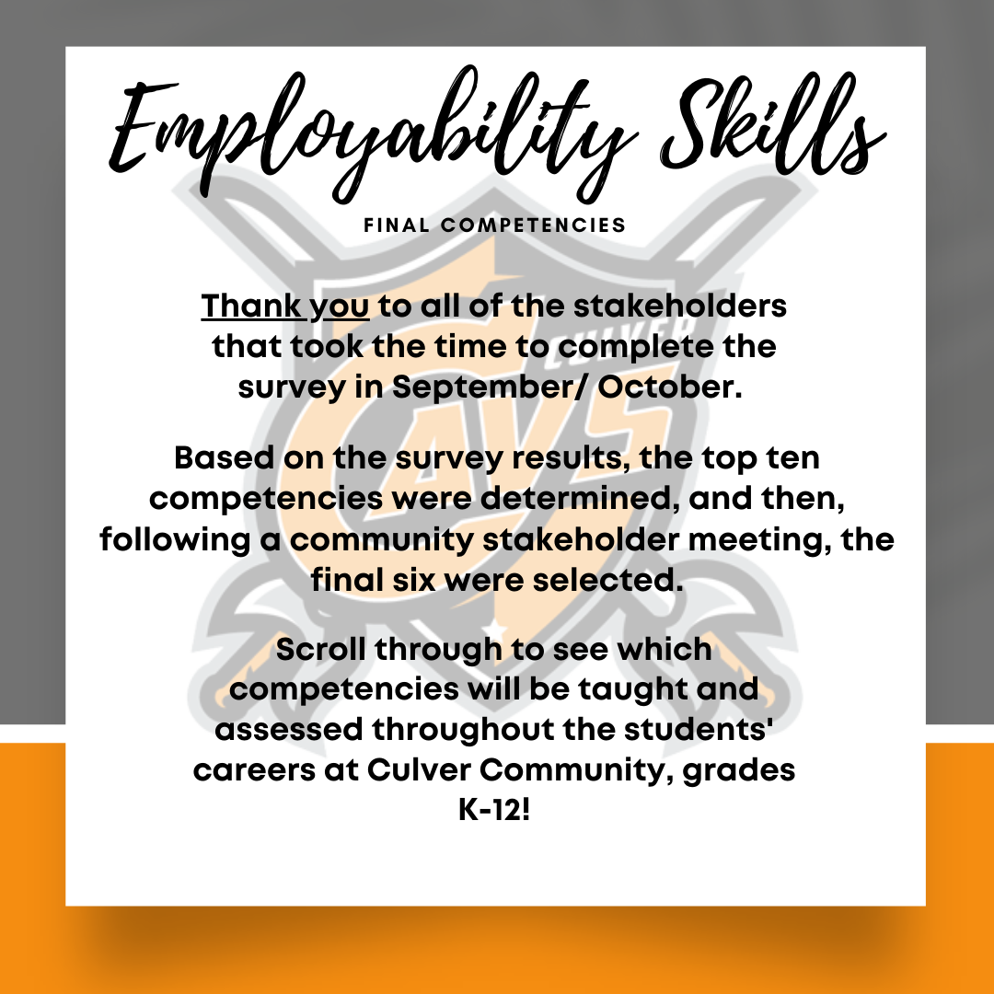
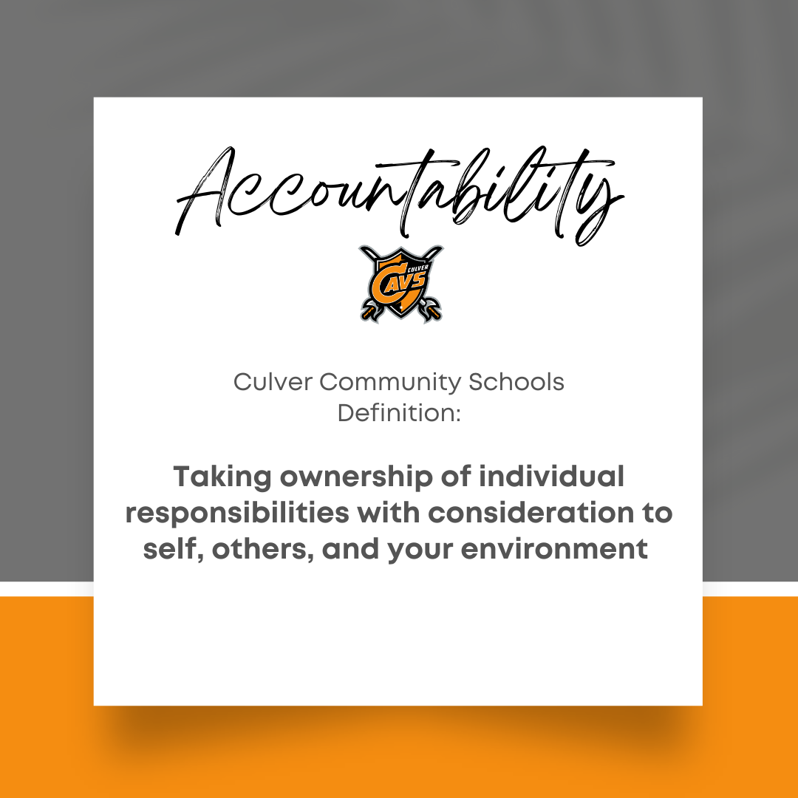
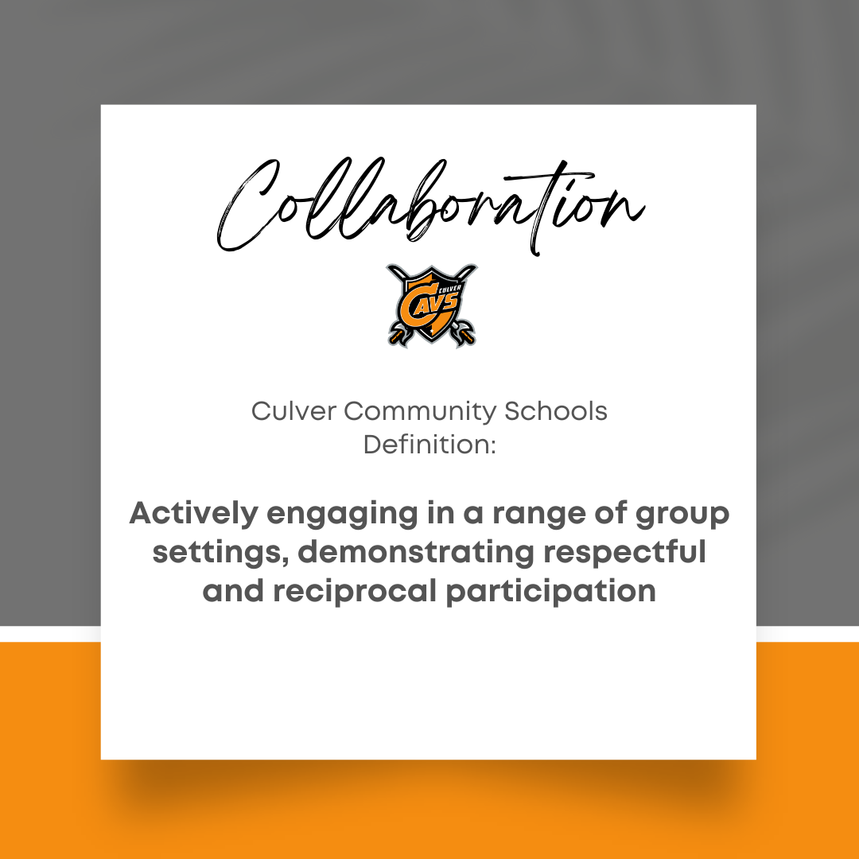
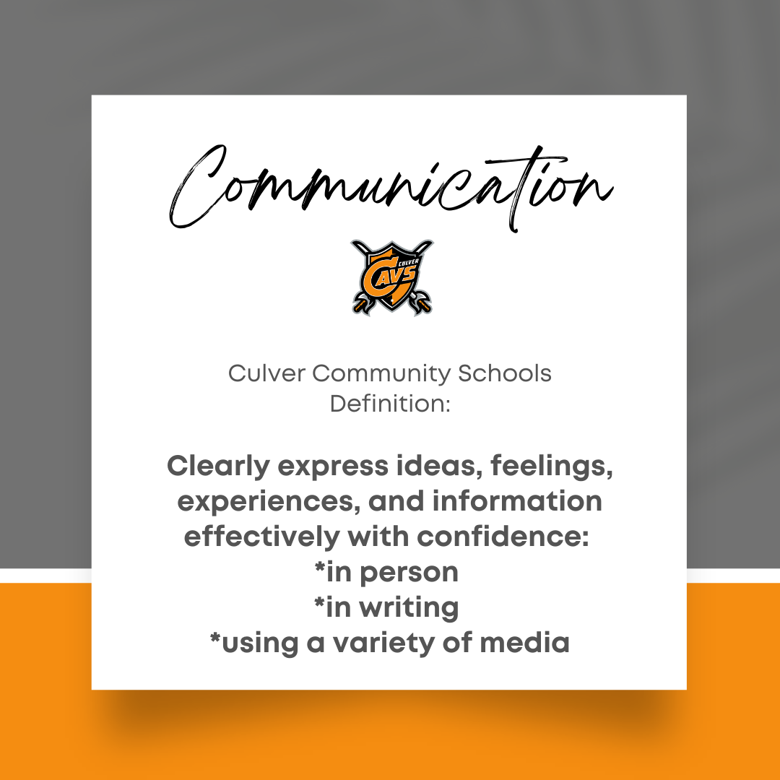
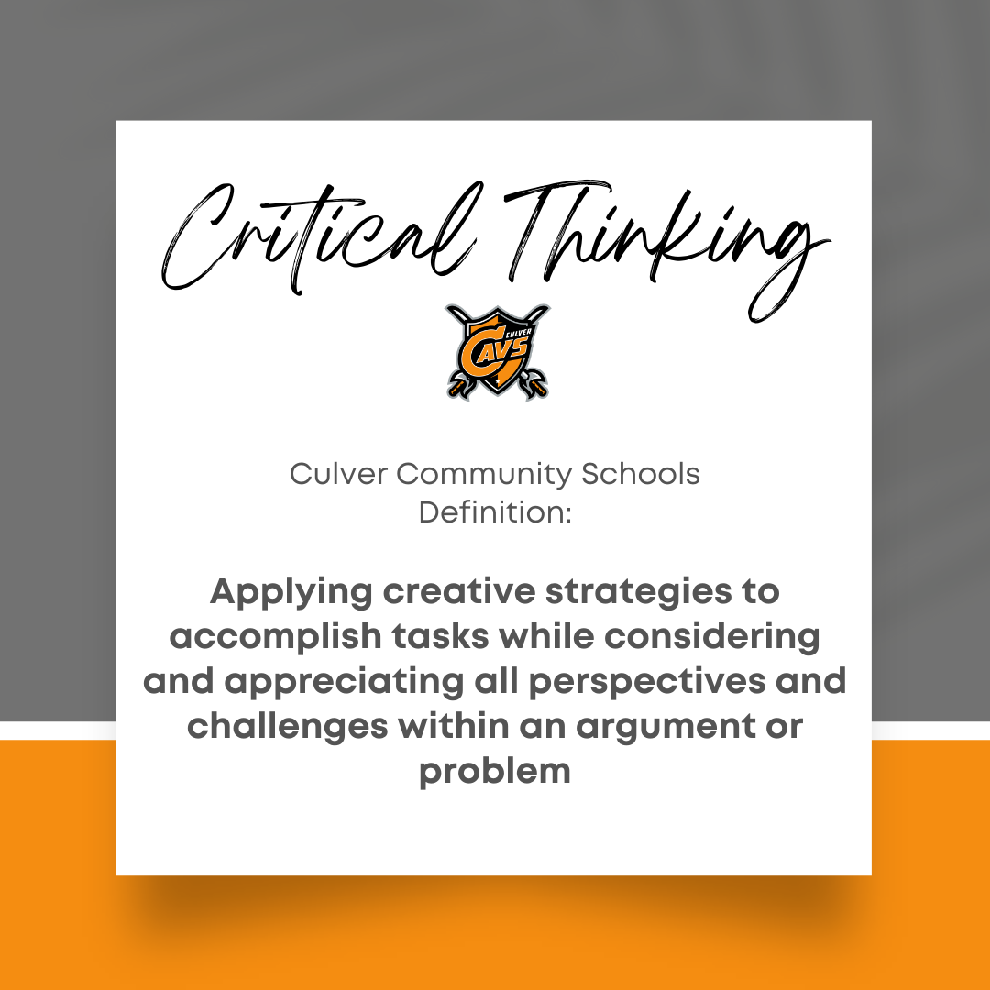
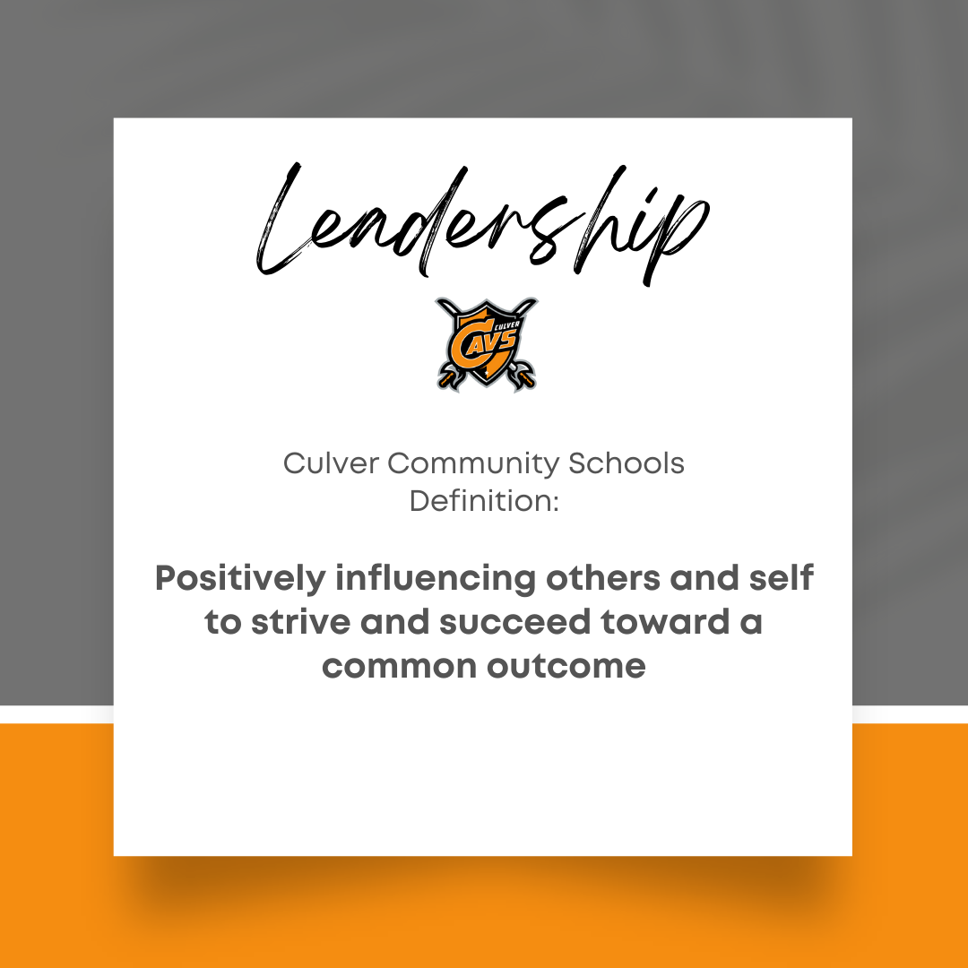
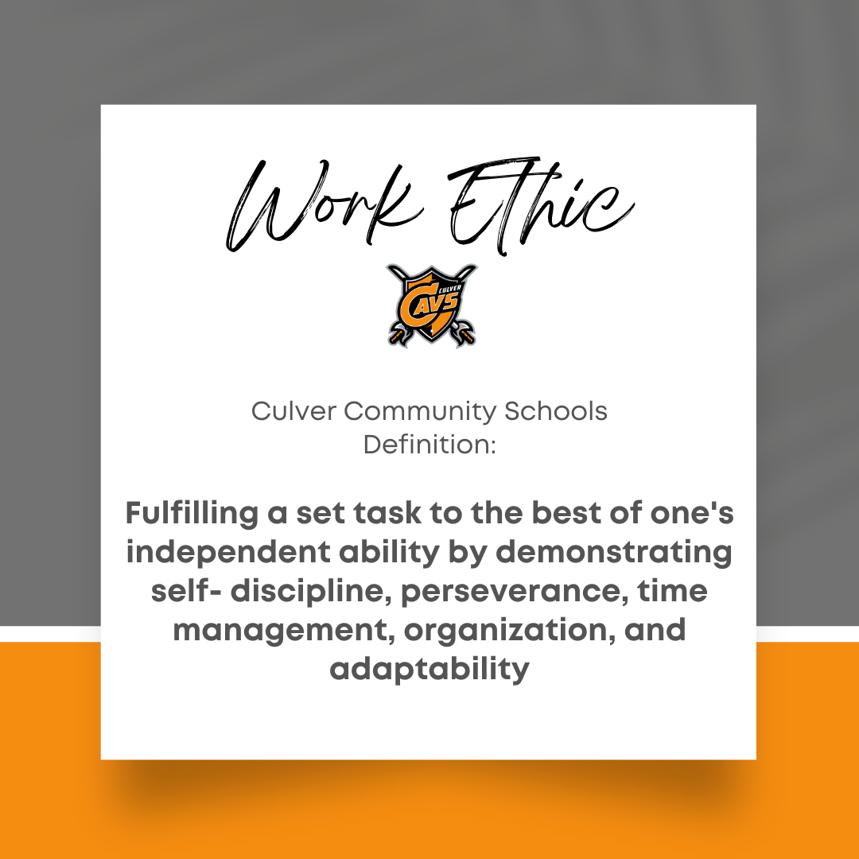
Process and Culmination
Notes:
The needs assessment data showed that these 6 employability skills were what stakeholders deemed most important for our students to learn in order to be successfully employed. Each skill is defined above by a group of stakeholders. They wanted the students to possess these skills before graduating. Capstone projects are to be completed in 5th grade, 8th grade, and 12th grade to show mastery. The project I have created and used 6 small group sessions to implement will be shown in the next few slides.

Slide 8
Lesson Outline
Session 1
Session 3
Session 5
Getting to know your team by using games to foster team building relationships
The importance of Gratitude
Project Proposals
Session 2
Session 4
Session 6
What is your leadership style and why it is important to know.
Game based learning for teamwork and leadership
Present Proposals to classmates and teachers
Notes:
Each session allowed time for activity and then group work on project proposals. During session 1, we used team building games to foster strong relationships among the leadership students. Session 1 also consisted of setting norms for our group. These norms were decided among the students. During session 2 we used the ”16 Personalities” Quiz for the students to take and then do a deep dive into what their own personality looks like when interwoven with leadership opportunities. They were then paired with a group peers that have different personalities. The students learned the strengths and weaknesses of their own personalities and that of their peers. They also understood the benefits of becoming aware of the different styles for themselves and their peers. Session 3 was spent learning and discussing the importance of Gratitude for mental health. Session 4 used “Game based” learning for teamwork and leadership. The students had fun and learned a lot about each other and overcoming adversity. Session 5 each group presented their project proposals to myself and some administrations and any teacher who had prep during that hour. Each group presented and at the end one project was chosen for the entire grade. That project was a “Touch a Truck” event. During session 6 the groups presents the project to their peers and teachers during SRT time.

Slide 9
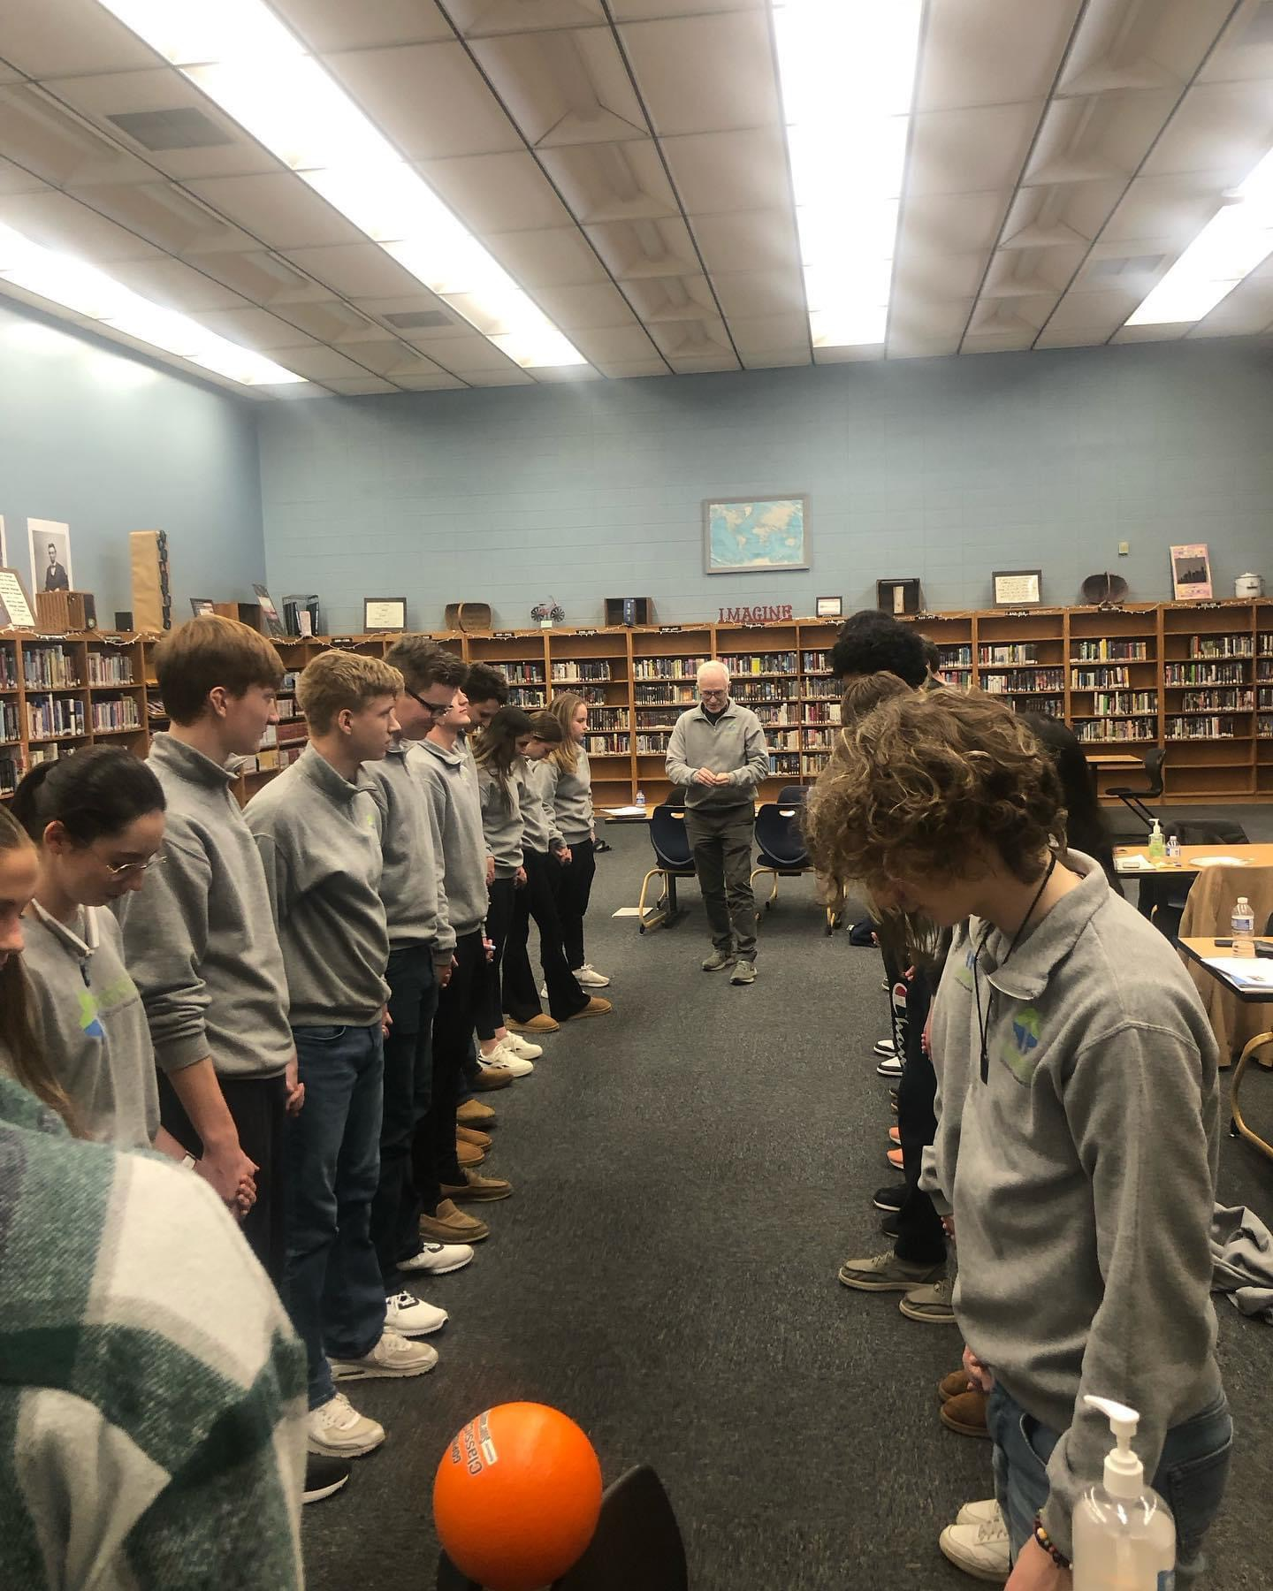
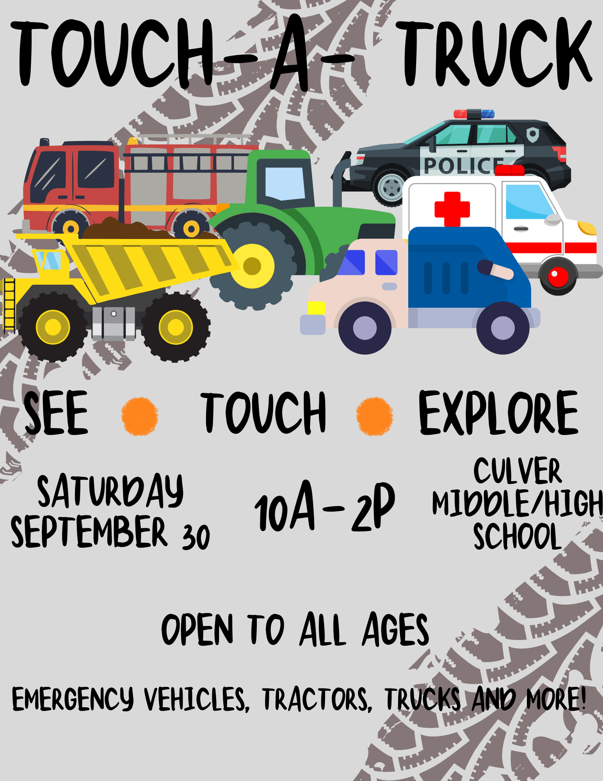
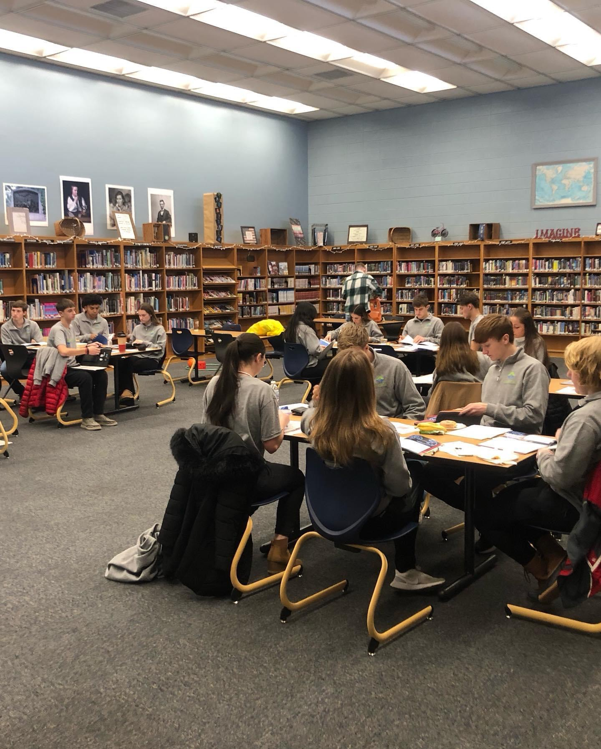
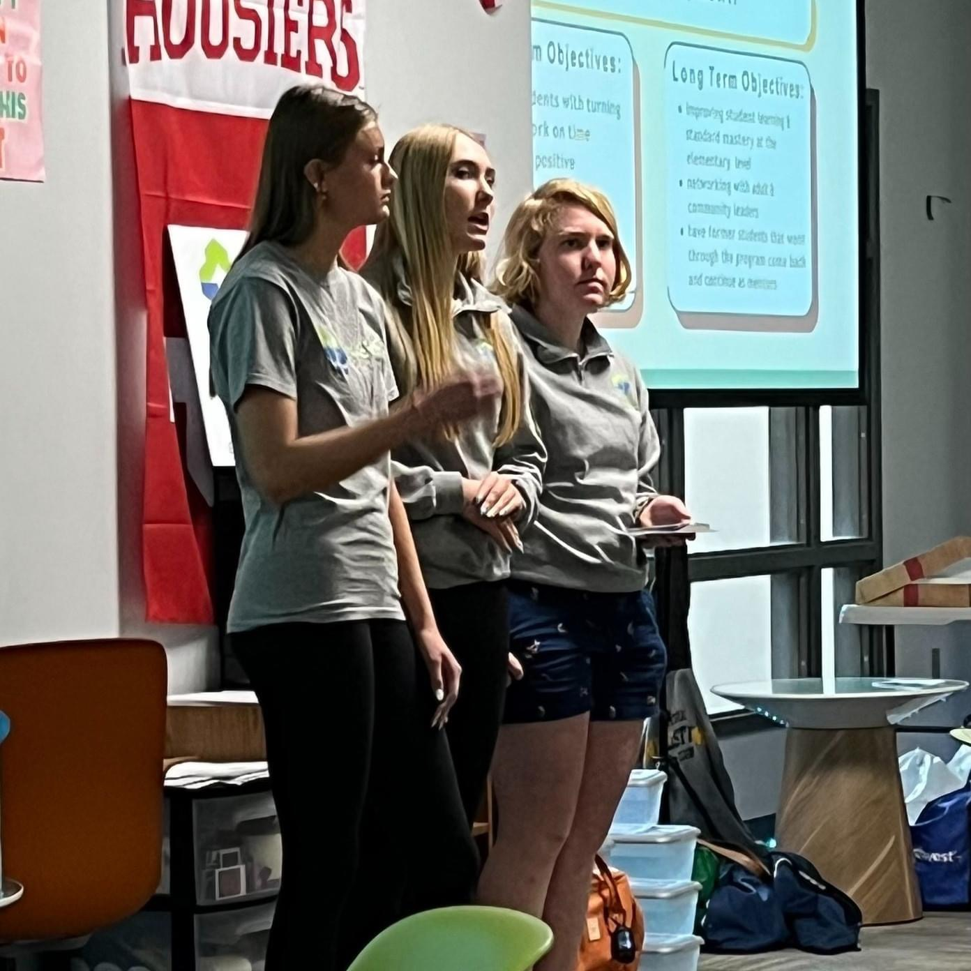
Process and Culmination
Notes:
The pictures above show groups working together within their grade level on the culminating project, game-based learning activity, and a presentation. You will also see a potential flyer that will be used to advertise the “Touch a Truck” event.

Slide 10
AIA Alignment/ASCA
  Counseling Prevention and Intervention
  Collaboration and Consultation
    B-LS 1. Critical thinking skills to make informed decisions
    B-LS 4. Self-motivation and self- direction for learning
    B-SS 1. Effective oral and written communication skills and listening skills
    B-SS 2. Positive, respectful and supportive relationships with students who are similar to and different from them
    B-SS 3. Positive relationships with adults to support success
    B-SS 6. Effective collaboration and cooperation skills
    B-SS 10. Cultural awareness, sensitivity and responsiveness
Notes:
Throughout their process the students in small group had to use critical thinking skills, have self-motivation and direction, effective communication skills with peers and adults, positive relationships with peers who are similar and different from them, positive relationships with adults, effective collaboration and cooperation skills, and cultural awareness, sensitivity, and responsiveness.

Slide 11


Cultural Sensitivity
At the start of the group, we will talk about group norms and write those group norms together, using student impute. As the counselor I will set up a safe space for collaboration and teamwork using the group norms, decided by the students, to create our Culturally Sensitive space. At the start of every group meeting, we will go over those norms and recognize the safe space.

Slide 12
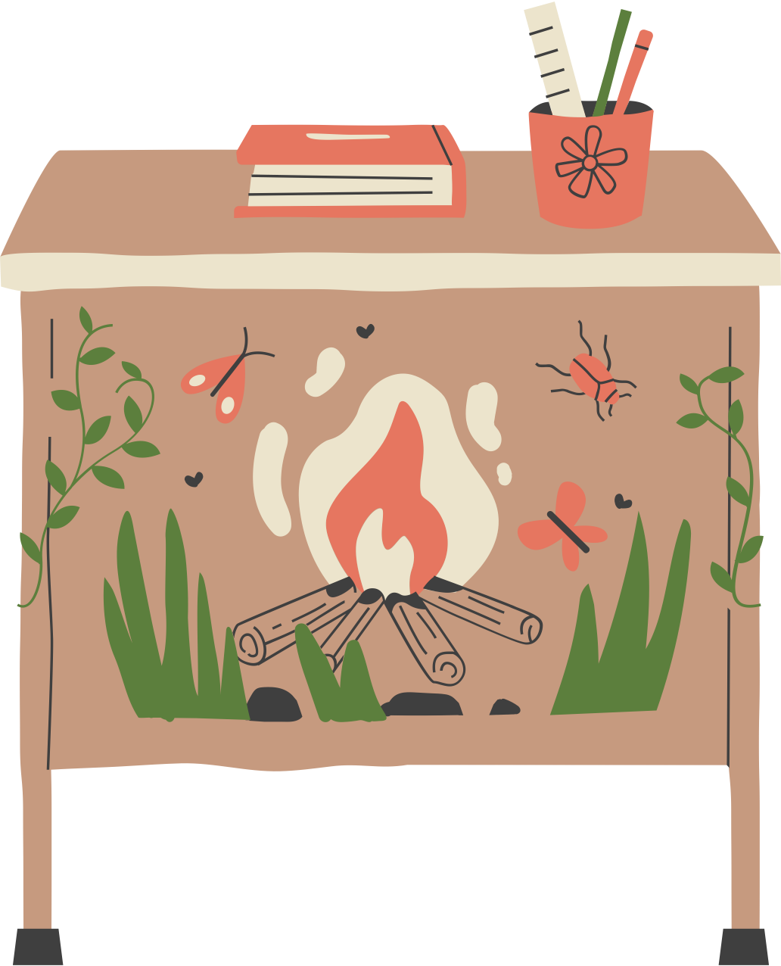
Evaluation
Strengths
Challenges
Reflections
Notes:
Strengths- The entire grade level is involved in the culminating project. The employability skills are taught to everyone within the project. The small group focuses on Leadership.
Challenges- This is a lot of extra work. After school hours requirements. Relies on other staff members to complete.
Reflections- I loved this project. I feel as though it was extremely beneficial to the students. The collaboration with classroom teachers was challenging, but overall, a very important step that paid off in the end.
The culminating project is a lot for one person to do and a project team of teachers to help facilitate the lessons would be instrumental in the application process.

