Slide 1
Internship Culminating Project
Brandy Zehner

Slide 2
Existing Data Sources
SEL Screener
Attendance- Harmony
Discipline- DOJO and Harmony

Slide 3

Needs Assessments

Slide 4
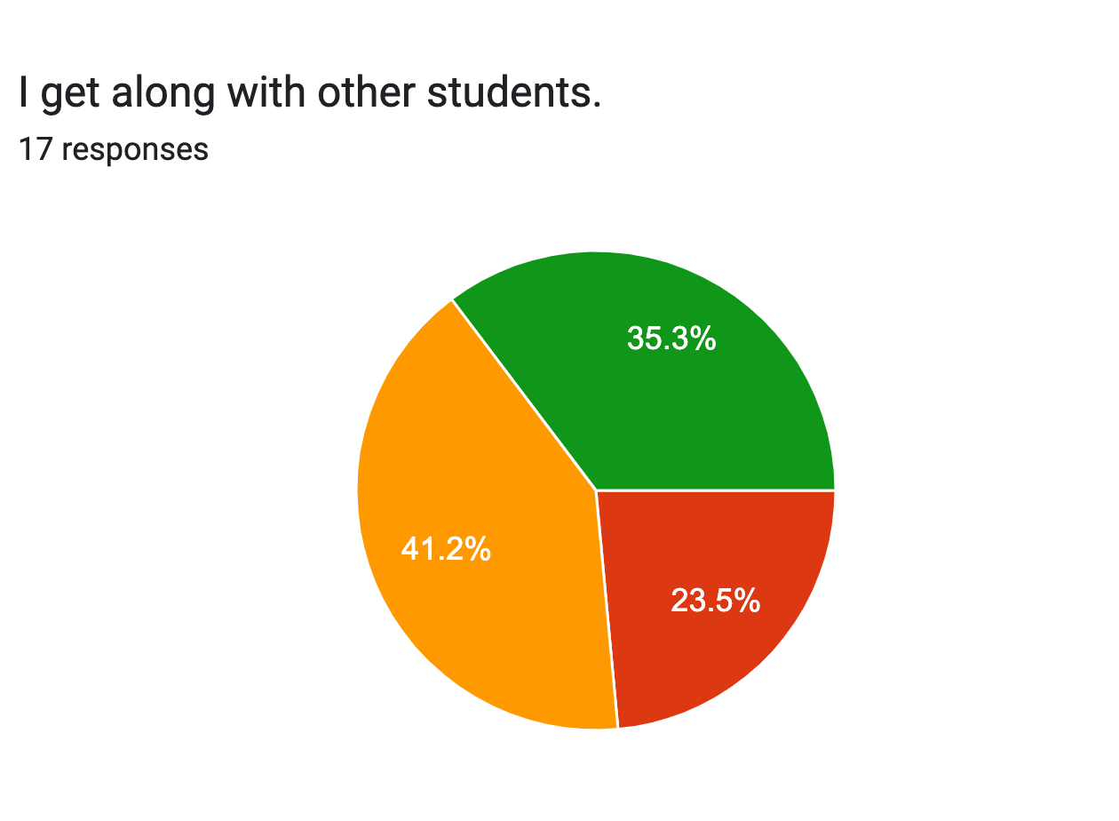
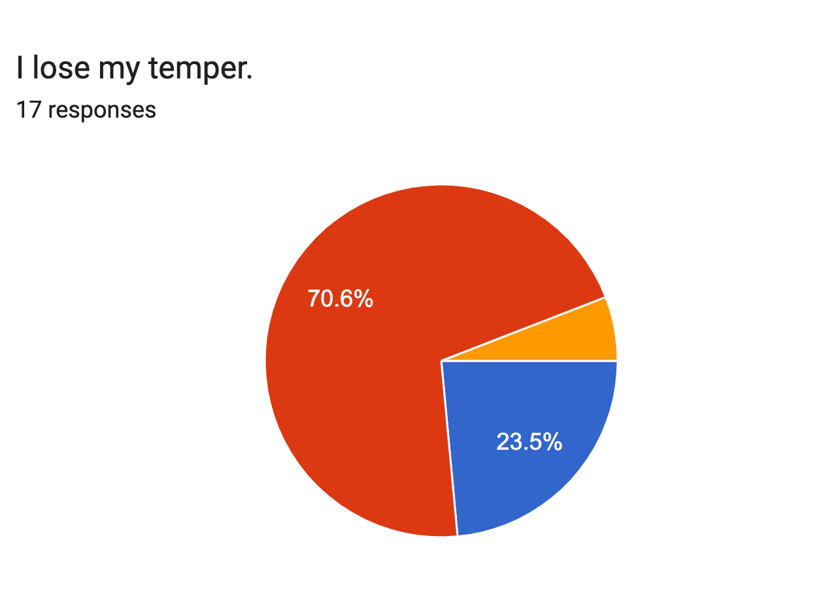
17 Students were surveyed using the needs assessment.

Slide 5
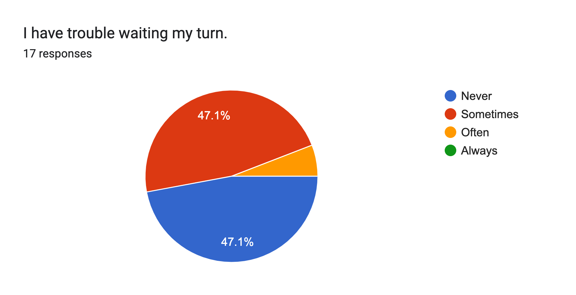
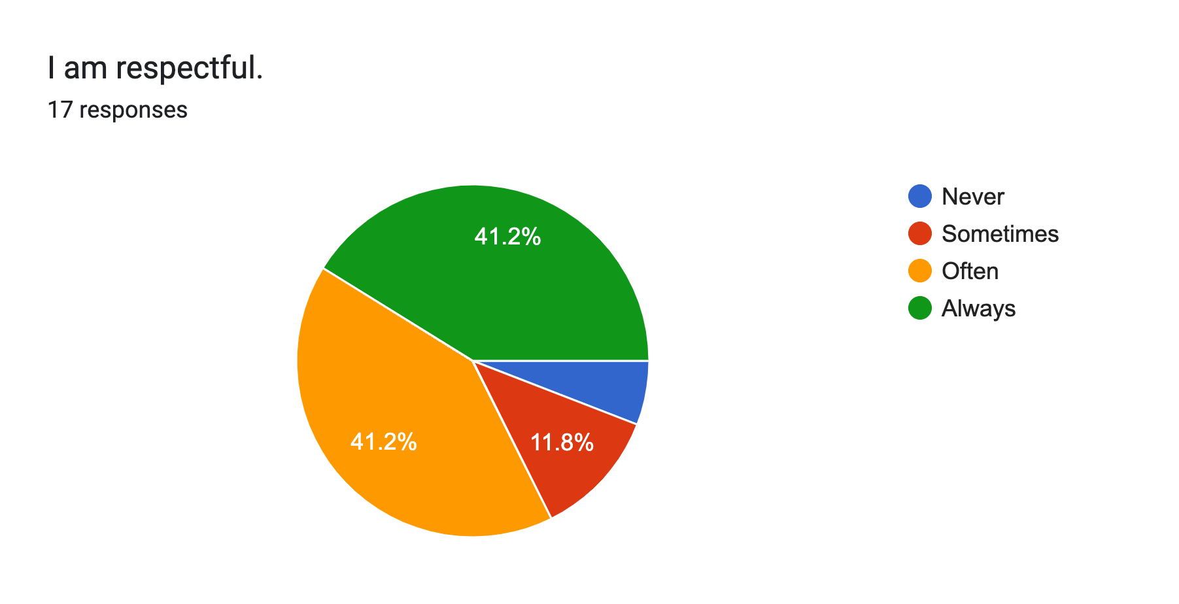
The assessment was administered by the classroom teacher using Google Forms.

Slide 6
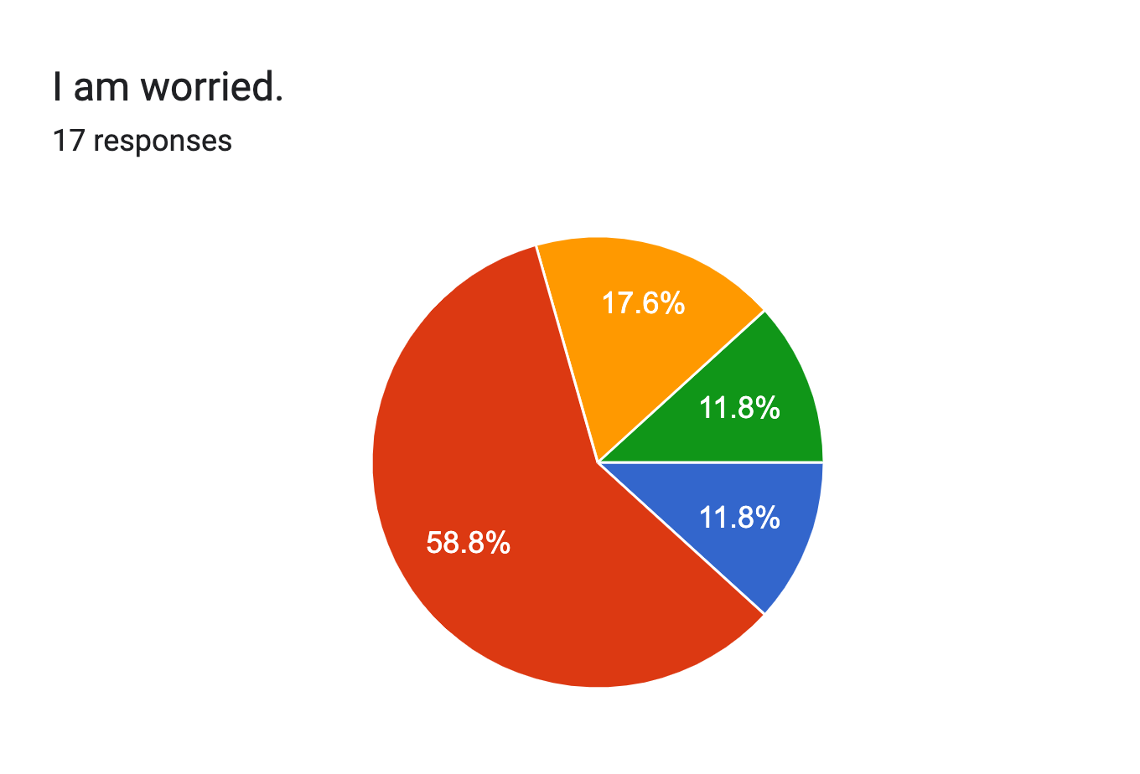
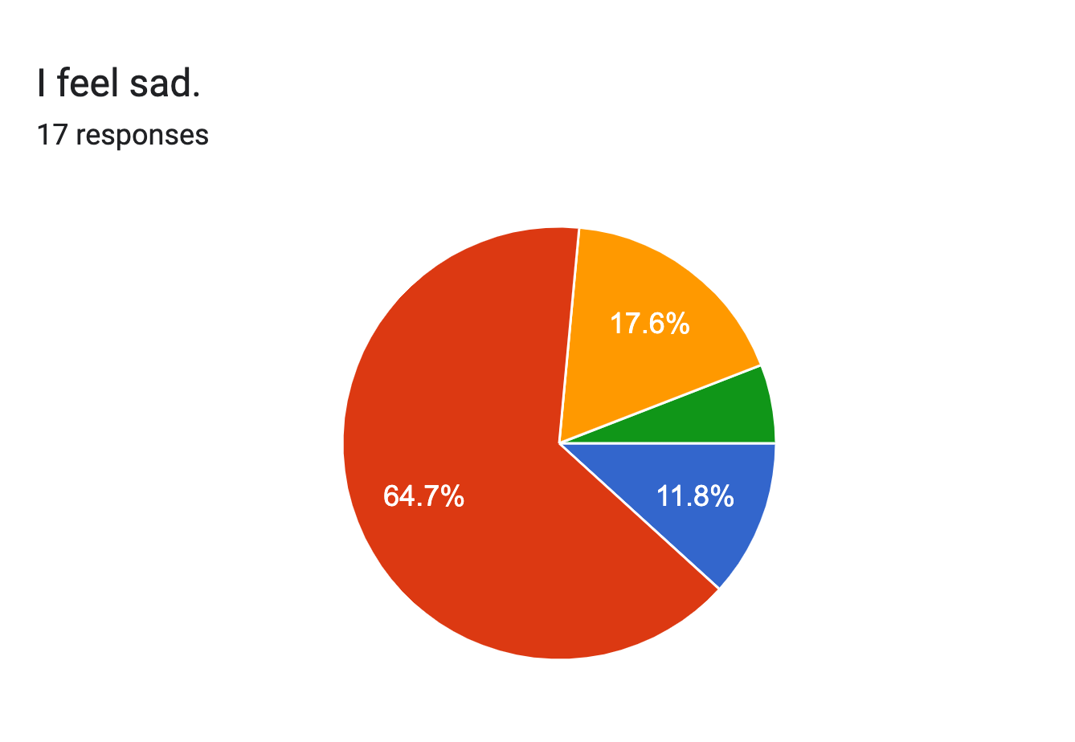
The students were asked a total of 14 questions for the needs assessment.

Slide 7
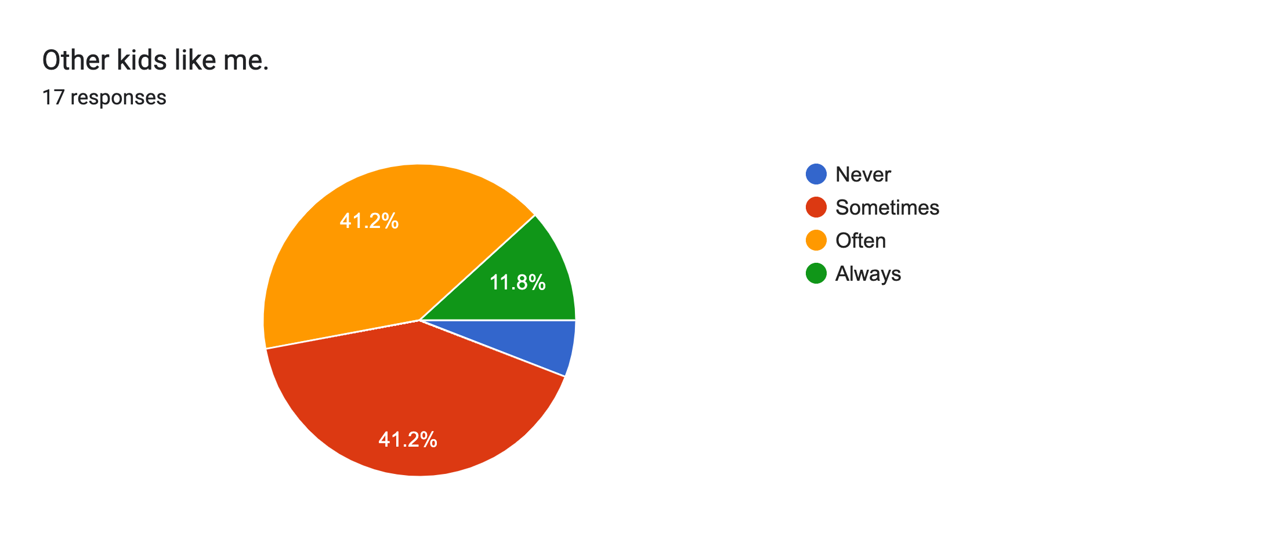
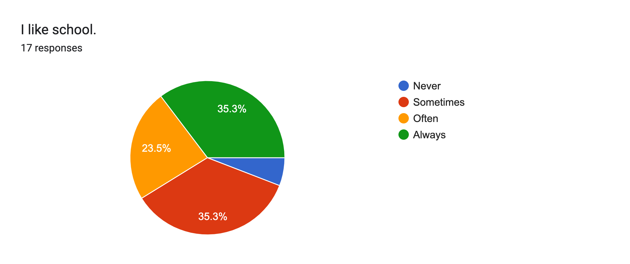
I scored each student’s assessment.

Slide 8
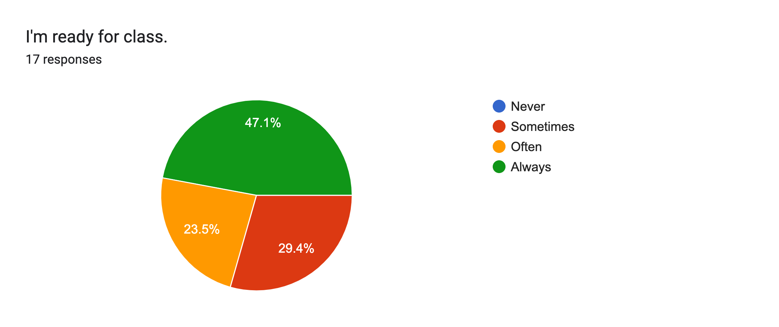
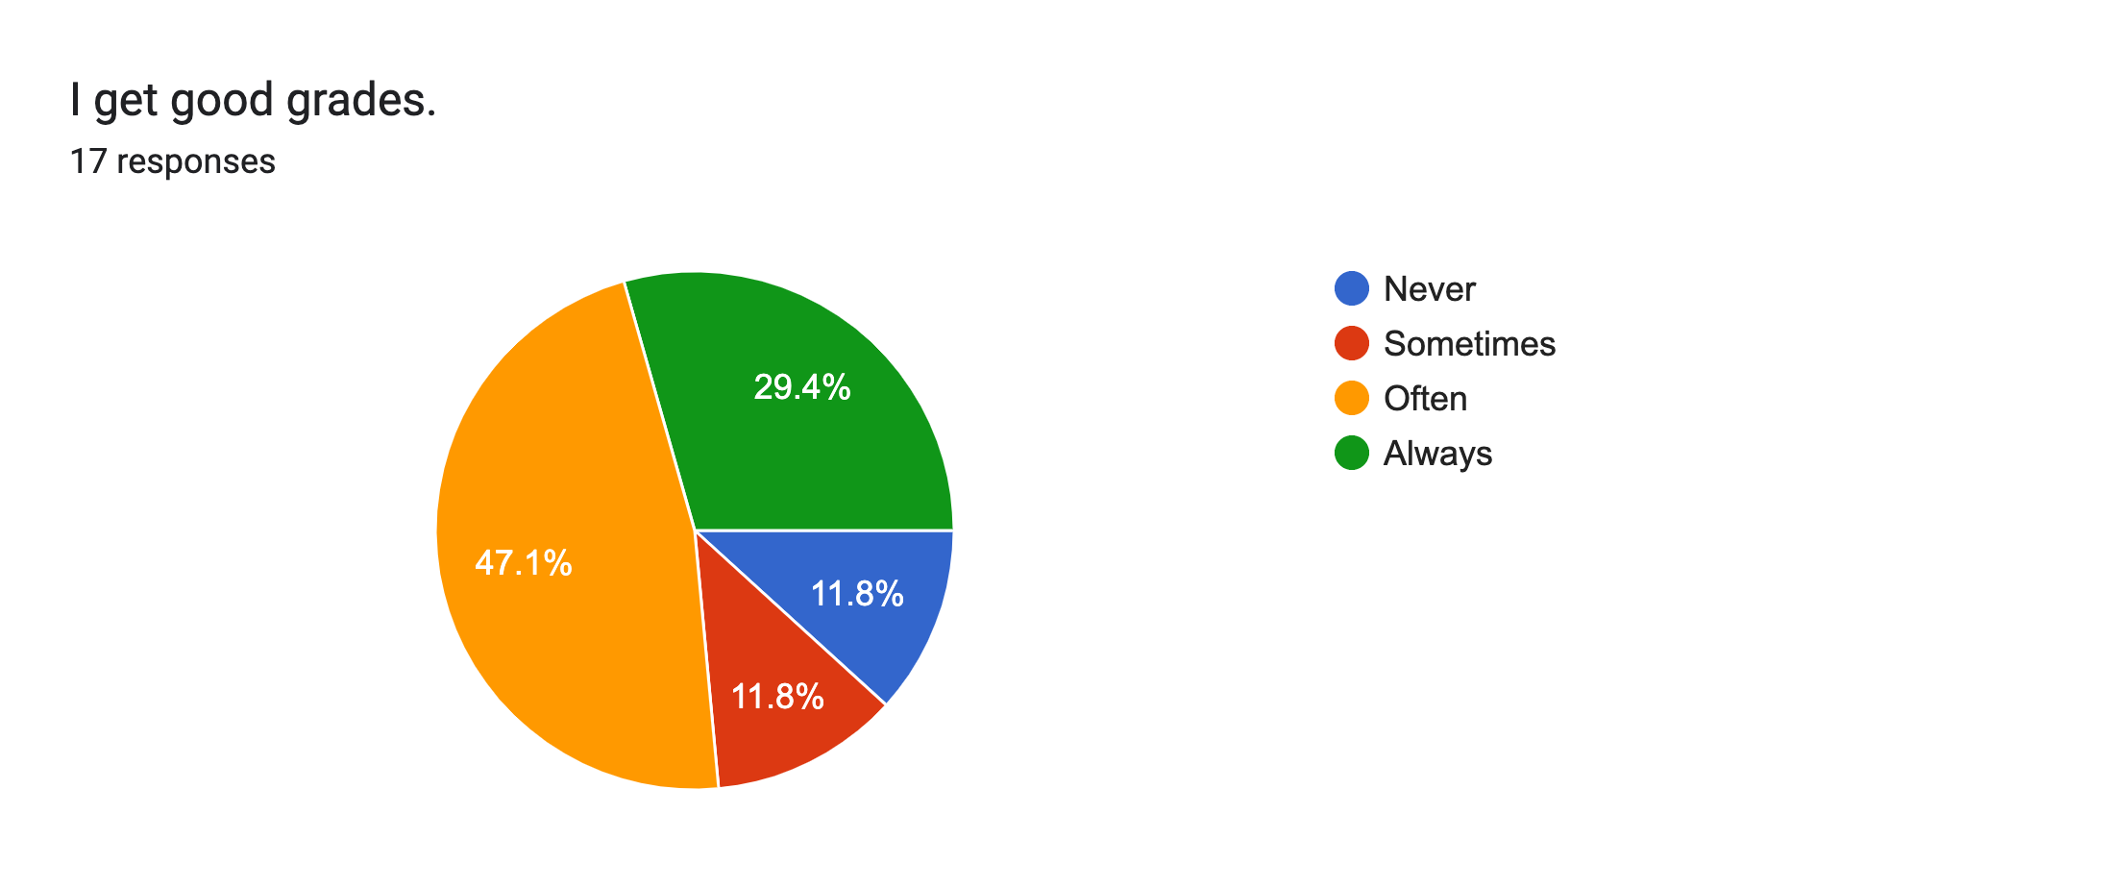
After looking at the scores of the class and based on where the needs were the greatest, I based by lessons on the skill of Growth Mindset.

Slide 9
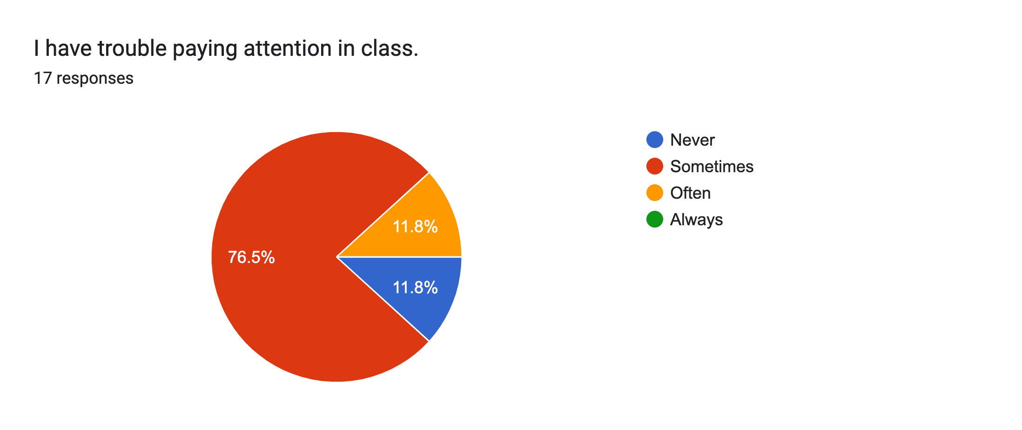
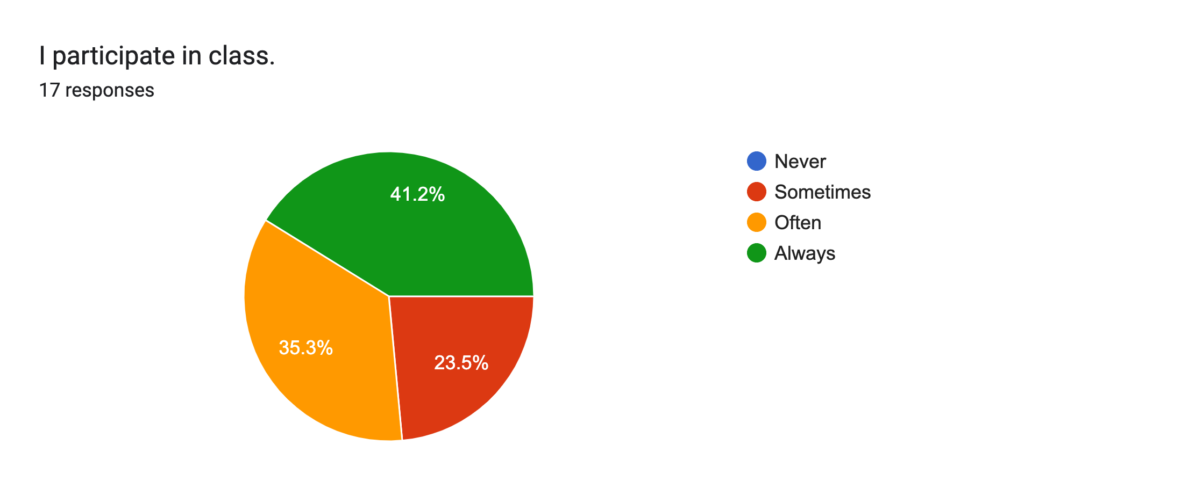
There were 4 classroom lessons taught.

Slide 10
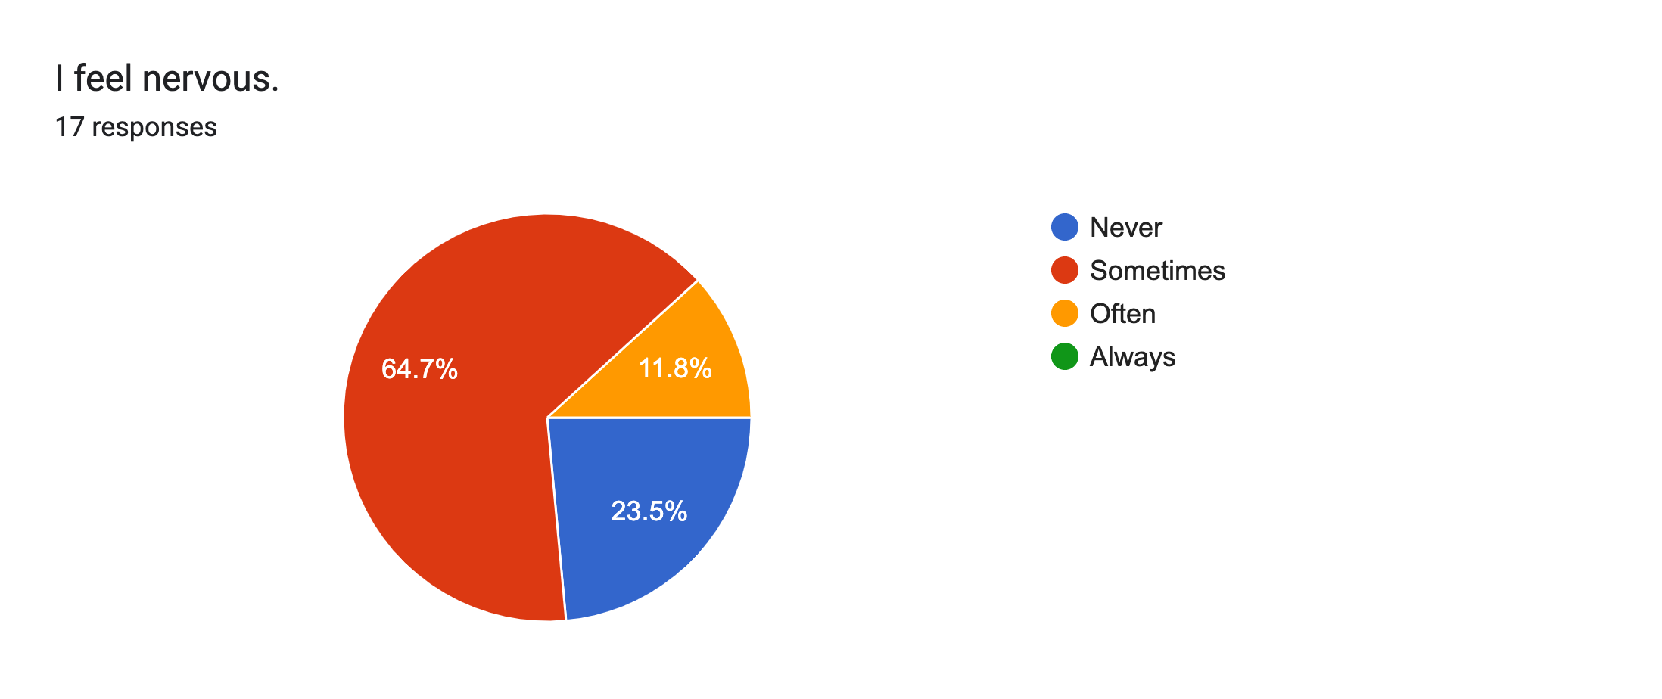
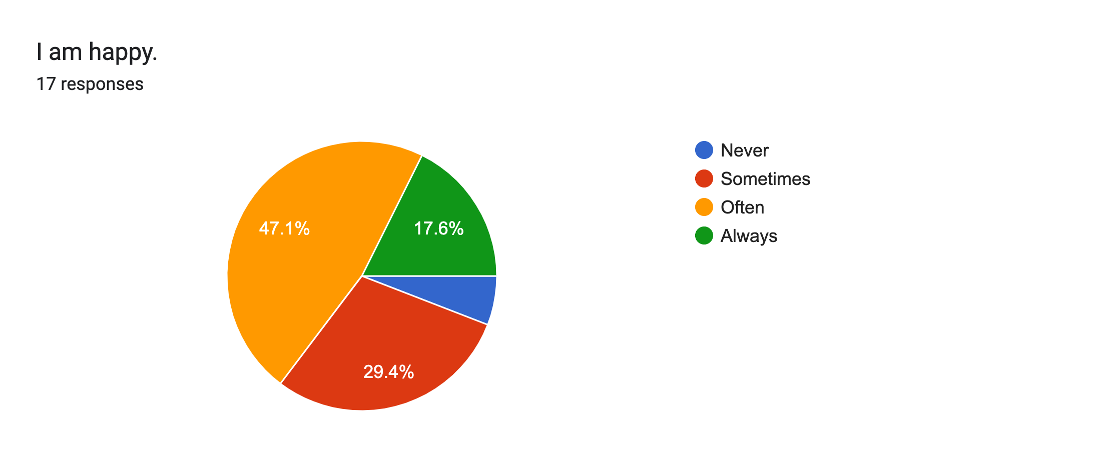
The students really enjoyed the lessons.

Slide 11

Project Description
The goal of this Classroom Guidance Unit is to teach the difference between fixed and growth mindsets, inspire confidence in students, and encourage students to embrace mistakes and learn from them.
Lesson #1- Fixed and Growth Mindset
Lesson #2- Change your Words Change your Mindset
Lesson #3- Discover Neuroplasticity
Lesson #4- The Power of Yet

Slide 12
AIA Specialty Standards and Rationale
Counseling Prevention and Intervention
These lessons provide classroom guidance to 4th grade students and promotes Social/Emotional development of students.
Diversity and Advocacy
By setting up group norms for a safe and collaborative environment for ALL students cultivates cultural sensitivity in others.

Slide 13
ASCA Mindsets and Behaviors and Rationale
M1
M3
M4
B-SMS 6
B-SMS 7
B-SMS 10
B-SS 2
B-SS 3

Slide 14
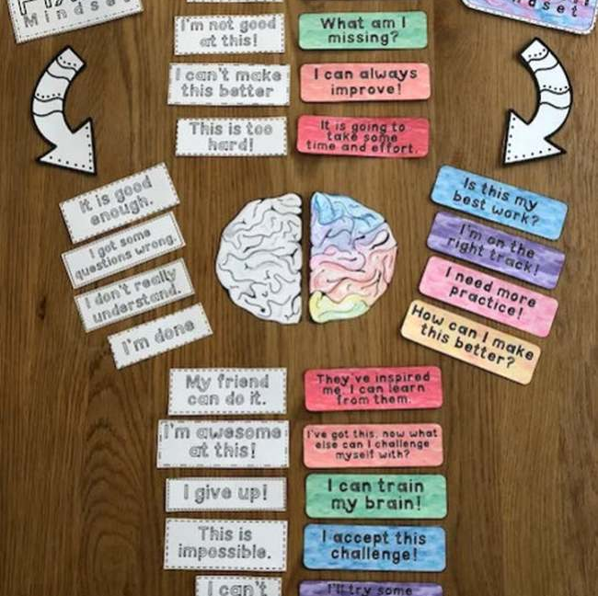
Artifacts and Examples
All activities were completed in small groups.

Slide 15
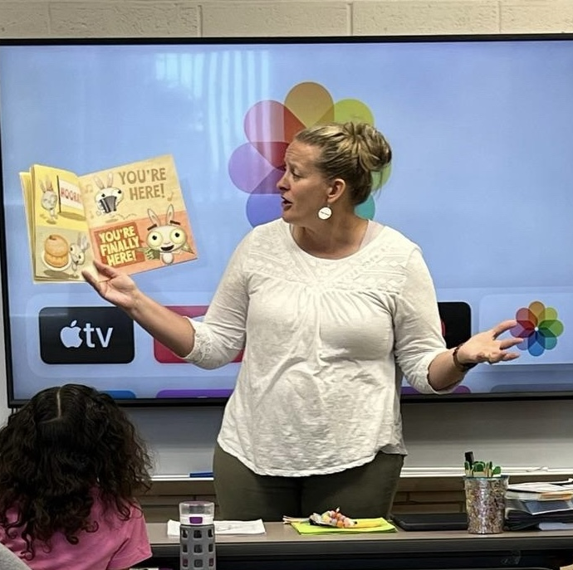
Artifacts and Examples
All activities were completed in small groups.

Slide 16
Cultural Sensitivity
The first lesson begins with developing norms for a safe and collaborative community.
Each lesson starts by going over the Norms decided at the start of our first lesson.
The importance of respecting each other’s values and beliefs, will be the most important.

Slide 17
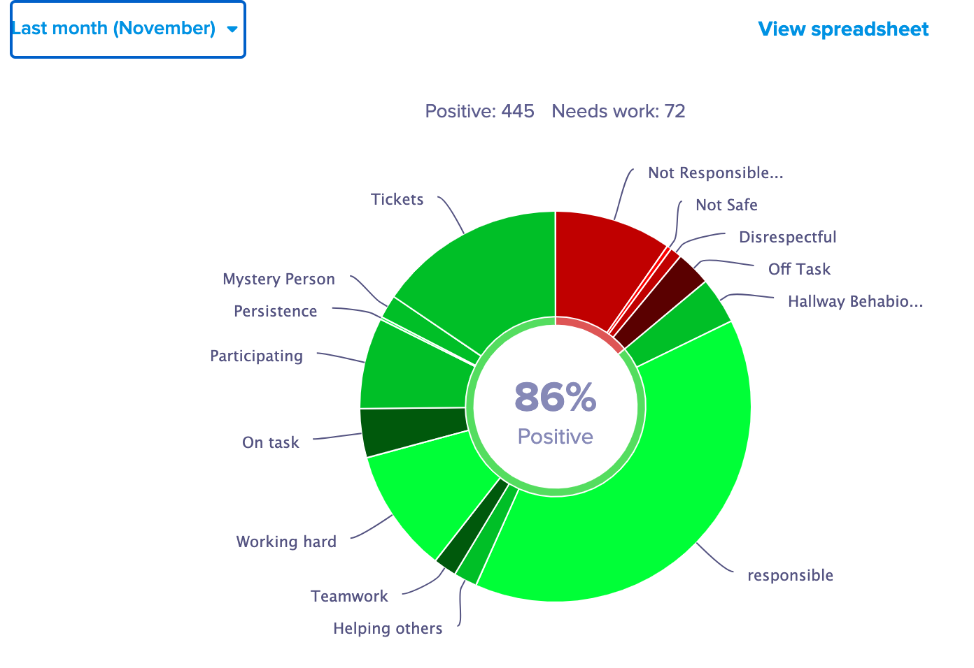
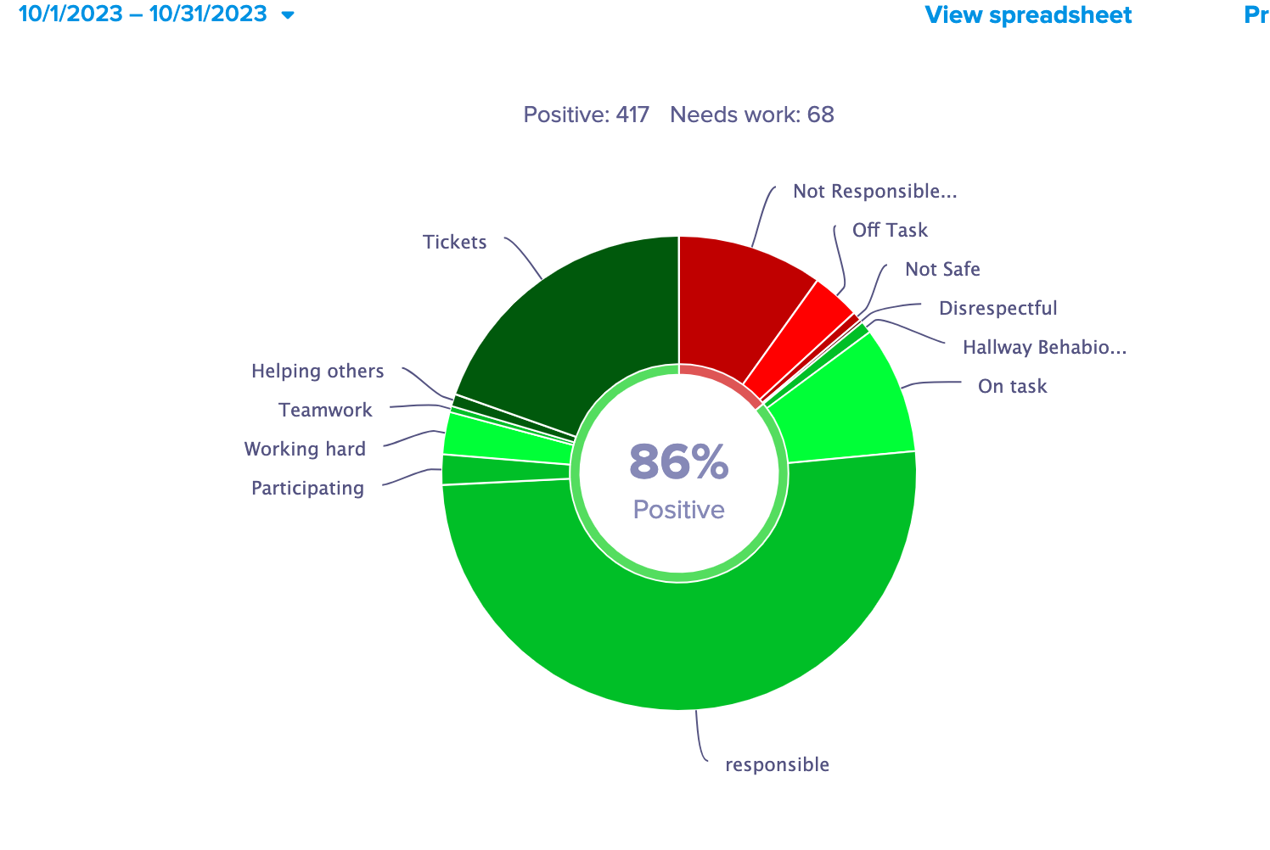
Evaluation of Project
The project has been evaluated using data gathered from:
  Pre/Post Survey
  Attendance
  Discipline Records
  Personal Reflection

