Slide 1
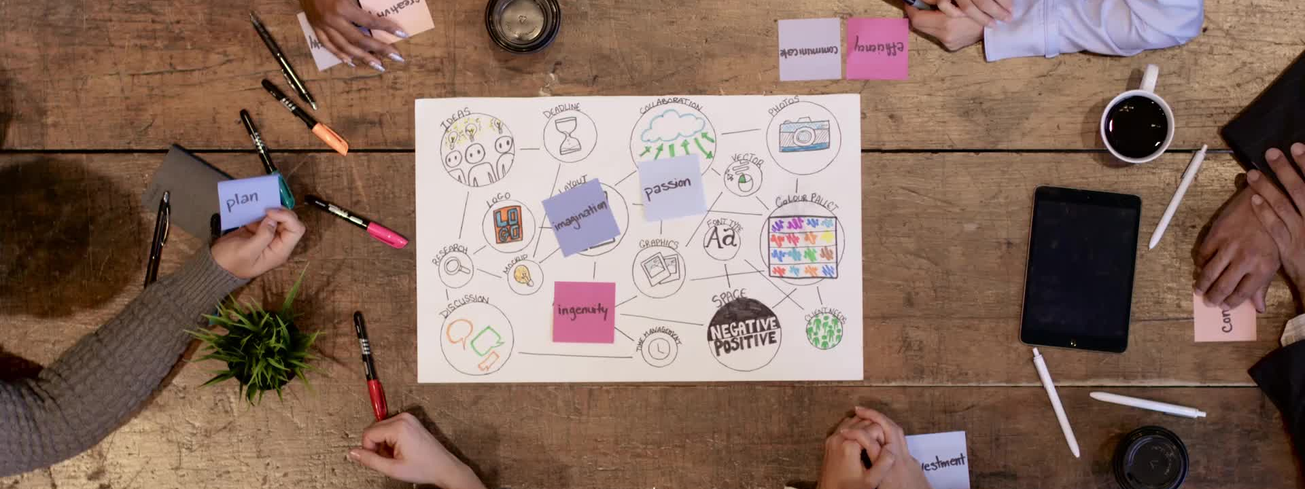
Psychoeducational small group project
Liberty University: : School of School Counseling
Brandy Zehner

Slide 2
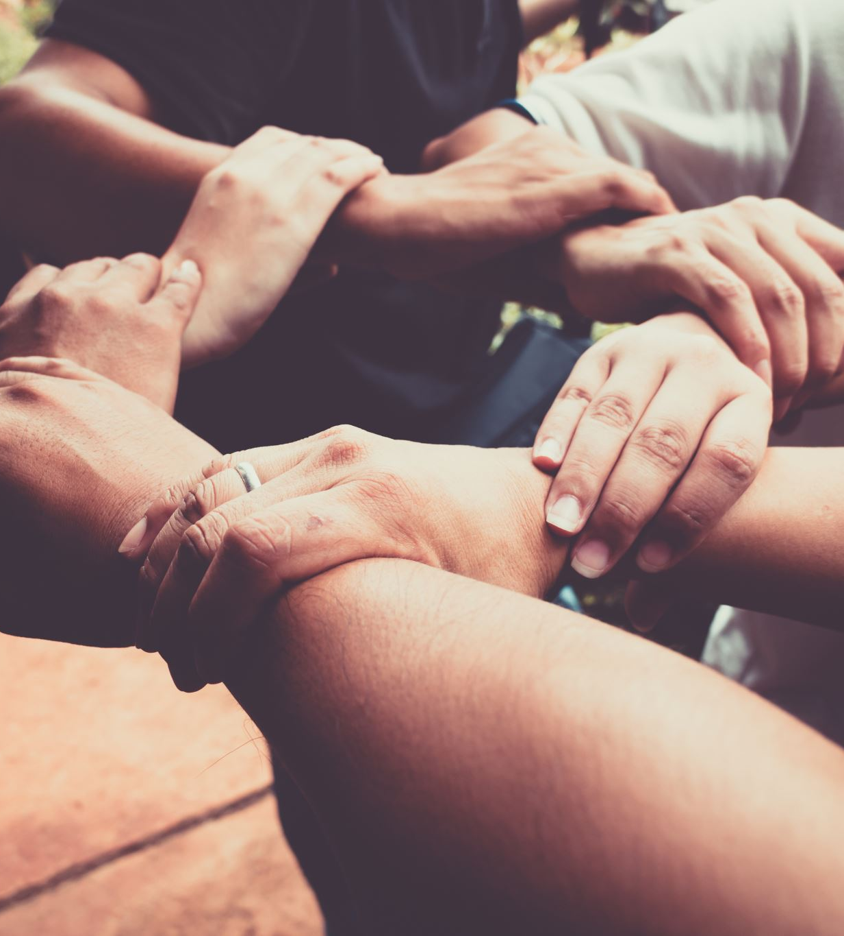
Friendship
5th Grade Girls
Making Friends
Keeping Friends
Being a good friend

Slide 3
Goals
To teach the students how to:
Make friends
Keep friends
Be a good friend
What a healthy relationship looks like
Reduce discipline
Raise attendance

Slide 4
DATa sources
Discipline referrals via Harmony
Teacher referrals via email or Google Doc
Student requests for a meeting with the counselor

Slide 5
Needs assessment
Teachers
Administrators
Students
Needs Assessment

Slide 6
Screening process
I used:
Data
Parent Consent
Common issues

Slide 7
Pre- Aia specialty standards
CACREP D.1, D.2 - I am self-aware and sensitive to others in the small group working on “Friendships”. This group is promoting social/emotional development of students by teaching the small group how to make and keep friends and what a healthy friendship looks like.
CACREP N.1, N.3 - With this small group, I will be working with students, teachers, and parents to promote social/emotional development by working on “Friendships”.

Slide 8
Culturally sensitive
Rules and Expectations
  Discussed and decided on as a group
Confidentiality Agreement
Students in the group are picked using DATA and a Screening Process
Issues will be addressed at the start- “Family dynamics and home situations are the biggest problem with this group of girls.”
Group is safe, caring, and sensitive to all.

Slide 9
Evaluation
Needs Assessment-
Students,
Teachers
Administrators
Parents
Harmony Discipline Referrals

Slide 10
References
Liberty University COSC 698 Master of Education in School Counseling (n.d.). Pre- Advanced Internship Assessment. Retrieved March 15, 2023.
Bryan, J., Steen, S., & Day-Vines, N.L. (n.d.). Psychoeducational. In Psychoeducational Groups in Schools.

