Slide 1
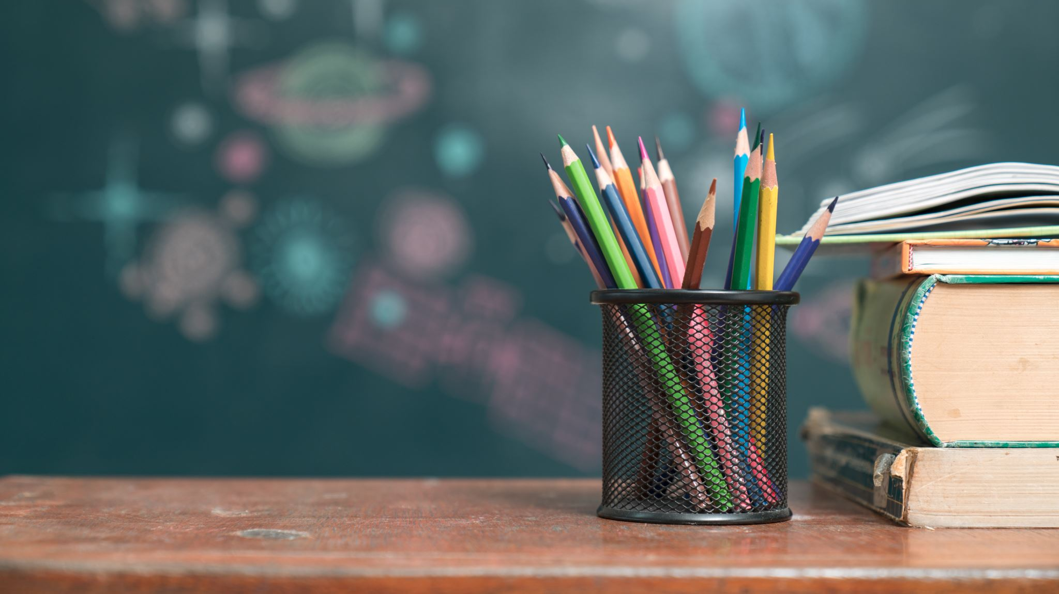
CULMINATING PROJECT
Marie Postiglione-Dupell

Slide 2
Classroom Guidance Lesson
CLASSROOM LESSON TOPIC:
Social Skills
GRADE LEVEL OF STUDENT PARTICIPANTS:
5th grade students
DESCRIPTION:
Social Skills Learning acceptable peer to peer interaction

Slide 3
DATA SOURCES
Oak Street School student counseling services data from:
Positive Behavioral Intervention (PBIS)
Student CDR & ORD

Slide 4
NEEDS ASSESSMENT(S)
Support the need for this classroom guidance lesson unit the following professionals were surveyed:
Oak Street School Counselor
Oak Street School Psychologist
Teaching Staff
Family Request

Slide 5
AIA STANDARDS
This Social skills learning lesson unit aligns with AIA Standards of counseling prevention and intervention. Furthermore, provides students with social skills to assist in navigating appropriate peer to peer social situations in the school environment.

Slide 6
CULTURAL SENSITIVITY
PROVIDE SAFE ENVIORMENT:
Establishing a safe environment by setting expectations and boundaries in learning space.
PROVIDE DIVERSE GROUP OF STUDENTS:
All students will have the right to confidentiality and respectful discussion of other worldviews.

Slide 7
EVALUATION
The students were evaluated with four different “smiley faces” scale representing this how I am doing before group Pre survey, and this is how I am doing after group(post survey).

Slide 8
PRE & POST SURVEY SCALE
Both Survey scales included 7 statement sentences:
I know ways to make friends.
I think about what others might feel about something I say or do.
I can identify words and actions that would HELP my friendships.
I know how to use “I messages”.
I can polity resolve an issue with another student.
I know what good manners are and use them when I speak and act.
I can identify words and actions that would HARM my friendship

Slide 9
PRE & POST SERVEY SCALE
The “Slimily Face” answer scale is represented highest to lowest rank as such:
Always
Sometimes
Hardly
Never

Slide 10
Resources
American School Counseling Association (2019)
Counselor Professional Standards & Competencies. Alexandria, VA; Author.

