Slide 1

PSYCHO-EDUCATIONAL SMALL GROUP
Marie Postiglione-Dupell

Slide 2
Psycho-Educational Small Group
GROUP:
Small Group Topic: Grief and Loss
CLINICAL MENTAL HEALTH ADULT SUPPORT GROUP:
Participants: Adult Mental Health and Substance Abuse Clients
GOAL Of Small Group:
Increased Understanding Grief
Acceptance
Manage Maladaptive Thoughts Regarding Grief
Develop Coping Skills Relating to Grief
Decrease Grief

Slide 3
Data/Needs Assessments
DATA: Two existing data sources to identify and support the need for this group at Behavioral Health Services North (BHSN) Clinical practicum site.
BHSN Mental Health Counseling professional referral and / or Family/Client request.
BHSN Therapist Referral: 60%
Family Referral: 10%
Client Referral request: 30%
NEEDS ASSESSMENT:
BHSN Mental Health Counselors

Slide 4
SCREENING PROCESS
BHSN Mental Health Adult Therapist were asked to provide adult clients names that would benefit from mental health counseling support group and have a diagnosis of a mental health illness and/or substance abuse issues in addition to unresolved grief.

Slide 5
Pre-AI Specialty Standard(s)
This small psycho-educational grief group aligns with the Pre-AIA Standards of counseling Prevention & Intervention: Group counseling approaches provide techniques in prevention and intervention in grief therapy include:
Encourage & Support client navigation through the grieving process towards mental health and wellness.

Slide 6
CULTURALLY SENSITIVE
Diverse Group Of Client Participants
both adult female & male genders
Confidentiality
Establish safe environment by setting group expectations and boundaries regarding each group participant has the right to confidentiality and respectful discussion of other worldviews.
Counseling Space Environment
Promote welcoming milieu to all participants in group regarding their worldview
Sensitivity to all group participants
Model empathy and respect to all participants

Slide 7
GROUP EVALUATION & OUTCOME
This Grief & Loss group was evaluated by” Inventory of Complicated Grief” scale to show data
how clients feel before and after participating in Psychoeducational Grief & Loss group
5-point scale
Never
Rarely
Sometimes
Often
Always
Outcome: Total of 4 client participants completed 6-week 1-hour per week psychoeducational Grief & Loss group sessions.
70% of client participants surveyed learned:
Importance of identifying their grief
Importance of addressing their grief
How grief has impacted their life regarding daily living.

Slide 8
Pre and Post Survey
Inventory of Complicated Grief (ICG)
H.G. Prigerson et al./Psychiatry Research 59 (1995) 65-79
Pre and Post Grief & Loss
Please circle the answer which best describes how you feel right now:
I think about this person so much that it’s hard for me to do the things I normally do…
Never rarely sometimes often always
Memories of the persons who died upset me….
Never rarely sometimes often always
I feel myself longing for the person who died…
Never rarely sometimes often always
I feel drawn to places and things associated with the person who died…
Never rarely sometimes often always
I feel I cannot accept the death of the person who died…
Never rarely sometimes often always
I can’t help feeling angry about his/her death…
Never rarely sometimes often always
I feel disbelief over what happened…
Never rarely sometimes often always
I feel stunned or dazed over what happened…
Never rarely sometimes often
Ever since she/he died it is hard for me to trust people…
Never rarely sometimes often always
Ever since she/he died I feel like I have lost the ability to care about other people or
Never rarely sometimes often always
I feel distant from people I care about…
Never rarely sometimes often always
I have pain in the same area of my body or have some of the same symptoms as the
Person who died…
Never rarely sometimes often always
I go out of my way to avoid reminders of the person who died…
Never rarely sometimes often always
I feel life is empty without the person who died…
Never rarely sometimes often always
I hear the voice of the person who dies speak to me…
Never rarely sometimes often always
I see the person who died stand before me…
Never rarely sometimes often always
I feel it is unfair that I should live when this person died…
Never rarely sometimes often always
I feel bitter over this person’s death…
Never rarely sometimes often always
I feel envious of others who have not lost someone close…
Never rarely sometimes often always
I feel lonely a great deal of the time ever since she/he died…
Never rarely sometimes often

Slide 9
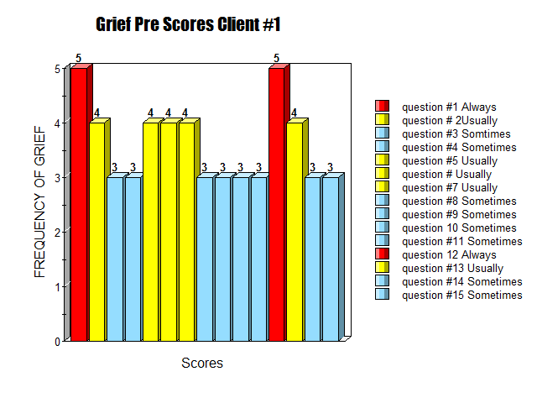
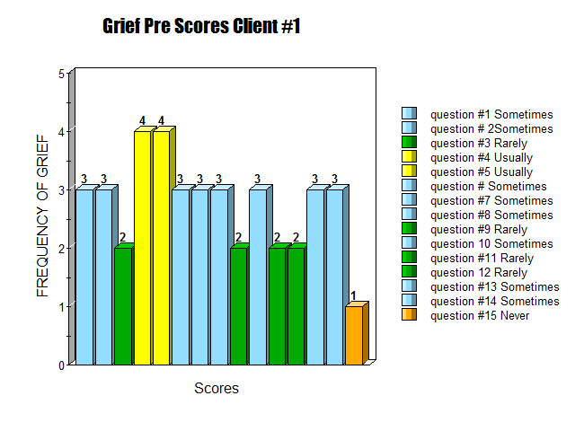
CLIENT #1 PRE & POST ICG SCORES
PRE-SCORE TOTALS = 54
POST-SCORE TOTALS= 47

Slide 10
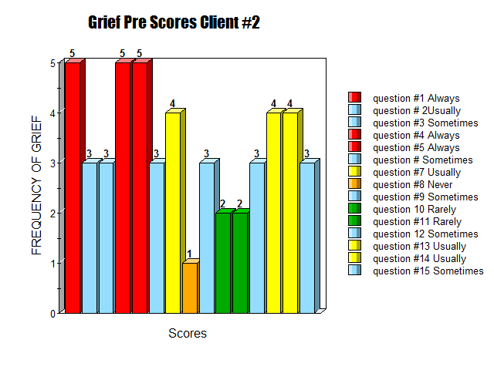
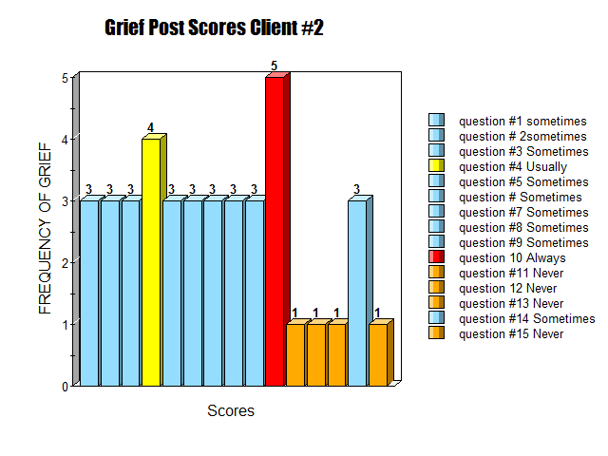
Client #2 PRE & POST ICG SCORES
Client Pre Score Totals= 50
Client Post Score Totals= 40

Slide 11
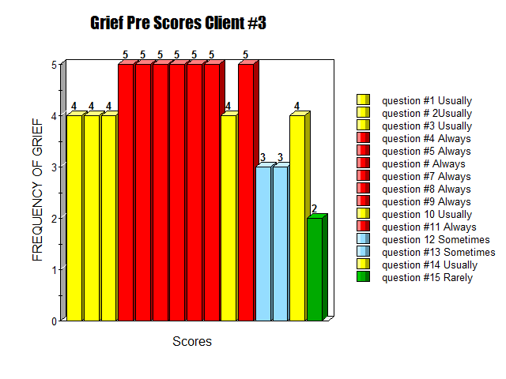
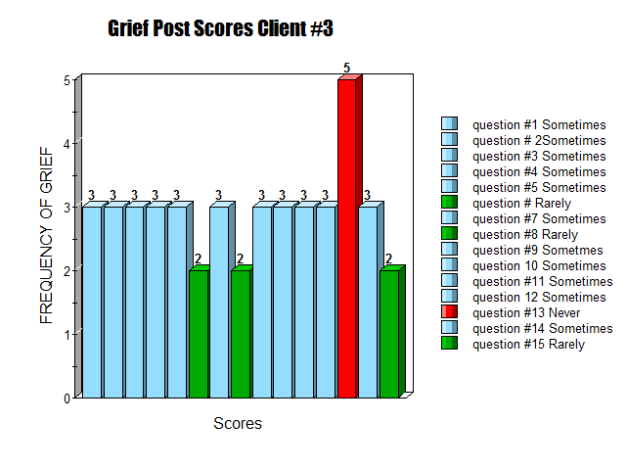
CLIENT#3 PRE & POST ICG SCORES
Pre ICG-Total Score=63
Post ICG Total Score= 45

Slide 12
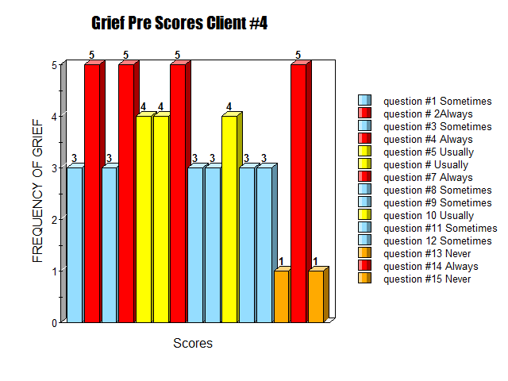
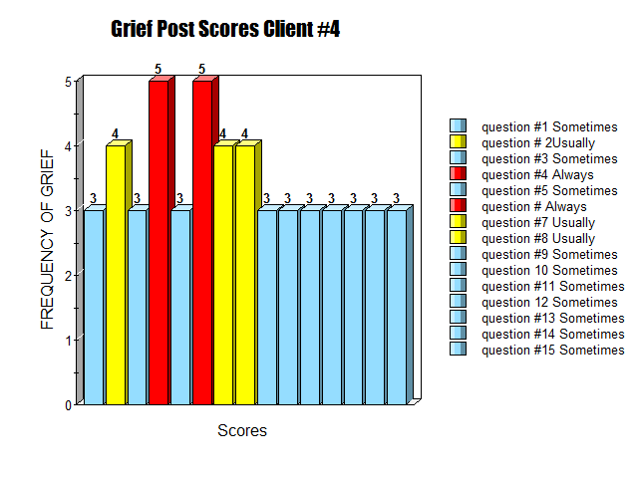
CLIENT PRE & POST ICG SCORES
Pre ICG Client-Total Score=52
Post ICG Client Total Score=52

Slide 13
RESOURCES
American School Counseling Association (2019). ASCA School
Counselor Professional Standards & Competencies. Alexandria, VA;
Neimeyer, R.A. (2000). Searching for the meaning of meaning: Grief therapy and the process of
reconstruction. Death Studies, 24, 541-558

