Slide 1



Self-Awareness
A Classroom Guidance Unit
Davina Schoulten
COSC 694: Internship II
Notes:
My name is Davina Schoulten, and this is my Internship II Culminating Project PowerPoint. I chose to do a classroom guidance unit on self-awareness for elementary students, specifically tailored to fourth graders.

Slide 2




Contents
Data Sources.........................................................3-7
Needs Assessment.............................................8-9
Project Description............................................10-14
AIA/ASCA/Utah Standards........................15-22
Cultural Sensitivity...........................................23-24
Evaluation..............................................................25-27
Notes:
The following slide is my table of contents addressing data sources, needs assessment, project description, AIA alignment, ASCA mindsets and behaviors, Utah academic standards, cultural sensitivity, and evaluation of the guidance unit.

Slide 3

Data Sources
The District's
Power BI
Platform
Self
Referrals
Teacher
Referrals
Notes:
Existing data sources that help identify the need for this guidance unit on self-awareness include my district’s Power BI Climate Survey, student self-referrals, and teacher referrals.

Slide 4

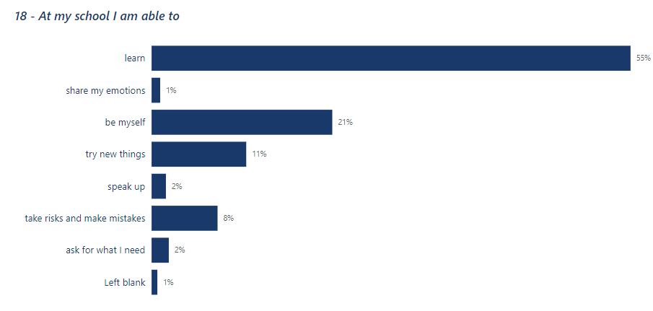


Data Sources
Power BI
Only 1% of students felt they could share their emotions
Notes:
This data source was taken from the district’s Power BI Climate Survey. At the end of the previous school year, students were given a survey with various questions. After reviewing the data, I noticed that only 1% of the students surveyed felt they could share their emotions. This makes me wonder if they have difficulty identifying their emotions, therefore they cannot share them, or if they don’t feel comfortable sharing their emotions. This indicated that they could use self-awareness skills to help share their emotions as well as have the confidence to speak up (only 2% felt they could) through a growth mindset (asking questions and making mistakes helps us grow).

Slide 5
Data Sources
Power BI
Only 8% of students felt they could take risks and make mistakes
Notes:
Another indicator for a guidance unit on self-awareness is that only 8% of students felt they could take risks and make mistakes. This also shows a need for a lesson on optimism and growth mindset.

Slide 6
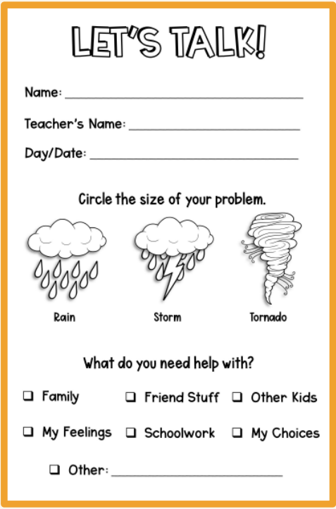
Data Sources
Self Referrals
Notes:
I have a system in place where students can reach out to me through a self-referral (see note above). Many students use this resource to discuss feelings and emotions. Many of the self-referrals I receive are related to negative outlooks on various situations as well as dishonest behaviors that infiltrate their friendships.

Slide 7
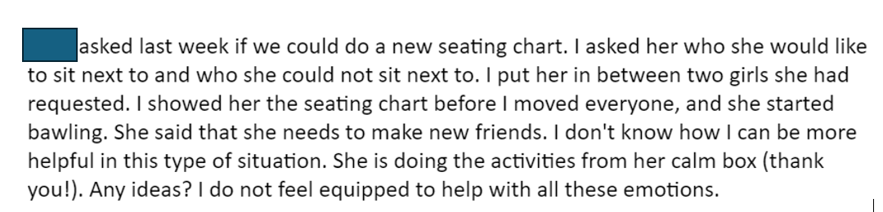
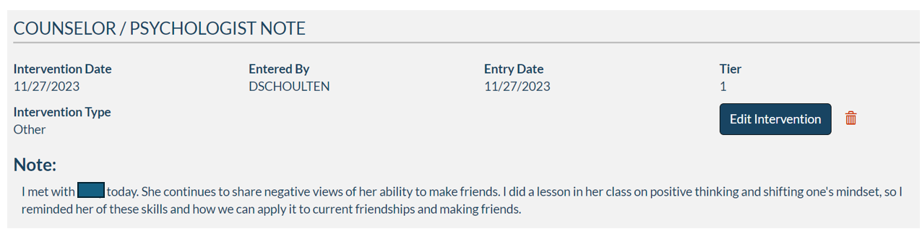
Data Sources
Teacher Referrals
One of many Teacher emails/Referrals focusing on
growth mindset and positive thinking
Notes:
Teacher emails and referrals also indicate a need for optimism and a growth mindset. This is one example of a teacher that is unsure how to navigate a students high emotions as it pertains to the student’s feeling that she cannot make friends (growth mindset and optimism). This particular student focuses on the negative in most situations rather than the positive.

Slide 8
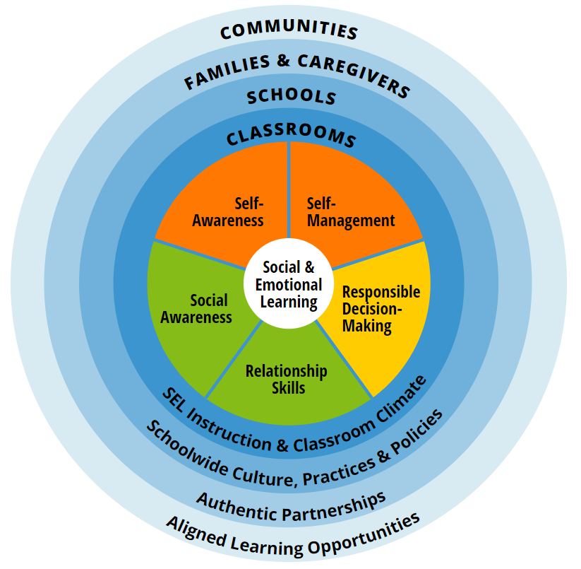

Needs Assessment
Microsoft Form based on the
CASEL Framework:
Self-Awareness
Self-Management
Social Awareness
Relationship Skills
Responsible Decision Making
Notes:
The Collaborative for Academic, Social, and Emotional Learning Wheel was utilized to develop this guidance unit. Under the “Self-Awareness” umbrella includes, among other things:
Identifying one’s emotions
Demonstrating honesty and integrity
Linking feelings, values, and thoughts
Examining prejudices and biases
Experiencing self-efficacy
Having a growth mindset

Slide 9
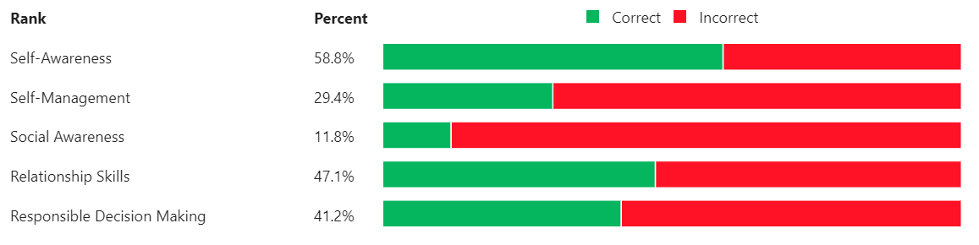
Needs Assessment
Teacher Survey Results
Collaboration with administration concurs findings
Notes:
I developed a Microsoft Form for teacher to take. This form included the components of the CASEL Wheel and descriptions of what each topic entails. Teacher results indicated the highest need for self-awareness skills.

Slide 10
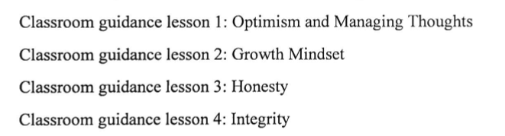
Project Description
Notes:
Given the data, I developed a guidance unit on self-awareness. Lesson one focuses on optimism and managing thoughts, lesson two is on growth mindset, lesson three is on honesty, and lesson four focuses on integrity.

Slide 11
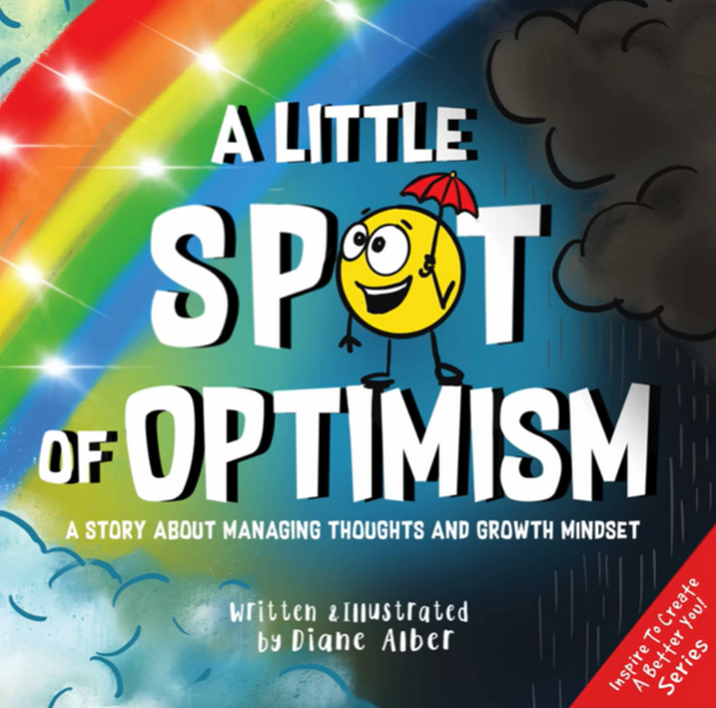
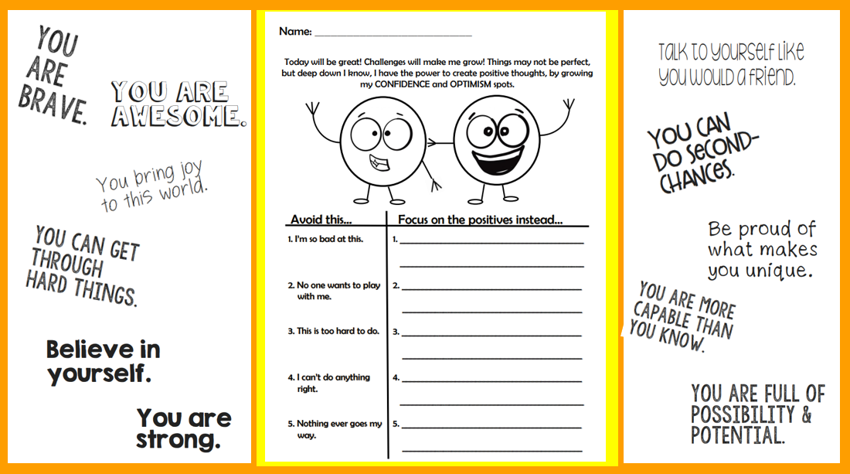
Project Description
Lesson 1: Optimism and Managing Thoughts
Notes:
Lesson one focuses on Optimism. I am a big fan of bibliotherapy. Most of my lesson incorporate a book on the topic at hand as well as an activity to show their understanding of the objective. In this lesson, I read “A Little Spot of Optimism: A Story About Managing Thoughts and Growth Mindset” by Diane Alber. We then turned our negative thoughts into positive outlooks.

Slide 12

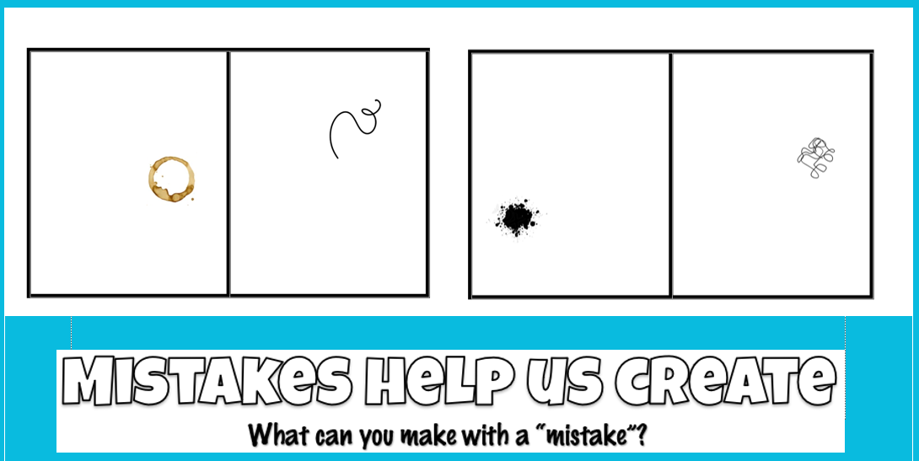
Project Description
Lesson 2: Growth Mindset
Notes:
For the second lesson of this guidance unit, I focused on a growth mindset. We read “Your Fantastic Elastic Brain: Stretch It, Shape It” by JoAnn Deak. Following the story, we discussed famous mistakes. Some inventors “accidentally” created their products by mistake: Popsicles, piggy banks, Post-Its, the chocolate chip cookie, etc. Afterwards, I gave them a worksheet that allowed them to turn a “mistake” into something creative.

Slide 13
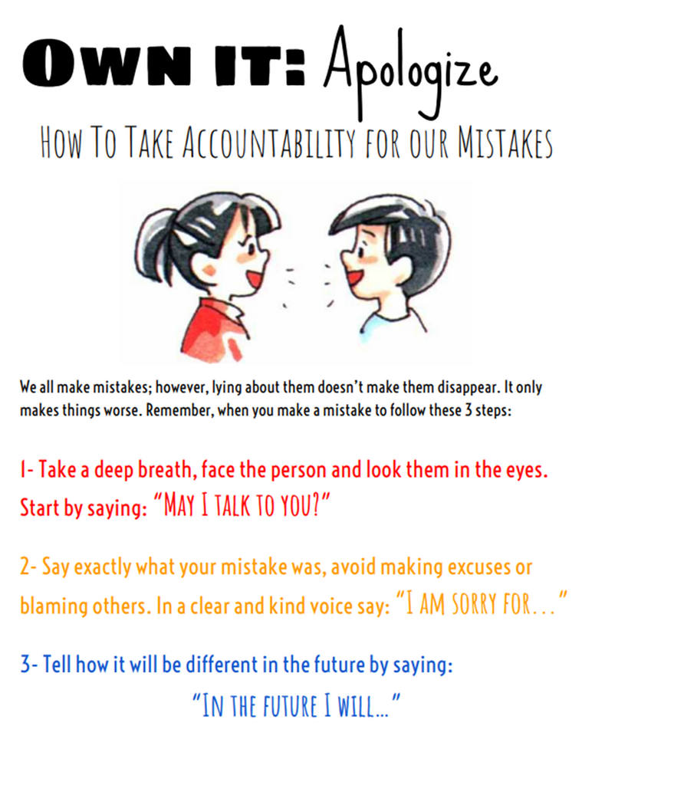

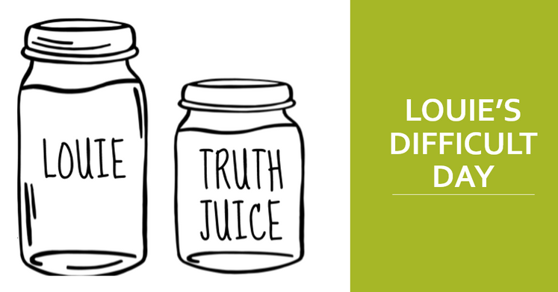
Project Description
Lesson 3: Honesty
Notes:
Lesson three was on honesty. I read “A Little Spot of Honesty: A Story About Trust and Integrity” by Diane Alber. Not only was this a great book about honesty, but it was a nice segue to our next lesson on integrity. After the book, I told a quick story about a boy named Louie. Whenever Louie lied, he felt worse and worse. I took a jar of water and added a drop of food coloring (various colors) every time Louie told a lie. This symbolized how “yucky” we feel when we’re dishonest. Louie attempted to make amends with those he lied to (add some bleach/truth juice to the Louie jar every time he apologizes). This shows how difficult it is to “undo” our impression on others when we lie. It gets better over time, but we can never quite undo our lies. Students then practiced the “Own It: Apologize” steps through modeling different situations.

Slide 14

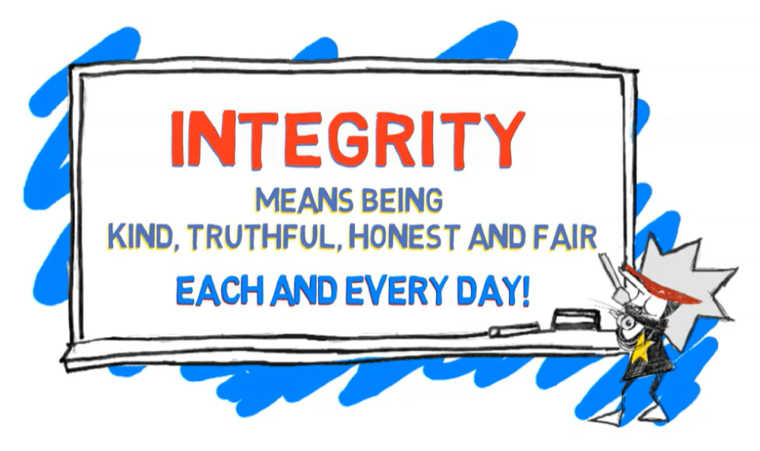
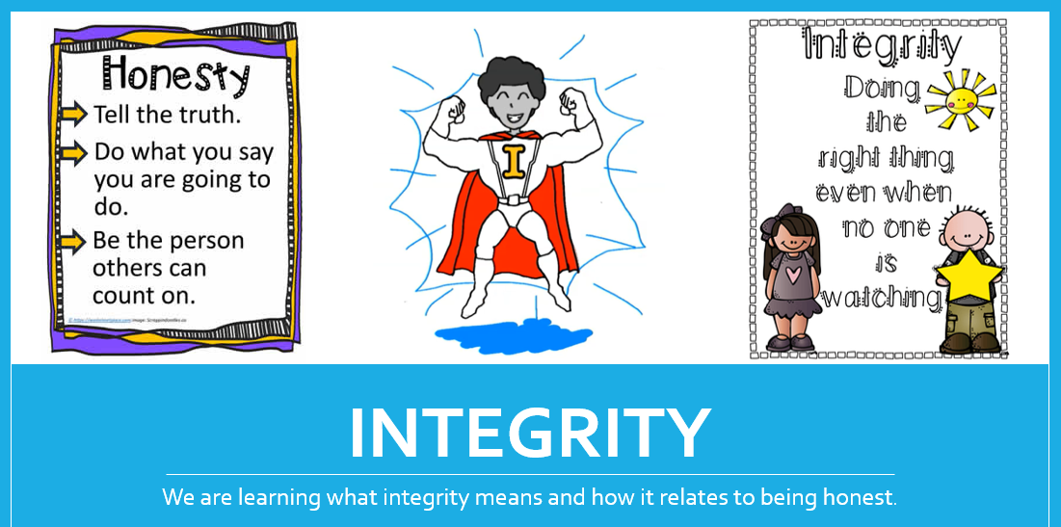
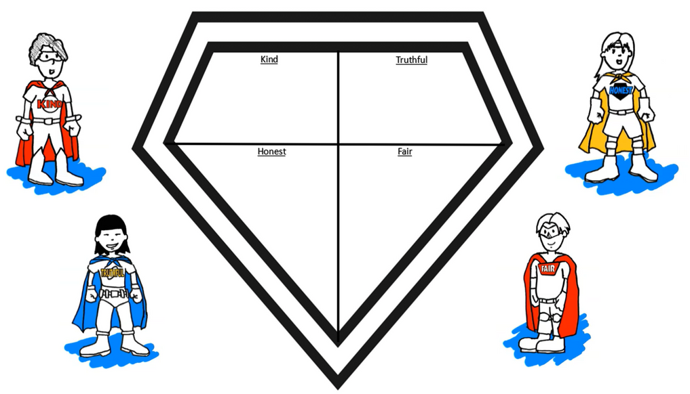
Project Description
Lesson 4: Integrity
Notes:
The final lesson was on integrity. First, we discussed how closely related honesty and integrity is. We then discussed the difference between honesty and integrity. We read “Honesty is My Superpower” by Alicia Ortega. Students were then directed to access their Nearpod accounts to drag/drop words into either an “honest” category or a “dishonest” category. Then they were directed to drag/drop situations in an “honest” or “dishonest” category. Students were then able to create their own superhero shield based on integrity characteristics.

Slide 15

AIA Alignment
Foundations
as in all counseling, this classroom guidance unit will adhere to all legal and ethical standards as well as cultivating ethical behavior in others.
Counseling Prevention and Intervention
This lesson provides classroom guidance to promote the academic, career, and social/emotional development of students through self-awareness skills.
Notes:
The following standards indicate how this guidance unit aligns with the AIA standards.

Slide 16
AIA Alignment
Diversity and Advocacy
this guidance unit focuses on self-awareness and helps all students advocate for their own learning and academic experiences (growth mindset, honesty/integrity) to promote academic, career, and social/emotional development.
Research and Evaluation
Data analysis of the district’s school climate survey was
used to enhance the school counseling program by incorporating self-awareness skills.
Notes:
The following standards indicate how this guidance unit aligns with the AIA standards.

Slide 17
AIA Alignment
Academic Development
incorporating growth mindset and positive thinking in the school counseling programs enhances student academic development.
Collaboration and Consultation
The development of this lesson was used in consultation
with stakeholders (students, teachers, administration) to promote student academic, career, and social/emotional development.
Notes:
The following standards indicate how this guidance unit aligns with the AIA standards.

Slide 18
AIA Alignment
Leadership
Throughout this lesson, I created the design and have implemented and managed this school counseling program, specifically regarding this guidance unit.
Notes:
The following standard indicates how this guidance unit aligns with the AIA standards.

Slide 19
ASCA Mindsets
M5: Belief in using abilities to their fullest to achieve high-quality results and outcomes. Positive thinking and a growth mindset reminds students that they are resilient and have the power to persevere by trying their best to achieve their goals.
M6: Understanding that postsecondary education and lifelong learning are necessary for long-term success. Through a growth mindset, student understand that we are all lifelong learners as we continue to learn from our mistakes and trying new things throughout our lives.
M3: Positive attitude toward work and learning. This unit focuses on positive thinking and a growth mindset for lifelong learning.
M4: Self-confidence in ability to succeed. A growth mindset understands that we learn from our mistakes which builds confidence in personal success.
Notes:
The following standards indicate how this guidance unit aligns with the ASCA Mindset standards.

Slide 20
ASCA Behaviors
B-LS8: Engagement in challenging coursework. Through a growth mindset students understand that challenging coursework may include making mistakes, but learning from our mistakes is what helps us grow academically and emotionally.
B-SMS1: Responsibility for self and actions. Students will learn they are responsible for their own honesty and integrity. When they make a mistake, they own it.
B-SMS2: Self-discipline and self-control. Although it may feel easier to lie, self-discipline is used to tell the truth. Trust is one of the foundations of a healthy relationship.
B-SMS5: Perseverance to achieve long- and short-term goals. Growth mindset incorporates perseverance.
Notes:
The following standards indicate how this guidance unit aligns with the ASCA Behavior standards.

Slide 21
ASCA Behaviors
B-SMS7: Effective coping skills. Positive thinking is a coping skill to help bounce back from difficult situations.
B-SS2: Positive, respectful, and supportive relationships with students who are similar to and different from them. Honesty and integrity help build positive relationships with all students.
B-SS5: Ethical decision-making and social responsibility. Honesty and integrity are paramount when it comes to ethics and social responsibility.
Notes:
The following standards indicate how this guidance unit aligns with the ASCA Behavior standards.

Slide 22

Utah Academic Standards
Speaking and Listening 1
Participate effectively in a range of conversations and collaboration, using age-appropriate vocabulary, on topics, texts, and issues.
Speaking and Listening 2
Clearly summarize information presented in various formats and media and explain how the information pertains to the topic.
Notes:
The following standards indicate how this guidance unit aligns with the Utah Academic standards.

Slide 23
Cultural Sensitivity
  counselor reiterates classroom norms to promote a positive, caring, and safe learning group environment
  fosters students’ self-awareness skills while equitably reaching and teaching students of all cultures
  culturally sensitive while considering various students’ backgrounds, ethnicities, and belief systems
Notes:
This classroom guidance unit fosters students’ self-awareness skills while equitably reaching and teaching students of all cultures. It is culturally sensitive while considering various students’ backgrounds, ethnicity, and belief systems. Names and visual representations in the books/examples/artifacts include various ethnicities. Students will understand that we all, no matter our background, have coping skills for various situations, including positive thinking. Positive thinking, growth mindset, and expectations of honesty and integrity of all individuals are specifically addressed in this unit. Prior to beginning each lesson, the counselor reiterates classroom norms to promote a positive, caring, and safe learning group environment.

Slide 24
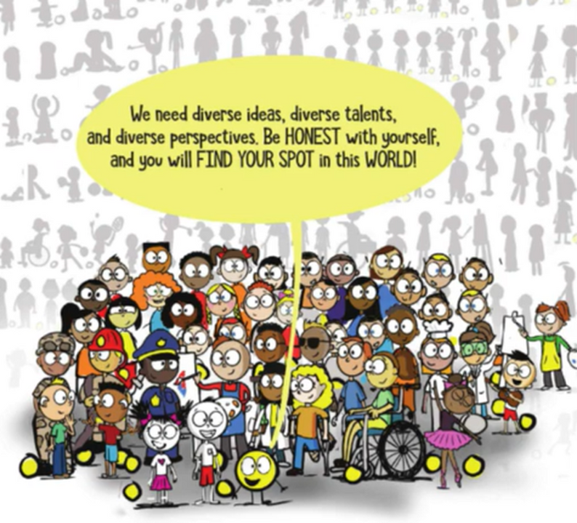
Cultural Sensitivity
  Names and visual representations in the books/examples/artifacts include various ethnicities
  no matter our background, we all have coping skills for various situations, including positive thinking
Notes:
These are the final bullet points on cultural sensitivity and an example from one of the stories I read to the students.

Slide 25
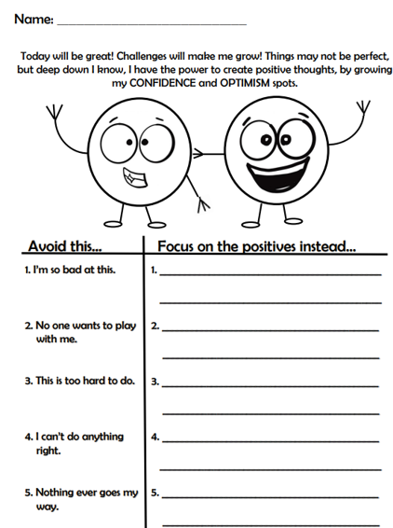
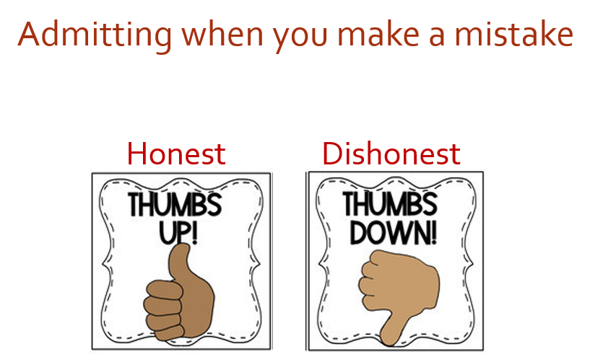

Evaluation
Informal Assessments
Notes:
I use various informal assessments to evaluate the effectiveness of the lessons. For example, students can give me a visual thumbs up or thumbs down to indicate whether a situation is honest or dishonest. Worksheets are another method to evaluate whether or not the objective was learned. This particular worksheet is from lesson one on optimism. Students were asked to flip a negative thought into a positive thought.

Slide 26
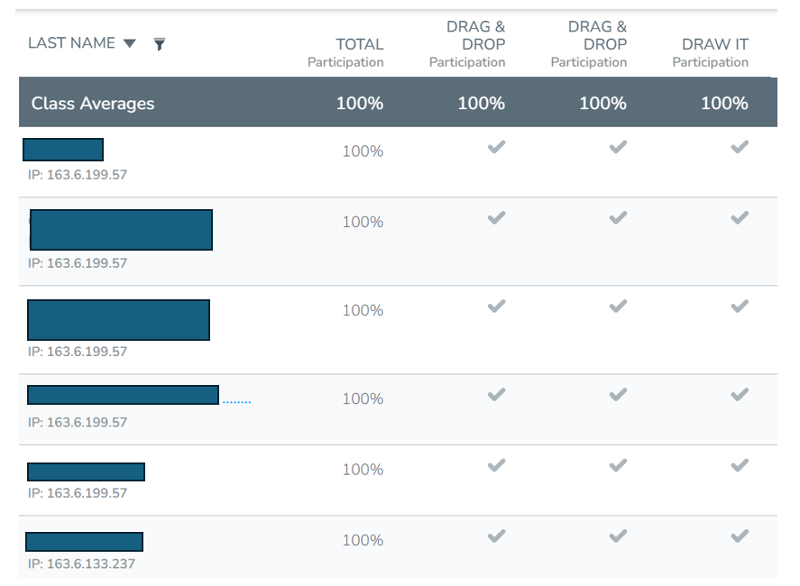
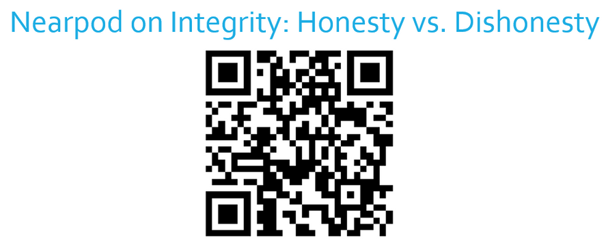
Evaluation
Informal Assessments
Notes:
Additional informal assessments to help me evaluate whether or not the objective was learned is through the Nearpod drag and drop assignment. I can see how many students are participating as well as their accuracy.

Slide 27

Evaluation
Future Data
Fewer Referrals for Dishonest Behaviors
Notes:
An overall evaluation to show the effectiveness of the guidance unit include future results on this year’s Power BI Climate Survey. Will more students indicate that feel capable of asking questions, making mistakes, and sharing their emotions? Will administration report fewer referrals for dishonest behaviors? If these percentages do not change in a positive manner, I will need to reevaluate the guidance lesson to improve outcomes.

