Slide 1


Friendships and Emotion Regulation
Davina Schoulten
COSC 698: School Counseling Practicum
Notes:
After repeated recess and classroom issues with four specific students, I thought it might be helpful to find a small group curriculum to help them learn the skills to play competitively but also manage their emotions.
Issues at recess were often brought into the classroom, and their competitive nature seeped into their personal relationships when working as partners, groups, or even individual tasks.
I located this small group curriculum on Teachers Pay Teachers. It was written with the ASCA Behavior Mindsets and CASEL Competencies in mind. Credit for this curriculum is given to Sara, The Responsive Counselor, www.responsivecounselor.com.

Slide 2
4th Grade Friendship and Emotion Regulation Small Group
Students will learn skills to:
  Build positive and supportive relationships
  Exhibit self-control and self-regulation
  Utilize responsible decision making
  Demonstrate social responsibility
  Implement effective coping skills when faced with relational problems
Notes:
These skills and expectations are part of the ASCA Mindsets and Behaviors:
create positive and supportive relationships with other students
demonstrate self-discipline/control
demonstrate ethical decision-making and social responsibility
demonstrate effective coping skills when faced with a problem
as well as the CASEL Competencies
responsible decision making
relationship skills
self-management.
The overall objective is to increase their use of self-control, management of emotions, and build positive social skills to improve their overall school behavior.

Slide 3
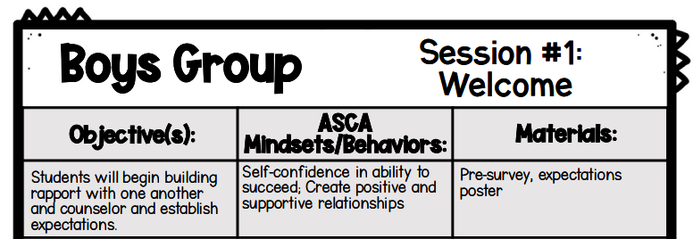
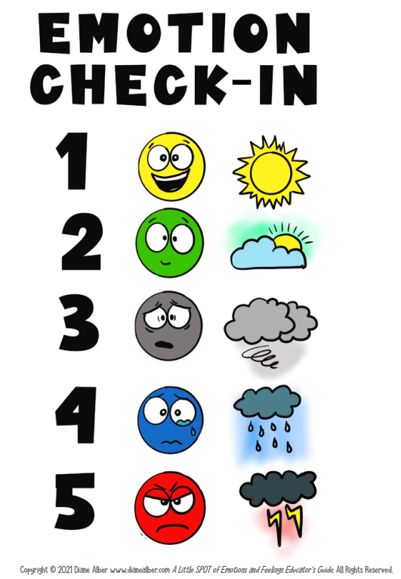
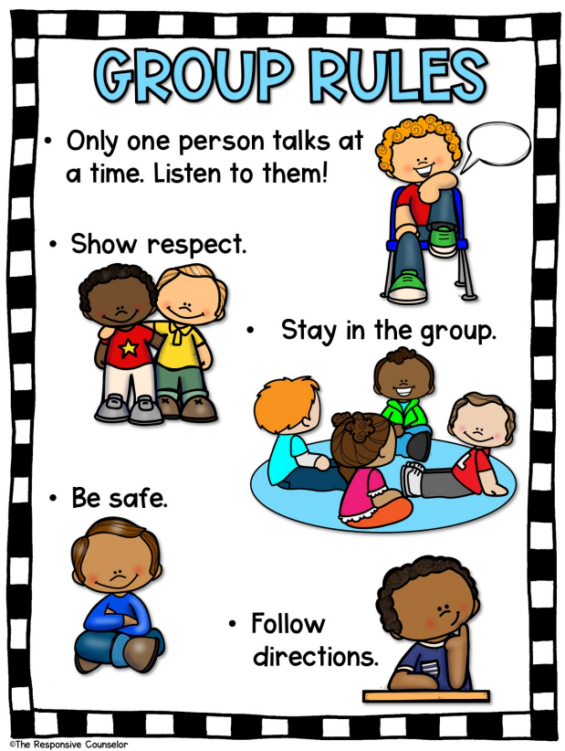
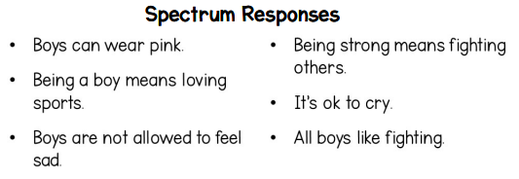
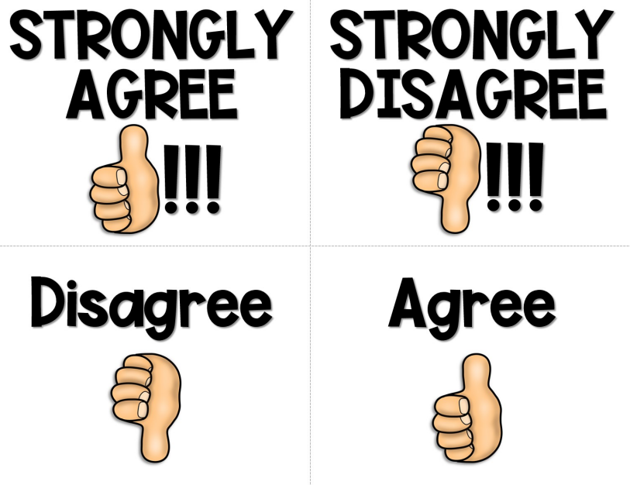
Notes:
Session 1: Welcome.
We initiated every group meeting with an emotion check-in. Usually this went well, was succinct, and allowed everyone to share a little bit about how they were feeling in the moment. This particular emotion check-in comes from Diane Alber’s Little Spot series (Alber, 2021).
I had each student fill out the presurvey and discussed what we would be working on in our small group. I explained confidentiality and our groups rules. We then delved into an icebreaker of “Would you rather?” before we discussed the Spectrum Responses statements.

Slide 4
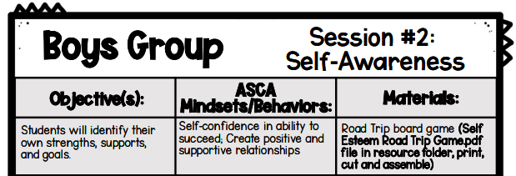
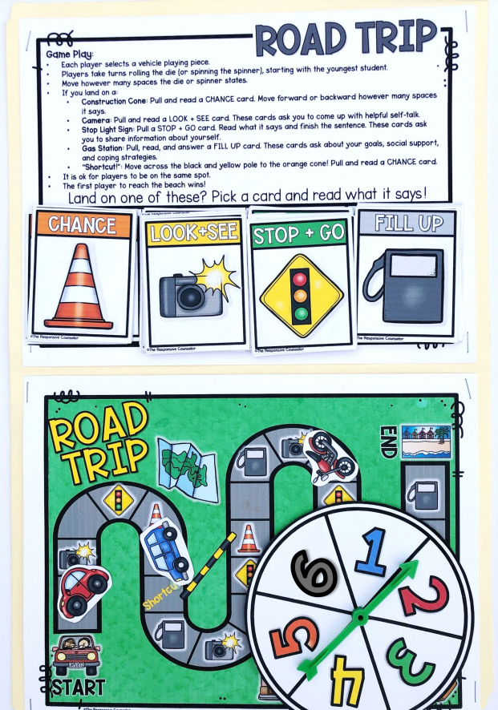
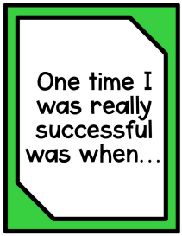
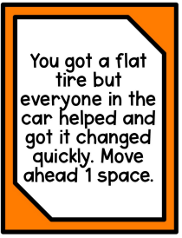
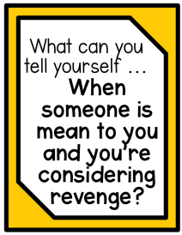

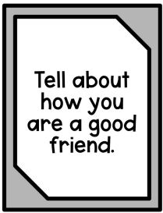


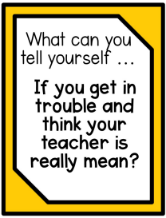
Notes:
Session 2: Self-Awareness. To make the session interactive, we played a Road Trip game. We discussed the positives and challenges of a road trip. The game uses card prompts to discuss elements of self-esteem including positive self-talk, social supports, and self-efficacy.

Slide 5

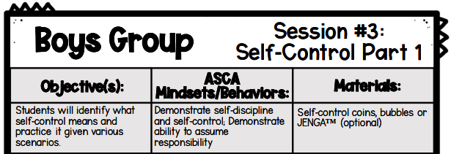
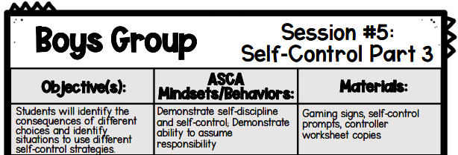



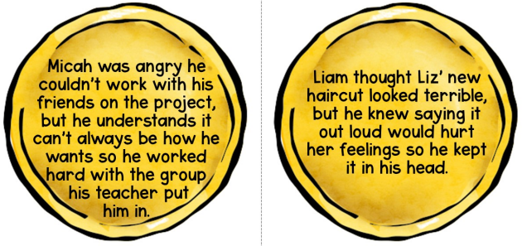
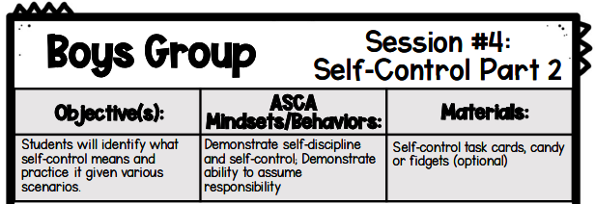
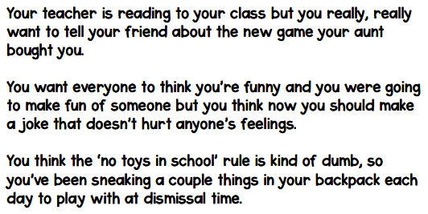
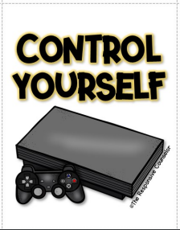
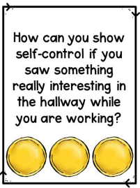
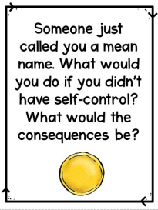
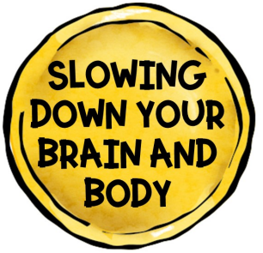
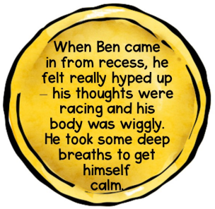
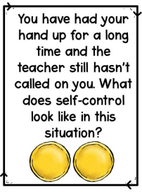
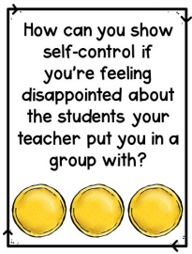



Notes:
Sessions 3, 4, and 5 were all focused on self-control. In session 3, we discussed what self-control means and matched scenario cards. Session 4, we reviewed the concept of self-control by giving answers to various scenarios. I also placed treats in the center of the table that they were not allowed to touch until the end of the session (to exhibit self-control). There was an option to keep score, but I thought the competition may take away from the objective. Session 5 reiterated the concept of self-control by having them act like a character in a video game to either “level up” with appropriate responses to a situation or “game over” if they provided a response that would not be an appropriate way to manage the situation. Side note, they never actually received a “game over,” instead we discussed what could be an alternative reaction and then they received a “level up” card. This helped them recognize the choices they make lead to consequences. We had extra time at the end, so we played Jenga to continue showing self-control.

Slide 6

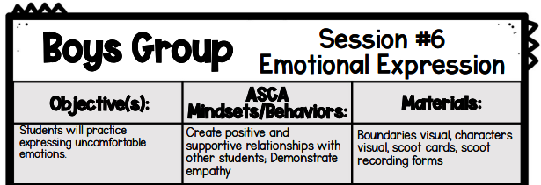

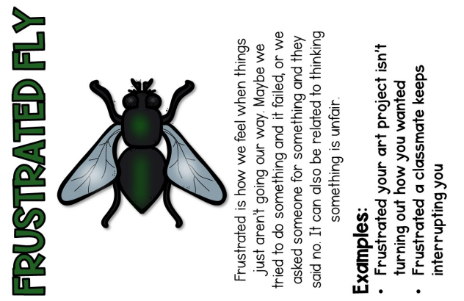
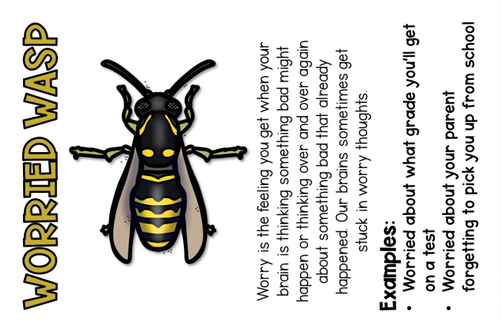
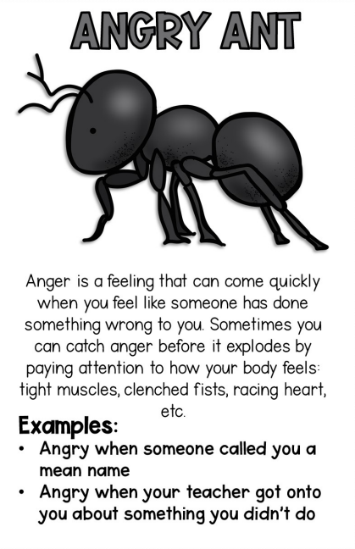
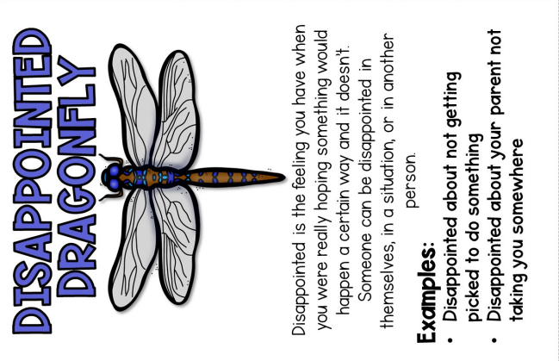
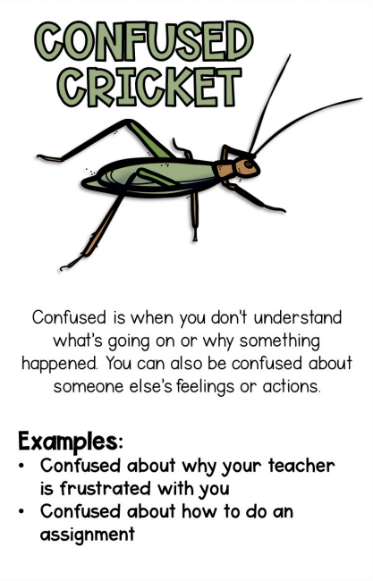
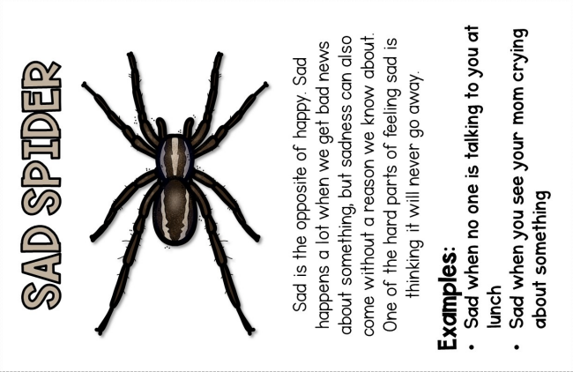
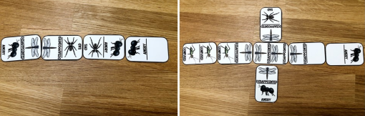
Notes:
Session 6: Emotional Expression. We discussed bugged feelings and used them to play Dominoes. When it was their turn, the students would place the card/domino down and state, “It bugs me when _________, and I feel _________.” We wrapped up the session by discussing which feeling bugs them the most often, which is the hardest to talk about, and which one is the most uncomfortable for each of them.

Slide 7
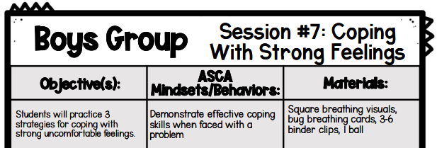
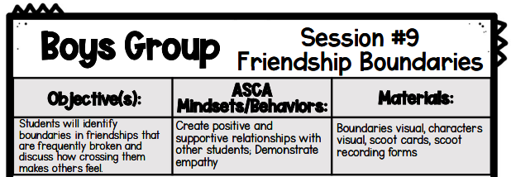
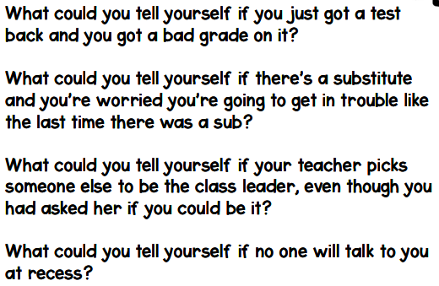
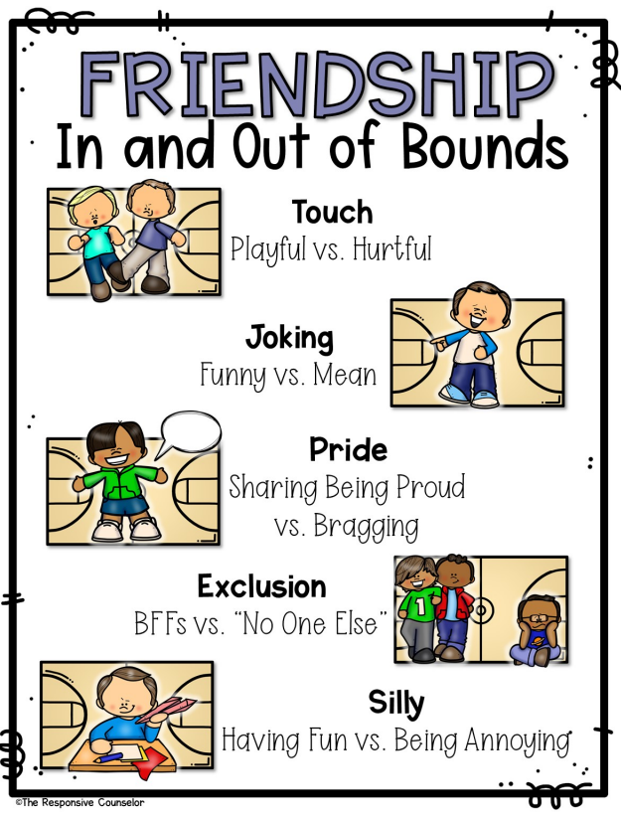
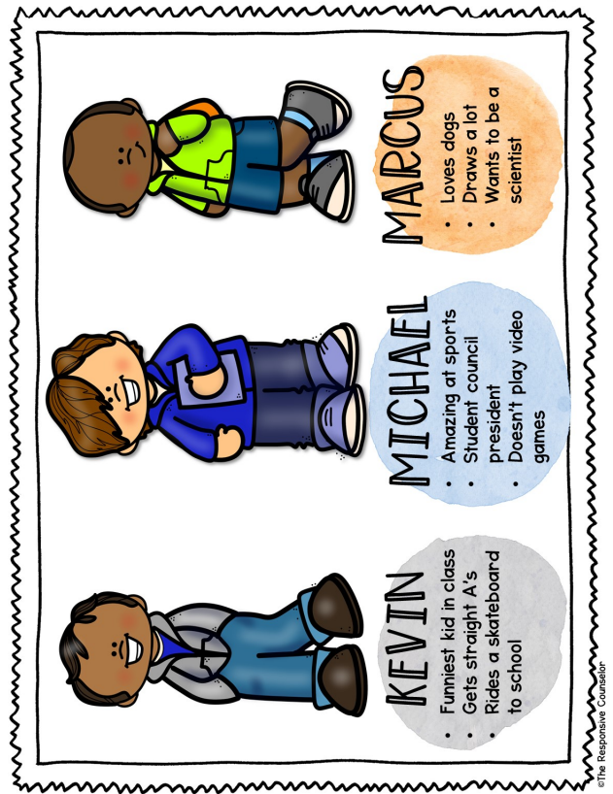
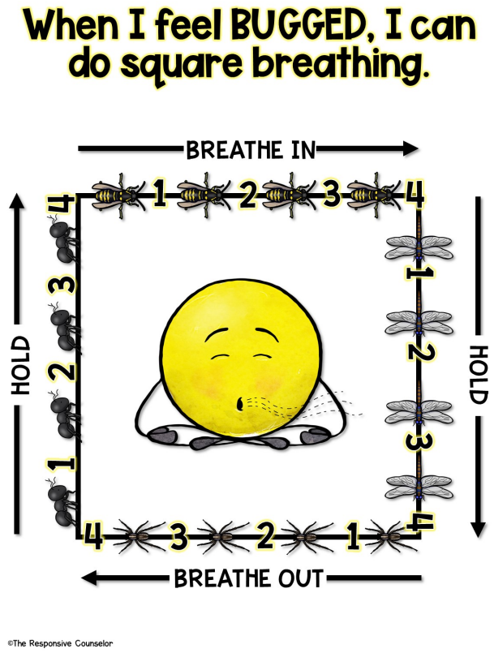
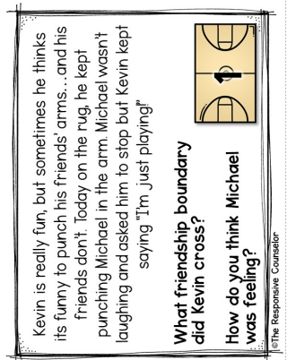
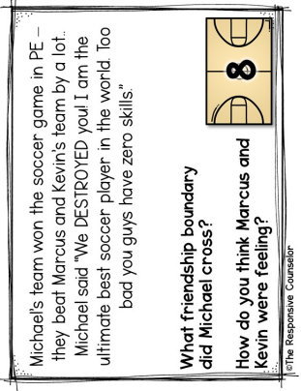
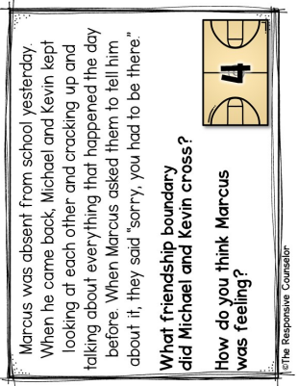
Notes:
Session 7: Coping with Strong Feelings. We discussed naming and talking about our feelings. Often this helps us feel better by taking control of them. We practiced strategies to help cope with our strong emotions like acknowledging them. We can catch them like bugs and name them, then let them go by slowing down, taking deep breaths, and relaxing our muscles. We also discussed the strategy of talking back to our feelings. We tend to have a negative inner dialog when we are mad, sad, worried, etc. It helps to talk back to yourself with positive thoughts to control and change your feelings.
I didn’t feel the need to incorporate session 8 with these students, so I moved forward with session 9.
Session 9: Friendship Boundaries. We discussed boundaries in sports and that they aren’t meant to be crossed. We also discussed how different people have different boundaries that we need to respect. We then reviewed different types of boundaries that we may cross with our friends. Students had to identify the boundaries that were crossed by Kevin, Michael, and Marcus (scenario characters) and record on their worksheet.

Slide 8
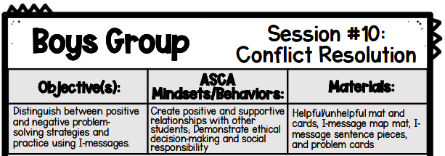
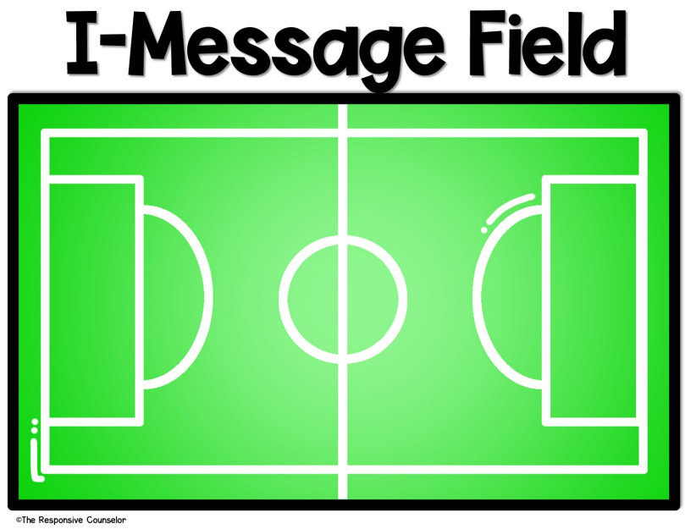
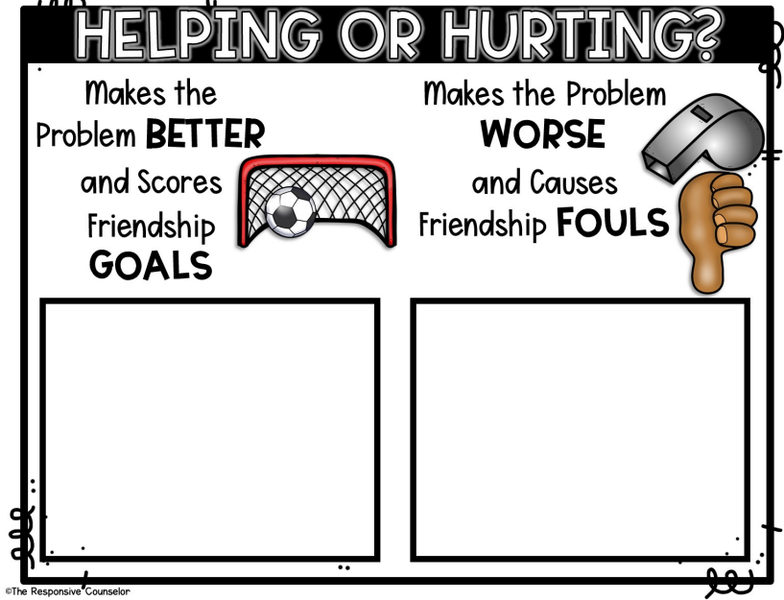
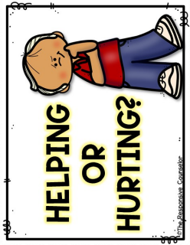

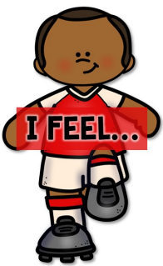



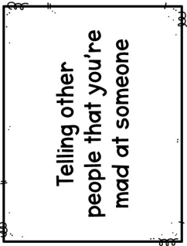
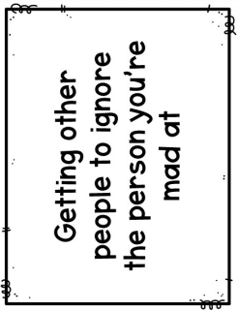
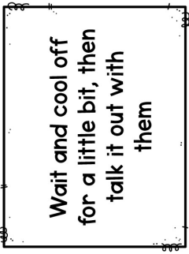
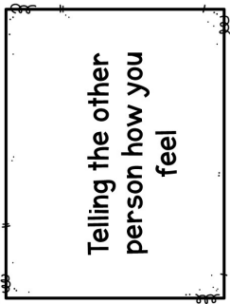




Notes:
Session 10: Conflict Resolution. Students identified positive and negative problem-solving strategies and practiced using I-messages (“I feel _______ when you _____, could you please _______.”)

Slide 9










Notes:
Session 11: Being a good S.P.O.R.T. We read a social story about Sam the Good Sport. SPORT is also an acronym (see slide) to help them remember qualities of good sportsmanship. We practiced things we could say/do to show good sportsmanship.
Session 12: Termination and Review. We used the Roll and Respond game to review concepts learned throughout our sessions. We also played Jenga as a self-control review (and the students REALLY wanted to). I ensured they knew they have the tools to move forward in a positive direction, and even though we won’t meet every week, I am not far.

Slide 10





Data Justifying Implementation
Discipline referrals
Interventions listed by teacher and previous counselors/administration
Parent/teacher emails
Conferences with administration, teacher, and parents
Notes:
NOTE: Two existing data sources to identify and support the need for this psychoeducational group includes online documentation in the Davis School District’s Encore system. This system contains cumulative documentation of behavioral and academic intervention as well as discipline documentation. Other included data sources are teacher referrals based on observed maladaptive behaviors, Principal personal communication, parent personal communication, and documentation of previous counselor visits. These documents prove that these individuals can benefit from a small group focusing on self-control and effective coping skills.

Slide 11

Needs Assessment
Individuals surveyed
  Teacher
  Administration
  Parent
Summary of survey
  Students were low on
    Self-control
    Appropriate behavior
    How to calm themselves down
    Problem solving
    Kind and respectful to peers
Notes:
Various individuals will be surveyed to determine the need and verify support for this group at West Bountiful Elementary School. First, the teacher will be presurveyed to identify the needs of the students identified. In addition, the potential members of the group will complete a presurvey to determine their own self-awareness of the skills that will be taught. This data will also help inform instruction. Finally, personal conversations with administration and documents from the previous counselor will be used to support activation of this psychoeducational group.

Slide 12
Screening Process
All students are the same age and gender
Survey results indicated all students were low in similar areas
Pre-interviews indicated all students were willing to participate
Parent interview
Administration and teacher agreement
Parent consent
Notes:
I discussed the group with all members. The students understood the goal of the group and were willing to participate. One student’s parent wanted to meet with me first, to view the curriculum and ensure it was in her son’s best interest. Although some of these boys have had altercations with one another, I didn’t feel it would become a hinderance to our group as they remain friends, but need the skills to manage behavior, control reactions, and problem solve. An opportunity for improvement: next time identify existing disabilities (ADHD). Half of the members have ADHD, but only one has it listed on his health plan. Another student has been referred to LCMT for possible attention issues.

Slide 13


Consent Form

Slide 14
Pre-AIA Specialty Standards
Foundations B.1.
  As in all counseling, this psychoeducational group will apply and adhere to ethical and legal standards.
Diversity and Advocacy F.1, F.2, F.4.
  The counselor will demonstrate multicultural competencies in this group by exhibiting awareness of members’ background, ethnicity, and belief systems while enhancing a positive school climate that is equitable and responsive.
Preventions and Intervention D.2, D.3.
  The counselor provides group counseling to promote the social-emotional development of students. This psychoeducational group will help students with self-regulation and group counseling is an effective method for this type of group and specifically this age group as issues arise among peers (Vernon & Schimmel, 2019). This group will support their social-emotional development and factors of resiliency on student learning development.

Slide 15
Pre-AIA Specialty Standards
Assessment H.1, H.2, and H.3.
  Through the pre-survey, this group addresses the students’ strengths and needs, and through analysis of the information, valid inferences will be made when evaluation the needs of individual students and the effectiveness of 2 the program. The counselor will use school data to determine the need for this group intervention.
Research and Evaluation J.1, J.2, J.3.
  This small group will analyze and use data (and relevant technology) to identify group members and enhance the school program. Pre/post surveys will be utilized as well as school data to determine effectiveness and opportunities to realign objectives. This is aligned with ASCA Ethical Standards (2022).
Collaboration and Consultation N.1 and N.3.
  The counselor will work with stakeholders to build an effective counseling program as it directly affects students’ social-emotional development and school success.

Slide 16
Cultural Sensitivity
Gender differentiation for our specific objective
  Movement-based, hands-on, boy-centered
Equitable for various disabilities and cultures
  Names and visuals are inclusive
  Activities consider a range of abilities, attention spans (ADHD), and spectrum disorder
Positive, caring, and safe environment
  Emotional check-in to begin each session
  Review of group norms
Notes:
This psychoeducation group fosters students’ social-emotional skills while equitably reaching and teaching students of all backgrounds (Donahue-Keegan et al., 2019). It is culturally sensitive and takes into consideration the students’ background, ethnicity, and belief systems. Names and visual representations in the psychoeducational group examples/artifacts include various ethnicities. Multiple perspectives and conflict resolution are skills addressed in the psychoeducational group. Prior to beginning each lesson, the counselor assesses current feelings and emotions (feelings chart) and reiterates group norms to promote a positive, caring, and safe learning group environment.

Slide 17

Evaluation
Pre/Post surveys implemented
Results will validate comprehension/implementation of skills addressed
Results will guide instruction for program improvement
Monitor behavior referrals post group to identify reduction, maintenance, or increase
Follow-up with teacher for in-class behavior post group.
  3 out of 4 students showed growth in most areas (per teacher)
Student post surveys
  2 out of 4 students stated growth
  2 out of 4 students stated they were lower on survey skills
  after the group
    Although there is room for growth, I don’t think I lowered their ability to implement the skills, are they now more
    aware of the skills they should be implementing (?)
Notes:
Evaluation of the group will identify successes and opportunities for improvement. Evaluation will consist of teacher and group member pre/post surveys. This will help to identify areas of growth among members and areas that continue to remain a challenge. This data will guide further instruction and program improvement. I will also collect behavioral outcomes following the small group via teacher assessment and Encore interventions and documentation. Are the behaviors ongoing? Are the behaviors displayed more or less frequently? This will help further guide the small group instruction, reteaching, or acquiring additional knowledge to implement in the group setting.

Slide 18
References
American School Counselor Association. (2022). ASCA ethical standards for school counselors. https://www.schoolcounselor.org/getmedia/f041cbd0-7004-47a5-ba01-3a5d657c6743/Ethical-Standards.pdf
Alber, Diane. (2021). A little spot of emotions and feelings educator’s guide. Diane Alber Art, LLC.
Donahue-Keegan, D., Villegas-Reimers, E., & Cressey, J. M. (2019). Integrating social-emotional learning and culturally responsive teaching in teacher education preparation programs: The Massachusetts experience so far. Teacher Education Quarterly, 46(4), 150- 168. https://go.openathens.net/redirector/liberty.edu?url=https://www.proquest.com/scholarlyjournals/integrating-social-emotional-learning-culturally/docview/2304939532/se-2
Davis School District Encore online documentation system (2023). https://dsdencore.davis.k12.ut.us/Account/Login?ReturnUrl=%2f
Murray, Kuhn, L. J., Willoughby, M. T., LaForett, D. R., & Cavanaugh, A. M. (2022). Outcomes of a small group program for early elementary students with self-regulation difficulties: Limitations of transportability from clinic to school. School Mental Health, 14(3), 531–549. https://doi.org/10.1007/s12310-021-09480-4
The Responsive Counselor. (2022). Boy group counseling curriculum. The Responsive Counselor. https://shop.theresponsivecounselor.com/product/boys-group-counseling-curriculum/
Romano, C. (2022). West Bountiful Elementary Students of Concern Word Document.
Vernon, A. & Schimmel, C. J. (2019). Counseling children and adolescents (5th ed.). Cognella Academic Publishing.

