Slide 1

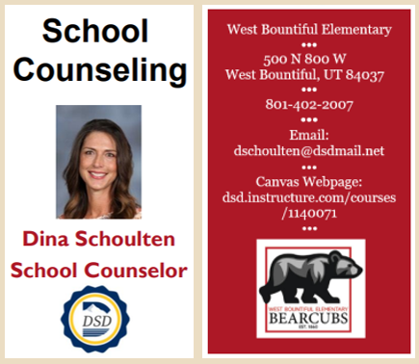

Parent-Teacher
Presentation

Slide 2

Comprehensive Program Elements
Beliefs
All students should have access to a quality education where learning comes first, and postsecondary opportunities abound after successful completion of high school. Every student should have access to an effective school counseling program where all stakeholders in our students’ education collaborate while working as a team to promote their success and achievement. School counselors enhance, advocate, and promote student academic, career, and social-emotional prosperity.
Vision
The school counseling program at West Bountiful Elementary School provides a culture for growth and learning to thrive. All students are encouraged and supported to strive for greatness as our educational community champions their academic and social-emotional success. Students will understand the value of character and connection as they become productive members of society.
Mission
The mission of the school counseling program at West Bountiful Elementary School is to provide students equitable access to academic, career, and social/emotional support, while implementing individualized interventions and engaging activities to promote a school culture where all students flourish. Through this positive and encouraging environment, students will be empowered and motivated to reach their full potential in elementary school and beyond.

Slide 3
Comprehensive Program Elements
Academic Development
Counselors facilitate short-term individual and group sessions to support academic needs.
Counselors create a safe school culture and deliver a program based on student needs, considering academic success, as identified in data assessment.
Counselors collaborate with stakeholders to provide interventions that promote individual academic success for all students.
Collaborate to remove barriers to provide academic rigor and challenge.
Career Development
School counselors collaborate with all stakeholders to promote career readiness after high school.
Counselors advocate for all students’ early awareness of college and career opportunities, exploration, planning, and decision making.
Counselors identify gaps in access to college and career development while addressing biases.
Encourage ASCA mindsets and behaviors among all students to promote career readiness and work ethic.
Social-Emotional Development
ASCA Mindsets and Behaviors will be used to identify students needs based on informed data, school improvement goals, and state standards.
Provide opportunities for all students to learn resilience, perseverance, life-long learning, and positive attitude and work ethic.
Counselors facilitate short-term individual and group sessions to support social-emotional issues.
Students are involved in peer-to-peer support programs under the directions of school counselors.

Slide 4
Advocacy
School counselors advocate for better school counseling programs, better schools, and more effective community resources in addition to social justice on a local, state, regional, national, and international level (Trusty & Brown, 2005):
  In collaboration with our family advocate, the counselor provides various community resources for all stakeholders: referrals, financial, clothing, behavioral health, etc.
  Identifies legislative issues and advocates for best practices
  Reference:
  Trusty, J., & Brown, D. (2005). Advocacy competencies for professional school counselors. Professional School Counseling, 8(3), 259–265. http://www.jstor.org/stable/42732467

Slide 5
Advocacy
Counselors advocate for a comprehensive school counseling program
for all members involved in students’ education:
  Utilize disaggregate data to identify academic gaps, attendance needs, and discipline discrepancies by subgroups to close these gaps
  Culturally responsive lessons in the classroom in line with standards and appropriate differentiation
  Counselors will design activities and interventions to affect outcomes
  positively

Slide 6
Advocacy
Counselors utilize data to support a comprehensive school counseling program which can include:
  Promoting a lower student-to-counselor ratio
  Identify achievement, attendance, and discipline elements that require attention and instruction through a review of the school improvement plan and data summary sheets
  Collaboration with all stakeholders to ensure the effectiveness of instruction and impact on students

Slide 7
Access, Attainments, and Achievement
In a diverse society, we value our differences and strive for equitable treatment of all individuals.
School counselors promote access, attainment, and achievement for all students through data driven practices that help promote change
  Valuing all students and groups equally and with equitable treatment.
  Creating an environment where students feel heard and feel comfortable coming forward with any concerns
  Promoting challenging courses with high rigor based on state-standards and career readiness for underrepresented groups as well as for those with special education needs.
  Ensuring staff are aware of diverse groups and maintain knowledge of how to work with these diverse groups and culture
  Collaborating with families in their child’s best interest when accessing outside resources to limit the barriers that may inhibit access, attainment, and achievement.

Slide 8
Barriers to Student Development
Students face various barriers in their academic achievement and social-emotional well-being
Factors that may contribute to these obstacles include:
  homelessness
  abuse
  low-socioeconomic status resulting in hunger, poverty, poor living conditions, limited access to technology
  bullying
  drug use
  depression and suicide
Through awareness and action, counselors, family advocates, and other stakeholders can provide support and resources
  Analyze data to identify gaps in achievement to limit barriers and provide equitable access for all students
  Locate community resources to assist students and families facing barriers

Slide 9
Thank you

