Slide 1
Career Development Program
COUC 522: Career Development and Counseling
Davina Schoulten

Slide 2
Proposal Components
INTRODUCTION 3
RATIONALE 5
PROGRAM STANDARDS 7
LEARNING OBJECTIVES 8
INTERVENTIONS 9
DELIVERY 11
MARKETING 13
RESOURCES & COSTS 14
EVALUATION 15
REFERENCES 16

Slide 3
Introduction
Setting: Utah State University
Summary of program: This program will help guide undergraduates towards a career path. Many students choose a major based on general interests, but do not know what specific careers are viable options for them, leaving them with a sense of insecurity. This program will enhance their outlook on a career path by providing group counseling and incorporating technology interventions to identify a variety of possibilities utilizing their interests, skills, abilities, personality, economic needs, values, etc. Counseling will explore John Holland’s Theory and Types of Person-Environment Interactions and John Krumboltz’s Learning Theory of Career Counseling. Technology interventions will be O*NET Interest Profiler, O*NET My Next Move, and the U.S. Bureau of Labor Statistics Occupational Outlook Handbook.
Notes:
The setting for this career development program is at Utah State University. In summary, this program will help guide undergraduates towards a career path. Many students choose a major based on general interests, but do not know what specific careers are viable options for them, leaving them with a sense of insecurity. This program will enhance their outlook on a career path by providing group counseling and incorporating technology interventions to identify a variety of possibilities utilizing their interests, skills, abilities, personality, economic needs, values, etc. Counseling will explore John Holland’s Theory and Types of Person-Environment Interactions and John Krumboltz’s Learning Theory of Career Counseling. Technology interventions will be O*NET Interest Profiler, O*NET My Next Move, and the U.S. Bureau of Labor Statistics Occupational Outlook Handbook.

Slide 4
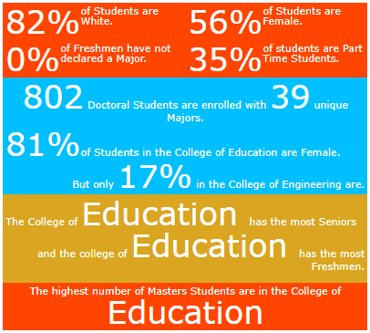
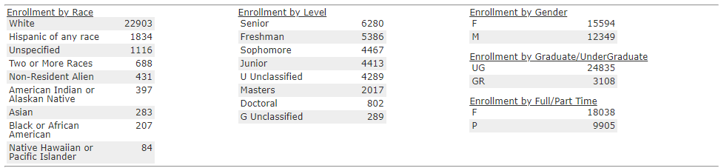
Introduction
Characteristics of participants: Individuals of all genders who exhibit career indecision and are struggling to find a career path. Generally, this tends to be undergraduates either with or without a declared major.
Utah State University - Office of Analysis, Assessment, and Accreditation (2022)
Notes:
Participants are male and female students, typically undergraduates, that exhibit career indecision and are struggling to find a career path that suits their interests and needs. This program is not culturally, racially, or gender specific, as all individuals may find themselves indecisive when it comes to making a career choice. General university statistics show that 82% of students are Caucasian, 56% are female, and 0% of freshman have not declared a major. This is interesting considering many freshmen are uncertain about their specific career path but have declared a major of interest.

Slide 5
Rationale
There is an increase in insecurity among undergraduates as shown in a career well-being survey given on a voluntary basis to undergraduates by their academic advisor
Individuals scoring 23 points or higher (5-point scale) on the following items are candidates for this comprehensive intervention program:
  Uncertain about their occupational future
  Sense of unrest regarding career path
  Sense of unrest associated with feeling under-informed about career options that fit their needs (skills, interests, abilities, personality)
  Lack of ability to obtain additional career information
  Pressure to identify their “forever” career choice
  Feeling of urgency to commit to one career in fear of wasting precious time
This data is used to screen individuals for counseling and other program interventions
Male and female undergraduates at Utah State University with a score above 22 on the needs assessment (well-being survey) are targeted to benefit from this program
Notes:
Academic advisors have noted insecurity among undergraduates as it pertains to career indecision. Many students are capable, if not eager, to select a major based on personal interests, but are not sure what career path to take after earning their degree. Academic advisors are trained to help undergraduates register and identify classes that they are required to take, and often share surface information regarding possible career opportunities, but they do not offer adequate assistance beyond potential career options the degree provides. To address this issue, advisors have been asked to provide a voluntary six question career well-being survey to determine potential program candidates. This five-point scale survey asks individuals to rank their feelings about whether or not they feel uncertain about their occupational future; if they have a sense of unrest regarding their career path; if their feeling of unrest is associated with little information about career options that fit their personal needs, interests, skills, abilities, and personalities; they feel a lack of ability to obtain accurate and unbiased career information, pressure to identify their long-term “forever” career choice, and the feeling of urgency to commit to a career plan now, otherwise they will have wasted their time. If individuals score 23 points or higher, they are optimal candidates for this career intervention program.

Slide 6
Rationale
Participants will take Krumboltz’s Career Beliefs Inventory (Niles & Harris-Bowlsbey, 2021) to help identify problematic career beliefs.
Based on results, group or individual counseling can provide cognitive restructuring and reframing of these self-defeating beliefs.
Contributing factors for program needs:
  Career indecisiveness has an important influence on one’s career decision-making process (Zhang et al., 2022).
  Counselors can promote career decision self-efficacy and lower career choice anxiety by enhancing individuals’ emotional intelligence and daily positive affect (Park et al., 2019).
  Students are shown to have difficulty in categories such as lack of readiness, inconsistent information, and lack of information (Boo & Kim, 2020).
Notes:
It is helpful to administer the Career Beliefs Inventory (CBI) at the beginning of counseling to identify participants’ career beliefs and assumptions (Niles & Harris-Bowlsbey, 2021). This is based on John Krumboltz’s Learning Theory of Career Counseling. The CBI is a 96-question inventory with five categories: current career situation, what seems necessary for my happiness, factors that influence my decisions, changes I am willing to make, and efforts I am willing to initiate. As Krumboltz explained, if their beliefs are not maladaptive, their behaviors will help them achieve their goals. However, maladaptive beliefs must be addressed, and cognitive restructuring and reframing are strategies that should be implemented in counseling to help address their self-defeating beliefs. These beliefs may be causing them to feel stuck and unable to take action. Studies show that career indecisiveness influences one’s career decision-making process (Zhang et al., 2022). Counselors also have the ability to positively influence clients’ career decision self-efficacy and lower their career choice anxiety by enhancing their emotional intelligence (Park et al., 2019).
There are many factors that enable career indecision. Counselors need to identify these factors to help individuals who may have difficulty in areas like lack of readiness and inconsistent or lack of information (Boo & Kim, 2020).
CBI results will help determine these problematic beliefs to guide counseling interventions.

Slide 7
Program Standards
American School Counselor Association (ASCA) Mindset and Behavior Standards
Mindset Standard 6 (M 6): Understanding that postsecondary education and lifelong learning are necessary for long-term success
Behavior Learning Standard 7 (B-LS 7): Long-and short-term academic, career and social/emotional goals
Behavior Self-Management Standard 10 (B-SMS 10): Ability to manage transitions and adapt to change
National Career Development Guidelines Framework
Personal Social Development Domain, Goal 3 (PS 3): Integrate growth and change into your career development
Career Management Domain, Goal 2 (CM 2): Use a process of decision-making as one component of career development
Career Management Domain, Goal 3 (CM 3): Use accurate, current, and unbiased career information during career planning and management
Notes:
The following program standards are from the American School Counselor Association Mindset and Behavior Standards (American School Counselor Association, 2021) and the National Career Development Guidelines Framework (National Career Development Association, 2004). Three ASCA Mindset and Behavior Standards that will be addressed in this program are M6: understanding that postsecondary education and lifelong learning are necessary for long-term success, B-LS7: long- and short-term academic, career and social/emotional goals, and B-SMS 10: ability to manage transitions and adapt to change.
NCDG Framework domains and goals include PS 3: integrate growth and change into your career development, CM 2: use a process of decision-making as one component of career development, and CM 3: use accurate, current, and unbiased career information during career planning and management.

Slide 8
Learning Objectives
At the end of six sessions, students will be able to…
Understand that lifelong learning, in college and beyond, is an integral part of their long-term success
Access resources as tools to provide accurate, current, and unbiased career information for planning and management purposes
Use the tools provided as part of the decision-making process of career development
Apply this knowledge by developing short- and long-term social-emotional, educational, and career goals
Manage and adapt to the transition from college to career readiness and integrate it into their career development
Notes:
At the end of six sessions, students will be able:
Understand that lifelong learning, in college and beyond, is an integral part of their long-term success.
Access resources as tools to provide accurate, current, and unbiased career information for planning and management purposes.
Use the tools provided as part of the decision-making process of career development.
Apply this knowledge by developing short- and long-term social-emotional, educational, and career goals.
Manage and adapt to the transition from college to career readiness and integrate it into their career development.

Slide 9
Career Development Interventions
Identification of participants
Academic Advising career well-being survey
Score of 23 points or higher
John Krumboltz’s Learning Theory of Career Counseling
CBI
Planned Happenstance
John Holland’s Theory and Types of Person-Environment Interactions
Notes:
As stated in the rationale, academic advisors have noticed that undergraduates seem to readily pick their major, but as time progresses, they experience more specific career indecision. To address this situation, our career intervention program has asked academic advisors to direct students to a survey (online through the academic advising portal, myUSU dashboard, or their learning management system - Canvas) that helps the career intervention program counselors identify candidates (those scoring 23 points or higher on the survey).
After identification of participants, it is beneficial to implement John Krumboltz’s Career Beliefs Inventory. This 96 question survey addresses 5 specific categories that may affect individuals’ career indecision. This includes my current career situation, what seems necessary for my happiness, factors that influence my decisions, changes I am willing to make, and efforts I am willing to initiate (Niles & Harris-Bowlsbey, 2021). The CBI measures maladaptive beliefs that students must overcome if they are to move forward in the career decision-making process. To do this, cognitive restructuring and reframing are used in counseling to confront these issues.
Part of this restructuring is understanding that people aren’t just “lucky” but that the opportunity to capitalize on unexpected events is inevitable and desirable (Niles & Harris-Bowlsbey, 2021). This theory of planned happenstance helps individuals recognize that opportunities will arise, and that they need to recognize and incorporate these events in their own career planning. The role that chance plays in our lives is significant. Individuals must understand that not all things are, or can be, preplanned. The pressure of a “forever” job is a created belief, not always set in reality. In the end, identifying this belief allows individuals to foster an internal locus of control and self-efficacy. Self-efficacy, as it pertains to career decision-making has positive correlations with optimism, persistence, curiosity, and risk taking (Niles & Harris-Bowlsbey, 2021).
Krumboltz’s Learning Theory of Career Counseling can also be used to help understand the development of interests that help formulate their personality-environment orientation towards a career that is referenced in John Holland’s theory of Types of Person-Environment Interactions. The beauty of Holland’s theory is that it links personality types with corresponding job titles in a structured system. In this system, personalities and environments are placed in six categories: realistic, investigative, artistic, social, enterprising, or conventional. Based on one’s personality, he/she seeks particular environments that correspond with the person’s interests, values, and abilities. When there is congruence between a person’s personality type and work environment, the individual is much more satisfied, increasing his/her well-being, and productivity.

Slide 10
Career Development Interventions
Occupational Information Network (O*NET) Interest Profiler (National Center for O*NET Development, 2023).
O*NET My Next Move
U.S. Bureau of Labor Statistics Occupational Outlook Handbook.
Notes:
One method to incorporate John Holland’s Types and Person-Environment Interactions with an online resource is through the Occupational Information Network (O*NET) Interest Profiler. This survey incorporates Holland’s six personality and environment traits to help individuals identify congruence between their personality and work environment. The O*NET Interest Profiler will be used to help participants discover their interests and how these interests relate to the world of work. The results give our participants a starting off point to begin finding a compatible career.
Once the Interest Profiler has been conducted, participants will use this information to research potential careers on O*NET’s My Next Move.
Through My Next Move, participants research various potential careers to identify which work best with their knowledge, skills, abilities, personality, and education. It also gives a general economic outlook. For a more specific outlook, the United States Bureau of Labor Statistics Occupational Outlook Handbook provides extensive information on median pay, economic projections in various states, similar occupations, work environment, etc. This information is accurate and unbiased while considering various cultures and ethnicities.

Slide 11
Delivery
Academic Advisors
Career well-being survey
  Via academic advising portal or career counseling department
Career counselors
Six one-hour sessions
Notes:
The first point of contact for program participants is generally through their academic advisors, career counselors, or simply through the advising portal, myUSU dashboard, or Canvas. Many students may not realize this program exists but often check-in with their academic advisors to ensure they are on the right track to complete their major. When advisors notice career indecisions, they can send them to the career well-being survey that is accessible via QR code through the advising portal, career counseling link, dashboard, or Canvas. Those scoring above 22 points will be directed to the career counseling department. Those willing to participate will be given a pamphlet, a digital link for information, and a verbal overview of the what the career counseling intervention program entails. If they choose, they will sign-up for six one-hour sessions.

Slide 12
Delivery
Session 1
Review of career well-being survey
Discussion of the program (group counseling, norms, confidentiality)
CBI
Session 2
CBI data results
Group counseling
Session 3
Continue group counseling
Session 4
O*NET Interest Profiler
Explanation of Personality Types and work environments
Assignment
Session 5
My Next Move
Occupational Outlook Handbook
Session 6
Next steps beyond this intervention program
Closure
Notes:
Session one will review the career well-being survey and why it served as a tool to identify candidates that can benefit from this program. Participants will be given an overview of the program, including theories we will implement and the resources and technology we will use. To guide the group counseling sessions, the Career Beliefs Inventory will be given.
In session two, we will discuss the results of the CBI and begin counseling sessions to help counselors identify problematic beliefs associated with career problem categories of indecision, unrealism, and multipotentiality (Niles & Harris-Bowlsbey, 2021). We will continue group sessions in session three to provide cognitive restructuring and reframing strategies.
At this point, participants should be ready to take the O*NET Interest Profiler to identify their specific personality types and work environments. We will discuss what each type means (realistic, investigative, artistic, social, enterprising, or conventional). They will then be given an assignment to research their top five options as it pertains to skill/education level, interests, work environment, daily tasks, etc.
In session five, we will delve further into the five top career options with O*NET’s My Next Move and the U.S. Bureau of Labor Statistics Occupational Outlook Handbook.
To conclude, in session six, participants will make short and long-term SMART goals to implement as it relates to their career decision-making. We will close by discussing these goals and ensuring they are aware that the counseling department is available for referrals, resources, or support. In addition, they will be given the career well-being postsurvey and program evaluation form to identify program improvement needs.

Slide 13
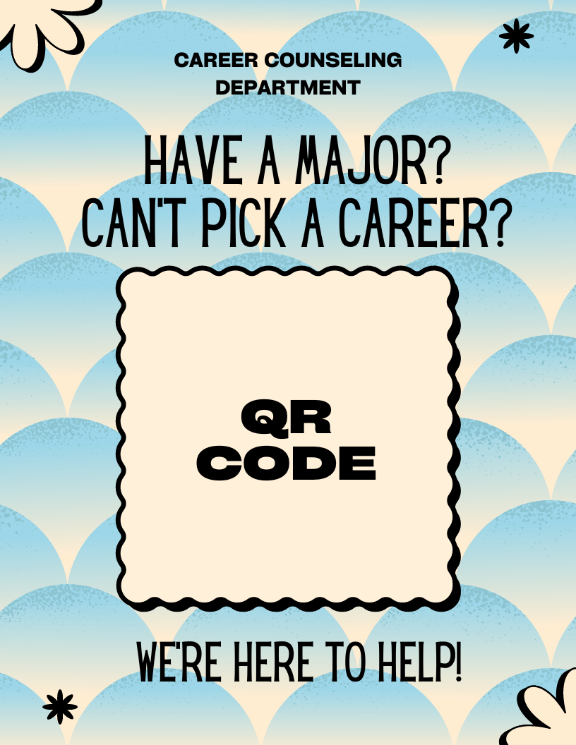


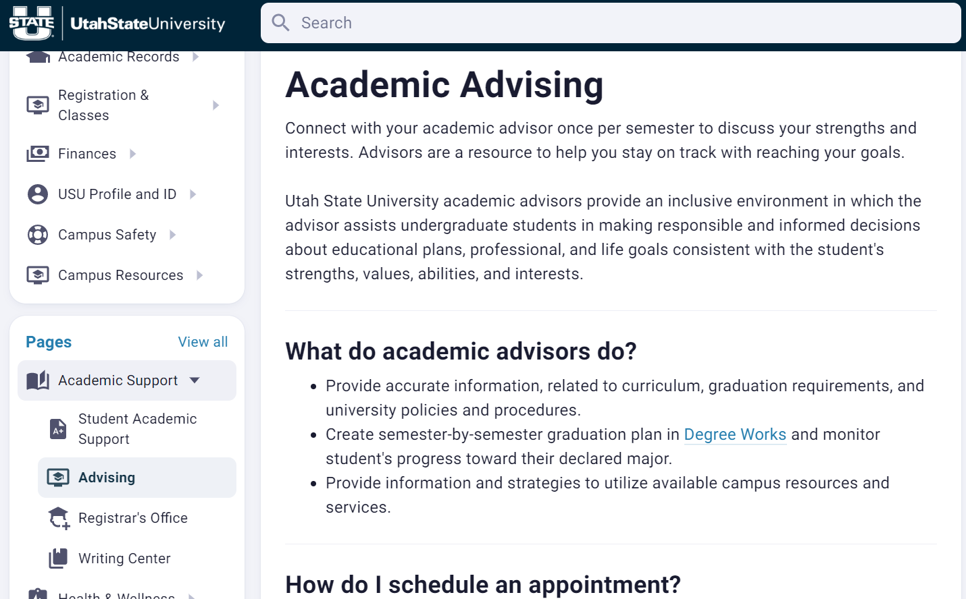
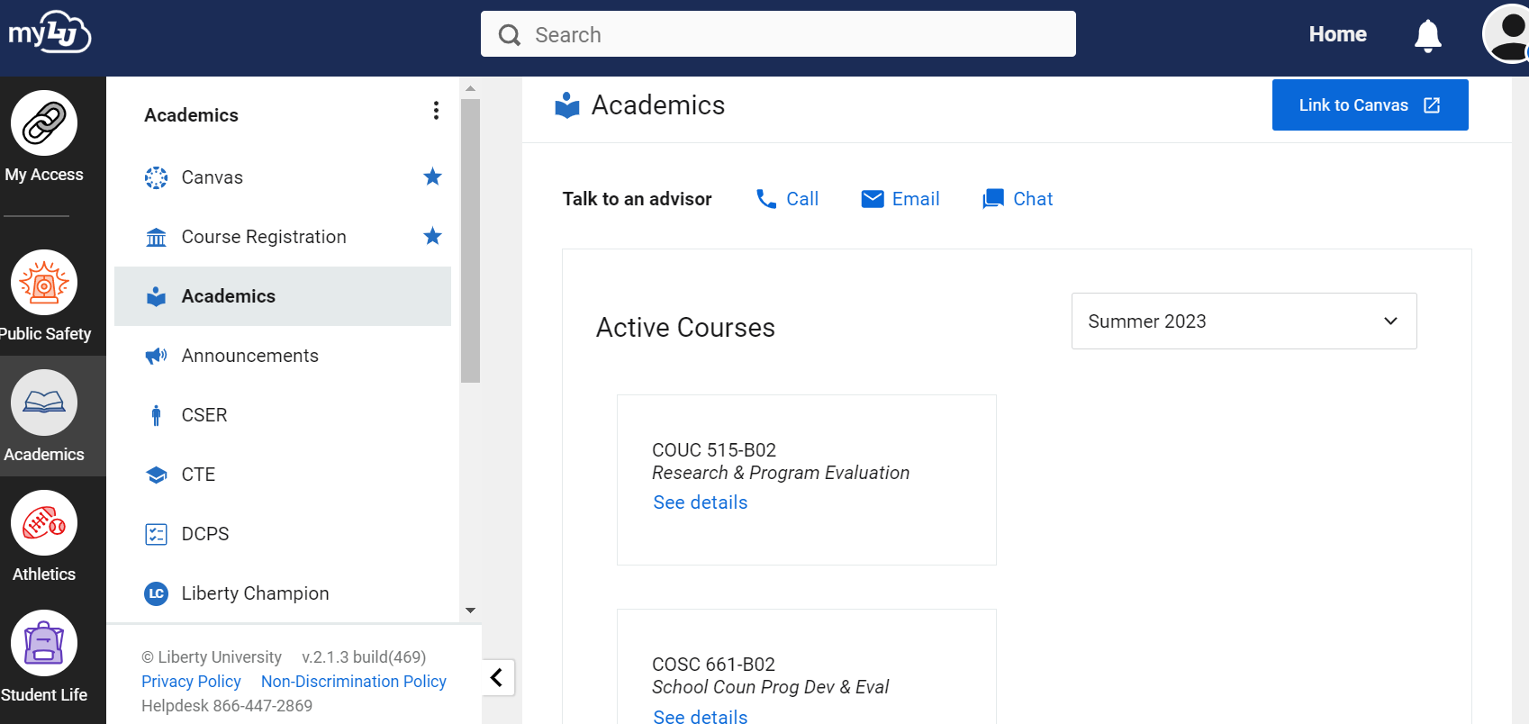
Program Marketing
Notes:
Marketing this program will be relatively simple considering all college students have access to a learning management platform like Canvas or their myUniversity account. Utah State students have their own myUSU account which provides access to all sorts of programs on their dashboard. The career counseling department will post this program on the dashboard, in the career counseling portal, the academic advising portal, and in Canvas under resources. Students will have access to a pamphlet in the career counseling center and a digital flyer by clicking on the link mentioned in their myUSU or Canvas resources account.

Slide 14
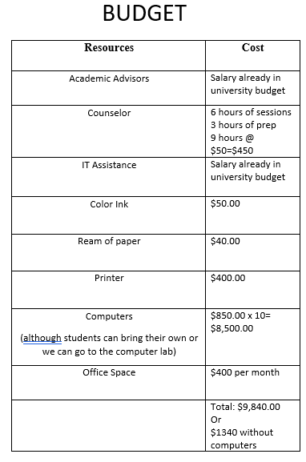
Resources and Costs
Input by academic advisors
Group counseling space
Counselors
IT assistance for marketing purposes
Make pamphlets (or print shop)
Notes:
Resources for this program includes referrals by academic advisors, office space for group counseling, access to computers (one per participant), and at least one counselor, but more may be needed depending on the success and future need of the program. We will also need IT assistance to post links for students to access the digital flyer in their myUSU account and in Canvas. Final resources include the print shop for pamphlets, unless counselors copy their own pamphlets. Monetarily, this program will only cost the university the hourly rate for the counselors and minimal cost for pamphlets. Computers for each student in the career counseling office would be ideal, but taking a field trip to a computer lab or asking students to bring their own device is an option.

Slide 15
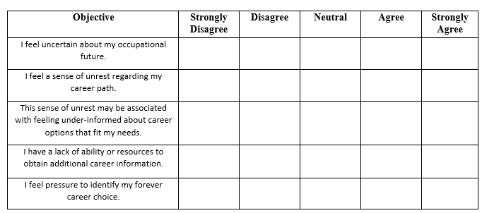
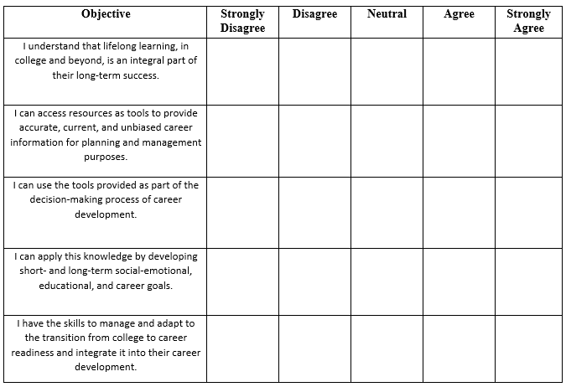
Evaluation
Career well-being survey
  Has their well-being increased?
Career development program survey – were the objectives met?
  Understand that lifelong learning, in college and beyond, is an integral part of their long-term success
  Access resources as tools to provide accurate, current, and unbiased career information for planning and management purposes
  Use the tools provided as part of the decision-making process of career development
  Apply this knowledge by developing short- and long-term social-emotional, educational, and career goals
  Manage and adapt to the transition from college to career readiness and integrate it into their career development
Notes:
To determine if the intended outcome is achieved, students will be given the career well-being survey again to determine if their career well-being has increased. In addition, they will be given a program survey to determine if the objectives were met. This survey will ask questions based on a five-point scale from strongly disagree, disagree, neutral, agree, and strongly agree. The objectives listed are:
I understand that lifelong learning, in college and beyond, is an integral part of my long-term success.
I can access resources as tools to provide accurate, current, and unbiased career information for planning and management purposes.
I can use the tools provided as part of the decision-making process of career development.
I can apply this knowledge by developing short- and long-term social-emotional, educational, and career goals.
I have the skills to manage and adapt to the transition from college to career readiness and integrate it into my career development.
The results of these surveys will determine program improvement initiatives. Initially, in the career well-being survey, a score of 23 or higher was considered maladaptive. To signify program effectiveness, the average score should be lower than 23. The further it deviates from 23, the better. When measuring if the objectives were learned, there was a five-point scale (strongly disagree=1, disagree=2, neutral=3, agree=4, and strongly agree=5). If the scores on the five-question survey average from 22-25 points, then the program objectives were securely reached. 18-21 points, somewhat reached, 17 points or less means significant program improvement must take place.

Slide 16
References
American School Counselor Association (2021). ASCA student Standards: mindsets and behaviors
for student success. Alexandria, VA: Author.
Boo, S., & Kim, S. (2020). Career indecision and coping strategies among undergraduate
students. Journal of Hospitality & Tourism Education, 32(2), 63-
76. https://doi.org/10.1080/10963758.2020.1730860
National Career Development Association. (2004). National career development guidelines
framework. Author.
https://www.ncda.org/aws/NCDA/asset_manager/get_file/3384?ver=7802067
National Center for O*NET Development. (2023). O*NET Resource Center: Interest Profiler.
Retrieved from O*NET Online website: https://www.onetcenter.org/IP.html

Slide 17
References
Park, I., Lee, J., Kim, M., Kim, J., & Jahng, S. (2019). Affect in daily career decision Self‐Efficacy
and career choice anxiety. The Career Development Quarterly, 67(4), 313-
326. https://doi.org/10.1002/cdq.12201
U.S. Bureau of Labor Statistics. (2022). Occupational Outlook Handbook. U.S. Bureau of Labor
Statistics. Retrieved from BLS Online website: https://www.bls.gov/ooh/occupation-
finder.htm?pay=&education=&training=&newjobs=&growth=&submit=GO
Utah State University (2022). Office of analysis, assessment and accreditation.
https://www.usu.edu/aaa/enroll_infographic.cfm
Zhang, H., Wang, D., Hou, Z., Zhu, J., Jiang, Y., & Chen, S. (2022). Career indecisiveness and
parent–child expectation incongruence in self-reliance: Does psychological separation buffer the
link? Personality and Individual Differences, 198,
111800. https://doi.org/10.1016/j.paid.2022.111800

