Slide 1
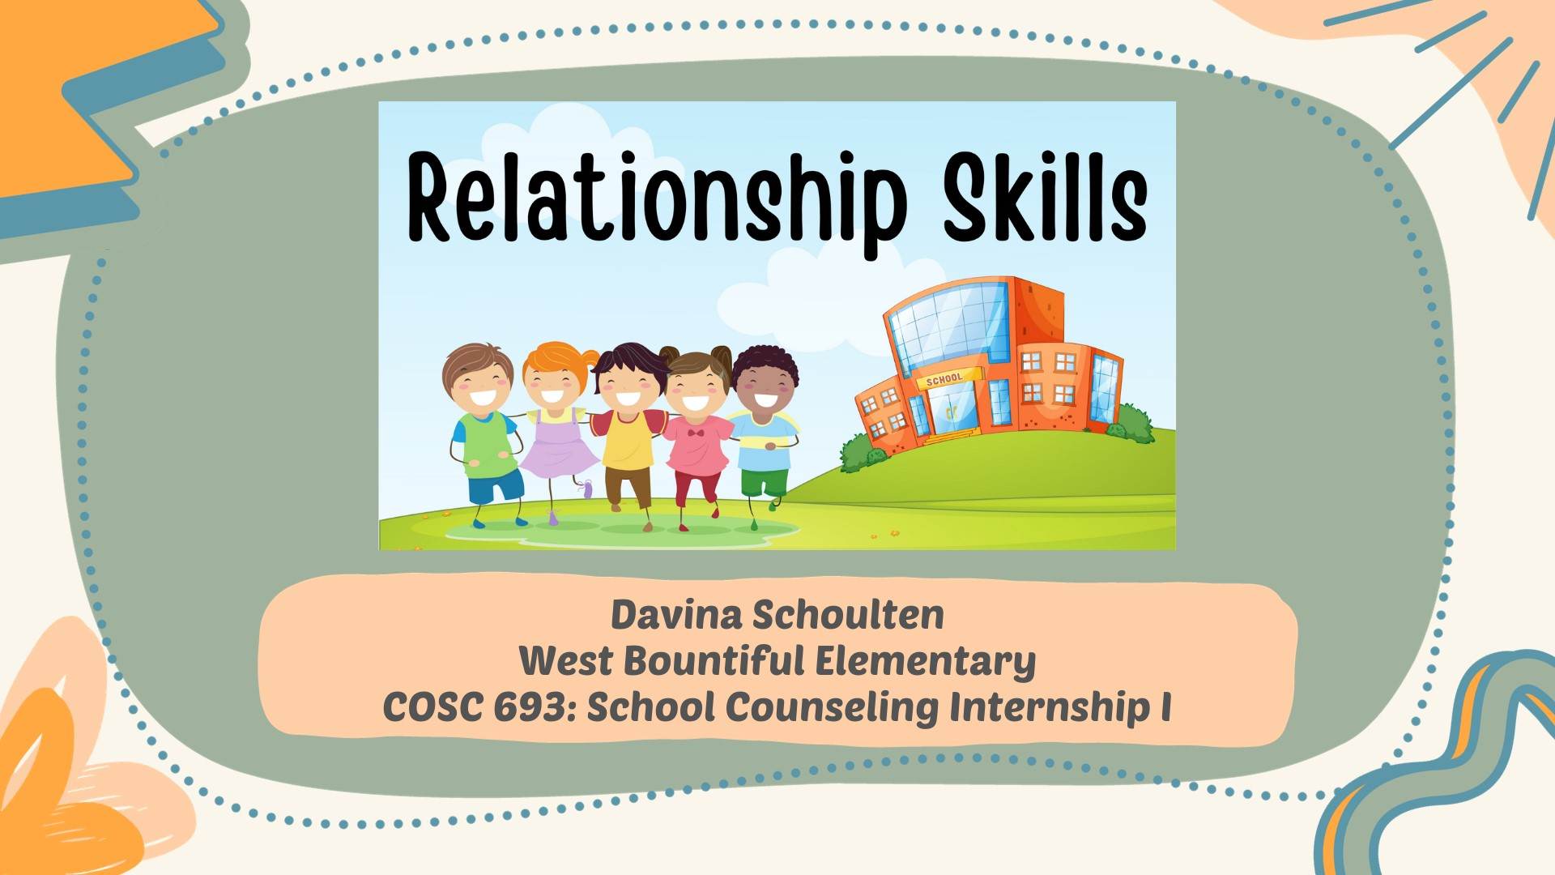
Notes:
This culminating project is a third-grade guidance unit comprising four lessons on relationship skills. Developed for COSC 693: School Counseling Internship I by Davina Schoulten.

Slide 2
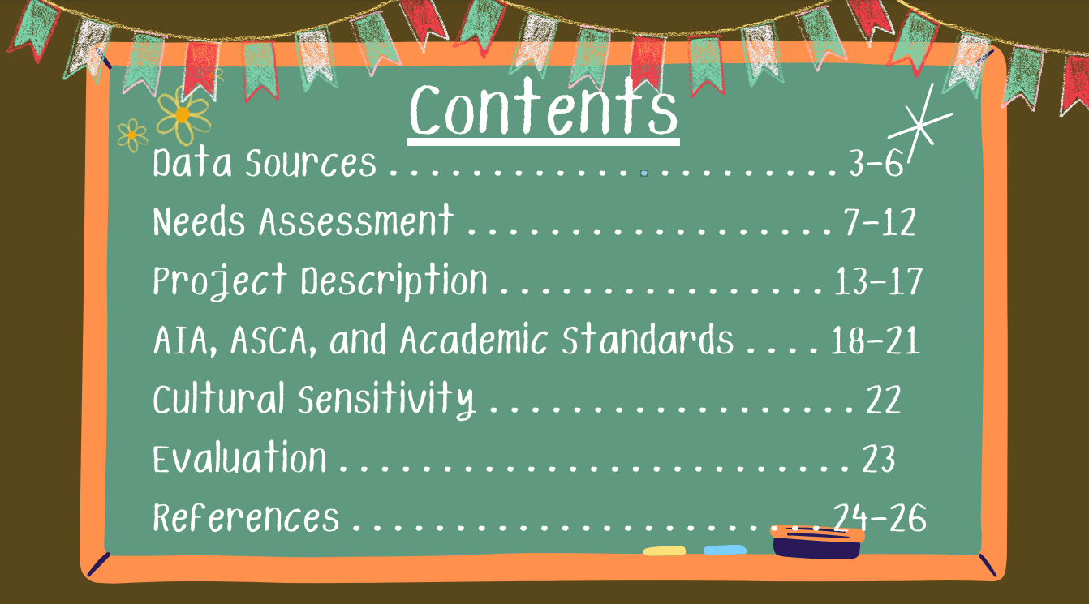
2
2
Notes:
The following items will be included in this culminating PowerPoint project: data sources, needs assessment, project description, standards alignments, cultural sensitivity, evaluation, and references.

Slide 3

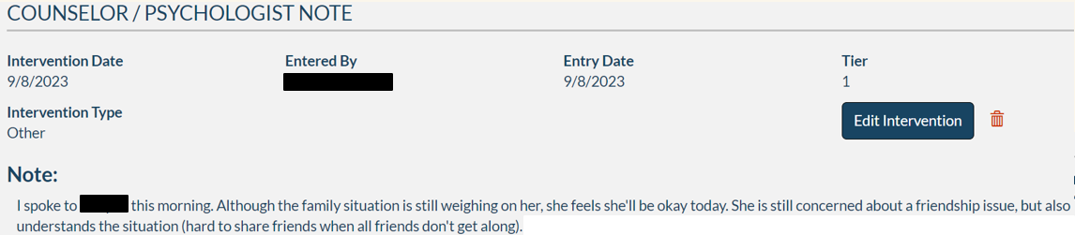
Data Sources
Encore: School database system listing behavioral interventions
Notes:
One data source is from Encore, the district’s online documentation system. This system documents interventions, discipline, academics, and behavior. Through this system, teachers, counselors, psychologists, and administration can document emails, phone calls, and classroom interventions and behaviors. This is a cumulative documentation system throughout the district. This information is accessible over time and helps glean an ovearll picture of behaviors and academics.

Slide 4
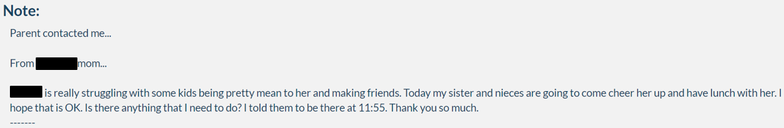
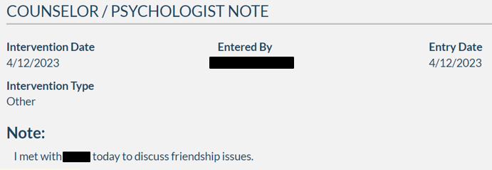
Data Sources
Parent Emails
Notes:
Parent Emails are significant sources of data. Through Encore, counselors and other stakeholders are able to view parent emails. This helps validate a need for individual counseling, group counseling, or classroom lessons.

Slide 5
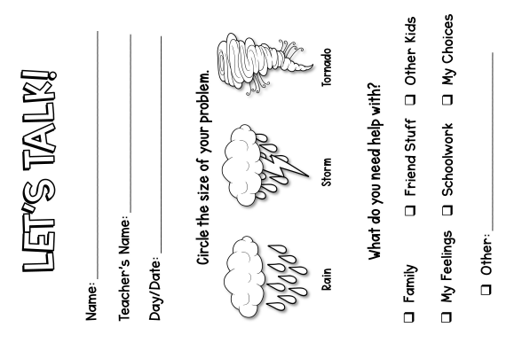
Data Sources
Self-Referrals
Notes:
Teacher, administration, and self-referrals are also data sources used for this classroom guidance unit. Students self-refer, and often due to friendship concerns. Teachers and administration can fill out a “Let’s Talk” slip or email their concerns as well.

Slide 6
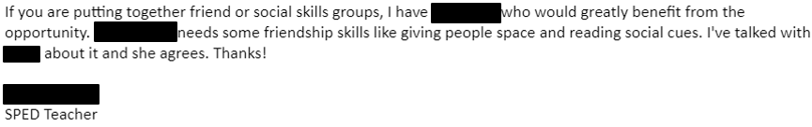
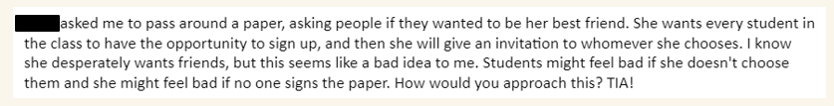
Data Sources
Teacher Emails
Notes:
The following is an example of teacher emails indicating a need for counseling on relationship skills.

Slide 7

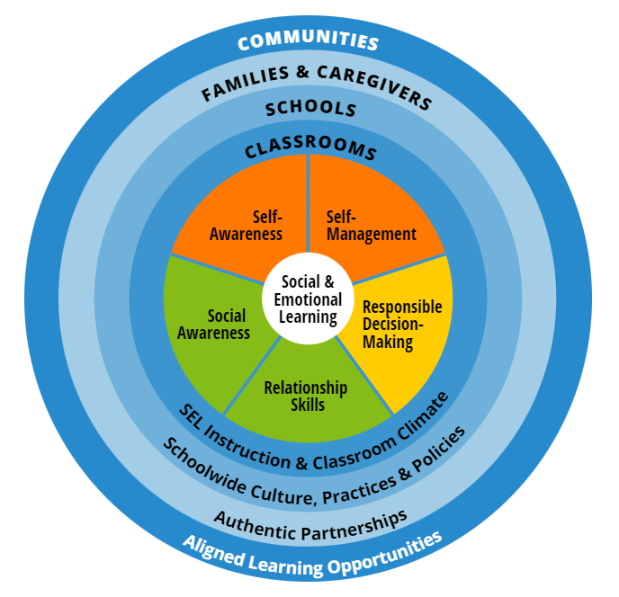
Needs Assessment
Teacher Survey: Based on CASEL Framework
Notes:
A teacher survey was created based on the CASEL framework (CASEL, 2023). Teachers were asked to rank these categories based on student needs. I structured my guidance lessons around this survey. The second highest ranked area was relationship skills. Self-awareness will also be a classroom guidance unit this school year.

Slide 8
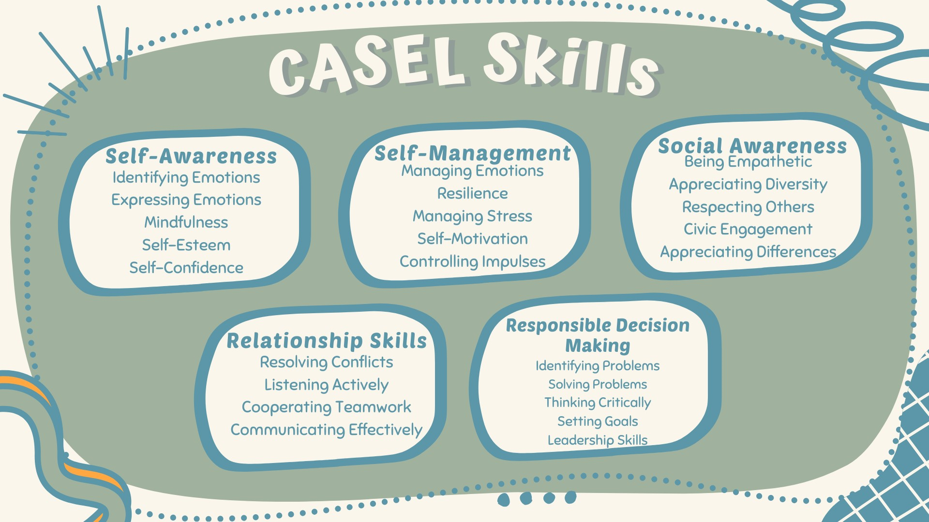
Notes:
To ensure teachers fully understand each CASEL skill in the survey, I incorporated correlating topics for each skill.

Slide 9
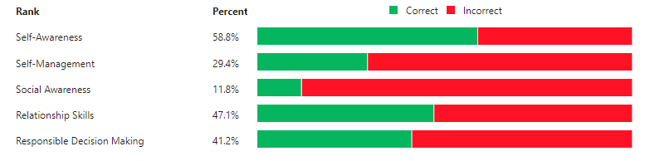
Needs Assessment
Teacher Survey Results
Notes:
These are the results of the needs assessment teacher survey. Self-awareness will be addressed this school year since it is the highest ranked need based on teacher input. I will also address relationship skills, as noted in this culminating project.

Slide 10
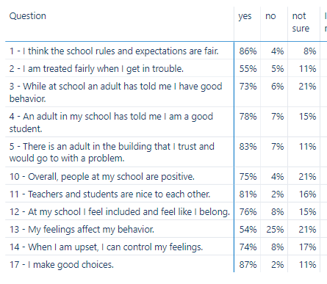
Needs Assessment
School Climate Survey
Notes:
This information was gathered through our PowerBI application as reported on our student school climate survey. I noted responses that pertain to relationship skills. For instance, question 11 states, “Teachers and students are nice to each other.” Alarmingly, 18% of students said no or were not sure. In addition, 23% of students stated either “no” or “not sure” about feeling included or feeling like they belong (question 12).

Slide 11
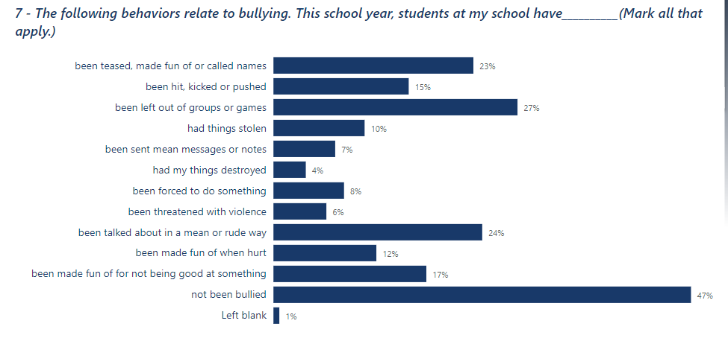
Needs Assessment
Notes:
Furthermore, question 7 asks, “The following behaviors relate to bullying. This school year, students at my school have…(mark all that apply). 47% of students said, “Not been bullied.” However, the second highest ranked option is, “Been left out of groups or games,” followed by, “Been talked about in a mean or rude way,” and “Been teased, made fun of or called names.” This is an indicator for a relationship skills unit.

Slide 12
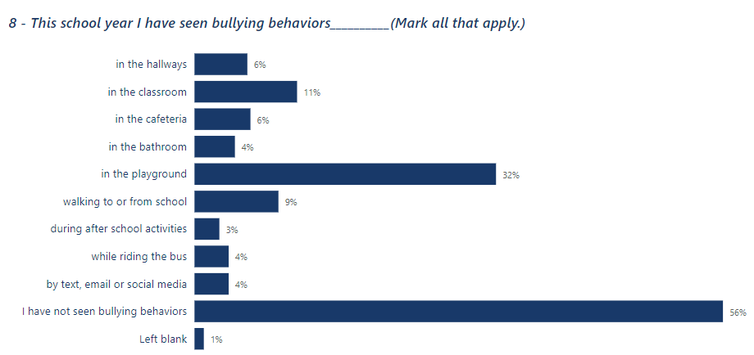
Needs Assessment
Notes:
Finally, question eight askes, “This school year I have seen bullying behaviors…(mark all that apply). Although the top answer is, “I have not seen bullying behaviors,” the next selection states, “In the playground.” Again, this indicates that students’ relationship skills seem to suffer during less structured times, like recess.

Slide 13

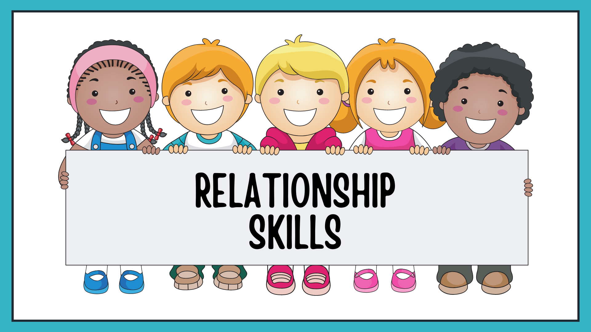
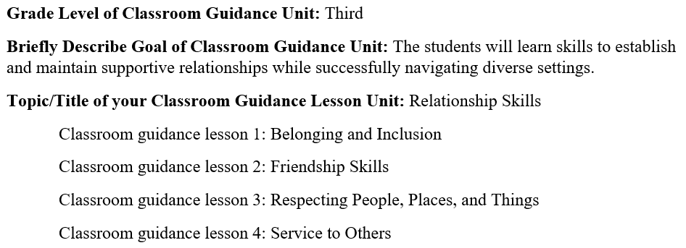
Project Description
Notes:
Based on the data, relationship skills should be incorporated in the school counseling program. In this classroom guidance unit, students will learn skills to establish and maintain supportive relationships while navigating settings with different social and cultural demands. These skills include how to build and maintain healthy friendships, belonging, inclusion, service to others, and respecting people, places, and things.

Slide 14
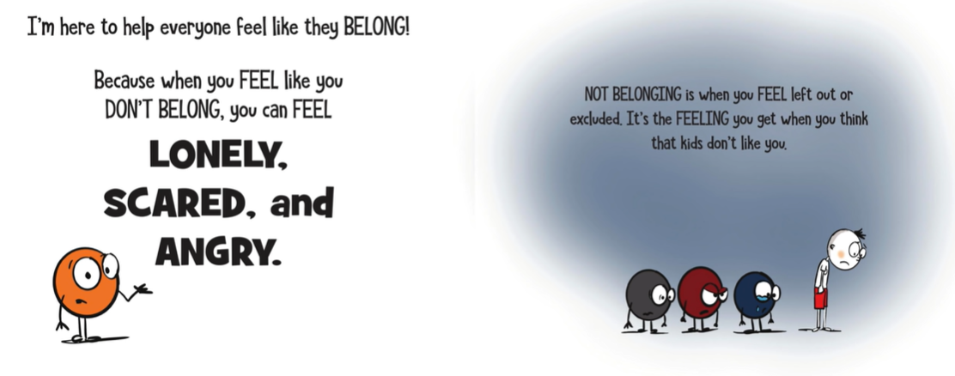
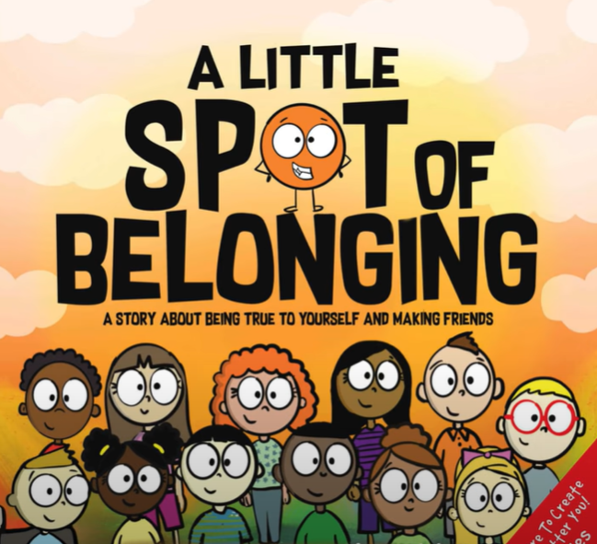
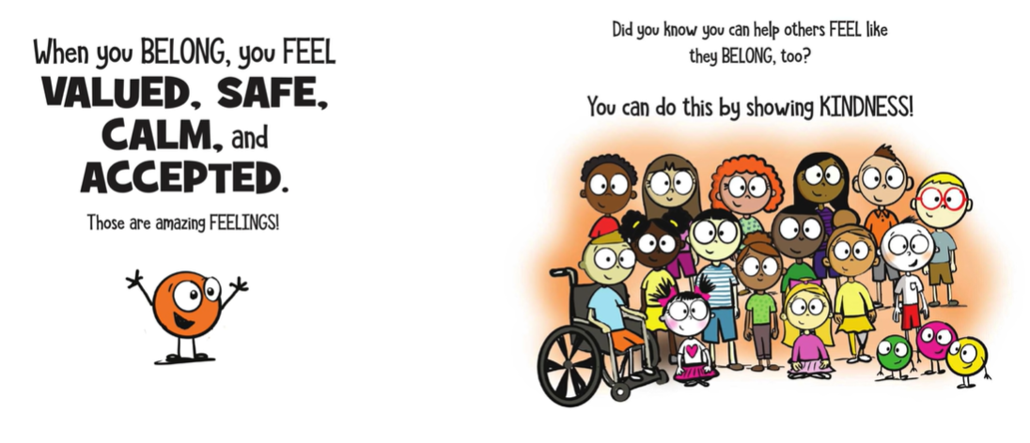
Project Description
Notes:
In a case study of preschool children, it was found that bibliotherapy had positive effects on children's helping and sharing behaviors (Akgün & Belli, 2019). In addition, a study of primary school children showed bibliotherapy techniques are effective in improving the prosocial behavior of students (Chitra & Noor, 2019).

Slide 15

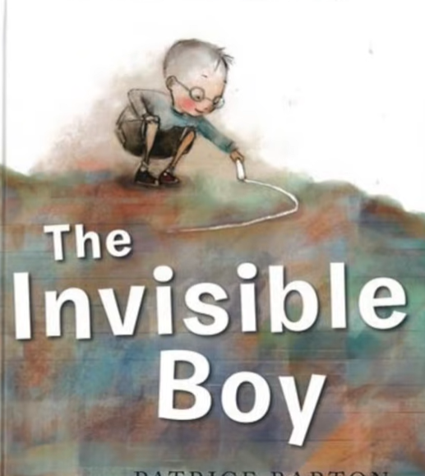
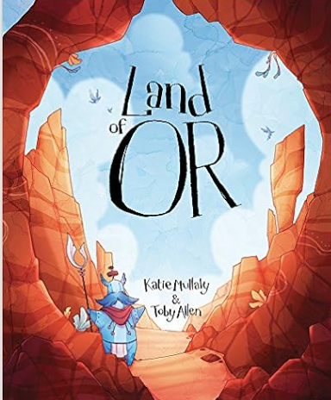
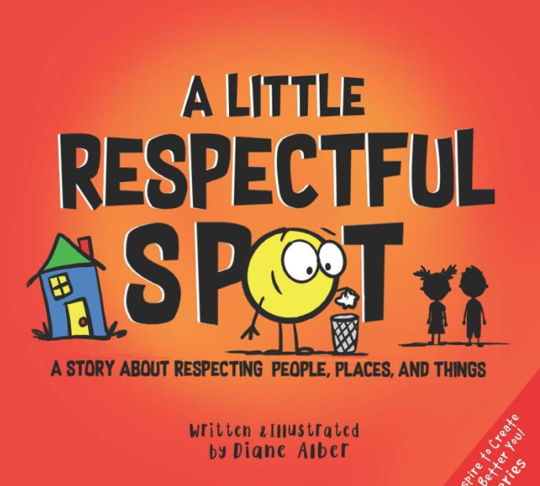
Project Description
Notes:
In this unit several books will help promote the idea of belonging, inclusion, friendship skills, responsibility to ourselves and others, and respecting people, places, and things. The books used are A Little Spot of Belonging (Alber, 2021), The Invisible Boy (Ludwig, 2013), Land of Or (Mullaly, 2015), and A Little Respectful Spot (Alber, 2020).

Slide 16
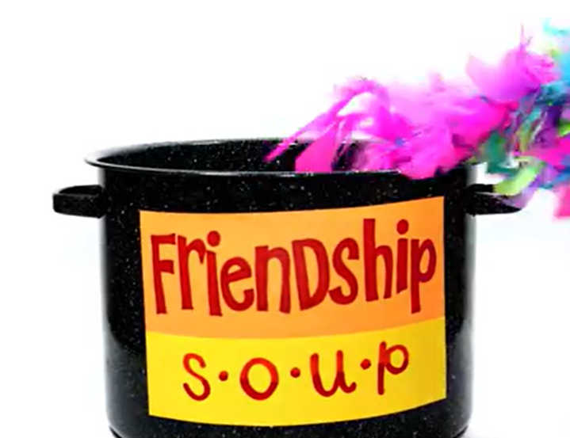
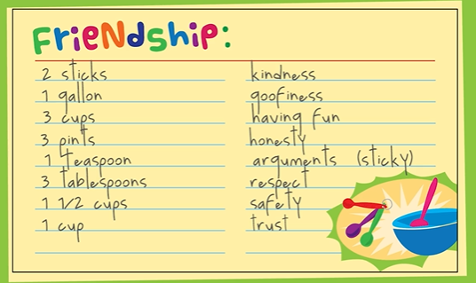
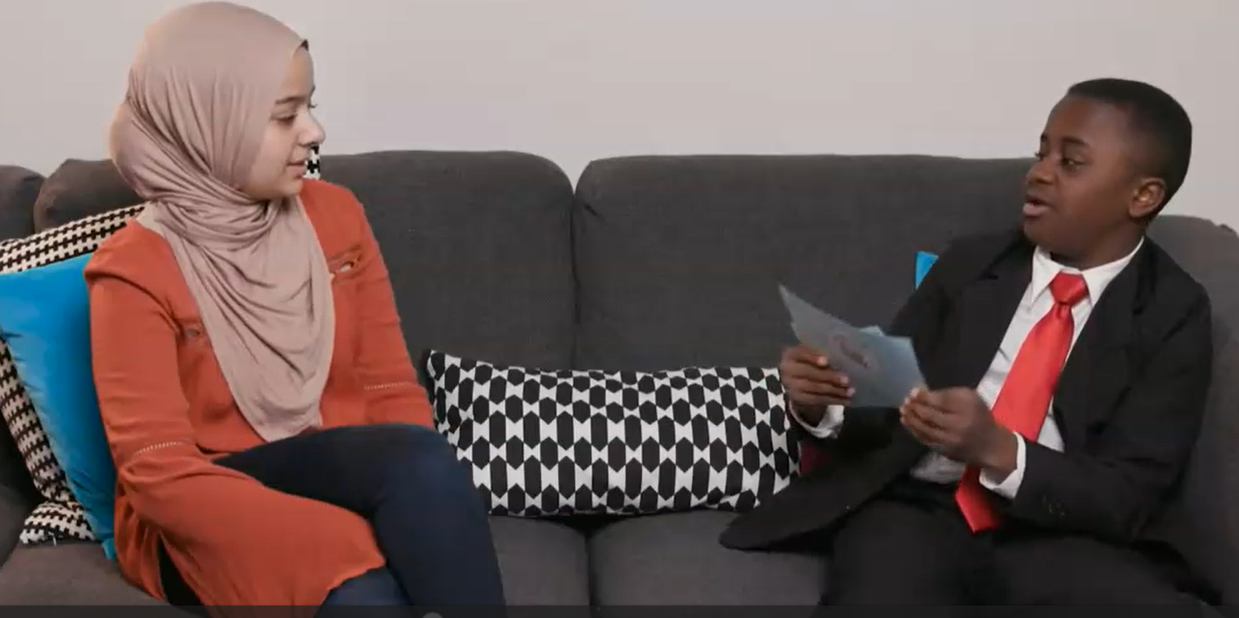
Project Description
Notes:
Beyond bibliotherapy, I try to engage the students with various videos and activities to keep them engaged while meeting our objectives. They really enjoy Kid President’s videos (SoulPancake, 2016). Another short video I included is “Friendship Soup” from the Ned Show (n.d.). Various activities include identifying qualities of a good friend and developing an acrostic poem using these qualities.

Slide 17
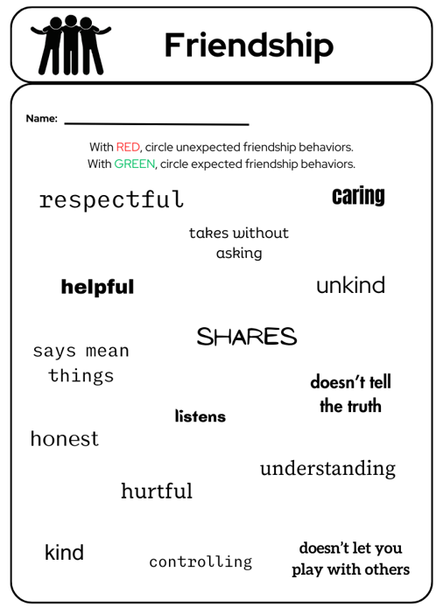
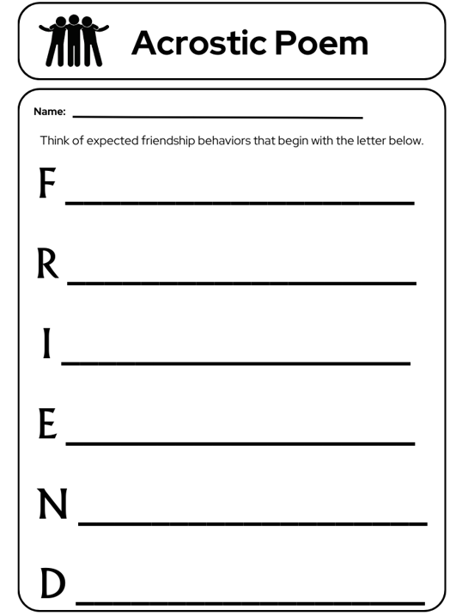
Project Description
Notes:
This is an example of some of the activities I incorporated in my lessons. Identifying expected and unexpected friendship behaviors and the acrostic poem allows differentiation of instruction for multiple levels of achievement.

Slide 18


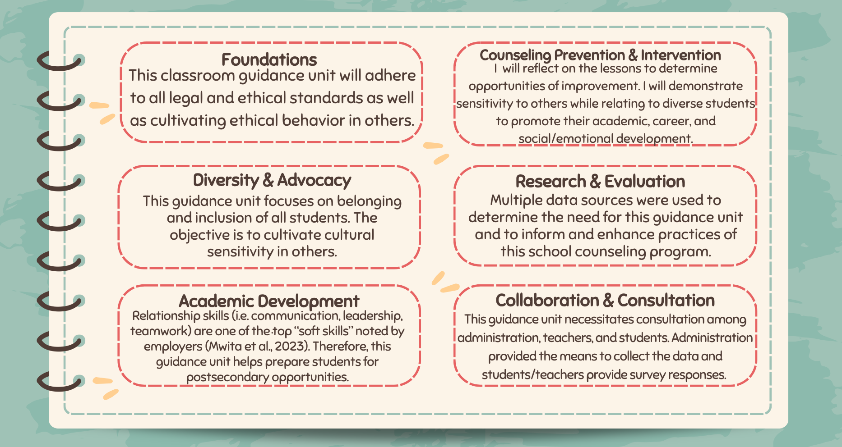
AIA Specialty Standards
Notes:
The following are AIA Specialty Standards (Liberty University, 2023) associated with this classroom guidance unit. It includes Foundations, Counseling Prevention and Intervention, Diversity and Advocacy, Research and Evaluation, Academic Development, and Collaboration and Consultation.

Slide 19

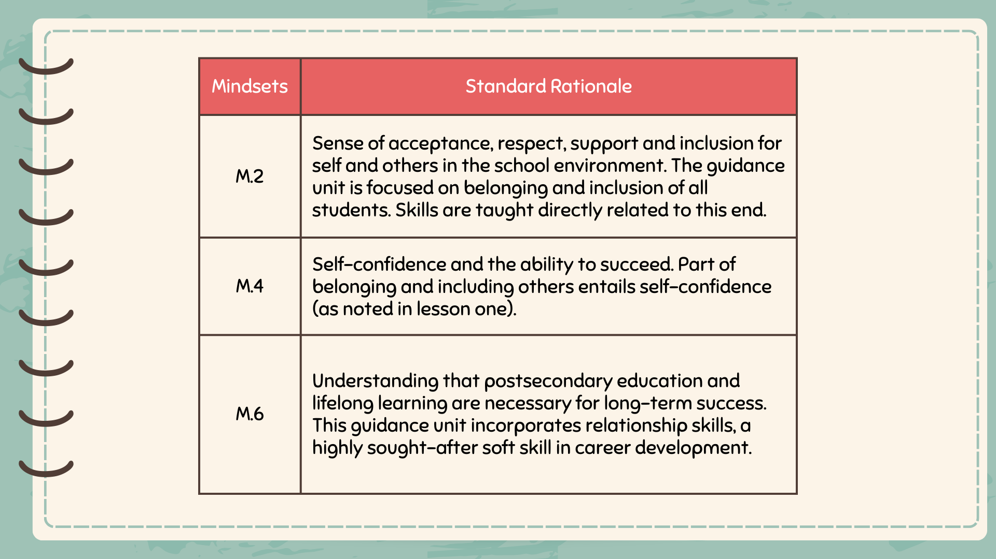
ASCA Mindsets & Behaviors
Notes:
The following are the ASCA Mindset Standards associated with this guidance unit (ASCA, 2021).

Slide 20
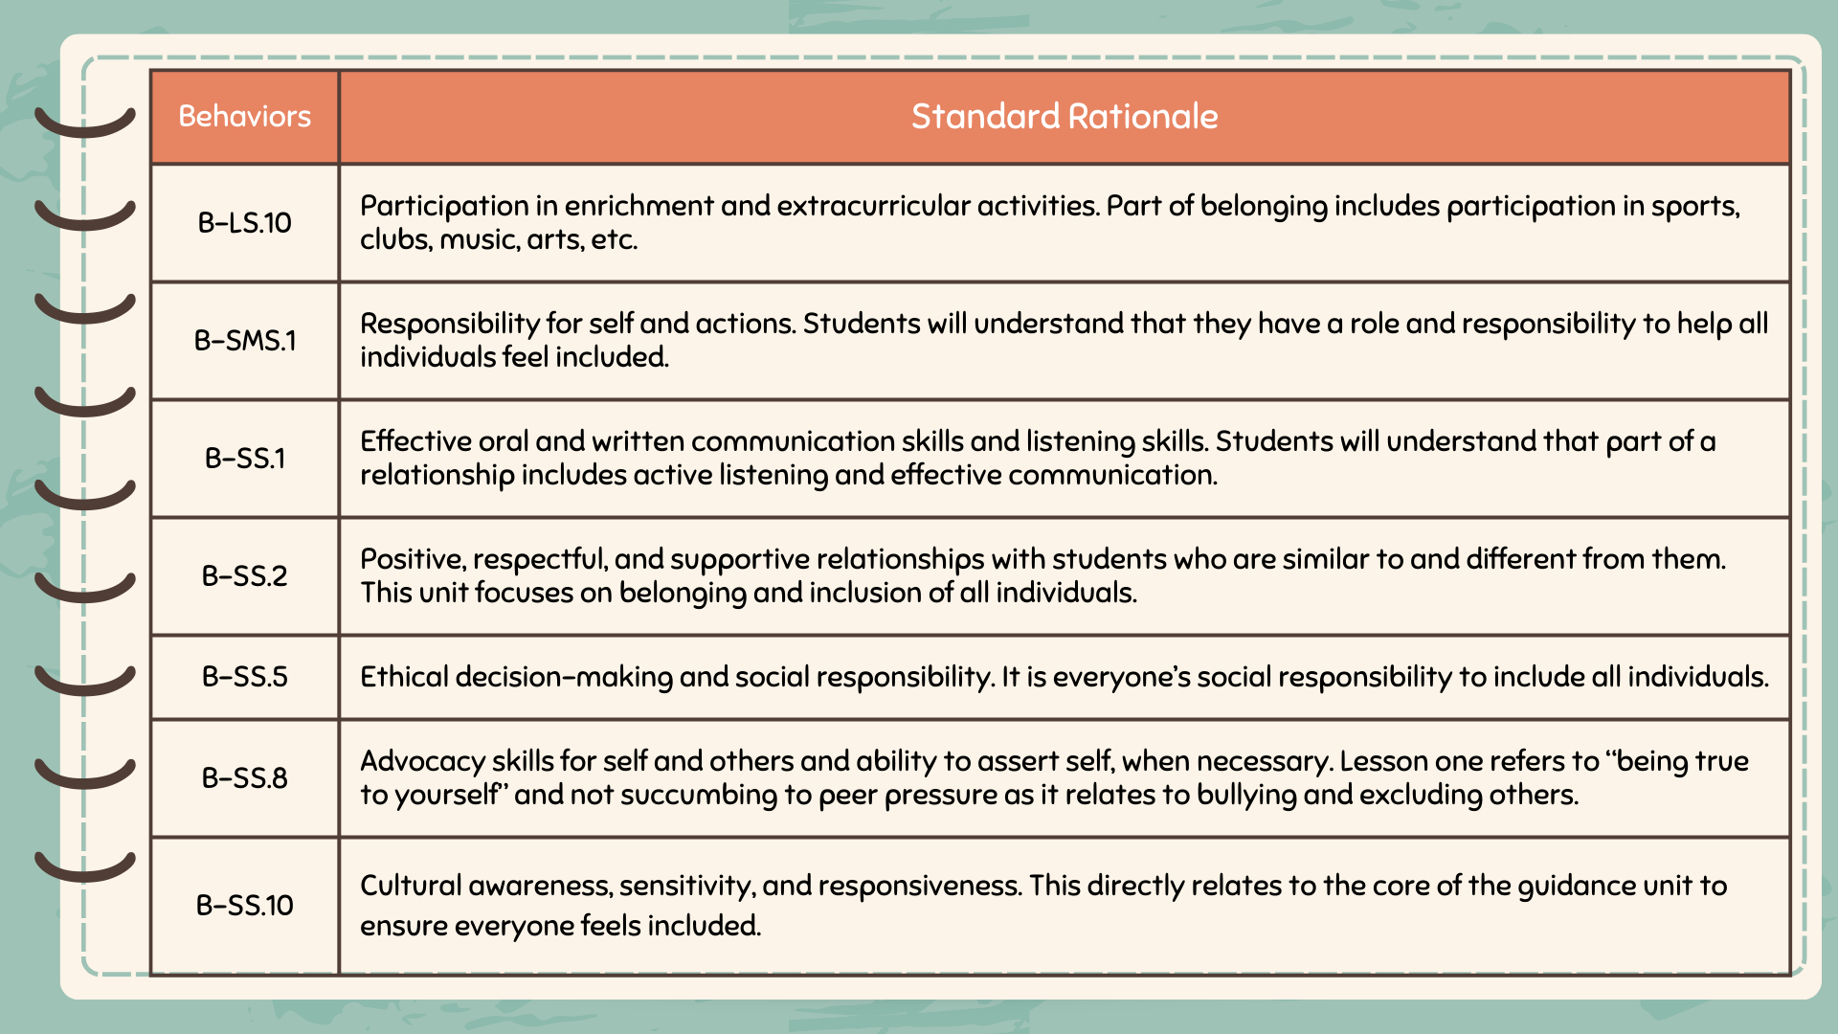
ASCA Mindsets & Behaviors
Notes:
The following are the ASCA Behavior Standards associated with this lesson (ASCA, 2021).

Slide 21

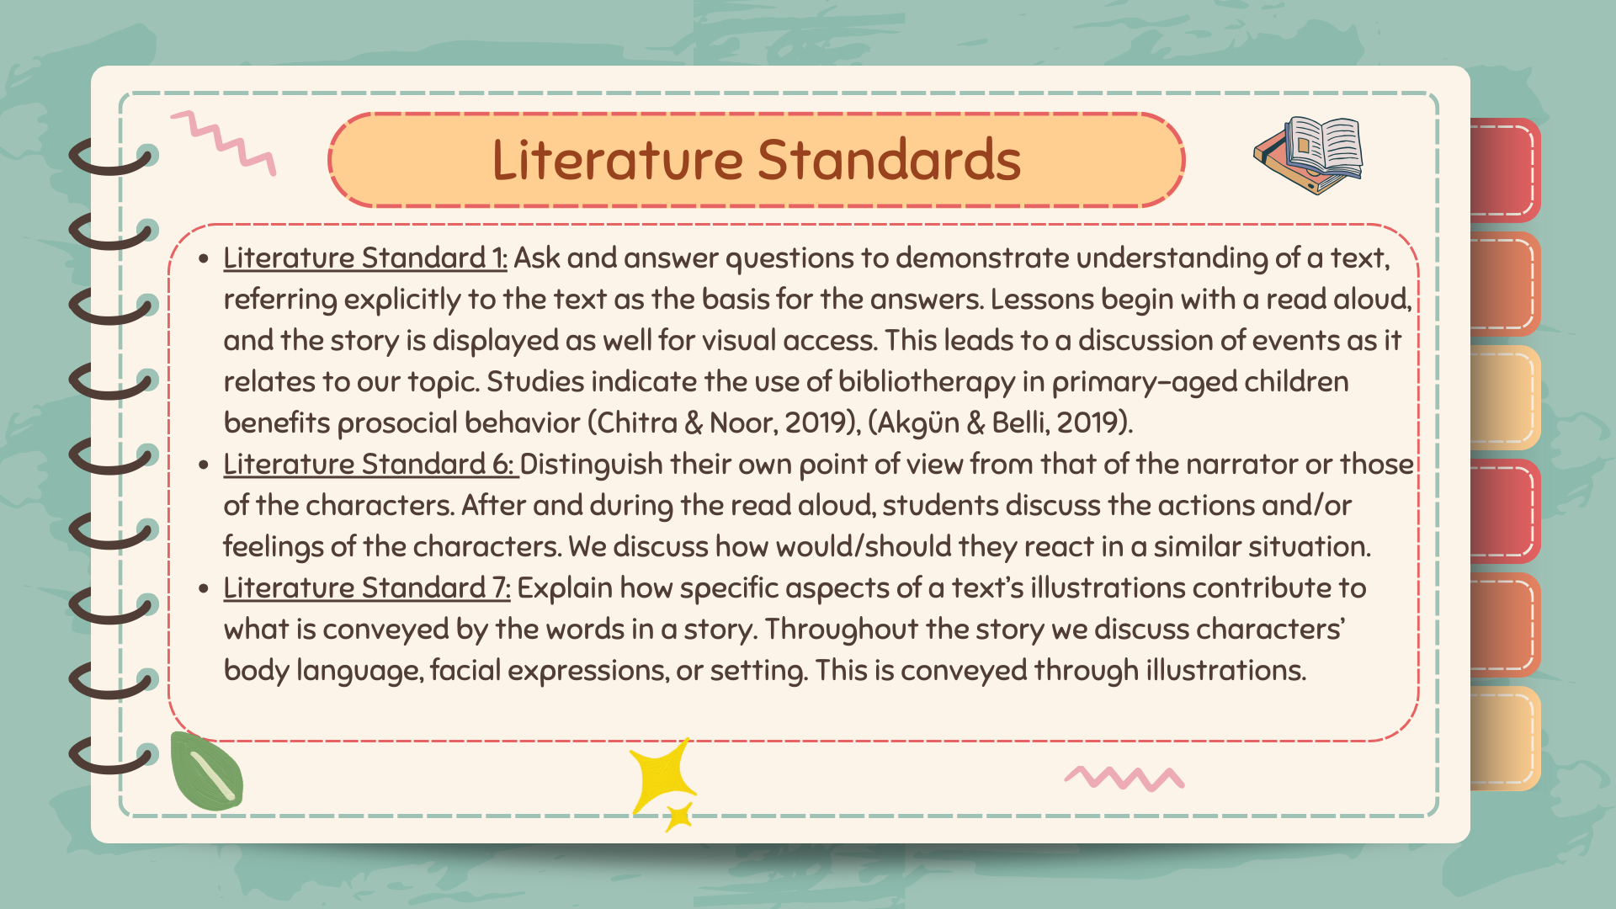
Academic State Standards
Notes:
Each lesson will be introduced through the use of books associated with the topic. This correlates with Utah Core Literature Standards (USBE, n.d.).

Slide 22
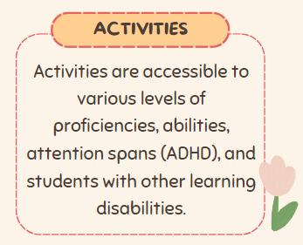
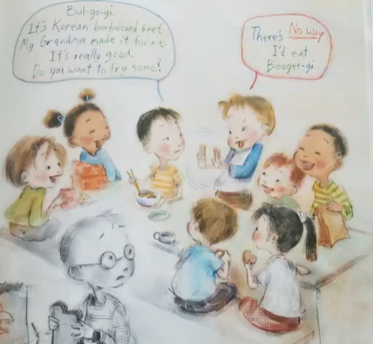
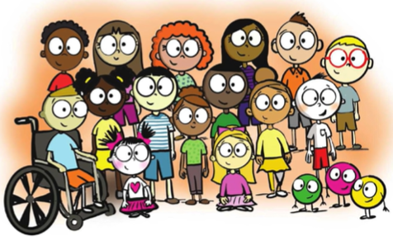
Cultural Sensitivity
Fosters relationship skills while equitably reaching all students
Content considers various backgrounds and ethnicities
Visual representations are culturally inclusive
Norms are reiterated to provide a safe learning environment
Notes:
This classroom guidance unit is culturally sensitive in various ways. First, it fosters students’ relationship skills while equitably reaching and teaching students of all backgrounds. It is culturally sensitive and considers a wide array of backgrounds, ethnicities, and belief systems. Visual representations in books, videos, and PowerPoints encompass multiple ethnicities while activities are accessible to various levels of learning to allow for differentiation.

Slide 23



Evaluation
Are referrals decreasing?
Are teachers experiencing less student conflict during unstructured times?
Did the results of school climate survey improve?
Are self-referrals decreasing?
Notes:
The evaluation of this unit includes teacher collaboration, administration input, school climate survey, and student self-referrals. Do teachers notice a reduction in friendship conflicts after the unit is taught? Are there fewer referrals to administration? Have our school climate survey results shown an improvement in belonging and relationship skills? Have student self-referrals for friendship issues decreased?

Slide 24

References
Akgün, E., & Belli, G. (2019). Bibliotherapy with preschool children: A case study. Psikiyatride Guncel Yaklasimlar, 11(1), 100. https://doi.org/10.18863/pgy.392346
Alber, D. (2021). A little spot of belonging : A story about being true to yourself and making friends. Diane Alber Art, LLC.
Alber, D. (2020). A little respectful spot: A story about respecting people, places, and things. Diane Alber Art, LLC.
American School Counselor Association (2021). ASCA Student Standards; Mindsets and Behaviors for Student Success. Alexandria, VA: Author
What is the CASEL Framework?. CASEL. (2023, March 3). https://casel.org/fundamentals-of-sel/what-is-the-casel-framework/
Chitra, C. I., & Noor, M. (2019). Development of guidance and counseling’s model services with bibliotherapy techniques to improve prosocial behavior for students of primary school. Journal of Physics: Conference Series, 1179(1). https://doi.org/10.1088/1742-6596/1179/1/012060
Notes:
The following are references used to create this culminating project.

Slide 25
References
Encore. (2023). Davis School District. https://dsdencore.davis.k12.ut.us
Liberty University. (2023). Advanced internship assessment (AIA) master of education in school counseling. https://www.liberty.edu/behavioral-sciences/counselor-ed/wp-content/uploads/sites/43/2021/02/ADVANCED-INTERNSHIP-ASSESSMENT_ASCA-1.pdf
Ludwig, T. (2013). The invisible boy. New York, Alfred A. Knopf.
Mullaly, K. (2015). Land of or. Faceted Press.
Mwita, K., Kinunda, S., Obwolo, S., & Mwilongo, N. (2023). Soft skills development in higher education institutions: Students’ perceived role of universities and students’ self-initiatives in bridging the soft skills gap. International Journal of Research in Business and Social Science, 12(3), 505-513. https://doi.org/10.20525/ijrbs.v12i3.2435

Slide 26
References
PowerBI. (2023). Davis School District. https://app.powerbi.com
Soul Pancake. (2016). Kid President’s Guide to Making Friends [Video]. YouTube. https://www.youtube.com/watch?v=OoHdwUEfBts&t=4s
The Ned Show. (n.d.). Friendship Soup. http://www.thenedshow.com/friendship-soup.html
The Responsive Counselor. (n.d.). School Counseling Self-Referral System.. https://shop.theresponsivecounselor.com/product/school-counseling-office-decor-bundle/
Utah State Board of Education. (n.d.). English Language Arts Grade 3 Core. Utah Education Network. https://www.uen.org/core/core.do?courseNum=4230

