Slide 1
Parent-
Teacher
Presentation
Sarah DeVoe
Liberty University
srdevoe@liberty.edu

Slide 2

Comprehensive Program Elements

Slide 3
Comprehensive Program Elements
Our Mission: Provide students with equal access to a high-quality school counseling program that improves social/emotional, academic, and career outcomes.
Our Vision: Students will be able to gain a positive sense of self, motivation toward their goals, and belief in their abilities. They will leave our school prepared for high school and beyond.
Our Beliefs: Every student can succeed. Every student deserves access to a comprehensive school counseling program that is supported by data. Our school counseling program improves student outcomes.
(ASCA, 2019 & DeVoe, 2022)

Slide 4
Comprehensive Program Elements
How does the school counseling program promote social/emotional, academic, and career development?
  Our mission is accomplished through the direct services of individual counseling, group counseling, and classroom lessons (ASCA, 2019).
  Our school counselors also perform indirect services that aid our mission including consulting and collaborating with other school faculty and mental health professionals, as well as making referrals (ASCA, 2019).
Empirical research supports the idea that school counseling programs improve social/emotional, academic, and career development (ASCA, 2022b).

Slide 5

Advocacy

Slide 6
Advocacy
Our school counselors act as advocates for the students in the classrooms, at home, and within the community.
We advocate for equitable access to educational opportunities, social/emotional wellbeing, and career opportunities.
We do this by:
  following the American School Counselor Association’s (ASCA) ethical standards as well as the Individuals with Disabilities Education (IDEA) act that states that every student has the right to free appropriate public education (Vernon & Schimmel, 2019).
  Ensuring inclusion for all students.
  Meeting the needs of our students.

Slide 7
Advocacy
School staff, parents, and community members can also act as advocates for the students.
This can be done by:
  Demonstrating inclusive perspectives (Hymel & Katz, 2019).
  Forming strong relationships with students and listening to their needs (Đurišić & Bunijevac, 2017).
  Providing opportunities for cross-group interaction (Hymel & Katz, 2019)
  Advocating for students' rights at the school district, state, and national level.

Slide 8

Access, Attainment & Achievement

Slide 9
Access, Attainment & Achievement
Access: Equitable opportunities for educational participation.
Attainment: Student progress reflected by personal, individual improvement.
Achievement: Student progress that is reflected by standard test results and grades.

Slide 10
Access, Attainment & Achievement
Cultural, ethical, socio-economic, legal, and political issues are all factors that may contribute to or hinder school access, attainment, and achievement.
School counselors consider the potential gaps caused by these factors and how to address them.
Cultural
English learning resources.
Ethical
Under-representation of students of color in honors classes.
Socio-economic
Laws blocking LGBTQ+ students from the resources they need.
Legal
Political Issues
Students not being able to afford school supplies.
Educational accessibility to students with disabilities.

Slide 11

Barriers to Student Development

Slide 12
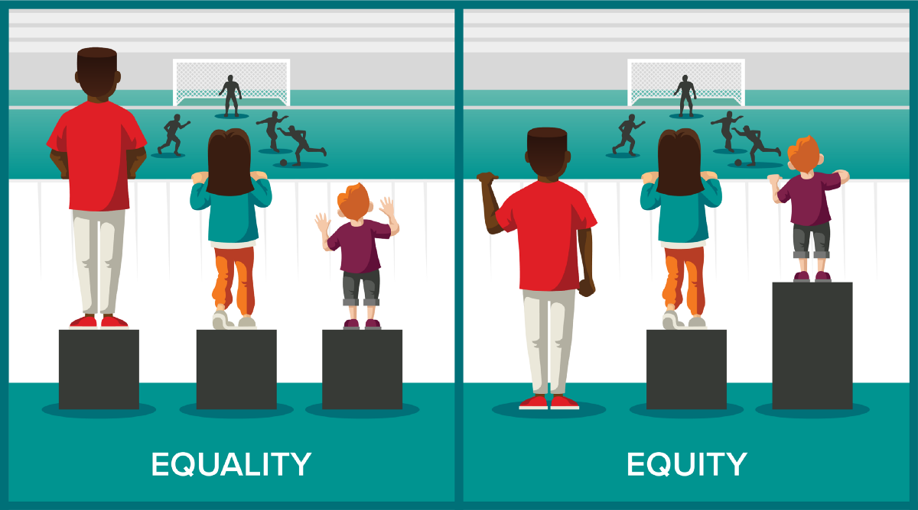
Barriers to Student Development
Previously discussed cultural, ethical, socio-economic, legal, and political issues can impact students' academic achievement, social/emotional well-being, and postsecondary opportunities.
This is why we insist on equity within the school.

Slide 13
Barriers to Student Development
We acknowledge that implicit biases held by school staff can act as a barrier to student development.
  This is why school counselors hold to the American School Counselor Association ethical standards that advocate for examining and eliminating these biases (ASCA, 2022a).
  We encourage all school staff to examine their personal biases, so that they do not allow them to impede student development.

Slide 14
Barriers to Student Development
Barriers to student development directly relates to issues in access, attainment and achievement as well as advocacy.
School counselors perform assessments to look for gaps and address them by advocating for or providing resources (ASCA, 2019).
For example, if an assessment shows that our students have low rates of post-secondary participation, school counselors may emphasize post-secondary opportunities in individual counseling, group counseling, and classroom lessons.
Barriers to Student Development
Advocacy
Gaps in access, attainment & achievement.
School Counselors advocate to close these gaps.

Slide 15
Thank you!
Thank you all for taking the time to listen to our school counseling program’s presentation. You are already taking steps to advocate for the students by spending time that will directly contribute to our student's positive development!

Slide 16

References:
American School Counselor Association. (2019). ASCA national model: A framework for school counseling programs (4th ed.).
American School Counselor Association. (2022a). ASCA Ethical Standards for School Counselors. https://www.schoolcounselor.org/getmedia/44f30280-ffe8-4b41-9ad8-f15909c3d164/EthicalStandards.pdf
American School Counselor Association. (2022b). Empirical research studies supporting the value of school counseling.
DeVoe, S.R. (2022). School counseling brochure. School of Education, Liberty University.
Đurišić, M., & Bunijevac, M. (2017). Parental Involvement as a Important Factor for Successful Education. Center for Educational Policy Studies Journal, 7(3), 137–153. https://doi.org/10.26529/cepsj.291
Hymel, S., & Katz, J. (2019). Designing Classrooms for Diversity: Fostering Social Inclusion. Educational Psychologist, 54(4), 331–339. https://doi.org/10.1080/00461520.2019.1652098
Vernon, A. & Schimmel, C.J. (2019). Counseling Children and Adolescents (5th Edition). Cognella Academic Publishing.

