Slide 1
Kindergarten Friendship Small Group
Here’s what we learned this week!

Slide 2
Kindergarten Friendship Small Group
The goal of this group will be to help students learn skills that will help them make and maintain healthy friendships. This group will meet once a week for 9 weeks for 45 minutes and it will include your child's lunch time.
In the group, we will learn and practice the following skills:
~ Identifying qualities of a good friend
~ Giving and asking for personal space
~ Listening and learning about others
~ Being kind to others and ourselves
~ Celebrating others accomplishments
Thank you for partnering in our school counseling program.

Slide 3
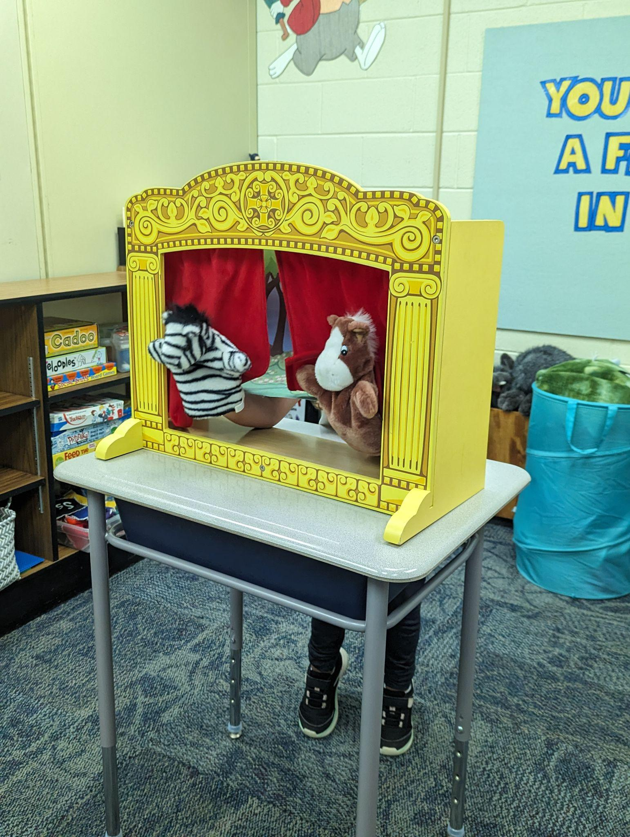
Week 1: Introduction + Qualities of a good friend
This week in our group we started off by getting to know one another! Everyone introduced themselves and shared what friendship means to us. Here is what some of the kiddos had to say about friendship:
“When someone is feeling sad we can be kind and be a friend.”
“My sister always shares with me, she is my friend.”
“Friendship means not saying mean things to your friends.”
Next we did a puppet show about a horse and a zebra who become friends.

Slide 4
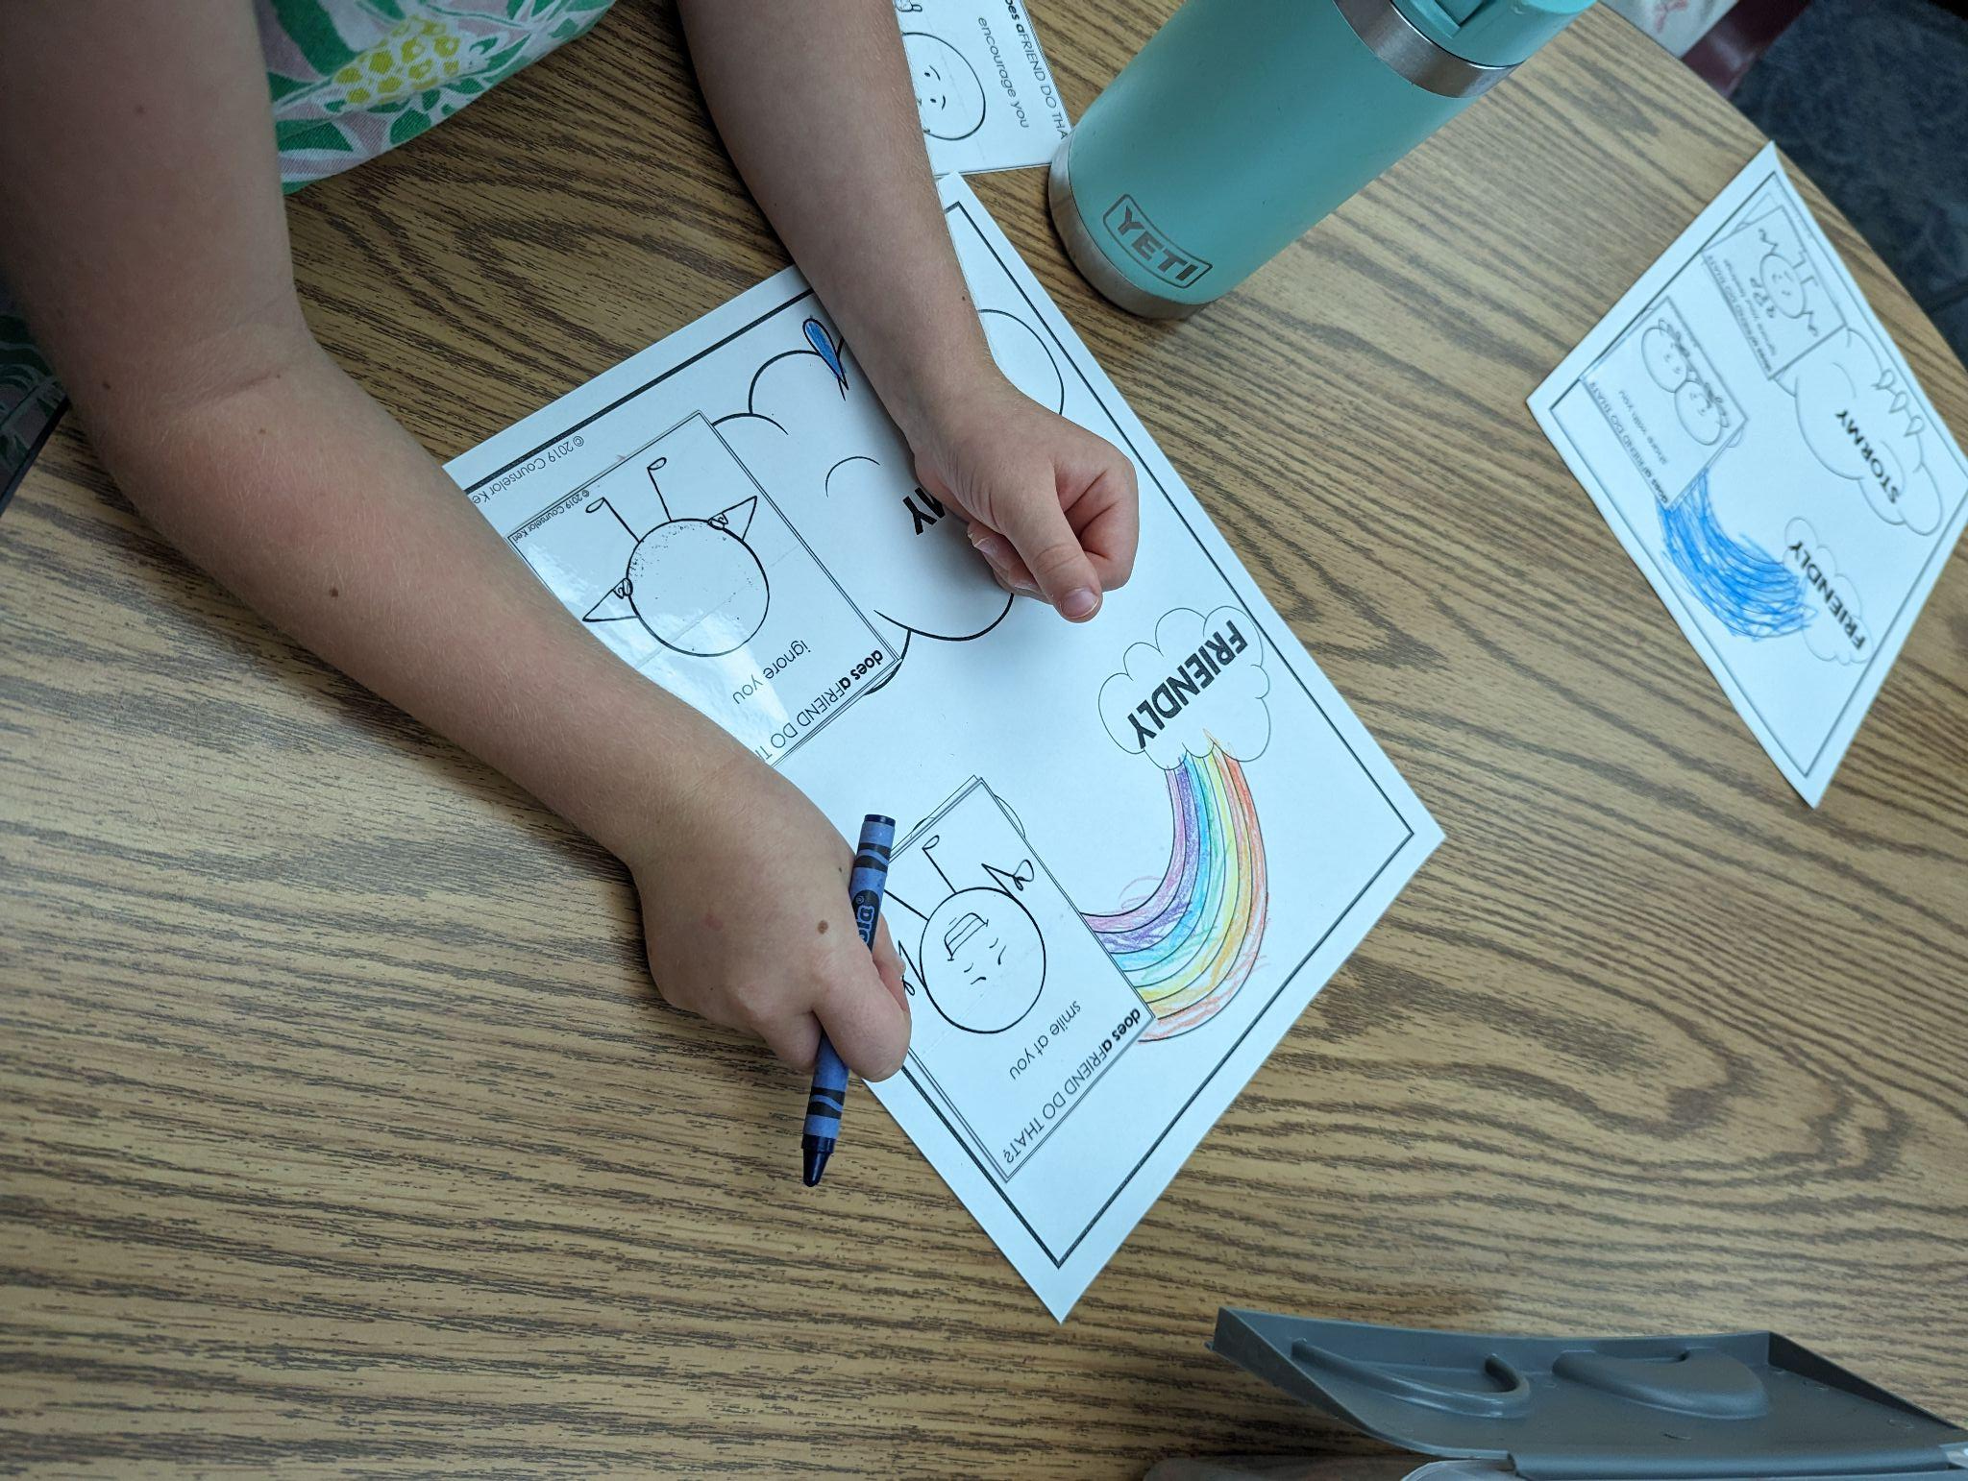
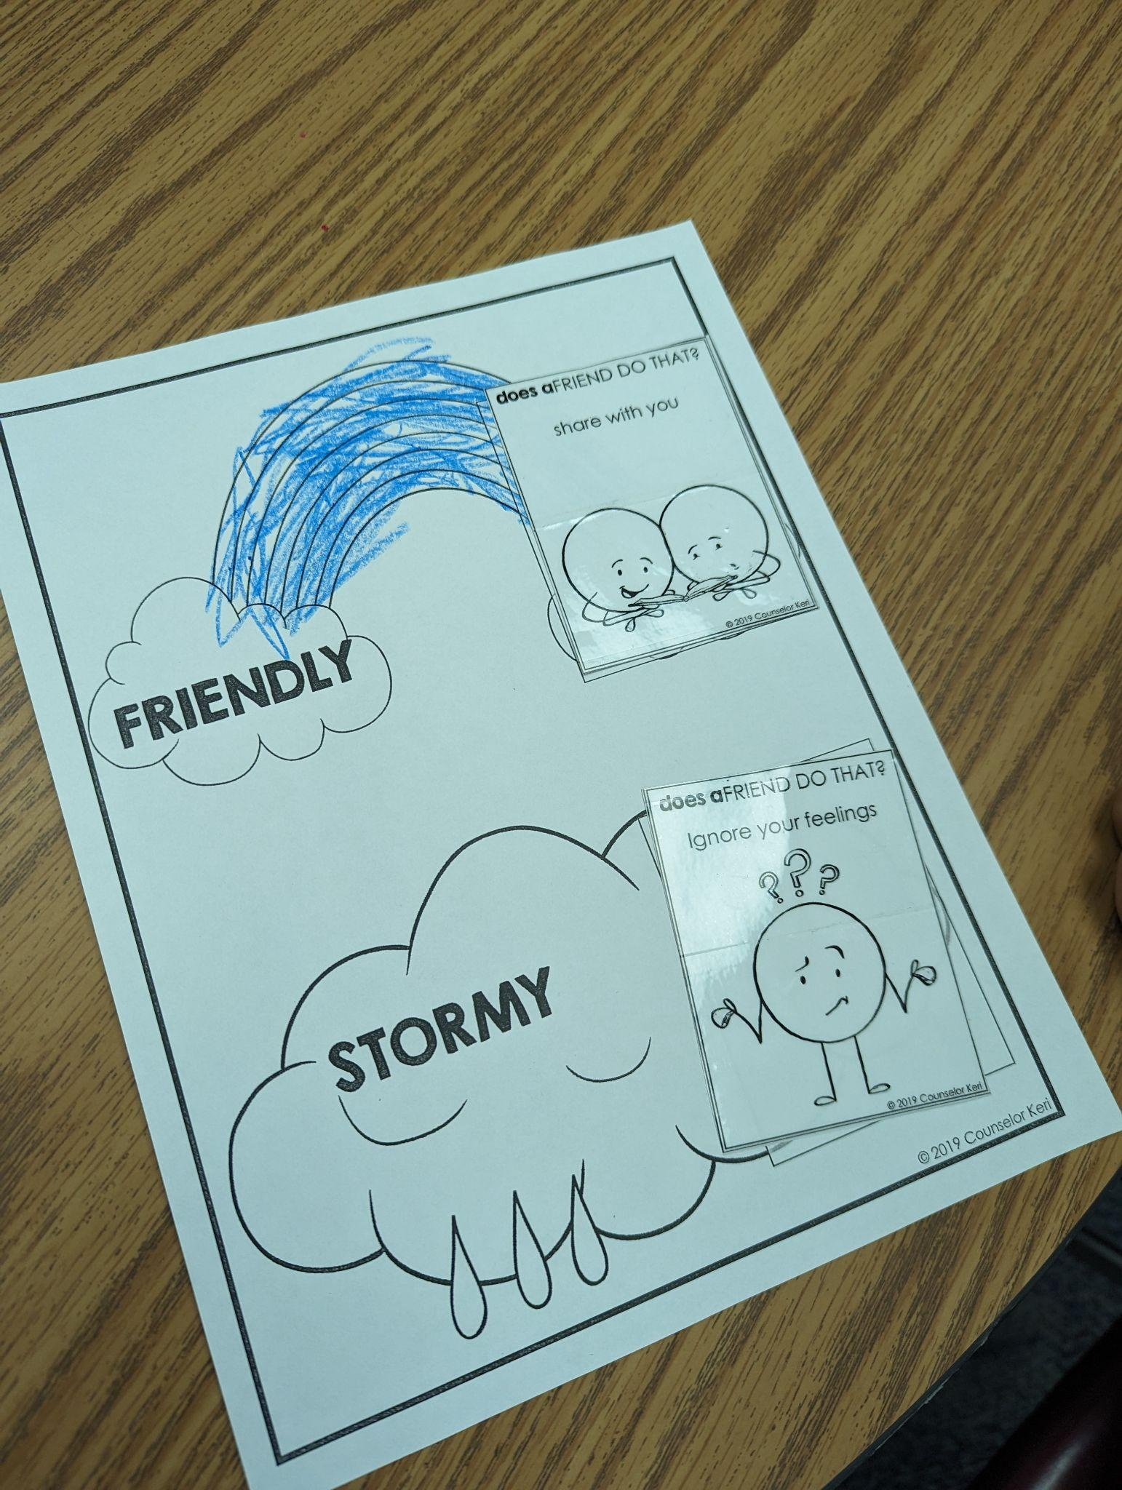

Everyone received cards with different friendship actions on them and sorted them into positive friendly clouds or negative stormy clouds. We discussed how kind friends act & choices we can make when friends are not being kind to us. Everyone was able to sort their cards correctly and I was so impressed that they were able to recall Kelso’s choices they have been learning in their Kindergarten class! Click this link for more information about Kelso’s choices.

Slide 5
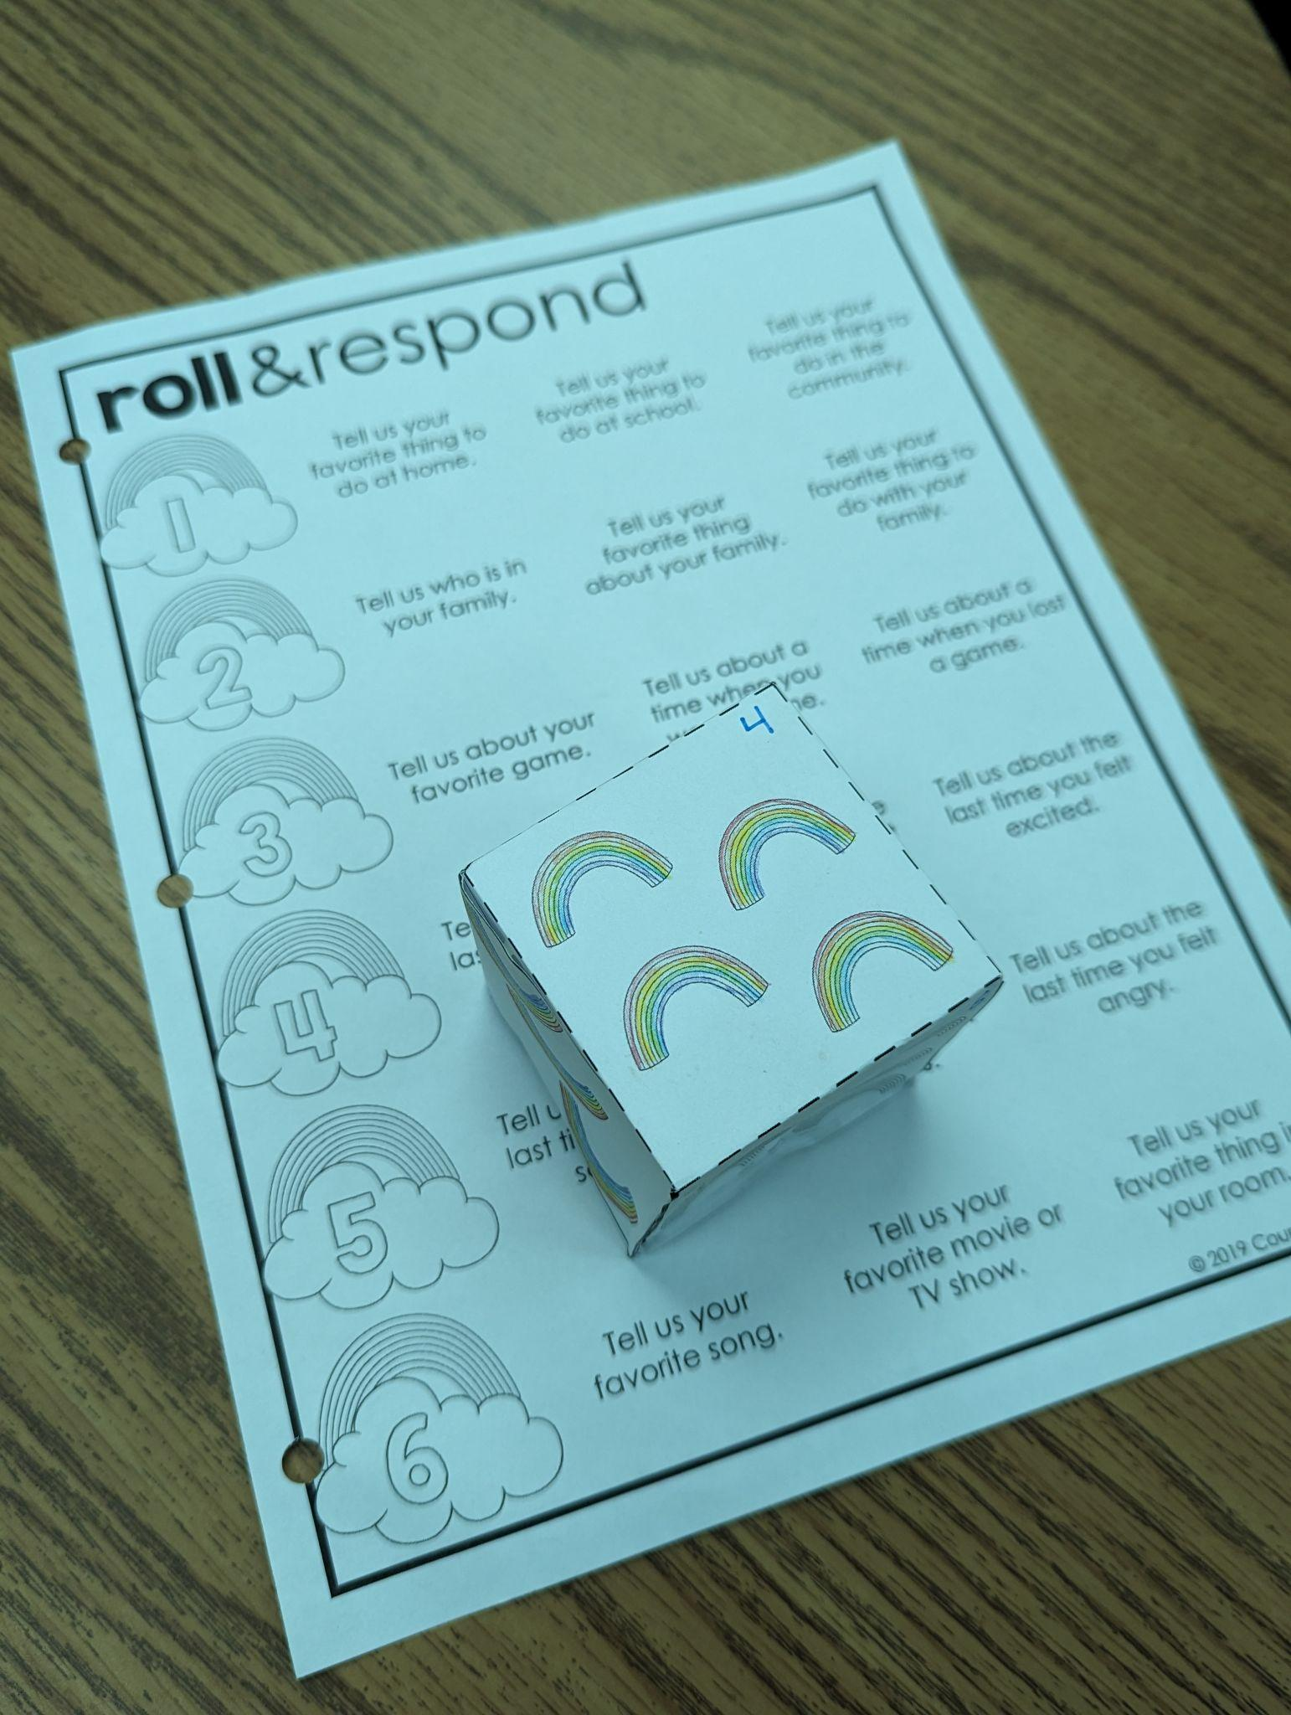
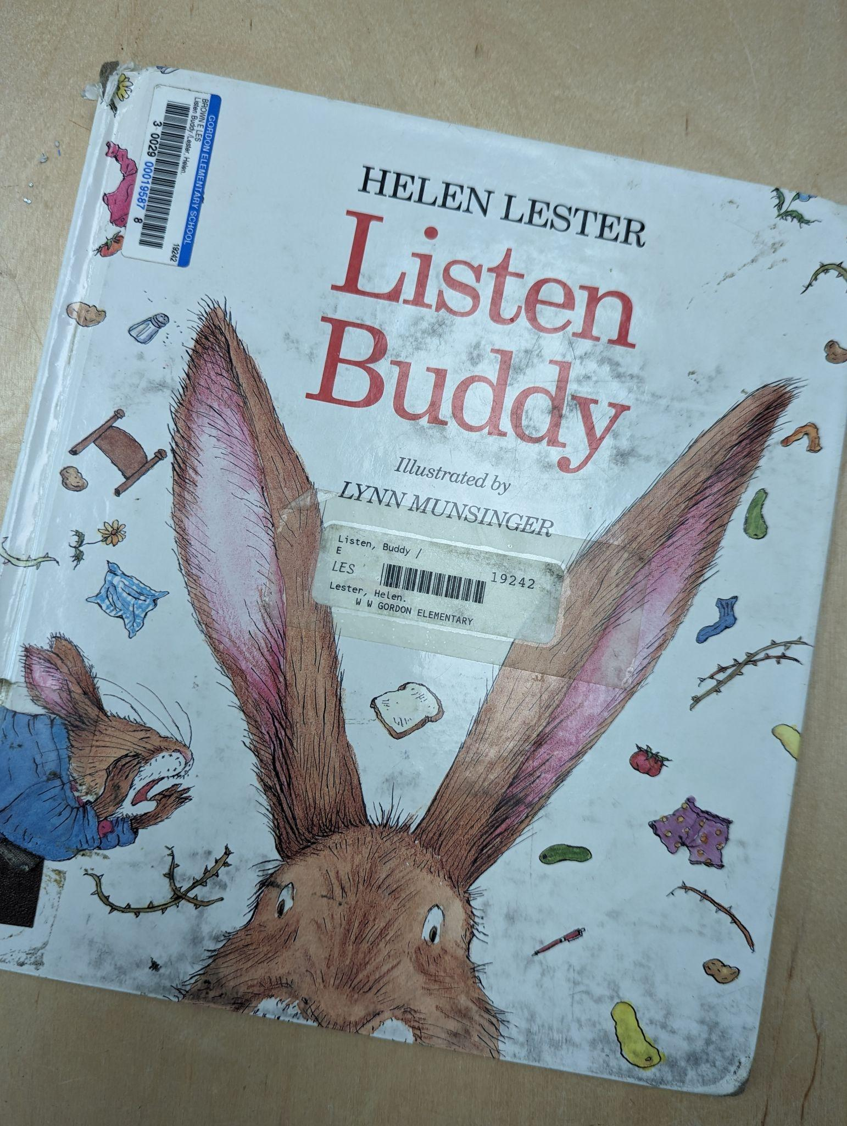
Week 2: Being friends who listen
This week in our group we talked about the importance of listening to one another. Everyone shared how it feels when friends listen to us, and how it feels when friends don’t listen when we talk.
We immediately put our listening skills to practice with a game! Everyone got a turn rolling a dice and answering a question while the rest of the group practiced listening to their answer.
Next we read the book “Listen, Buddy” about a bunny who learns the importance of listening.

Slide 6
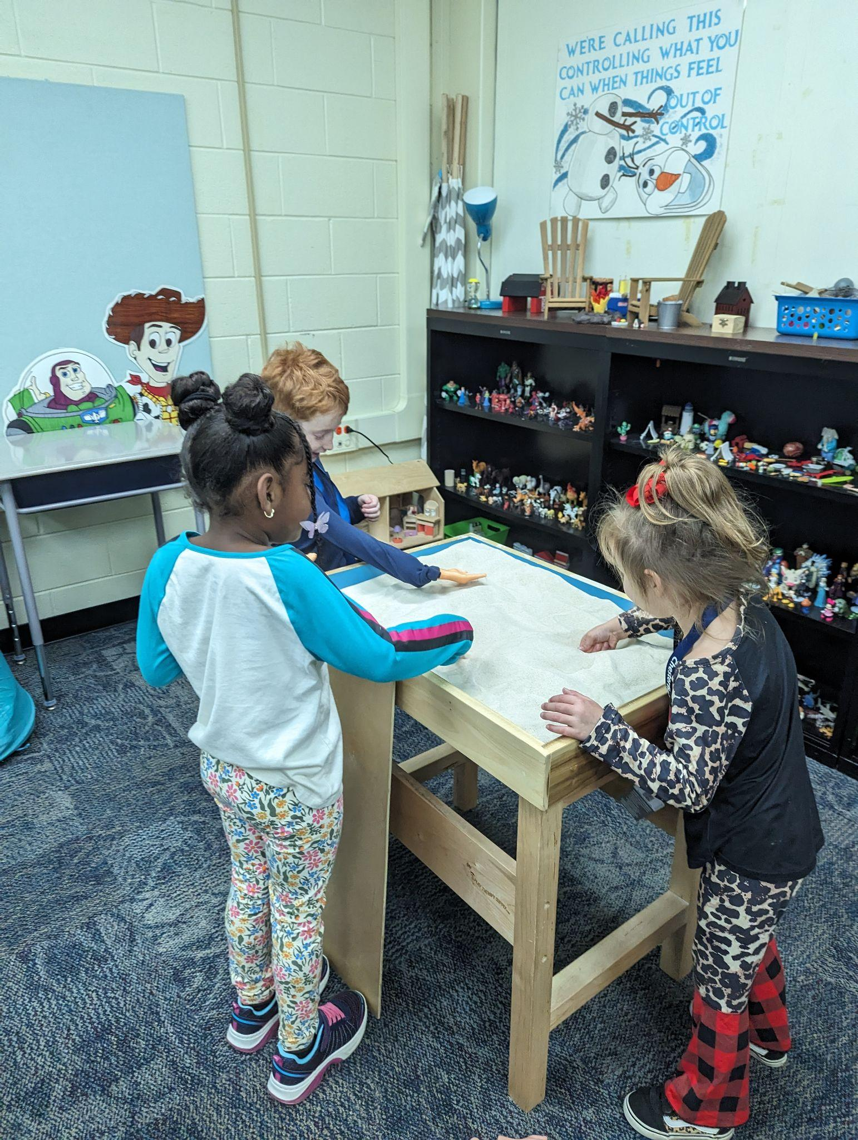


We also played a fun game of “guess the sound”
where we all carefully listened to try and guess
what sound we heard. Every group was able to
identify each sound- even the hard ones like bowling pins falling over!
With a few minutes left at the end of our group we got a chance to play in the sand tray together. This was a good opportunity to practice listening and getting along with one another. I encouraged everyone to practice being a good listener this week.

Slide 7
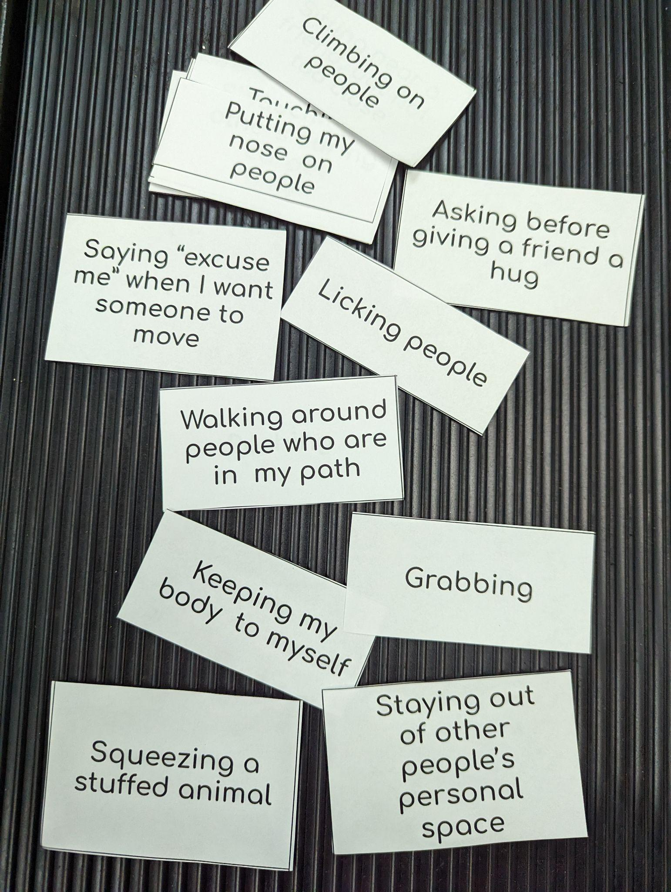
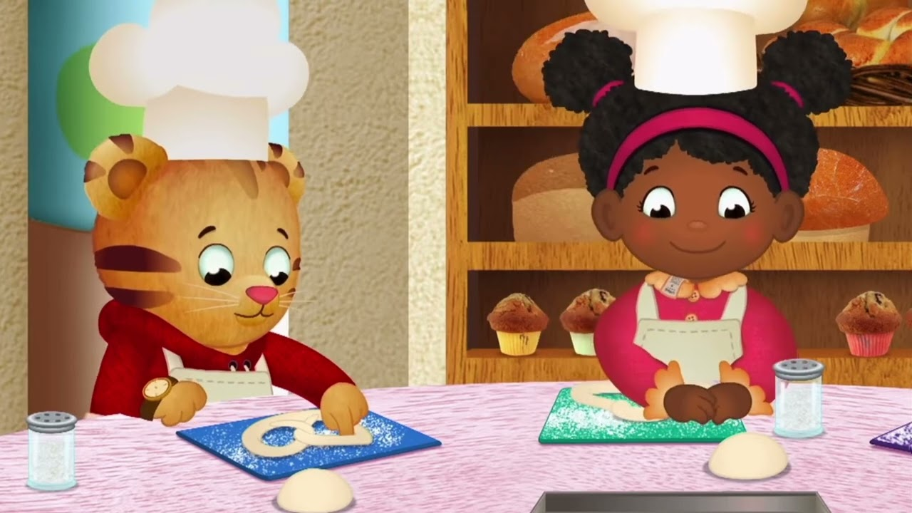
Week 3: personal space
This week we learned about personal space. Part of being a good friend is respecting others personal space, and asking for space when we need it too. We talked about how everyone is different- some people need a lot of personal space, and some people only need a little.
We started out with an activity where we sorted personal space choices and gave a thumbs up or a thumbs down for each choice.
Next, we watched a clip from the Daniel Tiger episode “Daniel and Miss Elaina Bake Pretzels.” In this clip, Miss Elaina gets upset when Daniel gets into her personal space. Miss Elaina learns to ask for space, and Daniel apologizes for being too close.

Slide 8
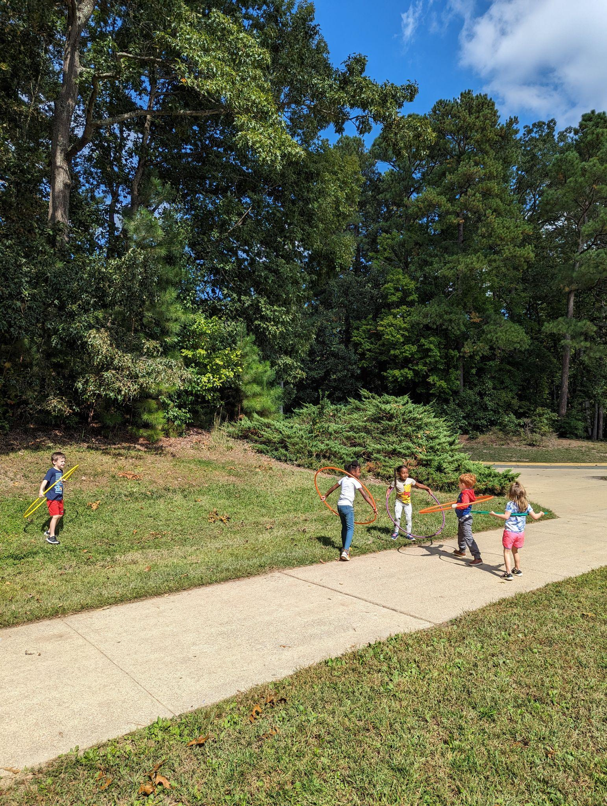
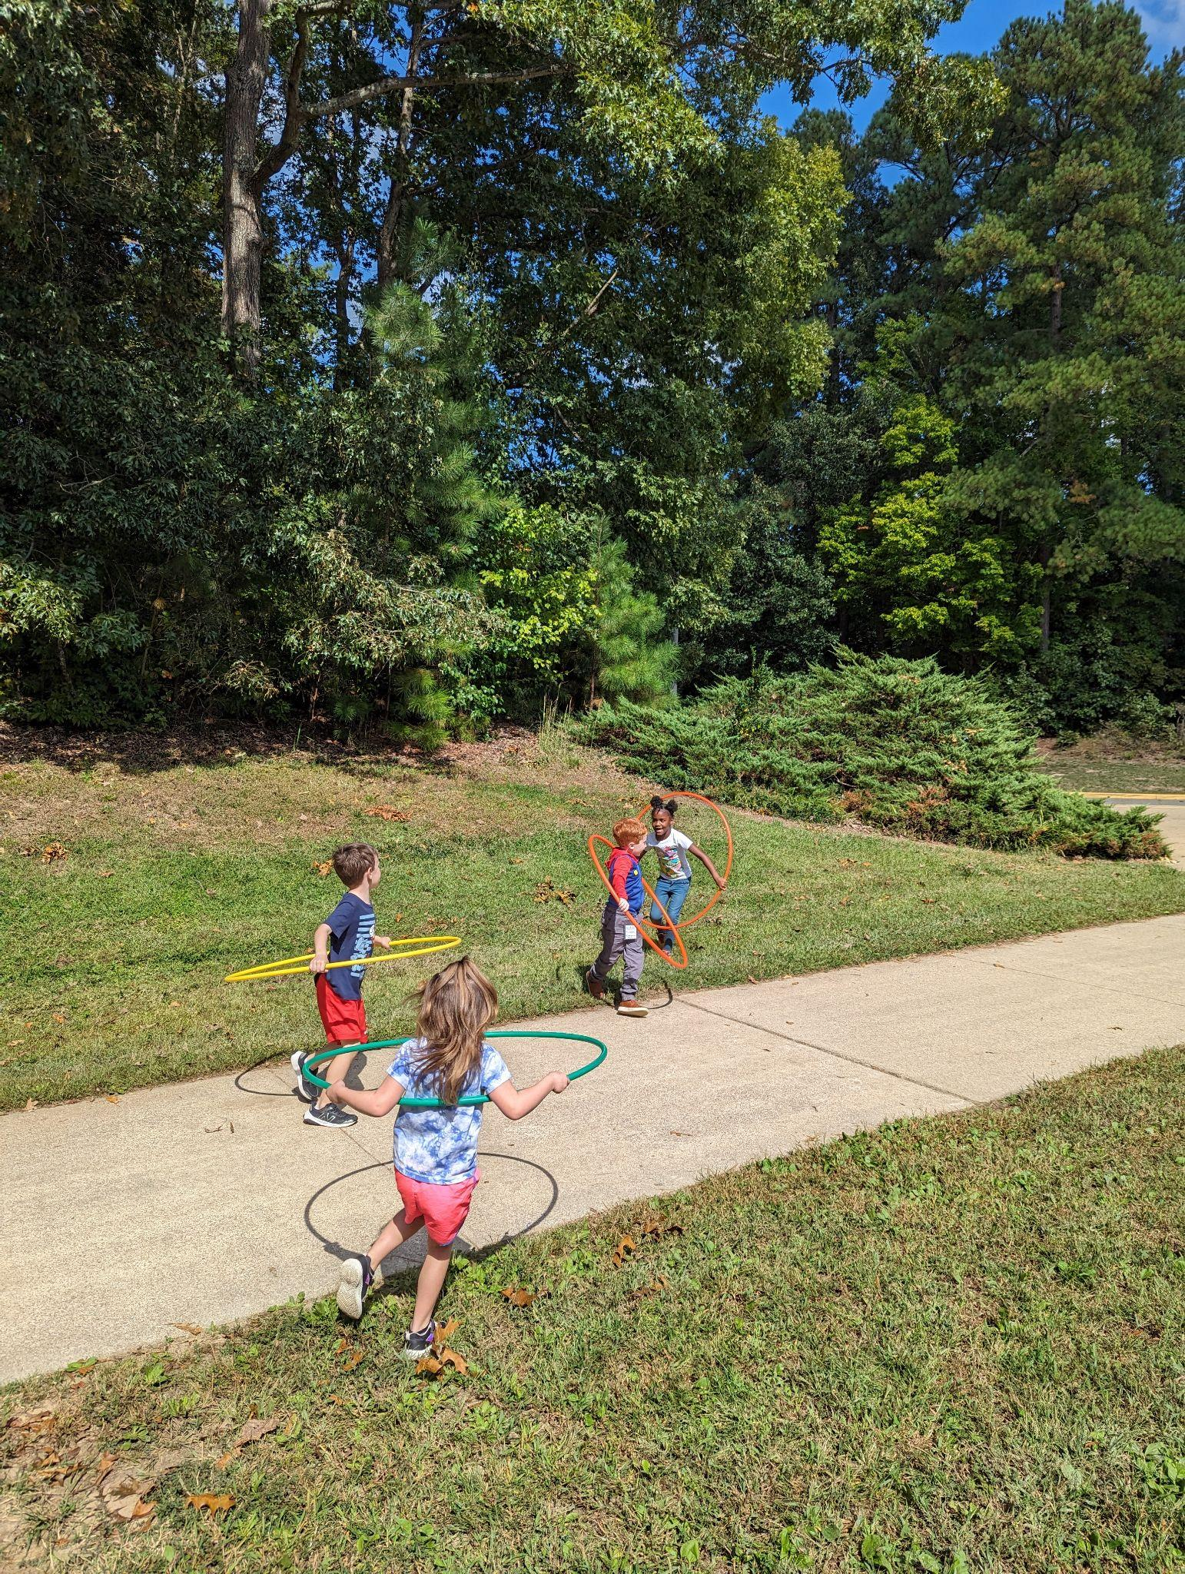
We also got to go outside and play! We played tag and sharks and minnows while using hula hoops to represent our personal space. This was great practice being mindful of others personal space and learning to apologize when we occasionally get into each other's space! At the end of our lesson, I encouraged everyone to keep practicing giving others personal space, and asking for space when we need it.

Slide 9
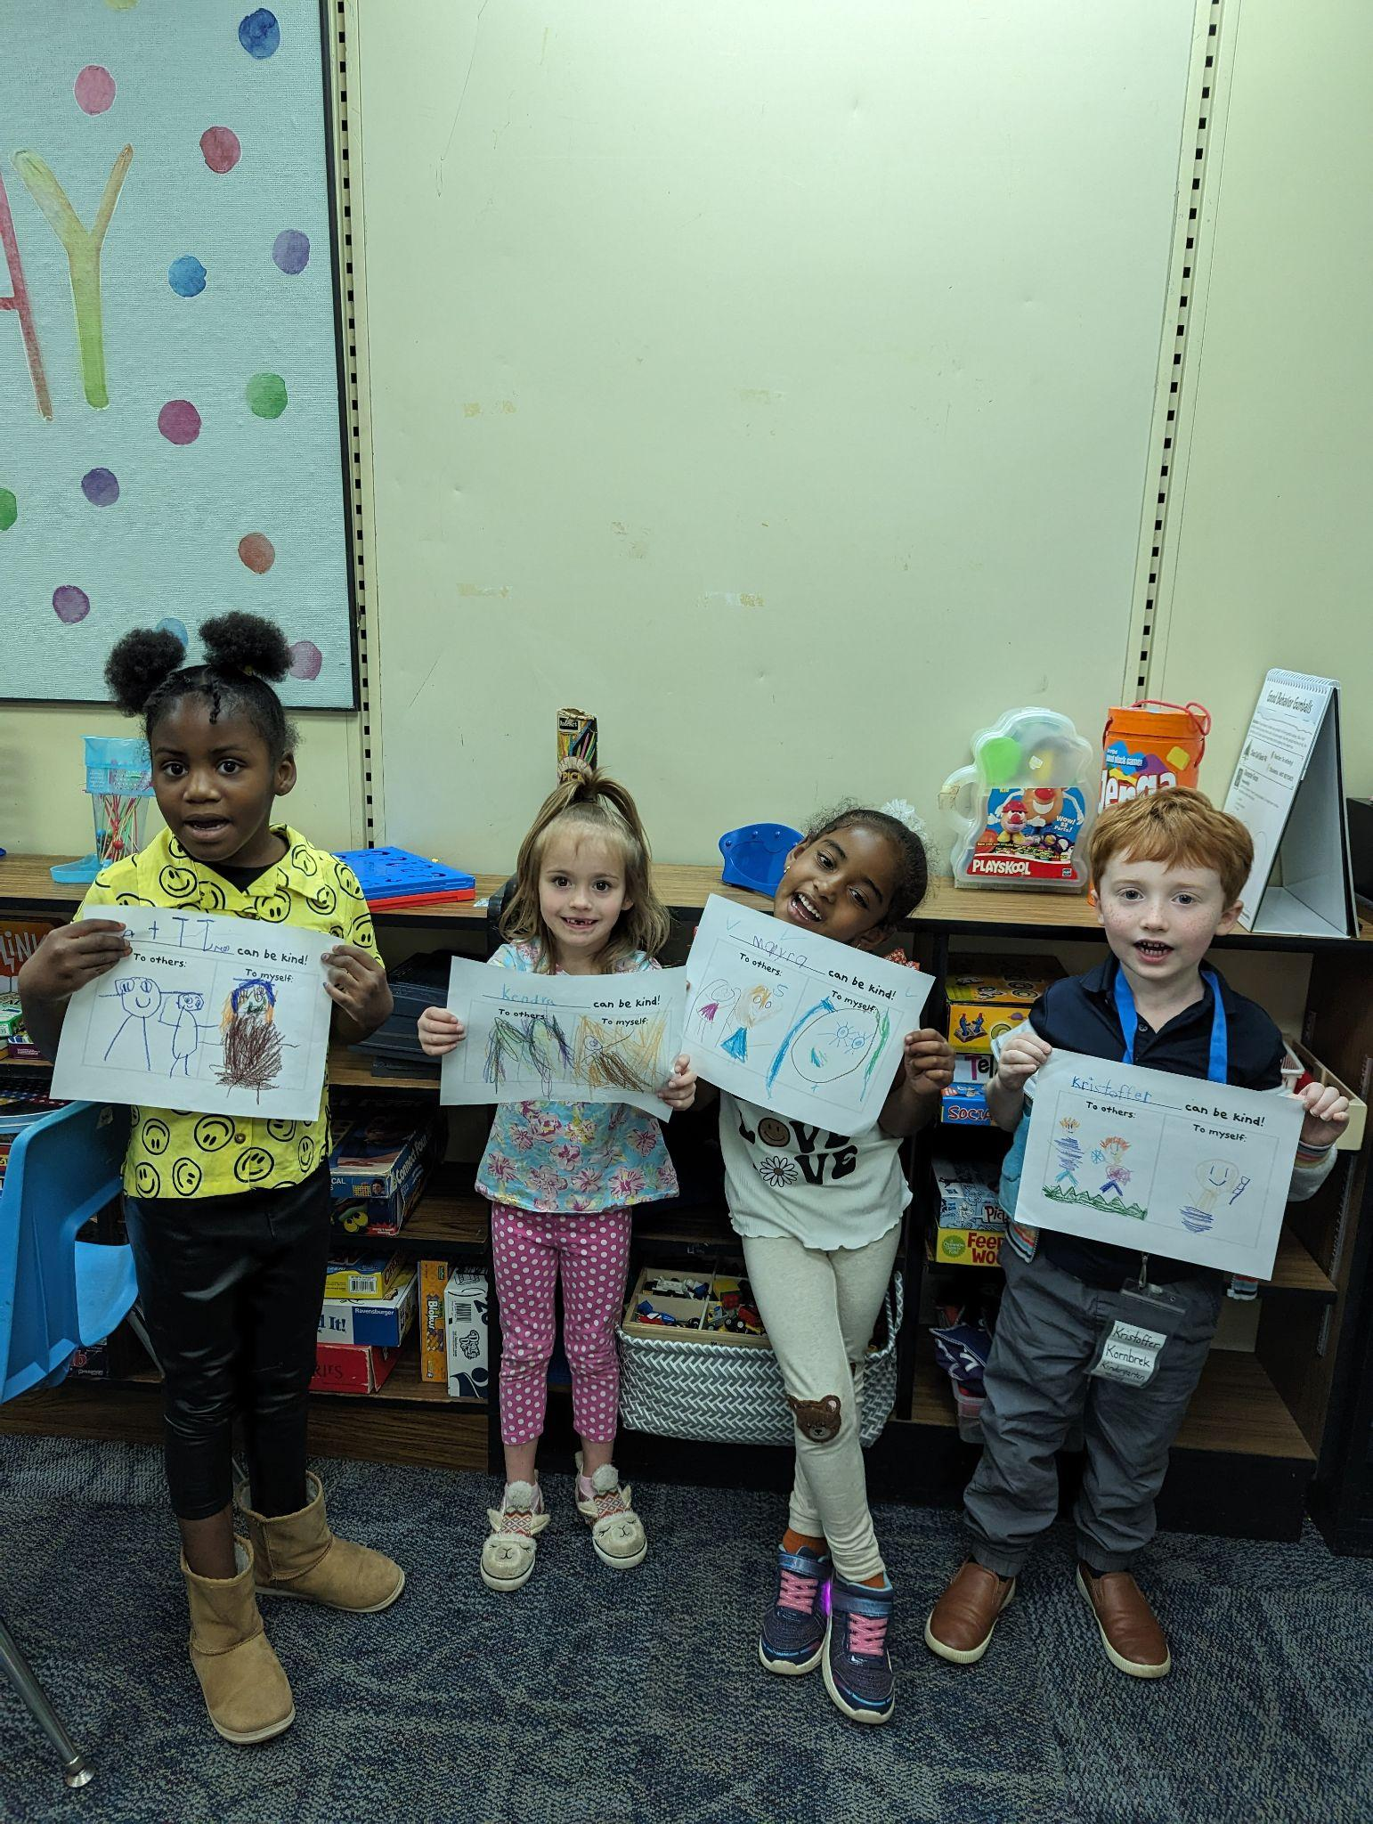
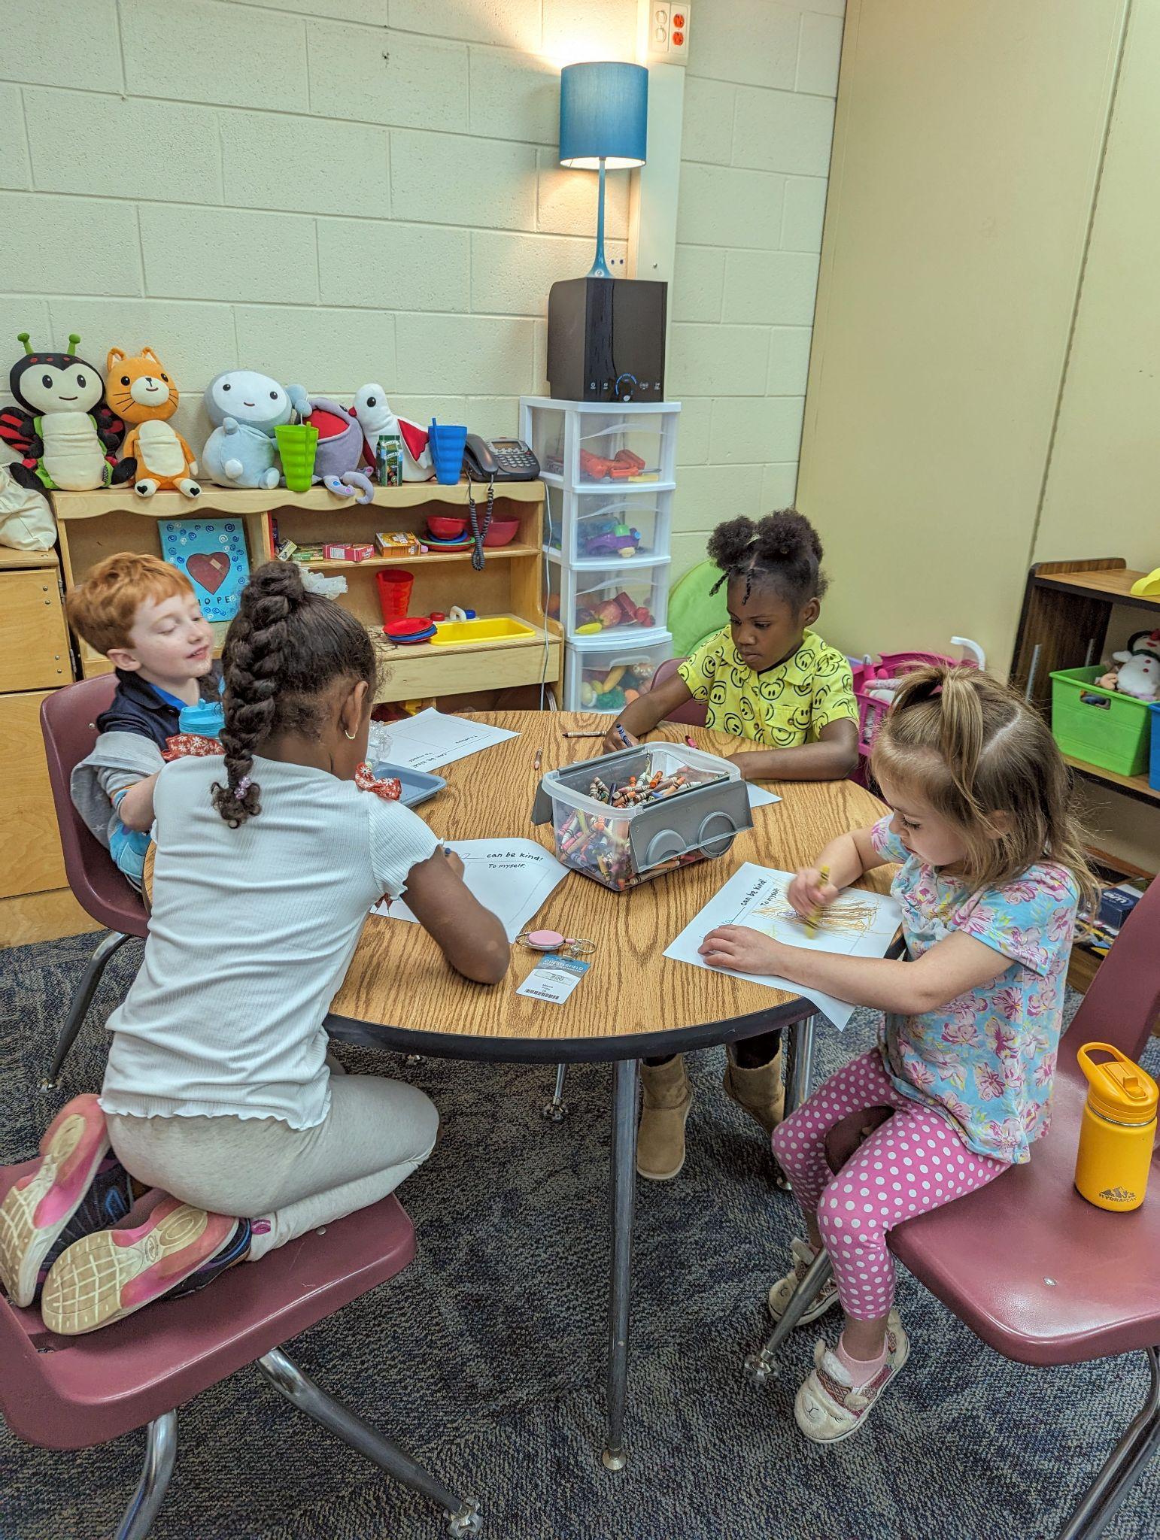
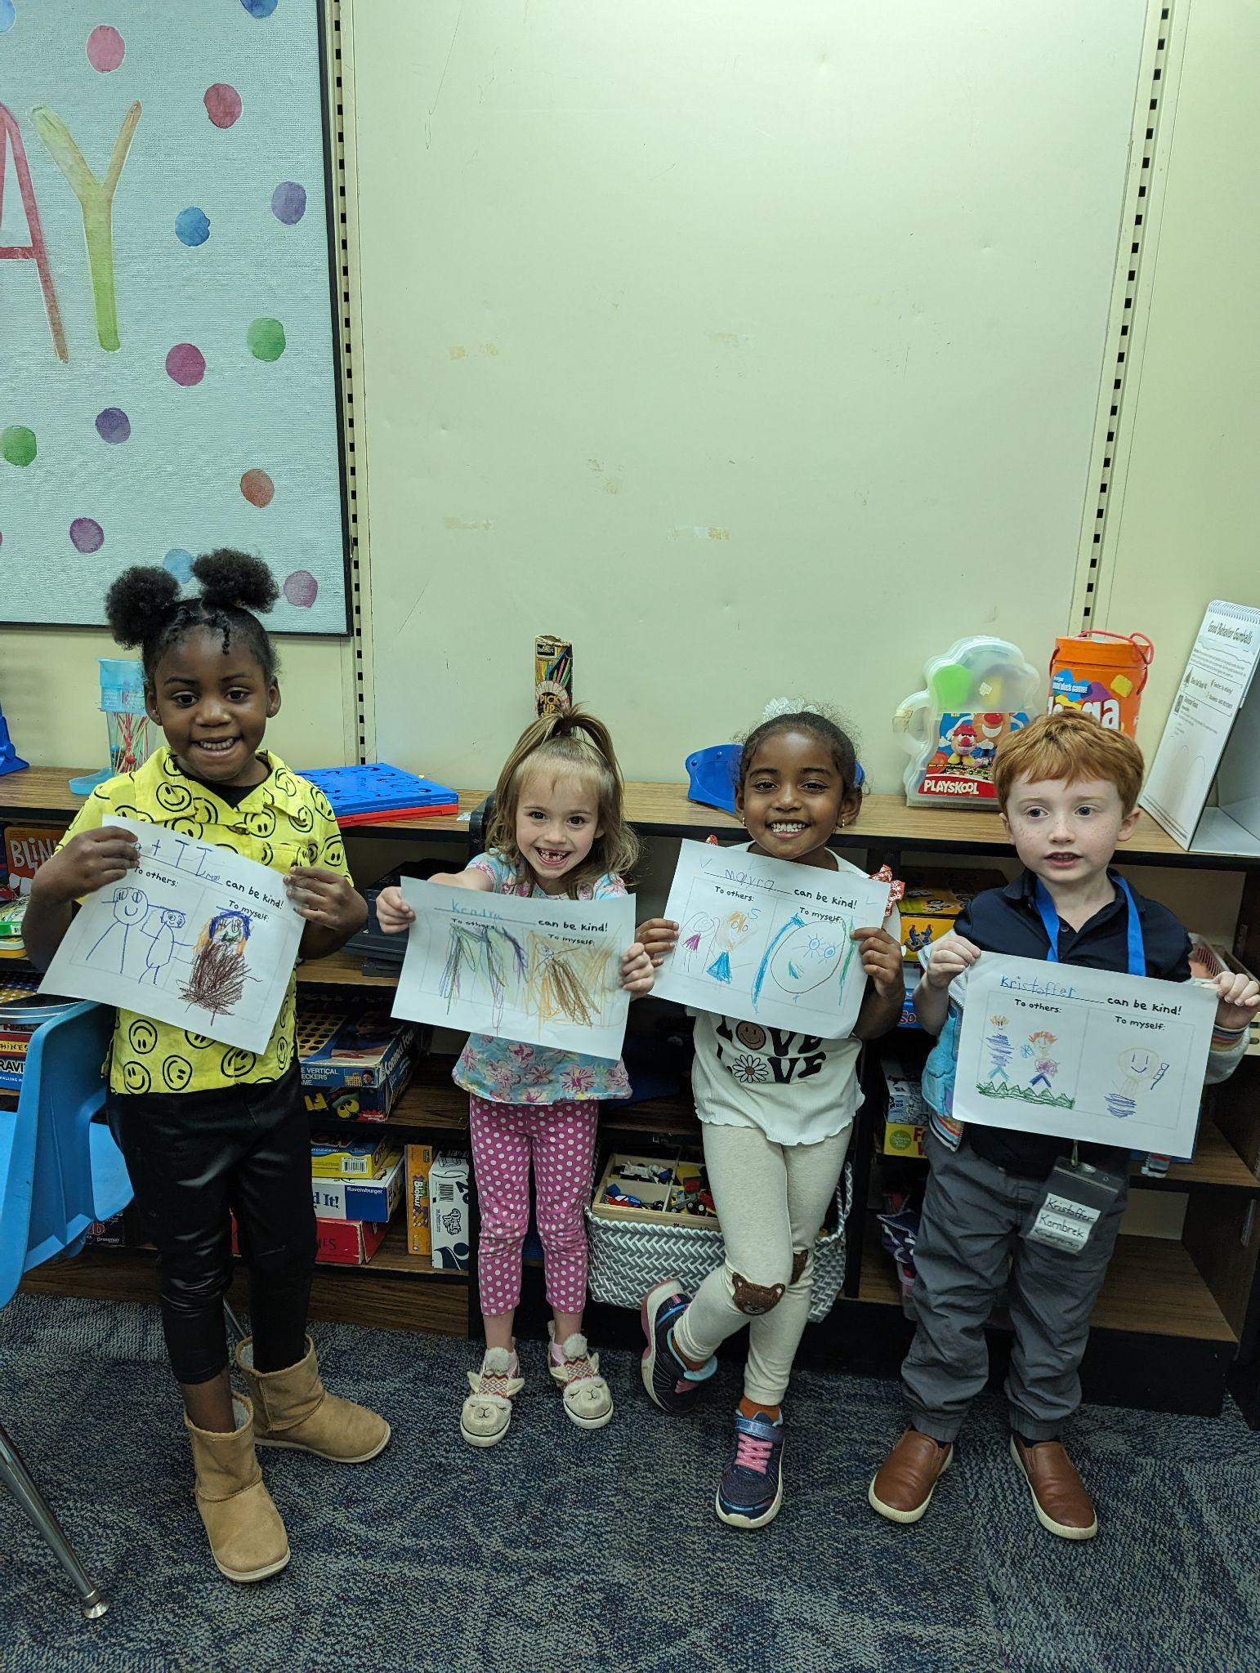
Week 4: Kindness
This week was all about kindness. We discussed ways that we can be kind to others, and how we can be kind to ourselves! October is anti-bullying month, so this topic goes along perfectly with the anti-bullying guidance lessons the school counseling program will be teaching in every classroom this month- Promote Respect. We teach all students to show kindness and be upstanders to prevent bullying before it can begin.

Slide 10
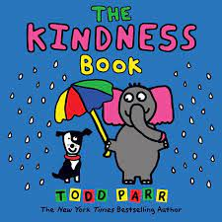
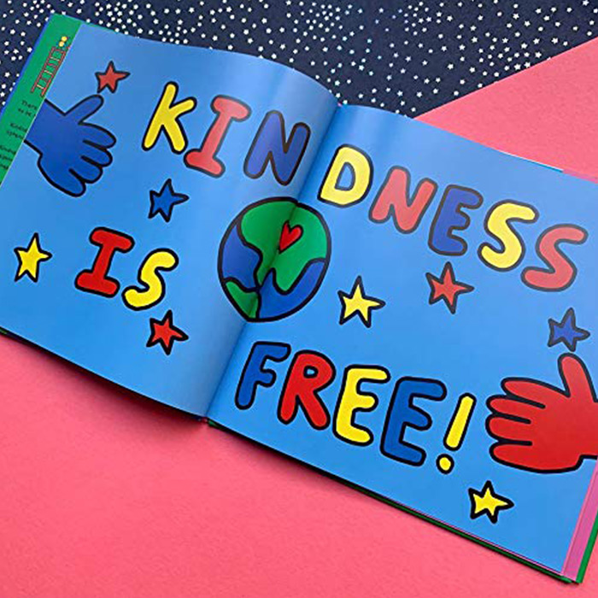
Alongside being kind to others, I think it is so important to learn about being kind to yourself! Everyone came up with some great ways to be kind to yourself- saying nice words about yourself, taking a nap if you feel tired, or petting a dog to feel relaxed!
We also drew some of our ideas of how we can show kindness. When you see these drawings in your child's backpack, I encourage you to ask them about what they drew!
Lastly, we read the book “The Kindness Book.” by Todd Parr. This is a super cute and colorful book that is perfect for this age. Click the link to see a read-aloud of the book.

Slide 11
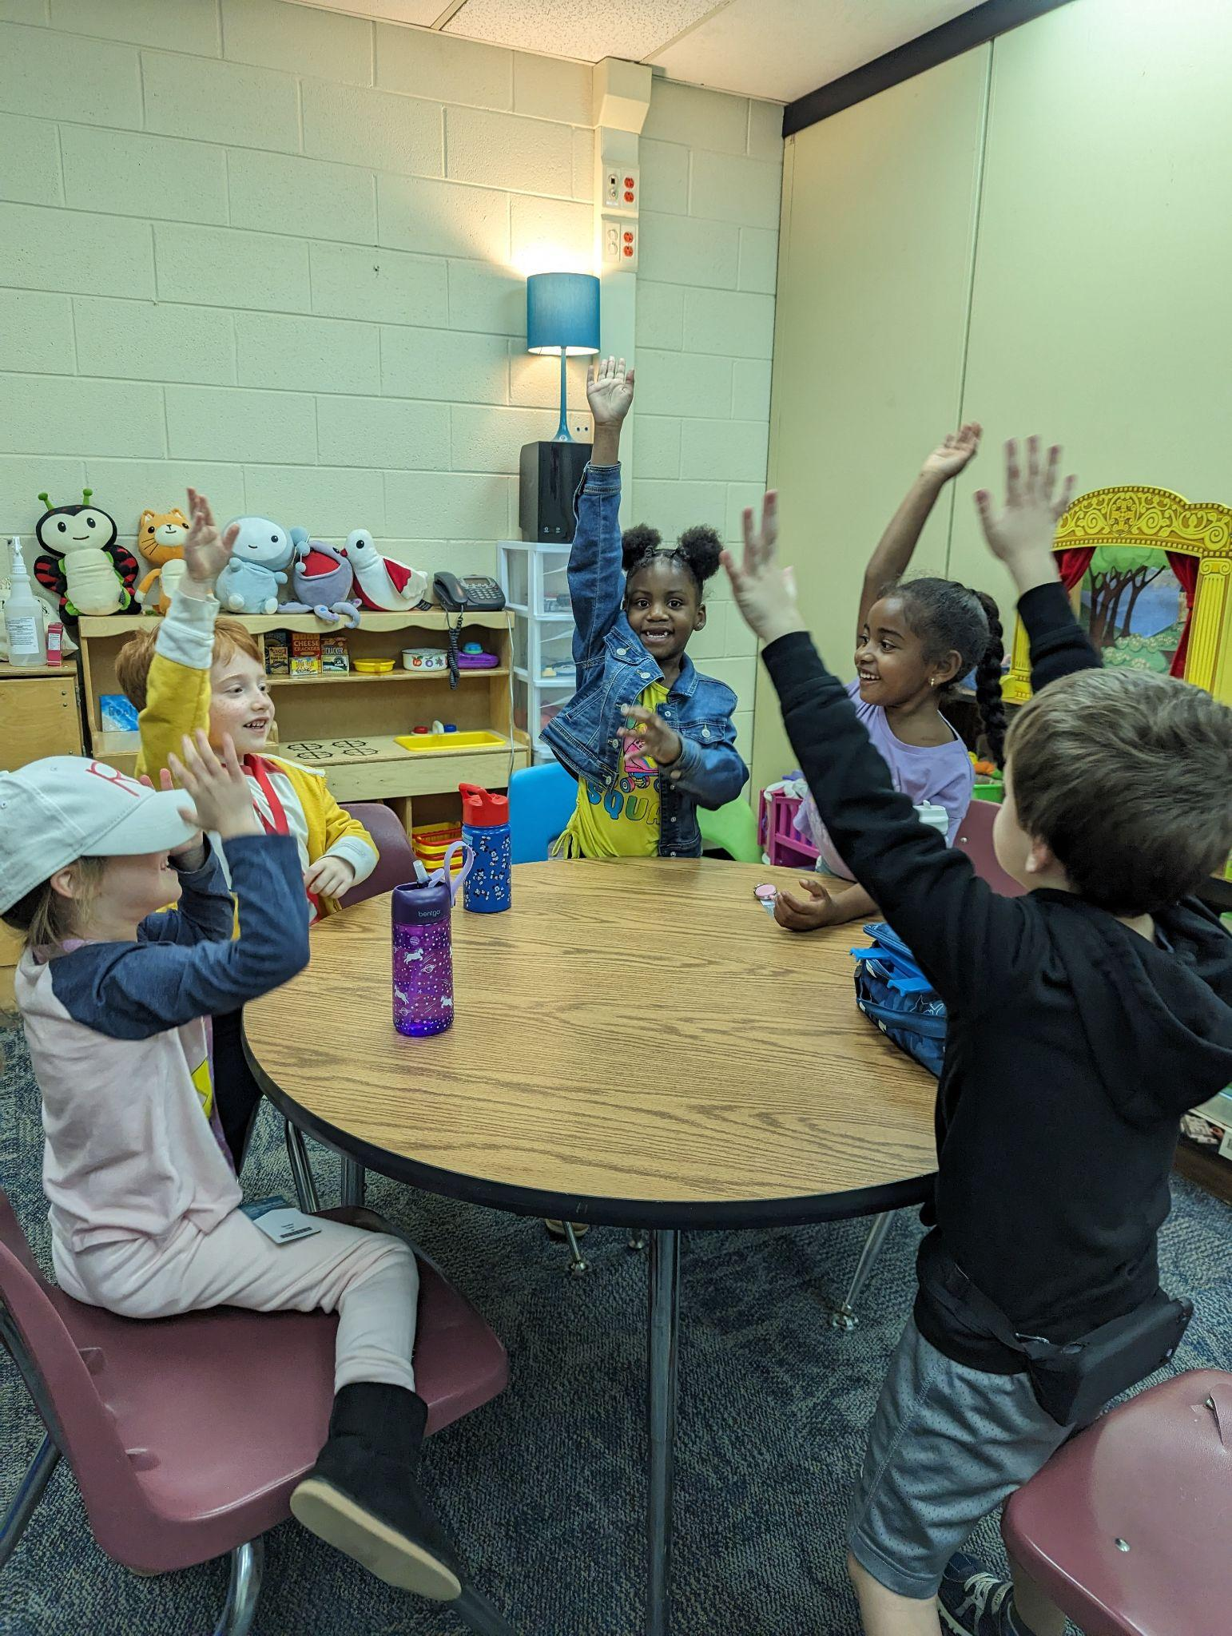
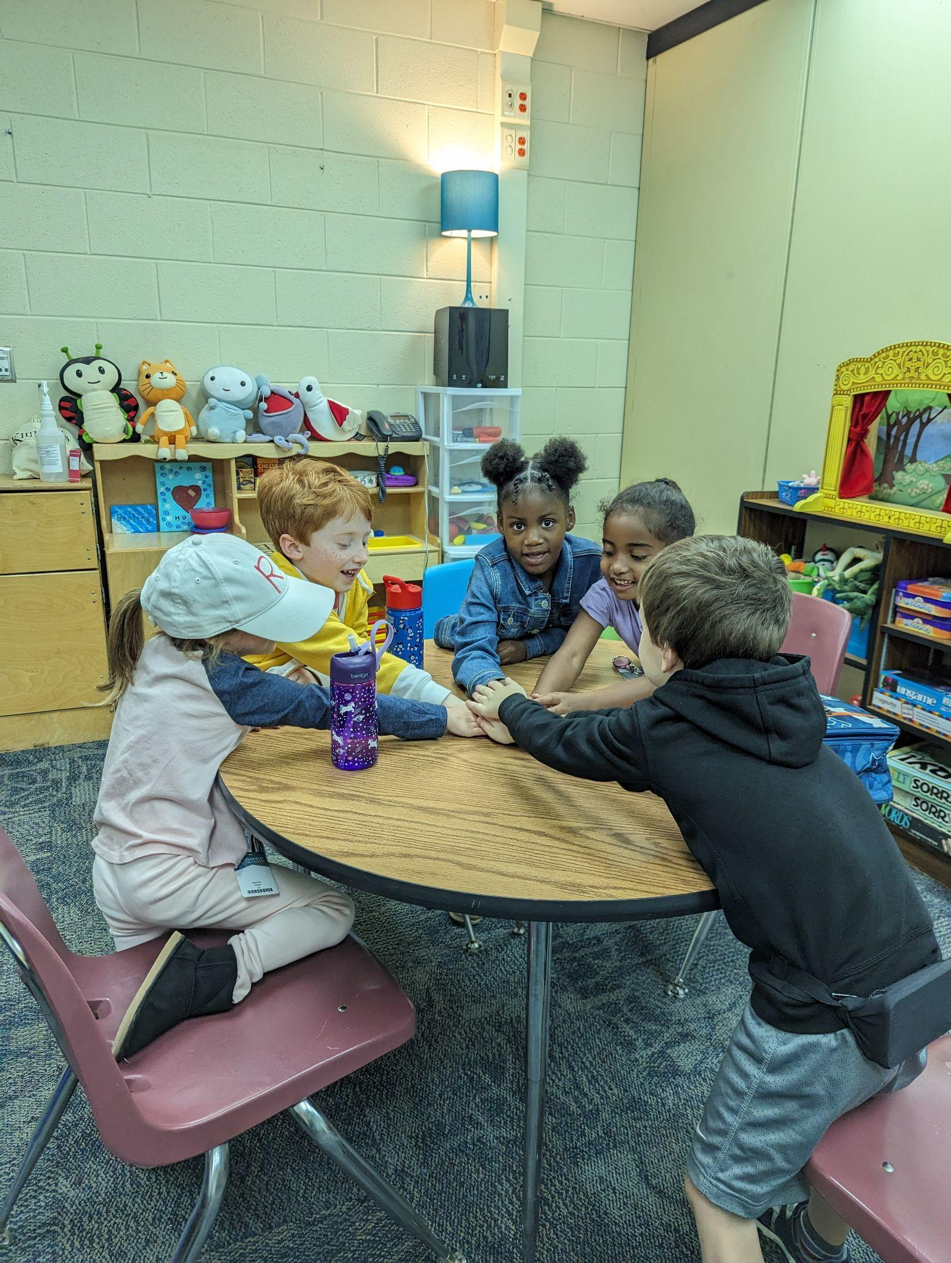
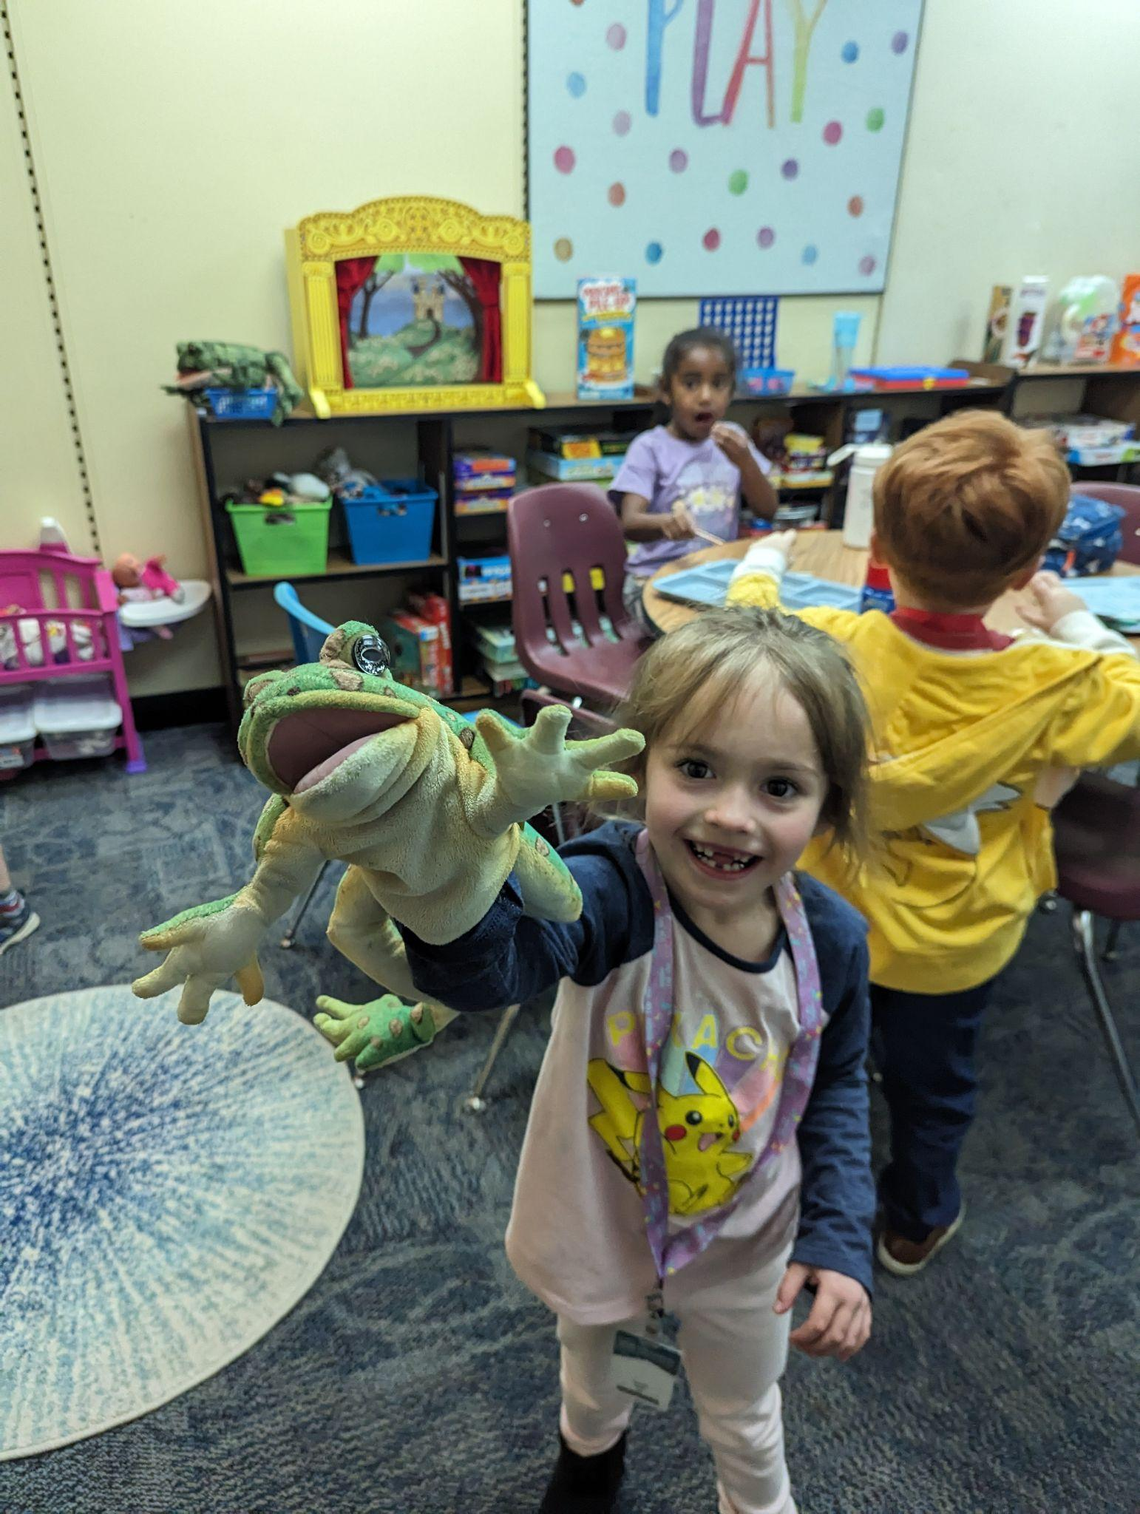
Week 5: working together
This week we talked about working together as a team and we got to put what we talked about into practice by opening our own restaurant! We discussed how workers at different jobs have to work together to achieve their goal, just like we work together at school to learn. It was such a joy getting to watch the kids have fun and learn through play this week.

Slide 12
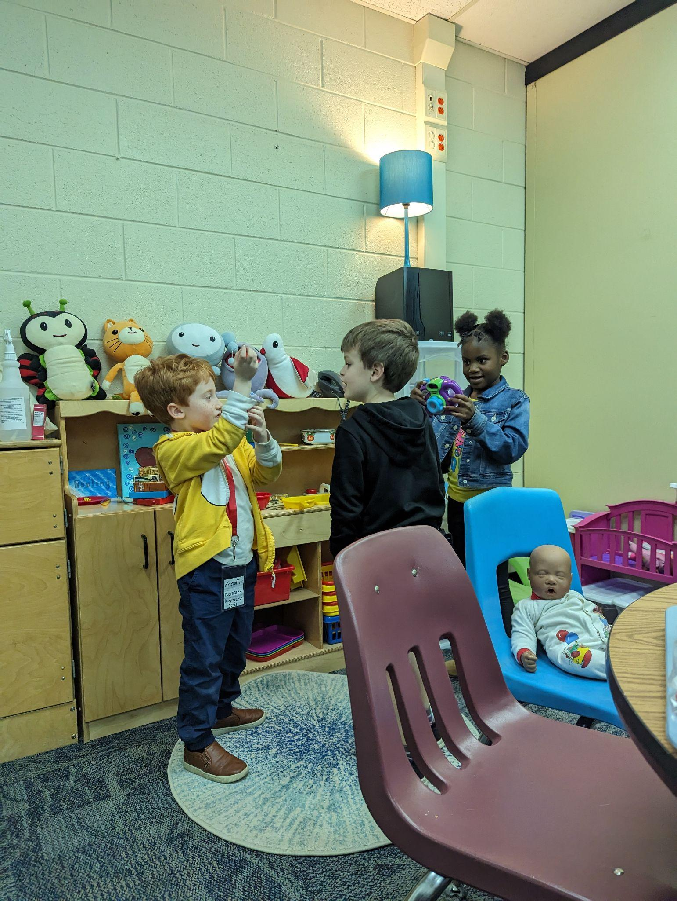
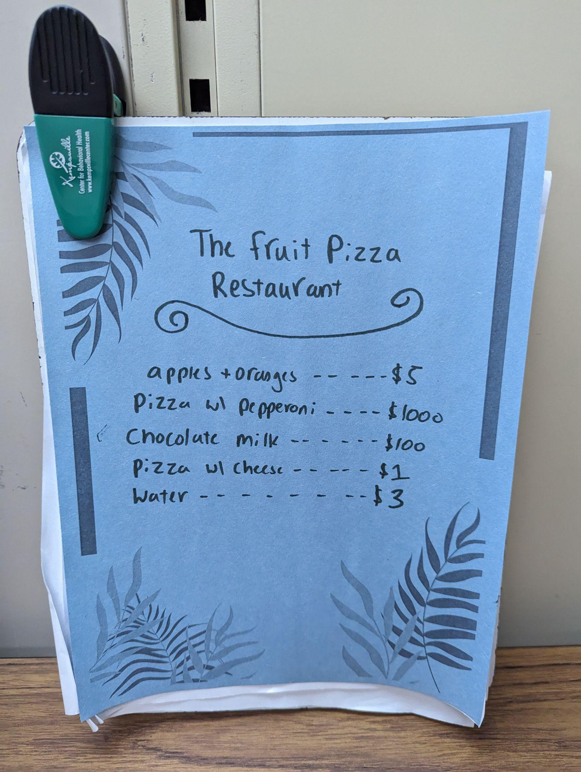
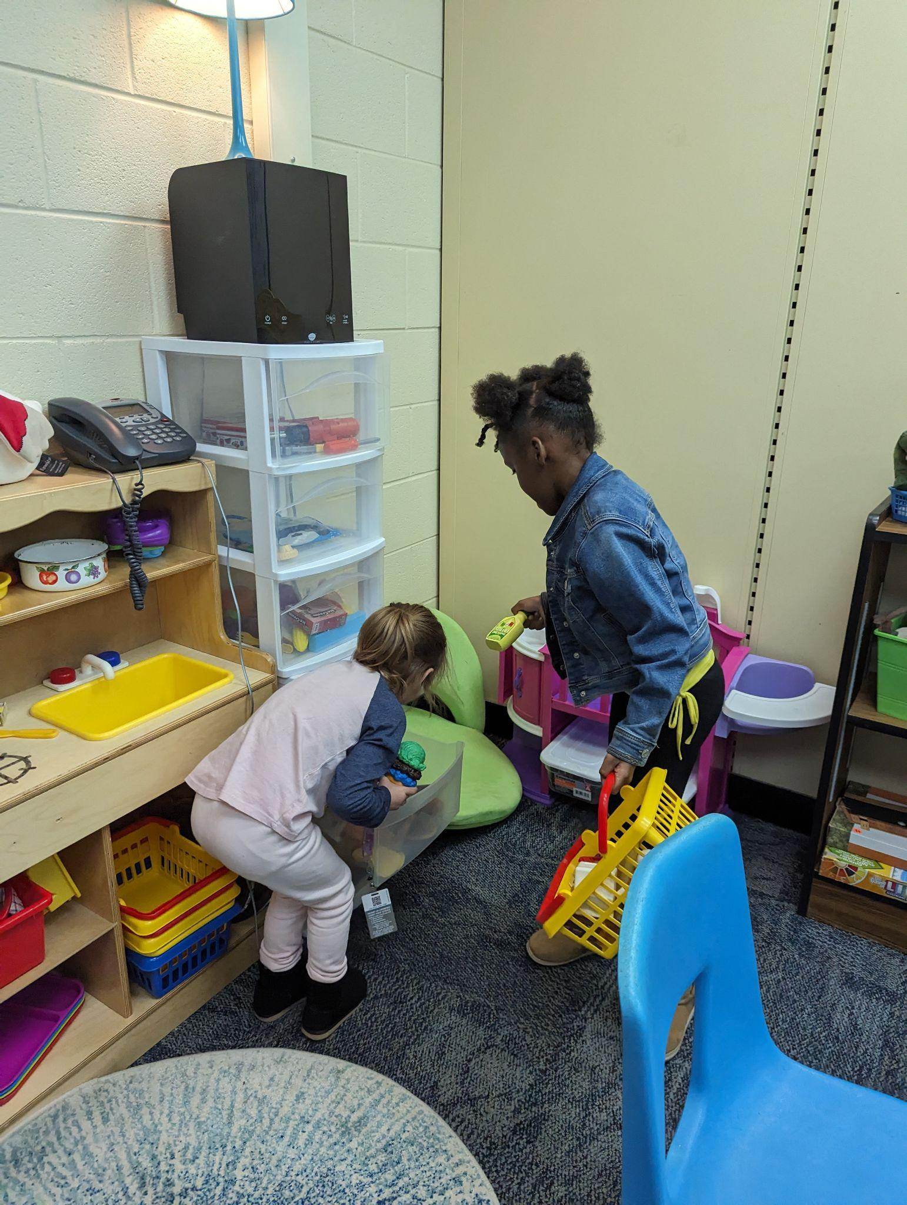
First, we worked together to decide on a name for our restaurant and everyone agreed on “The Fruit Pizza Restaurant”. Everyone got to pick what job they wanted to do at the restaurant, as well as what we would be serving. Menu items included pizza, chocolate milk, and you would all be proud that there were even some healthy fruit options. Thankfully I had my wallet on hand as prices ranged from $2 to $1000! When it was time to close up, everyone worked together to clean up and wash the dishes. This was such a fun lesson and I hope the students will share their enthusiasm for working together with you at home.

Slide 13
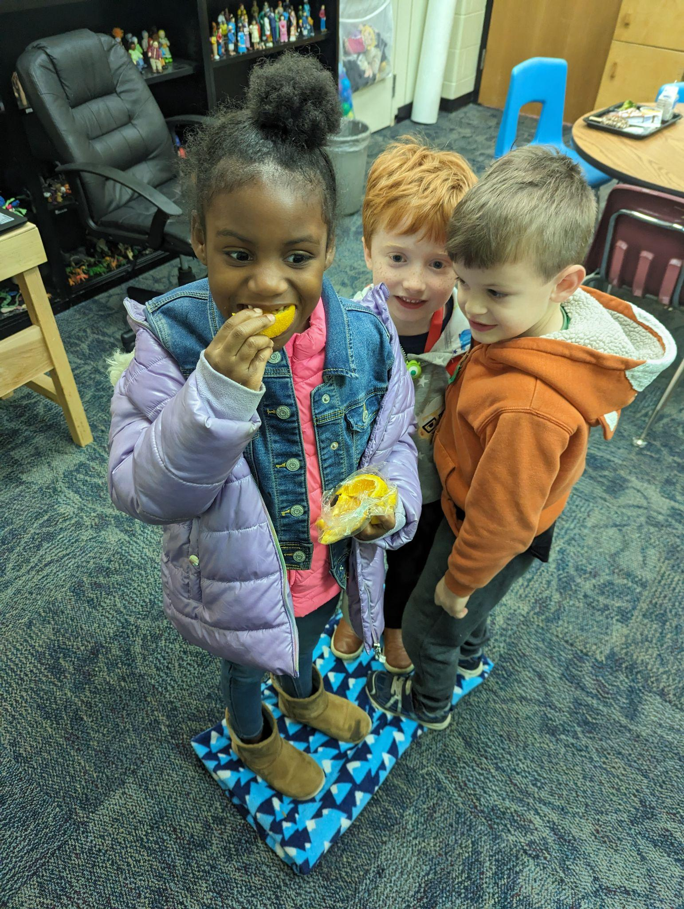
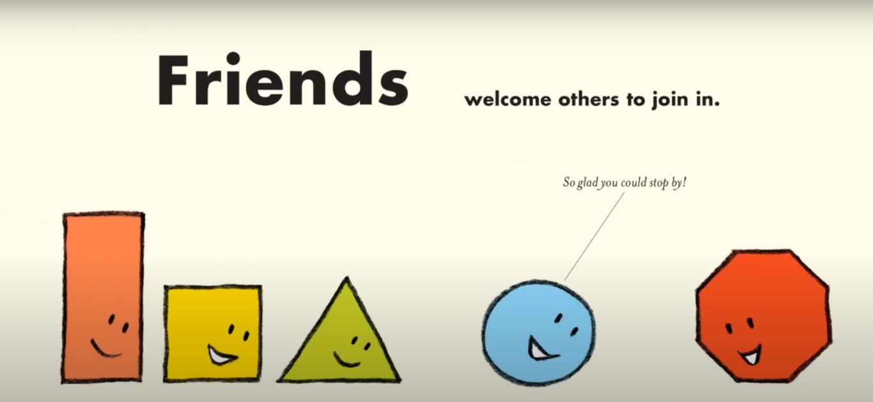
Week 6: Inviting friends
This week we talked about being inviting friends, and how it feels good to be invited or included by our friends. We started out group by going around the circle and greeting each other and asking one question about the friend next to us. This was great practice inviting others to have conversation and be our friend! Next we read the book “Friendshape” that talks about inviting others to join in.

Slide 14
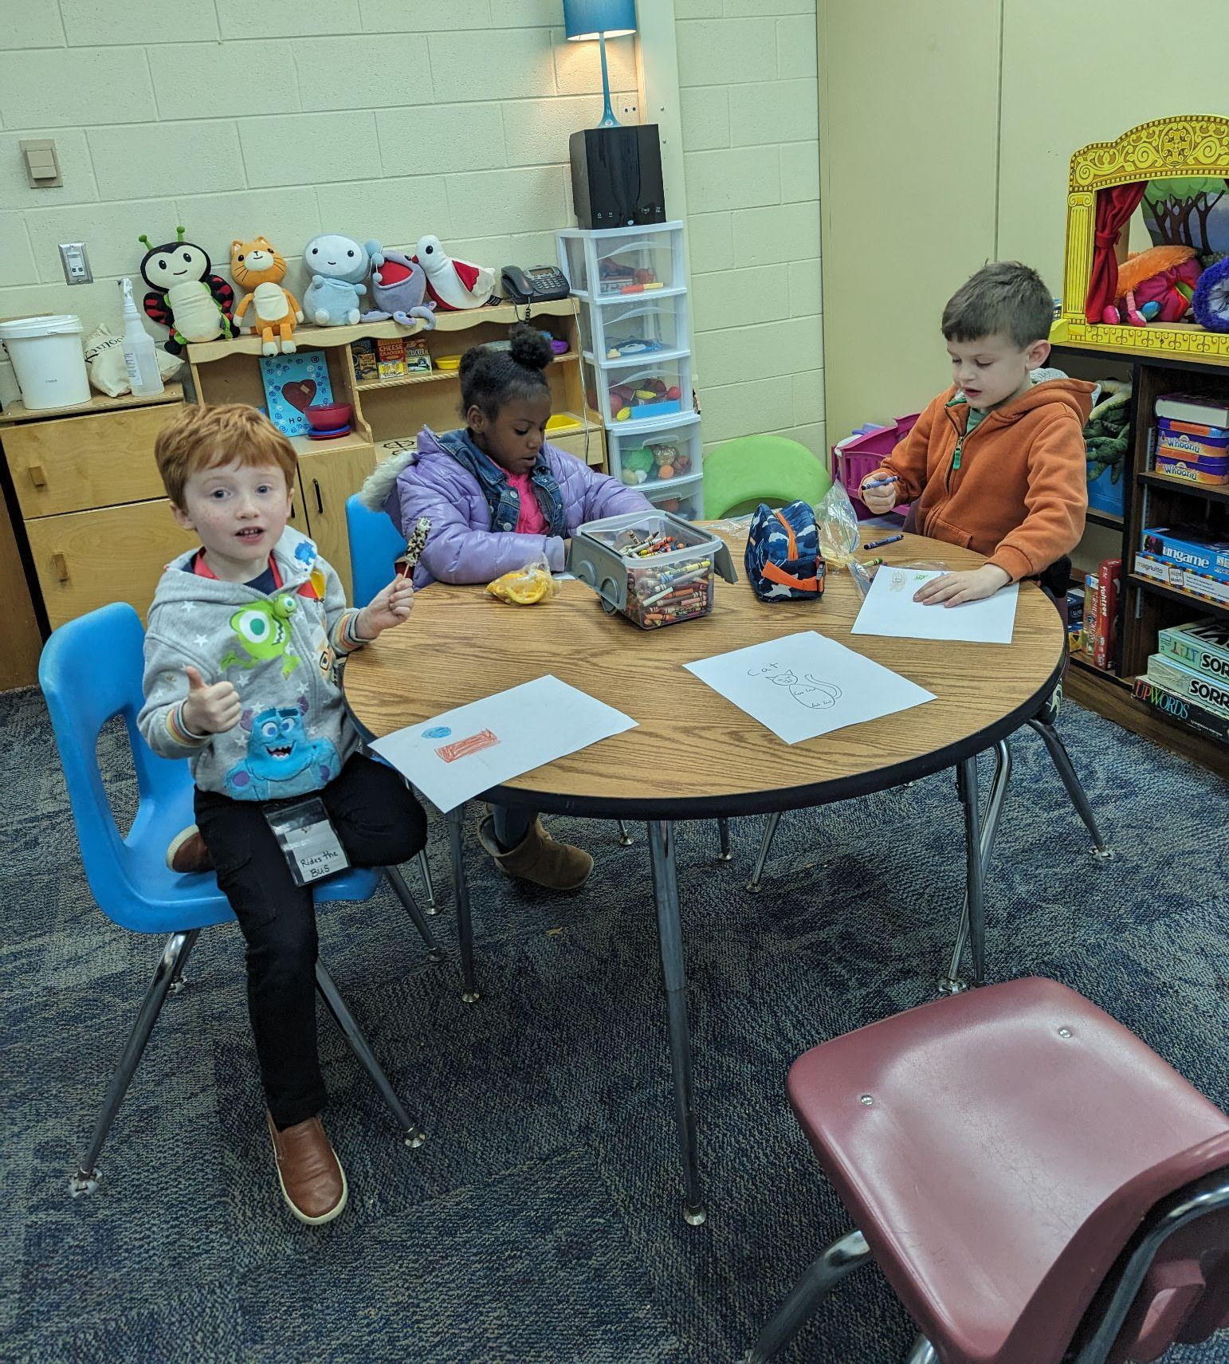
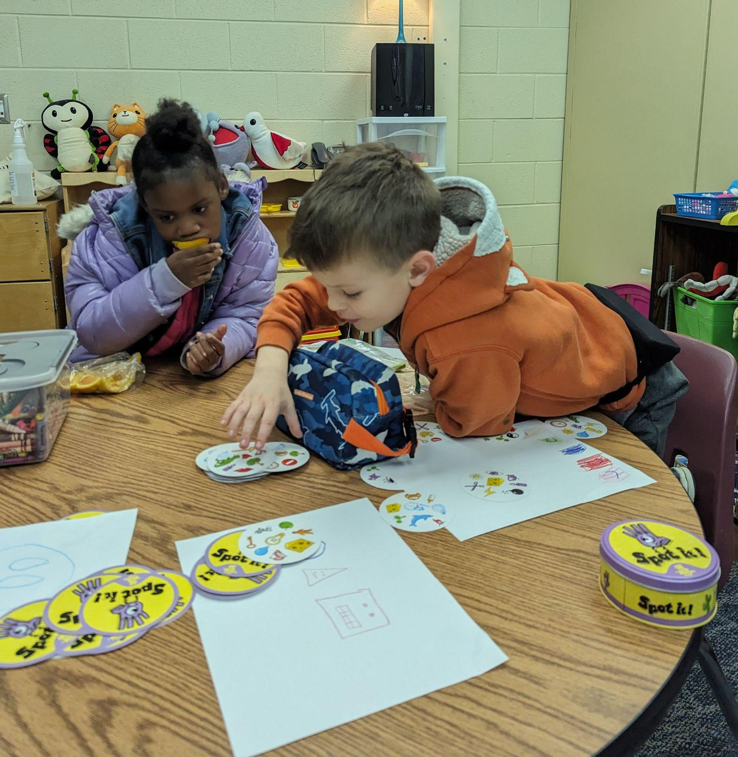
We played a really fun game to practice including others where everyone had to fit onto a blanket. Once everyone had fit, the blanket was then folded in half and they had to try and fit on an even smaller space! Everyone was cracking up as the blanket got smaller and smaller. I was really proud of how each student was helping one another.
Next, everyone got to color someone who is their friend, and we talked about how we could practice inviting our friends this week. We also played the Game “spot it”, which everyone loved and was great practice making sure everyone was included!

Slide 15
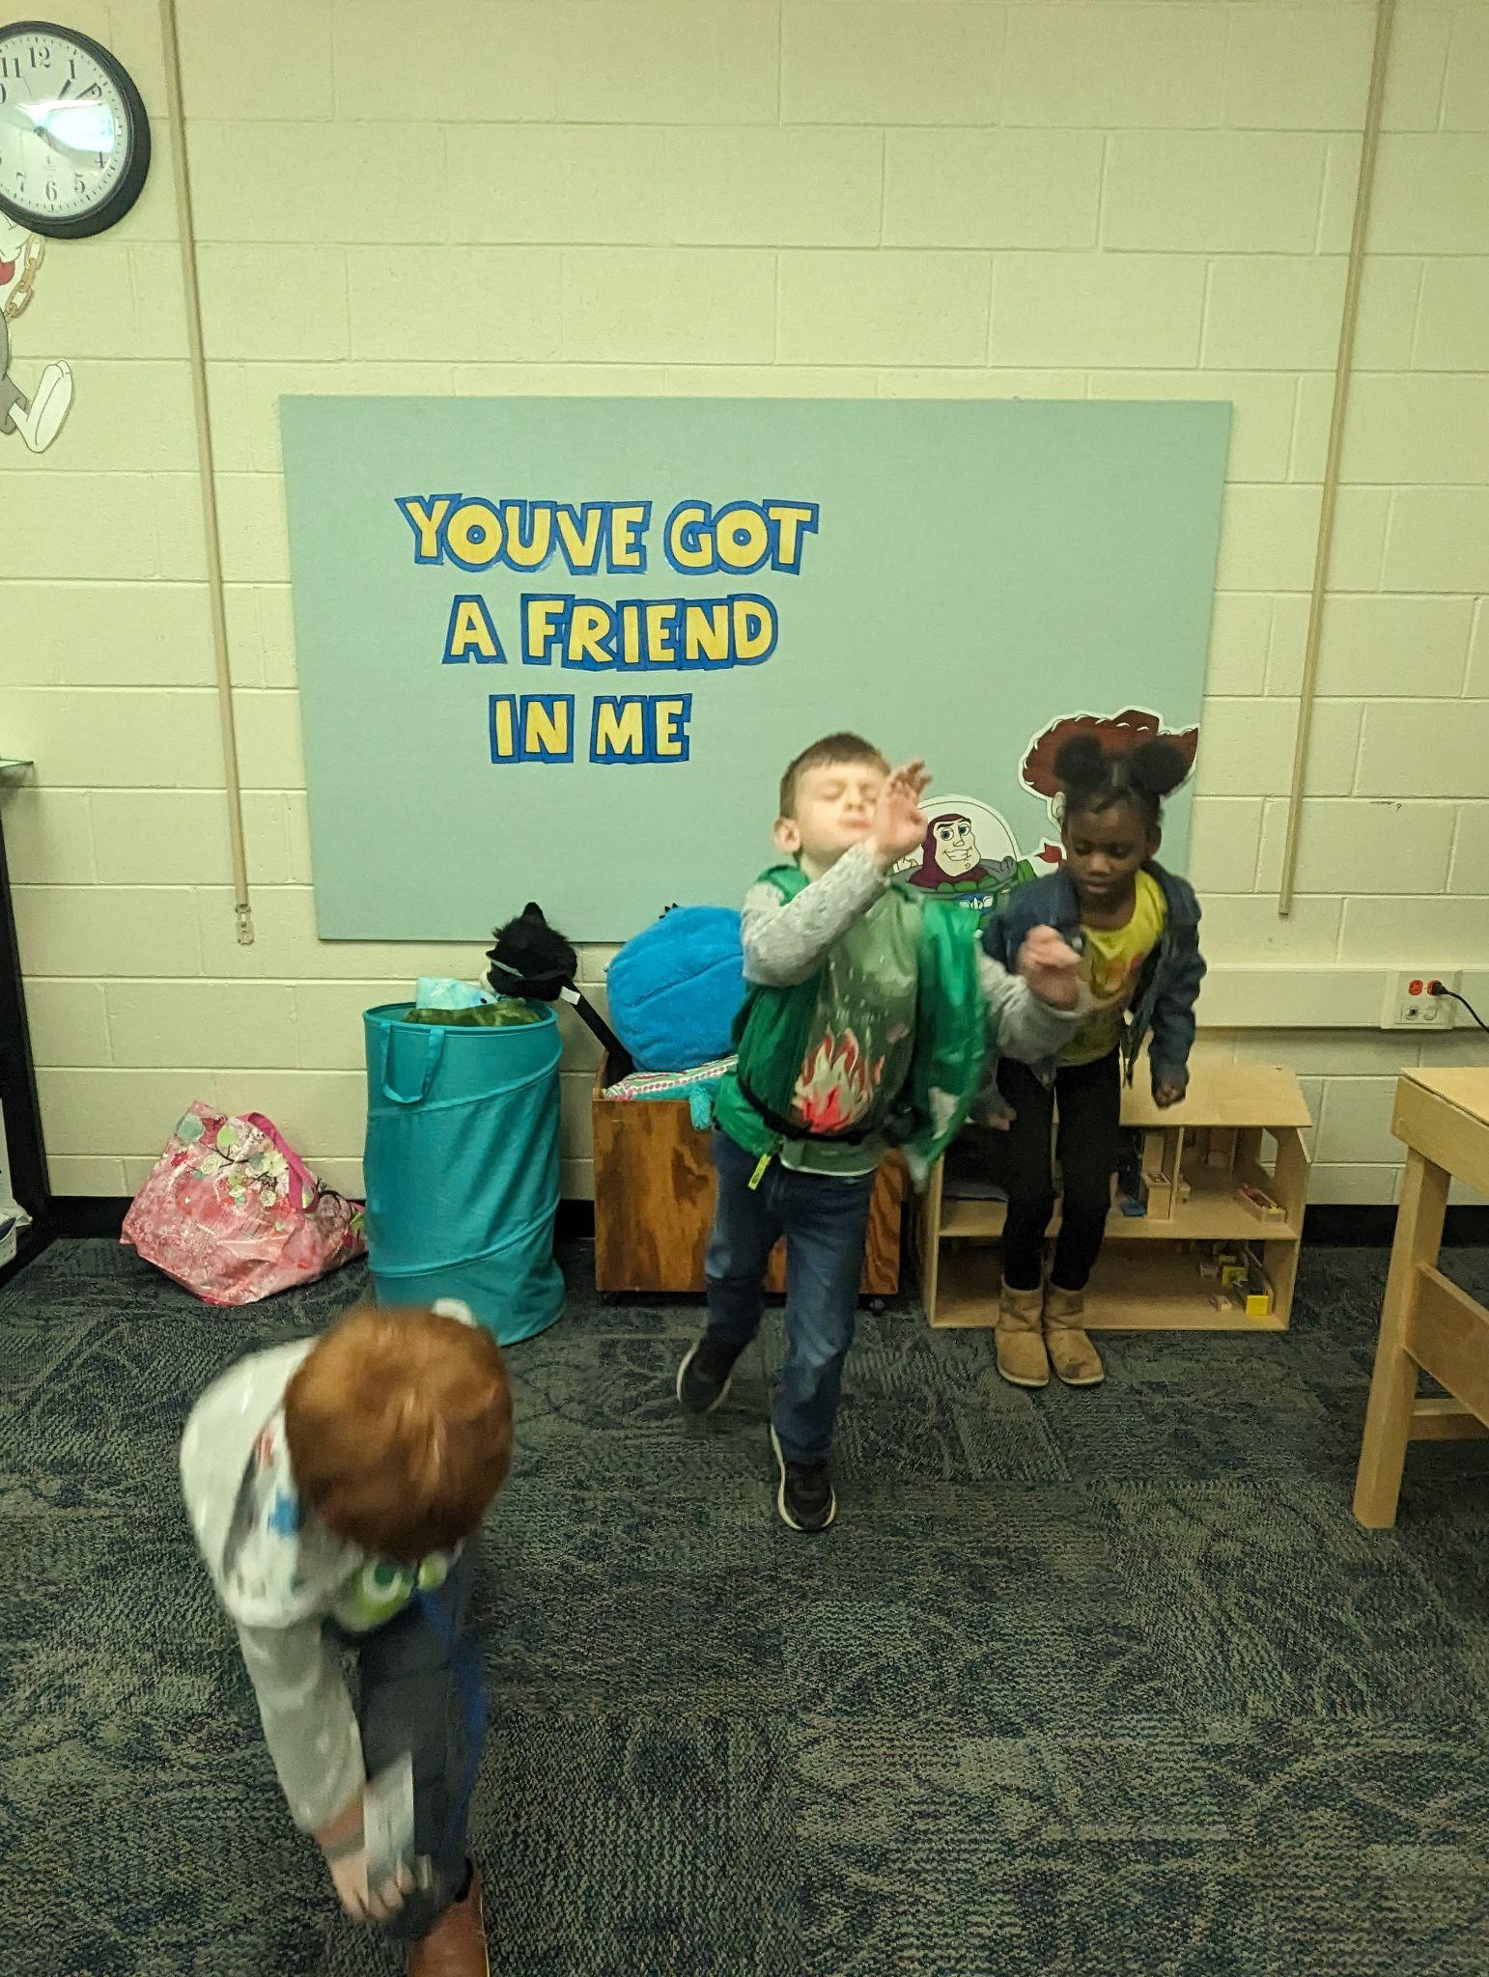
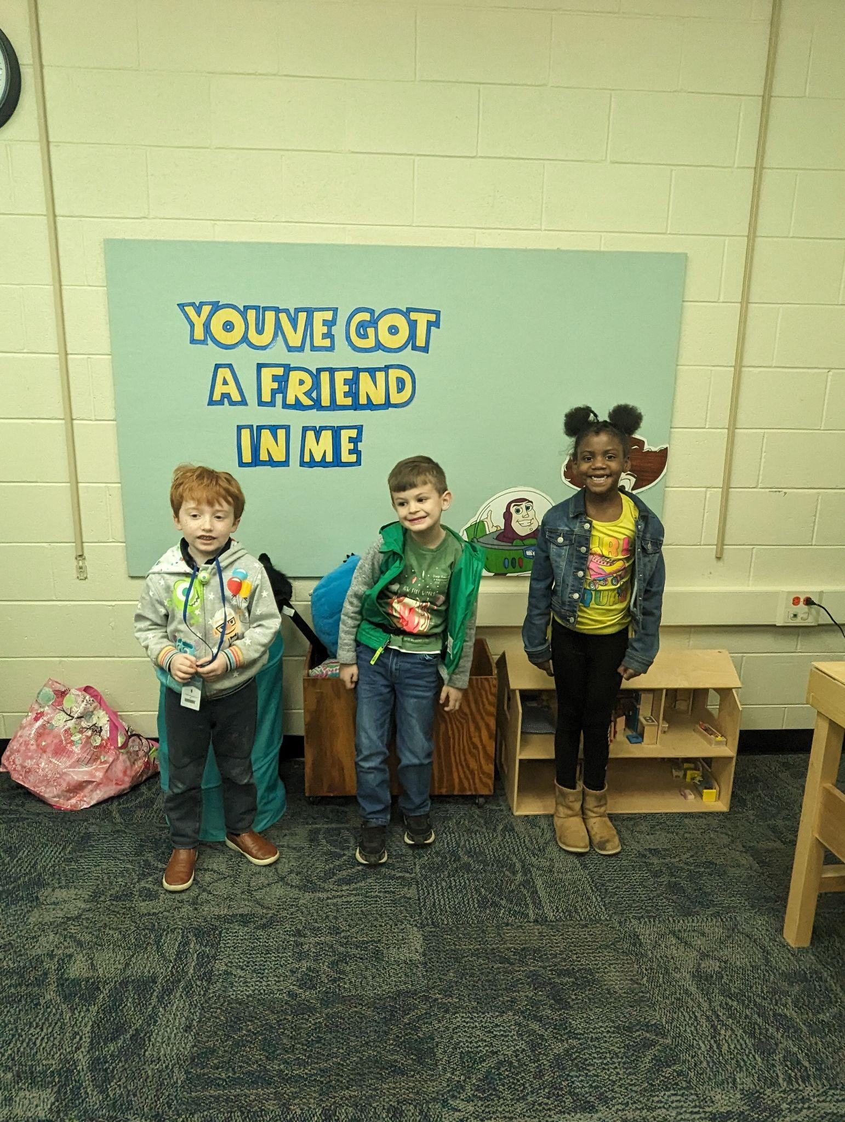
Week 7: Kind words & Compliments
This week we talked about how it feels to give and receive kind words and compliments. We learned that compliments are true, kind, and specific.
First, the students practiced identifying compliments by playing a game where they would jump forward if the compliment they heard was true, kind, and specific.

Slide 16

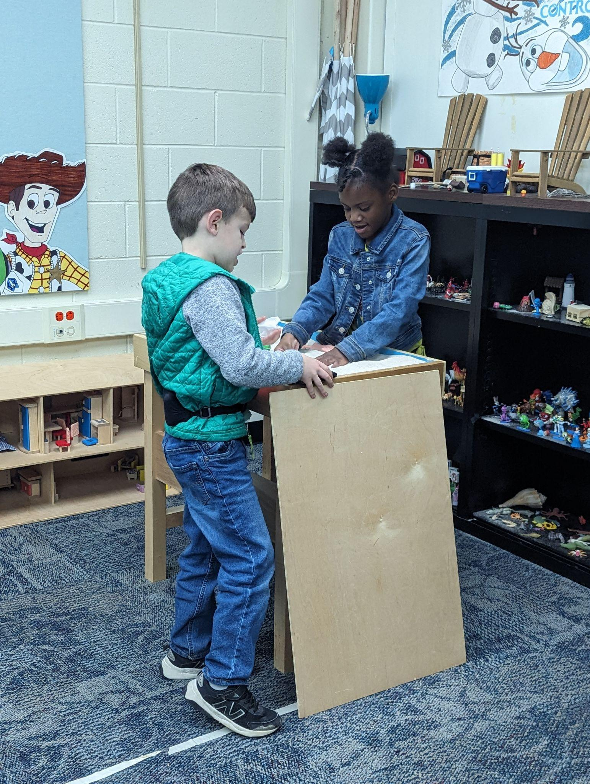
Next, we all went around in a circle and came up with one compliment for everyone in the group. The students complimented each other on how funny they are, how well they answer questions in group, and their good manners. I wrote down these compliments and put them in the compliment jar so that we can read them again next week. It feels good to hear compliments!
We also read the book “Edwardo: The Horriblest Boy in the Whole Wide World”. In this book, we see the power of kind words and compliments as Edwardo becomes the nicest boy in the world when others start using kind words towards him.

Slide 17
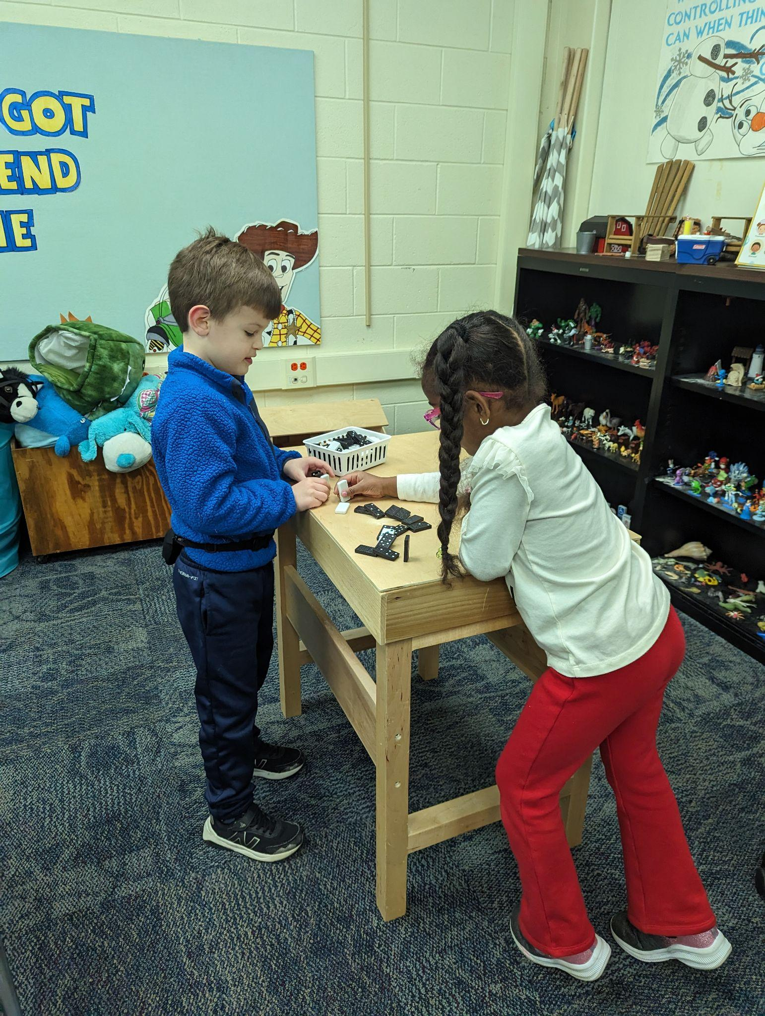
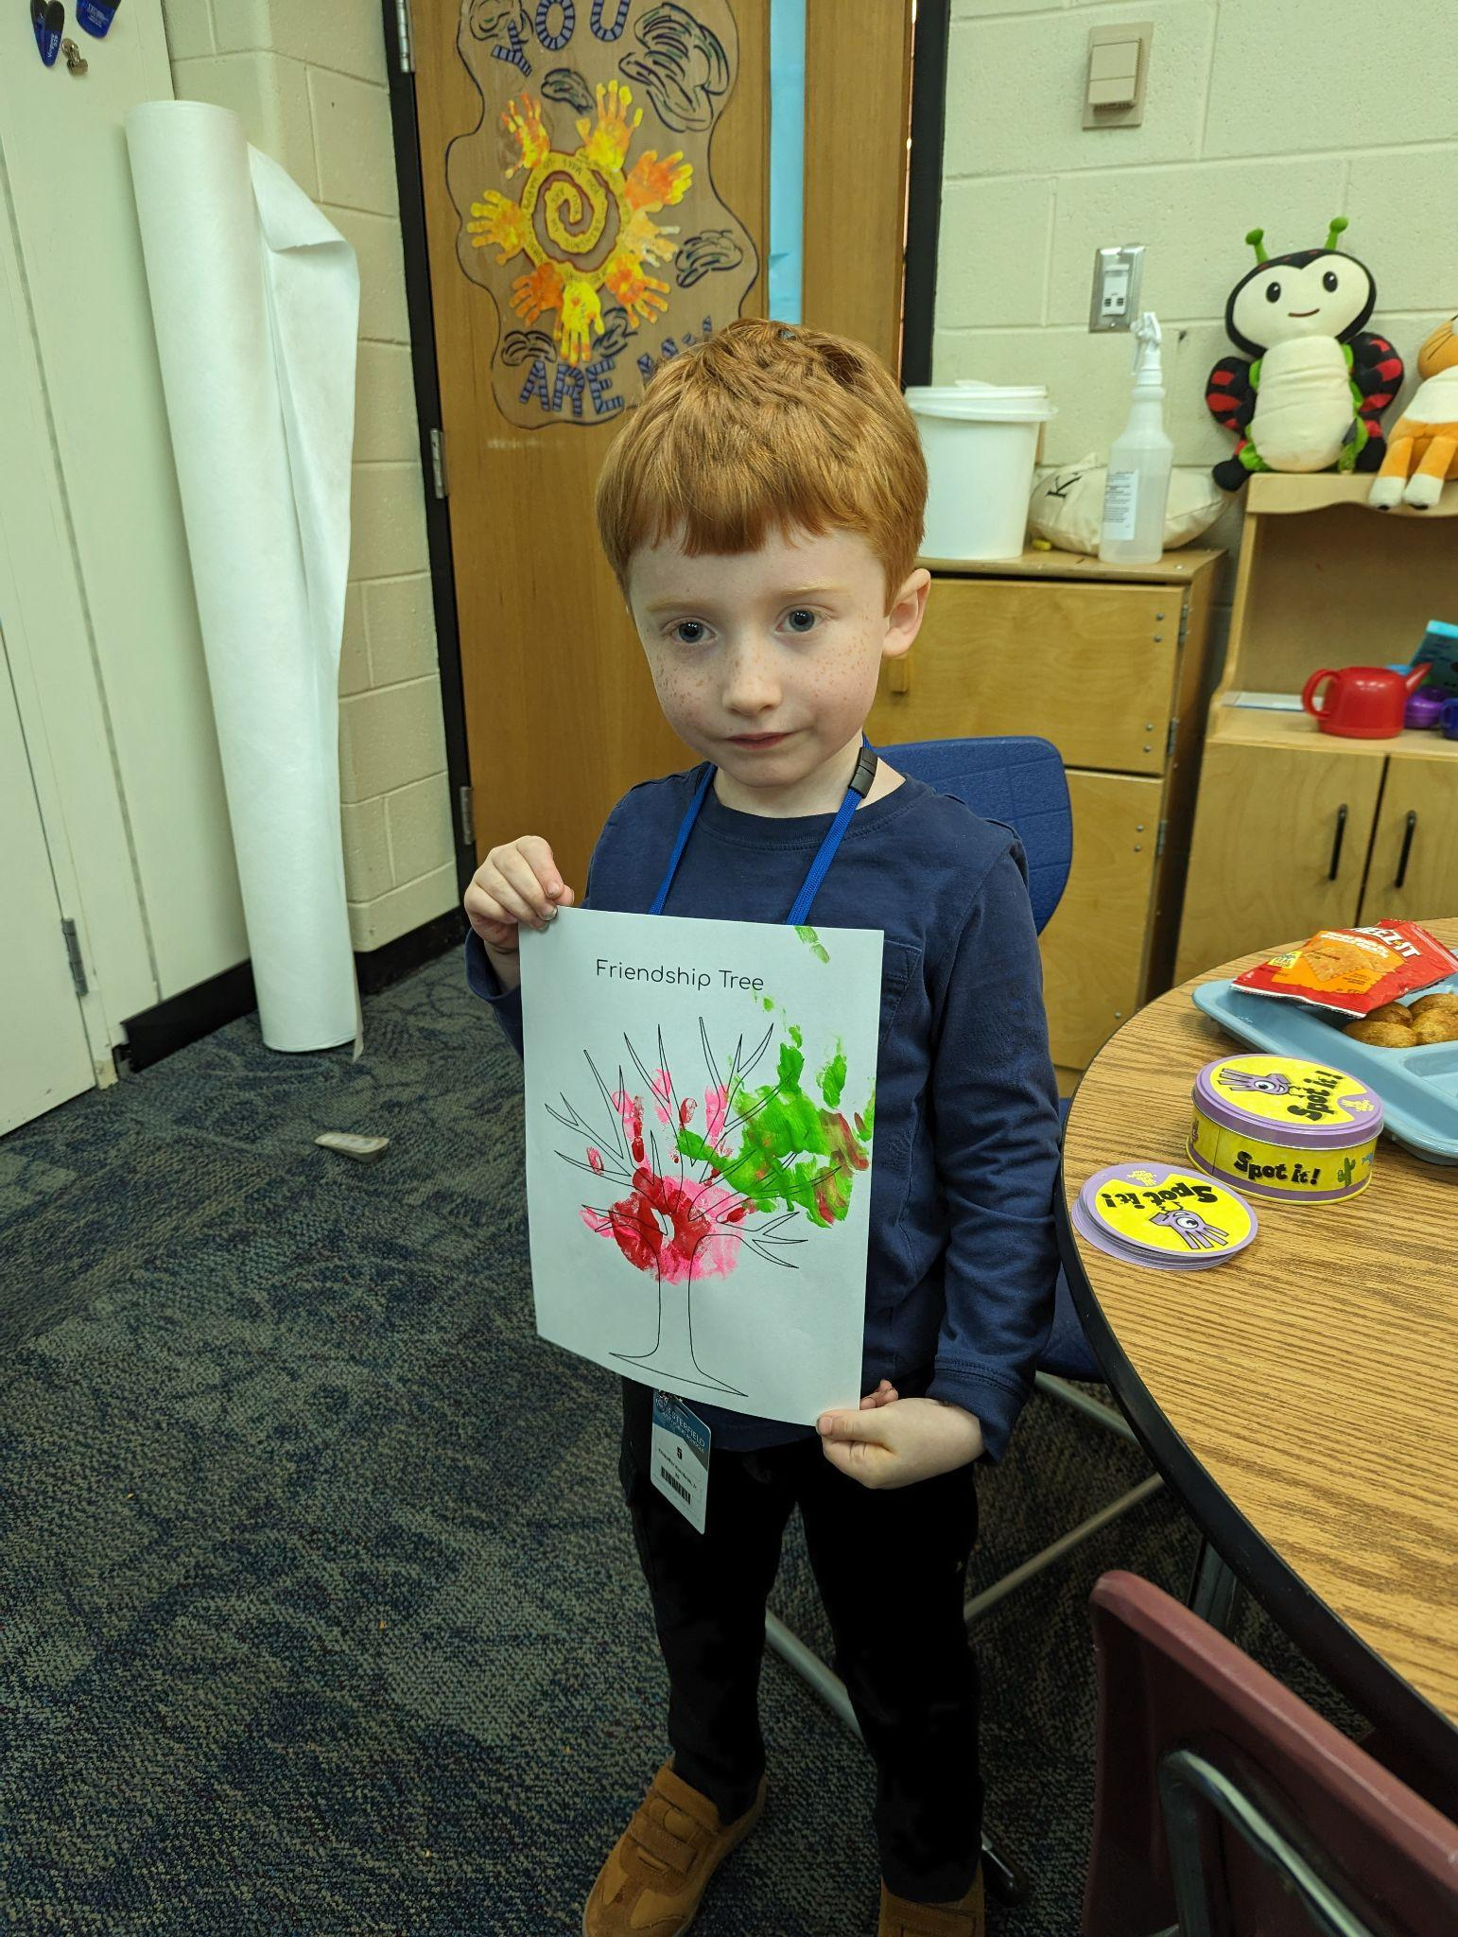
Week 8: Friendship skills Practice
We only have one more week of friendship group left, and we have learned so many friendship skills in the time we have had together! This week we put some of those skills into practice as we talked about our thanksgiving break. I was very impressed with how well everyone listened, included one another, and waited for their turn.
Next, the students painted their hands to create friendship trees! These will be a great reminder of the friendships made in group.
We also read the book, “The Not-So-Friendly Friend”, which is a great book about using friendship skills to put a stop to unkind behavior. We had a great discussion about how to solve conflicts in a kind way. Next week, we will review everything we have learned so far with a game to wrap up our group.

Slide 18
Thank you!

