Slide 1
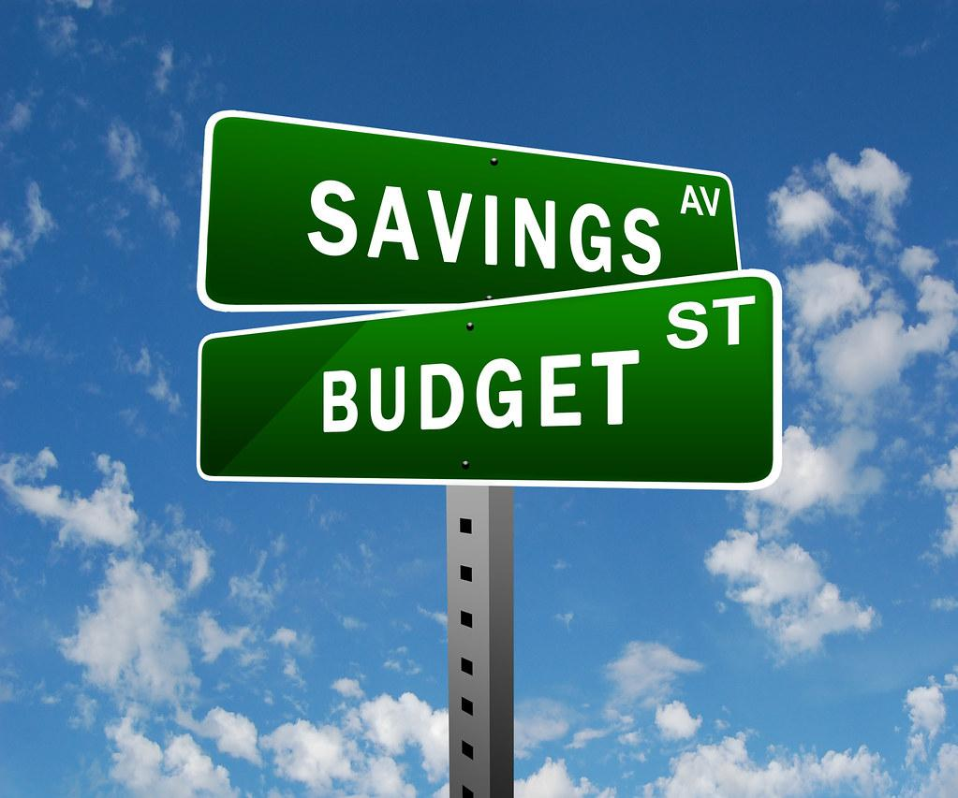
Budget Review Communication Strategies:
By:Neville Boone

Slide 2

Savannah Chatham Public School System
The Savannah Chatham County Public Schools System have over 37,000 students with over 3,000 teachers and instructional coaches (Unknown, 2020).
Notes:
SCCPSS produces more than 95,000 payroll checks with over 7,000 W2 dispersed per year (Unknown, 2020).

Slide 3

Savannah Chatham Public School System
314,640,886 dollars is allocated for direct instruction, 28,902,100 is for pupil services, 13,796,539 is slated for improvement of instruction and 8,288,795 is for educational media services (SCCPSS.ORG, 2020).

Slide 4

Savannah Chatham Public School System
Total instructional expenditure is 361,934,778. Net instructional expenditure per pupil is 9,768 dollars, total budget expenditure is 616,561,275. The total enrollment stands at 37,055 (SCCPSS.ORG, 2020).

Slide 5

Savannah Chatham Public School System
The general fund equates to 73% of all funding, debt service is 2%, capital service is 13%, special revenue funds is 11% and internal service fund is 1% (SCCPSS.ORG, 2020).

Slide 6
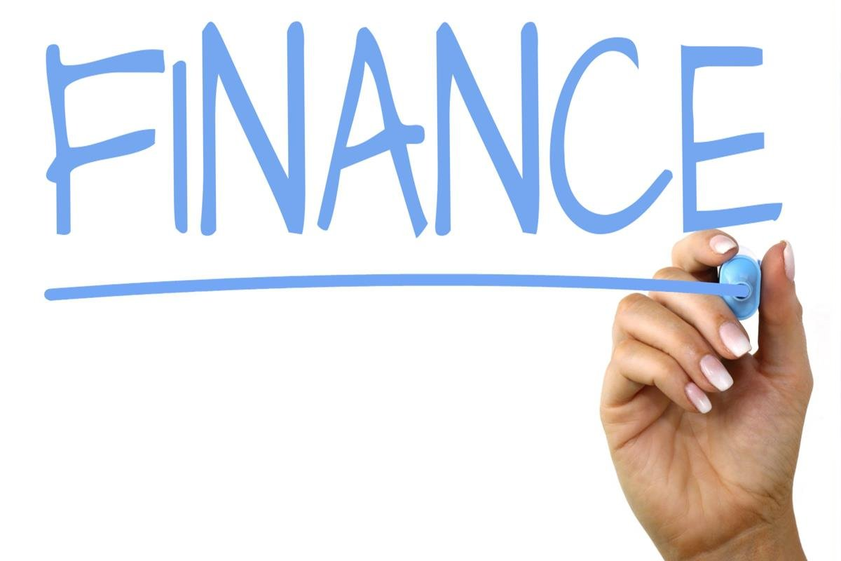
SCCPSS Forecast of Revenue
Local: 375,123,263
State: 187,493,933
Federal: 51,698,352
Other: 22,165,040
Salaries: 259,799,469 (SCCPSS.ORG, 2020).

Slide 7

SCCPSS Forecast of Revenue
Benefit: 114,446,626
Purchased services: 22,571,760
Utilities: 8,745,313
Supplies: 9,603,606
Books: 675,744 (SCCPSS.ORG, 2020).

Slide 8

Savannah Chatham Public School System
The three district/school systems and operations that can pose a possible threat to funding or an imbalance to funding is the
General fund
Student enrollment
Debt service.

Slide 9

Savannah Chatham Public School System
General Fund: The general aid/fund is one of the schools primary source of revenue, they do not place restrictions on the use of funds (Odden & Picus, 2019).
Notes:
The general fund comes from a variety of sources which includes property taxes, income taxes, and sales taxes. If taxes decrease then the expenditure per pupil will decrease.

Slide 10
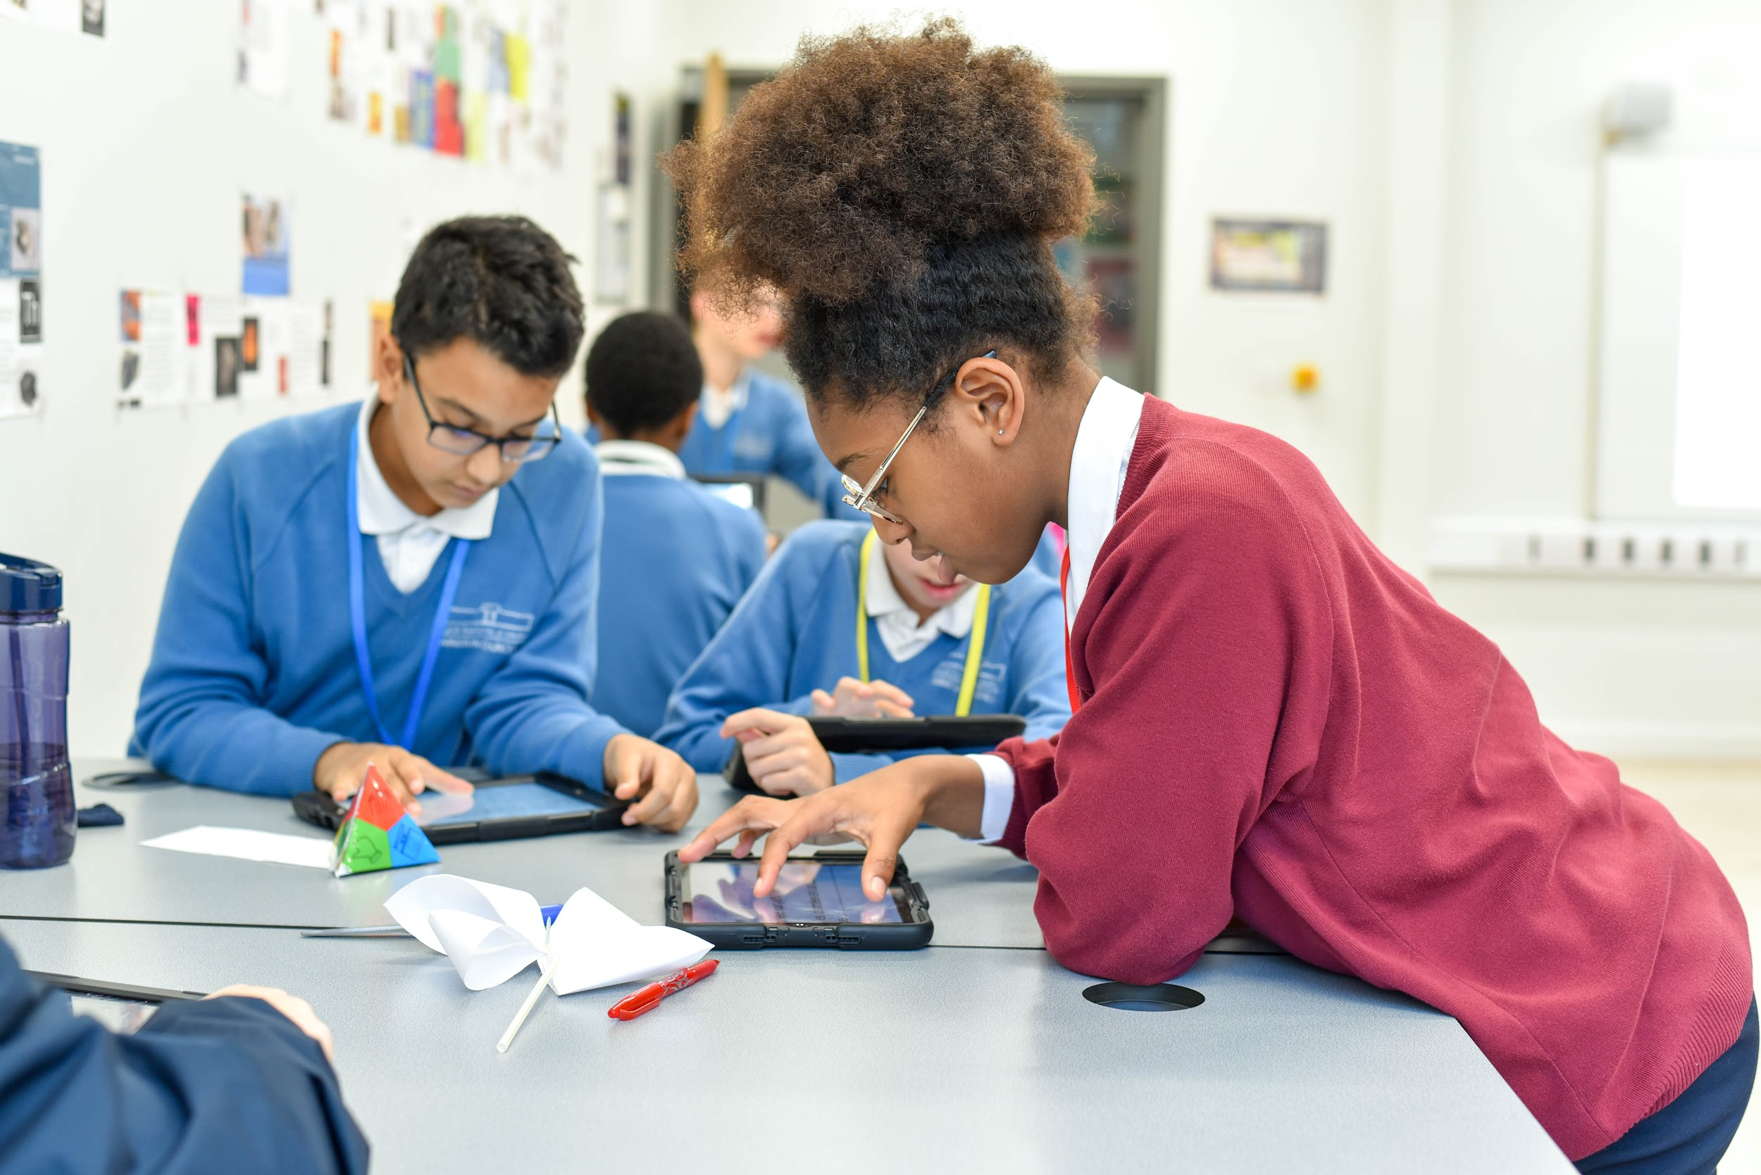
Savannah Chatham Public School System
Student enrollment: If parents choose to opt out their child from attending public schools and place them in private schools or out of district schools, then this can affect expenditure per pupil, per school (Edchoice.org, 2021).
Notes:
The School Choice program is a major threat to public school funding due to families choosing how to educate their child. One of the preferred freedoms of school choice programs is when a family lives in one county in a specific district and has their student attend another district. At least 84 to 90% of school choice enrollees are switchers, meaning they go back and forth to public or private schools of their choice. Overall, 47% of taxpayers found these programs are cost savers (Edchoice.org, 2021).

Slide 11
Savannah Chatham Public School System
Debt service: An increase in debt service can become a cause of concern and weaken the overall budget.
Risk: Layoffs, lack of funding for essential services, and/or effect the overall effectiveness of the budget.
Notes:
The reason why debt service can become a cause for concern is because funding will have to come out from a variety of sources to cover salaries, benefits, purchase of supplies, vehicle and maintenance services all which will overall weaken services.

Slide 12

Two Possible Financial Needs
Professional development
Alternative Education

Slide 13
SCCPSS Professional Development
According to SCCPSS.ORG (2020), the state has allocated 960,000 for professional development. The breakdown includes 640,000 from the state and 320,000 from the local government.
Notes:
If the state decided to cut funding which is already limited, this can cause an area of concern.

Slide 14
Alternative Learning
The state has allotted 1,673,878 for staff salary and 22,806 for the cost of operating the facility. The state allotted 1,116,365 while the local government funded 557,513, for a grand total of 1,650,992 (SCCPSS.ORG, 2020).
Notes:
If the state decides to cut funding for alternative learning, this can inadvertently affect the graduation and dropout rate, and this can become a major concern. According to Savannah Chatham graduation rate has increased from 87.8% to 89.77% over the past year, and at least eight out of 11 schools have improved their graduation rate (Graduation, 2020).

Slide 15

From the Perspective of two School Administrators About
Mr. Davis and Mr. Taylor agreed that the budget for the school district is adequate and equity amongst all stakeholders and the most important aspect is that no personnel have been laid off or has any program experienced major cuts.

Slide 16

Savannah Chatham Public School System
This concludes my presentation

Slide 17
Reference
Clay, H. (2017). Alternative Education. Retrieved 2021, from https://digitalcommons.liberty.edu/cgi/viewcontent.cgi?article=3286&context=doctoral
Edchoice.org. (2021). How does school choice affect public schools' funding and resources? Retrieved April 12, 2021, from https://www.edchoice.org/engage/faqs/how-does-school-choice-affect-public-schools-funding-and-resources/

Slide 18
Reference
Graduation. (2020). Savannah Chatham Schools graduation rate. retrieved 2021, from https://spwww.sccpss.com/Pages/2020-SCCPSS-Graduation-rate-sets-new-record,-once-again-surpasses-state-and-national-rates.aspx#:~:text=The%20Georgia%20Department%20of%20Education,sixth%20year%20in%20a%20row
Odden, A. R., & Picus, L. O. (2019). School finance: A policy perspective. New York, NY: McGraw-Hill education.

Slide 19
Reference
SCCPSS.ORG. (2020). Chatham County Public School System Budget. Retrieved 2021, from https://spwww.sccpss.com/fin/bud/Documents/FY21%20Adopted%20Budget/Adopted%20Budget%20for%20Fiscal%20Year%202021.pdf
Unknown. (2020). SCCPSS Payroll. Retrieved April 12, 2021, from https://spwww.sccpss.com/fin/Pages/Payroll.aspx

