Slide 1
The Importance of Intervention when students are victims of bullying
Neville Boone
School of Educational Administration, Liberty University
EDAS 747: Advanced Educational Law
Dr. Tammie Brown

Slide 2
Project Agenda/Outline
Objective
Definition
Introduction
Legal Consequences
Reporting Process
District Support
Literature Review
Data Analysis
Conclusions
Reference

Slide 3
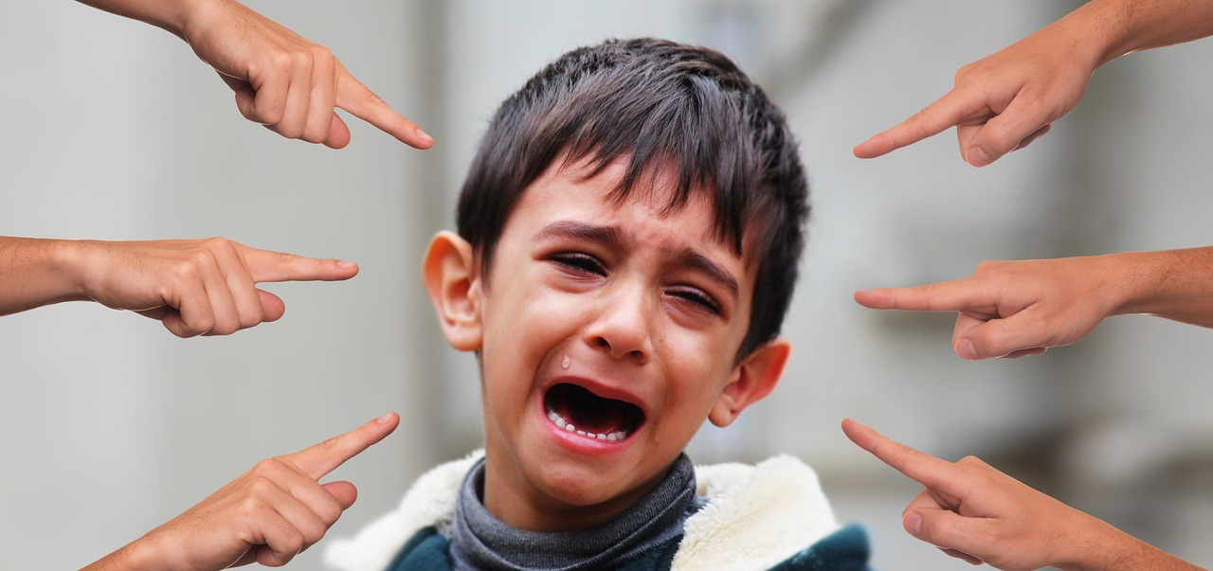
Objective
The objective of this presentation is to raise awareness of the devastating effects of bullying and the consequences and legal repercussions if schools choose not to intervene on behalf of the victim.

Slide 4
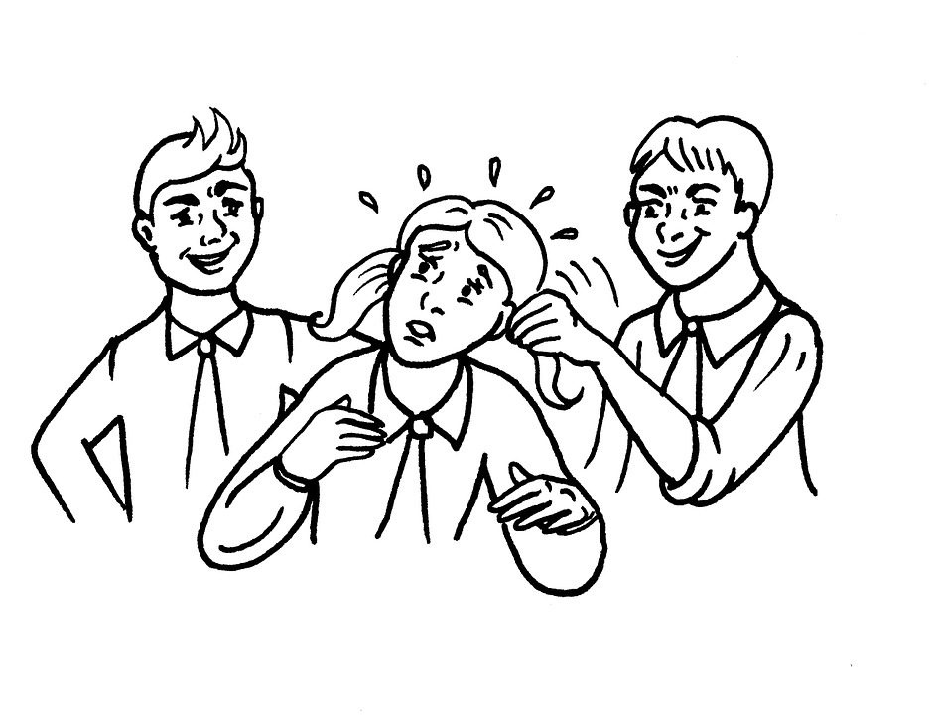
Definition
Battery: A person commits the offense of battery when he or she intentionally causes substantial physical harm or visible bodily harm to another.
Bullying: Means any willful attempt or threat to inflict injury on another person, accompanied by an apparent present ability to do so; or any intentional display of force such as would give the victim reason to fear or expect immediate bodily harm.
Cyberbullying: Bullying is a pattern of behavior, which may include written, verbal, or physical acts, that is so severe, persistent, or pervasive so as to have the effect substantially interfering with a student's education,threatening the educational environment, or causing substantial physical harm or visibly bodily harm.
Notes:
Battery: A person commits the offense of battery when he or she intentionally causes substantial physical harm or visible bodily harm to another. As used in this Code section, the term “visible bodily harm” means bodily harm capable of being perceived by a person other than the victim and may include, but is not limited to, substantially blackened eyes, substantially swollen lips or other facial or body parts, or substantial bruises to body parts. (1) Any person who commits the offense of battery against a teacher or other school personnel, engaged in the performance of official duties or while on school property shall, upon conviction thereof, be punished by imprisonment for not less than one nor more than five years or a fine of not more than $10,000.00, or both. O.C.G.A. § 16-5-23.1
Bullying: means any willful attempt or threat to inflict injury on another person, accompanied by an apparent present ability to do so; or any intentional display of force such as would give the victim reason to fear or expect immediate bodily harm. This definition has been amended by state law - refer to Board policy JCDAG, Bullying, for complete definition.
Cyberbullying: Bullying is a pattern of behavior, which may include written, verbal, or physical acts, that is so severe,persistent, or pervasive so as to have the effect substantially interfering with a student's education,threatening the educational environment, or causing substantial physical harm or visibly bodily harm. No student shall sexually, emotionally, verbally, physically, or by any communication by telephone, mail,broadcast, computer, computer network, or by any other electronic device or through the use of electronic communication as defined in O.C.G.A. 20-2- 751.4 or otherwise harass, threaten, intimidate, or bully or cyberbully any student, teacher, school employee, or other person (See Student Code of Conduct Procedure 4). Any student, in grades 6-12, committing the offense of bullying for the third time in a school year, shall be assigned to an alternative school pursuant to O.C.G.A. 20-2-751.4. Any form of harassment, threats,intimidation, or bullying or cyberbullying shall be promptly reported to an administrator or counselor.Teachers may be notified to maintain classroom discipline (Student code of conduct, 2020).

Slide 5

Introduction
Bullying has become such a significant phenomenon it has caught the attention of many schools and officials across the country. This effect has led to nationwide efforts to reduce and eradicate bullying in schools. Two events that caught the eye of many Americans were the Columbine High School shooting which depicted a victim of bullying as the perpetrator of a mass shooting, and the Davis v. Monroe Board of Education case (Cornell, 2016).
Notes:
Bullying can be a broad term that can overlap or capitulate behaviors such as criminal, sexual, extortion to lesser forms of aggression which includes teasing, horseplaying, and joking. Other forms are an imbalance of powers that can be in size, strength, verbal abuse with a perpetrator having a cognitive and self-confidence advantage.

Slide 6
Consequences if Legal Guidelines are not Followed
In the Davis v. Monroe Board of Education case, the courts decided to rule in favor of the plaintiff and agreed that schools could be held accountable for not intervening in peer-to-peer sexual harassment. Bullying is an aggressive form of verbal and physical aggression with the intent to inflict harm (Cornell, 2016).

Slide 7
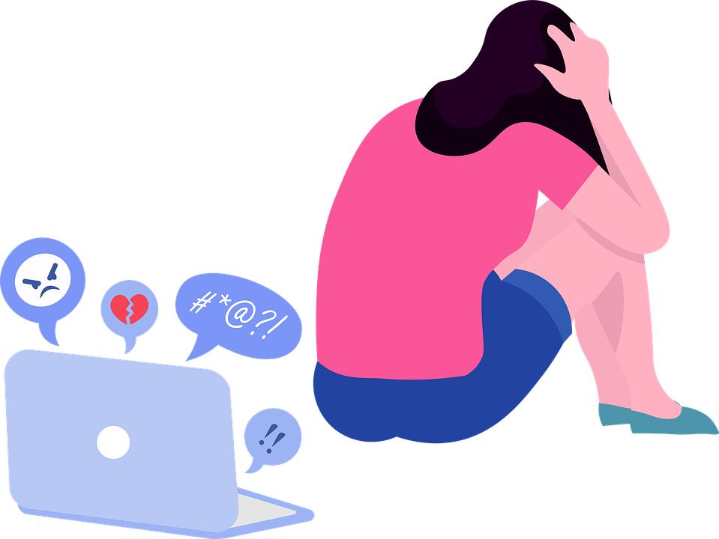
Consequences if Legal Guidelines are not Followed Continued
According to Title VI no one shall be treated differently based on the color of their skin, national origin, or race. Title IX states that no one should be treated differently based on their sexual orientation. In the case of Davis versus Monroe County Board of Education, the Supreme Court ruled in favor of the plaintiff that the school can be held liable for damages in peer-to-peer harassment. This case was a door opener for future cases requiring schools to become more
responsible for students' actions under their care (Cornell, 2016).

Slide 8
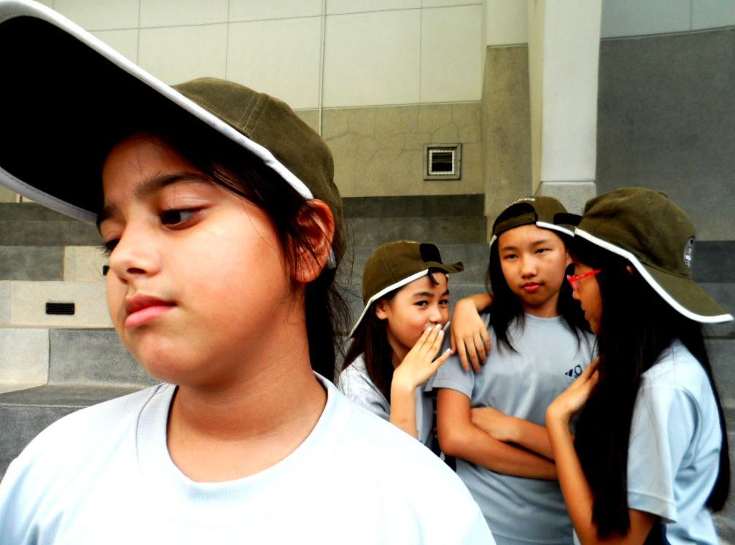
Consequences if Legal Guidelines are not Followed
The courts create four essentials for schools to follow to prevent or be held liable if
Schools do not intervene.
The nature of the bullying
The school must either know or have seen the harassment
The school is displaying indifference (Cornell, 2016).
Notes:
The courts create four essentials for schools to follow to prevent or be held liable.
Schools are held liable if they notice harassment and do not intervene.
The nature of the bullying has to be so severe and imbalanced that it creates an inability for the victim to learn and grow.
The school must either know or have seen the harassment; the school cannot be held accountable for harassment if they do not know.
The school is displaying indifference by not intervening, schools cannot always prevent or cease bullying, but they must interfere (Cornell, 2016).

Slide 9

The Reporting Process
When a policy needs to be amend or created staff member must first collaborated and form a written plan and that correlates with school and districts plan.
Staff member or members must present policy or plan to the administrator team before faculty monthly meeting to be added to the agenda.
Staff member will be notified by Myers Middles School principal Mr. Davis if policy, rule or procedure would be addressed.
If policy is beyond the scope or authority of Mr. Davis then he can request to address the board

Slide 10

District Support Needed
What is needed for stakeholders to amend a policy?
Board meetings are held monthly to establish and conduct official business of the board. All citizens are encourage to participate or request to make an appearance before the board. All meetings are opened to the public except executive sessions (Spwww, 2021).
Notes:
“Regular meetings shall be held monthly pursuant to regular schedule determined by the Board each year. No meeting of the Board shall be held unless proper notice to the public of the meeting has been made as required by law.
Special meetings may be called by the President or shall be called upon the written request of three (3) members. Except in cases of emergency, members shall be given at least twenty-four hours’ notice stating the purpose(s) of the meeting, which shall be the only order of business at said meeting.
The presiding officer at all meetings of the Board shall be entitled to vote on all questions which may arise at the meeting.
A majority of the Board shall constitute a quorum for the transaction of business at meetings of the Board. The presiding officer may be counted to make up this majority. The votes of a majority of the members present shall be necessary to take any binding action or to pass any resolutions, provided there is a quorum present. Any action taken by less than a majority of the Board members may be rescinded by a majority of the Board members at the next regular meeting or within thirty (30) days of such action, whichever is later. When a quorum is not present, a lesser number than a quorum may adjourn any meeting from time to time to another hour or date.
The rules contained in Robert’s Rules of Order, Newly Revised, shall govern the Board in all cases to which they are applicable in which they are not inconsistent with these Bylaws and any statutes or regulations applicable to the Board” (Spwww.sccpss.com, 2021).

Slide 11
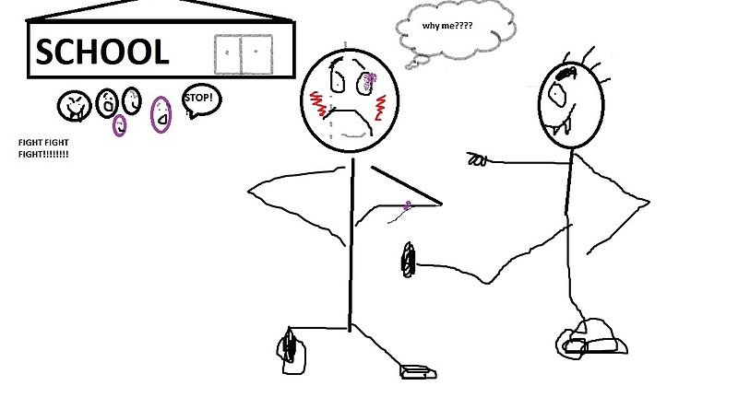
Literature Review
The effects of bullying can have long-term effects that are associated with victimization and bullying. According to longitude research, victims of bullying have long-term psychological trauma and have at least 1/3 chance of being exposed to violent acts of aggression or criminal behaviors due to bottled-up emotions. Research has shown that when students are bullied, they have social, emotional, and psychological disorders such as depression(Fullchange & Furlong, 2016).
Notes:
Research has also shown that 79% of bullied students attempt, commit, or have thoughts of suicide, and 61% have PTSD and severe depressive disorders. Students who are victims of bullying have lower grades and lower engagement connectivity amongst peers. Victims of bullying have difficulty making new friends and have social-emotional function deficiencies (Fullchange & Furlong, 2016).

Slide 12

Literature Review Continued
The United States has a systemic stratification and perception and association regarding race, ethnicity, education, and bullying. Stereotypes are defined as judging someone based on their membership, social group setting, or associations. (Williams & Peguero, 2013).
Notes:
Students learn about race and categories at an early age through actions that influence these preconceived established stereotypes through behaviors, academic skills, and motivating forces for academia. In the school house, students who are Black, Latino, or a Minority are associated with low socioeconomic status and have a disadvantage regarding funds for academic excellence. Teachers and students have a preconceived mindset that Black people and Latinos are poor and have limited abilities to succeed. Blacks and Latinos have also been stereotyped as naturally and physically superior and are pressured to enter sports.
If minorities do not comply with the stereotypical innuendos, they become verbally harassed, ostracized, and isolated by their peers. Research has suggested that stereotypes and victimization will only increase in high school due to learned behaviors from society and early upbringing. Also, the preconceived socioeconomic status will increase for Black and Latino with higher tests due to them not fitting the bill of their ethnic, social-economic stereotypical persona (Williams & Peguero, 2013).

Slide 13
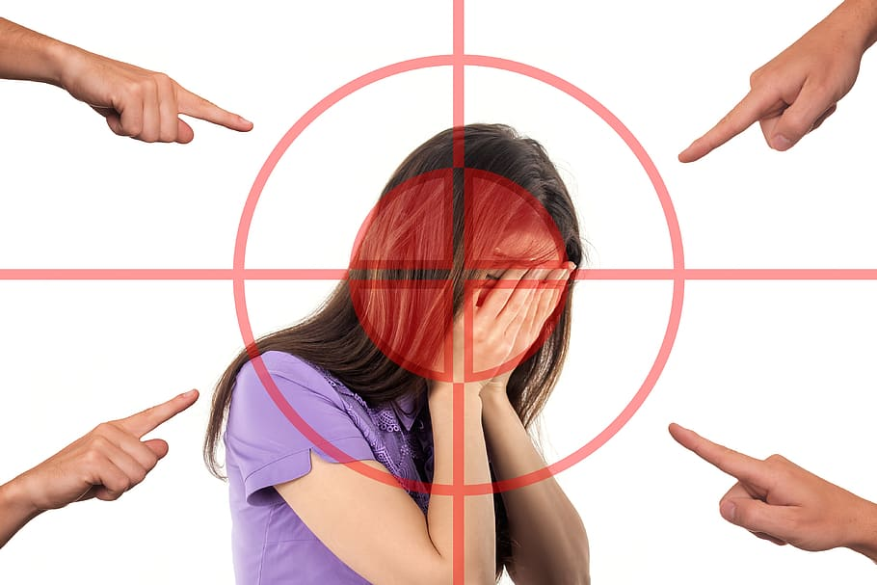
Literature Review Continued
Acts associated with bullying are a widespread phenomenon that has affected over 53% of youth in 6 out of 7 continents worldwide. Youth who have experienced acts of bullying can exhibit negative effects, including fear, doubt, humiliation, sadness, rejection, hopelessness, and helplessness. (Hall, 2017).
Notes:
As time progresses, the adverse effects of bullying can cause side effects such as poor health, suicidal ideation, anxiety, alcoholism, psychological distress, decreased cognitive skills, and overall dwindling well-being. When victims are compared to non bullied individuals, they exhibit low self-worth, lack of self-confidence, lack of self-efficacy, a higher tendency for aggression, and a lower tendency for learning. Victims tend to have family structure dynamics issues. The victims tend to have less hope, and school has moderate to no connections in relation to peer support and life satisfaction. Victims of bullying have higher absenteeism and lower education.
Youth who bully tend to have a harsh social-economic environment with limited resources, and they often have no self-control or lack of empathy. Bullies voluntarily skip school or even drop out. Perpetrators have similar psychological issues as victims, including suicidal thoughts, depression, low self-esteem, and criminal and violent behaviors (Hall, 2017).

Slide 14
Literature Review Continued
In the case of Saxe v. State College Area School District, the court ruled in favor of the school policy by concluding that there is no freedom of speech protection for language that is considered vulgar, indecent, and offensive to the school environment. Around August 1999 State College Area School District provided a new statute that was formed to hinder and sway destructive verbal behaviors (Alito & Rendell, 2001).
Notes:
The statute was in the form of an anti-harassment policy intended to make students on campus fuel safe, inviting, and comfortable in the learning environment, free from distractions or offensive language. Under the policy, harassment is anything unwelcome, including language, vulgarity, jokes, solicitation, bullying, sexual advances, to name a few (Alito & Rendell, 2001).
The anti-harassment policy furthers by giving a vivid view or description of harassment in the form of racial, sexual, and disability harassment. David Saxe is the plaintiff representing on behalf of his two sons who attend SCASD. He stated that the new policy would infringe on his children's First Amendment rights. Mr. Saxe furthers by expressing his concerns regarding a teacher at the school is who is homosexual, and is a source of concern for him and his children because they are Christians. As a Christian, Davis Saxe believes that the lifestyle of the teacher was sinful and harmful for the learning environment (Alito & Rendell, 2001).
The plaintiff believes that it is his moral obligation to stand and speak on behalf of his religion. The court's motion to dismiss the plaintiff's case because it is considered unconstitutional. The court also rejected the case because the policy which talks about hostile work or school environments is similar to Title VII, Title IX, of the Pennsylvania Human Relation Act (Alito & Rendell, 2001).

Slide 15
Literature Review Continued
In the case regarding Zamecnik v. Indian Prairie School District 204, a few students from Neuqua Valley High School sued the school district for infringement of their First Amendment rights, of freedom of speech. (Caselaw, n.d.).
Notes:
The students were religious, and they took offense to the lifestyle of same-sex relationships. The two students were upset that a Gay Lesbian and Straight Network group would come onto their school campus and wear t-shirts that brought awareness against harassment towards same-sex relationships The event was called the Day of Silence, and many of the school's students and staff would wear shirts such as "be who you are" to discourage harassment against homosexuals. The plaintiffs who are now graduated attended school the next day with a shirt saying, "be happy, not gay." The plaintiffs stated shirts were not intended to cause a Ruckus or harm to anyone but to stand for their beliefs. The plaintiffs brought up the case Chaplinsky v. New Hampshire, where the courts ruled in favor of the defendants based on the shirts "homosexuals go to hell." The plaintiffs explained that they could not wear those words on their shirts because they can provoke violent and aggressive behaviors towards them (Caselaw, n.d.).
The plaintiff stated that their school, which provides a platform for one advocacy, cannot stifle the opinions of the opposing party. The courts concluded the t-shirt was not causing a disruption to the learning environment, and the schools should use their platform to open up their floors for debate or discussion on different views. In this case, schools were not held liable, but it was encouraged to educate and create an atmosphere where debate is encouraged (Caselaw, n.d.).

Slide 16
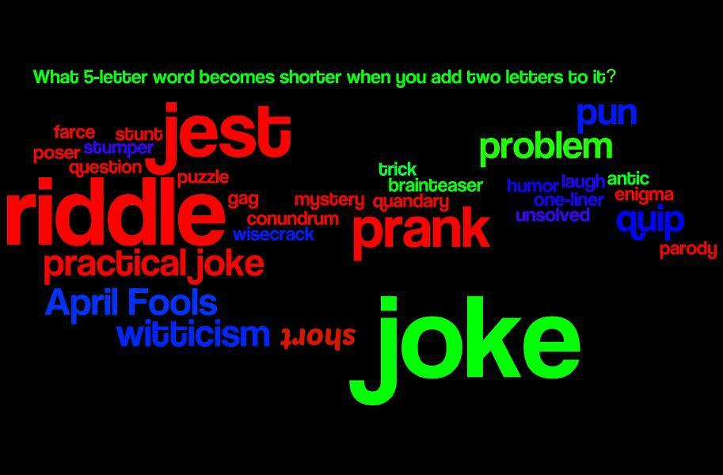
Literature Review Continued
In the case of Emmett vs. Kent School District number for 415. Nick Emmett, a high school senior attending Kent lake High School, was the co-captain of the boy's basketball team; with no discipline issues, and a high GPA, he decided to create a posthumous post on the web called The Unofficial Kent Lake high homepage (Law, n.d.).
Notes:
The plaintiff did notify viewers that this page had no affiliation with the school and only for humorous purposes. The page was created on February 13, 2000 and was written as a monk obituary of the death of students and staff at the high school. On February 16 2000, the news caught wind of the website and described it as a hit list on behalf of Nick Emmett. Nick Emmett took the page down and was ordered to be present the next day in the principal's office.
The principal acted out of haste by expelling Nick Emmett, but they later modified the sentence to five days. With the five days suspension, students cannot engage in any school-related activities, which includes basketball.
Chief Judge Coughenour stated that yes, the First Amendment awarded citizens the right to express their opinion, but it cannot disrupt the school's operations. The school abruptly handled the situation and was ordered that school suspension not count or be affected against the plaintiff. The judge stated no evidence of violence or potential harm targeting the school, staff, and students (Law, n.d.).

Slide 17
Literature Review Continued
In the case, Tinker versus Des Moines Independent Community School District, a group of students with concerns regarding the Vietnam War staged a meeting at Christopher Eckhardt's house. The goal of the meeting was to demonstrate in the act of solidarity with a peaceful protest against the Vietnam War with an armband (Law, n.d.).
Notes:
When the school's principal’s caught wind of the protest, they quickly adopted a policy to prevent students from wearing armbands. Even though this case does not have anything to do with bullying, it puts the school in an odd scenario where they seem to act out of haste as a bully by adopting policies preventing peaceful protest (Law, n.d.). The court case wound up in favor of the Tinker family, which played a part in the First Amendment and the Fourteenth Amendment rights of freedom of speech and due process clause

Slide 18
Conclusion Drawn from Literature
All past cases used this case as a reference for or against bullying. The schools are held liable if they do not intervene, but they must use caution and not act out of haste. When schools decide not to intervene, overlook and not act at all, this case open up a strong case of legal ramifications that can become costly.

Slide 19

Data Analysis of Myers Middle School
Myers Middle School is an urban area Title 1 middle school located in central Savannah, Georgia. Myers Middle School houses over 552 students grades 6-8 in an area filled with drugs, depravity, and low income.
According to Myers (2020), 75% of the parents are considered low income.
School's equity is very concerning; they are rated a 1 out of 10.
Notes:
The test scores are even more discerning according to Myers (2020); students' overall grade scores for all students on tests are 8 % out of 29% out of all students in surrounding schools. The demographics are as follows, 81% of students are African American, 6% are White, 8% are two or more races, 4% are Hispanic, and 1% are of Asian descent.
Myers's 6-8th grade math score proficiency is 10% compared to the state of Georgia's average score of 43%. Myers English test scores are 11% compared to the state average of 43%, and in science, the school average is 6% while the state average is 39%. The student-teacher ratio is 15:1, while the state average is 16:1. Teachers with three more years of experience are 83% than the state average of 91% (Myers, 2020).
All students at Myers average 29% in suspension rate compared to the states average of 7%. When data is compared by race, Black students average 29% of suspension while the state average is 13% for overall black students suspension rate. White students have a 19% suspension rate compared to the state's overall average of 4%. Two or more races have a 57% suspension rate compared to the state average of 9%. Hispanics have a 42% suspension rate compared to the state average of 5%, and finally, Asian students have a suspension rate of less than one percent while the state average is 4% (Myers, 2020).
These statistics are very alarming. It points to the very fabric of that poor test scores, above average out of school suspensions, and poverty-stricken environments is an instant open door towards aggressive behaviors in the form of bullying, cyberbullying, and battery. These associations create an environment where the trend continues and never ends but open the door towards grief.
As a former teacher at Myers Middle School, bullying, battery, and cyberbullying are some of the major culprits of out-of-school suspensions at Myers. Bullying is a phenomenon that has affected and garnered attention from several educators, administrators and policymakers in the past few years because of the catastrophic effects it has on the victims. Bullying consists of hit, kicking, screaming, pushing, and intimidating (Oliveira, Menezes, Irffi, & Oliveira, 2017).

Slide 20

Conclusion Drawn From Data
Building Bridges should follow the PBIS rewards system approach by modeling positive behaviors. The staff should model positive behaviors through attire, speech and interactions with students. Students should model behaviors their teachers are displaying and replicate it throughout the day.
Notes:
Cyberbullying, bullying, and battery are prevalent in today's school. Many students who attend schools have either been a victim, a perpetrator or a bystander of bullying. All levels of involvement in bullying can create adverse effects for all parties involved. It is imperative that the administration and schools staff create a climate where there is zero tolerance towards these behaviors.

Slide 21

Conclusion Drawn From Collaboration
I recommend that the administrators hire outside consultants that can help staff and students learn to connect in a positive and rewarding manner. Consultants can be business leaders who are equipped to form or build positive school cultures.
Notes:
After working with Mr. Davis principal of Myers Middle School, I learned that it is easier to judge a book by it’s cover from a distance, but when you are working with first hand knowledge and due diligence as Mr. Davis and his administrative team then only then can you decipher and notice implementation in effect.
Internal Data
Myers Middle School has internal data and behavioral goals that correlate with the P.B.I.S. modeling systems, which are to be proactive and begin with and end in mind. Myers Middle School's internal data includes mandatory student attendance in person and virtually, student etiquette, login time, passing all classes, and actively participating in class (Sccpss.com Myers, 2021). These expectations align with making sure students are actively engaged, leaving no room for horseplaying coarse jokes and any bullying tactics mentioned in the literature review.
Case review
Of all the case reviews researched on bullying, Kara Kowalski versus Berkeley County Schools was the one that stood out the most. Kara was a student who formed a website called S.A.S.H., and this website was built to instigate and pick on a fellow student. This case is prevalent towards both internal and literature review because the courts stated the schools were in the right by intervening, but if an intervention is absent, then the school could have been held liable for damages.
Literature
This literature is the culmination of the cause and effects of bullying. Cases where jokes can be taken as a form of a threat in Mr. Nick Emmett's case. Also, in a situation where students, even though they were standing up for their beliefs, in the Zamecnik v. Indian Prairie School District 204 case, they were rebuked by the school for wearing shirts contrary to the school's event. In that case, the courts reprimanded the schools and ordered them to debate and use this as a teaching moment. All cases, internal data, case review, and literature review have one central theme which pertains to Myers Middle School, and it is that the First Amendment right of freedom of speech is free, but it is not welcomed in all cases. Also, all students must govern themselves according, and the school must intervene if acts of bullying arise.

Slide 22
Reference
Alito, C., & Rendell, C. (2001). Saxe v. state college area school district. Retrieved April 13, 2021, from https://casetext.com/case/saxe-v-state-college-area-school-district/?PHONE_NUMBER_GROUP=P
Caselaw. (n.d.). FindLaw's United States Seventh Circuit case and opinions. Retrieved April 13, 2021, from https://caselaw.findlaw.com/us-7th-circuit/1557587.html
Zamecnik v. Indian Prairie School Dist. #204, 636 F.3d 874, 876 (7thCir. 2011).
Cornell, D. (2016). Do U.S. laws go far enough to prevent bullying at school? Retrieved April 11, 2021, from https://www.apa.org/monitor/2016/02/ce-corner

Slide 23
Reference
Fullchange, A., & Furlong, M. J. (2016). An exploration of effects of bullying victimization from a complete mental health perspective. SAGE open, 6(1), 215824401562359. doi:10.1177/2158244015623593
Hall, W. (2017). The effectiveness of policy interventions for SCHOOL bullying: A systematic review. Journal of the Society for Social Work and Research, 8(1), 45-69. doi:10.1086/690565
Law. (n.d.). Emmett v. Kent SCHOOL dist. No. 415, 92 F. Supp. 2d 1088 (W.D. wash. 2000). Retrieved April 13, 2021, from https://law.justia.com/cases/federal/district-courts/FSupp2/92/1088/2529495/

Slide 24
Reference
Spwww.sccpss.com. (2021). Board of public education bylaws //. Retrieved May 01, 2021, from https://spwww.sccpss.com/board/Pages/Board-of-Public-Education-Bylaws.aspx
Supreme.com. (n.d.). Tinker v. Des Moines independent Community school District, 393 U.S. 503 (1969). Retrieved April 13, 2021, from https://supreme.justia.com/cases/federal/us/393/503/#tab-opinion-1947775
Student code of conduct. (2020). Savannah Chatham county public schools student code of conduct. Retrieved 2021, from https://spwww.sccpss.com/District%20Public%20Forms/Student%20Code%20of%20Conduct.pdf
Williams, L. M., & Peguero, A. A. (2013). The impact of school bullying on racial/ethnic achievement. Race and social problems, 5(4), 296-308. doi:10.1007/s12552-013-9105-y

