Slide 1
Improvement Plan: Part 4
Neville Boone
School of Educational Administration, Liberty University
EDU741: Theories of Educational Leadership
Dr. Christy Hill

Slide 2
Purpose
To establish an atmosphere that will cultivate learning, growth and academic excellence.
To fulfill the mandated responsibility of fulling the schools vision and mission statement.
To create partnerships with the community to establish long-term partnerships with all stakeholders.

Slide 3
VISION
Chatham County Public School System vision is quality, leadership, resulting in effective instruction and learning for all students and every Georgia regent, district, school and classroom.
The mission is to provide a superior system of Statewide support to districts and schools in Georgia to advance school improvement efforts that positively influence school learning
Myers Middle School vision whis is aligned to the districts vision which is to provide a rich and fulfilling academic environment that will increase academic excellence and support from all stakeholders.

Slide 4
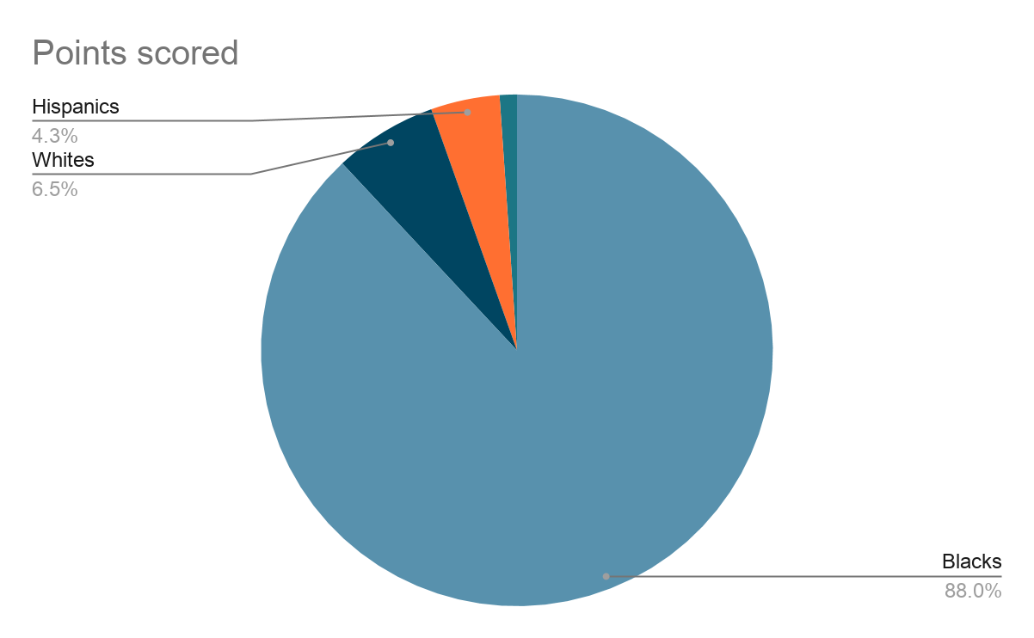
Myers Middle School
Demographics

Slide 5
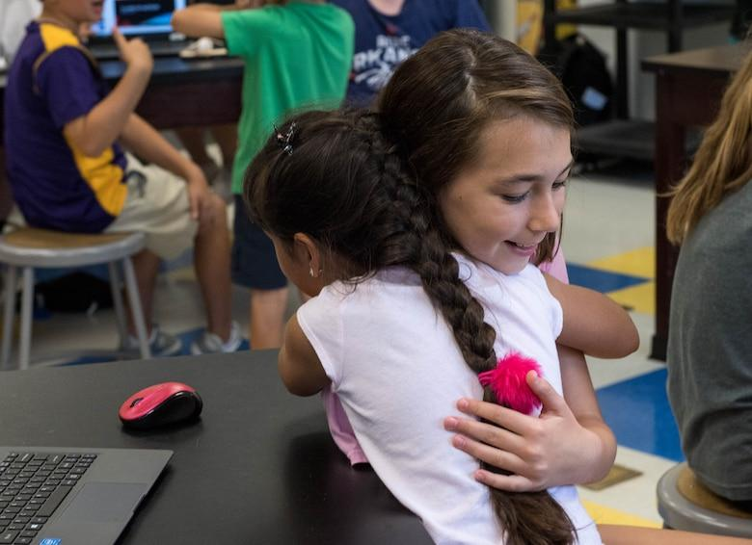
Demographics Continued
Student Teacher ratio stands at 15:1
Student counselor ratio stands at 313:1
Teachers with year or more experience 83%
Teachers who are certified 90%
Students with disabilities 29%
Gifted students 0

Slide 6
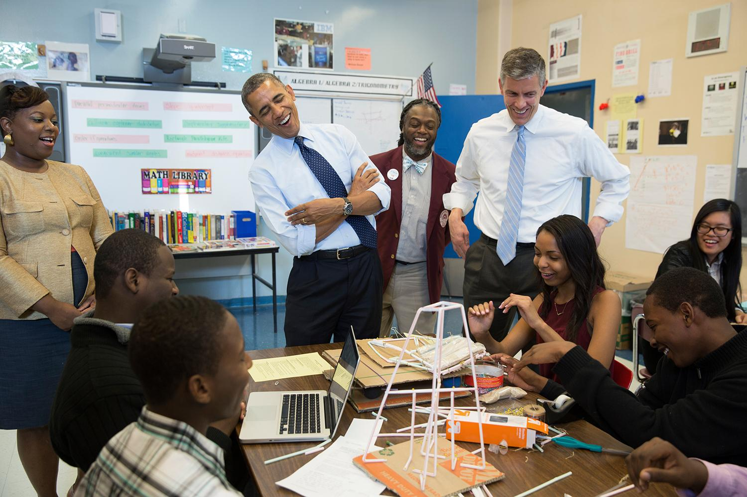
What is a School Improvement Plan?
A school improvement plan is designed to help improve an education institution setting who failed to meet certain key milestones and benchmarks in consecutive years
(SIP) are created by all stakeholders in the educational setting. Participants includes, District personnel, Administrators, Teachers, Parents and the community (Unknown, 2020, pp. 3).
Notes:
The Chatham county schools have a staff of current and retired teachers, principals, parents, board members and community leaders who are incharge of revising any new plans. All stakeholders have a voice when implementing and adopting new mottos, slogans, visions and missions. If the vision is designated at the school level, the principal may elect to create a task force of like minded leaders and motivated staff members who have a passion for learning in accordance to the vision of the district.

Slide 7

Operation Cost and Expenses
400 hundred million dollars in total revenue. Local revenue is
200 million dollars, state revenue is
27 million dollars. 100,000 designated to the general fund,
400,000 is allocated to the school-wide fund.
Notes:
Myers Middle School operates under the district's operation guidelines and budget discretionary. Total revenue for Chatham County Schools is as follows, 400 hundred million dollars in total revenue. Local revenue is 200 million dollars, state revenue is 27 million dollars. 100,000 designated to the general fund, 400,000 is allocated to the school-wide fund. 402,000 are for title I schools, 404,000 are for special education programs, 126,000 is for breakfast start-up, 400,000 for title II Programs, and 106,000 for vocational education funding.

Slide 8

Operation Cost Continued
402,000 are for title I schools,
404,000 are for special education programs,
126,000 is for breakfast start-up,
400,000 for title II Programs, and
106,000 for vocational education funding.
Notes:
Myers Middle School operates under the district's operation guidelines and budget discretionary. Total revenue for Chatham County Schools is as follows, 400 hundred million dollars in total revenue. Local revenue is 200 million dollars, state revenue is 27

Slide 9
Improvement Plan Goals
My goal is to increase 6th-8th grade english proficiency test scores from 11% to 15% in GMAS testing for academic calendar year 2021-2022
Decrease 6th-8th grade out of school suspension from 12% to 3% in GMAS testing for academic calendar year 2021-2022
Increase 8th grade science proficiency test scores from 7% to 10% in GMAS testing for academic calendar year 2021-2022
Notes:
The schools goal is to implement academic programs such as I-Ready, Khan Academy and PBIS systems to encourage academic performance.

Slide 10
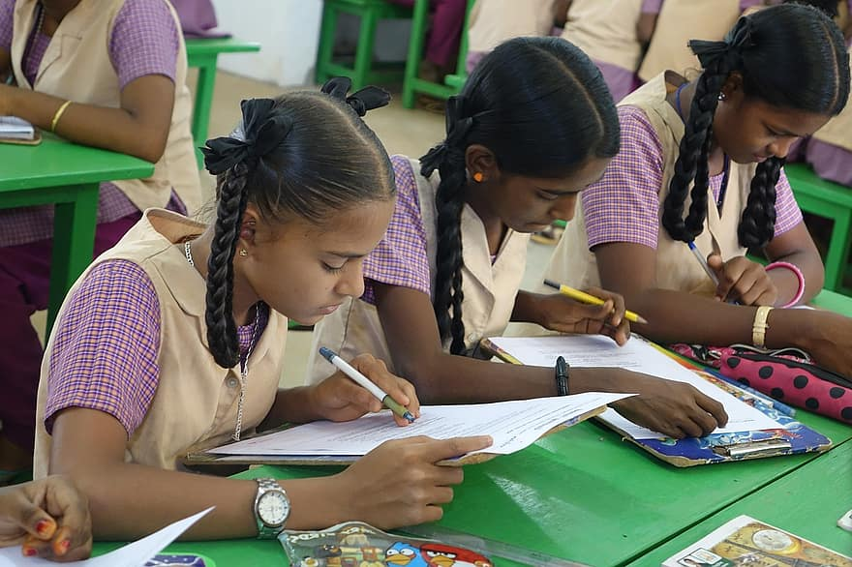
Strategies
6th-8th grade english proficiency test scores from 11% to 15% GMAS testing in academic calendar year 2022
The students will work daily on programs such as Khan Academy, I-Ready, Mappers, and Scholastic reading Articles to improve proficiency on their RIT score
Weekly curriculum guides that will be used to improve reading proficiency for each grade level in direction from the Academic Coach.
Notes:
Those involved will include Principal, Assistant Principal, District, Academic Coach, Teacher and Technology teachers.
Students will have quarterly MAP testing to determine students progress.
Students will be evaluated weekly on progress on I-Ready results

Slide 11

Strategies
Decrease 6th-8th grade out of school suspension from 12% to 6% in GMAS testing in academic calendar year 2022
Students will partake in weekly homeroom lessons on team building, personal and character traits.
Model and work with students on correct behaviors in a learning environment by using Live school and PBIS rewards systems to increase intrinsic and extrinsic rewards through gift giveaways and pep rallies.
Notes:
Students behavior referral will decrease, students will learn to become more empathetic towards one another.
Students will exhibit good characteristic traits. There will be a decrease in referral writes up, fights and suspension.

Slide 12

Strategies
Increase 8th grade science proficiency test scores from 7% to 10% in GMAS testing in academic calendar year 2022
The students will work daily on programs such as Khan Academy, I-Ready, Mappers, and Scholastic reading Articles to improve proficiency on their RIT score
Have designated material accordance with specific content support and technology resources to support an environment of advanced learning and instruction.
Notes:
Those involved will include Principal, Assistant Principal, District, Academic Coach, Teacher and Technology teachers.
Students will have quarterly MAP testing to determine students progress.
Students will be evaluated weekly on progress on I-Ready results

Slide 13
Strategies
Increase parent support to combat against OSS in the academic calendar year 2022
Monthly meeting with parents and family to demonstrate and instill behavioral based instruction for home and the academic learning environment.
Encourage and invite students to parent teacher meetings to form a bridge of academic excellence.
Notes:
Parent involvement will increase and students' behaviors will improve.

Slide 14

Why Are We Targeting These Specific Areas?
The goals is improve test scores in the area of reading and science while also targeting attendance to improve the overall climate of the school-wide culture.
Culture is built over time with effective partnership amongst students, teachers, parents, the school administration and the community. Everyone benefits from an effective running school with a culture that is vibrant, inviting and academically healthy (Ohlson, Swanson, Adams-Manning, & Byrd, 2016, pp. 12).
Notes:
According to Ohlson, Swanson, Adams-Manning, & Byrd (2016), School suspension is a major factor in determining what is the school culture. Also, school suspension plays a vital role in determining if students will remain or drop out of school due to academic failure (p. 13). The overall factors of the school culture and setting goals are imperative to the health and wellness of the school climate.

Slide 15

Ethical Reasoning and Legal Purposes
Foster and environment where accountability and shared vision is encouraged
Enforce and improve academic excellence through collecting data, monitoring test scores and attendance.
Foster and encourage continuous implementations towards vision.
Notes:
The goal for this school is to build a bridge between all stakeholders to form an unbreakable and long-term relationship.

Slide 16

Why Do You Matter
Parents are the heartbeat of the community
Parents encouragement builds trust between child and school environment
Without you, we would have no students
You set the tone
Notes:
Parents are the heartbeat of the community. They are the ones who helps to build, foster and maintain the schools climate. They are directly involved from when the child wakes up and is dropped off at the school.
When parents encourage and engage in their child’s education activities, this encourage further levels of learning and trust.

Slide 17

Why Do You Matter Cont..
The community wants to be a part of a growing and thriving environment.
The community relishes on participating in games, plays, and fashion shows.
Engagements like these are the bedrock of any community.
Notes:
Businesses want to participate in the schools because they can make money and it provides a source of recognition and familiarity with their brand and their products.

Slide 18

Why Do You Matter Cont..
Teachers are the quarterbacks in the classroom
Teacher develop and create lessons that are applicable for educational growth and development
Teachers provides cultures, community and protection.
Notes:
Teachers are the main foundation for implementing principals vision and establishing quality care and educational growth.

Slide 19

Thank You

Slide 20
References
Ohlson, Swanson, Adams-Manning, & Byrd (2016). A Culture of Success—Examining School Culture and Student Outcomes via a Performance Framework. Journal of Education and Learning, 5(1), 114. doi:10.5539/jel.v5n1p114
Unknown. (2020). What is a School Improvement Plan?: Resilient Educator. Retrieved November 15, 2020, from https://resilienteducator.com/classroom-resources/what-is-a-school-improvement-plan/

