Slide 1
5th Grade Problem Solving Small Group
Tiffany Groveman
COSC 692 Practicum
Dr Tamika Hibbert

Slide 2
Small Group Overview
My small group project consisted of 5th grade boys and my sessions focused on problem solving. The goal of the group was to provide the students with tools for problem solving in preparation for middle school and for everyday life situations.

Slide 3

Data Sources
Attendance Data
Behavioral data
  Office Referrals
  Parent Calls
Figure 1 google image of data (www.google.com)
Notes:
Attendance
Attendance data has shown an increase in student attendance on days when lunch bunch groups are scheduled
Behavioral
Behavior data showed that there is an increase in office referrals, bus referrals and parental calls for issues at school, in the classroom and at home. Although some of these referrals included other grades the largest amount of referrals for behavior came for 5th grade students.

Slide 4
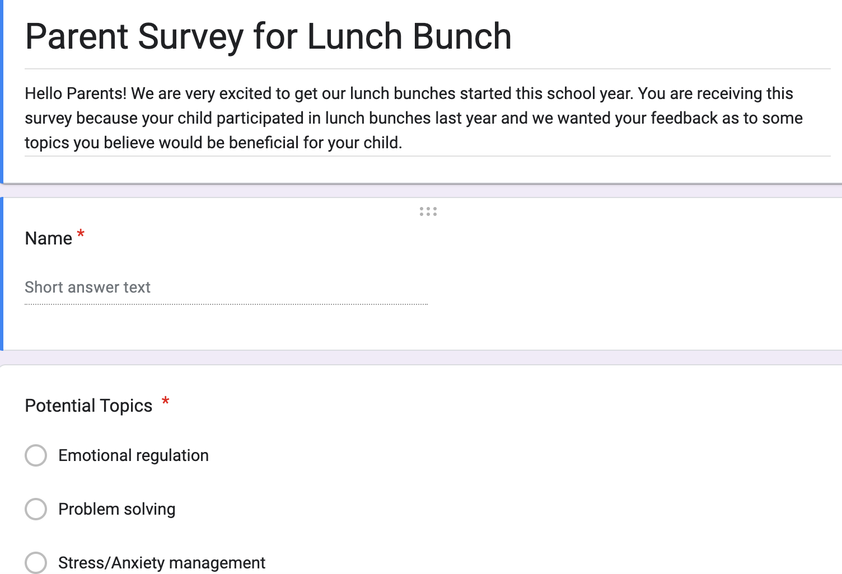
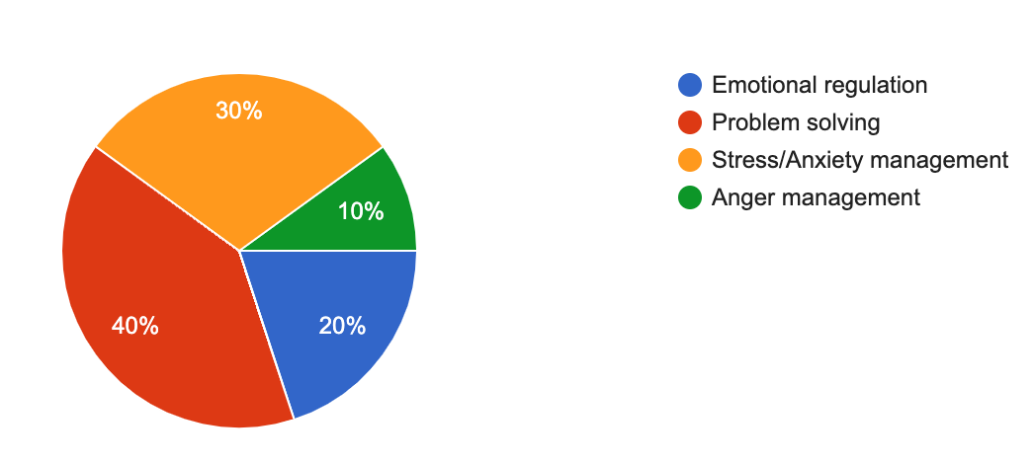
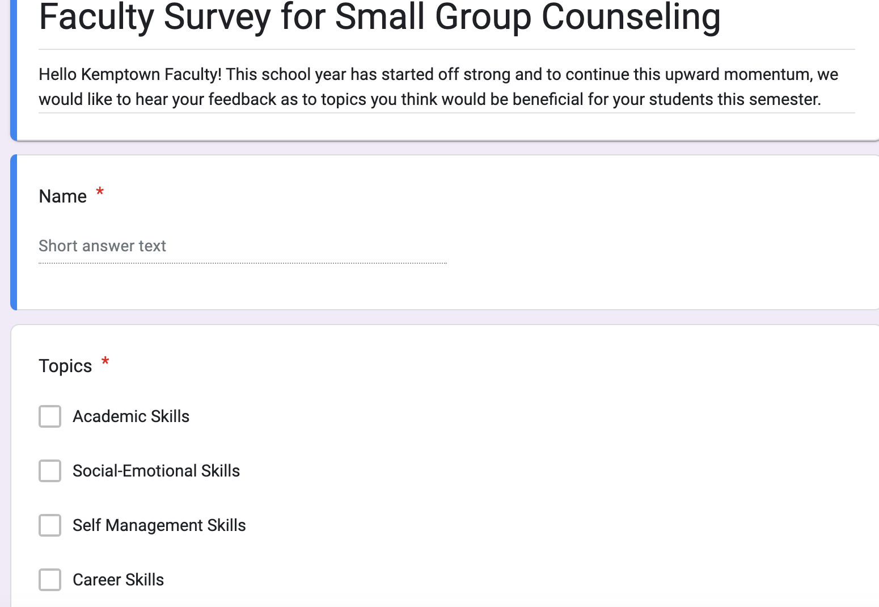
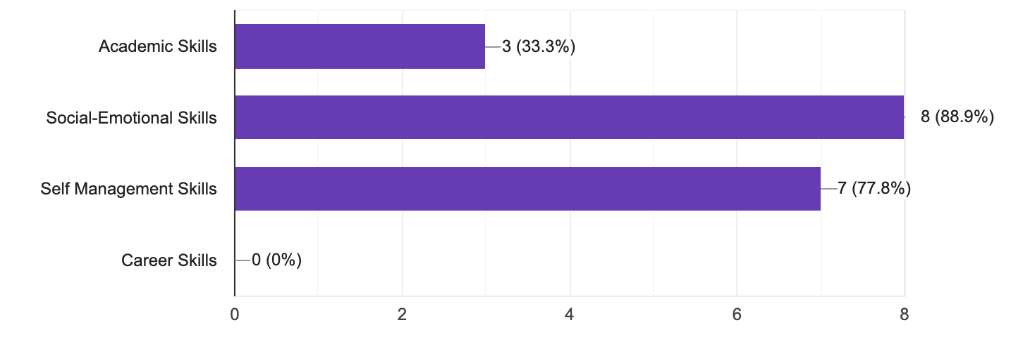
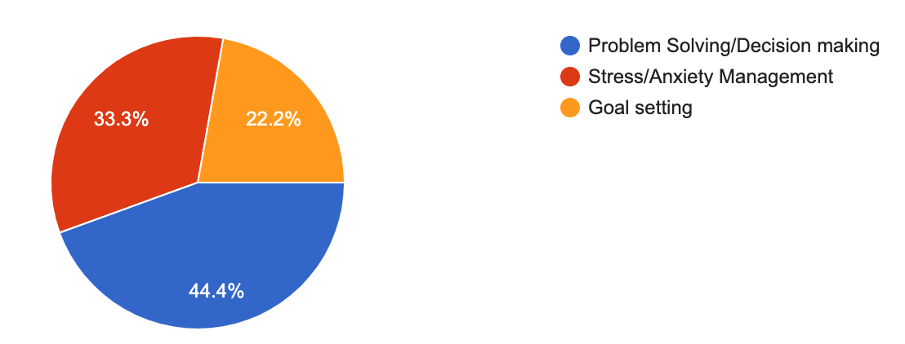
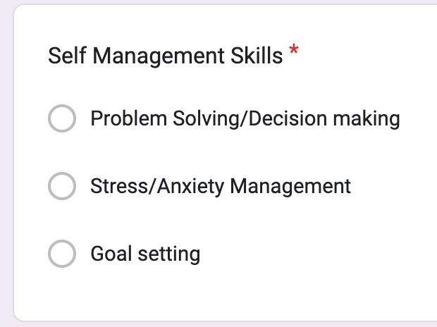
Needs Assessment
Parents/Guardians
Faculty
Notes:
I surveyed 2 different groups to support the need for this problem solving group: Parents/Guardians and Faculty. The biggest trends we found between the two groups were both groups wanted to focus on components of social-emotional learning and self-management skills. I noticed there was a bunch of overlap in social emotional learning and self-management so I decided to focus on problem solving based on the data sources and this assessment as I felt that it would cover multiple areas.
We asked the faculty about topics they felt would be beneficial to their students (academic skills, social-emotional skills, self-management skills and career skills) and then based on their topic choice, I broke it down to more specific group work within those topics (EX: in self management there were 3 choices, problem solving, stress/anxiety management and goal setting).
For the parents, I provided a more simplistic form which gave 4 broad yet specific topics (3)emotional regulation, (1)problem solving, (2)stress/anxiety, (4)anger management).

Slide 5
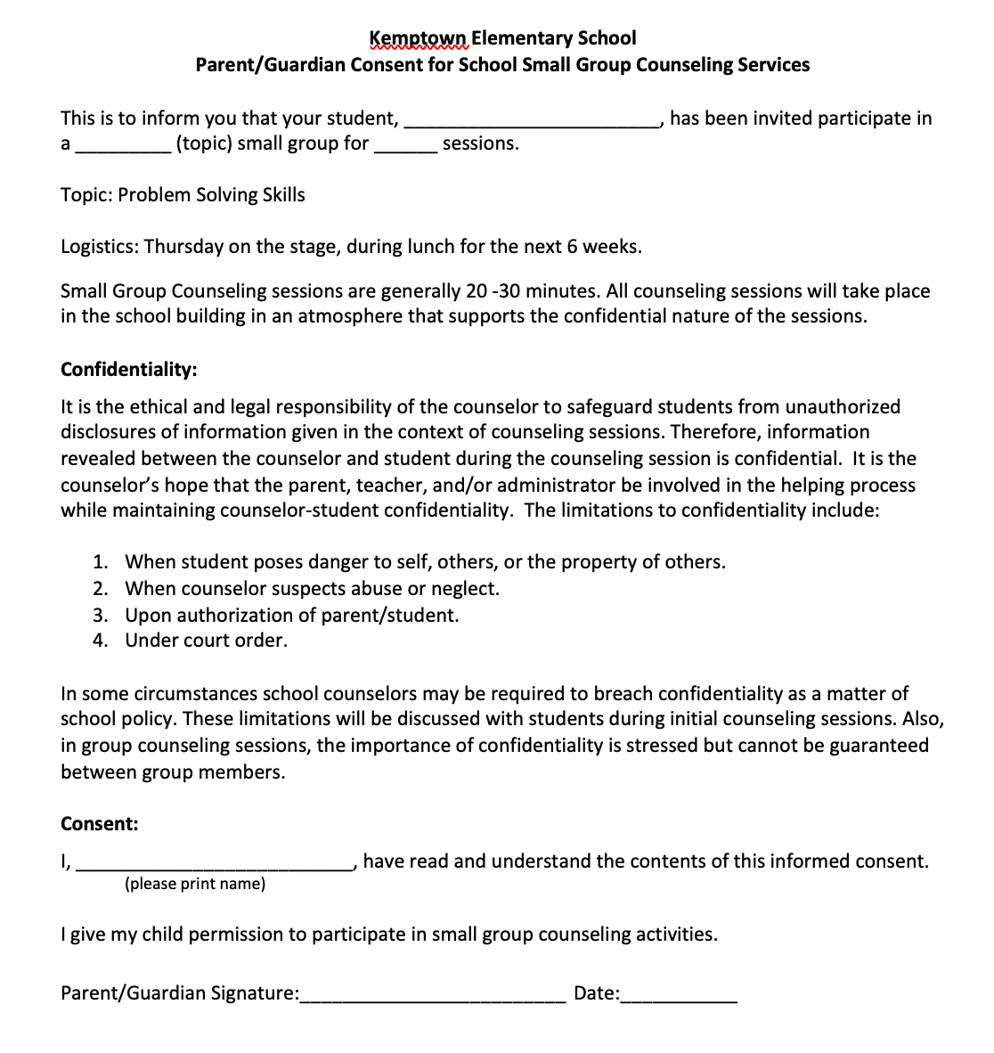
Screening process/Consent form
Screening
  Past group participants
  Referrals
Consent form
Notes:
Screening
In order to screen for this problem solving group, the counselor and I reviewed past group participants, topics, and referrals to see what students would benefit from the most from this group

Slide 6
AIA Alignment
Counseling prevention and intervention
  Belief in development of whole self, including a healthy balance of mental, social/emotional and physical well-being (M.1)
  Create positive and supportive relationships with other students (B-SS 2)
Leadership
  Positive attitudes toward work and learning (M.5)
  Use effective oral and written communication skills and listening skills (B-SS 1.)
Assessment
  Belief in using abilities to their fullest to achieve high-quality results and outcomes (M.5)
  Gather evidence and consider multiple perspectives to make informed decisions (B-LS.9)
Notes:
Counseling prevention and intervention
The small group was designed and implemented with the goal of teaching problem solving skills to students to help prevent the problem from overtaking their emotional state or response. Students who are in this group will grow in confidence in their ability to build healthy mental, social/emotional and physical habits.
Leadership
This group will help students to grow in leadership skills by using effective communication and listening skills. If students learn to work through their own issues that will help them grow in confidence and their ability to make effective choices and grow in being a leader
Assessment
The group is designed to help students gather the correct information in order to make informed decisions when they are faced with any problem. Through gaining the correct tools, students should recognize that they have the ability to achieve quality results.
Liberty University. (2023). School Counseling Practicum. Week two. Pre-advanced internship assessment. https://learn.liberty.edu

Slide 7
Cultural Sensitivities
Group rules that are inclusive of all students
Activities that encourage open and honest dialogue about personal perspectives on handling problems
Lessons that celebrate each students unique upbringing, family dynamic and individual preferences
Notes:
Group Rules
We had 3 rules: no talking while someone else was talking, respect yourself and others, what is discussed in group stays in group. One of the students was not being respectful during our group time and I had to address him 3 different times. I was able to speak to him after and let him know that I know he can respond better in group and that I would appreciate if he would be respectful of others while we are working in group. He responded really well and the rest of the group session went smoothly.
Lesson/Activities
One lesson activity we did was about decisions choices and solutions. I asked the students a series of questions to help prompt discussion about problem solving. One or two of those questions are as follows:
1. What do you usually do when faced with a problem?
- Ex: do you cry, worry, get angry
2. What happens if you don’t do anything about the
problem?
- Ex: does it get worse, does it get better,
does it go away
3. What are some choices or decisions you have to make each day or each week?
- Ex: brushing my teeth, put deodorant on
4. What happens if you don’t choose or decide what to do?
- Ex: I will start to stink
5. What do you do if your first decision or choice doesn’t work out well?
From there, we played a game where each student got to draw a choice card. That choice card could say, “I brush my teeth every night before bed” or “I lay my clothes out before going to bed" to ”I hit my friend when he is being mean to me”. Each student would roll the decision-maker die (Definitely yes, no, maybe) and regardless of what answer the dice lands on the student would answer the
Prompted questions:
1. Do you agree with the decision on the dice
2. What might the result be from doing what the dice said
3. What happens if you decided to make your own choice instead of doing what the dice said
These lessons and activities allowed the student to think of decisions that would be best for them and helps to inform the other students how they process and think through problems. Then I would remind the students that decisions, choices
and solutions will occur regardless of the student’s action. At the end, I had students wrap up by sharing one word that described how they were feeling after the lesson.

Slide 8
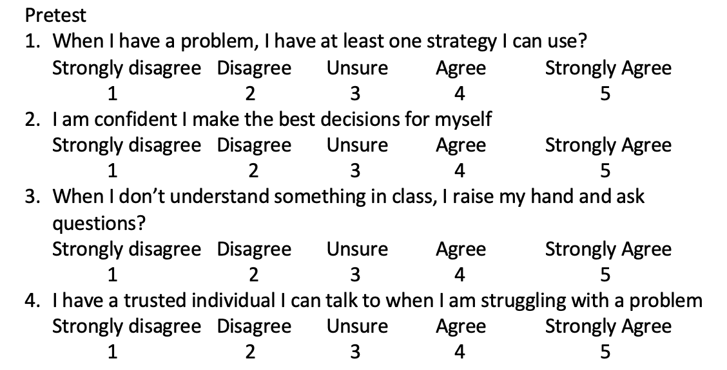
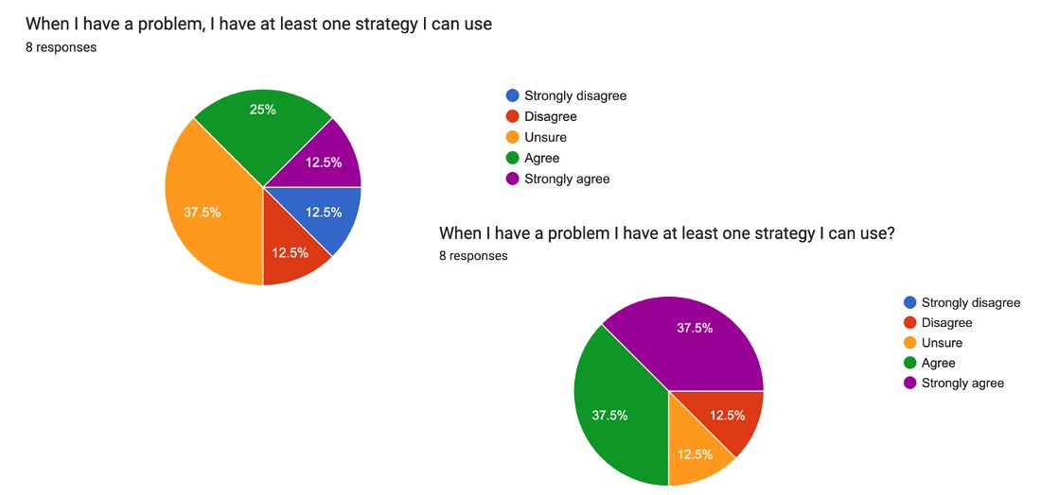
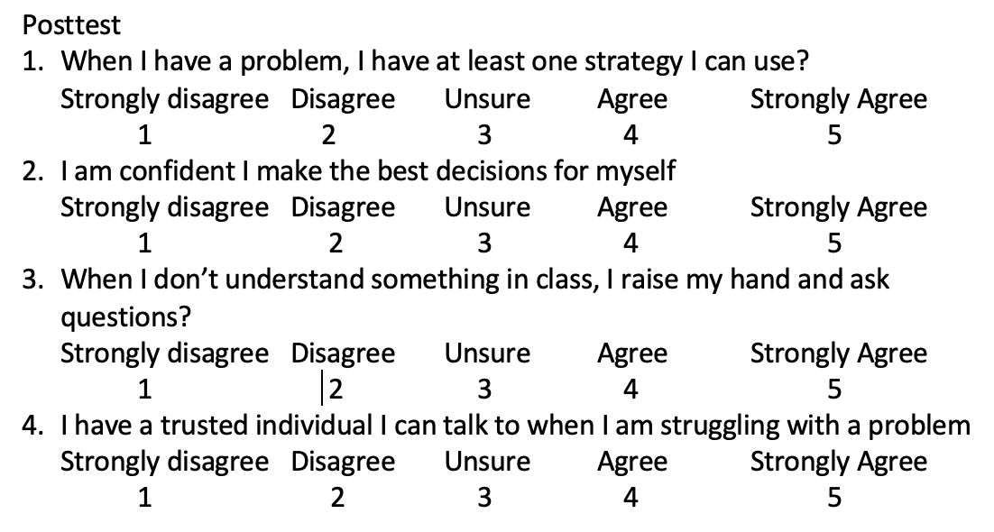
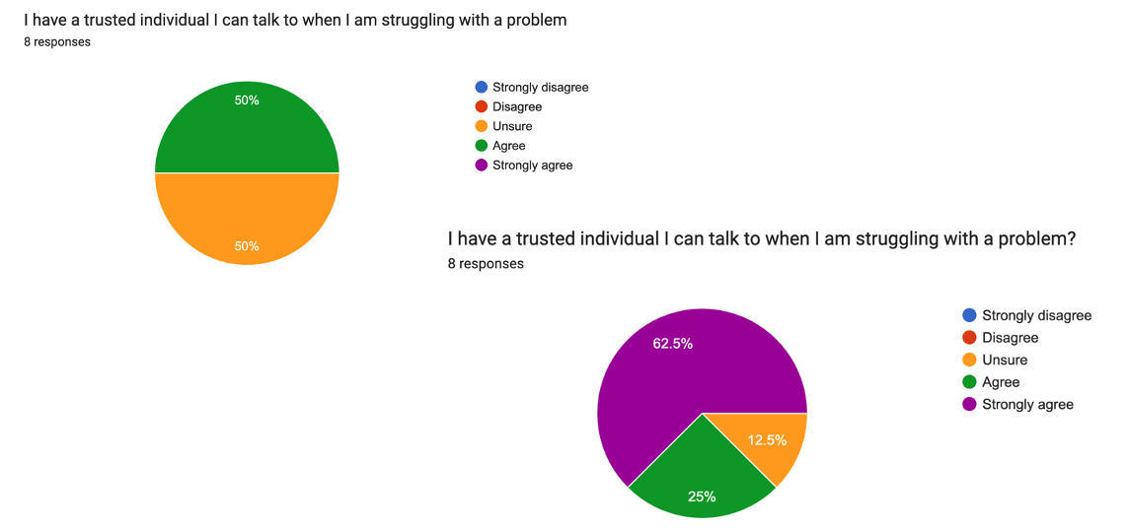
Evaluation
Google Forms
  Pre Assessment
  Post Assessment
The pre/post test assessment showed that students increased their knowledge on strategies they can use when problem solving and grew in confidence in their ability to problem solve.
An area of improvement would be helping students to ask for help from a trusted adult when they are unsure of how to approach a problem
Notes:
Google Forms:
Students were administered a paper pre and post test assessment and I utilized google forms in order to compile the data.

Slide 9
Refereneces
Liberty University. (2023). School Counseling Practicum. Week two. Pre-advanced internship assessment. https://learn.liberty.edu

Slide 10
Thank you!

