Slide 1
Friendship
Tiffany Groveman
COSC 694 Internship II
Dr. Tamika Hibbert

Slide 2
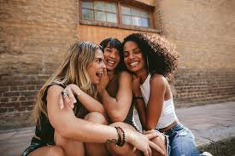
Overview
Who : 7th grade girls
What: Social Skills (Friendship)
Why: Provide this group of girls with a framework to operate within friendship and to help them build social skills that can be used throughout grade school and post-graduation
Figure 1 google image of friends www.google.com
Notes:
The first week at my site was fairly rough. Every single day that week we were pulling multiple kids in to address issues between friends. I had mentioned to my site supervisor exploring the idea of doing a social skills group with the focus on friendship (pre-needs assessment).

Slide 3
Existing Data Sources
Discipline Referrals
Behavioral Data
  teacher, counselor, & parent emails
  Schoology
Notes:
Discipline Referrals
Frederick county utilizes a system called eschool which houses all of the discipline referrals made my staff and administration. After reviewing the data, the highest numbers of referrals for 7th grade were due to fighting. Monocacy middle is a title 1 school which houses many students who come from single family homes, low income and often left alone by parents/guardians as they need to be at work. In many cases, students are surrounded by negative influences and spend more time with friends/ extended family than their immediate families.
Behavioral Data
The counselor and I reviewed parents/teacher emails, counseling team referrals (as well as admin referrals) and kept data related to the number of times students would request time in the counseling office through schoology. Many of these cases were in due to behavior and issues with other students.

Slide 4
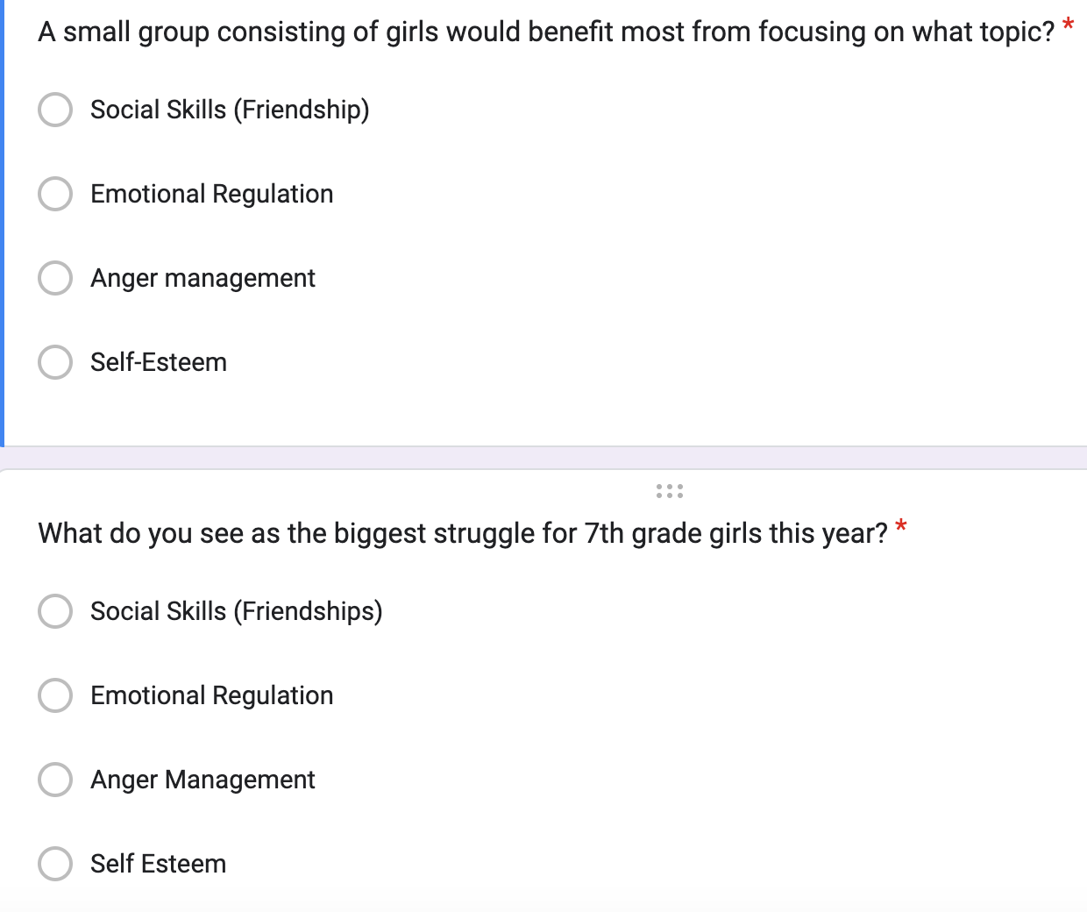
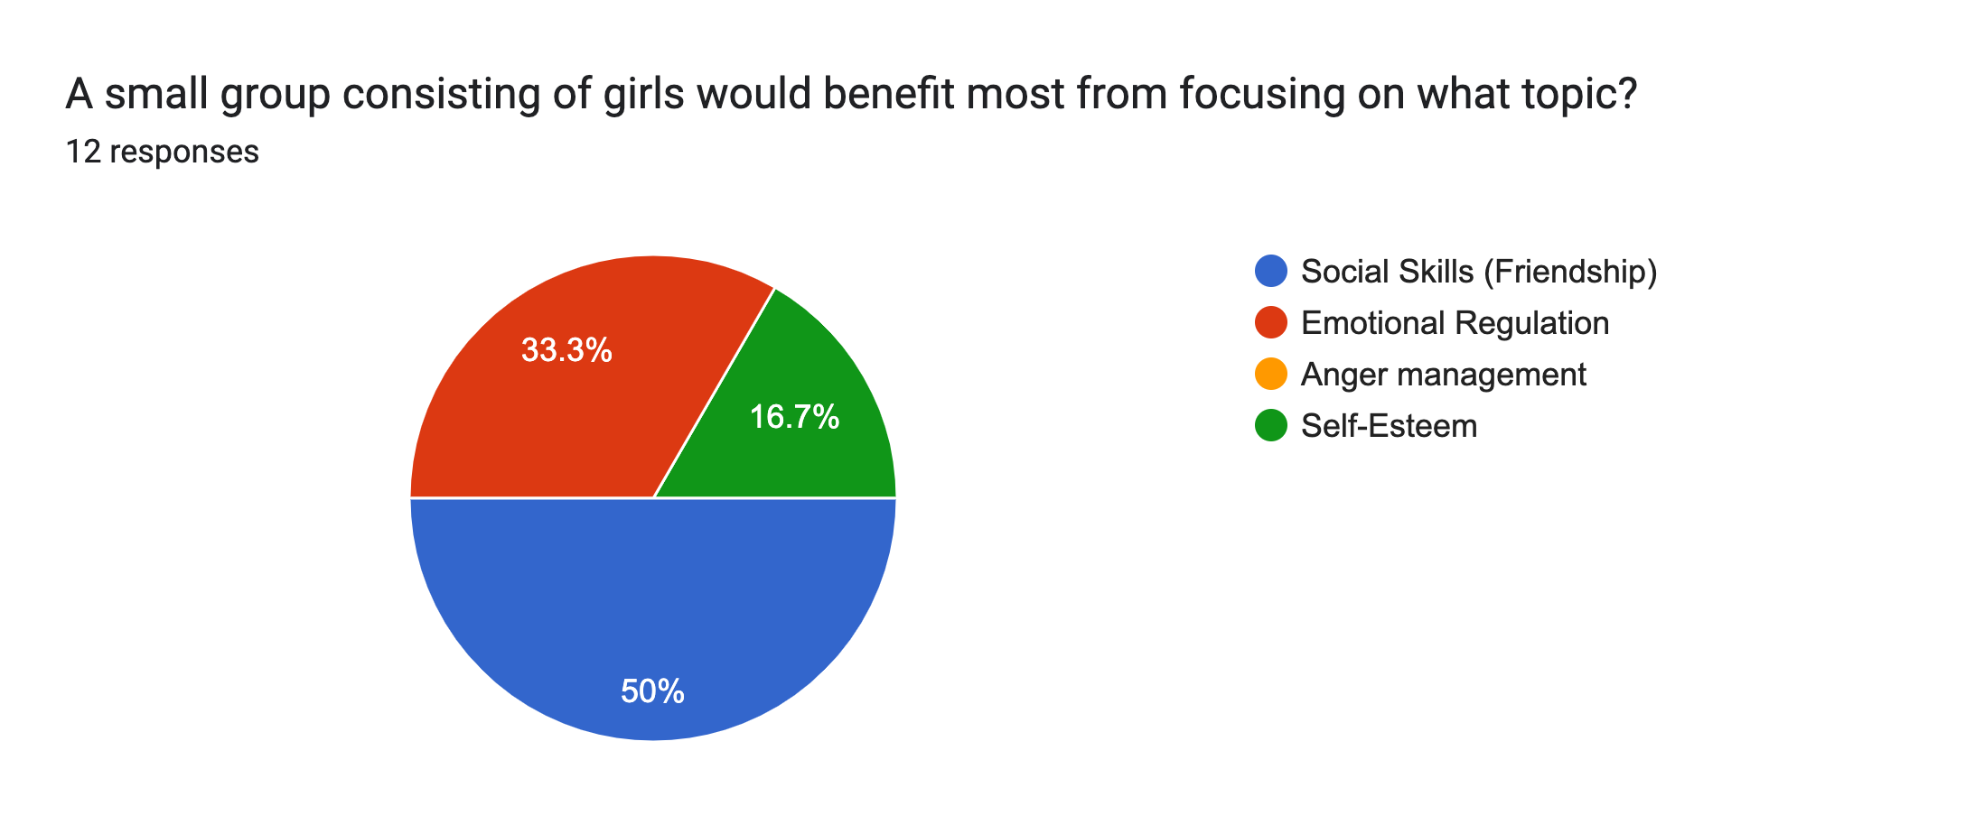
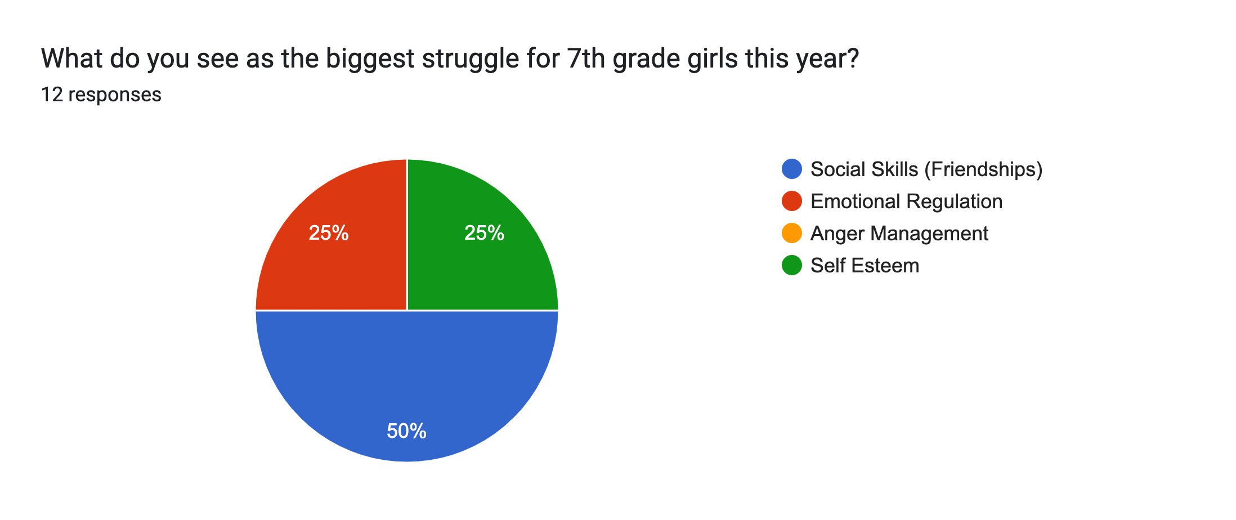
Needs Assessment
Counselors
Administration
Teachers
Notes:
Counselors
4 counselors
Administration
4 admin
Teachers
4 teacher
Question 1: A small group consisting of girls would benefit most from focusing on what topic?
Question 2: What do you see as the biggest struggle for 7th grade girls this year?
The above questions showed that counselors, administration, and teachers, see the need for friendship/ social skill building groups. THe second runner up would be emotional regulation

Slide 5

Description of Project
Group details
The “How to’s” of Friendship
  How to communicate
  How to make good decisions
  How to resolve conflict
  How to maintain friendship
Figure 2 google image of data www.google.com
Notes:
Group Details
The group consisted of 6, 7th grade girls who had a history of visiting the counseling office due to fighting and relational discord with other peers. There was a list of girls complied by myself, the site supervisor and the assistant principle over 7th grade in order to assess whether the small group would be a good fit. After the list was compiled, consent forms were sent home and phone calls were made in order to receive permission for the girls to attend the group.
The “How to’s” of Friendship
How to communicate
non-verbal
listening
speaking
expressing opinions constructively
How to make good decisions
-Recognition of how many decisions we make in a day and the factors that influence those decisions (anger, sadness, happy etc.) I read a story to the girls (about a paragraph long) and had them identify how many decisions the individual makes in the story. We then discussed the importance of making wise decisions and how our emotions often influence our decision.
How to resolve conflict
Identify emotions
Controlling your emotions in conflict
Communicating effectively
Creating a win-win
How to maintain friendship
I had the girls write down the characteristics they thought a good friend would have and then encouraged them to do some self evaluation of themselves and ask if they exhibited the characteristics they wrote down

Slide 6
AIA Specialty Standards and Rationale
Counseling Prevention & Intervention CAEP (A1.1d,f)
  Demonstrates self-awareness, sensitivity to others, and the skills needed to relate to diverse individuals, groups, and classrooms
Diversity & Advocacy ASCA (M-1; M-2; B-PF 6; B-PF 9)
  Demonstrates multicultural competencies in relation to diversity, equity, and opportunity in student learning and development
Assessments ASCA (B-PA 1-B-PA 9)
  Assesses and interprets students strengths and needs, recognizing uniqueness in cultures, languages, values, backgrounds, and abilities
Notes:
Counseling Prevention & Intervention
For this group, my goal was to teach the girls how to operate within a friendship by becoming self-aware of how they treat their peers and those who are different than them.
Diversity & Advocacy
In group, we spent a good amount of time discussing communication within friendships and how important it is to listen to what their friends are saying, even when they don’t agree or wouldn’t handle a situation the same way. Having respect for others and understanding that they are unique and bring a unique perspective to friendship that can encourage and challenge others to succeed in multiple areas of their lives.
Assessments
We spent sometime discussing areas of strengths and weakness in the girls friendships and I think it was helpful for them to recognize the positive and the areas the need improvement as it strengthens them as individuals
Liberty University. (2023). Internship Assessment (AIA).
https://www.liberty.edu/behavioral-sciences/counselor-ed/wp-
content/uploads/sites/43/2021/02/ADVANCED-INTERNSHIP-
ASSESSMENT_ASCA-1.pdf

Slide 7
ASCA Mindsets & Behaviors Rationale
M 3. Positive attitude toward work and learning
B-SS 2. Positive, respectful and supportive relationships with students who are similar to and different from them
B-SS 7. Leadership and teamwork skills to work effectively in diverse groups
Notes:
American School Counseling Association. (2021) Mindsets & behaviors for student success. www.schoolcounselor.org/getmedia/7428a787-a452-4abb-afec-d78ec77870cd/Mindsets-Behaviors.pdf

Slide 8
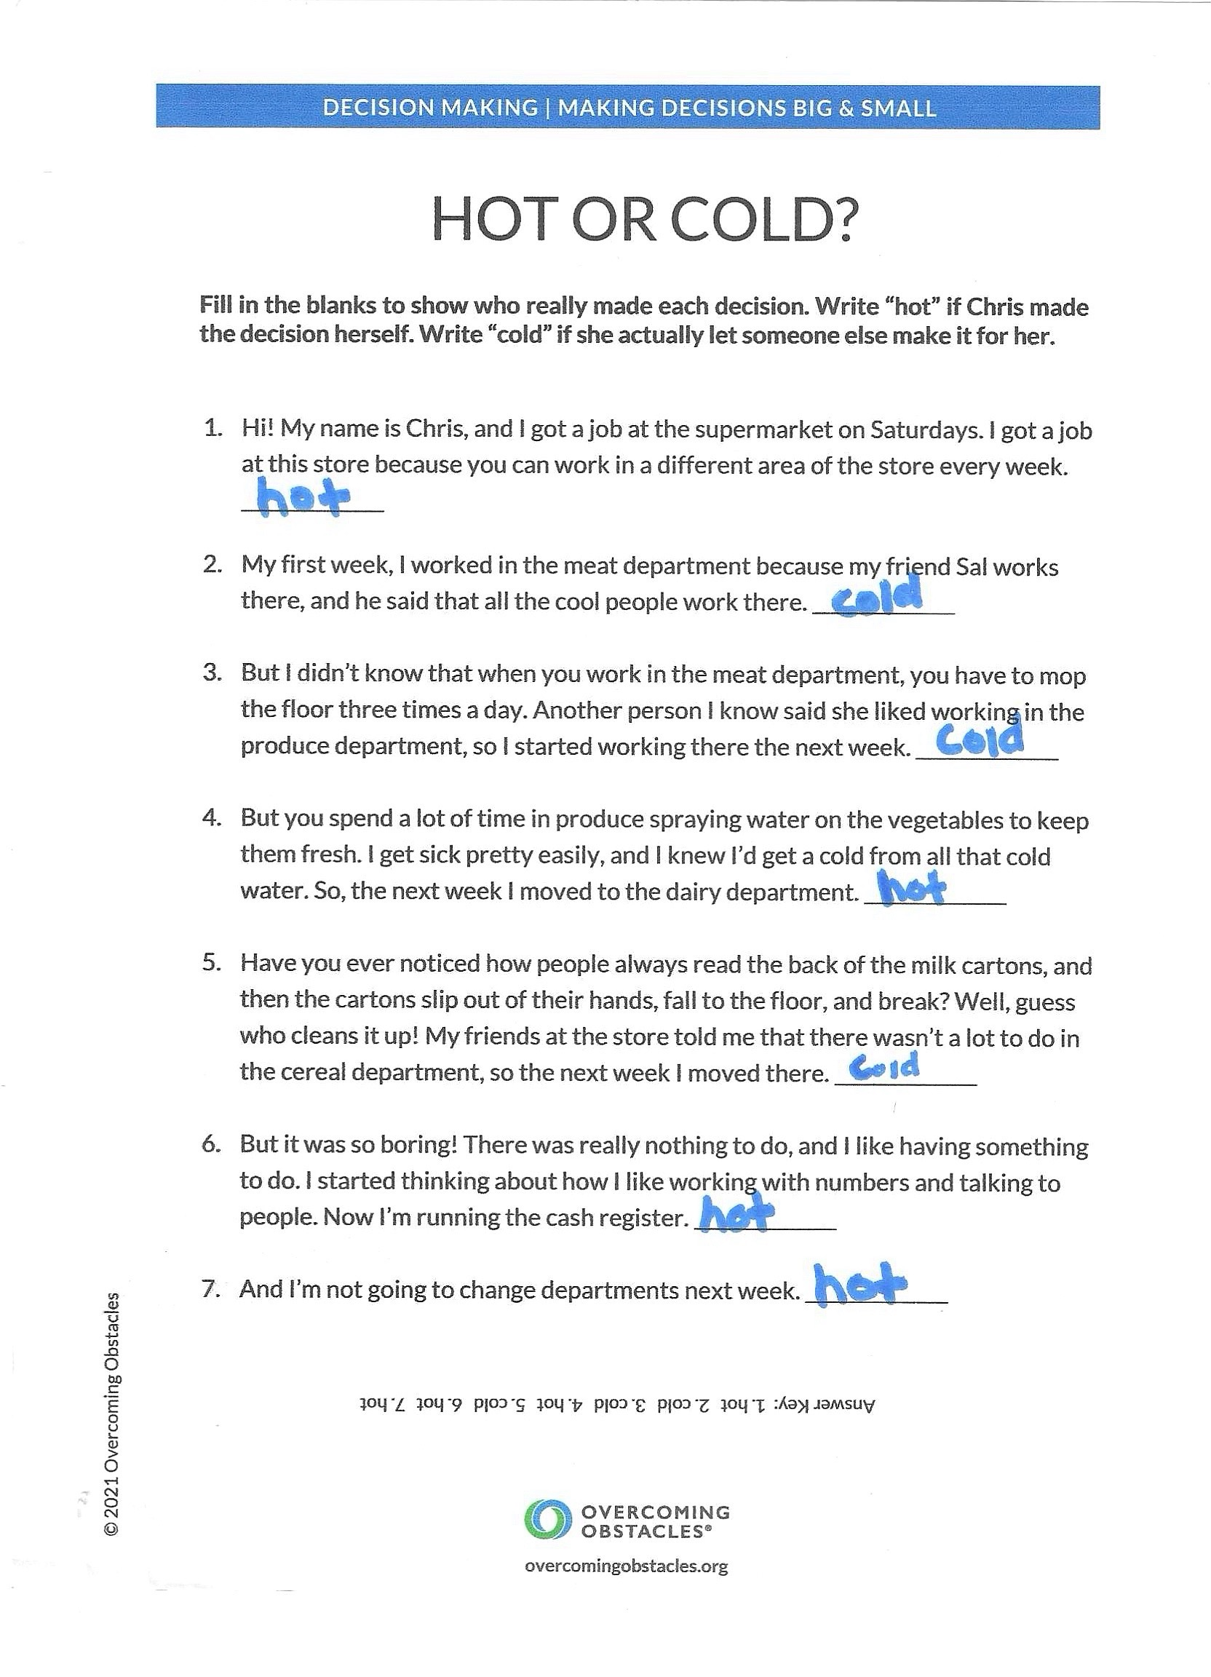
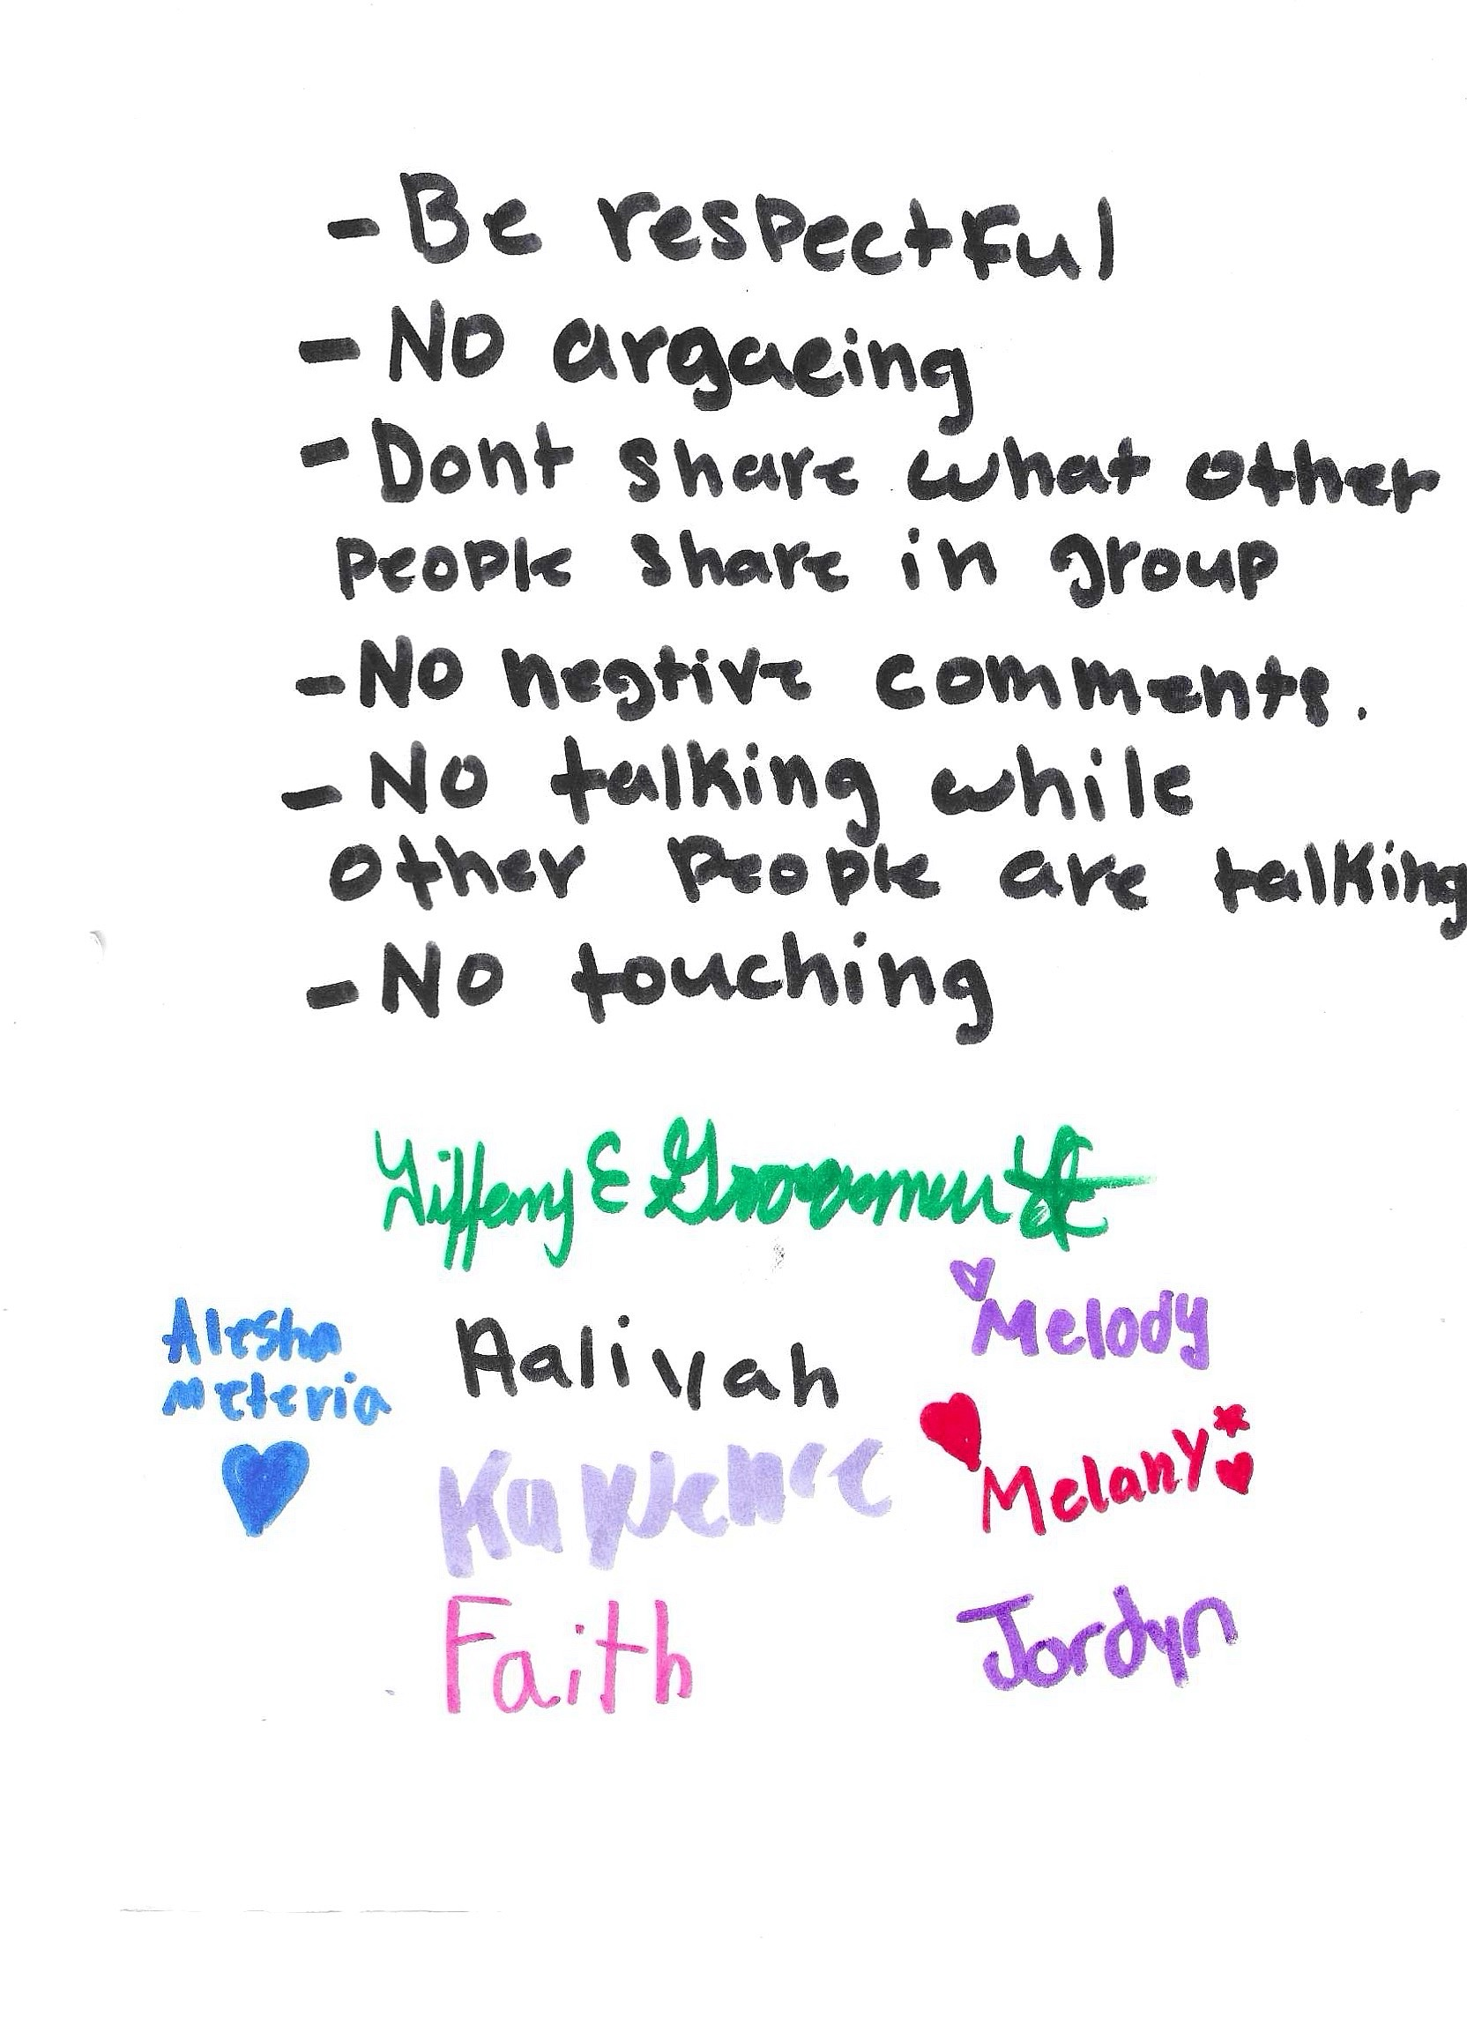
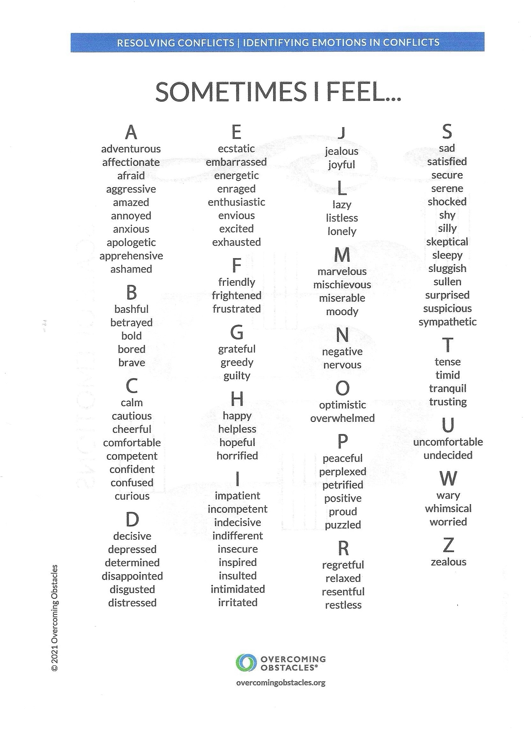
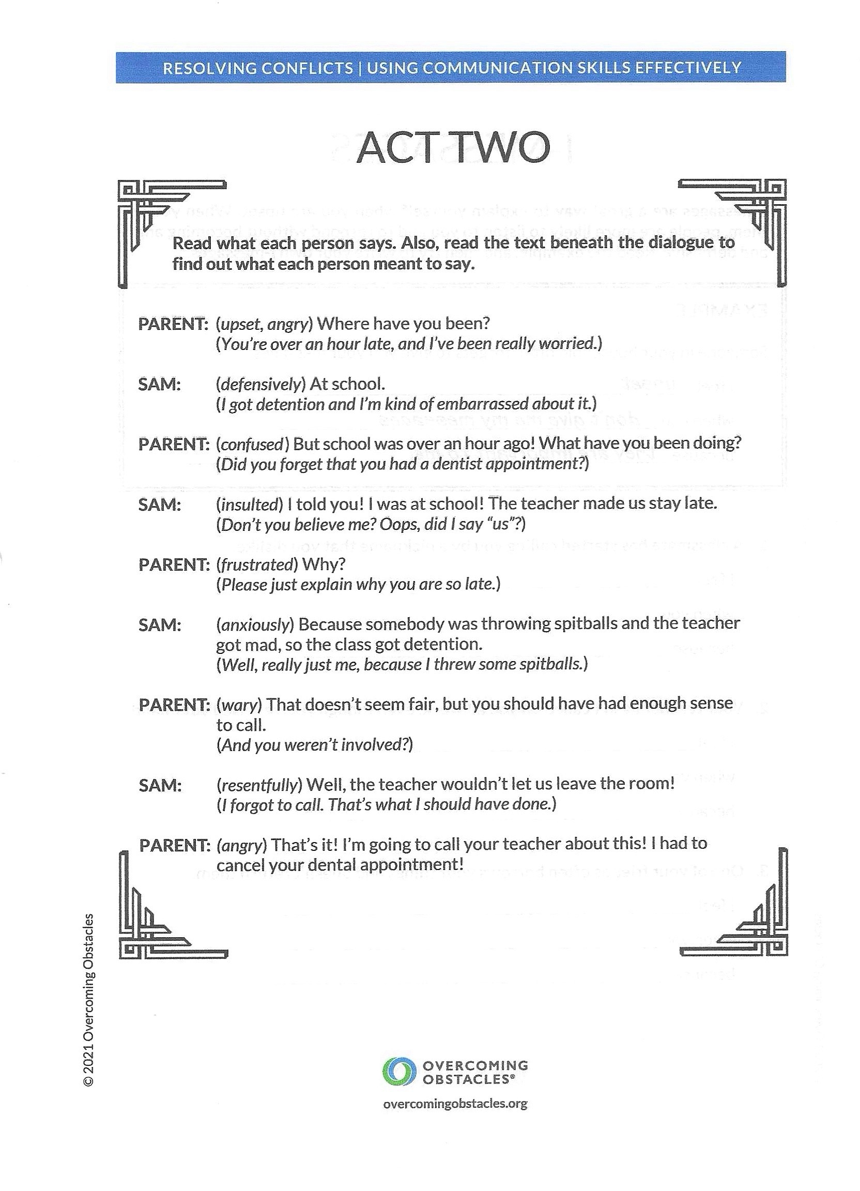
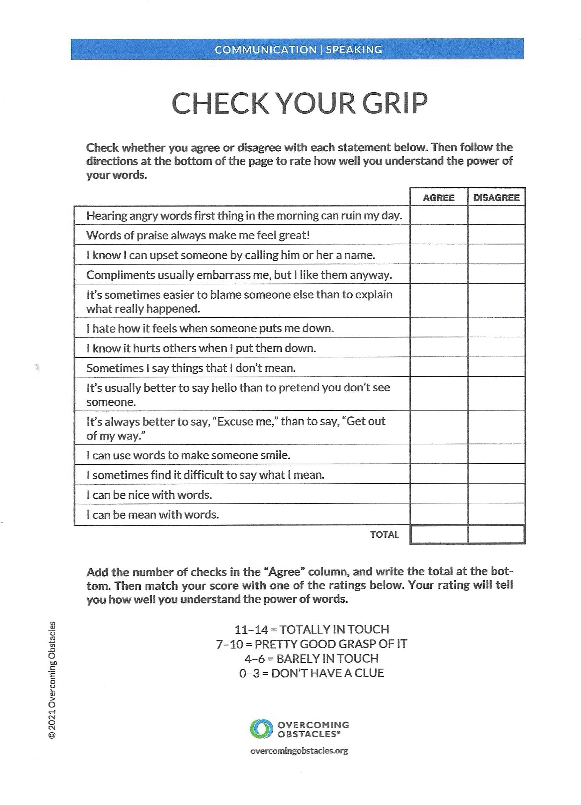
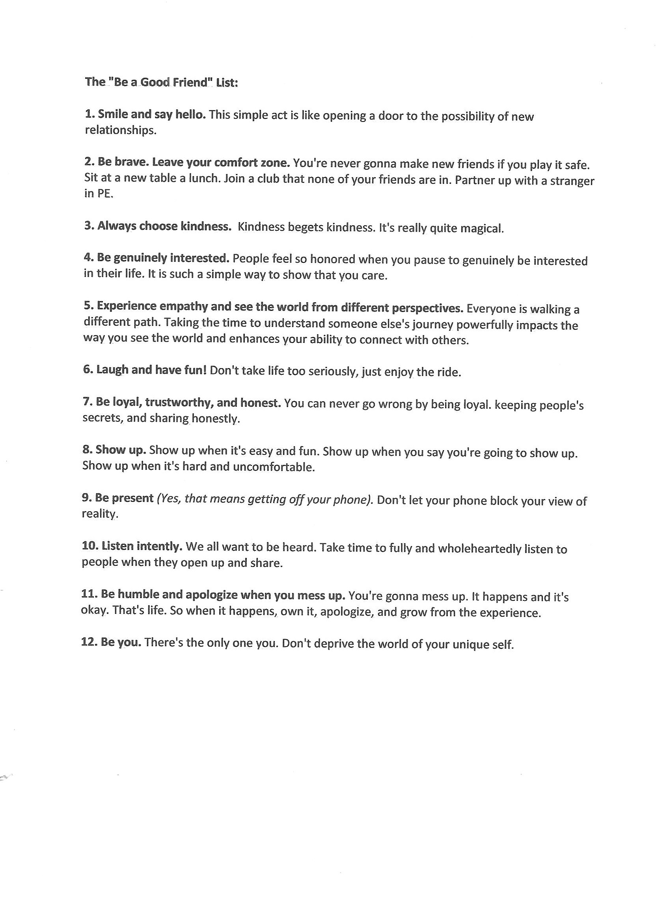
Lesson Plan Examples

Slide 9

Cultural Sensitivities
Group rules
Activities/games
Note card rule
Food
Figure 3 google image of world www.google.com
Notes:
Group Rules
I think one of the best ways to create a space that is inclusive of all individuals is have the group to create rules that will be implemented throughout the lessons. This provides space for the girls to work together and allows for them to express what they are feeling in a safe environment and where they feel comfortable. The girls came up with a great list of rules to follow for our time together which included the following rules:
Be respectful
No arguing
Don’t share what other share in group
No negative comments
No talking while others are talking
No touching
I had one girl volunteer to write the rules down in our group notebook and all of the girls signed in showing agreement with what was asked.
Activities/games
I learned very quickly how much this group of girls loves to talk (obviously) but also how much they enjoyed participating in games and activities. I found I often would lose their attention when I was in the “teaching” part of the lesson but when I focused on more activities/ games while teaching the content, it made it easier to keep their attention. I sought to create an environment that focused on drawing them out about how they would manage or respond to certain situations in friendships. I found myself being surprised more often than not as many times I would hear a shocking response in how they would handle a situation with a friend and it made me realize that they need a context in school where they can safely express and work through interactions with their peers without the fear of judgment or assessment. We often found ourselves in group “playing out” the situation described or comments that were made.
Note card rule
Notecards will be placed on the table at the beginning of each group. If at any point during the group someone wants to write down a question or a thought about the topic or about future conversations we can have in the group, write it down and the student counselor will review it and go over it in next group
Food
Every group I would bring in a small snack for the girls as I realized early on that food was a big way for them to engage in the lesson and for them to connect with me and build relationally. I would ask them what food they would love to have at the sessions and I would seek to make that happen at least a couple times throughout our time together.

Slide 10
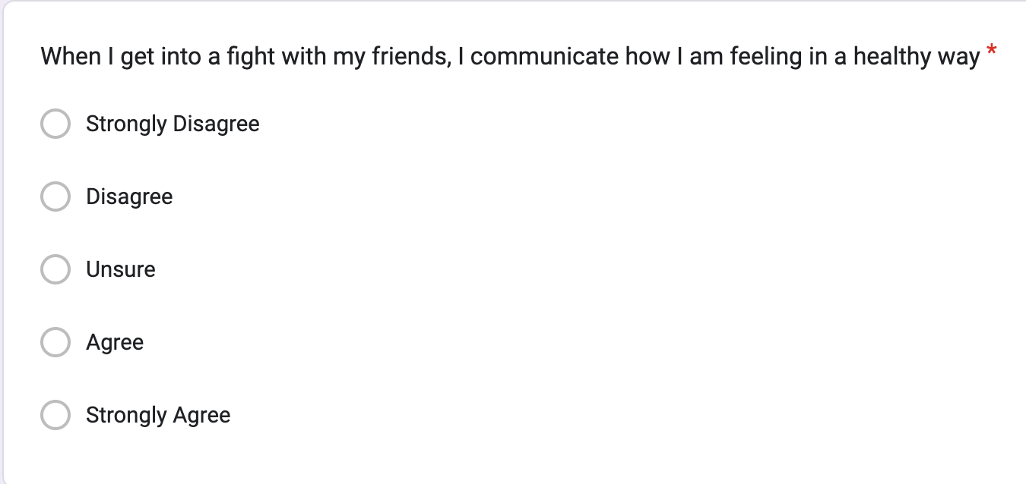
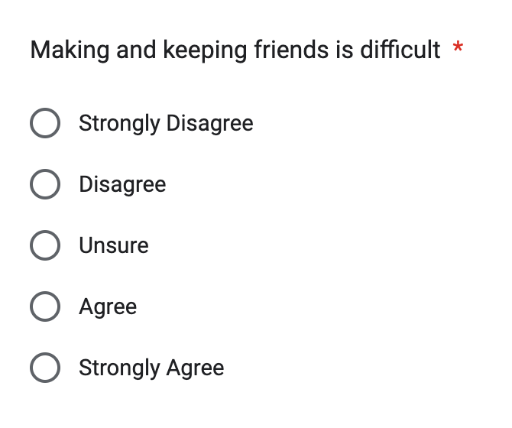
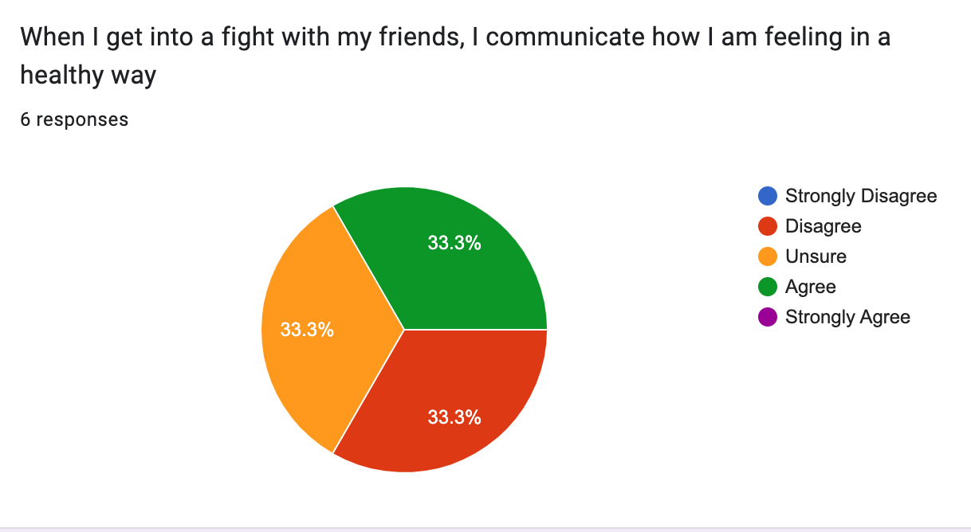
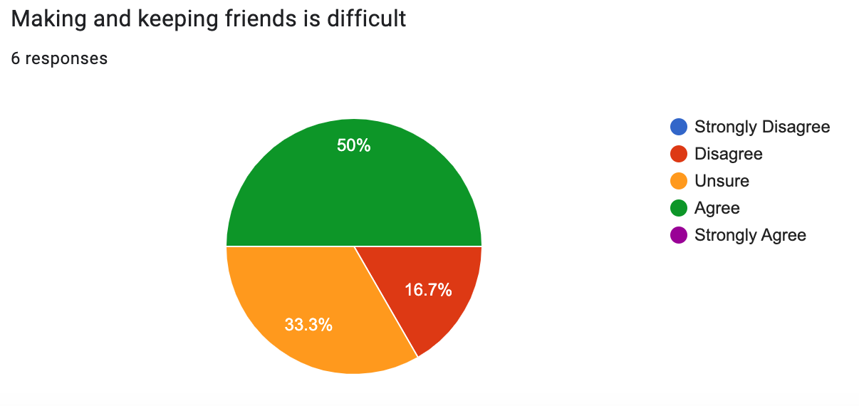
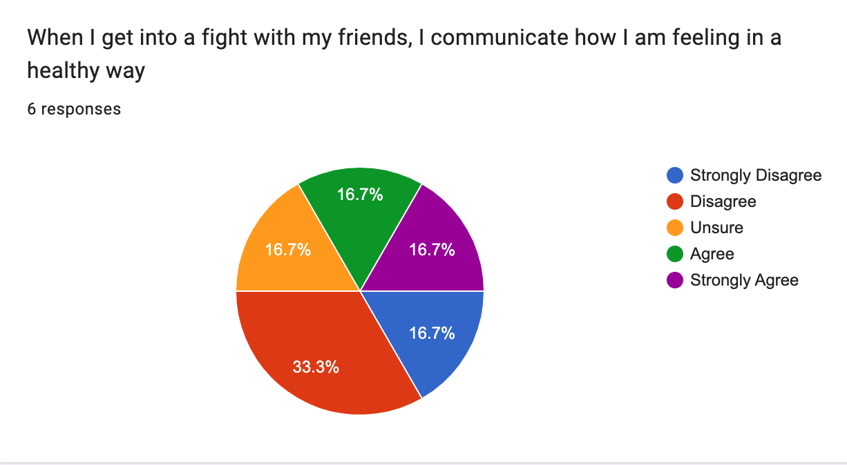
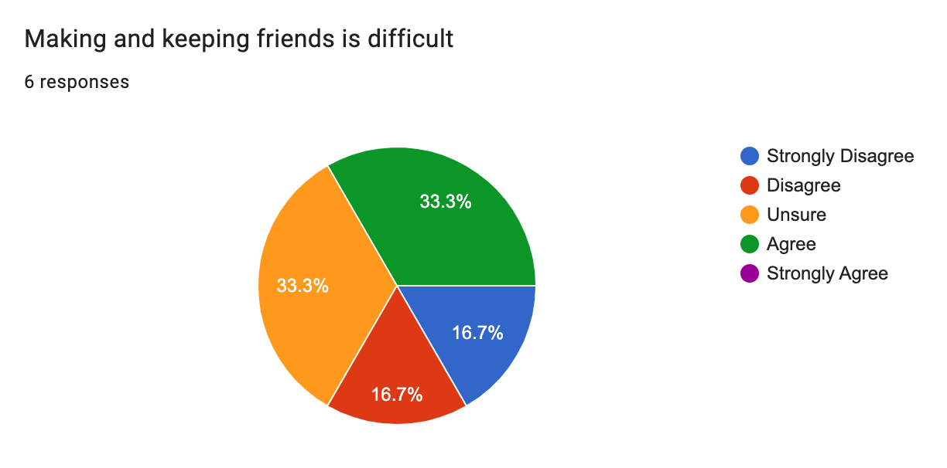
Evaluation
Pre and post assessments
Site supervisor feedback
Areas of improvement
Notes:
Pre and post assessments
One way that I evaluated the effectiveness of the group was through pre and post assessments. I wouldn’t say responses necessarily improved in a complete positive direction but the responses changed in a way that indicates growth of thought and a bigger awareness of self and what is true about themselves. Overall this group showed improvement on how they think about friendships and how they process interactions with their friends. An example would be, I asked on this assessment “Making and keeping friends is difficult” and the results showed
Pre-test:
33% Agree, 33.3% Unsure, 16.7% Disagree, 16.7% Strongly Disagree
Post test:
16.7% Strongly Agree, 16.7% Agree, 16.7 Unsure, 33.3 Disagree, 16.7% Strongly Disagree
This data communicated to me that the girls were learning more about being friends and analyzing what their relationships look like and how they operated within their friend groups which in my mind is growth.
Site supervisor feedback
Throughout my time at the site, my supervisor provided feedback after every small group in order to improve on the effectiveness of the group. We discussed IEP accommodations, simplifying content, group management and overall effectiveness.
Areas of improvement
A couple of ways that I would improve for future small groups would be amount of content presented and a more thorough knowledge of the academic levels of the girls. I had a bunch of good content but given the amount of time I had the girls, it felt like a ton to teach and I found myself rushing through important information instead of allowing the space for the girls to talk. This also ties into the girls understanding of the content and their academic level. I had several girls that had IEP’s in the group and were on 3rd grade reading levels and couldn’t always read the activities we were doing or needed extra time in doing pre/post assessments or needed me to ask/answer a question terms they were familiar with.

Slide 11
References
American School Counseling Association. (2021) Mindsets & behaviors for student success. www.schoolcounselor.org/getmedia/7428a787-a452-4abb-afec-d78ec77870cd/Mindsets-Behaviors.pdf
Liberty University. (2023). Internship Assessment (AIA).
https://www.liberty.edu/behavioral-sciences/counselor-ed/wp-
content/uploads/sites/43/2021/02/ADVANCED-INTERNSHIP-
ASSESSMENT_ASCA-1.pdf

