Slide 1
Study Skills
Tiffany Groveman
COSC 693 Internship I
Dr. Tamika Hibbert
Notes:
This group was implemented into a 9th & 10th grade career preparation class majority being honor students.

Slide 2
Lesson Plan Overview
This lesson plan was created and implemented with the purpose to teach healthy study habits within the classroom setting, empowering students to balance school, personal and professional life.
Notes:
When I began exploring some of the existing data on these students, I began realizing that teaching study skills is not simply about knowing how to appropriately organize, note take, test take, and time manage but it was about teaching students how to do this in a healthy way

Slide 3
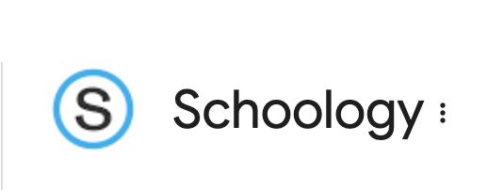
Existing Data Sources
Behavioral Data
  Counselor Referrals
    Email referrals from parents & teachers
    Schoology messaging from students
Achievement Data
  Consistency in grades
Figure 1 google image of Schoology www.google.com
Notes:
Review what data sources you used to help develop this project. Be sure to include a description of the data. For example, if you mention using attendance data, be sure to discuss the specifics of the data.
Behavioral Data
Referrals that are verbal or written via email or schoology. (EXPLAIN SCHOOLOGY). My site supervisor organizes the parents emails by their grade so we reviewed many of the emails from the parents of 9th-10th grade students throughout the year, to better understand a pattern of what many students are struggling with this school year. We also went through the emails from 9th-10th grade teachers looking at the referrals that were sent in.
In Walkersville high school in Frederick county there is a system called schoology where students have direct messaging with staff such as teachers and counselor. Parents also have access to schoology but more limited in what they can do on the system. Many student referrals or self referrals in the 9th & 10th were coming from schoology where students were asking to meet with the school counselor to discuss dropping classes or wanting to talk about their anxiety because of their work load.
Achievement Data
Registrations sheets house academic requests for following year as well as a general overview of the classes students were initially placed in based on needs and desires. Students at the beginning of the year manually fill out the classes they desire to take and the counselors have meetings and work with the student to accommodate their schedule. As we began looking at referrals over the past year from parents, teachers and students we began to notice many students in the 9th & 10th grade class were getting referred to the counselor for anxiety and being overwhelmed. The school counselor and I began too look into these students who were being referred and noticed that these students were excelling in their studies but the way in which they were obtaining those grades were unhealthy.

Slide 4
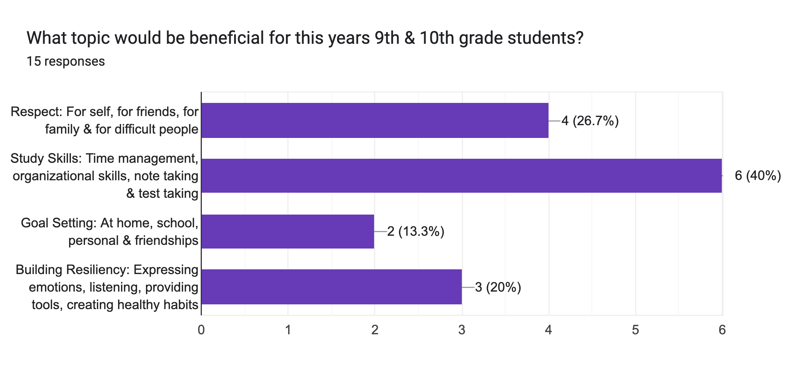
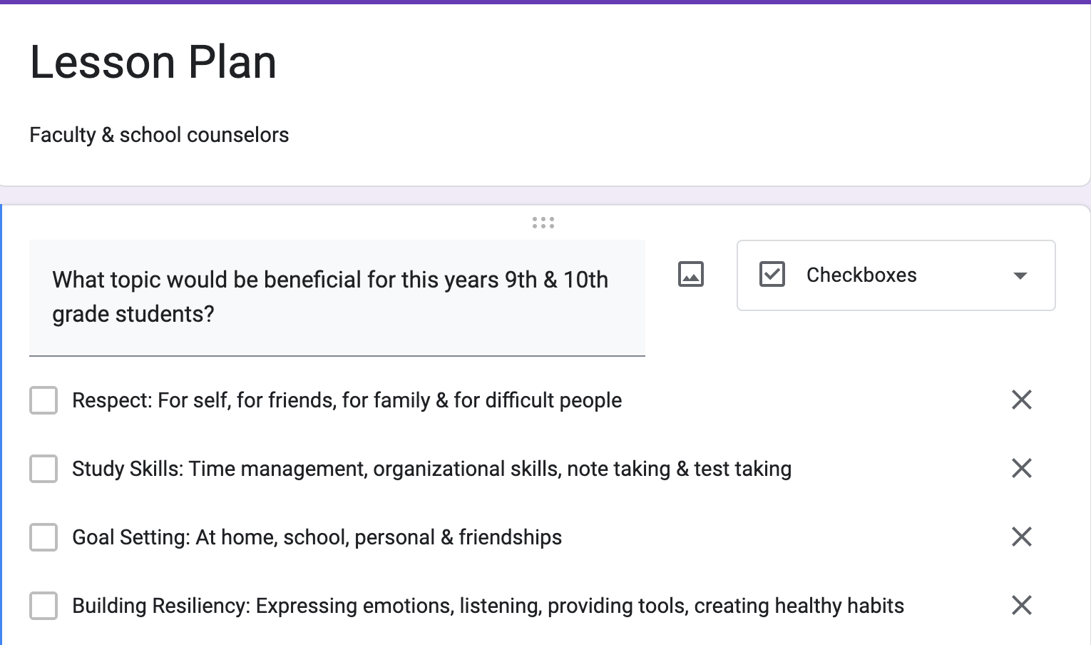
Needs Assessment
Student’s in 9th & 10th grade & Parents
Faculty
School Counselor
Notes:
Students in 9th & 10th grade and parents
Walkersville has about 1200 students with half of that being 9-10th grade students, give or take. I did not choose to send a formal assessment to 9th & 10th students, however ,we reviewed schoology messages and self-reports for students who had expressed anxiety or being overwhelmed in their workload along with parents referral of students. This provided enough data to recognize a need in this area for a healthy balance of study skills.
Faculty /\School Counselor
I surveyed about 15 faculty members in the 9th and 10th grade classes and the school counselors using a google form sent via email. The site supervisor and I also reviewed teacher referrals through schoology messaging, in-person discussion with these teachers which included, at my request, to have them forward emails sent to them from parents that mentioned students anxiety, course load, or extra support. The data also included the direct emails parents sent to the counselor.
After collaboration with the school counselor, looking at the existing data and discussing the results of the needs assessment (students/parent and faculty/school counselors), I made the decision to focus on study skills. I felt it was important that students in these younger grades learned healthy study habits early on as it can help prevent future burnout or potential grade worsening. I chose to not send needs assessments to parents or students as I felt I would not have sufficient time to gather the necessary data but I did incorporate the referral emails sent by 9th and 10th grade parents as well as students self-referral into the decision.

Slide 5
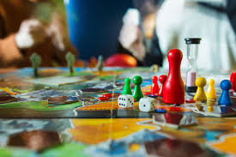
Description of Project
Study skills
  Time Management
  Organizational Skills
  Note Taking
  Test Taking
Group details
Board game
Figure 2 google image of board game www.google.com
Notes:
Study Skills: Time management, organizational skills, note taking, test taking
My goal with this group was to teach the students healthy study skills and provide them tips and tricks to make their workload and lifestyle feel more manageable. The project they had to work on to ”present” at the end of the 4th lesson plan was a group board game that can be implemented at a lower school level. I told them that each lesson I teach will provide them with tools to utilize when creating this board game. Each lesson I gave them time to collaborate with the other students in the classroom to create the board game.
Group Details
The group consisted of 18 students taking a college and career prep class. It was a combine group of 9th and 10th graders, male and female, who took this class as an credit toward their requirements. I spoke with the teacher about the class and the class consisted a diverse population with a majority of students being academically driven and very successful. 8 of the students were in honors classes, 3 were taking AP or college level courses and the other 7 were in regular courses. I obtained the students names from the schoology and grades from the most recent report card and was surprised to see how well many of the students were doing in their course relate to their grades.
Time Management
Prioritizing
Planning
Pushing/Productivity
Organizational Skills
Keeping a time log and planner
Note Taking
Outlining method
Mapping method
Charting method
Sentence method
Test Taking
We practiced what we learned in following week by laying out the time we had for the week, organizing our notes and learning material, planning time to study
Board Game
The game should include the following:
Name of Game
Skill they want to teach the students
How many students can play at one time
How long the game will take to play
What supplies will be required
Delegating jobs
Rules of game
Purpose of game

Slide 6
AIA Specialty Standards and Rationale
Counseling Prevention & Intervention (CAEP A1.1d, f)
  Provides individual and group counseling and classroom guidance to promote the academic, career, and social/emotional development of students.
Academic Development (CAEP A1.1.d,e,f)
  Implements strategies and activities to prepare students for a full range of postsecondary options and opportunities.
Collaboration & Consultation (ASCA M-5; M-6; B-SS 4;B-SS 5; B-SS 6;B-PA 1; B-PA 5; B-PA 8)
  Uses peer helping strategies in the school counseling program.
Diversity & Advocacy (CACREP G.1.d;G.2.b;G.2.d;G.2.j;G.3.d,G.3.f;G.3.k)
  Provides individual and group counseling and classroom guidance to promote the academic, career, and social/emotional development of students.
Notes:
Identify the standards and provide the rationale for alignment.
Counseling Prevention & Intervention
-In this case I was aiming to teach healthy coping skills so encouraging them to continue to work hard but also to fin opportunities to lighten their load and their stress. The aim is also to encourage them in post secondary education and if they are too overwhelmed in their season of life now, it may effect them wanting to further their education!
Academic Development
-In post secondary education the need for balance is extremely important as
Collaboration & Consultation
The aim of the board game was too not only implement the skills taught but also to teach communication amongst peers and to work together, learn to ask for help and grow as a group
Diversity & Advocacy
Liberty University. (2023). Internship Assessment (AIA). https://www.liberty.edu/behavioral-sciences/counselor-ed/wp content/uploads/sites/43/2021/02/ADVANCED-INTERNSHIP-ASSESSMENT_ASCA-1.pdf

Slide 7
ASCA Mindsets & Behaviors Rationale
M 1. Belief in development of whole self, including a healthy balance of mental, social/emotional and physical well-being
B-LS 2. Creative approach to learning, tasks and problem solving
B-SS 1. Effective oral and written communication skills and listening skills
Notes:
Identify the standards and provide the rationale for alignment.
American School Counseling Association. (2021) Mindsets & behaviors for student success. www.schoolcounselor.org/getmedia/7428a787-a452-4abb-afec-d78ec77870cd/Mindsets-Behaviors.pdf

Slide 8
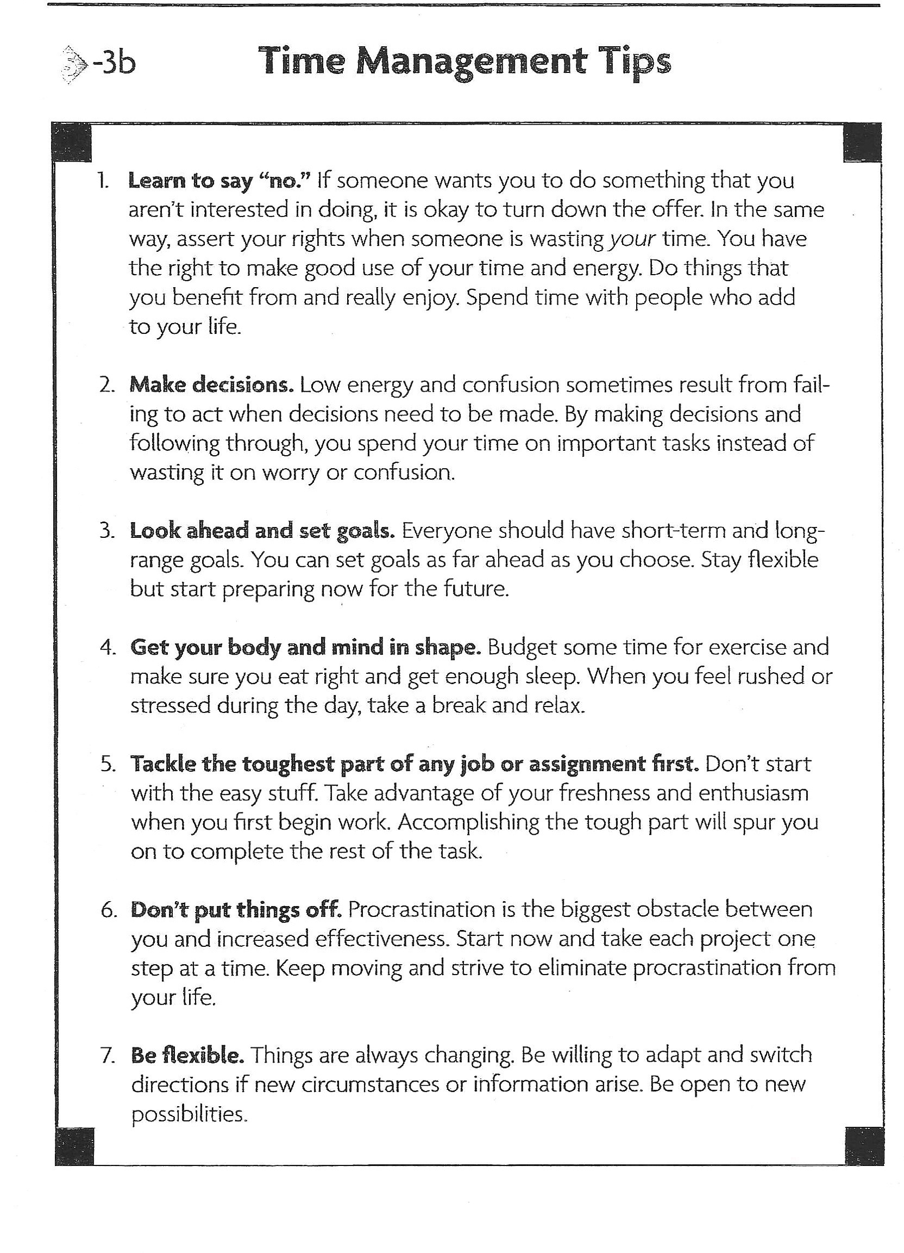
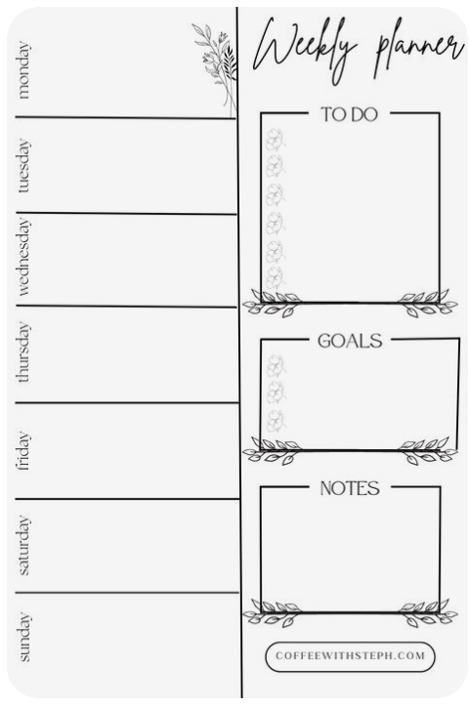
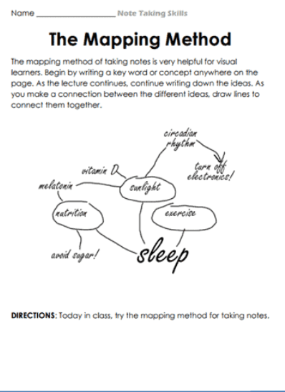
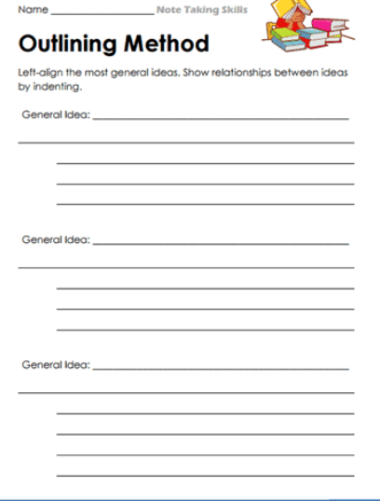
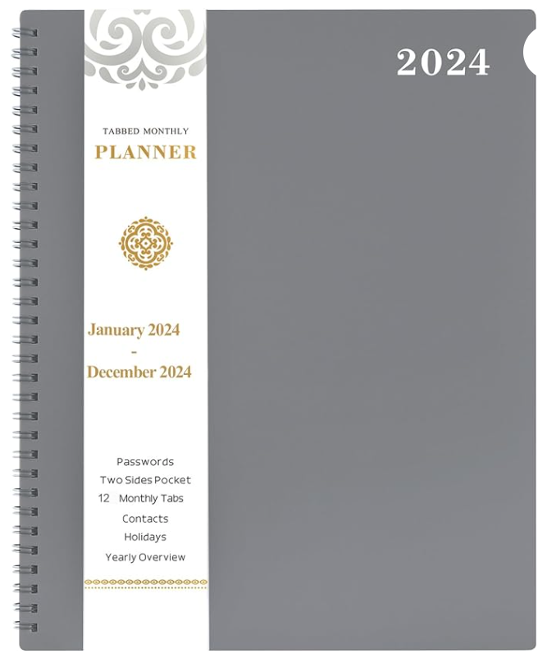

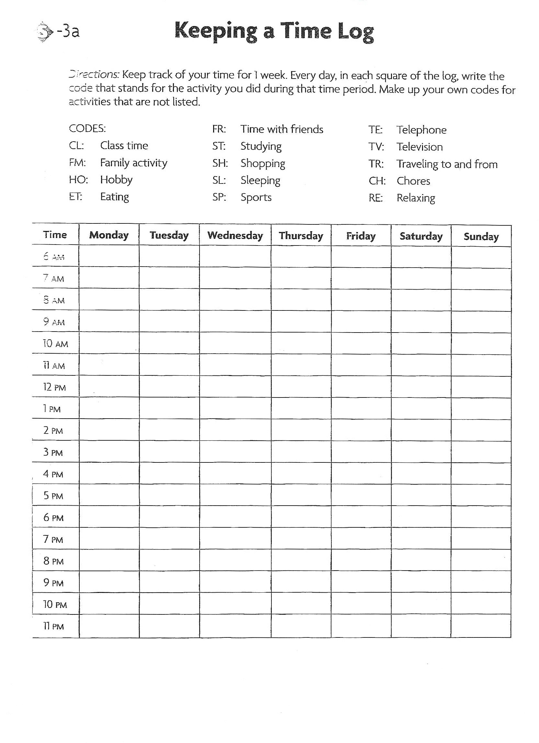
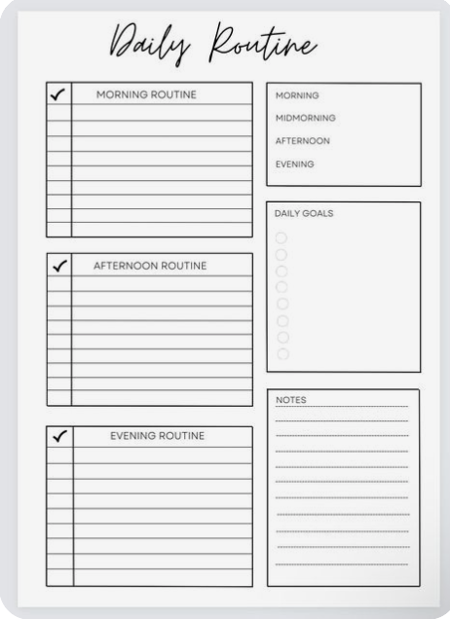
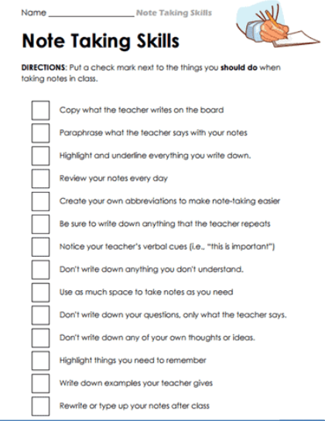
Lesson Plan Pictures/Examples
Notes:
Time Management -Tips/Time Log Worksheet -Purchased Amazon Planner
Organizational -Weekly/Monthly Calendars
Note taking methods – outlining method, mapping method, charting method, the sentence method
Test taking –we practiced what we learned in following week by laying out the time we had for the week, organizing our notes and learning material, planning time to study

Slide 9

Cultural Sensitivities
Study skills conversations
Application of information
Group board game activity/creation
Figure 3 google image of heart of hands www.google.com
Notes:
Study skills conversations
After the information was shared with the students, I sought to ask them questions about how, if any, are these skills utilized at home or in their lives. This provided the students with opportunities to share about their own experiences with these skills and also provided a context for other students and myself about their cultures or lifestyles.
Application of information
One of the things I sought to do while teaching the lesson plan was too provide students with options in how they would apply the information being taught, One small example on organization would be I printed multiple type of organization sheets that that included monthly and weekly options for how a student can organize their school and personal/home life. We discussed that not everyone would be served by specific types or organizational planners so I sought to have open communication about those types of styles in the group.
Board Game Creation
One activity geared toward cultural sensitivity was the creation of a board game. The students were given instructions to create a board game that could be played at the elementary school level, for any age and all different students. They were given parameters and were encouraged to think about their population and the character trait or skill they wished for the students to learn. It allowed for everyone to be heard ad have a voice.
National Center for Center for Educational Statistics. (2022). Walkersville Highschool.https://nces.ed.gov/ccd/schoolsearch/school_detail.asp?Search=1&DistrictID=2400330&SchoolPageNum=4&ID=240033000655

Slide 10
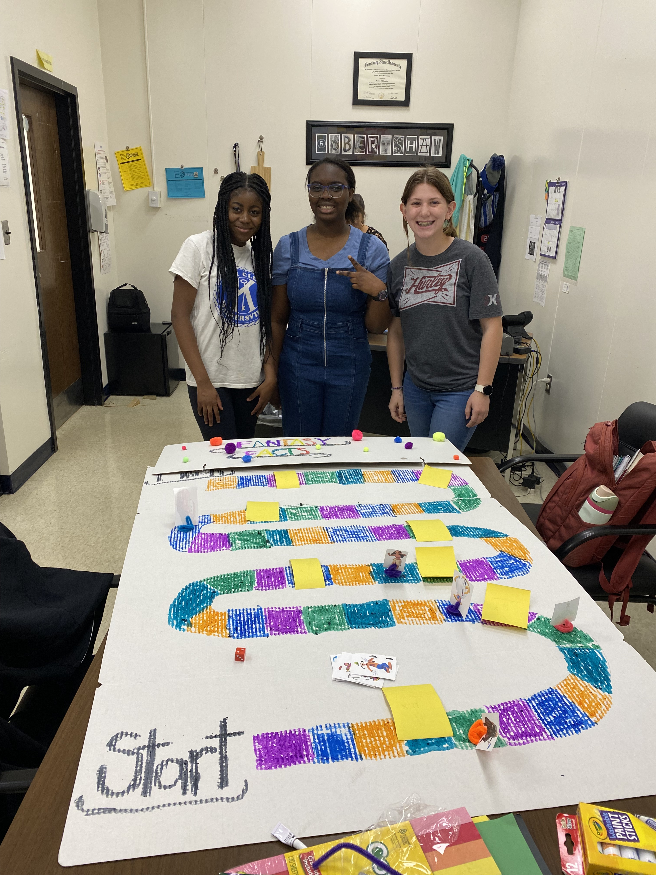
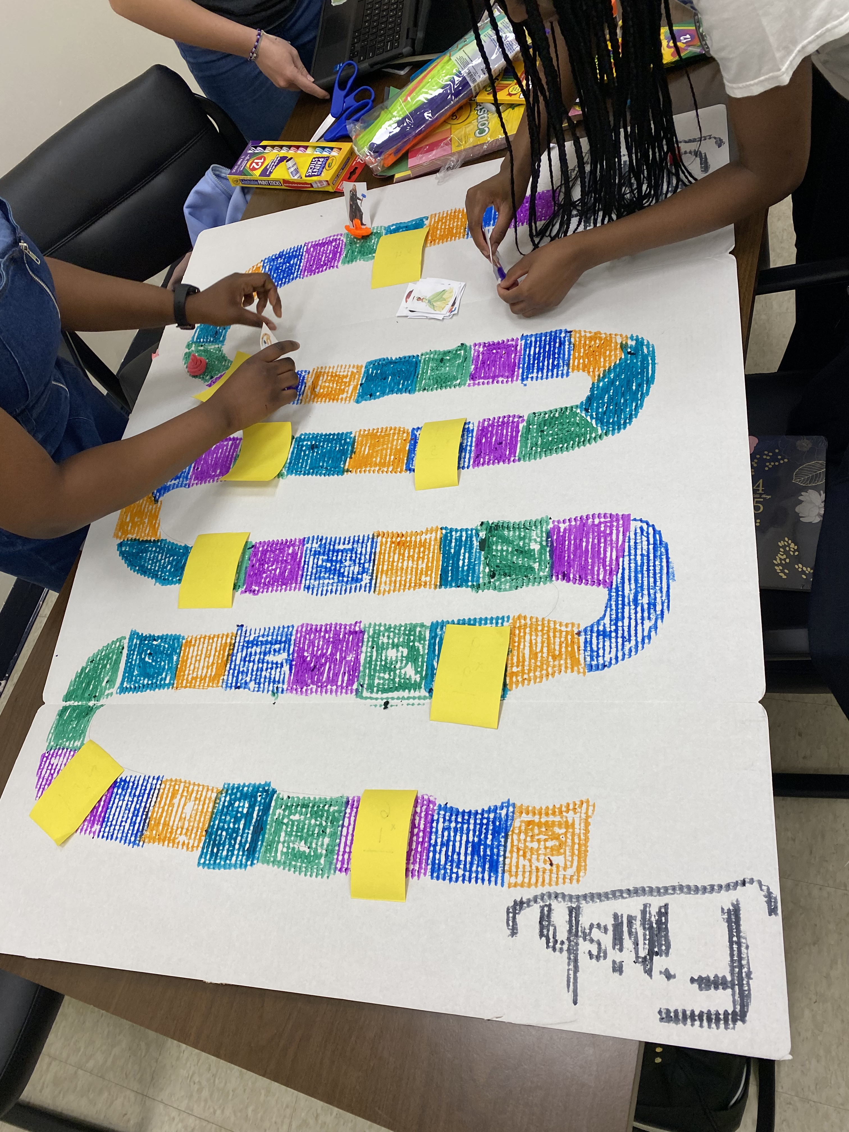
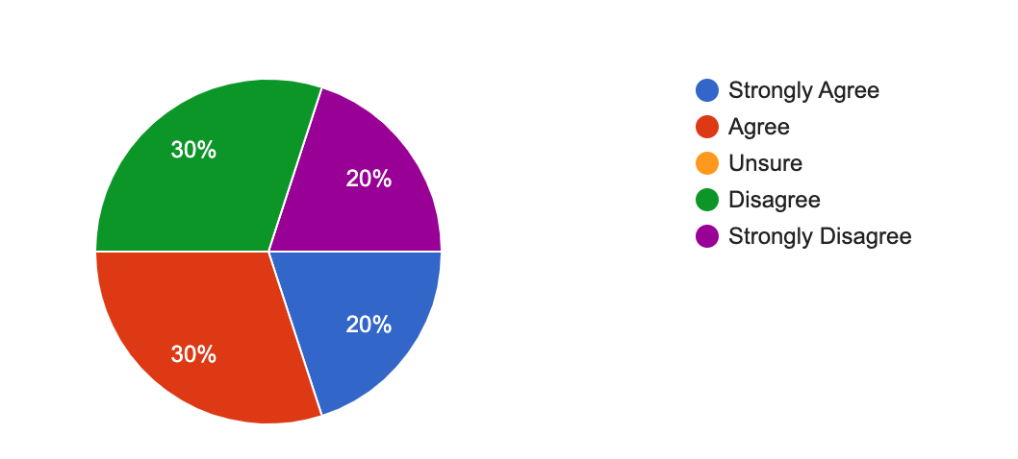
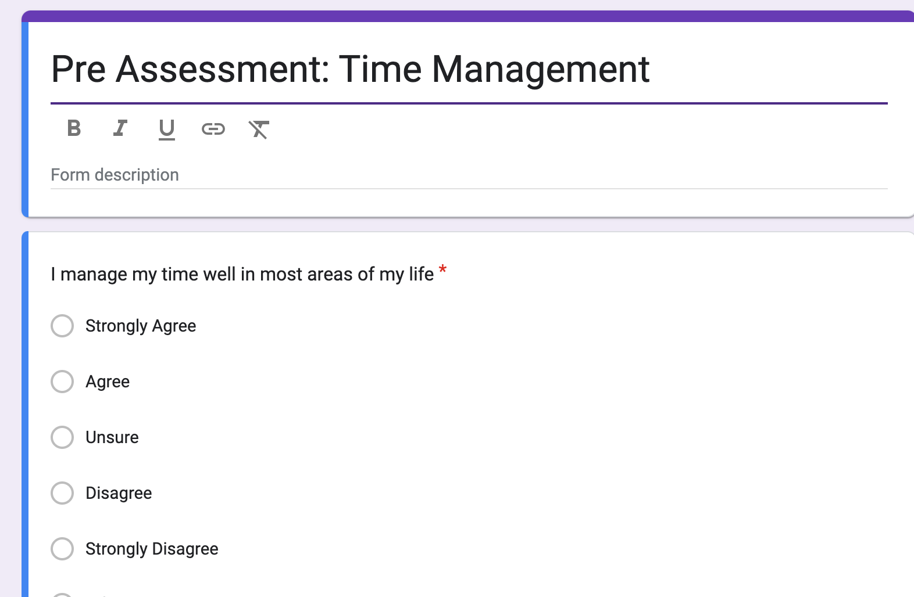
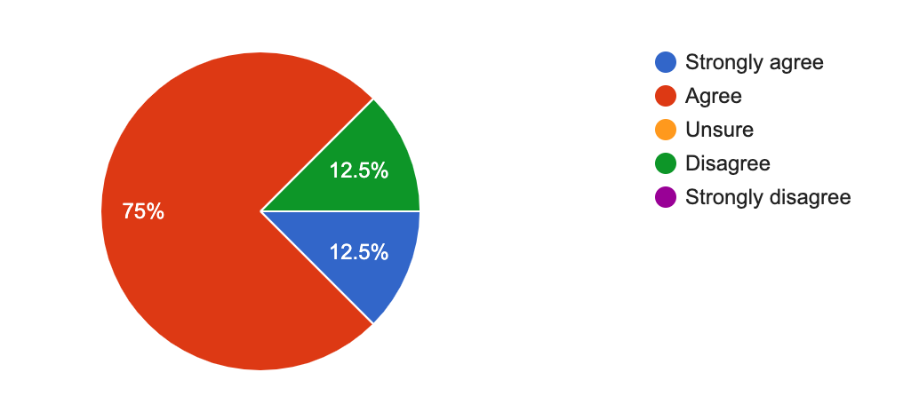
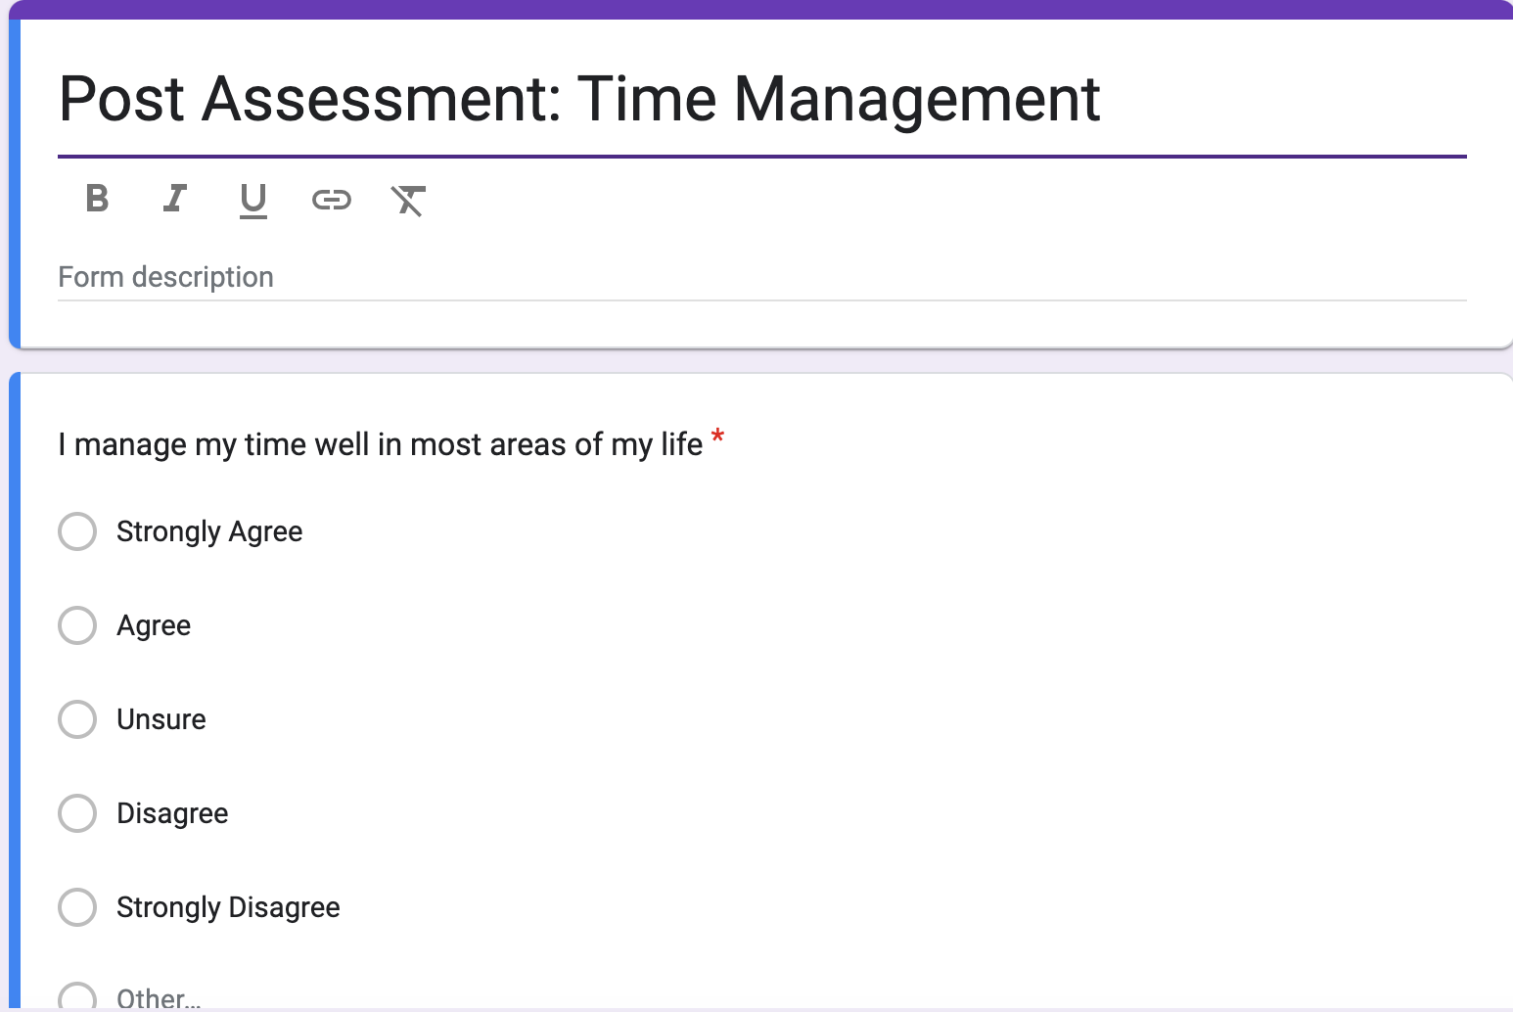
Evaluation
Pre/Post assessments
Supervisor feedback
Student engagement/board game completion
Areas of Improvement
Notes:
How did you evaluate your intervention?
How effective was your intervention? Provide data to support your response. For example, if you gave a pre/post assessment, you would share that data.
Pre/Post assessments
The pre and post assessments that were administered help provide me, the student counselor, with a way to evaluate the effectiveness of the lesson plan and to measure changes in knowledge skills or attitudes . The pre/post questions were administered to the students at the beginning and end of each of the 4 lesson plans. I used a 5 point likert scale (Strongly agree to Strongly Disagree) when asking the students questions and used that data to compile a chart to evaluate knowledge on the subject. Example of the data that was collected is the pie chart which shows the pre and post question data of time management” I often get overwhelmed with my schedule?”. The data shows, from that particular question that the students became more aware and understanding of the importance and recognition time management
Time management ”having a strong understanding of time management increased from Unsure at 21% to no one being unsure and 75% of the students agreeing.
Organizational “I organize tasks and events in my life in a healthy way” Unsure at 33% to 12% being unsure
Note Taking “ I understand what it means to take good notes” 37% Unsure to no one being unsure and 80 % agreeing
Test taking “ I understand what it means to be a good test taker” 33% unsure to 25% being unsure
Supervisor feedback
Another means of evaluation was supervisor feedback. After each of the lesson plans, the site supervisor would provide me with written and verbal feedback as to what was effective in the lesson plans and what could be modified or worked on. My site supervisor also sought to collaborate with me on how to most effectively communicate and present the study skills information.
Student engagement/board game completion
Another way I evaluated the intervention is by student engagement and participation The students loved engaging in questions and working through different aspects of their lives. They all participated and were eager too jump in and create this board game (yes I did get permission from several of the girls to take a picture of them with some oof the project). After the lesson plan ono the 4th week the students and I discussed what they enjoyed about the lesson and I asked them what could be improved.
Areas of Improvement
Manage my time better! I felt like I was rushed at every single lesson plan and it was a huge reminder for me how important these skills are for school counselors as well. Another area I would like to improve on is classroom management. I think it was easy for me to see where I fell short and in getting to know my students on a more personal level. I know there isn’t much you can do about that in a lesson but it reminded me of how important it is to be in the classroom and getting to know the students on a more personal level.

Slide 11
References
American School Counseling Association. (2021) Mindsets & behaviors for student success. www.schoolcounselor.org/getmedia/7428a787-a452-4abb-afec-d78ec77870cd/Mindsets-Behaviors.pdf
Liberty University. (2023). Internship Assessment (AIA).
https://www.liberty.edu/behavioral-sciences/counselor-ed/wp-
content/uploads/sites/43/2021/02/ADVANCED-INTERNSHIP-
ASSESSMENT_ASCA-1.pdf
National Center for Center for Educational Statistics. (2022). Walkersville Highschool.https://nces.ed.gov/ccd/schoolsearch/school_detail.asp?Search=1&DistrictID=2400330&SchoolPageNum=4&ID=240033000655

