Slide 1
School Counseling Program Design
Tiffany Groveman
College of Humanities and Social Sciences, Grand Canyon University
Organization and Administration of a School Counseling Program
Dr. Latinia Shell

Slide 2
Learning Objectives
Importance of school counseling National Model
Roles of a school counselor
National Model
  Define
  Manage.
  Deliver
  Assess
How the National Model ensures: access, equity, compassion, and success
Notes:
*The objective is to provide a thorough explanation of the importance of a school counseling program.

Slide 3
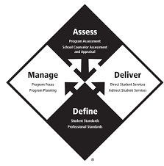
ASCa National Model
Standards
Structure
Safety
Notes:
Standards
ASCA ethical standards is a set of guidelines that school counselors adhere to when administering trainings, interaction or providing documentation.
Structure
This model provides a framework for school counseling programs that ”outlines the components of a school counseling program that is integral to the school’s academic mission and is created to have a significant positive impact on student achievement, attendance and discipline” (ASCA, 2019 pp1). This structure helps guide counselors in the development of their programs to fulfill the needs of the state and school requirements.
Safety
The school national model provides protection and accountability, not just for the client/student but also for the counselor. Having this structure in place allows for the counselors to ethically instill practices that help improve students academic and social/emotional development.
Reference
American School Counselor Association. (2016). 2016 ASCA Ethical Standards for School Counselors. https://www.schoolcounselor.org/About-School-Counseling/Ethical-Legal-Responsibilities/ASCA-Ethical-Standards-for-School-Counselors-(1)

Slide 4
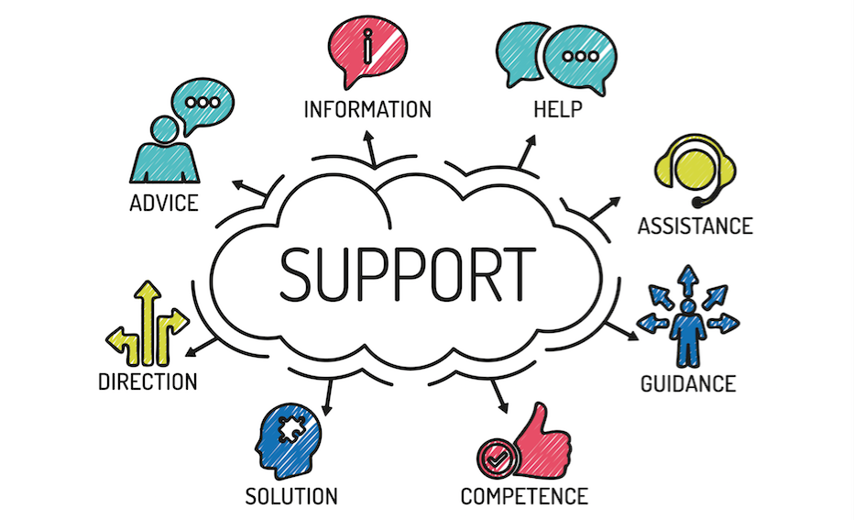
School Counselor Roles
Academic success
Career planning
Social/emotional development
Notes:
School counselors are educators that are certified/ licensed who implemented a school counseling program which help to them to create a culture of success for all students (ASCA: Professional Standards & Competencies, 2019). They are, “advocates, leaders, collaborators and consultants who create systemic change by providing equitable educational access and success by connecting their school counseling programs to the district’s mission and improvement plans” (ASCA: Ethical standards for school counselors. 2016 pp1).
Academic success
Counselors are to work with students in order to establish strategies to achieve academic goals. They are advocates for students in education meetings and support students with the help of teachers, administration, and family. They provide/ implement plans when supporting the student body as a whole through documentation such as “closing the gap” and work with individuals by using “classroom and group mindset & behavior action plans” to achieve academic success (ASCA: Professional Standards & Competencies. 2019).
Career planning
Planning a future can be intimidating and overwhelming as the steps forward are never quite as simple as it seems. School counselors help to provide organization, encouragement and support while moving forward academically and socially/emotionally. Through conversations and the desires of the student, counselors provide attainable goals and information to encourage college readiness and academic success.
Social/emotional development
The school counselors role is not only to encourage and provide educational success but to provide social/emotional success for every student. The counselor provides short-term counseling to students and data analysis to help identify students needs in order to adequately create change and success.
Reference
American School Counselor Association (2019). ASCA School Counselor Professional Standards & Competencies. https://www.schoolcounselor.org/getmedia/a8d59c2c-51de-4ec3-a565-a3235f3b93c3/SC-Competencies.pdf
American School Counselor Association. (2016). 2016 ASCA Ethical Standards for School Counselors. https://www.schoolcounselor.org/About-School-Counseling/Ethical-Legal-Responsibilities/ASCA-Ethical-Standards-for-School-Counselors-(1)

Slide 5
ASCA National Model: Define
Professional standards & competencies
Mindsets & behaviors
Ethical standards
Notes:
The National Model “define” is the professional practice and standards for students. The 3 standards that define the profession and provide all counselors with help are as follows: development, implementation and assessment.
Professional standards & competencies
Help provide in detail the intense demand of the school counseling. Since the demand is so high in a profession such as this, the ASCA has provide standards to ensure counselors are properly equipped “to establish, maintain and enhance a school counseling program” (ASCA, 2019: Define. pp 8). This can be accomplished through self-assessments of personal mindsets and behaviors, followed by an action plan to help in professional development.
Mindsets & behaviors
The “beliefs a school counselor holds about student achievement & success” (ASCA, 2019: Define. pp 10) are called mindsets. These mindsets are usually identified in behaviors "as a result of implementation of school counseling program” (ASCA, 2019: Define. pp 10). Behaviors are what school counselors demonstrate through the implementation of the school counseling program. These behaviors include: professional foundation, direct and indirect students services, and planning and evaluations.
Ethical standards
Ethical standards guide decision-making of school counselors and “specify principles of ethical behavior necessary to maintain the highest standard of integrity, leadership and professionalism” (ASCA: Define, 2019 pp. 11). These standards provide a foundation to protect the counselor and the student. The ethical standards guide practice, provide direction and support, and inform stakeholders.
Reference
American School Counseling Association. (2019). ASCA National Model 4th Edition: Define. https://halo.gcu.edu/resource/3efaddba-273d-43f4-8408-4d4f4de1c286?nestedResourceId=b6820429-b312-4e68-94b2-0cdc9ea04e18

Slide 6

ASCA National Model: Manage
Program focus
Program planning
Notes:
The section manage provides school counselors with the appropriate tools needed to create and complete an effective school counseling program that serves the needs of the students and aligns with the vision, mission and beliefs of the school.
Program focus
The focus of the school counseling program includes 3 components that help to support effective creation and implementation of a school counseling program. The first is beliefs which are personal and individuals based on background, culture and experiences. What you believe normally influences how you behave. Unexamined beliefs can negatively affect the implementation of the program as bias and inequalities can arise, affecting fair treatment for all students. The second component is having a clear vision for the program. A clear vision unifies all parties and allows the counselors, administration, teachers, stakeholders to work toward a common goal. It also provides desired, future outcomes and encourages movement forward. Lastly, the mission statement provides clear path for the ”school counseling program to reach the vision” (ASCA: Manage, 2019. pp 5). The mission statement provides an overall goal of thee program, aligning with school, state/district mission statements. It also focuses on long-term results and emphasizes success for all students (ASCA: Manage, 2019).
Program planning
Program planning provides documentation for school counselors to: “monitor student progress, identify students having difficulties or discipline problems, • identify barriers to learning, understand factors affecting student behavior, identify access and equity issues, close achievement, opportunity and attainment gaps, assess and evaluate the effectiveness of school counseling program activities, improve, modify or change services provided to students and educate stakeholders about the power of a school counseling program” (ASCA: Manage, 2019. pp 5).
Reference
American School Counseling Association. (2019). ASCA National Model 4th Edition: Manage. https://halo.gcu.edu/resource/fede9f60-d64d-4afa-a0e2-63f4f2c91328?nestedResourceId=996a1d18-e26a-4bb8-90a9-e9967c301ece

Slide 7
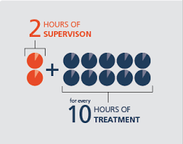
ASCA National Model: Deliver
Direct Hours
Indirect Hours
Notes:
In deliver of the ASCA National model, the components of direct and indirect hours will be discussed. These services are designed to support the student through multiple avenues.
Direct Hours
Direct hours includes instruction, appraisal and advisement and counseling. For these services, counselor are working toward student success through activities that attain mindsets and behaviors. Through these interactions, counselors collect data (discipline, student achievement, attendance) in order to inform what needs should be focused on (ASCA: Deliver, 2019).
Indirect Hours
Indirect hours include consultation, collaboration and referrals. These services are carried out on behalf of the students and include advocacy such as conversations with faculty, family members, stakeholders etc., data collection and referrals. Indirect services operate to create systematic change for the student(ASCA: Deliver, 2019).
Reference
American School Counseling Association. (2019). ASCA National Model 4th Edition: Deliver. https://halo.gcu.edu/resource/03934c2b-800d-43ed-9237-52c6f5917b05?nestedResourceId=bb9e9509-790e-4008-ad9b-71a2338c37be

Slide 8
ASCA National Model: Assess
Program assessments
Annual reports
Assessment and appraisal
Notes:
The program model assess, helps provide a general overview of how the implementation of the school counseling program is doing. These assessment give informative information as to the value of the school counseling program. Having data to provide to stakeholders and government, helps to validate the importance of keeping school counselors and the programs well-funded and in schools.
Program assessments
The program assessment is comprised of 4 different parts: purpose, identity, guide, and annual. The first is to anaylize how the implementation of the school counseling program is going. After reviewing the purpose of the program, strengths and weaknesses are sought out in order to establish what is being done well and what needs growth. The information provided by the first two components will then help to guide future actions and have better results for the students. These assessments are conducted annually.
Annual reports
The reports provide a way for the counselors to collect data and narrow in on the areas students need support. The annual results reports include: document instructions, advocacy for system change, verification all students were served, analyze and explain, improvement for future activities and interventions and confirmation the impact of services. (ASCA: Assess, 2019).
Assessment and appraisal
Assessment and appraisals are design to keep the school counselor accountable through self assessments of mindsets and behaviors, creation of a professional development plan and a yearly evaluation of the school counselors performance.
Reference
American School Counseling Association. (2019). ASCA National Model 4th Edition: Assess. https://halo.gcu.edu/resource/384b19f1-ea84-
4e27-bc09-3c40ffe6fc4f?nestedResourceId=14873102-25eb-4c08-ae26-0d1da149dc71

Slide 9
Program Access, Equity, Compassion & Success
Access
Equity
Compassion
Success
Notes:
Access
The ASCA National model is designed to help the implementation and support of the school counseling program. The school counseling program, “provides students with a comprehensive school counseling program that ensures equitable academic, career and social/ emotional development opportunities for all students” (ASCA, 2016. pp 1). Through these programs, students are provided with access to high quality and ethically sounds practices that serves them academically and socially/emotionally.
Equity
One of the ways the National Model provides fairness for all students is through the “assess”. The ”assess” section of this model provides counselor evaluations along with program evaluations in order to ensure fairness and equal treatment. Collect data will also provide elements of cultural awareness and understanding when assessing the individual, groups and school as a whole.
Compassion
The integration of faith and work put our role as school counselors into a beautiful depiction of the goal of the national model. It states, “therefore, we are convinced that the Christian life must involve compassion and care, not only for the spiritual needs of mankind, but also for basic physical needs that stem from poverty, oppression and injustice” (GCU n.d. pp 1).
Success
As a school counselor, success is only achieved when students are meeting the goals they set out to accomplish. As counselors, our success is only possible if the students are meeting their goals. Establishing relationships, working toward goals, building confidence and creating a safe space for students to feel supported is considered success, according to the national model.
Reference
Grand Canyon University (n.d.). Statement on the Integration of Faith and Work. https://www.gcu.edu/Documents/Statement-IFLW.pdf
American School Counselor Association. (2016). 2016 ASCA Ethical Standards for School Counselors. https://www.schoolcounselor.org/About-School-Counseling/Ethical-Legal-Responsibilities/ASCA-Ethical-Standards-for-School-Counselors-(1)

Slide 10
Review
Importance of school counseling National Model
Roles of a school counselor
National Model
  Define
  Manage.
  Deliver
  Assess
How the National Model ensures: access, equity, compassion, and success
Notes:
*Throughout this power point, I was able to talk about the major support systems of school counselors. The importance of the National Model was reviewed and how it provides standards, structure and safety for the school counselor. After reviewing the importance of the model, I then discussed the roles of a school counselor and how they provide support to the student during the implementation of the school counseling program. Each component of the school counseling National Model was then broken down and discussed in detail. Those components include: define, manage, deliver, and assess. Lastly, access. equity, compassion and success was discussed and how the national model ensures these characteristics.

Slide 11

Questions
Image from www.google.com
Notes:
*During this time, the floor will be opened up to not only hear personal thoughts/experiences but also to provide an opportunity for questions to be asked. This information can be overwhelming as it touches every aspect of school counseling but this can also be a great time of growth. The ASCA encourages continued growth for school counselors and no question is too small or too big when it comes to growth.

Slide 12
References
American School Counseling Association. (2019). ASCA Student Standards: Mindsets & Behaviors for Student Success. https://schoolcounselor.org/getmedia/7428a787-a452-4abb-afec-d78ec77870cd/Mindsets-Behaviors.pdf
American School Counseling Association. (2019). ASCA National Model 4th Edition: Define. https://halo.gcu.edu/resource/3efaddba-273d- 43f4-8408-4d4f4de1c286?nestedResourceId=b6820429-b312-4e68-94b2-0cdc9ea04e18
American School Counseling Association. (2019). ASCA National Model 4th Edition: Manage. https://halo.gcu.edu/resource/fede9f60-d64d- 4afa-a0e2-63f4f2c91328?nestedResourceId=996a1d18-e26a-4bb8-90a9-e9967c301ece

Slide 13
Reference (Cont.)
American School Counseling Association. (2019). ASCA National Model 4th Edition: Deliver. https://halo.gcu.edu/resource/03934c2b- 800d-43ed-9237-52c6f5917b05?nestedResourceId=bb9e9509-790e-4008-ad9b-71a2338c37be
American School Counseling Association. (2019). ASCA National Model 4th Edition: Assess. https://halo.gcu.edu/resource/384b19f1-ea84- 4e27-bc09-3c40ffe6fc4f?nestedResourceId=14873102-25eb-4c08-ae26-0d1da149dc71
American School Counselor Association. (2016). 2016 ASCA Ethical Standards for School Counselors. https://www.schoolcounselor.org/About-School-Counseling/Ethical-Legal-Responsibilities/ASCA-Ethical- Standards-for-School-Counselors-(1)

Slide 14
References (Cont.)
American School Counselor Association. (2022). ASCA The Role of a School Counselor. https://www.schoolcounselor.org/getmedia/ee8b2e1b-d021-4575-982c-c84402cb2cd2/Role-Statement.pdf
American School Counselor Association. (2019). ASCA School Counselor Professional Standards & Competencies. https://www.schoolcounselor.org/getmedia/a8d59c2c-51de-4ec3-a565-a3235f3b93c3/SC-Competencies.pdf
Grand Canyon University (n.d.). Statement on the Integration of Faith and Work. https://www.gcu.edu/Documents/Statement-IFLW.pdf

