Slide 1












PSYCOEDUCATIONAL
SMALL GROUP

Slide 2

OVERVIEW
Topic: Friendships/Social Skills
Grade: 4 students from Ms. Blakely’s 5th grade class. Two boys and two girls.
Time: Usually Wednesdays at lunch

Slide 3
NEEDS ASSESSMENT
  Sent out a lunch bunch interest form to all of 5th grade.
  We consulted the teacher whose class filled it out first, and she recommended students.
  We also consulted SSRS data from the teacher as it was completed to see which students needed it most
  I also consulted my supervisor as to which students would most benefit from the group

Slide 4



GOALS
Objectives
  For students to gain an understanding of what a healthy friendship is and how to form and keep healthy friendships
Data Sources
  Pre and Post Assessment done by students
  Pre and Post Assessment done by teacher
  SRSS data

Slide 5








SCREENING PROCESS
1
Teacher recommended for group
2
Students asked if they were interested in joining group
3
In one case, a parent specifically asked for student to join

Slide 6

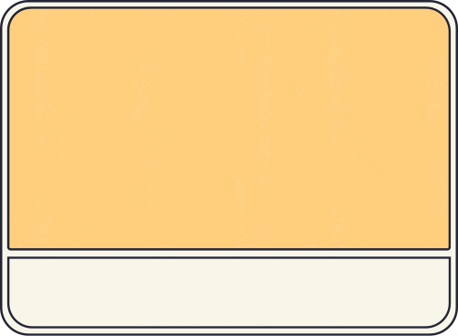


AIA AND ASCA STANDARDS
B-SS 2. Positive, respectful and supportive relationships with students who are similar to and different from them
B-SS 8. Advocacy skills for self and others and ability to assert self, when necessary
M 1. Belief in development of whole self, including a healthy balance of mental, social/emotional and physical well-being
AIA Standard: COUNSELING PREVENTION AND INTERVENTION

Slide 7
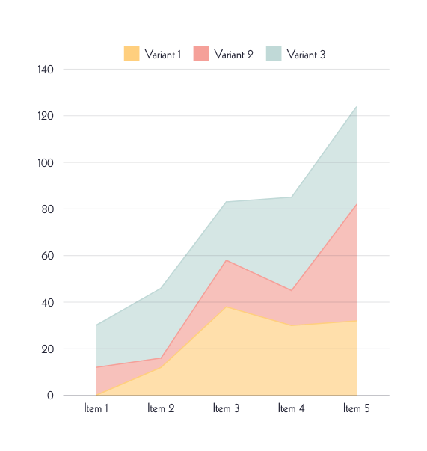
DIVERSITY
•Encouraging the participants to engage with each other respectfully.
•Modeling respectful ways to interact with others that was mindful of each student’s background (Sue, et al., 2009).
•There was a lot of diversity within the group as pertains to grade, race, culture, and family/home life.

Slide 8
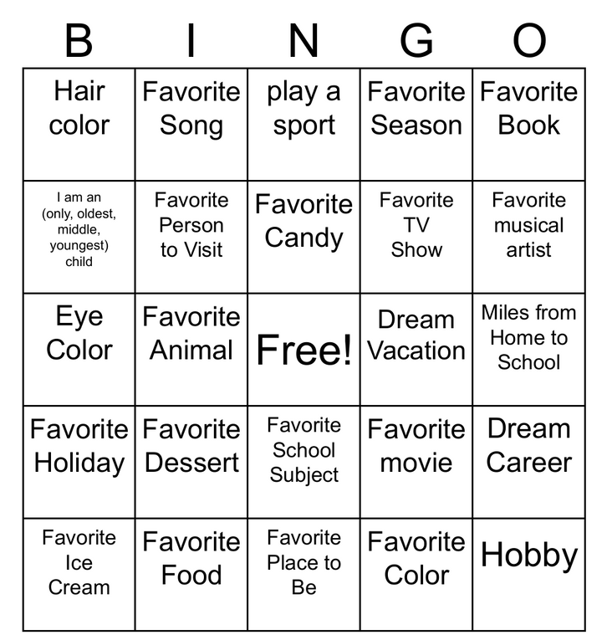



CURRICULUM
  First Group: Get to Know You
  Activity: Things in Common Bingo

Slide 9
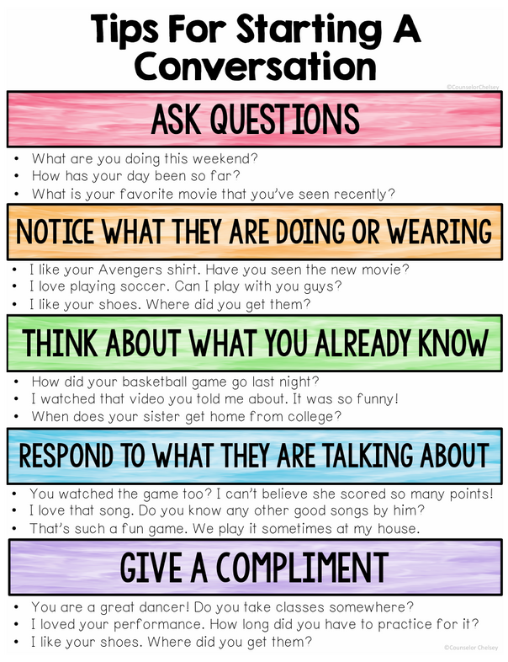
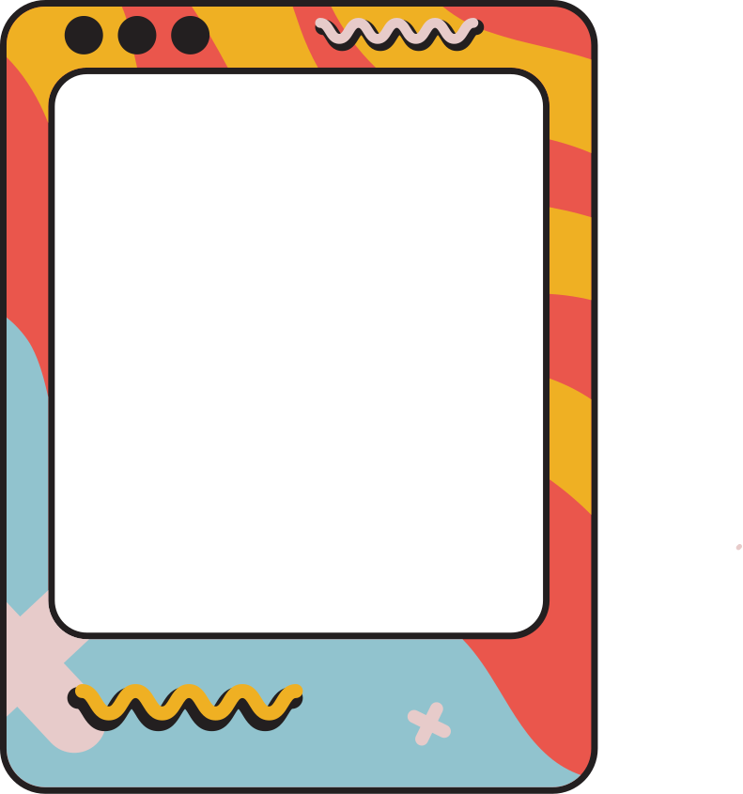
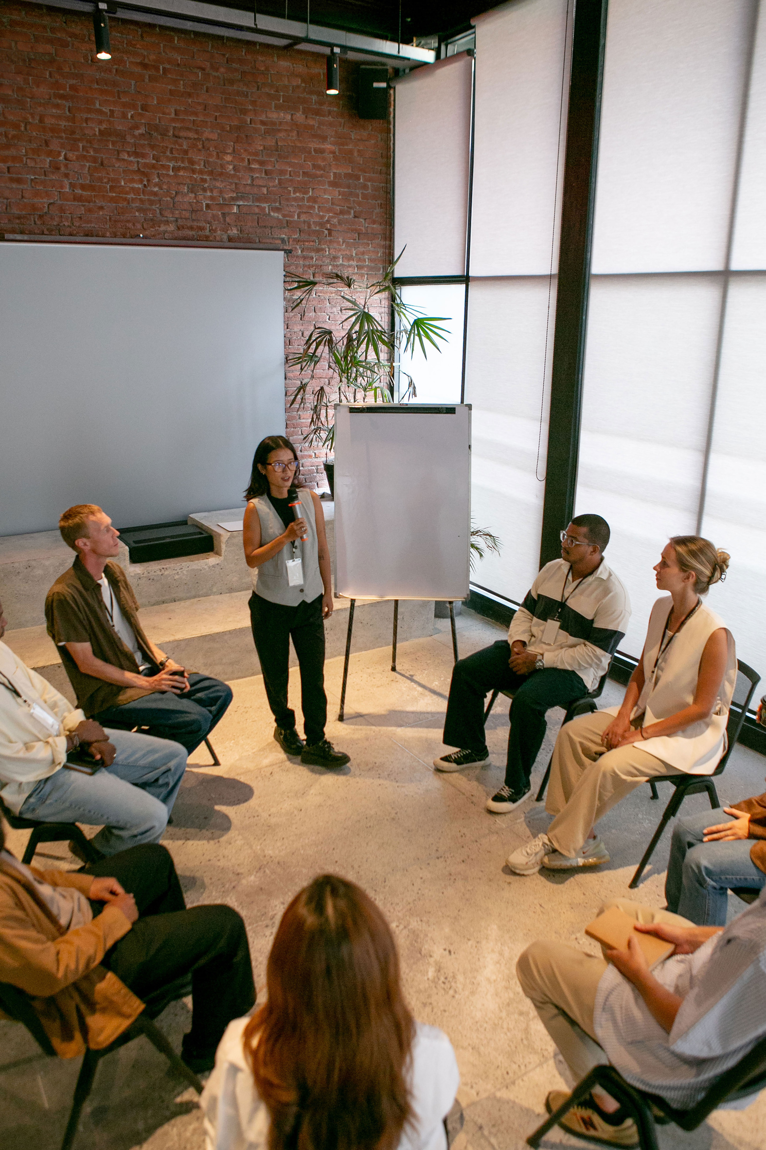
CURRICULUM
  Second Group: Get to Know You
  Activity: How to Start a Conversation
  Combined this sheet with UNO colors, so every time a student laid down a the matching UNO color they had to use one of the conversation starters, with purple being wild cards

Slide 10
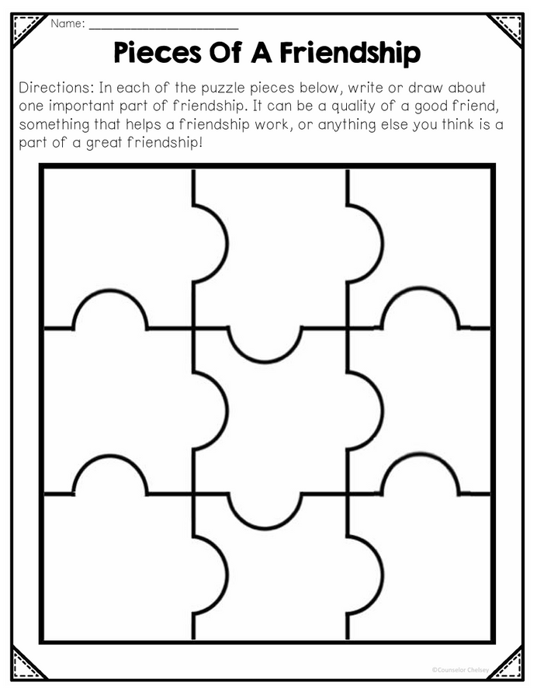
CURRICULUM
  Third Group: Healthy Friendship
  Activity: Pieces of a friendship
  Students wrote down what they thought was important to a friendship and we discussed

Slide 11
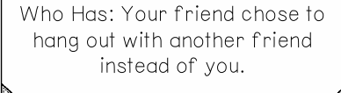
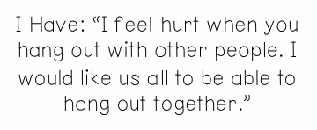
CURRICULUM
  Fourth Group: Dealing with Conflict
  Activity: I-statement match ups
  Students matched up situations with an appropriate I-statement

Slide 12
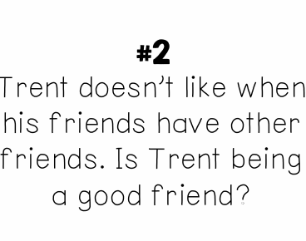

CURRICULUM
  Fifth Group: Healthy Friendship Identification
  Activity: Each student read a scenario and the group decided and discussed whether that was healthy or unhealthy.

Slide 13
CURRICULUM
  Sixth Group: Closing/Review
  Activity: Review of Healthy vs Unhealthy and I-statements
  By this point, the group was very comfortable around each other and were extremely goofy and chatty. For this group I reminded them that it would be the last group, and we briefly reviewed friendship characteristics and played games, such as a “would you rather” game my supervisor had.

Slide 14
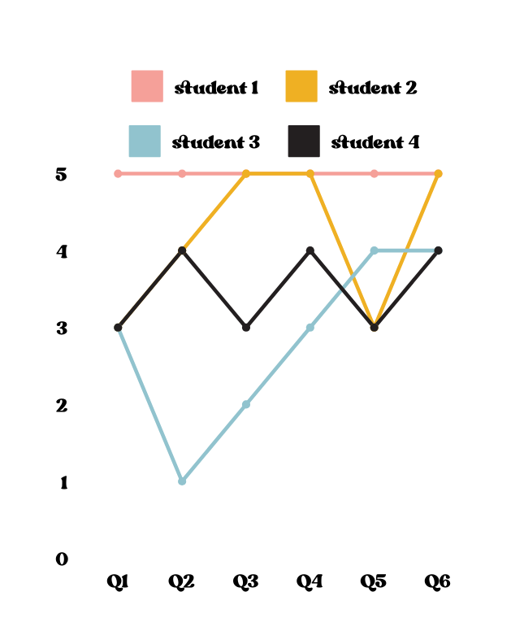
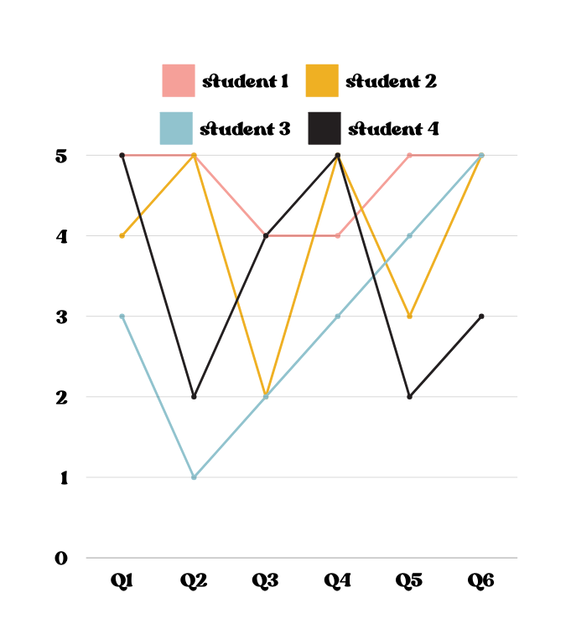
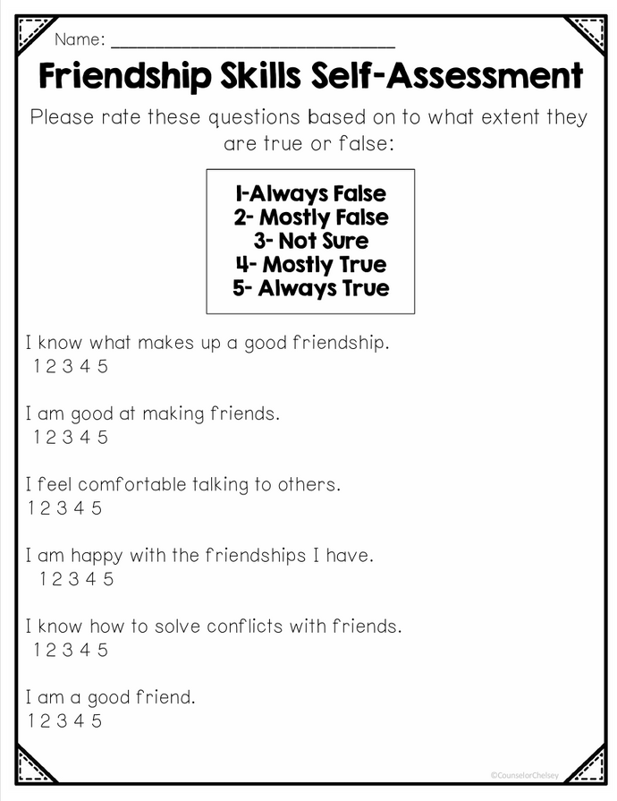
Data Outcomes
  Each student completed a
pre-test and post-test

Slide 15
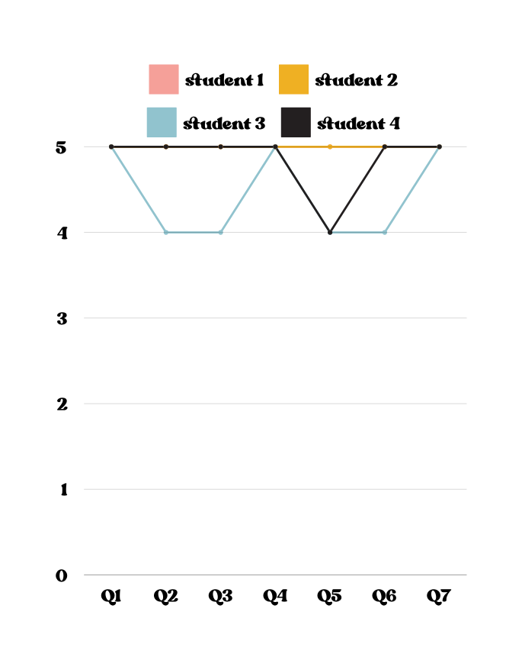
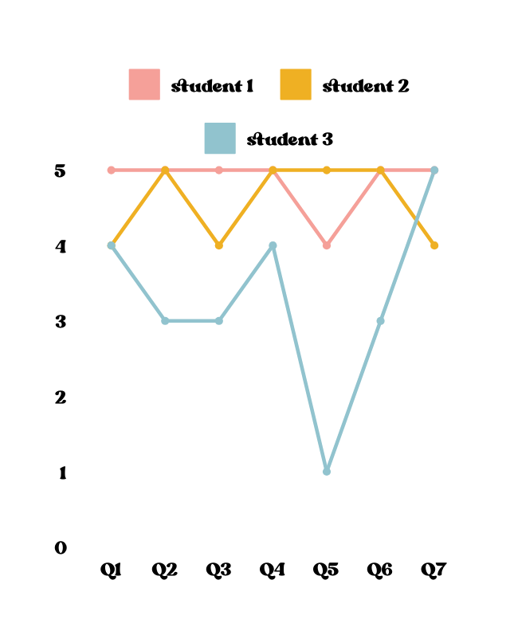
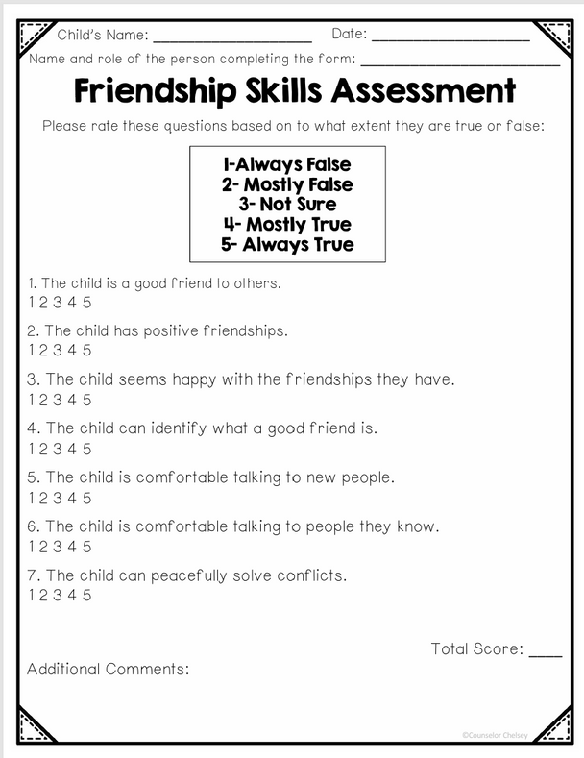
Outcomes
  The teacher filled out both pre-assessments on three students, because the fourth joined late. Even though the fourth did not have pre-assessment data, the teacher did note that student 4 was more confident and comfortable after participating in the group

Slide 16
SRSS DATA
Although I wasn’t able to use the SRSS data as a post assessment, I was able to
use to spot some students in Blakely’s 5th grade class that may benefit from the friendship group.
Student 1: no risks.
Student 2: no risks.
Student 3: moderate risk, with a score of 7. The risks presented are a score of 3 for “shy, withdrawn,” 2 for “sad, depressed,” and a 2 for “lonely”
Student 4: low risk, with a score of 3 for “low academic achievement.” This student was also extremely quiet and slower to warm up to the group.

Slide 17
CONCLUSION
  It was difficult to run the group during lunch time, as there was only 20 minutes for the group to get their lunch, eat, and discuss. Oftentimes, there was not enough time to complete the activity between getting lunch and asking them how their day was. Next time, I would like to collaborate with the teacher and the principal on a specific 30-minute time slot to pull the students.
  Unfortunately the SRSS data was not sent out as early as originally planned, thus, I was not able to use it for a follow-up to see if there were any changes
  I think if I went over the pre-post test more clearly with the students I think the results may have been more positive. I saw saw changes in the students as the interacted, and I wonder if the scores did not reflect the changes as there may have been a comprehension issue.

Slide 18
SOURCES
ASCA student standards: Mindsets & behaviors for student success. American school Counselor Association. (n.d.). https://www.schoolcounselor.org/Standards- Positions/Standards/ASCA-Mindsets-Behaviors-for-Student- Success
Sue, S., Zane, N., Nagayama Hall, G. C., & Berger, L. K. (2009). The case for cultural competency in psychotherapeutic interventions. Annual review of psychology, 60, 525–548. https://doi.org/10.1146/annurev.psych.60.110707.163651

Slide 19




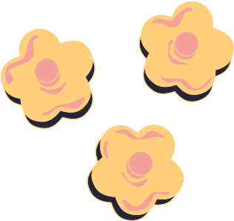
THANK
YOU

